Slide 1
Nurse Scheduling
Benedikt Skulason, Lucas Van Drunen

Slide 2
What’s so special about nurse scheduling?
A branch of the general staff scheduling problem.
However, staffing problems within hospitals are particularly challenging because of the following:
  Variations in staffing requirements between different shifts within the day
  (e.g. day/evening/night-shift specific activities)
  Variations in staffing requirements between different days
  (e.g. based on schedules from the operating room, etc.)
  The extreme importance of maintaining an acceptable service level at all times.

Slide 3
Two problem stages
Determine staffing requirement
  Average census
  Average case severity
  Gov’t and hospital regulations
Build the schedule
  Assign nurses to shifts subject to constraints

Slide 4
We wanted to know…
How to achieve feasible nursing schedules?
How to maintain schedule feasibility in case of unexpected events?
Are academic methods of nurse scheduling used in the real world?

Slide 5
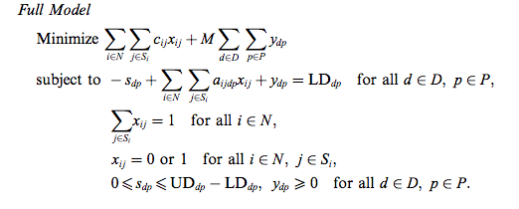
Preferential IP method
“Preference scheduling for nurses using column generation” Jonathan F. Bard, Hadi W. Purnomo, 2003.

Slide 6
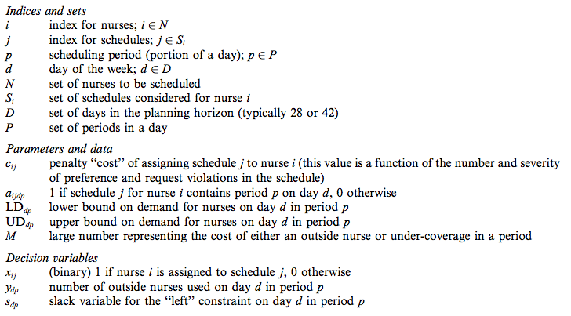
Preferential IP method

Slide 7
Self-scheduling method
Blank schedule posted with:
  Deadline
  Required staffing level
  Other constraints: minimum number of experienced nurses, etc.
After deadline, manager may need to rework schedule to achieve required coverage
Notes:
30% of hospitals self-schedule

Slide 8
A nurse calls in sick… what to do?
Genetic Algorithm for creating schedules similar to a given base schedule
Step 1: Initial individuals (schedules) are generated by a random permutation of each individual’s two chromosomes. Chromosome 1: A list of tasks. Chromosome 2: The ordering of nurses associated with the tasks.
Step 2: The current individuals are mated randomly and crossovers and mutations are applied to them, creating offspring.
Step 3: Each individual’s fitness is evaluated (feasibility & similarity).
Step 4: The fittest individual is moved to the next generation.
Step 5: Remaining individuals for the next generation are chosen by the roulette wheel method, with likelihood proportional to their fitness. Step 6: If a predefined stopping criteria is satisfied, stop, otherwise we go back to step 2.

Slide 9
Barriers to implementation
Many researchers have stated intentions of their work being implemented
Few models actually make the jump to implementations
Causes:
  Narrow focus
  Customer support
  Proprietary concerns
  Nursing acceptance: lack of flexibility, “black-box” perception
Notes:
86% intended implementation, 30% actually were
Nursing acceptance: empowerment, acknowledge their individual differences, nurses are caregivers and notice nuances in the schedule that mathematicians may not

Slide 10
Case study: NYU Medical Center
Staffing requirement from: average census, average care level
Self-scheduling used to build schedule
Non-unionized nurses
Role of software
Notes:
35 bed average census
Rubric to determine care level, avg of 4:1 required
In reality, 5:1 seems to be more normal
4 week schedules
Tiers of minimum # of weekend days per schedule
Minimum of 2 senior nurses on each day shift
Software seen to be a big help for first stage of problem, not wanted for second stage

Slide 11
Conclusion
There is a need for scheduling methods that interface with the real world
The preferential IP method attempts this
Benefits:
  Avoids the “black-box” syndrome
  Avoids conflicts from exercising seniority or playing favorites

