Slide 1
Exact vs Approximate Solution for QCQPs
Daniel Bienstock, Columbia University and Gurobi
IEEE PES-GM July 2022

Slide 2
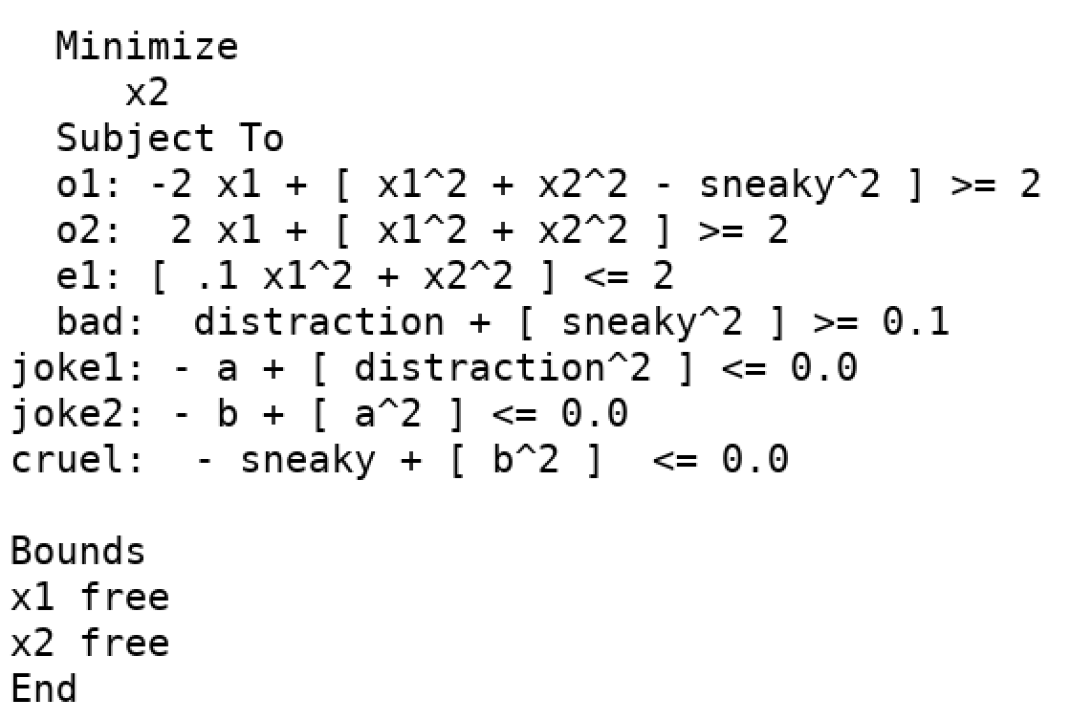
An unlucky optimization problem
What do serious optimization packages do with this problem?
Gurobi 9.x, SCIP: value = -1.4142…
Not quite: actual value is approximately -1.22

Slide 3
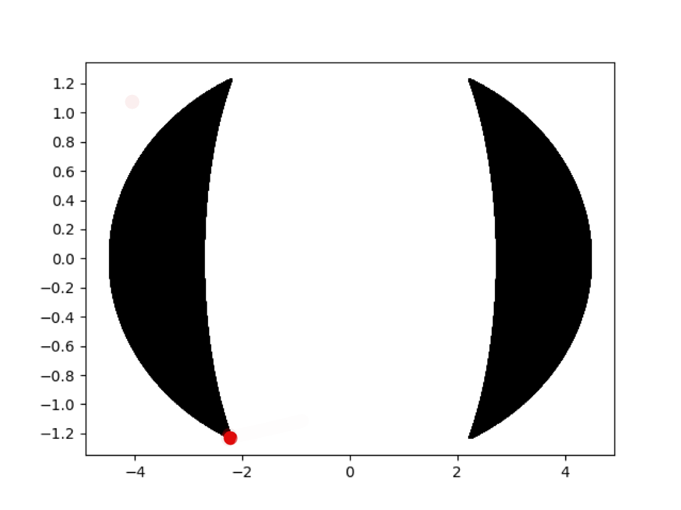
Projection of feasible region to (x1, x2) plane
Unique optimal solution; changes smoothly under small coefficient alterations
Problem is “well-posed”

Slide 4
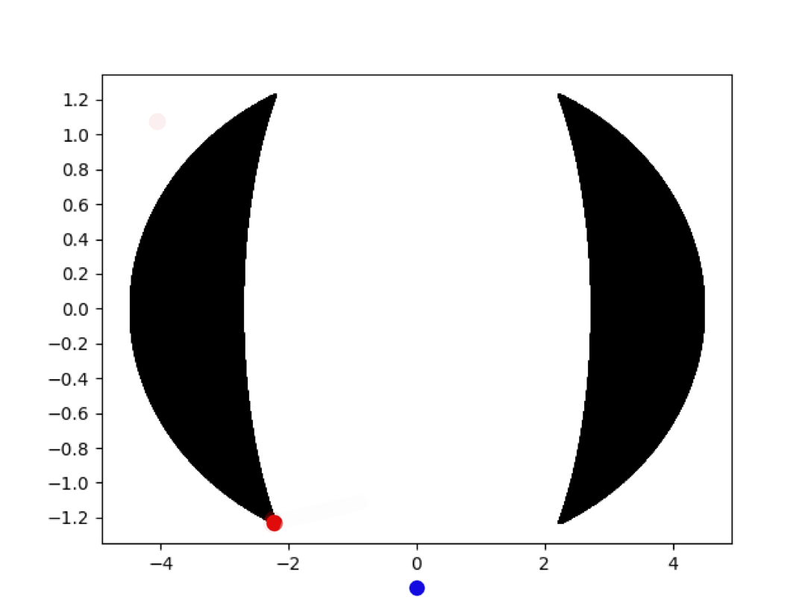
Projection of feasible region to (x1, x2) plane
Solvers produce a point that is far from the feasible region

Slide 5
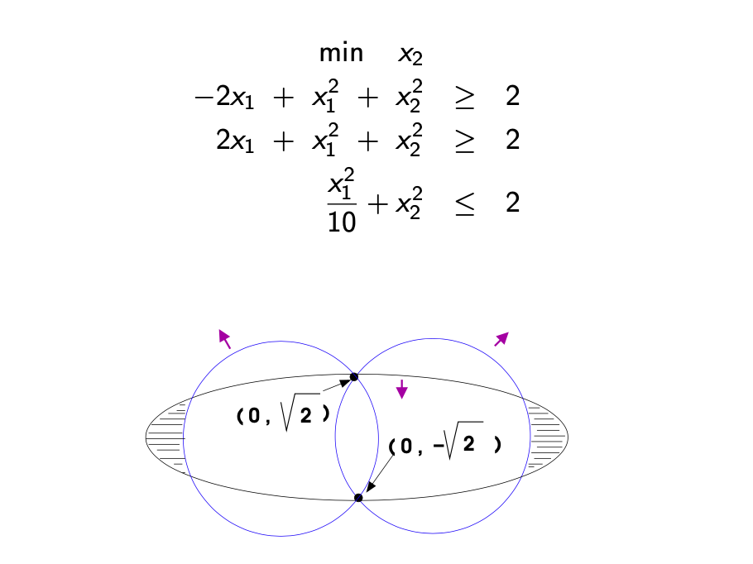
What is going on? Projection to (x1,x2) plane with roundoff errors

Slide 6
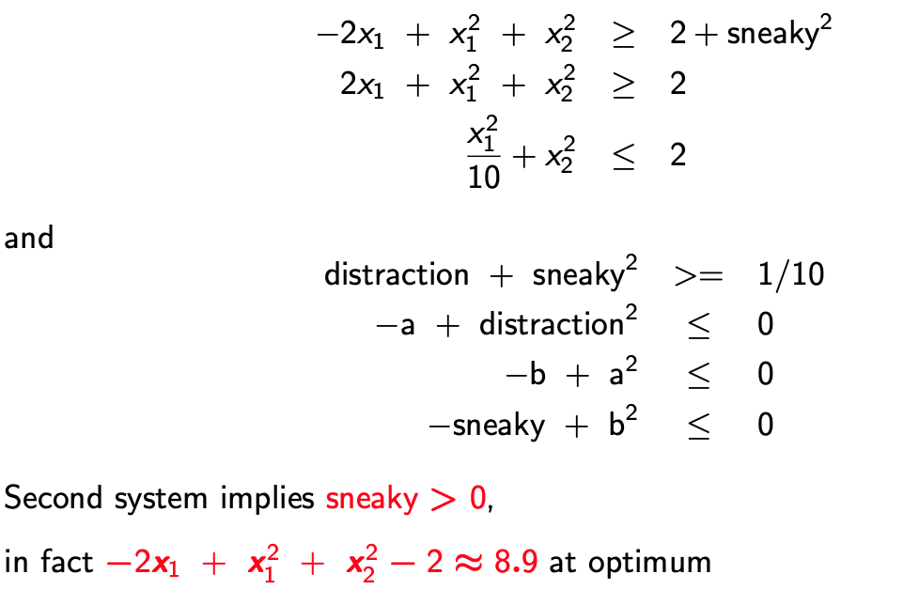
But the actual set of constraints is:

Slide 7
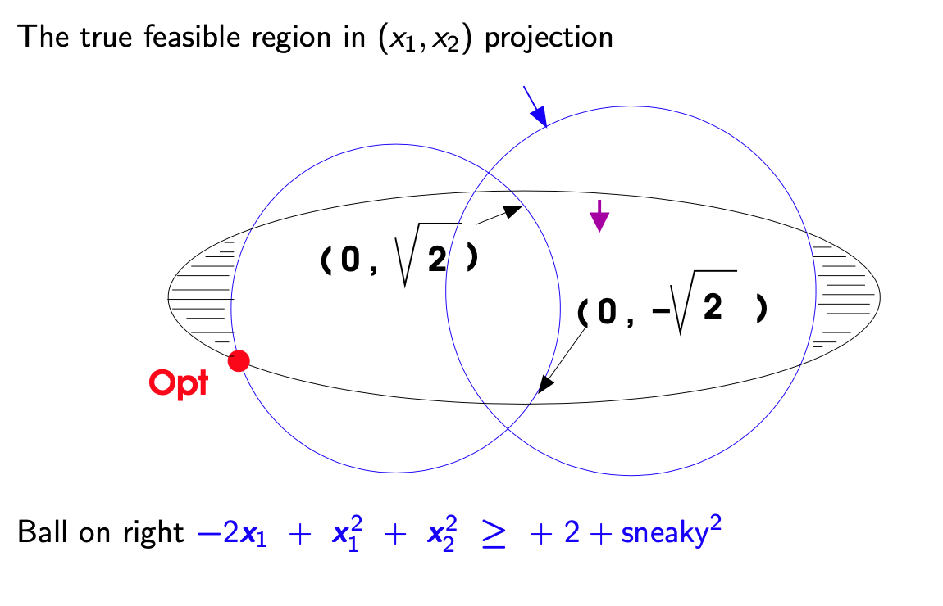

Slide 8
Summary
Nonconvexity together with nonlinearities can cause problematic behavior
In particular, slightly infeasible solutions can be very superoptimal
Numerical near-feasibility (no matter how tight) does not mean near-to-feasible
Or structurally feasible
Should we care? Is this even new?
Can we even detect when this happens? Can we check a purported solution?
Should the users of optimization tools care?

Slide 9
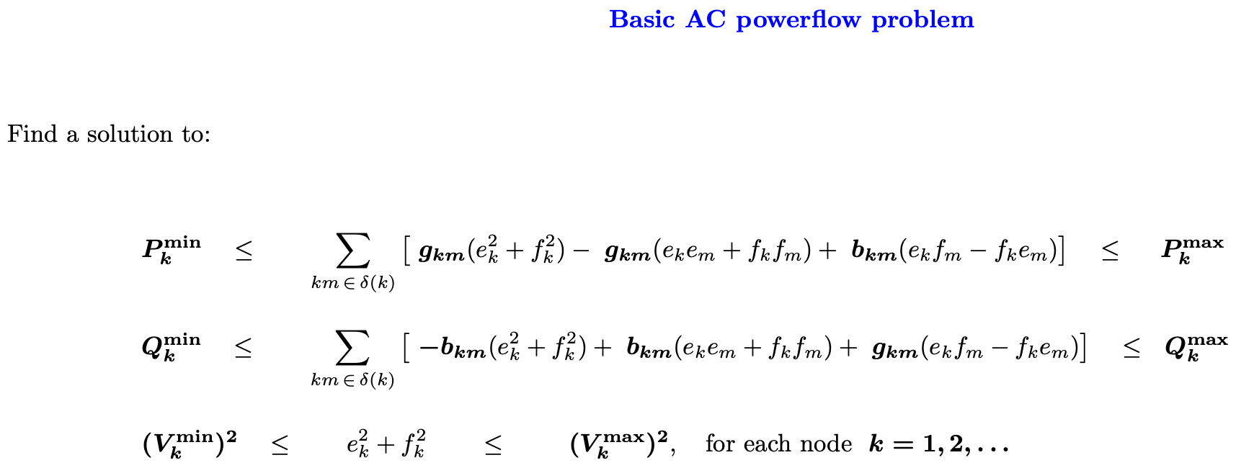
ACOPF problem as a QCQP
In complex coordinates

Slide 10
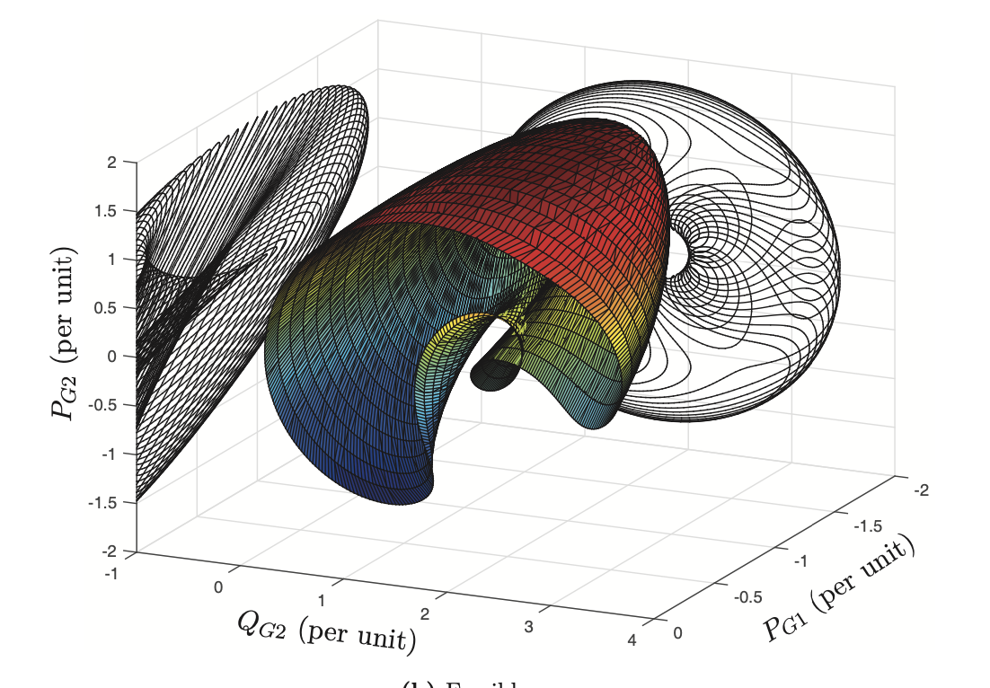
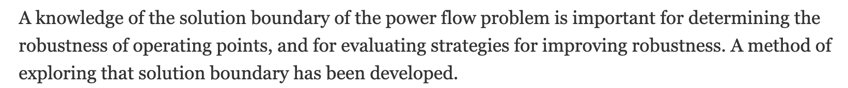
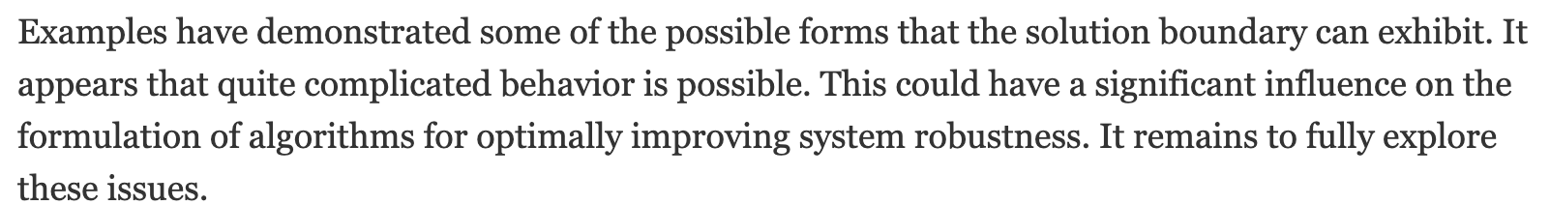

Slide 11
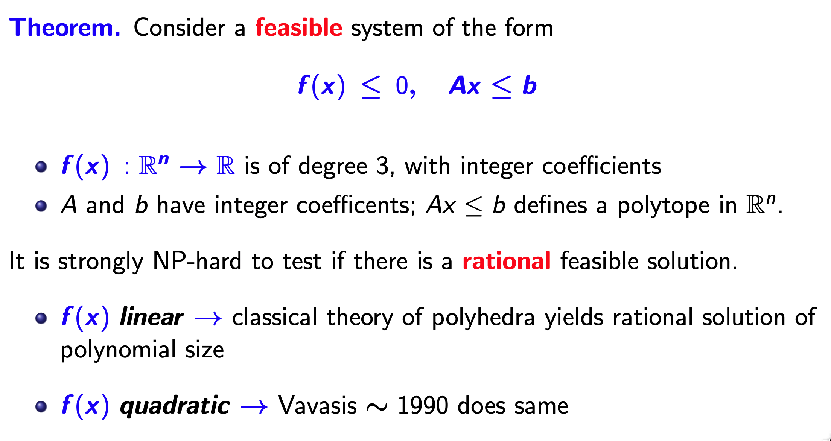
Let’s dispense with mathematics
(with Alberto del Pia and Robert Hildebrand, IPCO 2021, MPB 2022)

Slide 12
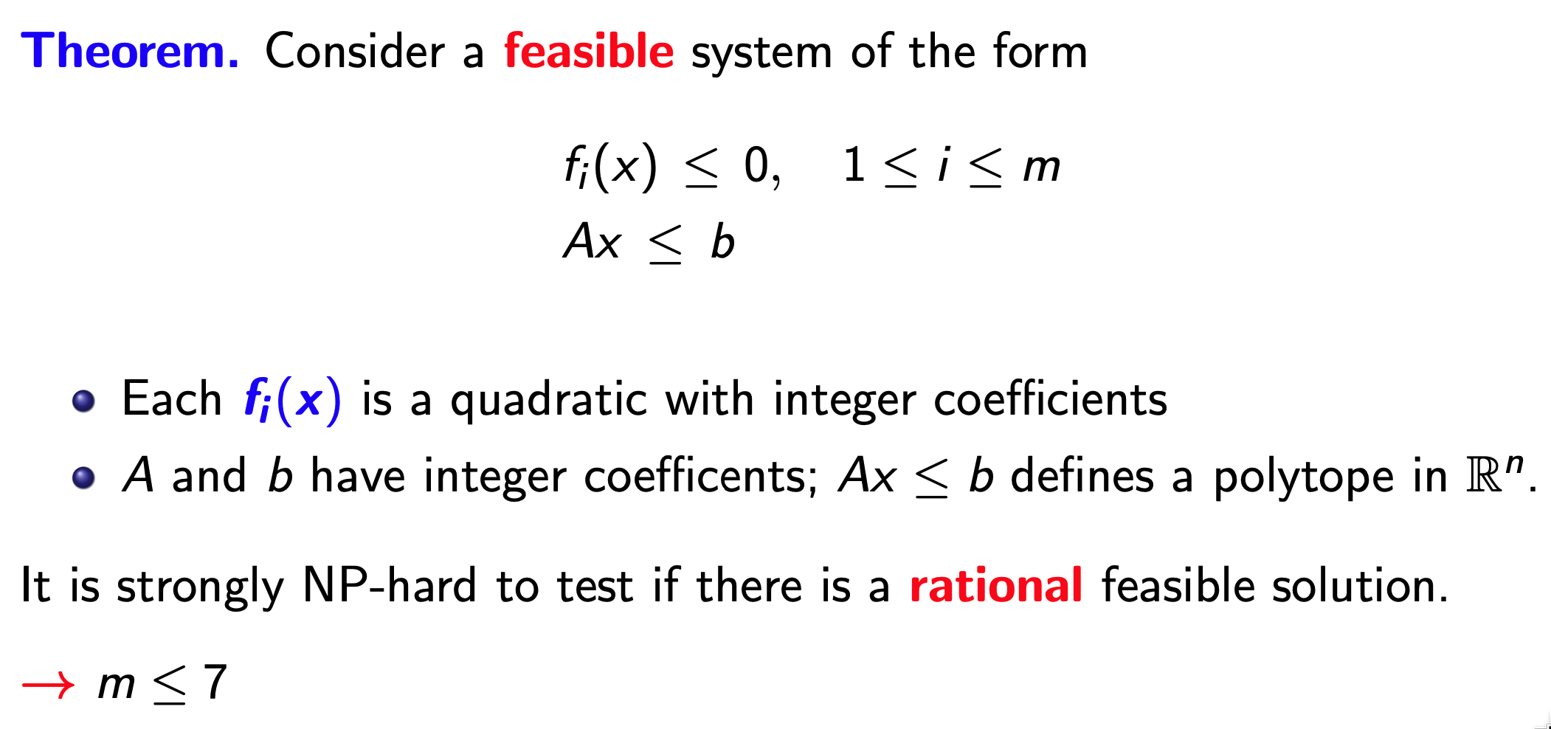

Slide 13
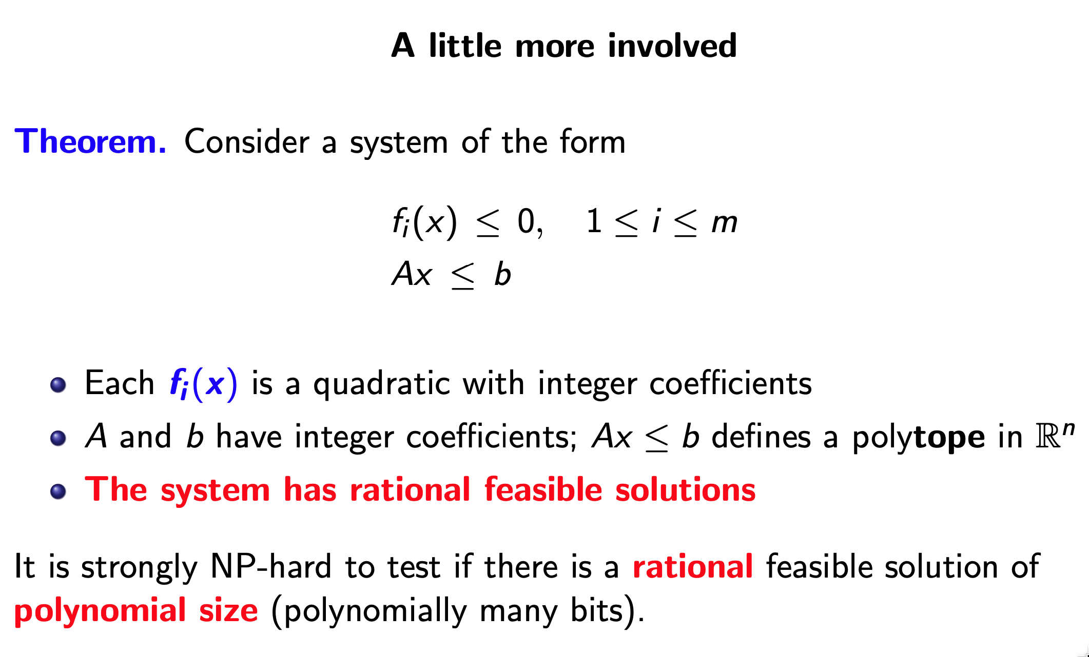
Data-driven, very fast computation at the core

Slide 14
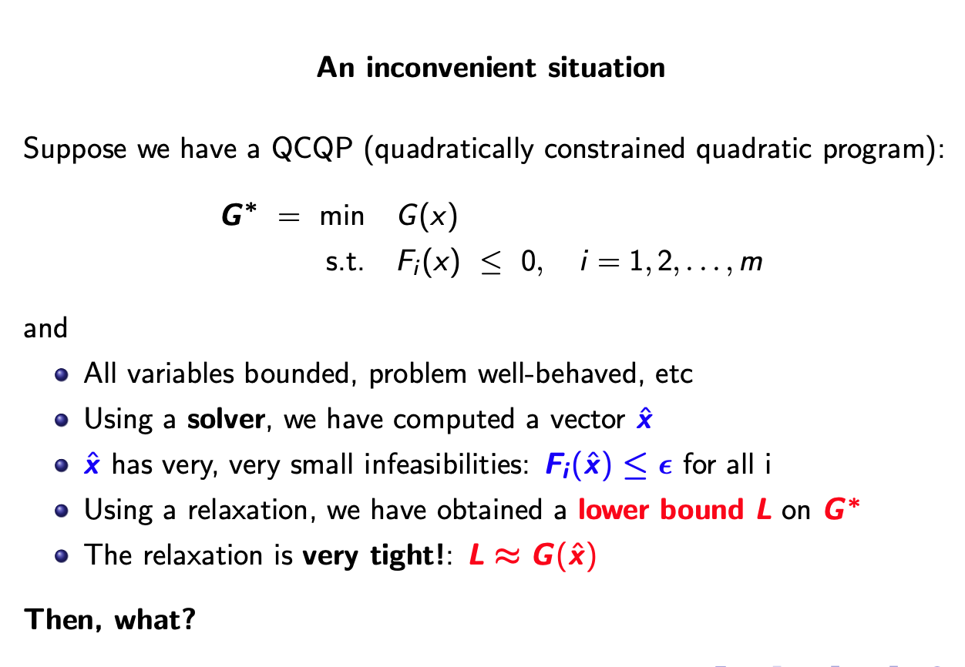
Data-driven, very fast computation at the core

Slide 15
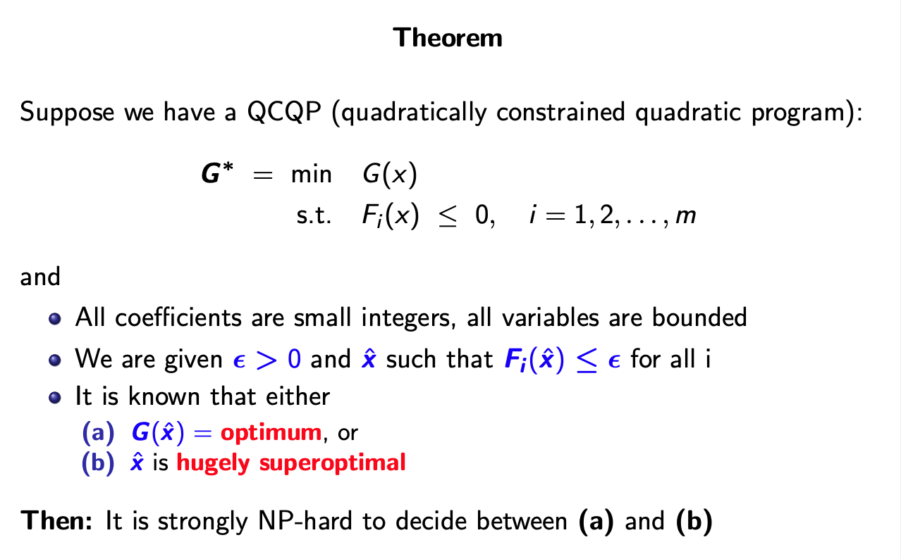
Data-driven, very fast computation at the core

Slide 16
QCQPs are hard!
Numerically challenging.
It is difficult to certify nearness to feasibility of a nearly feasible solution.
It is difficult to certify infeasibility of a model.
How do we explain infeasibility of a model? IISs, anyone?
Real-world cases can be at the boundary of infeasibility.
Nonlinear != linear

Slide 17
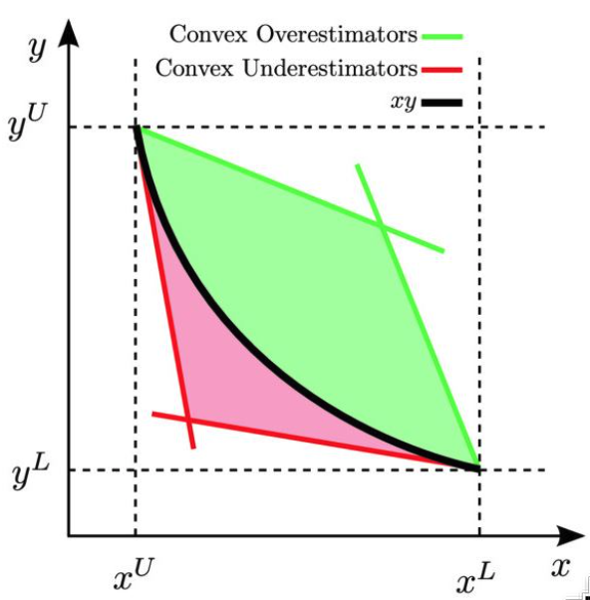
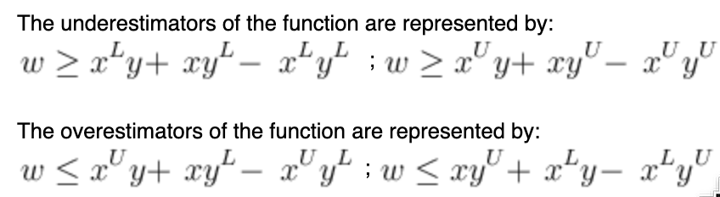
McCormick relaxation - an important workhorse
Convex hull provided by under/over estimators
Works well in tandem with spatial branching
(source: Wikipedia)

Slide 18
Issues with McCormick relaxation and spatial b&b?
On hard instances, e.g., hard and large ACOPF, bounds can be very weak and we will grow an immense tree
Numerical issues! SOC and rotated cone constraints approximated with many outer envelope cuts
Numerical issues! Nodes can be very iffy, in particular:
Infeasibility fathoming! Mr. Solver, are you sure that node is infeasible?
And what does infeasibility actually mean, in light of our prior slides?
Upper bounds: Mr. Solver, are you sure that solution is feasible?

Slide 19
What else? Hierarchies
Sums-of-squares relaxations
Moment relaxations
Many such relaxations frequently relying on semi-definite programming
Very elegant theory! Under appropriate assumptions, value of the relaxation(s) converges to optimum as dimension goes to infinity
On the other hand, formulations can become very large
Semidefinite programming is still not well understood
Fundamental issue – the convergent relaxations might require irrational solutions

Slide 20
Upper bounds: log-barrier methods
A must-have tool!
Knitro, IPOPT, LOQO, others?
Knitro and IPOPT are excellent
Also, very elegant theory!
But, also, excellent implementations!
Theory only guarantees convergence to (?) a critical point for the barrier function
Works extremely well for standard ACOPF
A (minor?) issue: solutions can exhibit small infeasibilities

Slide 21
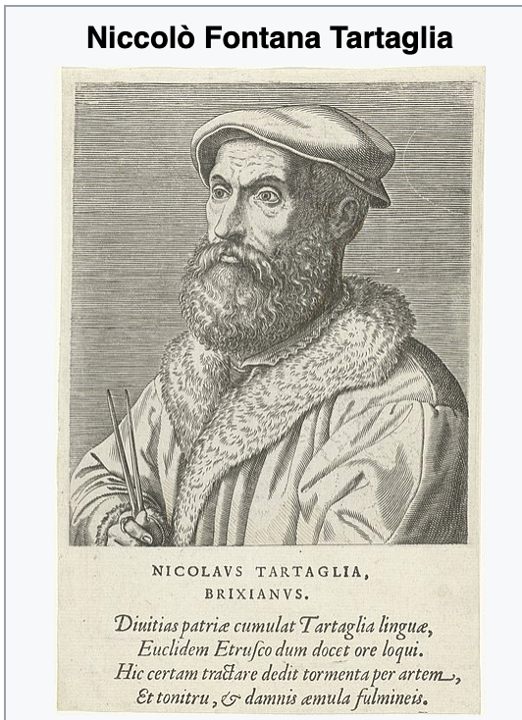
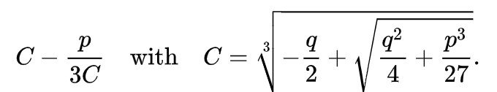
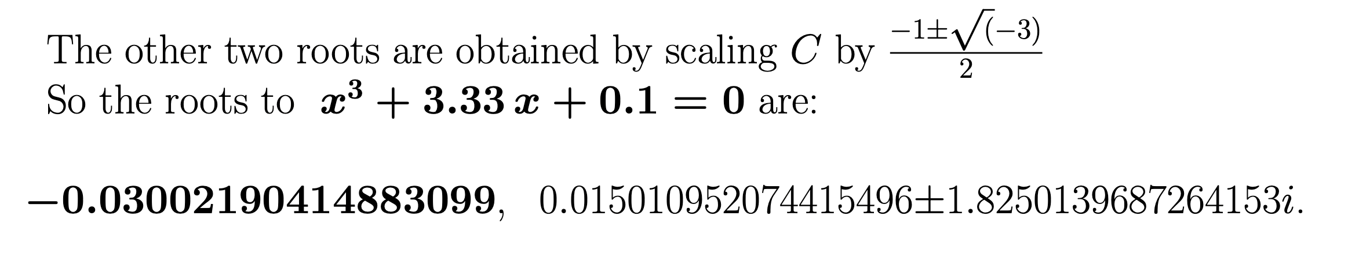
Another fun example:
Niccolò Fontana, a.k.a. Tartaglia (the stammerer), Cardano (both 1500s):

Slide 22
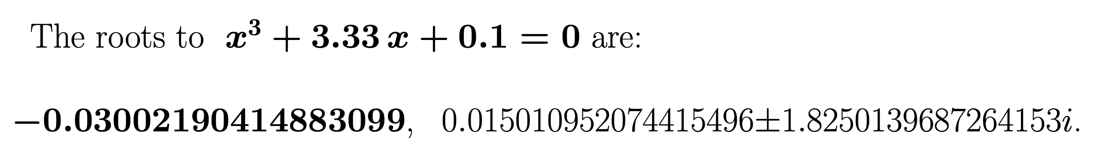
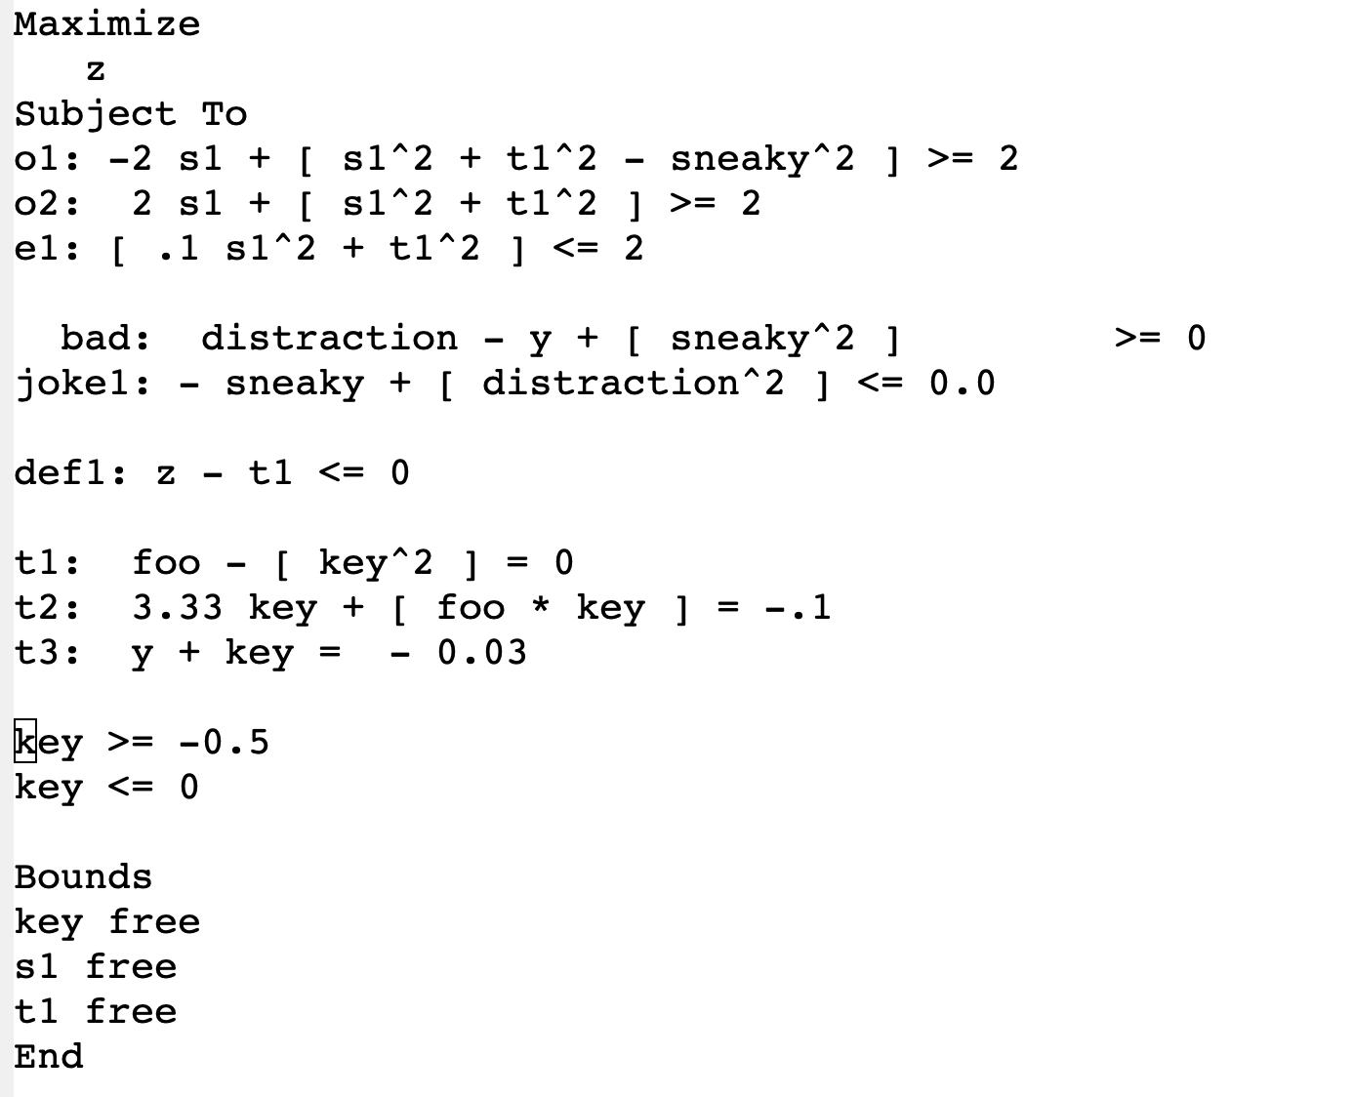
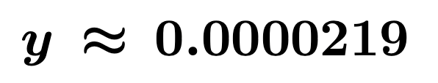

Slide 23
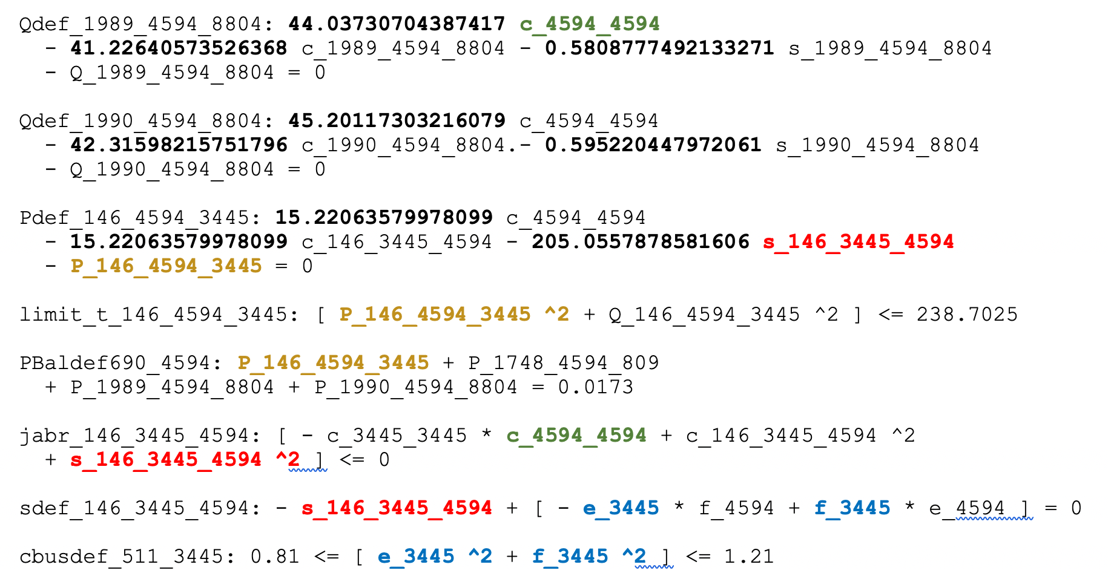
An excerpt from a (real) instance of ACOPF (pegase1354)

Slide 24
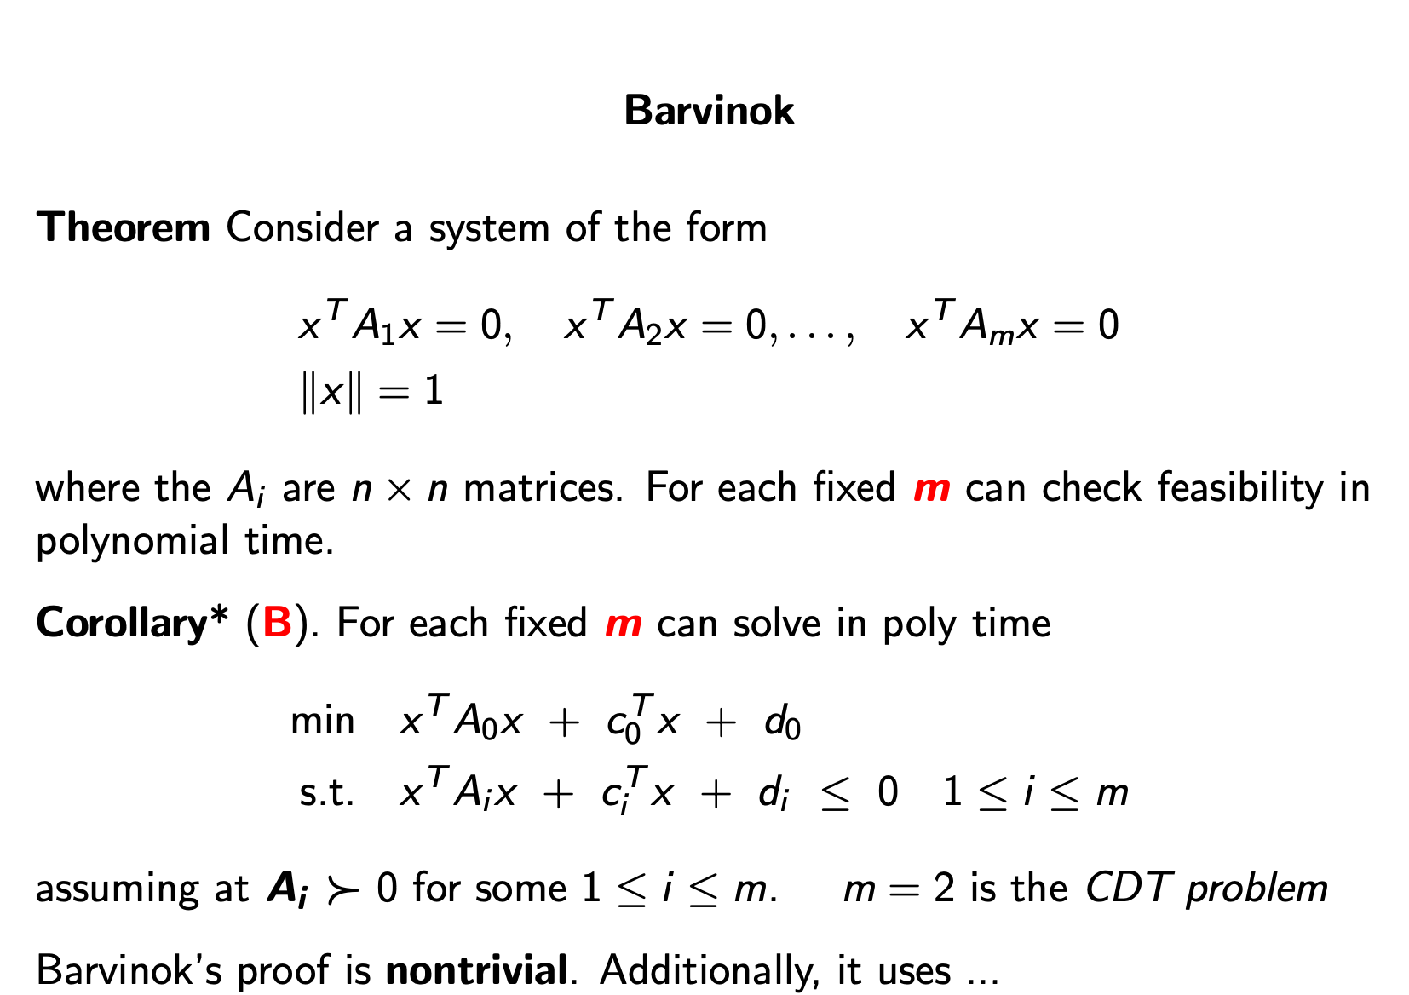

Slide 25
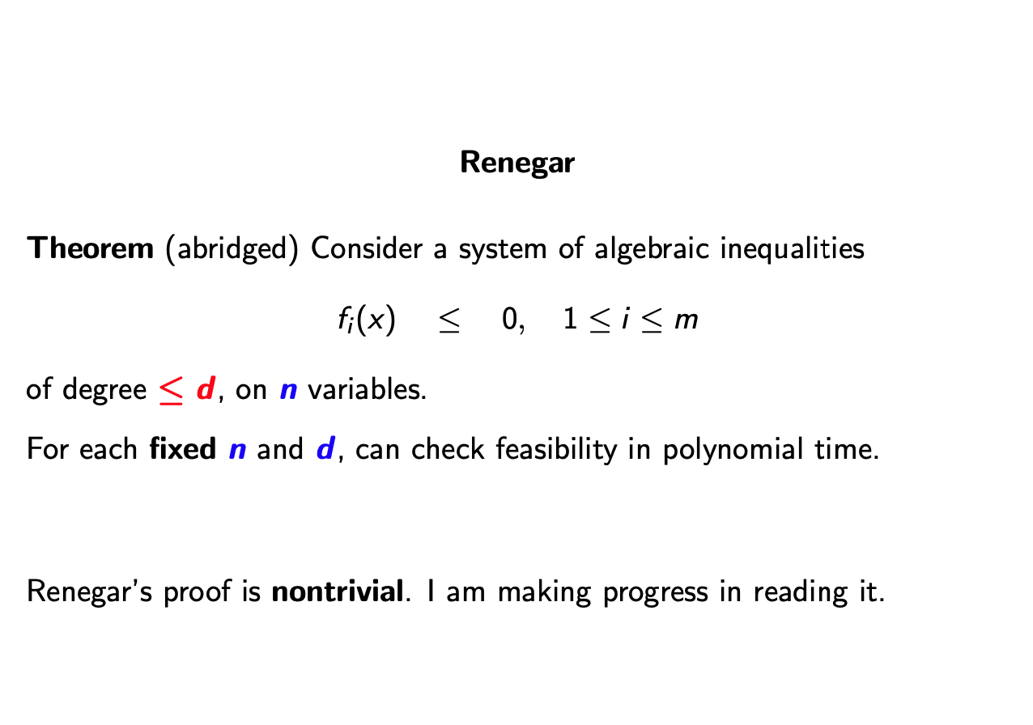

Slide 26
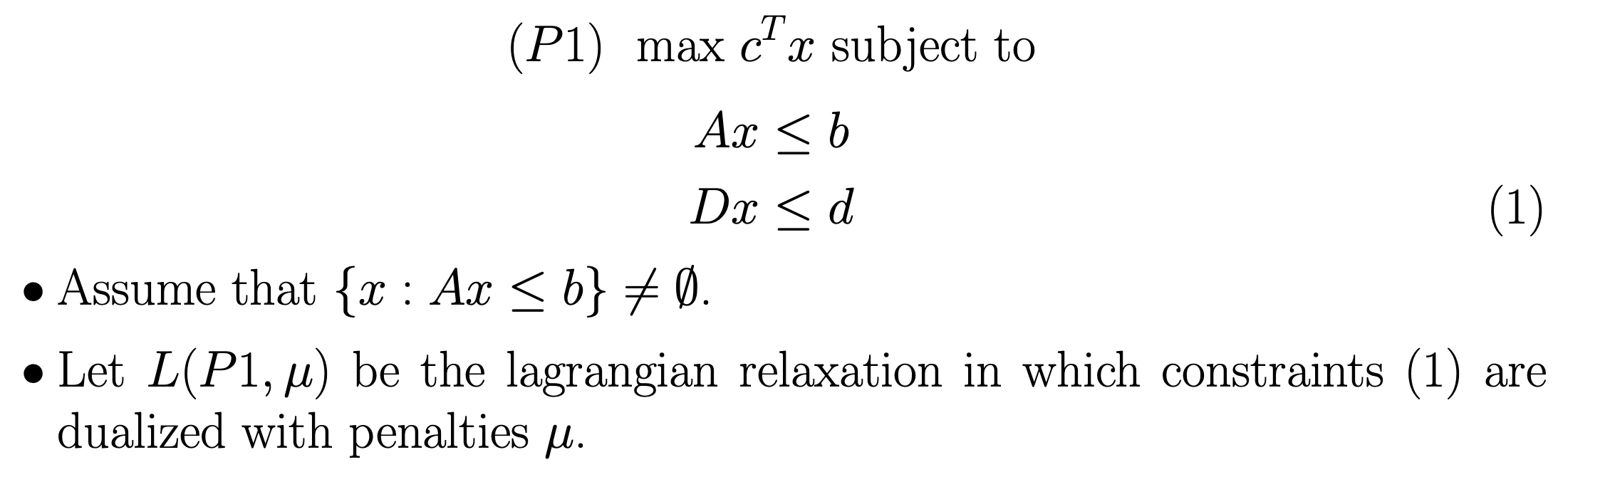
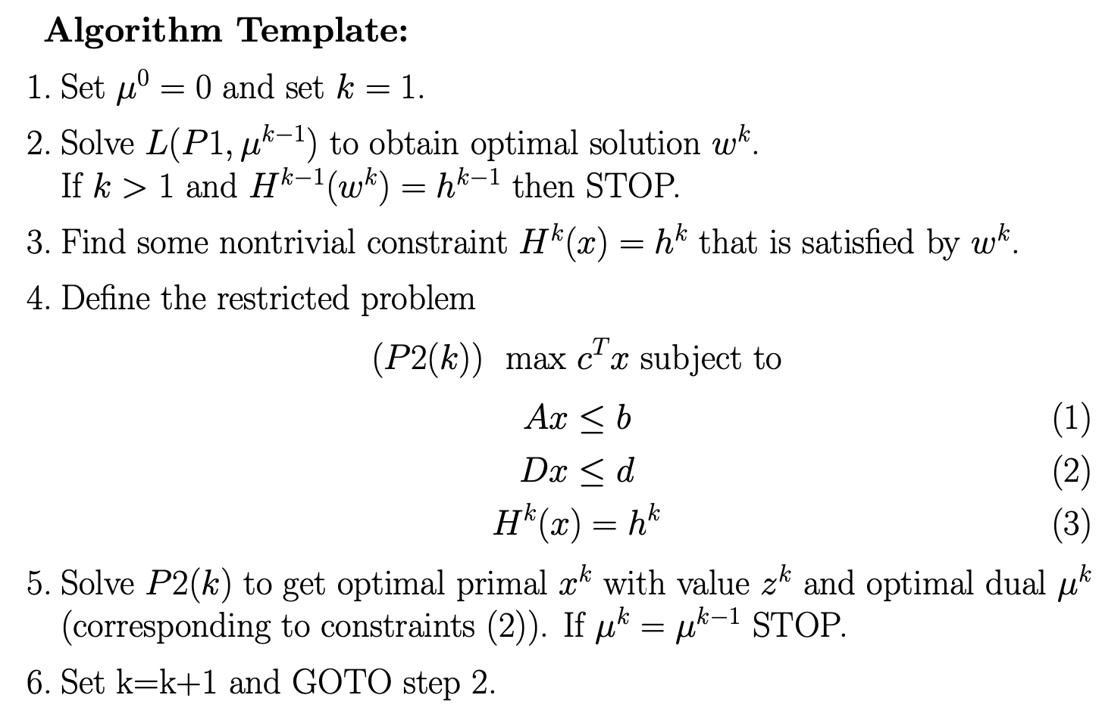
Theorem:
At termination we have solved the LP.

Slide 27



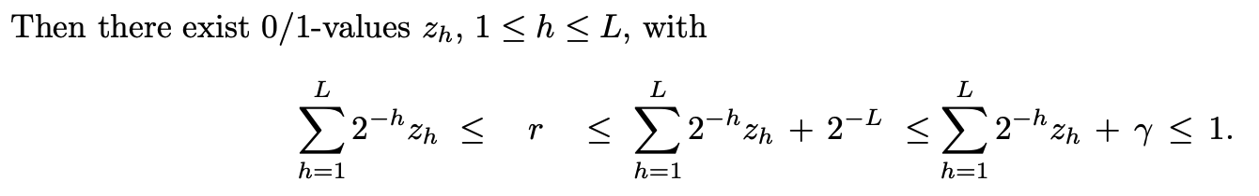
Joint work with Gonzalo Muñoz (2015)
Arbitrarily close approximations of QCQPs using pure-binary integer programs
Approximate continuous variables using binary variables. Why?
Given (quantity to approximate) and (the tolerance)
set

Slide 28
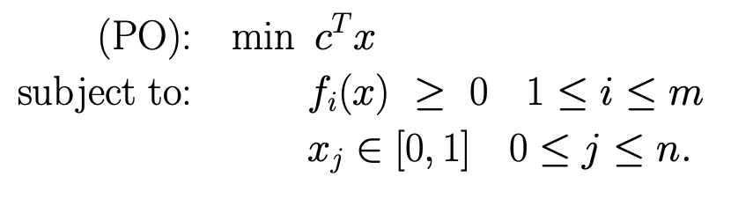
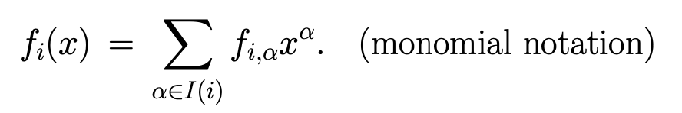
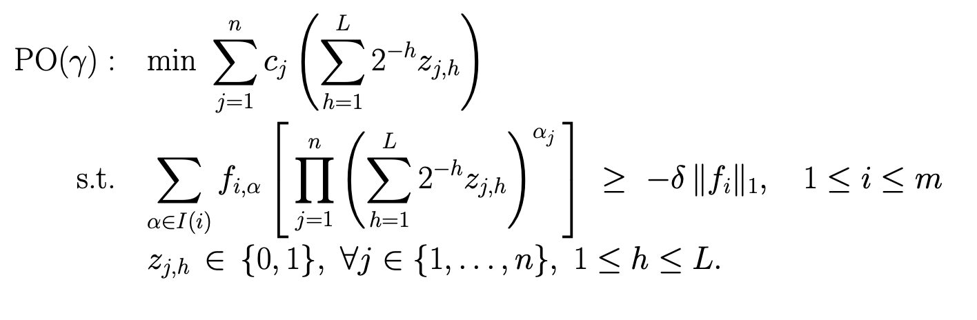

Slide 29
Is this a crazy approach to QCQP?
We start with a bad, large QCQP and we end up with a much, much larger and probably badder MIP
But it is linear …
Numerics should be less of an issue …
And it has a lot of structure …
This is ongoing work with Matίas Villagra and Yuri Faenza

