Slide 1
Modeling Infrastructure Failures: From Flood Damage in Urban Areas to Power Grid Blackouts
Daniel Bienstock
Columbia University

Slide 2
Ongoing work: NSF CRISP
joint with George Deodatis, Heather Lazrus, Kyle Mandli and Rebecca Morris
focus: protecting coastal infrastructure under risk from changing climate
integrating: modeling, optimization, social science

Slide 3
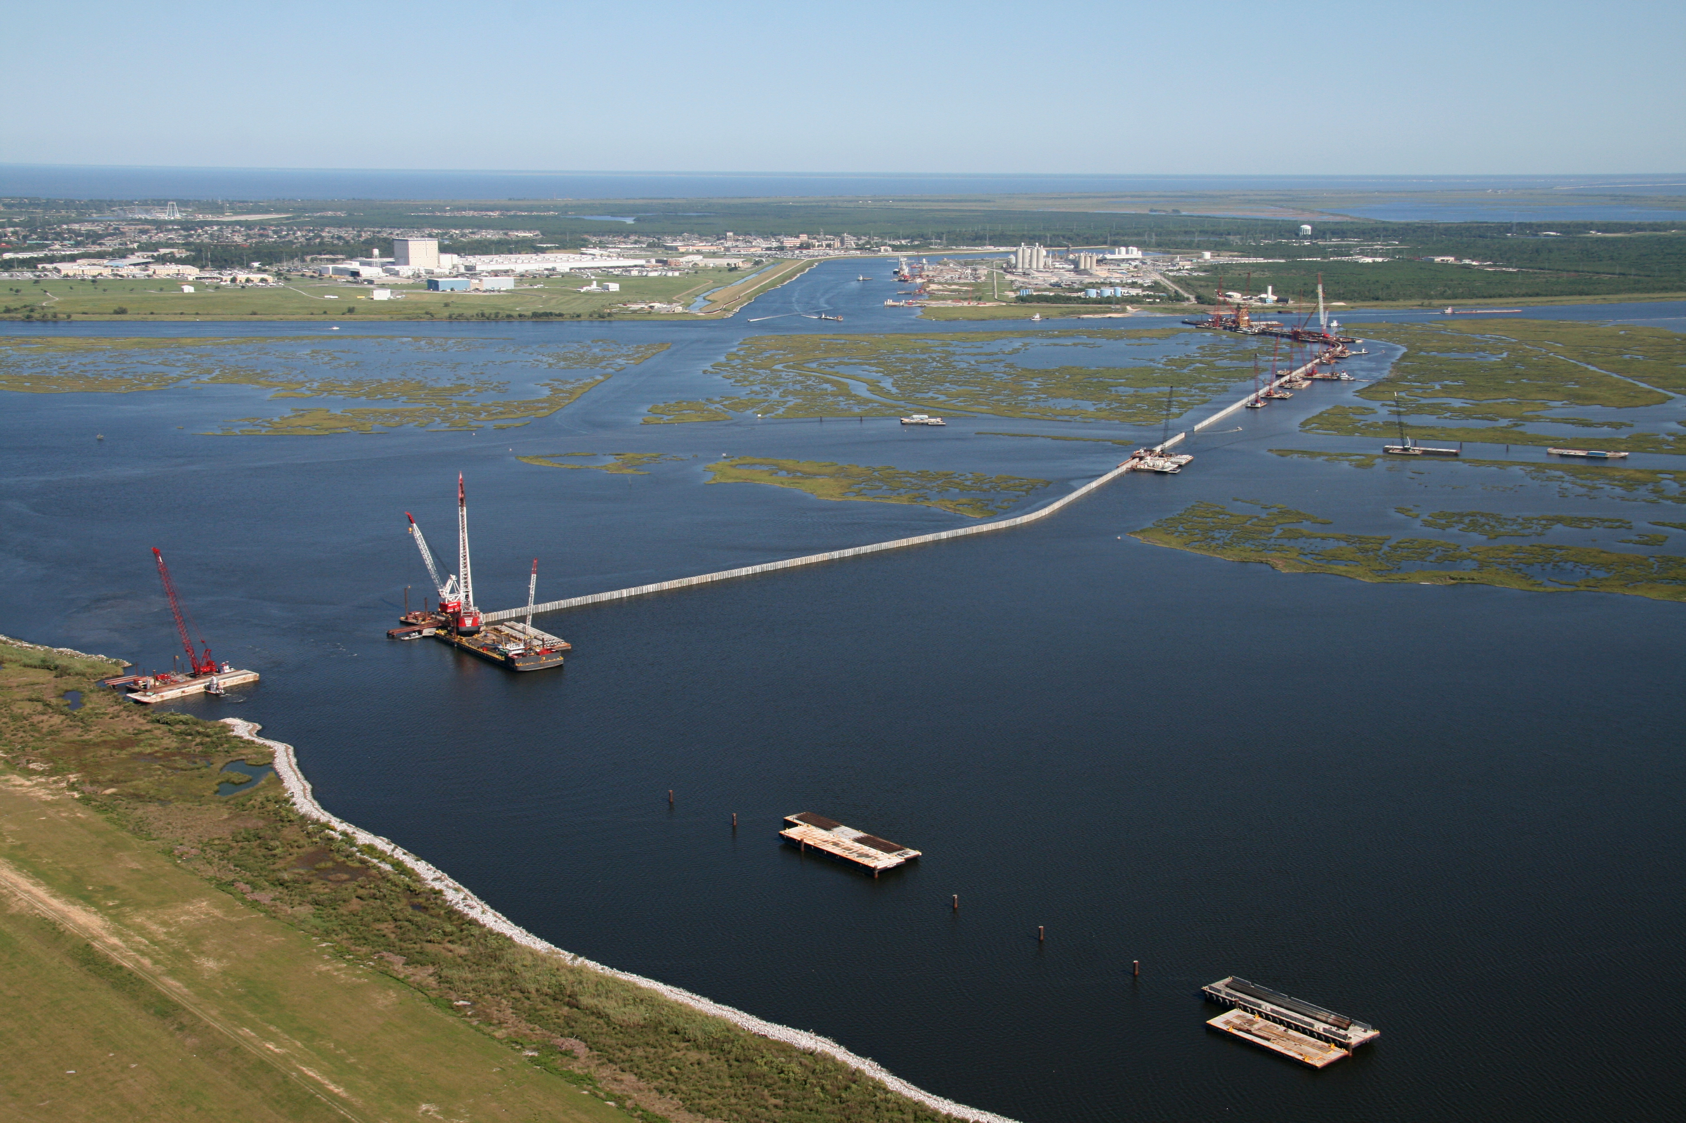
Battery Tunnel post-Sandy (10/2012)
Power outage in Lower Manhattan, post-Sandy
Storm surge barrier construction, New Orleans

Slide 4
Project premises
Infrastructure threatened by climate change
Threat most acute along coastlines
Interdependent Critical Infrastructure
(ICI) at risk, but
ICI important not just along coastlines
diminished ICI impacts inland populations
Example: power grid impacted along coast, but effects cascade far inland

Slide 5
A few facts
Hurricane Sandy (2012): $67 billion in damage
Typhoon Haiyan (2013, Philippines): 6000 lives
Over 1-meter sea level rise predicted by the end of the century
More big storms!
How do we plan? What is the methodology?
How to perform agnostic risk assessments?

Slide 6
Focus: NYC
Transportation at the top of the list
Subway especially important
Subway infrastructure is flood-prone
Subway ventilation systems, electrical, all vulnerable
Restoration, today, is problematic
Amtrak, NJ Transit, LI Railroad, Metro-North:
regional transportation systems interconnected
with NYC’s subway

Slide 7
Focus: NYC
Power grid at risk
Power grid: distribution system (lower voltage)
But complex in the case of NYC
Many underground assets (power lines, transformers)
Real-time knowledge not always available
But fast reaction to events, critical
Damage magnifier: NYC imports a substantial amount of its power. But damage to infrastructure near NYC could imply 100% loss

Slide 8
Focus: NYC
Power grid at risk: a primer on cascades
Exogenous event (e.g. storm) damages electrical equipment
But power keeps flowing (drawn by demand)
Power flows obey laws of physics (hard to predict and not necessarily what we want)
New power flows may overload equipment
Such equipment may (perhaps rapidly) shut down to protect itself
We have lost more power grid assets
Go to 2
Eventually this process may accelerate and cut-off large sectors of demand

Slide 9
Focus: NYC
Power grid at risk: what is needed
Fast, accurate meters for situational awareness
Algorithmic intelligence to make sense of what the meters report, in near-real time
Computational studies
Ability and willingness to perform real-time hedging

Slide 10
Focus: NYC
Emergency services
Especially critical after a big storm
What is included:
Distribution of services via transportation
Coordination between services, hospitals
During Sandy, evacuation of e.g. Bellevue Hospital was a large and dangerous operation
The ability to continue operation is not enough: if a hospital is surrounded by a flooded area then emergency vehicles cannot reach the hospital
This was experienced during and after Sandy

Slide 11
Focus: NYC
Summary: interdependency is critical
Flooding, winds, caused loss of power
Loss of power required evacuation of Bellevue
Flooding, winds made evacuation difficult
Flooding rendered other medical/treatment facilities unavailable
Emergency power generators available but lengthy loss of power limited their usefulness

Slide 12
What data do we have
Detailed map of subway system and all tunnels available (from MTA and Port Authority)
Includes critical elevations of all openings (entrances, ventilation)
Size of openings
Exact mapping of all stations (locations, dimensions)
Above ground transportation system map:
Location and elevations of all streets, plus
Some selected bus depots, subway car parking areas
Critical Medical Facilities:
Location and critical elevations of all hospitals, etc
Includes data on all openings through which water can enter premises
Stakeholder interview process

Slide 13
Proposed methodology

Slide 14
GIS-Based Dynamic Flood Risk Simulator Deodatis, Jacob, et al (2011)

Slide 15
GIS-Based Dynamic Flood Risk Simulator Deodatis, Jacob, et al (2011)
Fast but less accurate
Detailed model with resolution of 1 ft for above ground structures
Very detailed model for underground infrastructure
Overall estimation requires approx 1 CPU second

Slide 16
GeoClaw model Mandli, LeVeque et al, 2016
Slower than GIS system but much more accurate
Finite volume, wave-propagation numerical method
Uses AMR (adaptive mesh refinement)
AMR places computational resources to use “where it matters”
Has been benchmarked/validated using tsunamis, hurricane driven storm surge
Comparable in accuracy to ADCIRC, but approx. 1000 times faster.

Slide 17
GeoClaw model: adaptive discretization

Slide 18
GeoClaw model: adaptive discretization

Slide 19
Storm surge model

Slide 20
GeoClaw model: adaptive discretization

Slide 21
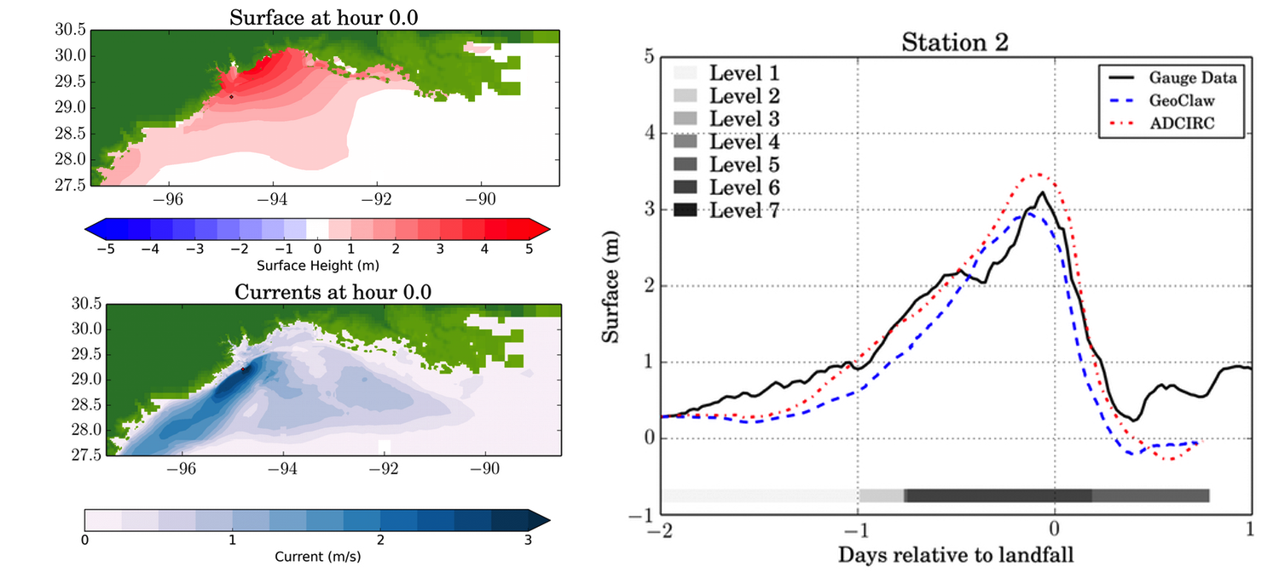
GeoClaw model Mandli et al, 2016
.
Simulation of Hurricane Ike
4 thread: 2 hours

Slide 22
Social Science Methodology
Stakeholder interviews
Interviewees to be selected through collaboration with NYC’s Office of Emergency Management, NY State’s Office of Emergency Management, and the MTA
Interview structure: “Mental models” approach and “assembly method”
Interviews have a progressive structure where successive questions are used to identify stakeholder’s perceptions as to risk, causality and damage propagation
“Scenario method” leads to a diagram which is then tested through additional interviews
Follow-up interviews
Community meetings

Slide 23
Optimization Methodology!!
Problem poorly defined
Data is suspect
A lot of assumptions, e.g. about causality
What are we using optimization for?
Low-lying fruit: optimization asks agnostic questions
It usually reveals pitfalls in planning assumptions
Which leads to reevaluation of procedures, etc.
All very good, but WHAT do we do, computationally?

Slide 24
What do we do??
This is not such an uncommon situation
E.g. it arises in engineering applications
Example: design a machine component
A few critical parameters involved
Suitability of a parameter choice is
computationally expensive
What are appropriate tools?

Slide 25
High-quality toolsets
Simulation-driven optimization
Trust-region methods
Derivative-free optimization
If we are brave:
Stochastic-gradient methods
If we are very brave:
Use ML tools to “learn” from simulations

Slide 26
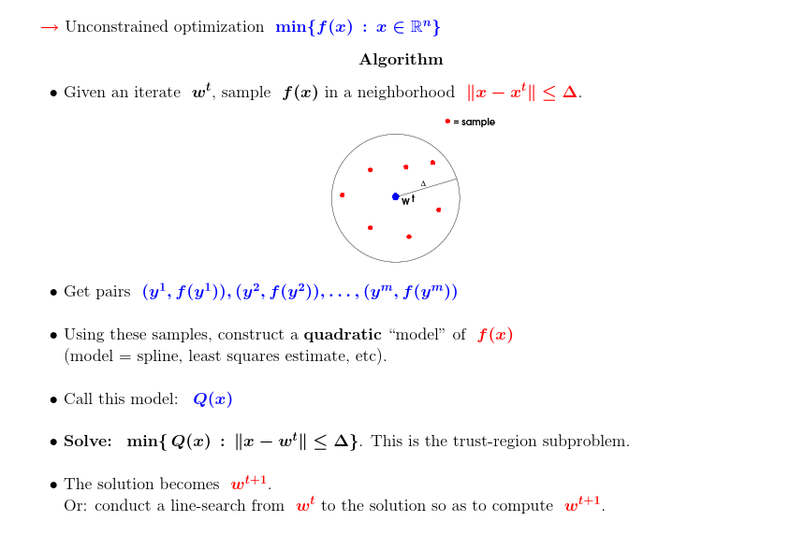
High-level view of sampling methods

Slide 27
Thank you!

