Slide 1
Solving QCQPs
Daniel Bienstock, Columbia University and Gurobi
IEEE PES-GM July 2022

Slide 2
Special thanks to some of my PhD students
Oktay Gϋnlϋk
Abhinav Verma, Alex Michalka
Mark Zuckerberg
Gonzalo Muñoz
Matίas Villagra

Slide 3
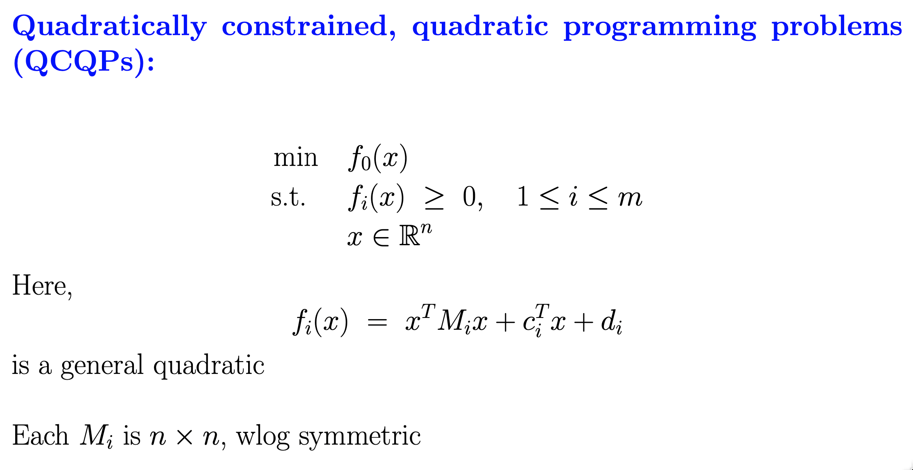

Slide 4
QCQPs
They arise in many applications. For example, pricing problems. The pooling problem. ACOPF.
Moving forward, we expect numerous applications in hard science and engineering.
QCQPs can be very large: real-world ACOPF instances can have millions of variables and constraints.
QCQPs are a rich modeling language: you can efficiently encode any polynomial optimization problem as a QCQP.
And, second-order Taylor approximations of complex mechanisms.

Slide 5
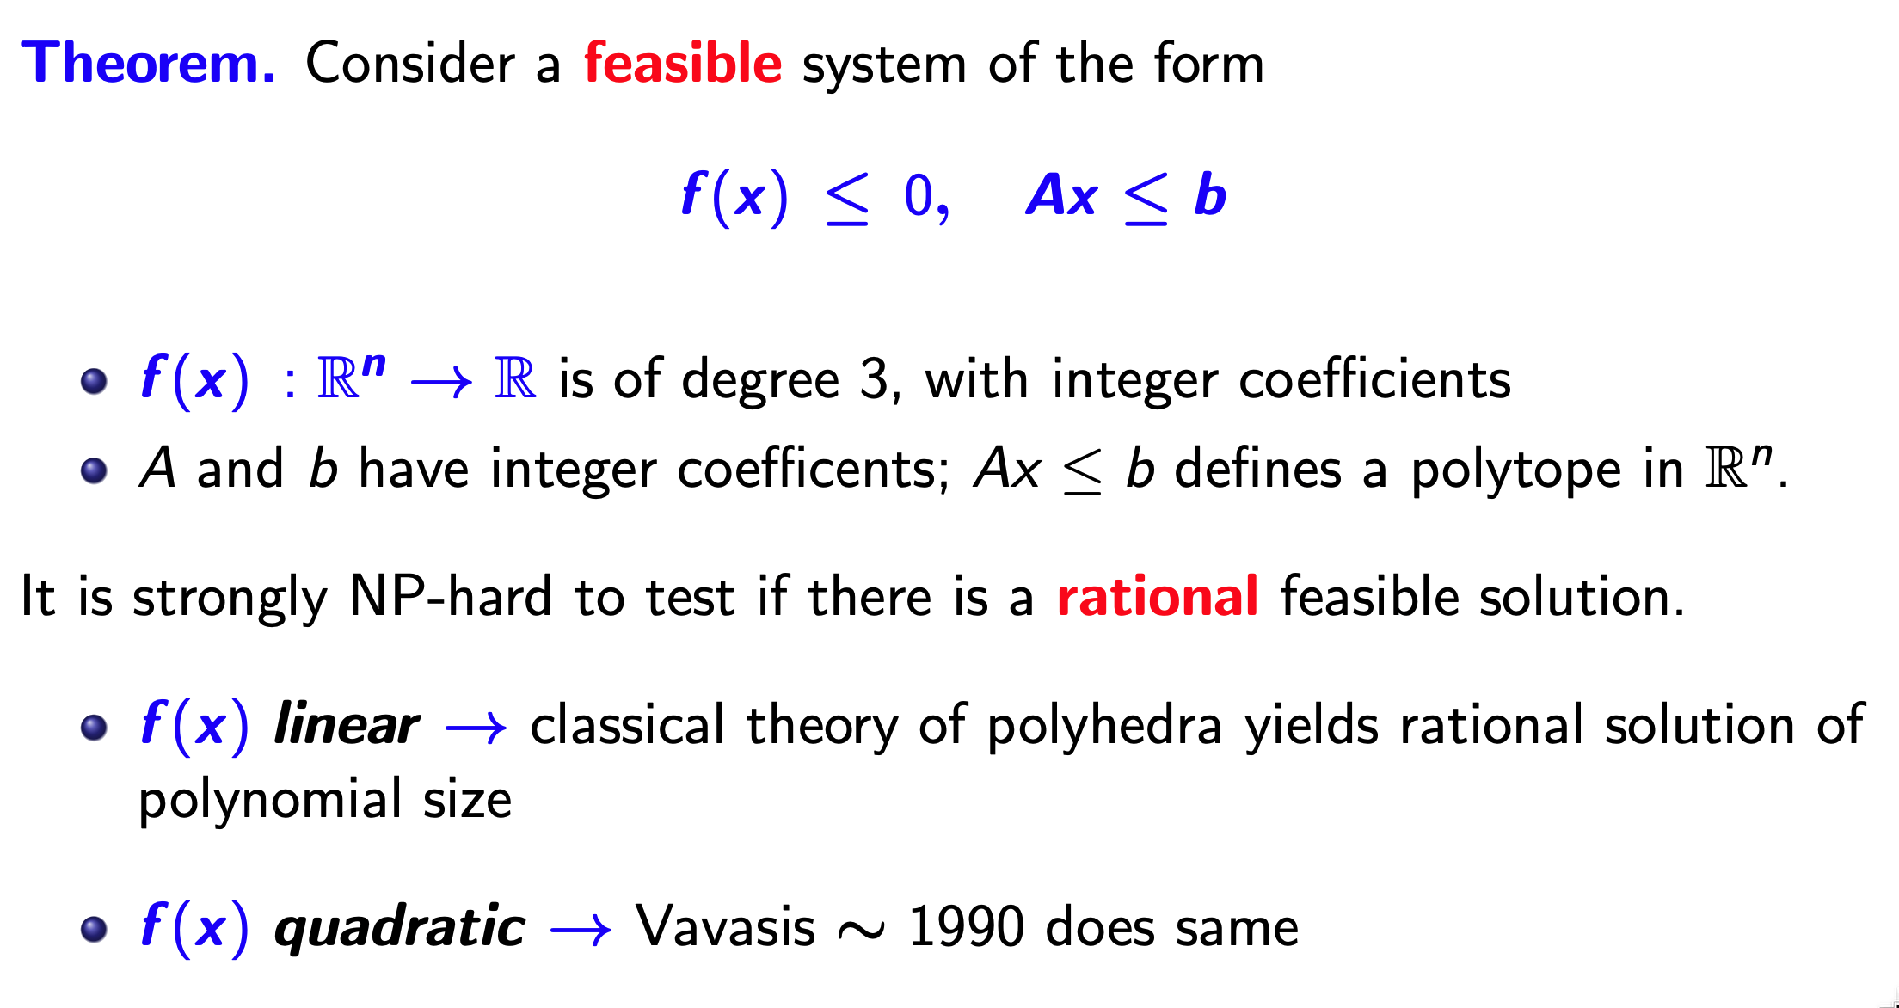
Let’s dispense with mathematics
(with Alberto del Pi and Robert Hildebrand, IPCO 2021, MPB 2022)

Slide 6
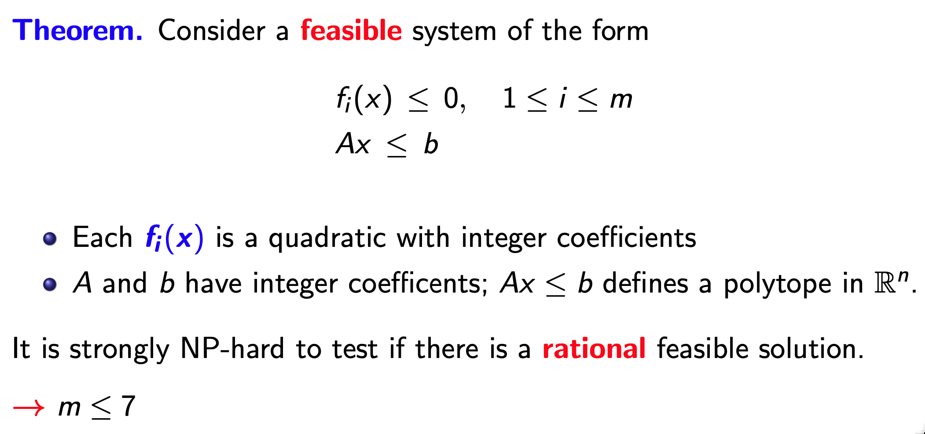

Slide 7
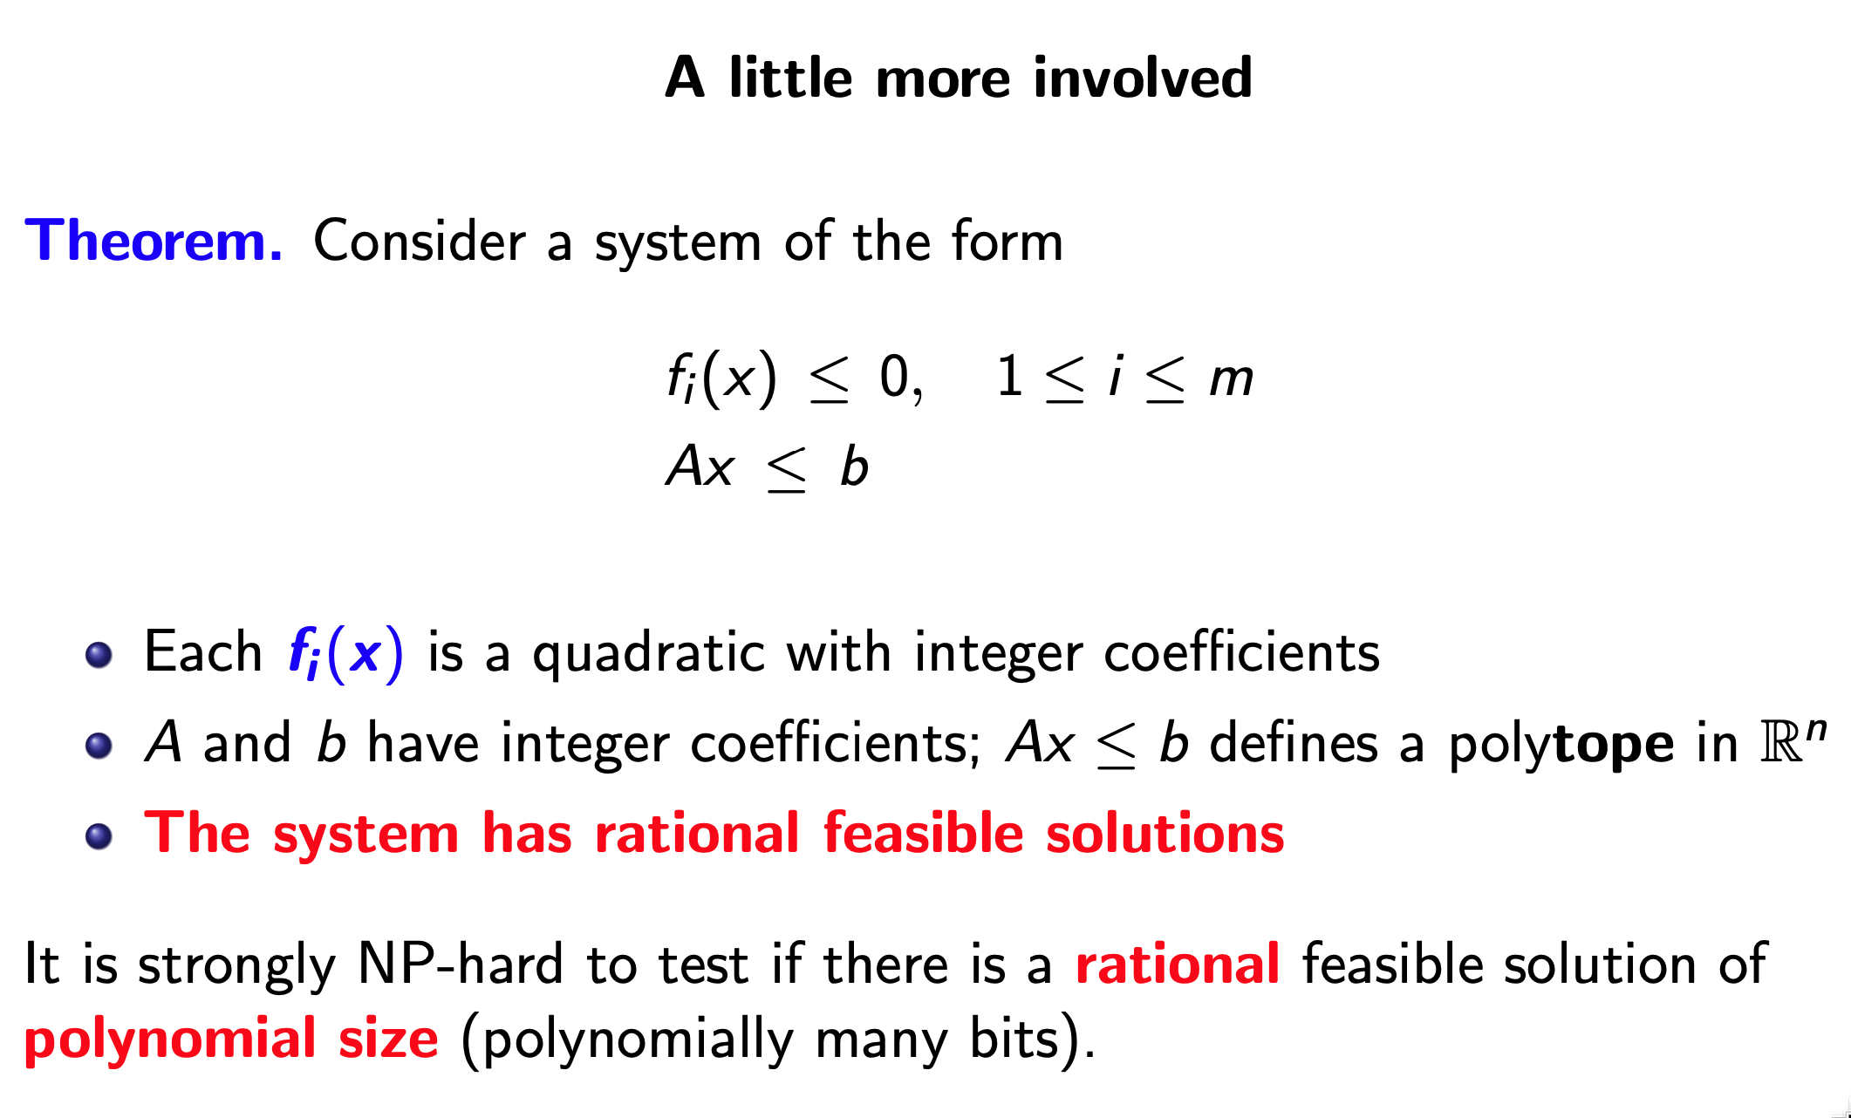
Data-driven, very fast computation at the core

Slide 8
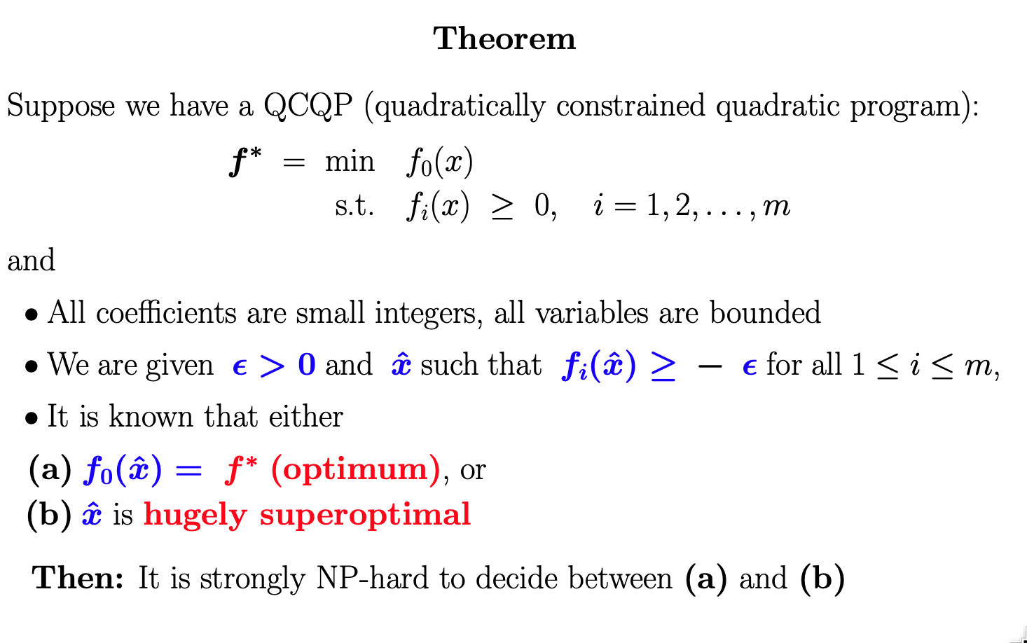
Data-driven, very fast computation at the core

Slide 9
QCQPs are tricky!
Numerically challenging.
It is difficult to certify infeasibility of a model.
How do we explain infeasibility of a model? IISs, anyone?
Real-world cases may be at the boundary of infeasibility.
Nonlinear != linear
It is difficult to certify nearness to feasibility of a nearly feasible solution.
A nearly-feasible solution can be very superoptimal and far from the feasible region

Slide 10
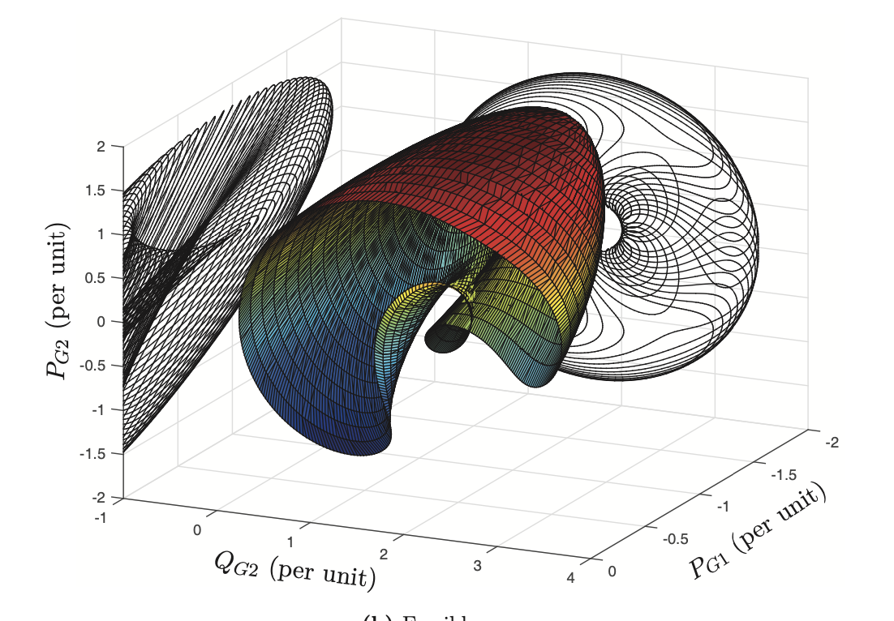
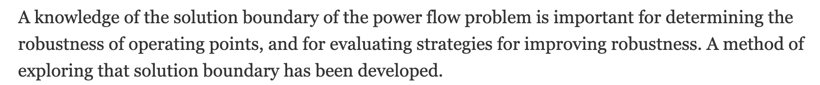
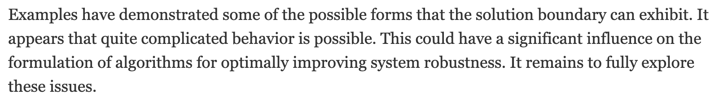

Slide 11
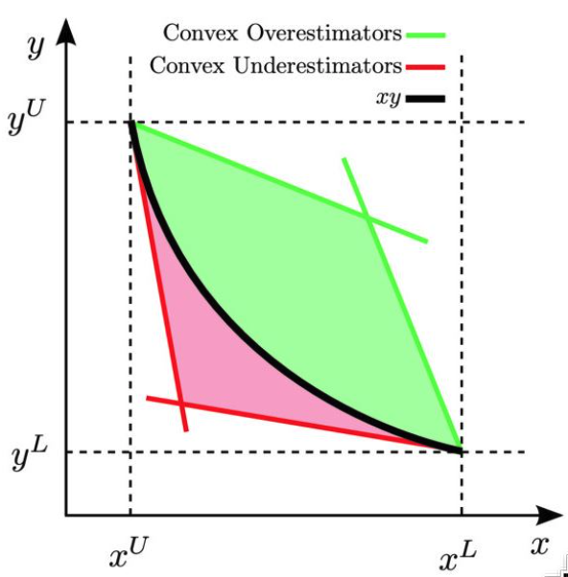
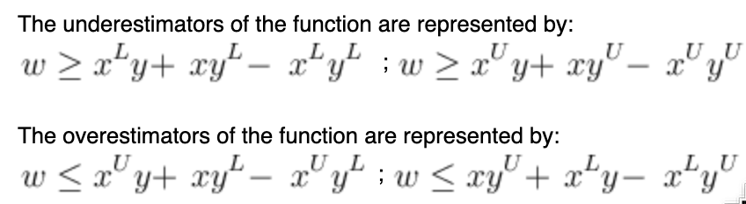
McCormick relaxation - an important workhorse
Convex hull provided by under/over estimators
Works well in tandem with spatial branching
Sometimes
Why do I say so?
(source: Wikipedia)

Slide 12
Issues with McCormick relaxation and spatial b&b?
On hard instances, e.g., hard and large ACOPF, bounds can be very weak and we will grow an immense tree
Numerical issues! SOC and rotated cone constraints approximated with many outer envelope cuts
Numerical issues! Nodes can be very iffy, in particular:
Infeasibility fathoming! Mr. Solver, are you sure that node is infeasible?
And what does infeasibility actually mean, in light of our prior slides?
Upper bounds: Mr. Solver, are you sure that solution is feasible?
Especially when your different solver options give different values for a problem?

Slide 13
What else? Hierarchies
Sums-of-squares relaxations
Moment relaxations
Many such relaxations frequently relying on semi-definite programming
Very elegant theory! Under appropriate assumptions, value of the relaxation(s) converges to optimum as dimension goes to infinity
On the other hand, formulations can become very large
Semidefinite programming is still not well understood
Fundamental issue – the convergent relaxations might require irrational solutions

Slide 14
Upper bounds: log-barrier methods
A must-have tool!
Knitro, IPOPT, LOQO, others?
Knitro and IPOPT are excellent
Also, very elegant theory!
But, also, excellent implementations!
Theory only guarantees convergence to (?) a critical point for the barrier function
Works extremely well for standard ACOPF
A (minor?) issue: solutions can (do) exhibit small infeasibilities

Slide 15
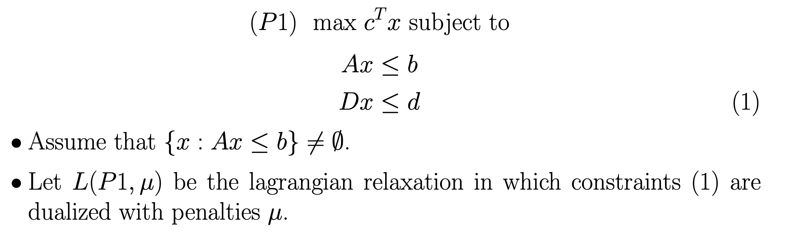
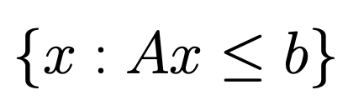
Joint work with Mark Zuckerberg (2009)
Solving LP relaxations of very large 0-1 integer programs
We are interested in cases where is integral and has “special structure”

Slide 16
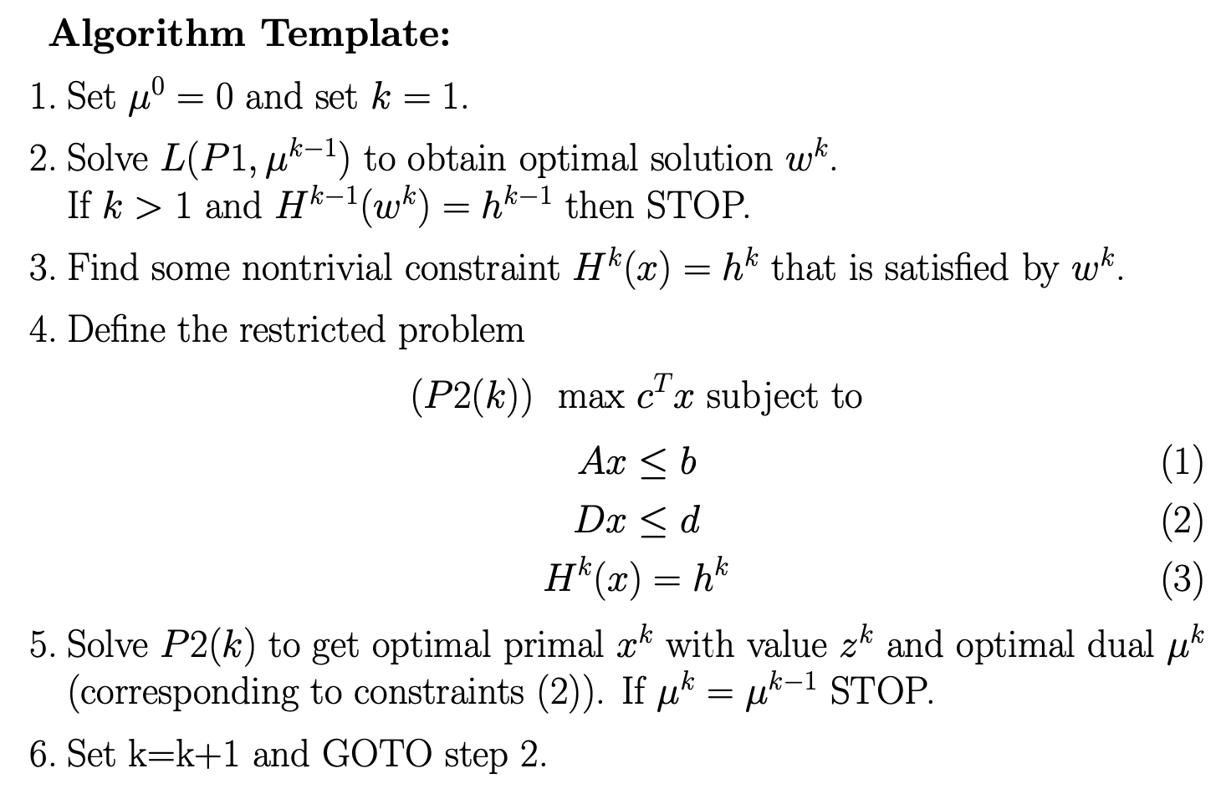
Theorem:
At termination we have solved the LP.

Slide 17



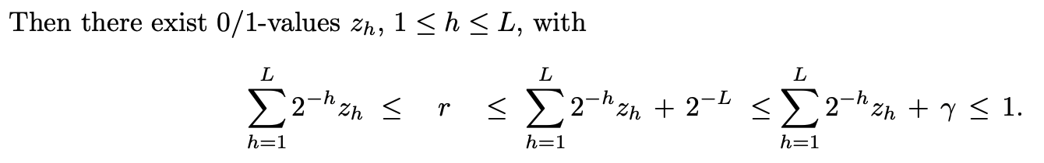
Joint work with Gonzalo Muñoz (2015)
Arbitrarily close approximations of QCQPs using pure-binary integer programs
Approximate continuous variables using binary variables. Why?
Given (quantity to approximate) and (the tolerance)
set

Slide 18
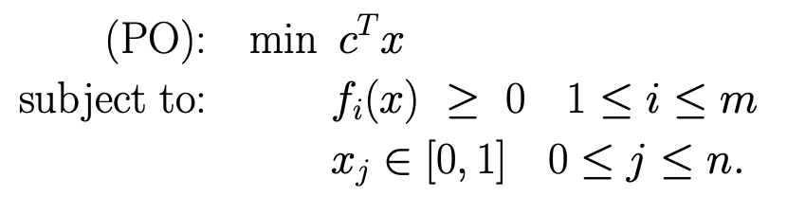
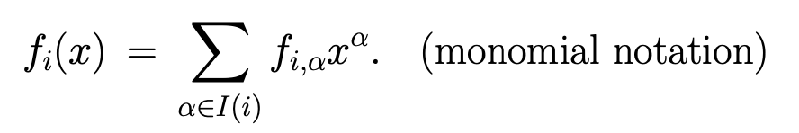
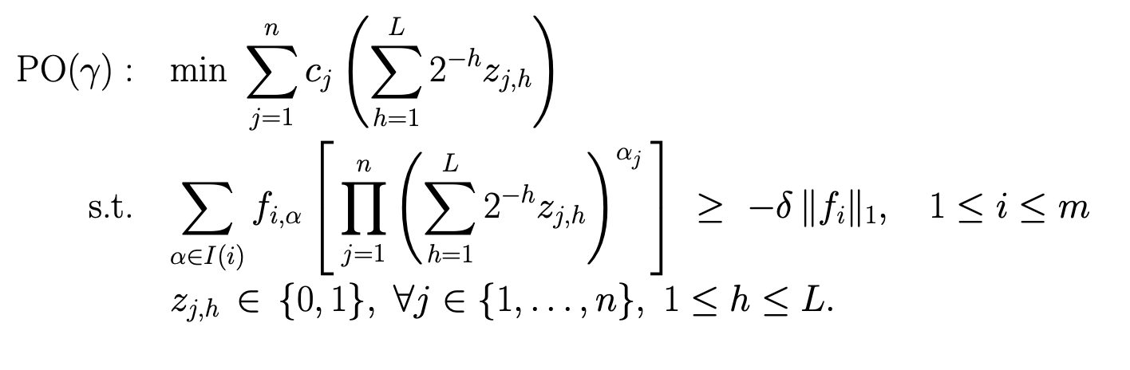

Slide 19
Is this a crazy approach to QCQP?
We start with a bad, large QCQP and we end up with a much, much larger and probably badder MIP
But it is linear …
Numerics should be less of an issue …
And it has a lot of structure …
This is ongoing work with Matίas Villagra and Yuri Faenza

