Slide 1
The Thompson-McFadden Commission, the Public Health Service, and Pellagra
Steve Mooney
Epic: Using R for Simulation
June 2015

Slide 2
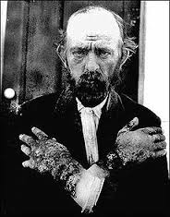
Pellagra
4D’s: dermatitis, diarrhea, dementia and death
First formally described in 1735; endemic in Europe for many years, but not well understood
In Italy, “cured by change in diet and surroundings”
Note the lesions on his hands

Slide 3
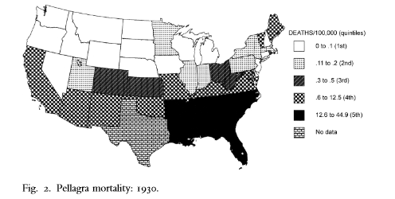
Pellagra in the US
“Unknown” in the US until early 20th century…
…then epidemic in American South
  Between 1906-1940, estimated 3 million cases & 100,000 deaths
Increased incidence among socially disadvantaged
  Almost all cases very poor
  Disproportionately female
  Disproportionately African-American

Slide 4
Theories of Pellagra Etiology At Start of US Epidemic
Dietary, but dietary agent unidentified
  Toxin in diet (agent=bad)
  Deficiency in diet (agent=good)
Infectious, but infectious agent unidentified
  “You might as well ask me to believe the boll weevil is not alive as to ask me to believe that pellagra is not caused by a living organism”
    -Dr. E.H. Martin of Hot Springs, Arkansas

Slide 5
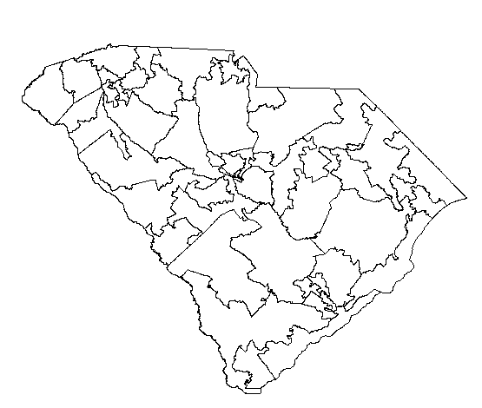
Our focus: two investigations of pellagra in cotton-mill villages in South Carolina
This part of South Carolina, near Spartanburg

Slide 6
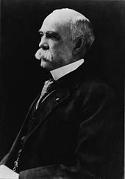
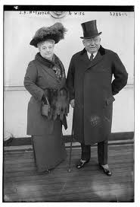
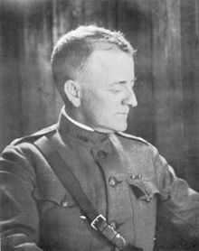
The Thompson-McFadden Commission
Privately funded governmental investigation into the causes of pellagra circa 1912
Funders
Lead Investigator
RM Thompson
McFadden (and his wife)
Joseph Siler, US Army Medical Corps

Slide 7
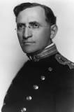
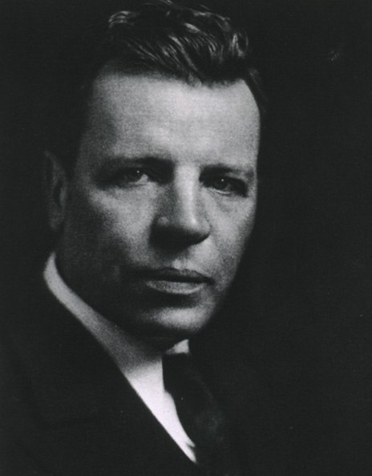
The Public Health Service
Publicly funded follow-up to Thompson-McFadden Commission study, circa 1916
Joseph Goldberger, leader of the PHS investigation
Edgar Sydenstricker, chief statistician of the Public Health Service

Slide 8

Mooney, Knox & Morabia (later)
We had wanted to re-analyze the PHS commission’s data with modern multi-level analytic techniques
  Multi-level analysis requires detailed individual level data, which we didn’t have
But in our investigation, we noticed the similarity of study designs and started wondering: why didn’t the Thompson-McFadden Commission figure out the puzzle?
Unauthorized Photo of Justin & Steve at the National Archives – taken by Alfredo Morabia

Slide 9
Study Design
Both TMcF and PHS compared pellagra incidence within and between a set of cotton-mill villages, wherein poverty and pellagra were both common and known to be associated
Key exposures:
  Diet
  Home location
Outcome: pellagra incidence
Within Villages

Slide 10
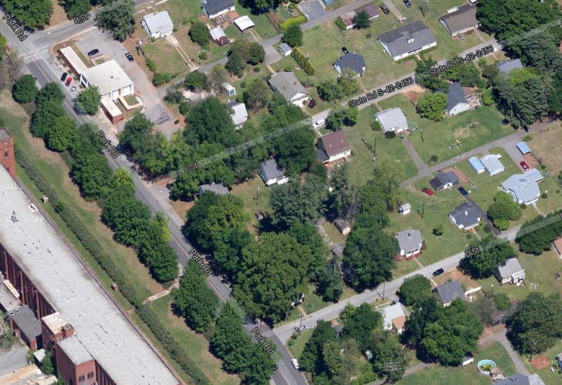
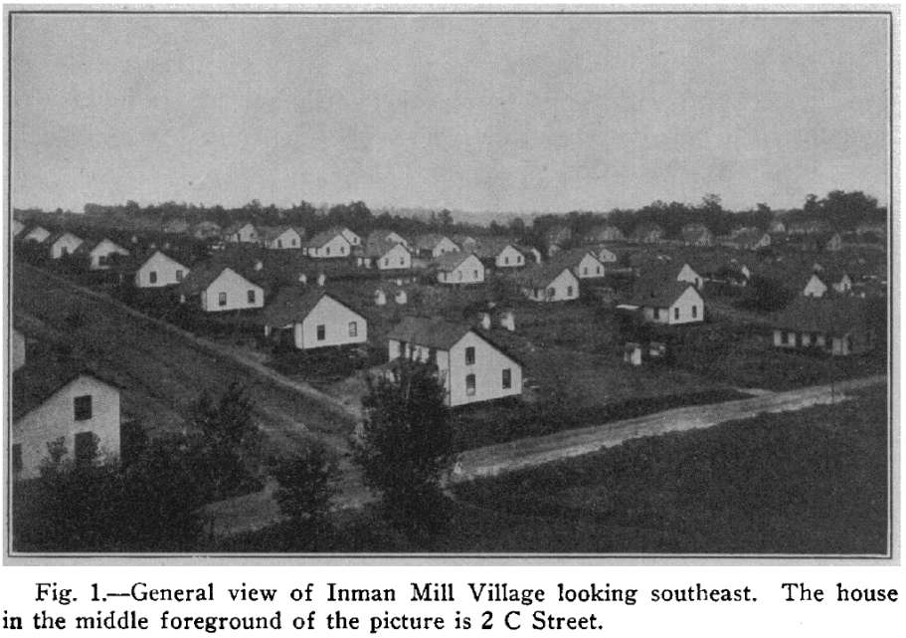
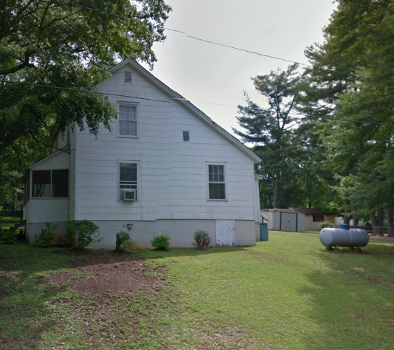
Cotton-mill villages
Location of 2 C Street
“company towns”
2 C Street in May 2012 (from Google Street View)

Slide 11
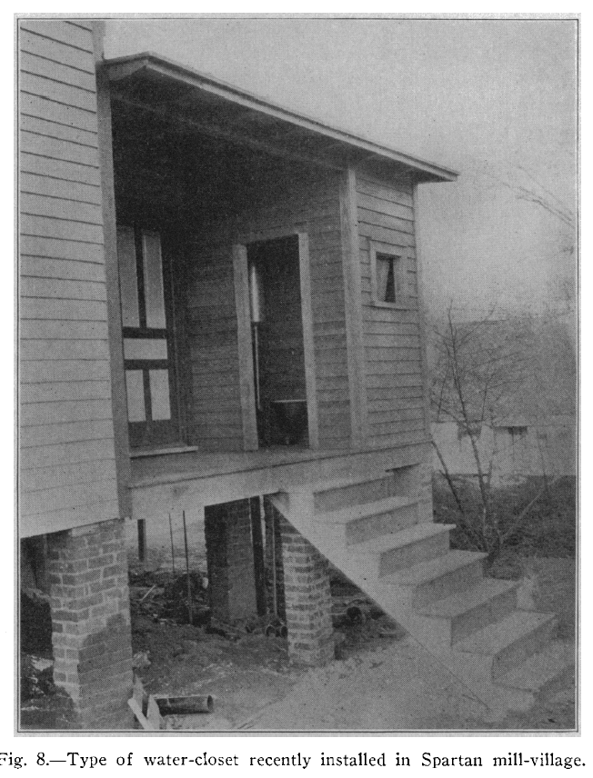
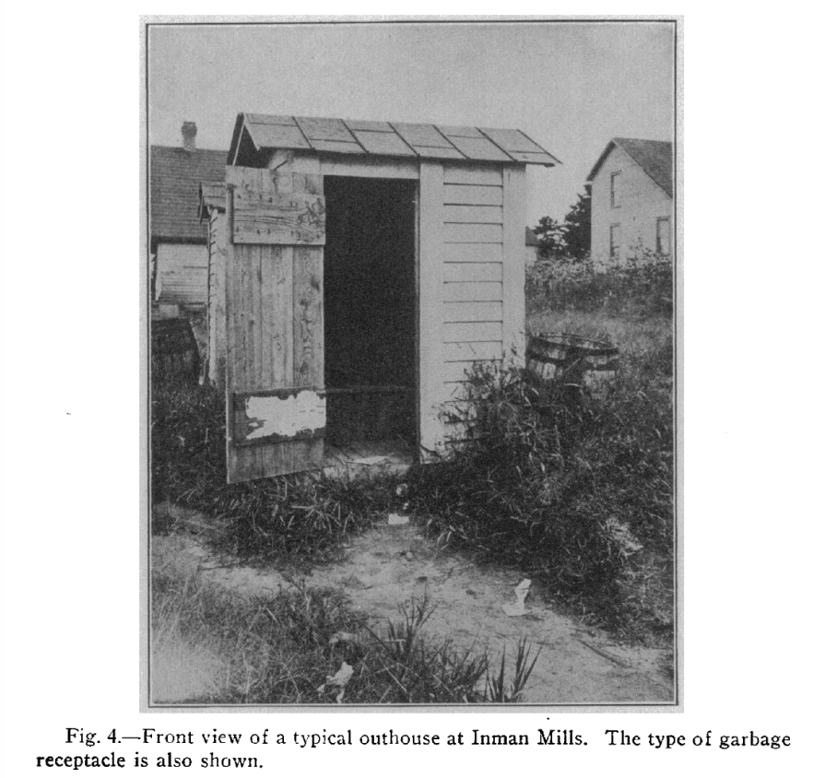
Cotton-mill villages
Many had poor sanitation

Slide 12
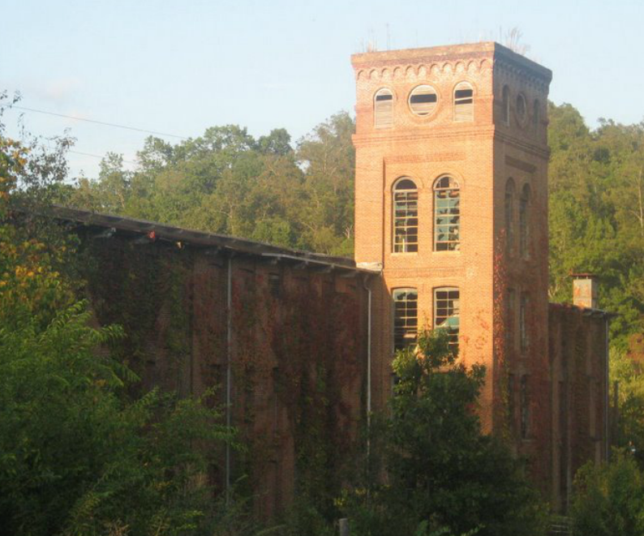
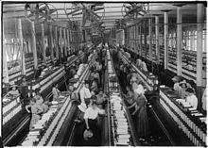
Cotton-mill villages
Most individuals had same employment
Newry Cotton Mill (now), From Google Maps
Spinning Room of a cotton mill (From Wikipedia)

Slide 13
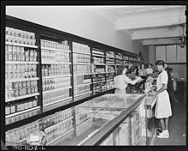
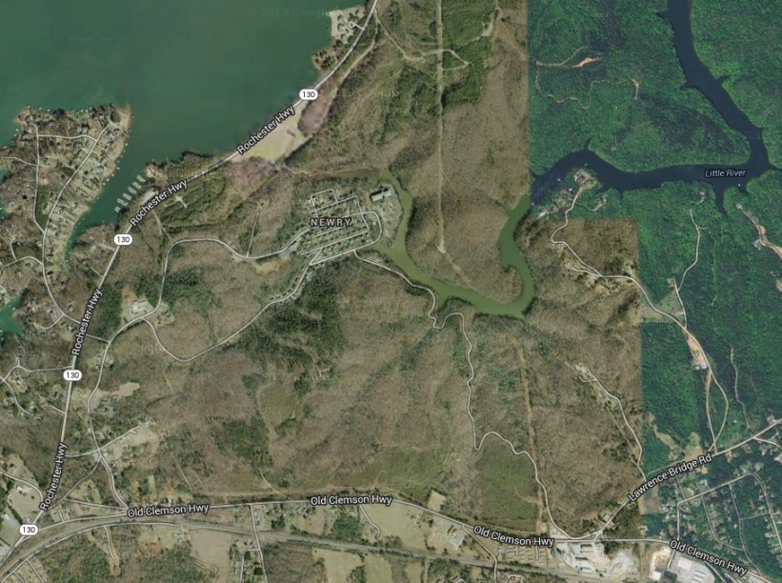
Cotton-mill villages
This is Newry
Most groceries from company store
This is a company store from a coal mining town (via Wikipedia), but you get the idea.
Some cotton-mill villages were physically isolated

Slide 14
Different villages
The PHS picked a set of villages that overlapped with TMcF’s selection, but were slightly different:
  TMcF: Inman Mills, Whitney, Pacolet Mills, Saxon Mills, Arkwright, and Spartan Mills
  PHS: Inman Mills, Whitney, Saxon Mills, Arkwright, Newry, Republic, and Seneca
Why did PHS select different villages?
  Never explicitly stated, but my belief is that they were attempting to address the sanitation issue
    Newry and Republic had “improved” sewage systems (internal plumbing?), unlike the other villages
    TMcF had contrasted Seneca (poor sanitation, high pellagra) and Newry (good sanitation, no pellagra) in a prior analysis (not the cotton-mill village study)

Slide 15
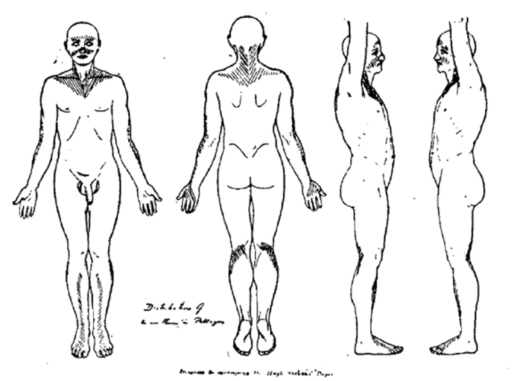
Different Case Ascertainment
TMcF: either of
  Skin lesions leading to diagnosis at canvass time
  Report of both patient confirmed by treating physician
PHS: clearly defined, bilaterally symmetric dermatitis
Notes:
Discuss pellagra sin pellagra

Slide 16
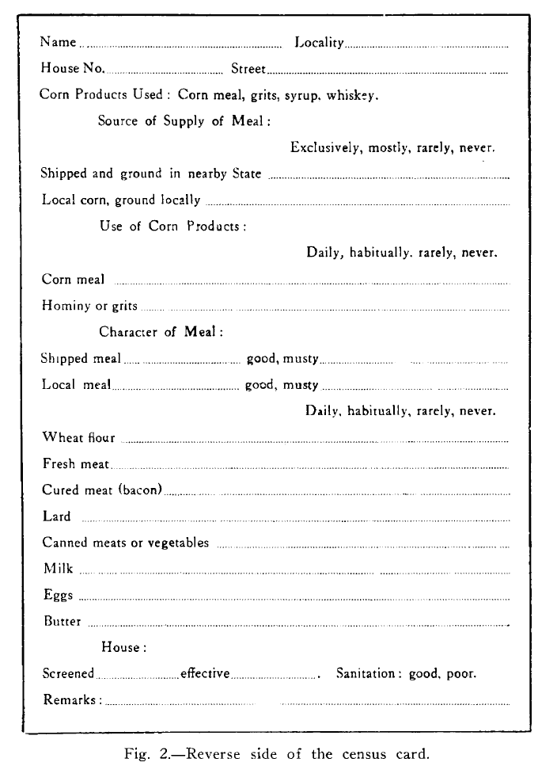
Different Dietary Assessment
TMcF: Self-report of products consumed
  Reported by one individual per household (“usually the housewife”)
  Daily/habitually/rarely/never

Slide 17
Different Dietary Assessment
PHS: Using administrative data
  Company store records
  Additional follow-up with other possible food suppliers (“hucksters”, etc. )
Note: PHS assessed food supply rather than food consumption. Why?
  Avoid both recall bias and poor recall
  Allowed focus on seasonal supply
  Estimation of portion sizes, given household composition

Slide 18
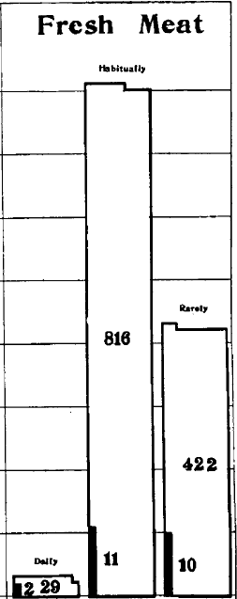
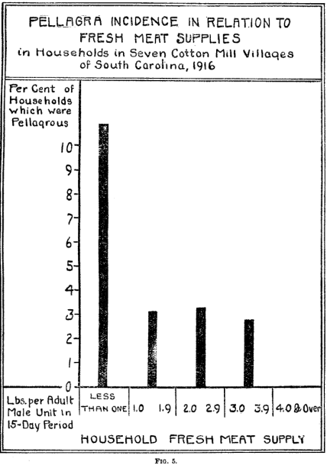
Results: Diet
Each investigation looked for a dose-response relationship between diet (as assessed) and pellagra incidence
PHS
TMcF

Slide 19
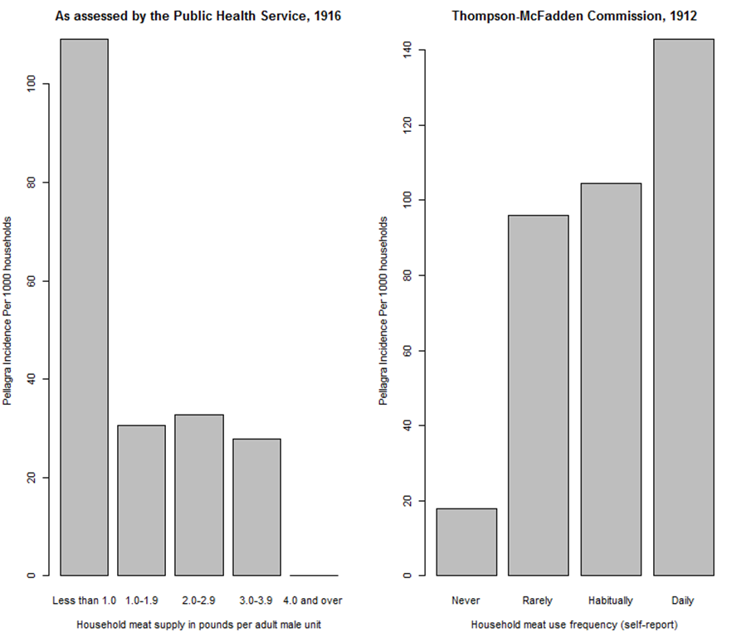
Analyses of Diet (in comparable charts)
Thompson-McFadden Commission found no suggestive associations
Public Health Service found strong dose-response associations with some food types.
The investigations found opposite trends for meat supply/consumption

Slide 20
Our Analysis
We could not find original PHS data, so we could not reanalyze it.
  Dang!
But as we read about the studies, another question arose: why didn’t TMcF find the right answer?
  Couldn’t they have taken PHS’s multi-level approach?
  Could measurement error explain TMcF’s null results?

Slide 21
Our Analysis
Assessing effects of measurement error using simulation:
  Using incidence data from the villages both assessed, treating PHS incidence as the gold standard and assuming perfect sensitivity, we backed into a diagnostic specificity of 97.8% for TMcF
  So, we misclassified 2% of non-cases as cases…
  … and then ran repeated simulations with measurement error in PHS’s meat assessment to see what it takes to erase meat/pellagra association in PHS data

Slide 22
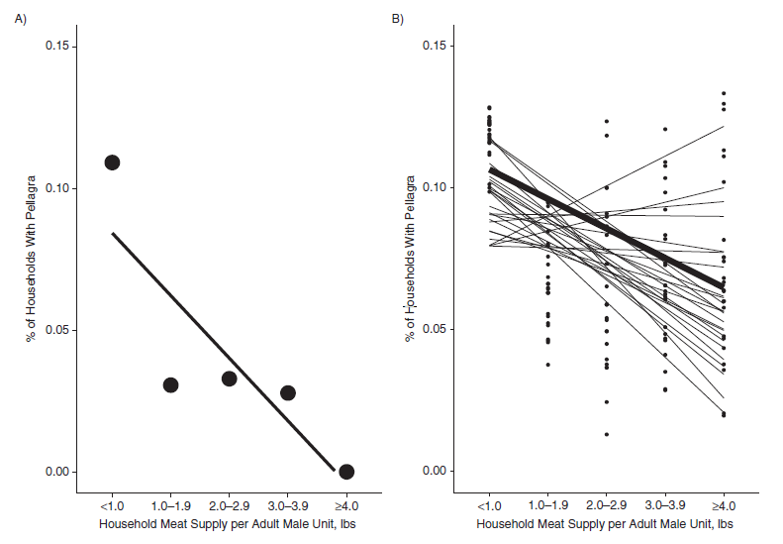
Our Analysis (results)
50% of simulations in which 20% of households had misclassified meat supply failed to find significant association

Slide 23
Our Analysis (conclusions)
Not a lot of measurement error needed to erase real association
  100% sensitivity, 97.8% specificity, 20% meat misclassification isn’t out of the question
PHS’s superior study design choices led to more accurate measurement and ultimately, the right conclusions.

Slide 24
Summary
PHS’s key insights:
  Importance of measurement
    The use of company store records and the Atwater scale allowed better assessment than self-report
    Strict case definition ruled out pellagra sine pellagra
  Importance of sampling
    Broader set of villages allowed between-village analysis to break collinearity of poverty and diet.

Slide 25
Summary (an Ironic Footnote)
Encouraged by these results, in 1917, the PHS broadened their investigation:
  Included more villages (24 total)
  Relaxed the case definition (not bilateral)
    (which made the relation with diet less apparent)
  Results not published until 1929.

Slide 26
Thanks
Alfredo Morabia
Justin Knox
EPIC Fund (for funding our travel to the National Archive)

