Slide 1
Gels!
Around the household

Slide 2
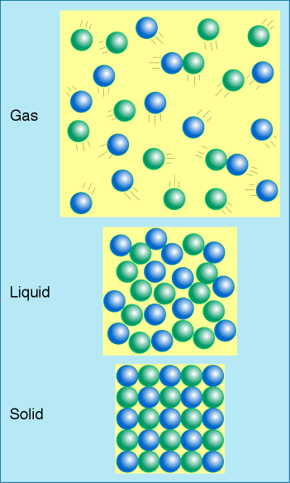
Atoms & molecules
Units of matter
Remember: All things are made of atoms
Atoms pack together in different ways: phases of matter
  Gas: lots of empty space
  Liquid: packed close, disordered
  Solid: packed close, ordered
Molecules are atoms bonded together

Slide 3
Gels
What are gels?
Gels are not quite solids or liquids
  Network structure with “empty” space
Molecules
Pores
Can be empty or filled with fluids

Slide 4
Polymers
What are polymers?
Many gels are also made of polymers
Polymers are long chains of molecules with repeating units
Many
monomers
One
polymer

Slide 5
Properties of gels

Slide 6
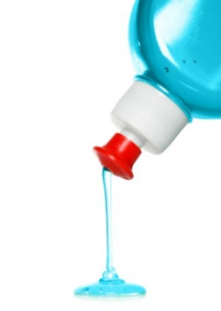
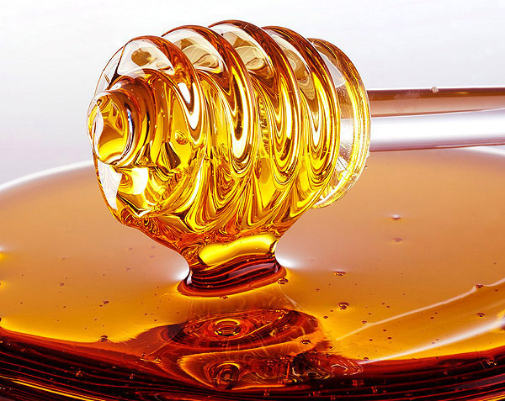
Thickness
Known as viscosity
Resistance to flow
Honey is very viscous
Dishwasher detergent is less viscous

Slide 7
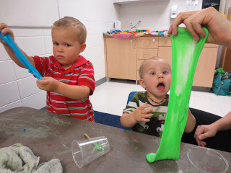
Stretchiness
Elastic: returns to original shape
Inelastic: does not return to original shape
Silly putty
Somewhat elastic when you first pull, but inelastic if you continue to stretch it

Slide 8
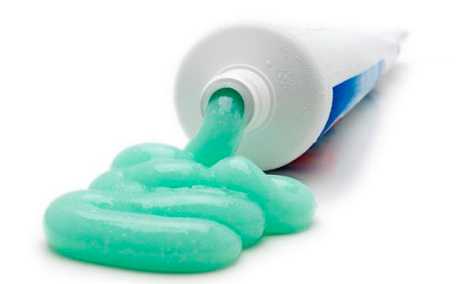
Yield stress
Minimum force to change shape
Squeezing toothpaste

Slide 9

Activity A
What are some gels that we encounter in the household?
Brainstorm!

Slide 10
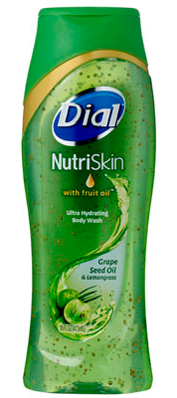
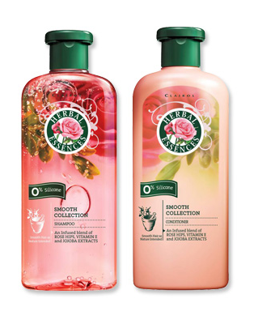

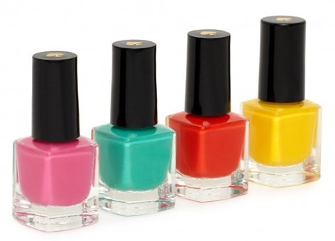

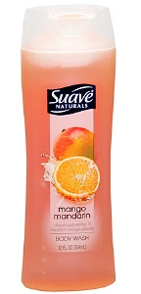
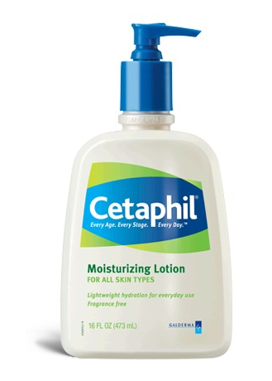
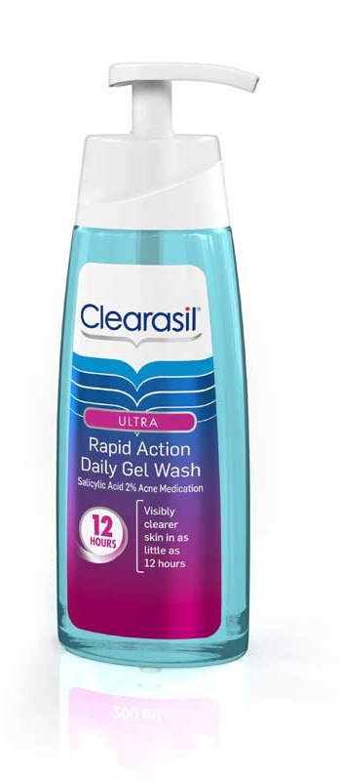
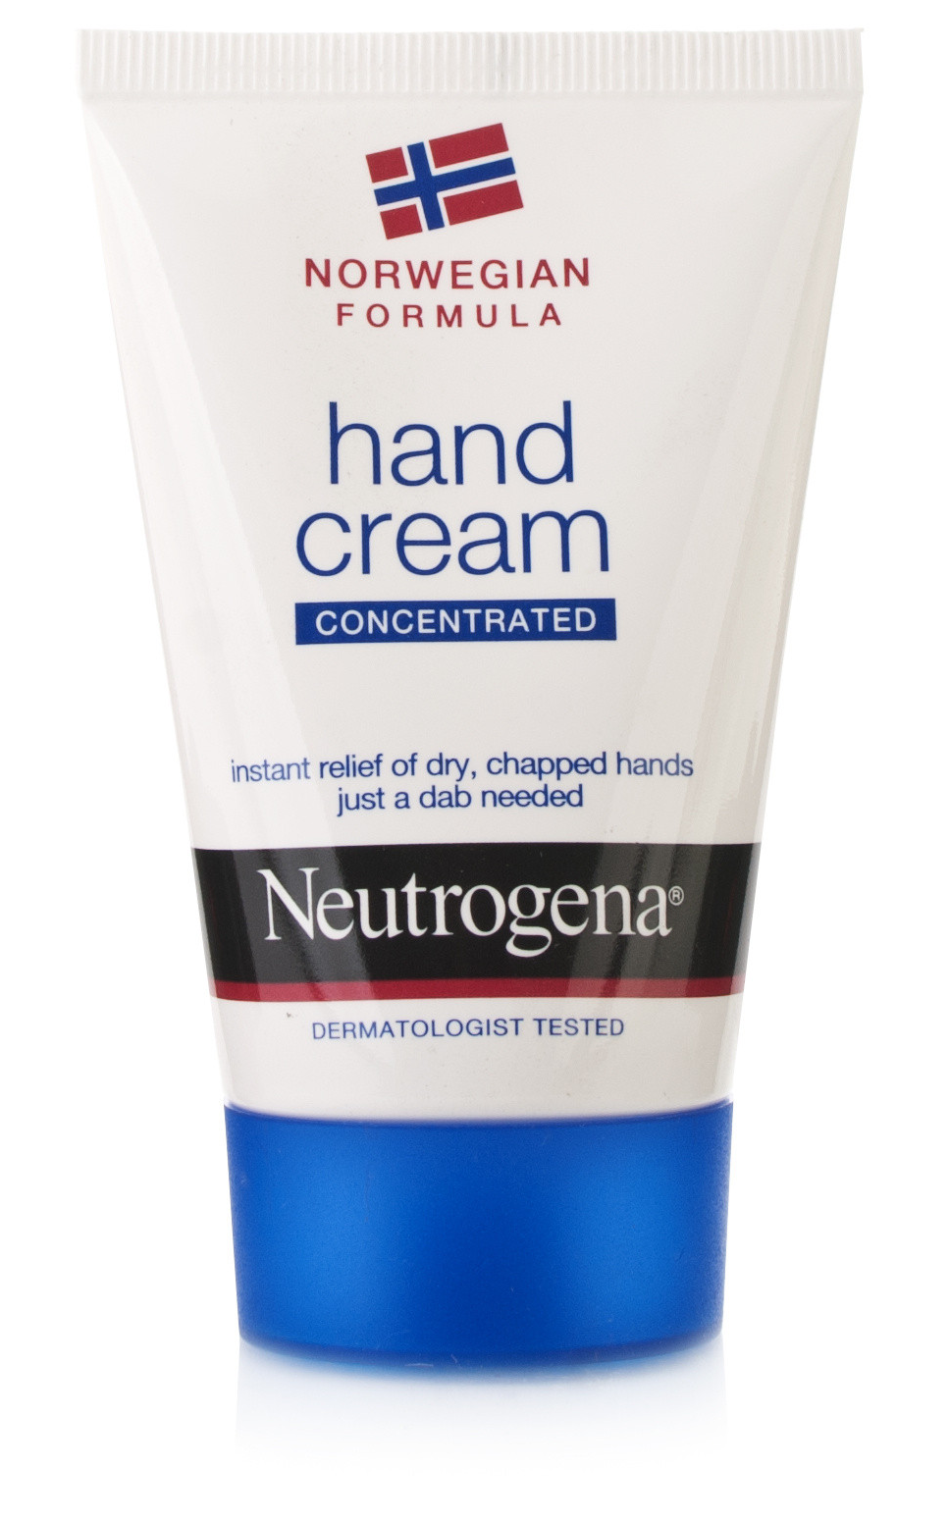
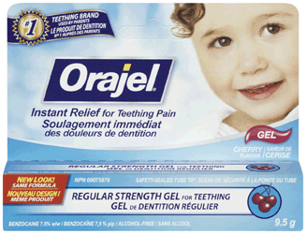
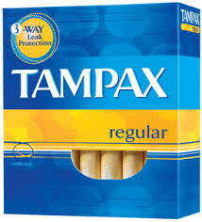
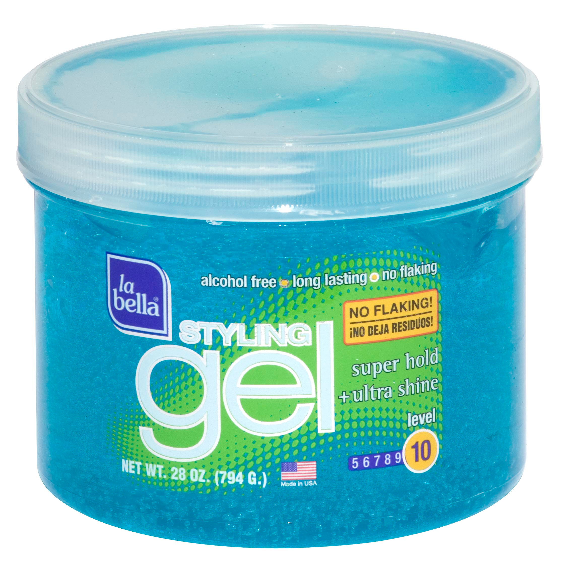
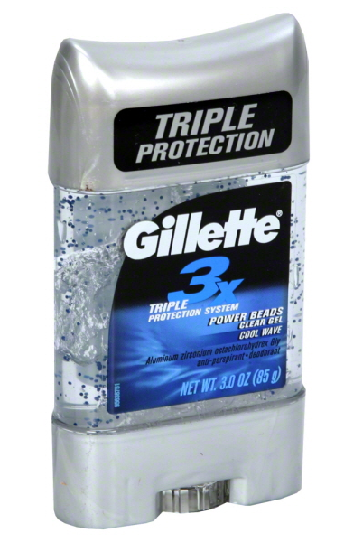
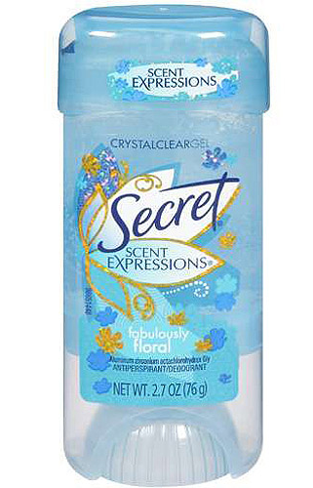
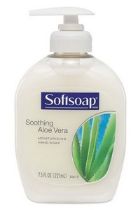
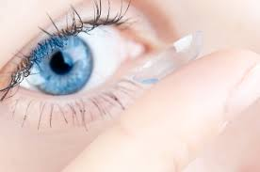
In the bathroom

Slide 11
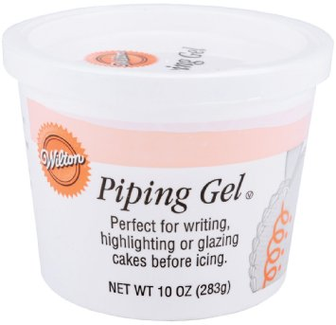
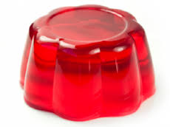
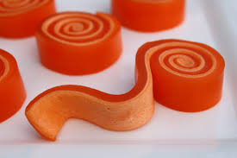
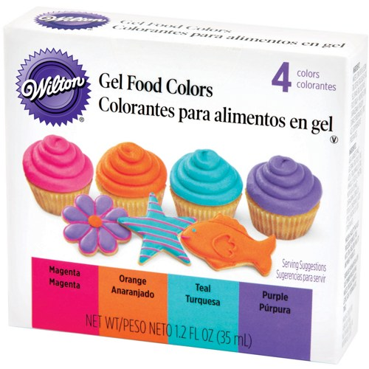
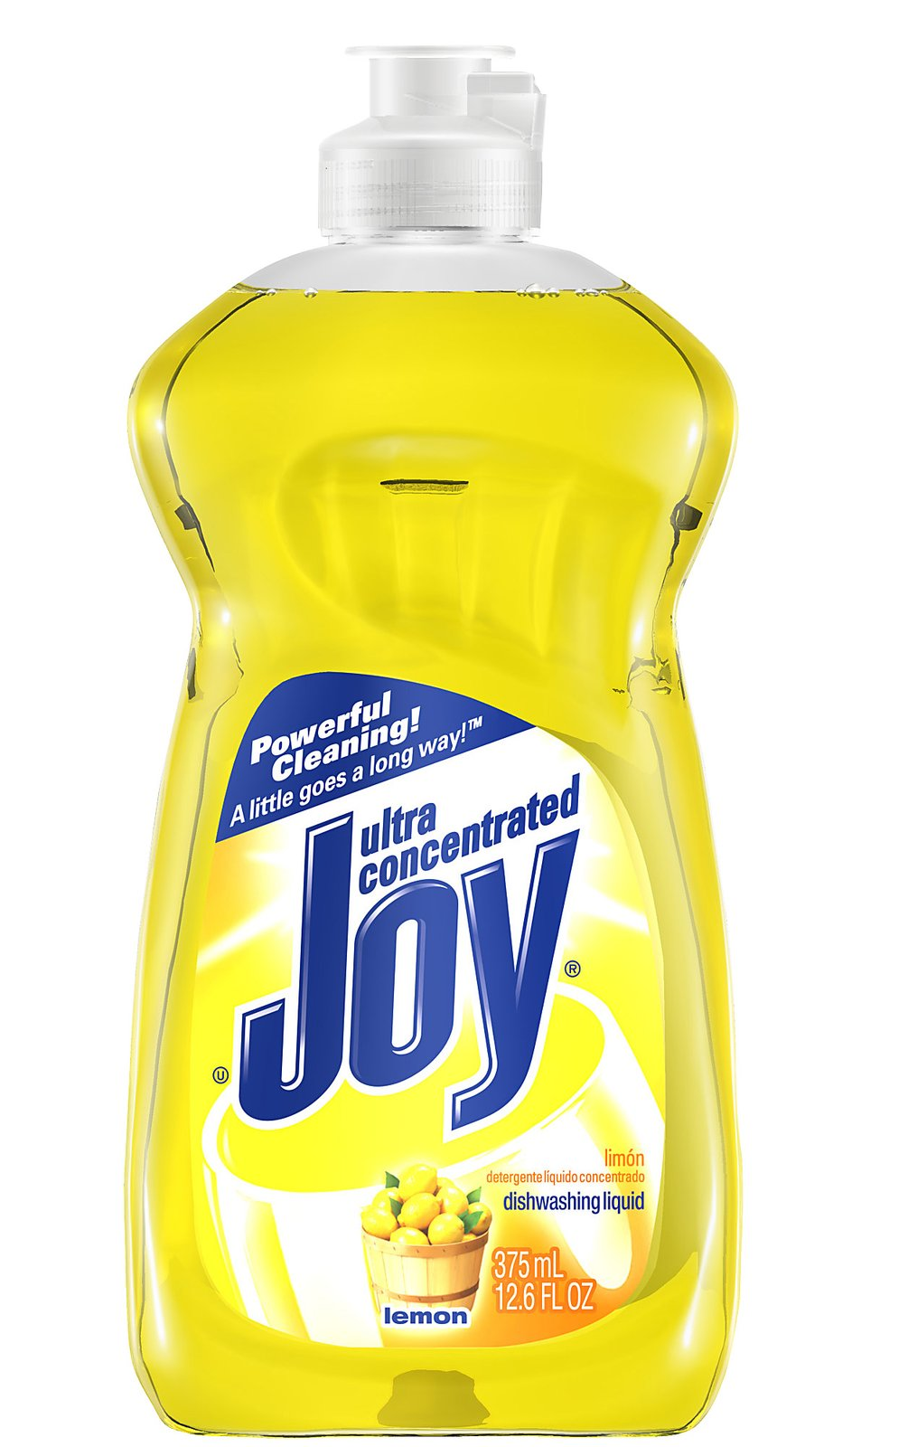
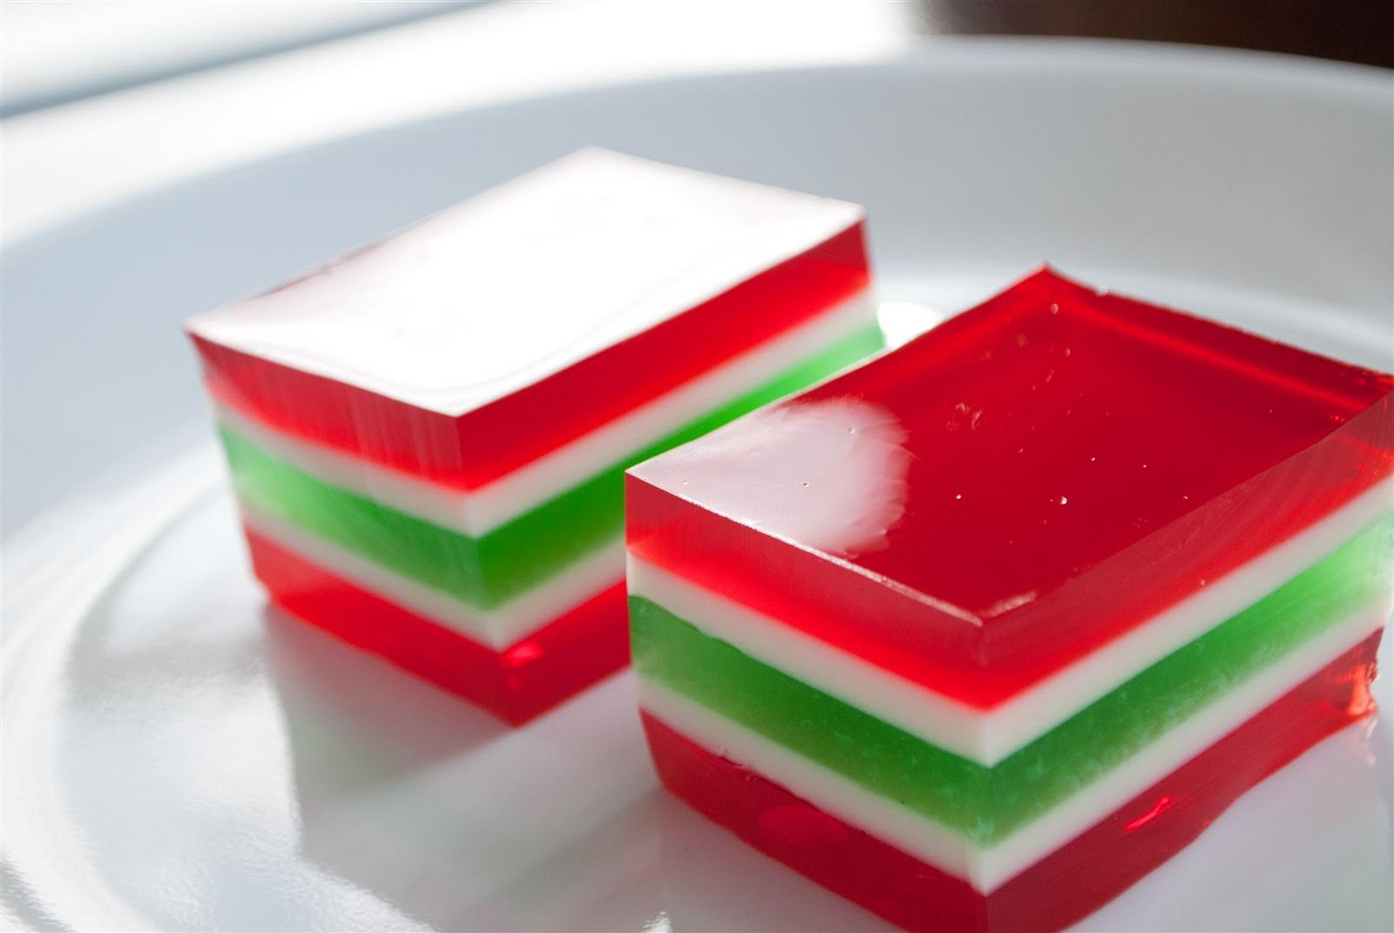
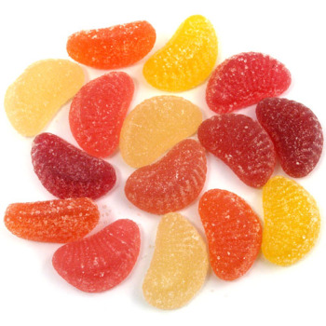
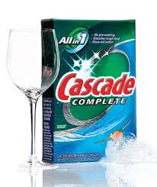
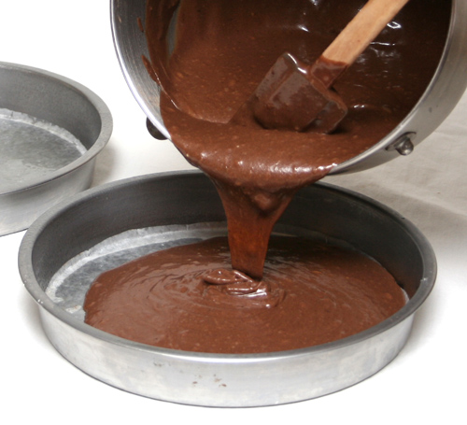
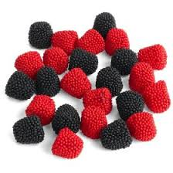
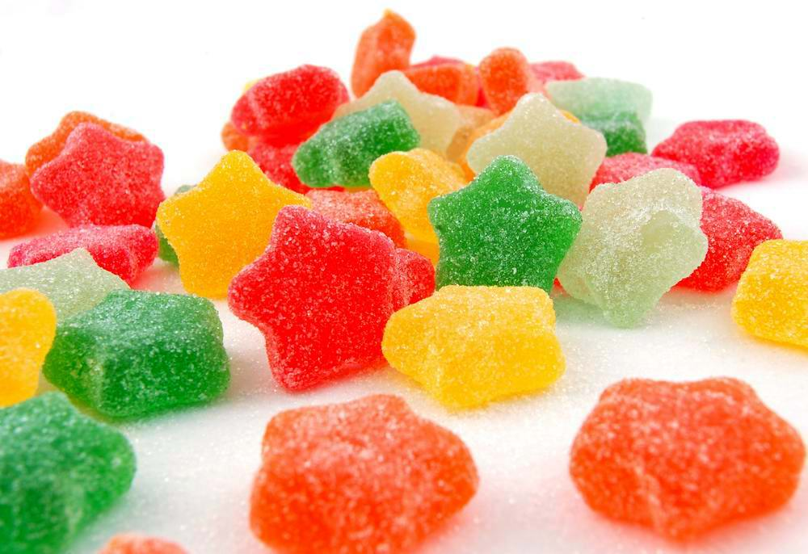
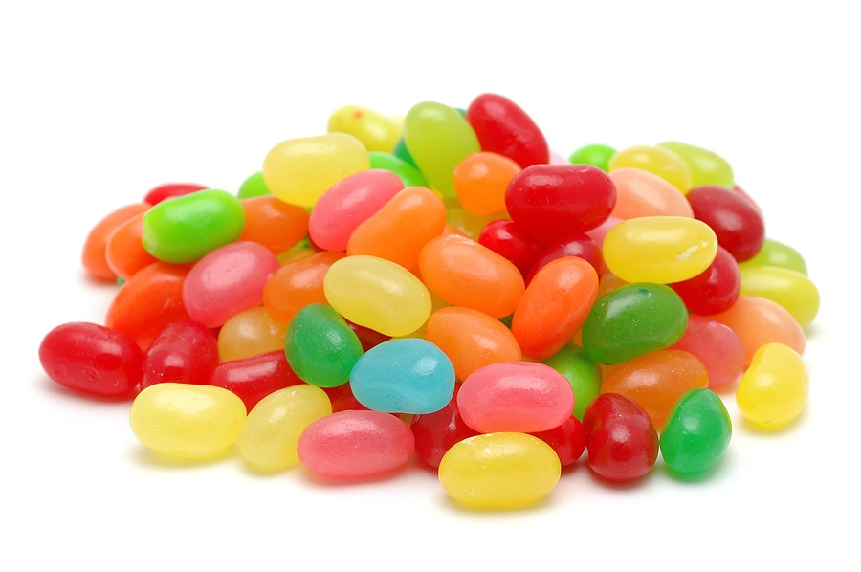
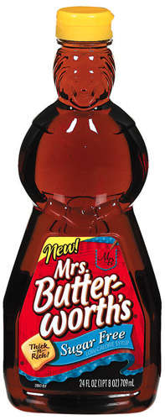
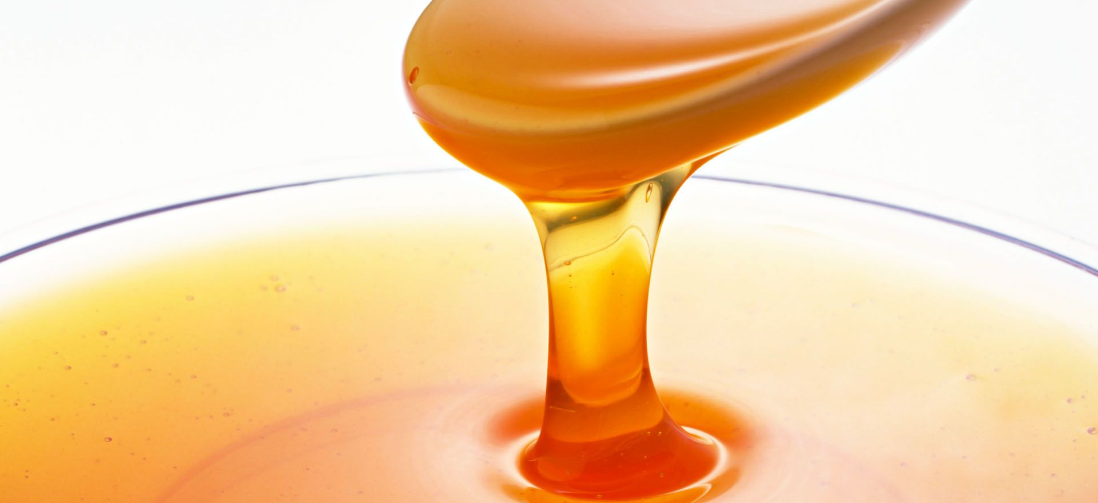
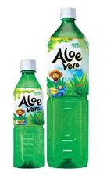
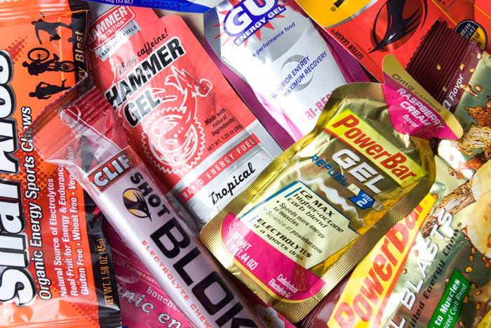
In the kitchen

Slide 12
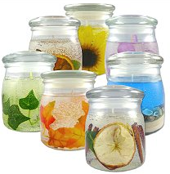
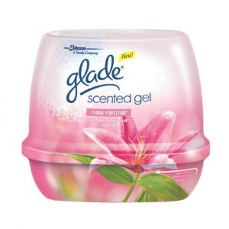
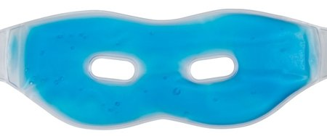
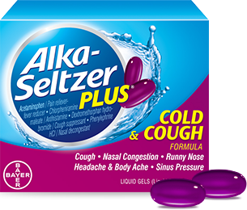
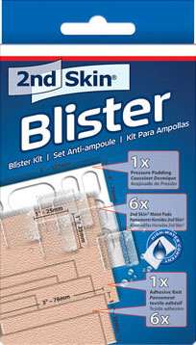
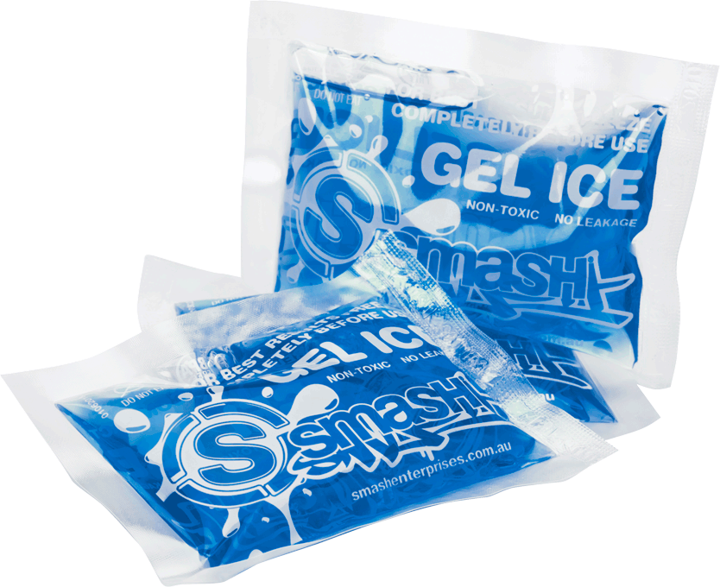
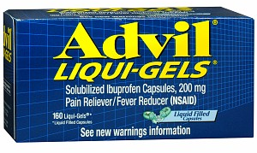
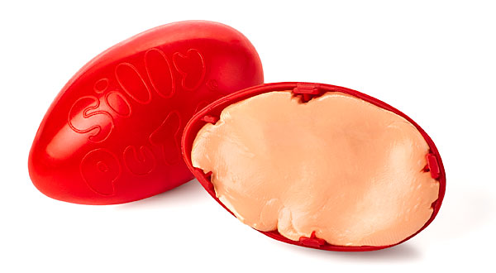
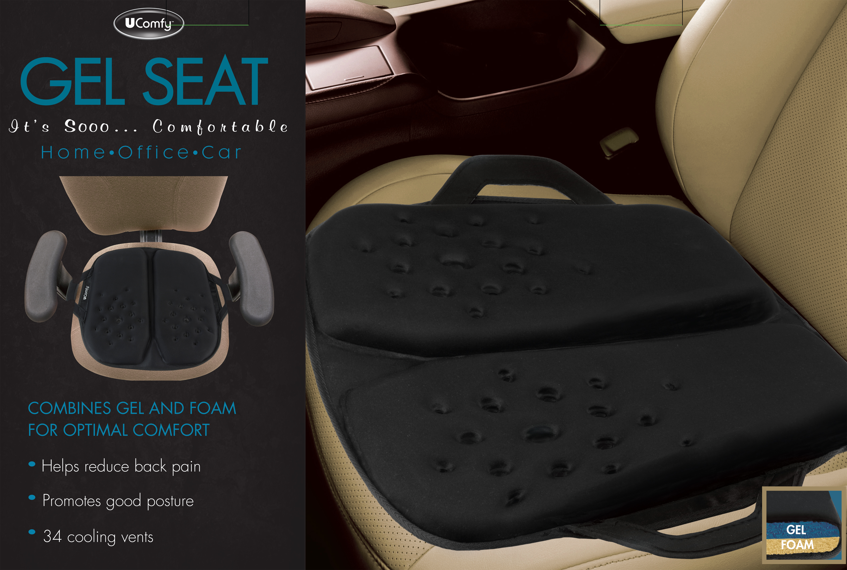
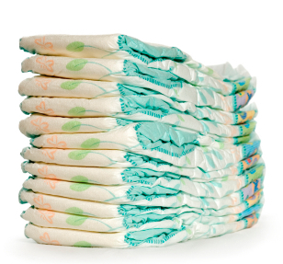
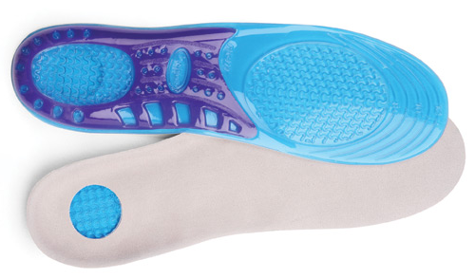
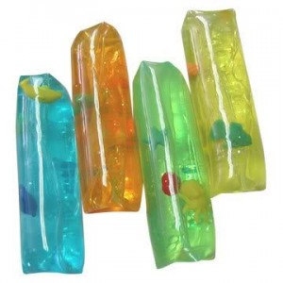
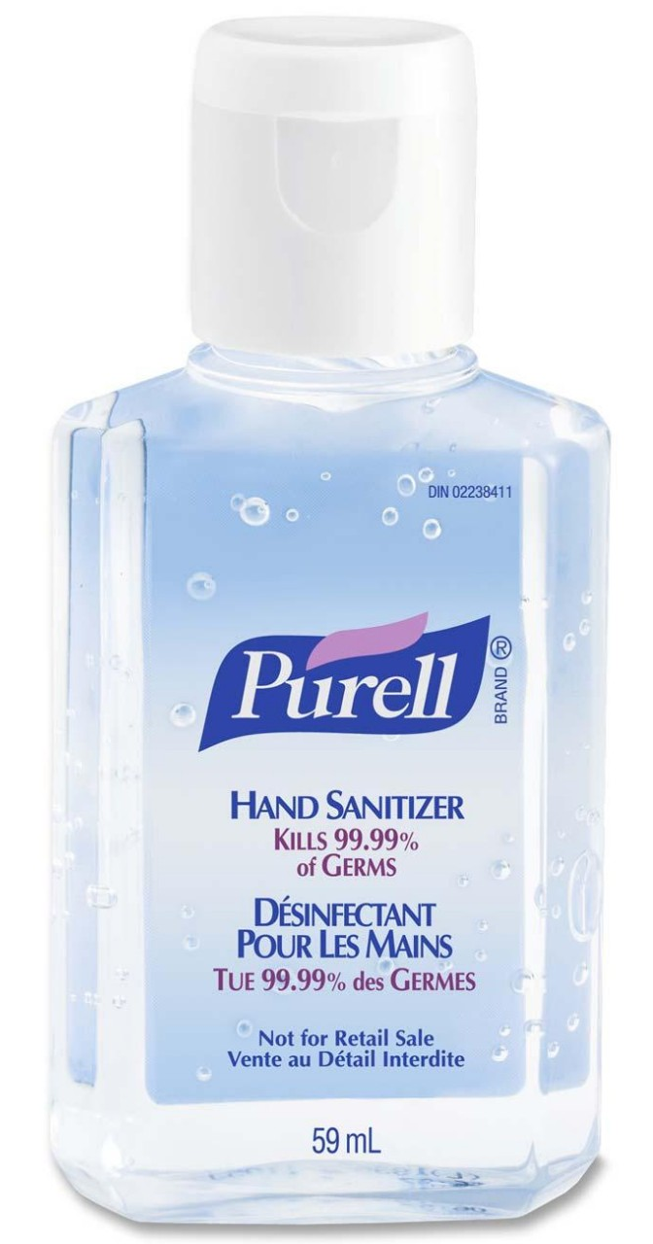
Throughout the home

Slide 13
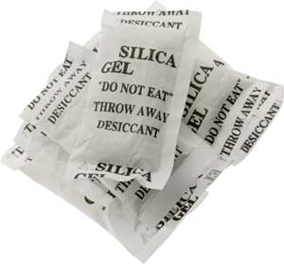
Silica gel packets
Household highlight
Found in many places: new shoe boxes, beef jerky packages…
Soaks up liquids – “desiccant”
  Limits mold growth
Fun uses:
  Rescue wet cell phones
  Keep in shoes, laundry hamper
  Refrigerator, kitchen cabinets
“DO NOT EAT” WARNING: Most are harmless and unreactive, but watch out for blue gel beads! That is usually a toxic coating of cobalt chloride.

Slide 14
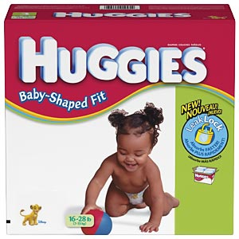
Activity B
Gels in diapers

Slide 15

Diapers
Diapers contain sodium polyacrylate, a polymer that can absorb liquids very well
Why is this important for diapers?

Slide 16

Sodium polyacrylate in action
Watch this video! Demo video
Now it’s your turn. You will be removing diaper stuffing to see just how well it can absorb liquids!
Notes:
From?

Slide 17

Post-activity questions
What happened when you added water to sodium polyacrylate?
What happened when you added salt to the mixture?
People make fake snow
with this! Video

Slide 18

Activity C
Making Gak

Slide 19

Let’s make some slime
Watch this video: How-to Video
Now it’s your turn!
We’ll be mixing Borax,
glue and water. Add as much
Borax to give your slime the
texture you want

Slide 20


Post-activity questions
What happened when you added more Borax to the mixture?
What’s the difference between what you made and what’s sold in stores?
  Answer: Instead of glue, polyvinyl alcohol is used to give the slime the desired texture and a more transparent look.

Slide 21

Activity D
Gels in food using sodium alginate

Slide 22


Sodium alginate
A polymer from seaweed
Molecular gastronomy
  The science of cooking
  Mixture of sodium alginate and calcium chloride is used to make gels in food

Slide 23


How it works
Sodium alginate solution forms a sphere when added to calcium solution
Crosslinking occurs along outside of sphere to form a thin, flexible skin

Slide 24


Making spheres and worms
Watch this video! How-to Video
Now it’s your turn! You’ll be making differently shaped gels. DO NOT EAT!

Slide 25

Post-activity questions
What happened when you added sodium alginate to the calcium solution?
What was different about making beads vs. worms?
You can do this at home!
Sodium alginate and
calcium are sold in kits.

Slide 26
Conclusion
Why do we care about gels?

Slide 27
Gels are important to us!
Understanding gels
Model texture and consistency for many household and food items
Research helps us understand how to give these items the properties we want
  Some questions to think about:
    Why is shampoo more liquidy than conditioner?
    Why is lotion much thicker than water?
    Why do we want bandaids like Second Skin that conform to the shape of a wound?

Slide 28


Other uses
Medicine delivery through contact lens
Aerogels: used on space probes to collect star dust to study
Clean up
radioactive
contaminants
Cellular molds

Slide 29


Gels in the body
Biological importance
Collagen
Not the type you buy in stores!
One of the most abundant proteins in the body
Very important for structure of body and organs
Cells are surrounded by collagen
Collagen network similar to that in the body, magnified 20,000x

Slide 30


Applications
Collagen research
Understand cellular behavior
Wound healing
Bioengineering tissues

Slide 31
Kaufman Lab
http://www.columbia.edu/cu/chemistry/groups/kaufman/

