Slide 1


Modeling hydraulic fracture of glaciers using continuum damage mechanics
Mostafa Mobasher, PhD Student
Civil Engineering and Engineering Mechanics
Collaborators:
Prof. Ravindra Duddu, Vanderbilt University
Prof. Jeremy Bassis, University of Michigan, Ann-Arbor
Prof. Haim Waisman, Columbia University

Slide 2
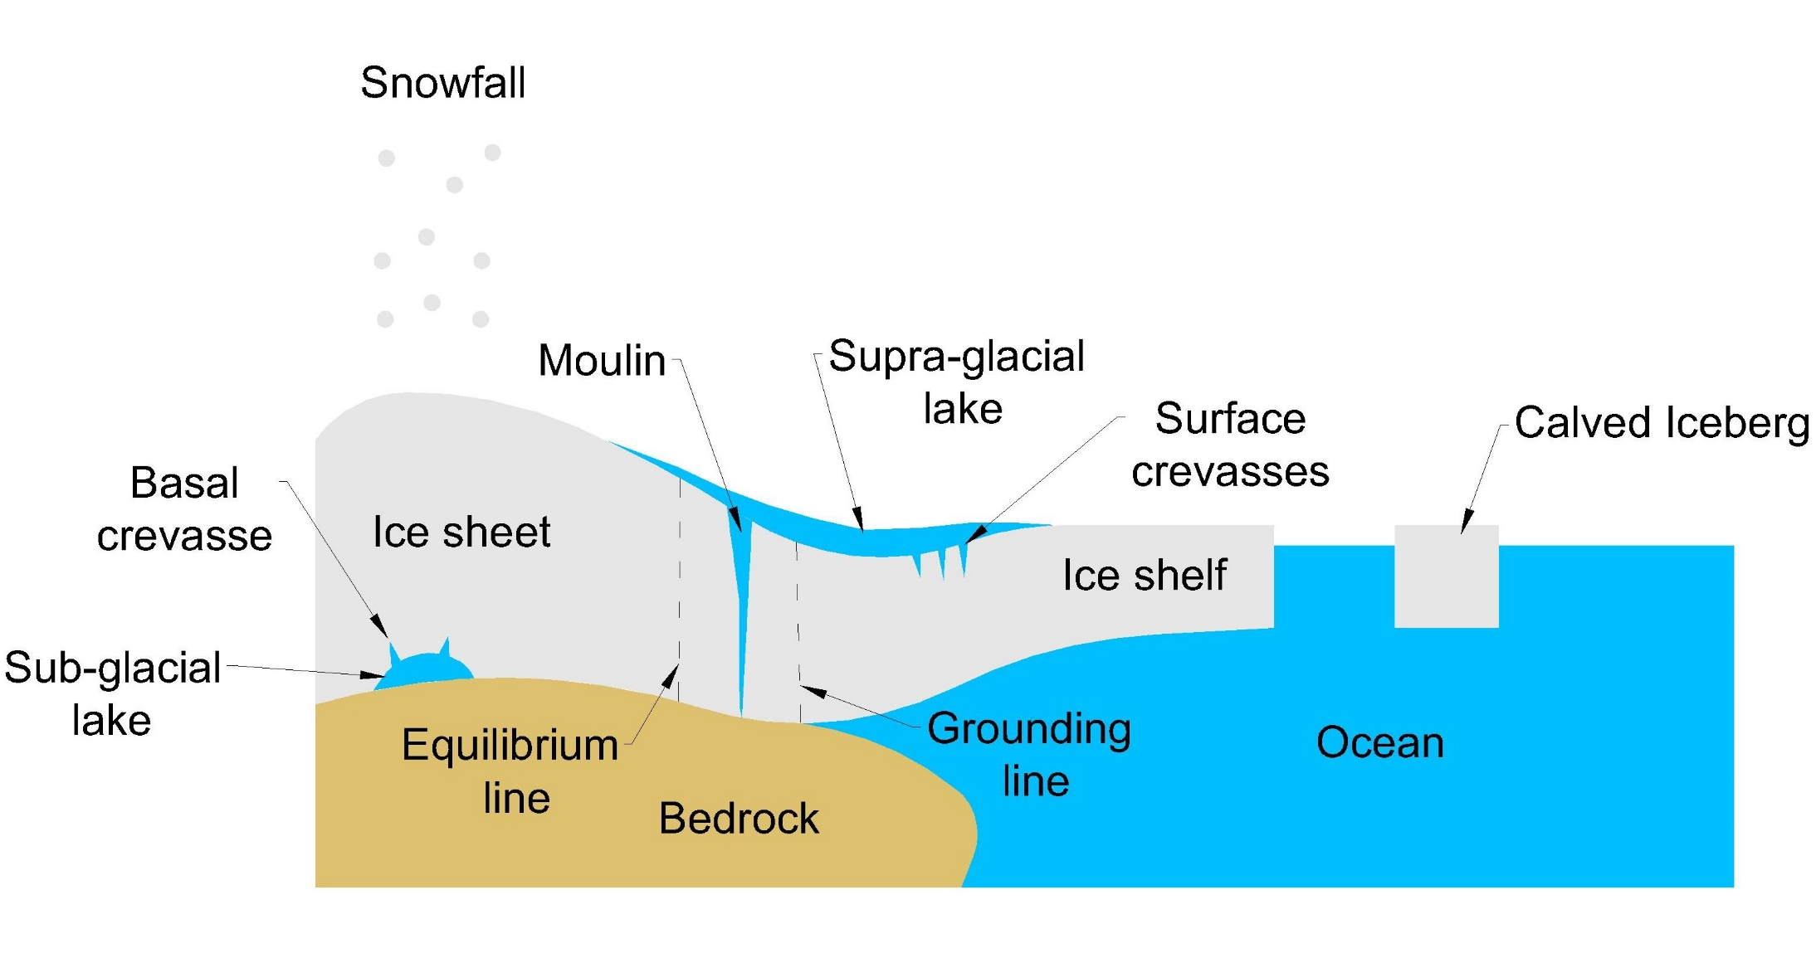
Introduction
Damage Model Of Hydraulic Fracture Of Ice
Introduction
Mechanical model:
  Viscoelastic ice
  Damage
  Hydro-visco damage
FEM:
  Idealized model
  Time scaling
  Effect of surface crevasse
  Effect of basal crevasse
  Mutual effect of water filled crevasses
Summary and future work
Calving ice is responsible for 50 % of the total ice mass loss.

Slide 3
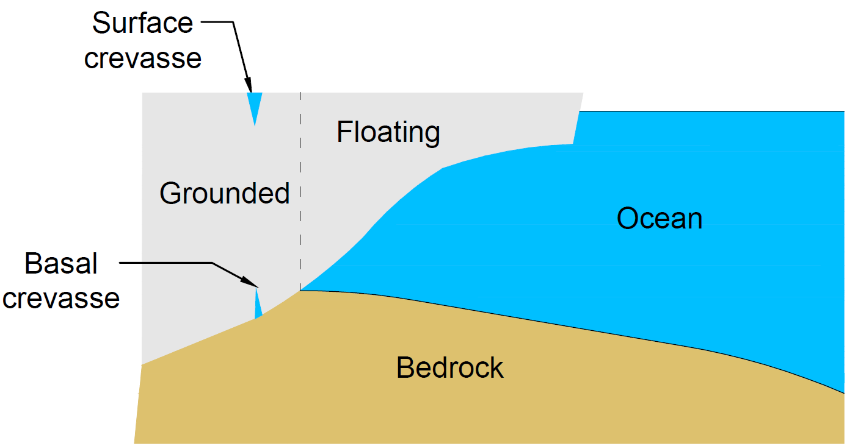
Introduction – Literature review
Damage Model Of Hydraulic Fracture Of Ice
Introduction
Mechanical model:
  Viscoelastic ice
  Damage
  Hydro-visco damage
FEM:
  Idealized model
  Time scaling
  Effect of surface crevasse
  Effect of basal crevasse
  Mutual effect of water filled crevasses
Summary and future work
Empirical models e.g. height-above-buoyancy and water-depth:
  Limited applicability to specific cases
  Ignore physical factors e.g. strain rate and hydro-fracture
Linear Elastic Fracture Mechanics:
  Difficulty of incorporating non-linear material behavior, ice is usually described as a viscous fluid of a viscoelastic solid
Continuum Damage Mechanics, viscoelastic damage models:
  Difficulty of incorporating “hydro-damage” – crack surface is not explicitly defined.
Computational difficulty:
  Multiple length scales
  Multiple temporal scales

Slide 4

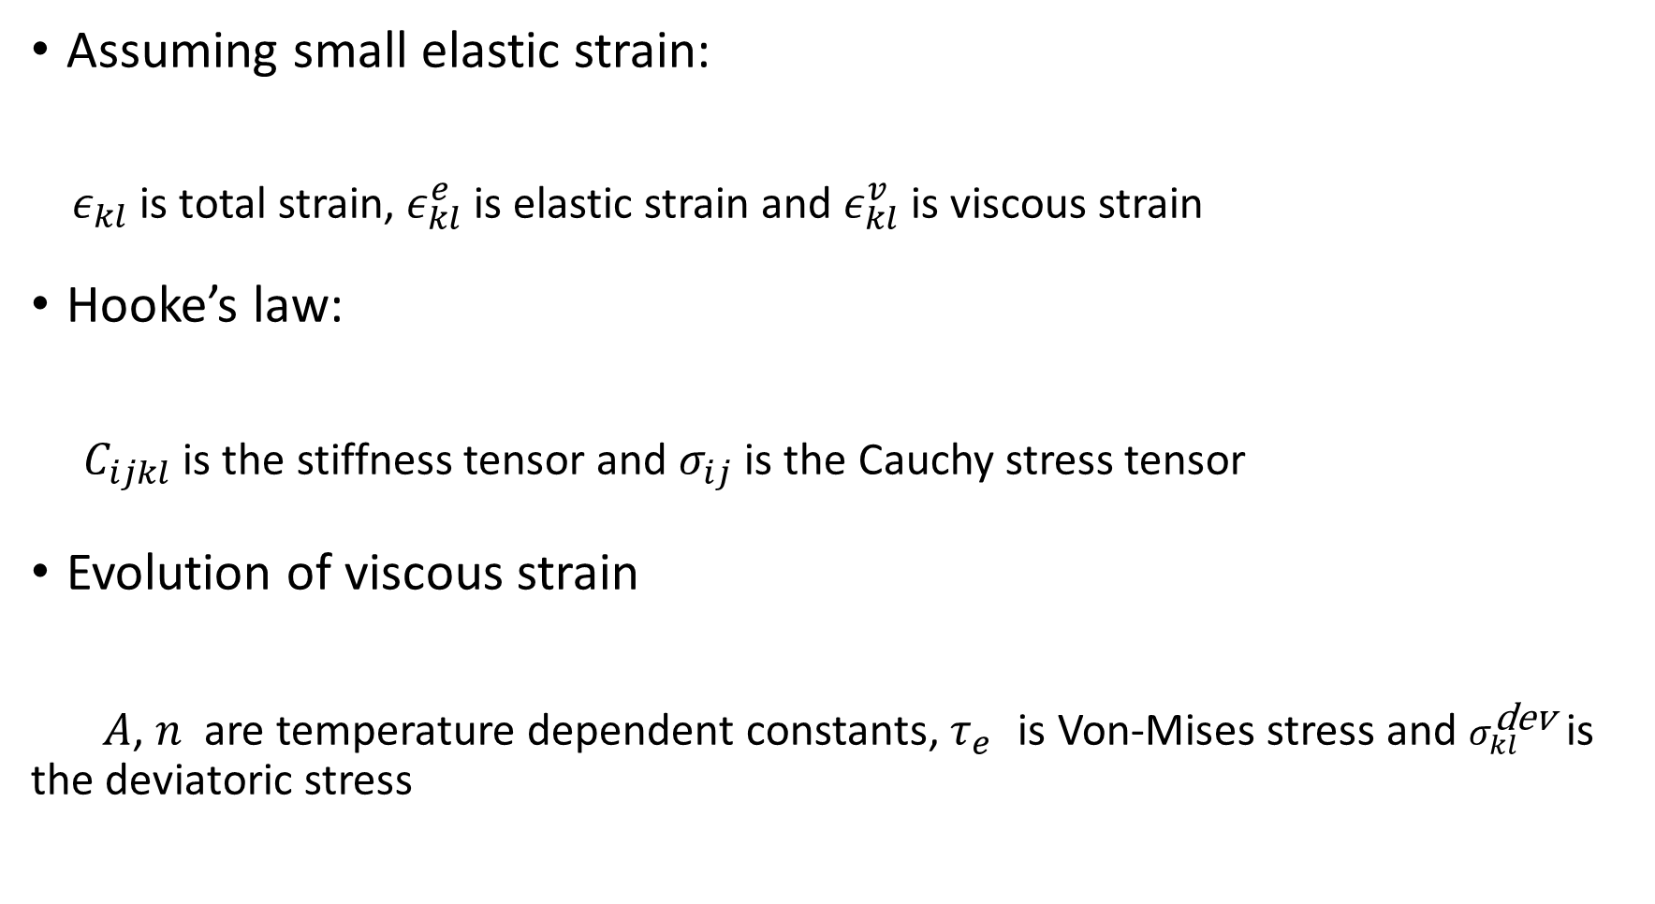


Mechanical Model – Viscoelastic model of Ice
Damage Model Of Hydraulic Fracture Of Ice
Introduction
Mechanical model:
  Viscoelastic ice
  Damage
  Hydro-visco damage
FEM:
  Idealized model
  Time scaling
  Effect of surface crevasse
  Effect of basal crevasse
  Mutual effect of water filled crevasses
Summary and future work
Assuming small elastic strain:
$ε_{kl}$ is total strain, $ε_{kl}^{e}$ is elastic strain and $ε_{kl}^{v}$ is viscous strain
Hooke’s law:
$C_{ijkl}$ is the stiffness tensor and $σ_{ij}$ is the Cauchy stress tensor
Evolution of viscous strain
$A$, $n$ are temperature dependent constants, $τ_{e}^{}$ is Von-Mises stress and $σ_{kl}^{\text{dev}}$ is the deviatoric stress
$$ε_{kl}=ε_{kl}^{e}+ε_{kl}^{v}$$
$$σ_{ij}=C_{ijkl}ε_{kl}^{e}$$
$${\dot{ε}}_{kl}^{v}=Aτ_{e}^{n−1}σ_{kl}^{\text{dev}}$$

Slide 5




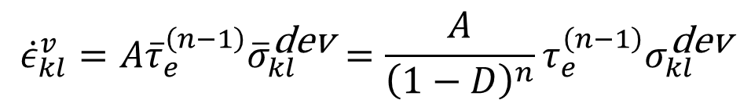
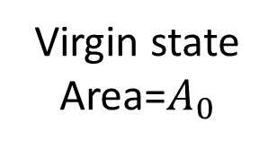
Mechanical Model – Viscoelastic damage
Damage Model Of Hydraulic Fracture Of Ice
Introduction
Mechanical model:
  Viscoelastic ice
  Damage
  Hydro-visco damage
FEM:
  Idealized model
  Time scaling
  Effect of surface crevasse
  Effect of basal crevasse
  Mutual effect of water filled crevasses
Summary and future work
Virgin state Area=$A_{0}$
Equivalent state A_{eff}=(1-D)$A_{0}$
Cracks & pores
Effective stress concept:
$D$ is the damage variable
Magnified viscous strain:
Loading
Damage $=D$
$${\overline{σ}}_{ij}=\frac{σ_{ij}}{1−D}$$
$${\dot{ε}}_{kl}^{v}=A{\overline{τ}}_{e}^{\left(n−1\right)}{\overline{σ}}_{kl}^{\text{dev}}=\frac{A}{{\left(1−D\right)}^{n}}τ_{e}^{\left(n−1\right)}σ_{kl}^{\text{dev}}$$

Slide 6



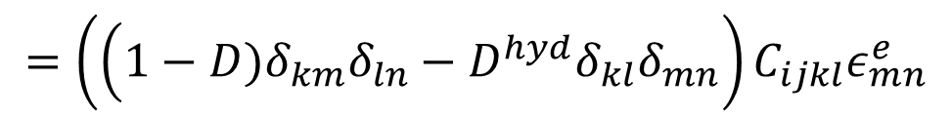

Mechanical Model – Hydraulic effects on damage
Damage Model Of Hydraulic Fracture Of Ice
Introduction
Mechanical model:
  Viscoelastic ice
  Damage
  Hydro-visco damage
FEM:
  Idealized model
  Time scaling
  Effect of surface crevasse
  Effect of basal crevasse
  Mutual effect of water filled crevasses
Summary and future work
Stress state
Hydrostatic pressure
Assumption: pressure remains hydrostatic, fluid fills all pores instantly
This formulation can be mapped to poroelasticity, however, this assumption leads to a system of equations that is function of solid displacements only. Hence, reduced computational effort.
Final Hooke’s law form:
$$σ_{ij}=(1−D){\overline{σ}}_{ij}−DP^{h}δ_{ij}$$
$$P^{h}=ρ_{f}g〈z〉$$
$$σ_{ij}=(1−D)C_{ijkl}ε_{kl}^{e}−ρ_{f}g〈z〉Dδ_{ij}$$
$$D^{hyd}=\frac{ρ_{f}g〈z〉D}{{\overline{σ}}_{qq}}$$
$$=\left(\left(1−D)δ_{km}δ_{ln}−D^{hyd}δ_{kl}δ_{mn}\right.\right)C_{ijkl}ε_{mn}^{e}$$

Slide 7




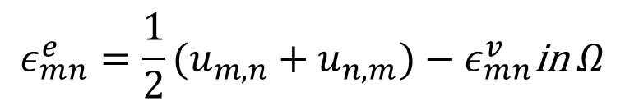

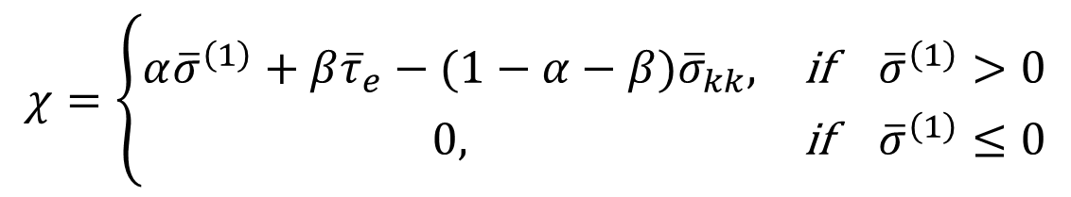

Mechanical Model – Hydro-viscoelastic damage
Damage Model Of Hydraulic Fracture Of Ice
Introduction
Mechanical model:
  Viscoelastic ice
  Damage
  Hydro-visco damage
FEM:
  Idealized model
  Validation-LEFM
  Time scaling
  Effect of surface crevasse
  Effect of basal crevasse
Summary and future work
Damage evolution law – Pralong and Funk (2005):
$B$ is the time scale constant, $k_{σ}$ ,$r,α$ and $β$are constants and
${\overline{σ}}^{\left(1\right)}$ is the largest eigenvalue of effective stress
Boundary value problem
$$χ=\left\{\begin{matrix}α{\overline{σ}}^{\left(1\right)}+β{\overline{τ}}_{e}−(1−α−β){\overline{σ}}_{kk}, & \text{if} {\overline{σ}}^{\left(1\right)}>0 \\ 0, & \text{if} {\overline{σ}}^{\left(1\right)}≤0\end{matrix}\right.$$
$$\dot{D}=\frac{B{〈χ〉}^{r}}{{\left(1−D\right)}^{k_{σ}}}$$
$$σ_{ij,j}+b_{i}=0\text{in} Ω$$
$$ε_{mn}^{e}=\frac{1}{2}(u_{m,n}+u_{n,m})−ε_{mn}^{v}\text{in} Ω$$
$$σ_{ij}=C_{ijmn}^{hd}ε_{mn}^{e}\text{in} Ω$$
$$u_{i}={\overline{u}}_{i}\text{in} Γ_{t}$$
$$σ_{ij}n_{j}={\overline{t}}_{i} \text{in} Γ_{u}$$

Slide 8
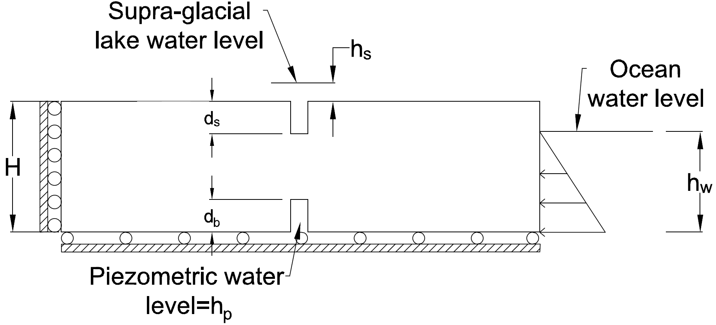
FEM – Idealized model
Damage Model Of Hydraulic Fracture Of Ice
Introduction
Mechanical model:
  Viscoelastic ice
  Damage
  Hydro-visco damage
FEM:
  Idealized model
  Time scaling
  Effect of surface crevasse
  Effect of basal crevasse
  Mutual effect of water filled crevasses
Summary and future work
Idealized grounded rectangular slab

Slide 9

FEM – Time scaling parametric study
Damage Model Of Hydraulic Fracture Of Ice
Introduction
Mechanical model:
  Viscoelastic ice
  Damage
  Hydro-visco damage
FEM:
  Idealized model
  Time scaling
  Effect of surface crevasse
  Effect of basal crevasse
  Mutual effect of water filled crevasses
Summary and future work
Damage evolution law:
Time scale parameter: B
Surface crevasse propagation: Wet (solid line) – Dry (dotted line)
Variation of B leads to stretching in time scale, minor effect on final crevasse depth.
$$\dot{D}=\frac{B{〈χ〉}^{r}}{{\left(1−D\right)}^{k_{σ}}}$$

Slide 10
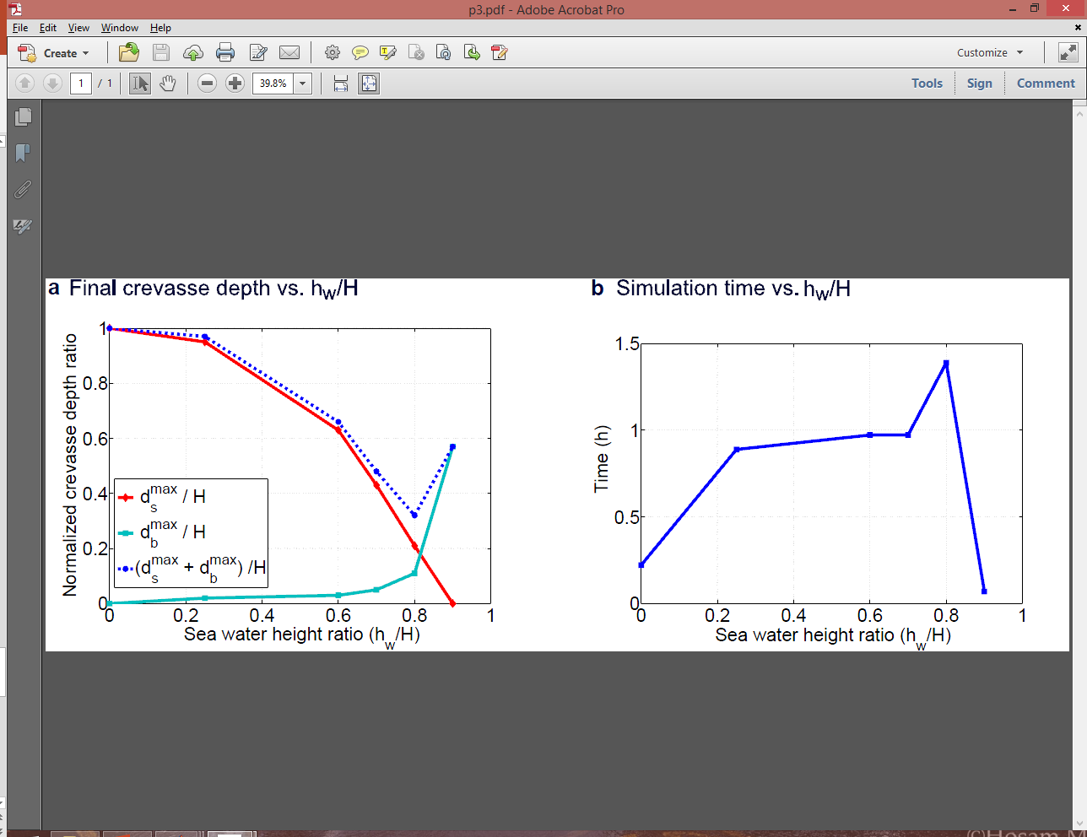
FEM – Effect of water in surface crevasses
Damage Model Of Hydraulic Fracture Of Ice
Introduction
Mechanical model:
  Viscoelastic ice
  Damage
  Hydro-visco damage
FEM:
  Idealized model
  Time scaling
  Effect of surface crevasse
  Effect of basal crevasse
  Mutual effect of water filled crevasses
Summary and future work
Dry surface crevasses
Wet basal crevasses
Higher h_{w} leads to higher pressure in basal crevasse
As h_{w} increases, stress at surface crevasses decreases and stress at basal crevasses increases
Final crevasse depth vs. hw/H
Crevasse evolution time vs. hw/H

Slide 11
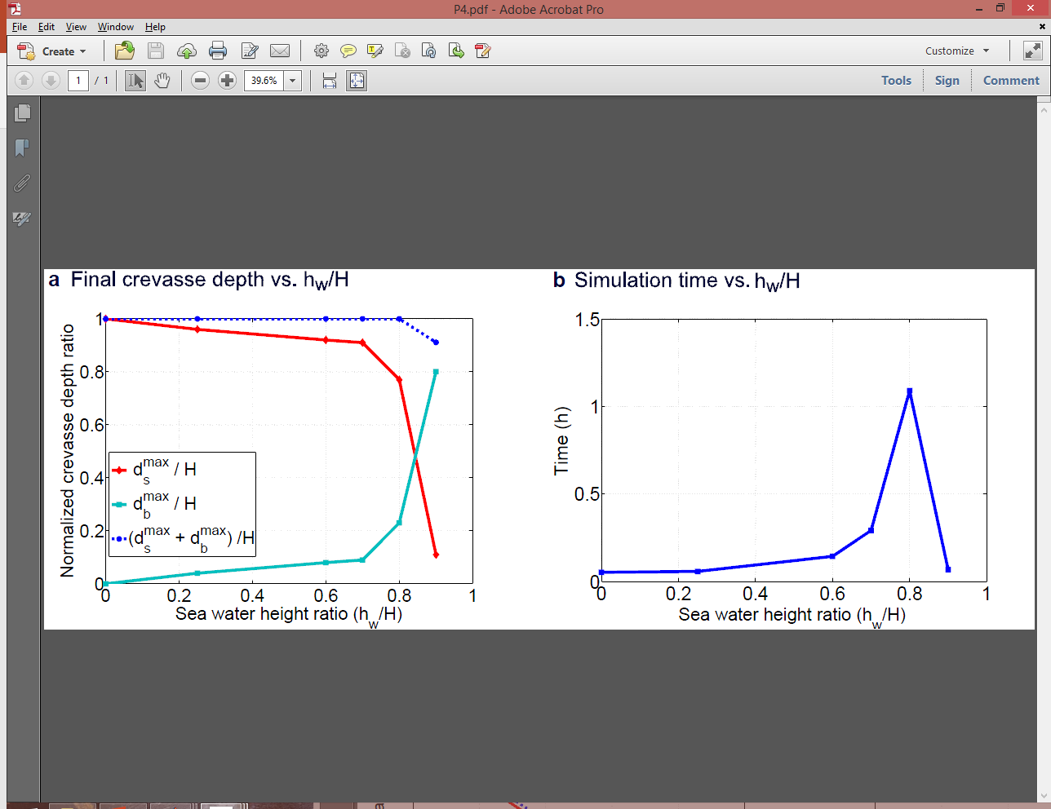
FEM – Effect of water in surface and basal crevasses
Damage Model Of Hydraulic Fracture Of Ice
Introduction
Mechanical model:
  Viscoelastic ice
  Damage
  Hydro-visco damage
FEM:
  Idealized model
  Time scaling
  Effect of surface crevasse
  Effect of basal crevasse
  Mutual effect of water filled crevasses
Summary and future work
Wet surface crevasses
Wet basal crevasses
As h_{w} increases, stress at surface crevasses decreases and stress at basal crevasses increases
In the case of wet surface crevasse, mutual effect of hydraulic cracks lead to higher calving possibilities
Final crevasse depth vs. hw/H
Crevasse evolution time vs. hw/H

Slide 12
FEM – Mutual effect of propagating crevasses
Damage Model Of Hydraulic Fracture Of Ice
Introduction
Mechanical model:
  Viscoelastic ice
  Damage
  Hydro-visco damage
FEM:
  Idealized model
  Time scaling
  Effect of surface crevasse
  Effect of basal crevasse
  Mutual effect of water filled crevasses
Summary and future work
Final crevasse depth vs. hw/H
Final crevasse depth vs. hw/H

Slide 13
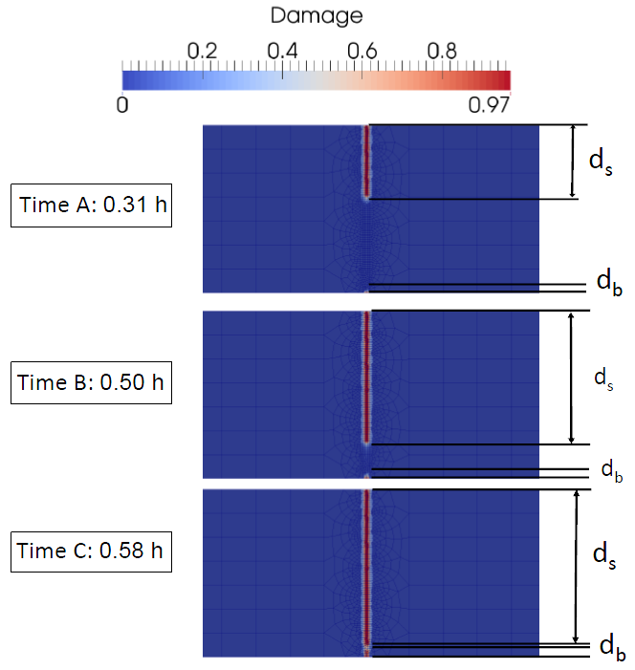
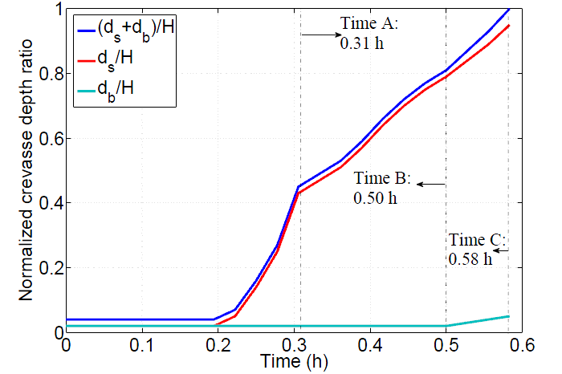
FEM – Analysis of evolution of basal crevasses
Damage Model Of Hydraulic Fracture Of Ice
Introduction
Mechanical model:
  Viscoelastic ice
  Damage
  Hydro-visco damage
FEM:
  Idealized model
  Time scaling
  Effect of surface crevasse
  Effect of basal crevasse
  Mutual effect of water filled crevasses
Summary and future work
Under low piezometric pressure in the basal crevasse, the basal crevasse remains idle until the wet surface crevasse gets close to the basal crevasse.
h_{w} /H=0.25

Slide 14
Summary and future work
Damage Model Of Hydraulic Fracture Of Ice
Introduction
Mechanical model:
  Viscoelastic ice
  Damage
  Hydro-visco damage
FEM:
  Idealized model
  Time scaling
  Effect of surface crevasse
  Effect of basal crevasse
  Mutual effect of water filled crevasses
Summary and future work
Summary:
  Half of ice mass is lost in calved ice
  Hydro-visco-damage mechanics model is proposed for hydro-fracture of ice
  Thorough analysis of surface and basal crevasses under different conditions
  Mutual effect of water-filled crevasses
Future work:
  Floating ice shelves
  Large deformations
  Multiple crevasses
  Variable permeability – analysis of flow behavior
  Freezing and crack closure
Acknowledgment: Funding support provided by the National Science Foundation, Polar Programs division, Grant # PLR‐1341472, PLR‐1341568 and PLR-1341428.

