Slide 1

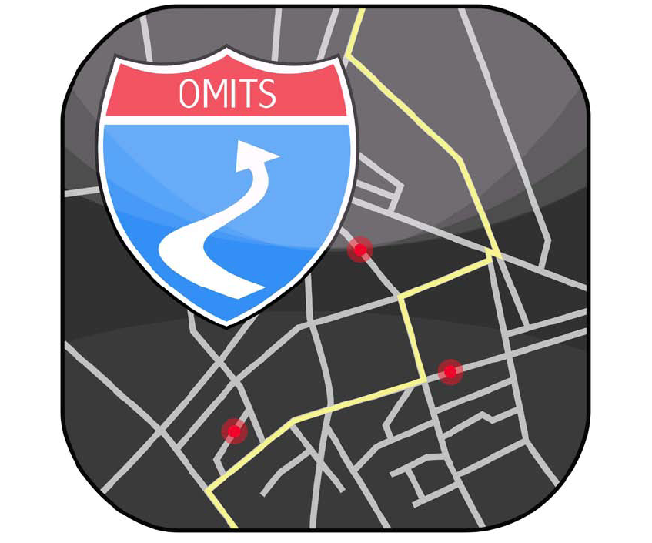
Dynamic Transit Service through the Open Mode Integrated Transportation System
Huiming Yin, P.E., PhD
Liang Wang
Paul Maurin
Heqin Xu, P.E., PhD
Dept. of Civil Engineering
& Engineering Mechanics
Columbia University
Jan 16, 2012
Notes:
Good afternoon ladies and gentlemen. Today I am happy to present this topic .....(title) This is icon we use on iphone android and internet.
This is our group. I am the second author Liang Wang.

Slide 2
Challenges of carpooling service
Most carpooling systems cannot guarantee a ride for riders in a timely manner
The usage of cell phones for communication between drivers and riders raises concerns about the safety of driving the car
The charges and savings of carpooling services have not been clearly and fairly specified
Many single drivers hesitate to give ride to strangers
Carpooling
HOV lane
Environment
Fairness
Safety
Certainty
No Carpooling
Stranger
Notes:
Carpooling is a environmental
So Many people prefer to no Carpooling.

Slide 3
What is the OMITS?
The Open Mode Integrated Transportation System (OMITS) has been proposed in 2009 and tested in 2012.
  Columbia University
  NDJ Sustainable Engineering LLC
The OMITS developing essentially relies on:
  Effective information communication
  Accurate traffic data and prediction
  Comprehensive understanding of transit customer behavior
Urban ridesharing
Services
Optimal Routing
Traffic reporting

Slide 4





How does the OMITS work?
Public commuters or riders
  Trace the coming vehicles
  Obtain the ridesharing service integrated with the public transit
  Pay the service through account
Private car or van owners
  Provide dynamic carpooling or vanpooling service
  Receive routing service
General members
  Access the OMITS for traffic condition and trip planning
iPhone
user
Real time traffic data
OMITS SERVER
Android
user
Optimize route Ridesharing service
Webpage
user
Notes:
not stop How does
Driver have to use the smartphone to update its speed and location to the server.
The General member can

Slide 5
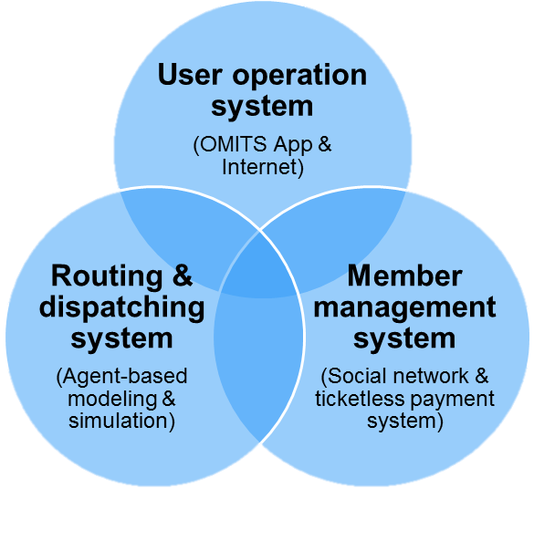
OMITS system structure
The User Operation System
  Smartphone interface
  Internet interface
The Routing and Dispatching System
  Running in the background
  Optimal route
  Matching a driver and riders
The Member Management System
  Social network design and maintenance
  Billing and payment
Notes:
I want to introduce the OMits

Slide 6
Entity-relationship of OMITS
OMITSMember
  Rider service is available for all OMITS members
  OMITS Driver must own a PrivateVehicle
Route
  A Route consists of Links
  A Link connects two Nodes
FrequentTrips are provided for each member for easy service request
Notes:
I want to introduce the Entity-relationship of OMITS.
The data structure start from OMITSMember

Slide 7
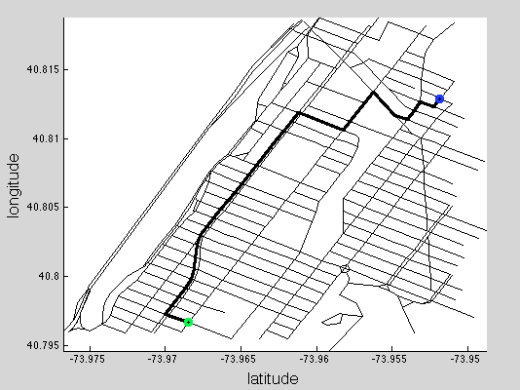
Roadway network data structure
Roadway network
  Adjacency list
a
b
weight
c
weight
b | weight | pointer
b
a
weight
d
weight
c
a
weight
d
weight
e
weight
d
b
weight
c
weight
f
weight
e
c
weight
f
weight
f
d
weight
e
weight
a
b
c
d
e
f
Notes:
I want to introduce the Network data structure
This is a little example to show how it works.
We use this form to construct the digital network.

Slide 8
Dynamic shortest routing algorithm
function Dynamic Dijkstra (Graph, source, destination):
. . .
timeCost[v]=timeCost[u]+ timeCost_between(u,v,timeCost[u]) ;
//the time cost between u and v is depend on the departure time. In OMITS dynamic map system, the dynamic edge weight will be listed in the table.//
. . .
b | weight | pointer
The weight is time-depend value
Departure time | Time cost between u,v
6:00 | 3 min
6:10 | 3 min
6:20 | 4 min
6:30 | 6 min
6:40 | 8 min
... | ...
Notes:
In our code. The algorithm use time dependent weight instead of static value.
to solve the Dynamic shortest routing problem.
This table shows how the weight change with time.

Slide 9
Social network-based grouping
There is no difference between Social network and Roadway network
G
Relationship | Weight | Symbol
Neighbor | 1
Coworker | 1
Friend | 2
Ride-sharer | 3
B
A
C
D
E
H
I
J
F
K
Engineering School
Teacher college
Appling Dijkstra Algorithm in social network
  The shortest relationship between two person
  Minimizing the sum of weight values in one carpooling vehicle
Reducing the opportunity to be a “stranger”
Enforcing the relationship after each ridesharing service
Notes:
let move to the Social network-based grouping
It is very common that the relationship between different group of people is very week.

Slide 10
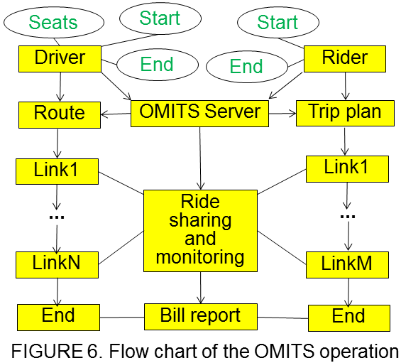
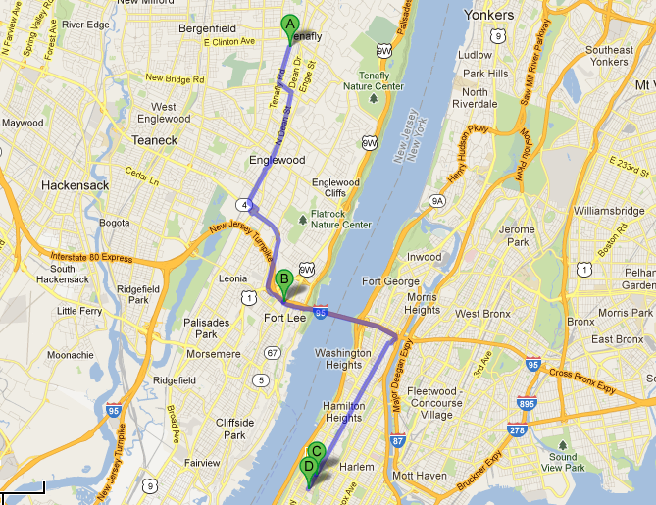
Urban ridesharing service
Urban Ridesharing Service for the daily commute
Automatically and Rapidly

Slide 11
Urban ridesharing service
OMITS
Driver
Rider

Slide 12
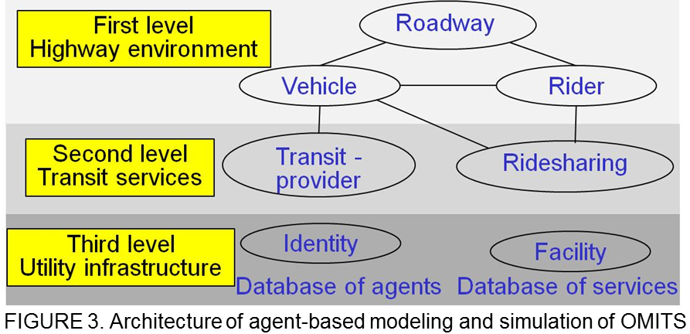
Agent Based Modeling and Simulation
Traffic prediction based on Historical and Current traffic data.
Three levels of Agent Based Modeling and Simulation system
  Sharing data and results between levels
  More effective for large amount of requirements
  Reducing repetitious Calculation work
Historical traffic data
OMITS
route guiding
services
Agent Based
Modeling and
Simulation
Current traffic data
Notes:
The Agent based Modeling and simulation collects the

Slide 13
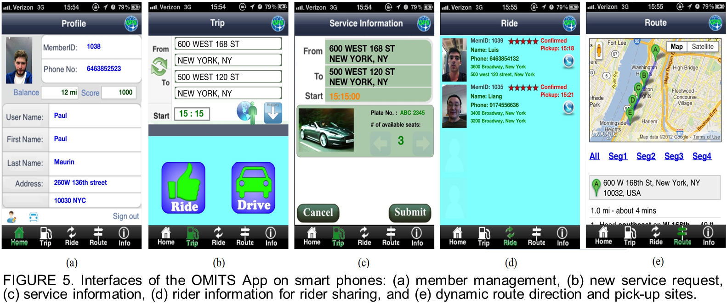
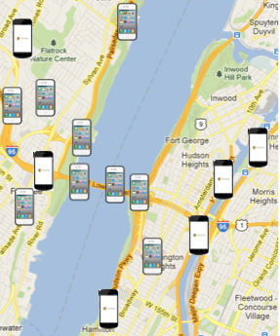
Communication through smartphones
The OMITS App has been developed for iPhone and Android Phone
  Communicate with the OMITS server
  Receive driving directions
  Submit service requirement
Detecting roadway traffic conditions
  Large coverage
  Real-world spatial distribution
  No extra construction fee
Notes:
Smartphone plays a very important role in our OMITS.

Slide 14
Who cares?
City resident
  Providing efficient and safe carpooling service
  Reducing travel time for each trip
  Reducing transport costs
Governmental agencies
  Providing organized and detailed traffic data
  Improving transit operating efficiencies by reducing number of cars
  Increasing transit ridership of public transit system
  Cutting down oil consumption for nation energy safety
  Improving urban environment

Slide 15
What is the next?
R&D
  Optimize system structure
  Improve algorithm
  Data communication
  Social network
Operation
  Optimize system
  Transit service
  Information service
Scale up
  User number
  Database
  Algorithm
R&D
Operation
Scale up
Columbia community
NYC
USA
Notes:
With in the Colum
Expand to New york
Even to the USA as a term goal.

Slide 16


About us
Cooperation project of Columbia University and NDJ Sustainable Engineering LLC.
This work has been sponsored by the DOT-UTRC Region II and the RISE Fund of Columbia University
OMITS webpage: http://www.ndjse.com/omits.php

Slide 17
Dynamic Transit Service through the Open Mode Integrated Transportation System
Welcome to join OMITS
http://www.ndjse.com/omits.php
lw2451@columbia.edu
Notes:
All the work has been posted on the Internet, including the smart phone apps and web interface. However, because the OMITS is a social network based system, you have to be invited by a friend. Please feel free to shot me an mail. I can send you formal invitation, so that you can join the OMITS. Thank you for your attention.

