Slide 1
Digital Preservation
Strategies and Technologies
Stephen Paul Davis
Director, Libraries Digital Program
Columbia University
April 2011

Slide 2
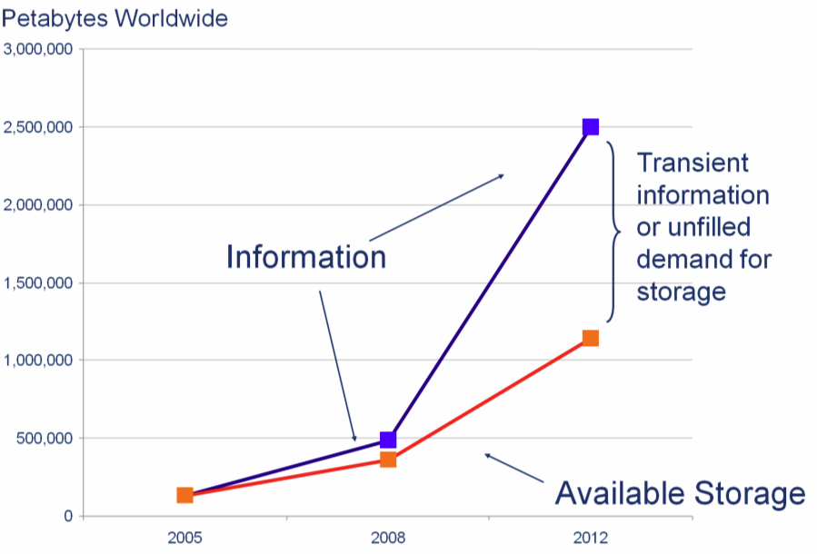
From: Sustainable Economics for a Digital Planet (2010)
Notes:
From: Sustainable Economics for a Digital Planet (2010) Petabyte – 1,000 TB – 1 quadrillion bytes

Slide 3
Digital Preservation Challenges
Uncertainty about selection criteria for assessing long-term value, especially with large-scale data sets, small “hand-crafted” digital collections, and the emerging genres of collective authorship on the Web;
Misalignment of incentives between those who are in a position to preserve and those who benefit from preservation and access;
Lack of clear responsibility for digital preservation, coupled with a prevailing assumption that it is someone else's problem;
Little coordination of preservation activities across diffused stakeholder communities;
Difficulty in separating preservation costs from other costs, that is, in distinguishing between the processes of making things available now and making things available in the future; and
Difficulty in valuing or monetizing the costs and benefits of digital preservation, which are necessary to secure funding and investment.

Slide 4
Ensuring Access
Digital information is vital
Digital information is fragile
Access in the future means action today

Slide 5
Columbia University Libraries
Preservation
Strategies and Technologies

Slide 6
Columbia University Libraries / Information Systems
  One of the top five academic research library systems in North America.
  The collections include over 10 million volumes, over 100,000 journals and serials, as well as extensive electronic resources, manuscripts, rare books, microforms, maps, graphic and audio-visual materials.
  The services and collections are organized into 22 libraries and various academic technology centers.
  The Libraries employs more than 470 professional and support staff. The website of the Libraries at www.columbia.edu/cu/lweb is the gateway to its services and resources.

Slide 7
Technology at Columbia Libraries
  LDPD: Libraries Digital Program Division
  CDRS: Center for Digital Research and Scholarship
  CCNMTL: Center for New Media Teaching and Learning
  LITO: Libraries Information Technology Office
  PRES: Libraries Preservation and Digital Reformatting Division

Slide 8
Preservation Focus at Columbia
Local Digitization Projects
Institutional Repository / Data Sets
Born Digital Archival Content
Archived Web Sites

Slide 9
Local Digitization Projects
Preservation of unique digitized content created from print, manuscript and multimedia collections
E.g.,
- papyri, medieval manuscripts, image and object collections, rare books and journals, archival collections, useful reference and curricular material, oral histories

Slide 10
Institutional Repository
  Preservation of University-generated content of all kinds (working papers, conference proceedings, theses, preprints, research data sets)
  Academic Commons (Columbia’ Institutional Repository)
NSF Data Management Plan Support

Slide 11
Born Digital Archival Content
  Preservation of born-digital personal and organizational archival collections (e.g., of authors, political figures, publishing houses, philanthropic organizations)
  E.g.,
  Human Rights Watch Records
  Bomb Magazine Records
  Carnegie Corporation of New York Records

Slide 12
Archived Web Sites
  Preservation of significant and at-risk Web sites of potential value to scholars and researchers of the future
  E.g.,
  Columbia Human Rights Web Archive
  … archived via “Achive-It,” a service of the Internet Archive.

Slide 13
Other Areas
Digitized Books: Hathi Trust Digital Library
Commercial Journal Literature: Portico, LOCKSS, JSTOR

Slide 14
Columbia’s Digital Preservation Infrastructure
Columbia is building a repository system and robust application development platform for:
  Digital asset management
  Digital asset ‘curation’
  Controlled access to digital assets and collections
  Long-term digital preservation
Essential infrastructure for digital preservation.

Slide 15
Fedora Commons Repository Software
  Robust open-source development community
  Supported by Duraspace consortium & several funding agencies
  Broad adoption within higher education (see User Registry)
  Columbia is a “gold” member of the Duraspace and one of our programmers is a Fedora “committer

Slide 16
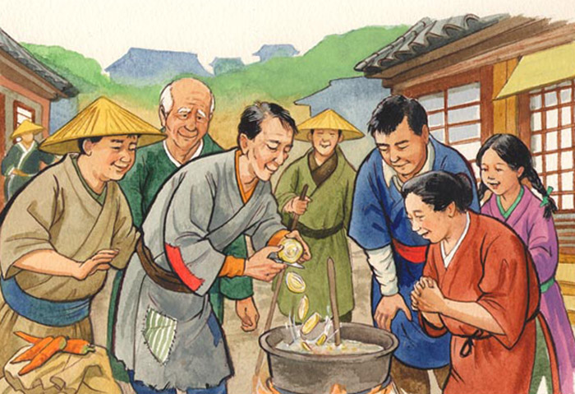
Fedora Stone Soup

Slide 17
Stone Soup
Once upon a time, somewhere in [Eastern Europe | China | India | etc.], there was a great famine in which people jealously hoarded whatever food they could find, hiding it even from their friends and neighbors. One day a wandering [soldier | beggar | wanderer | etc.] came into a village and began asking questions as if he planned to stay for the night.
"There's not a bite to eat in the whole province," he was told. "Better keep moving on."
"Oh, I have everything I need," he said. "In fact, I was thinking of making some stone soup to share with all of you." He pulled an iron cauldron from his wagon, filled it with water, and built a fire under it. Then, with great ceremony, he drew an ordinary-looking stone from a velvet bag and dropped it into the water.
By now, hearing the rumor of food, most of the villagers had come to the square or watched from their windows. As the soldier sniffed the "broth" and licked his lips in anticipation, hunger began to overcome their skepticism.
"Ahh," the soldier said to himself rather loudly, "I do like a tasty stone soup. Of course, stone soup with cabbage -- that's hard to beat."
Soon a villager approached hesitantly, holding a cabbage he'd retrieved from its hiding place, and added it to the pot. "Capital!" cried the soldier. "You know, I once had stone soup with cabbage and a bit of salt beef as well, and it was fit for a king."
The village butcher managed to find some salt beef . . . and so it went, through potatoes, onions, carrots, mushrooms, and so on, until there was indeed a delicious meal for all. The villagers offered the soldier a great deal of money for the magic stone, but he refused to sell and traveled on the next day. The moral is that by working together, with everyone contributing what they can, a greater good is achieved.

Slide 18
CUL/IS Fedora Architecture
Fedora Software Platform
Digital Preservation Storage System
Application and authentication middleware
Applications to support Long Term Preservation Archive

Slide 19
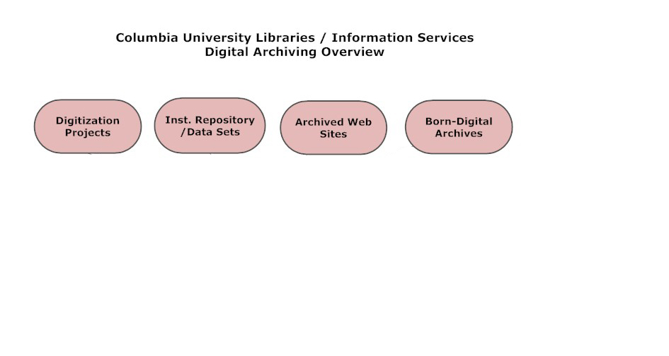

Slide 20
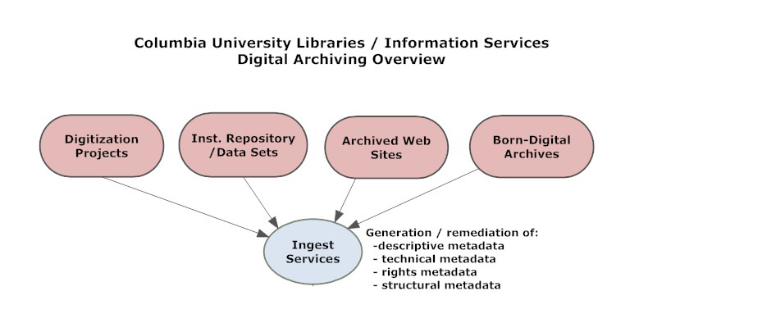

Slide 21
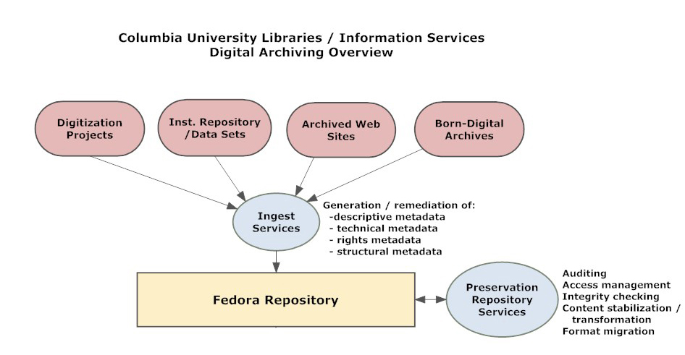

Slide 22
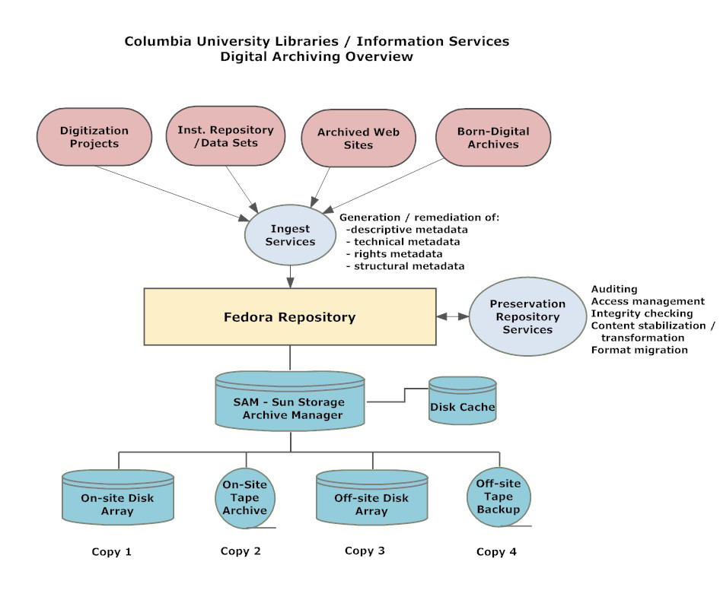

Slide 23
Fedora Repository Tools
Metadata creation & editing tool (Hypatia, 2010)
Staff Collection Viewer (2011)
Command line admin tools

Slide 24
TRAC
Trustworthy Repositories Audit & Certification: Criteria and Checklist (2007) – OCLC, CRL & NARA. Previous: RLG-NARA Task Force on Digital Repository Certification (2003)
Drambora: Digital Repository Audit Method Based on Risk Assessment (2008) – Digital Curation Centre (UK) and DigitalPreservationEurope

Slide 25
Issues
Access – Needed for Preservation?
Sustainability – Budgetary, organizational, technological
Preservation – Dark archives? Dim archives? Open archives?
Curation -- Semantic and ontological continuity and comparability of the collection content

Slide 26
The Future
Mixed, distributed environment
Efforts to coordinate within subcommunities
A few large trusted digital archives in the U.S. and elsewhere
Many smaller digital archives that provide initial stabilization and packaging for later deposit in larger archives

Slide 27
What Would You Preserve ?
Harlem Hospital Murals
Encyclopedia Iranica
Mapping Gothic France
Top 100 CUL Oral Histories

Slide 28
Only the beginning …
Questions:
daviss@columbia.edu
CU Libraries Digital Program
http://www.columbia.edu/cu/libraries/inside/units/ldpd/

