Slide 1
Ford International Fellowships Program Archive at Columbia University Accomplishments & Lessons Learned

Slide 2
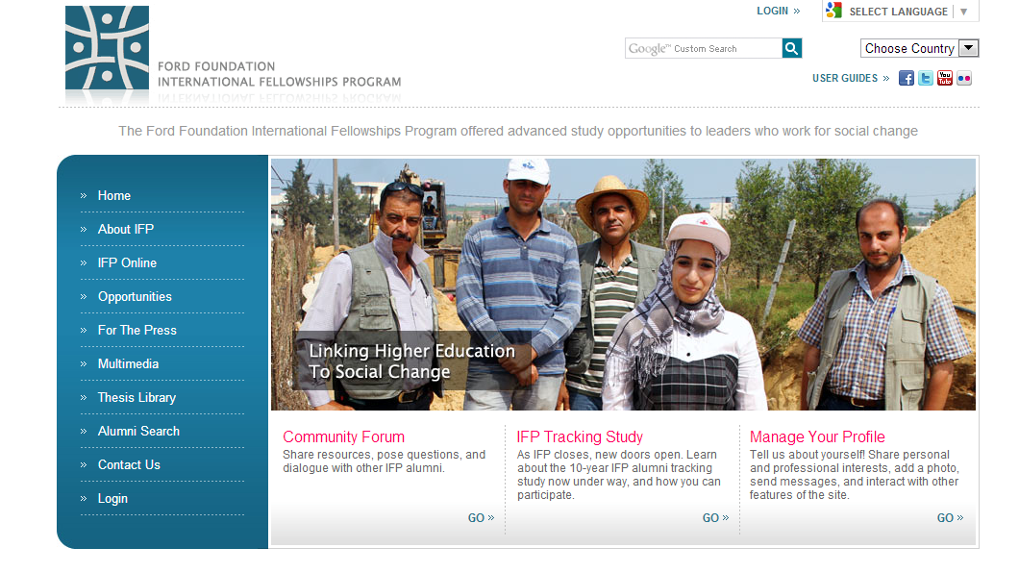

Slide 3
Columbia’s tasks …
To house and make accessible IFP’s archives
But also ….

Slide 4
Ford IFP Grant Key Objective:
“… to enable Columbia Libraries to build out a full set of repository-based systems and services so that it can more easily acquire, ingest, process, preserve and make accessible both the paper and born-digital organizational records. The technological infrastructure built for this project will ultimately allow Columbia act as the central repository for the electronic records of other institutions whose archives are deposited at Columbia.”

Slide 5
Bird’s Eye View

Slide 7
Lessons Learned …
#1. How to build a robust, extensible, standards-based, open-source local workflow for born-digital content preservation from soup to nuts.

Slide 8
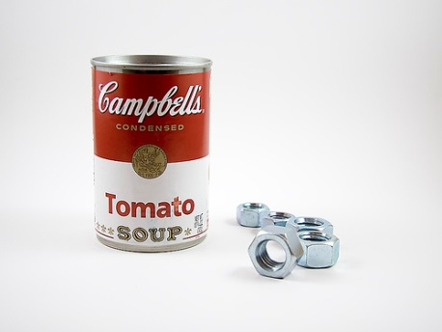

Slide 9
What does our new infrastructure do?
Helpful to have a very quick overview of what it is we have built so the lessons learned can be understood in context.

Slide 10
Born-Digital Content Preservation
Stage 1: Negotiate & work with / scope & advise content owners before content transfer
Stage 2: Arrange for transfer of content: hard media preferred
Stage 3: Receive and accession content in curatorial division
Stage 4: Create preliminary documentation
Photograph transfer media
Create preliminary metadata for transfer media
Stage 5: Read in content: Use digital forensics tools as needed to read media / copy content (e.g., FRED)

Slide 11
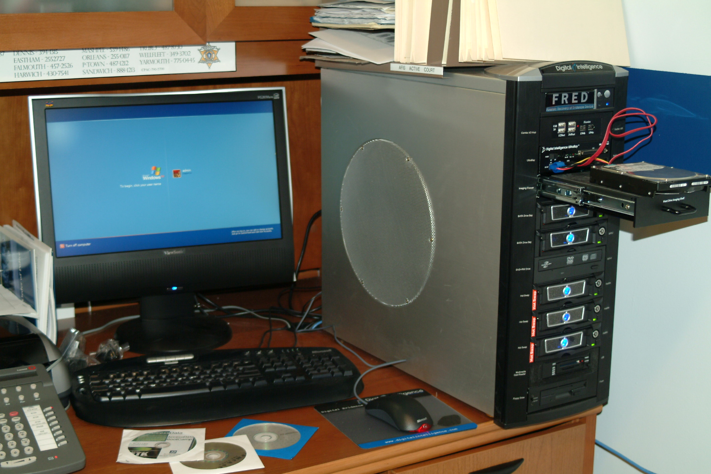

Slide 12
Born-Digital Preservation, cont.
Stage 6: Check and validate content
Create detailed inventory manifest
Perform fixity checks
Perform virus checks
Stage 7: Create archival master of original content
Stage 8: Perform ‘appraisal’
Content review (using FTK as needed)
Content weeding, if needed
Content reorganization, if needed
Stage 9: Create Ingest Package (SIP)
Stage 10: Create full set of structural, preservation and rights metadata; optionally create preservation derivatives (Archivematica)

Slide 13
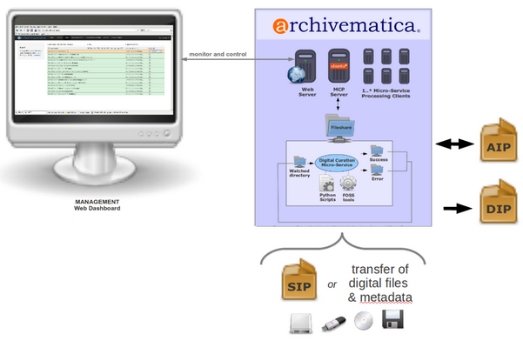

Slide 14
Born-Digital Preservation, cont.
Stage 11: Generate Archival Information Package (AIP)
Stage 12: Ingest into Preservation Repository (Fedora)
Stage 13: Generate preservation and/or access derivatives as needed and integrate into original Fedora content

Slide 15
Lessons Learned …
Archivematica is a great open-source application!
Software development deadlines slip (we knew that)
Over the last two years, ‘tooling’ in this domain has developed rapidly and continues to develop
Working with content owners is highly desirable and very tricky
The concept of a digital “original archival artifact” is very tricky
There are more data formats floating around than you think there are (we’re up to 170 and counting)
No one knows how best to preserve ‘databases’ and ensure their accessibility in the future
Preserving and making accessible email is very challenging

Slide 16
Biggest Challenge …
Sorting through and addressing confidentiality requirements

Slide 17
Our agreement with IFP:
Content would come to us sorted into three categories:
Publicly accessible
Viewable only onsite
Embargoed until 2075
In retrospect, probably too ambitious a task for small offices in developing countries in their last weeks of operation

Slide 19
Access restrictions …
Now requires substantial manual remediation
In 18 languages
Uncertainties remain about accuracy of status assignment and risk presented by possible errors
We need to build new level of security and access functionality for our preservation repository and effective take-down mechanisms

Slide 20
In sum …
The project was all that we expected it to be and more ….
We have already built a workflow and digital processing infrastructure that will serve this project and other born-digital projects in the future
That infrastructure will continue to evolve and will need ongoing investment to stay current
There are many born-digital preservation challenges we will need to work on with colleague institutions
This is an entirely new programmatic area for CUL/IS currently resourced chiefly by grant funds

Slide 21
Thank you.

