Slide 1

Libraries ONLINE Exhibit support

Slide 2
Topics to cover today …
What is Omeka?
Why do we use Omeka?
How does Omeka fit into our digital library infrastructure?
How does Omeka work?
What’s in the pending upgrade?
What’s the timetable for upgrade?
What’s in the future?

Slide 3
What is Omeka?
“Omeka is a free, flexible, and open source web-publishing platform for the display of library, museum, archives, and scholarly collections and exhibitions.”

Slide 4
What else is Omeka?
“Omeka is a Swahili word meaning to display or lay out wares; to speak out; to spread out; to unpack.”
– Omeka web site (!)

Slide 5
Why do we use Omeka?
We implemented Omeka in in 2009 to allow CUL curators to create and publish online exhibitions of material digitized from our specialized collections with a minimum of support from central technology staff.

Slide 6
One key implementation decision was that a modest number of display templates, colors and designs would be made available for curators to select from. No specialized design work or programming would be needed.

Slide 7
Another key implementation decision was that digitized content and metadata created for online exhibitions would be done to an appropriate standard that would allow it to be incorporated into our overall digital library collection.

Slide 8
How does Omeka fit into our digital library infrastructure?

Slide 9
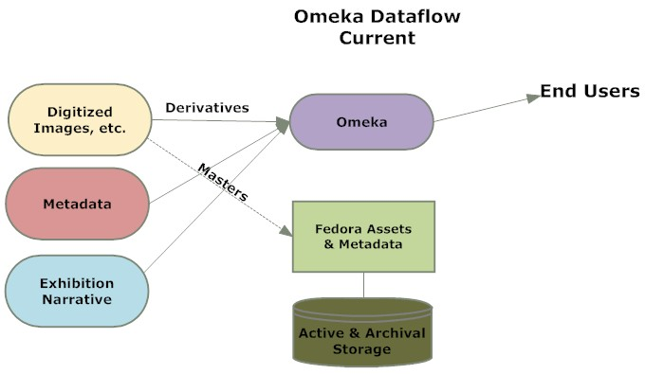

Slide 10
Great! But … Omeka is a growing metadata silo. We need to ‘unsilo’ by moving Omeka metadata and derivatives into Fedora so the content is available more broadly.

Slide 11
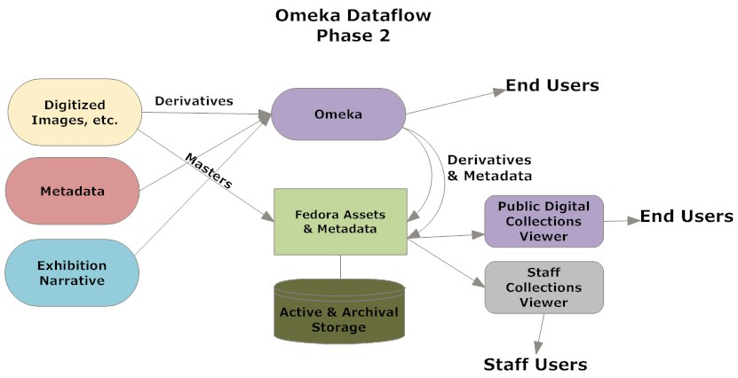

Slide 12
To improve workflows and reduce content duplication, in Phase 3 we will implement the “Fedora / Omeka connector.”

Slide 13
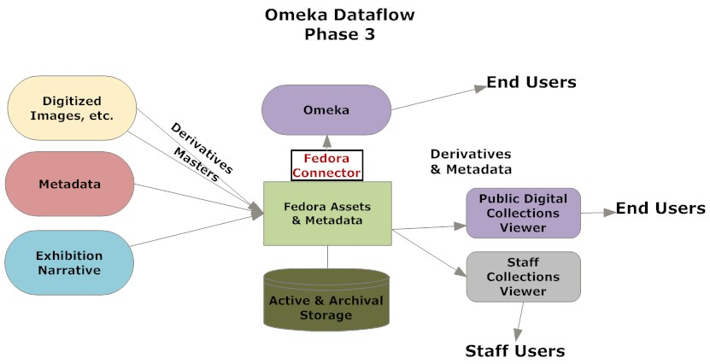

Slide 14
Over to Robbie:
How do you use Omeka? (brief demo)
What’s in the pending upgrade?

Slide 15
Omeka 2 Upgrade Timetable
Oct. 18: Complete internal LDPD testing
Oct. 21: Notify content contributors about upcoming upgrade and content freeze
Oct. 23: One-day content freeze
Oct. 24: New version available in production; old version still available for reference

Slide 16
What’s in the Future?
Additional training, support and documentation for new version, better use statistics
Migration of Omeka content to Fedora
Implementation of Omeka / Fedora plug-in
Investigation of geographic / mapping plug-ins (e.g. Neatline)
Possible implementation of other plug-ins, depending on curator needs

