Slide 1
Time-Based Media Use Cases in an Integrated Access Environment, or …

Slide 2
Should Columbia implement Avalon?

Slide 3
Columbia Use Cases
Support scholars and researchers using Columbia’s archival & special collections
Be able to accept and provide access to archival/special collections responsibly
Future?
  provide collection-based instructional support
  provide learning object preservation and access

Slide 4
Columbia Libraries A/V Sources
Content from:
“hybrid” archival collections
born-digital archival collections
new (and ongoing) born-digital oral history projects
preservation-driven digitization projects
video from obsolete course-related projects
surprise “delivered digital” content
possibly -- faculty collections (e.g., ethnographic recordings)
Columbia Lions football games (no, just kidding)

Slide 5
Sample A/V Content
Digitized analog oral history audio tapes (1200 hours and counting)
Ongoing born-digital oral history audio, video (thousands of hours)
Columbia Dupont Video Awards archive (2000 hours)
Theodore Conant history Korean films (hundreds of hours)
Ford International Fellowships Program Archive Audio and Video (hundreds of hours)
Composers Forum audio (600 hours)
Amiri Baraka audio and video (dozens of hours)

Slide 6
Also ….
… New York City Opera, Prokofiev Archive, Ditson Archive, Hudson Guild, Reiner Audio, Shapiro Lectures, Tibet Information Network audio, Jack Agueros audio, Creative Music Studio Archive audio, Wiener Foundation Archive audio, Zuckerman Archive video, Columbia Speech Lab Archive, patron orders, etc. etc. etc. etc. etc.

Slide 7
All well preserved in our replicated preservation storage environment, but …
… many disparate file formats
… no access
… no reliable, Columbia-based streaming capacity
… spotty metadata
… unclear rights

Slide 8
So Columbia Needs to Implement …
robust multiformat transcoding support
production streaming media capacity
ingest workflows optimized for time-based media
full-featured browser-based displays
future: transcription display / content indexing

Slide 9
But we also want …
a single Fedora, Hydra, Blacklight, SOLR stack to the extent feasible
a standard application of MODS w/ extensions
staff use of our new configurable MODS-based metadata system (Hyacinth) for most metadata creation and management
a minimum number of specialized applications and services
an integrated discovery environment

Slide 10
Our new Integrated Digital Library Collections Portal / Discovery Environment (DLC)
Fedora, Hydra, Blacklight, SOLR, JPEG2000, OpenSeaDragon, IIIF
standard MODS, with defined extensions
selective use of METS structure maps
gradual ingest of all earlier collections
gateway to trusted digital repository (APTrust)
platform for all new digital collections and, eventually, exhibitions
will include all media types

Slide 11
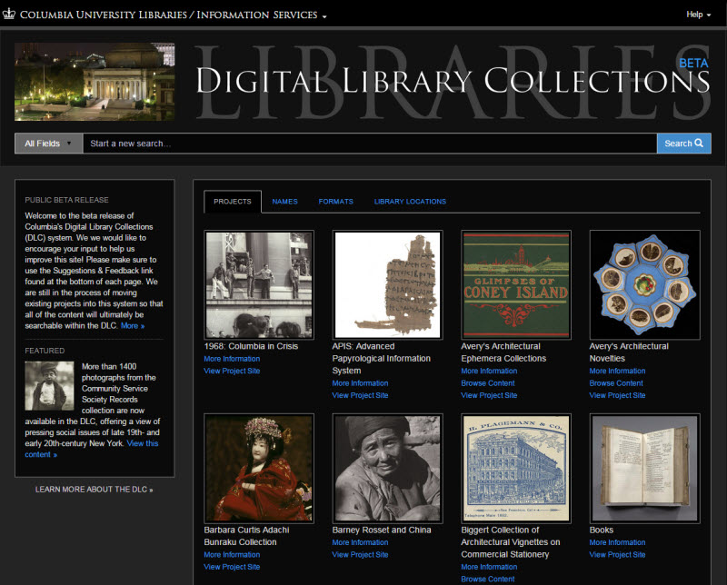
New Columbia Digital Collections Portal (click to access)

Slide 12
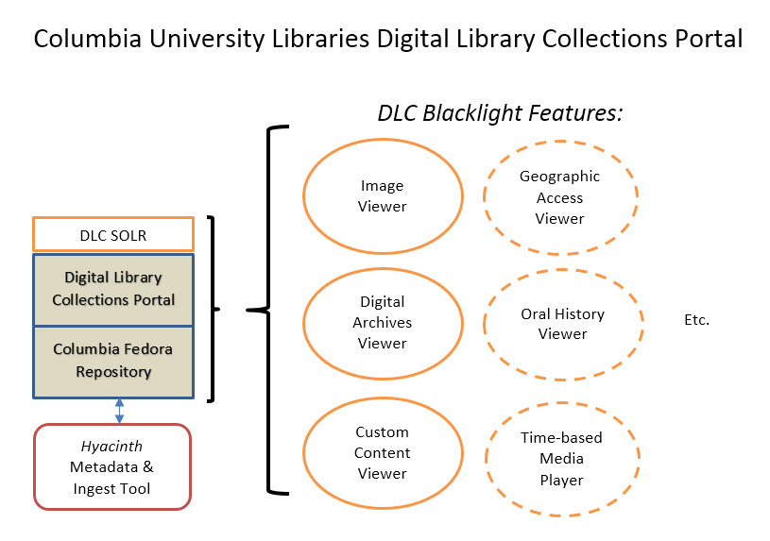

Slide 13
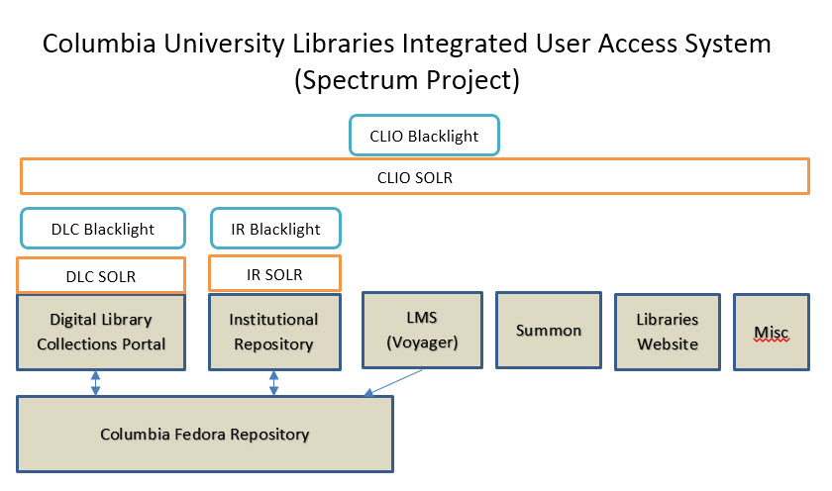

Slide 14
Where Does Avalon Fit In?
To find out, we will:
Implement Wowza streaming media server as an interim multimedia delivery system
Conduct an Avalon pilot with key internal stakeholders (Nov-Dec)
Investigate possible integration scenarios
Talk with Avalon development team about roadmap and options

Slide 15
Decide on our options (2015 Q2)!

