Slide 1

Columbia Spectator Archive Project
Behind the Scenes
Stephen Paul Davis
Director, Columbia Libraries Digital Program
November 20, 2014

Slide 2
The Plan
Partnership between Columbia Libraries / Information Services and the Spectator
High quality scanning of original Spectator issues from Columbia University Archives and the Spectator Editorial Offices
State-of-the-art text processing (OCR) of scanned images and article segmentation
Feature-rich online presentation
Permanent, long-term digital preservation

Slide 3
The Players
The Spectator staff and board
Columbia University Archives
Libraries’ Preservation & Digital Conversion Division
Libraries’ Digital Program Division
Libraries’ Information Technology Division
Digital Divide Data (DDD)
Brechin Imaging Services
Digital Library Consulting (Veridian provider)

Slide 4
Columbia Libraries Digitization Program
Digitization Projects
(Books, manuscripts, papyri, archives, oral histories, multimedia, etc.)
Digital Exhibitions
(See especially: Core Curriculum:CC, Core Curriculum:LitHum, 1968:Columbia in Crisis, Varsity Show)
‘Born-Digital’ & Web Archives
(Columbia University, Human Rights Organizations, etc.)

Slide 5
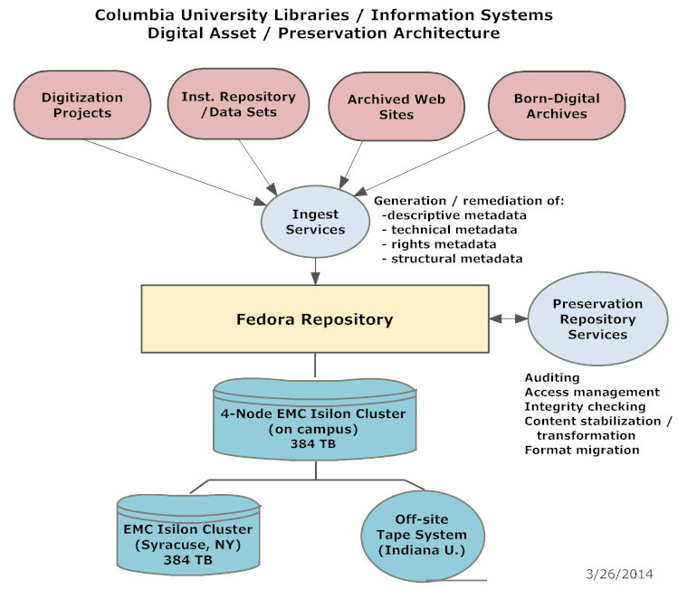

Slide 6







Slide 7
Digital Divide Data
“DDD’s innovative social model enables talented youth from low-income families to access professional opportunities and earn lasting higher incomes. This model, established by DDD in 2001, is now called “Impact Sourcing” and has been implemented by dozens of firms around the world.”

Slide 8
Newspaper Access !?
Providing flexible access to newspaper content is complicated and expensive
Not cost-effective for single institutions to build custom, newspaper-oriented software
Only two major vendors provide software optimized for newspapers
DL Consulting’s Veridian is by far the better & most frequent choice for research libraries

Slide 9
Spectator Stats
Spectator run from 1877-2012:
No. of pages = 127,623
No. of vols. requiring disbinding = ~100
No of vols. unable to be digitized = ~10
NB: Most older volumes contain severely brittle paper; only 24 volumes have flexible paper

Slide 10
Why Scan From Originals?

Slide 11
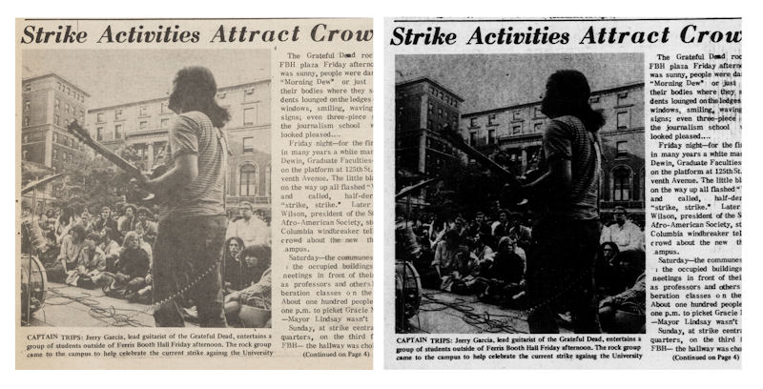
Scanning from originals retains visual content
6 May 1968

Slide 12
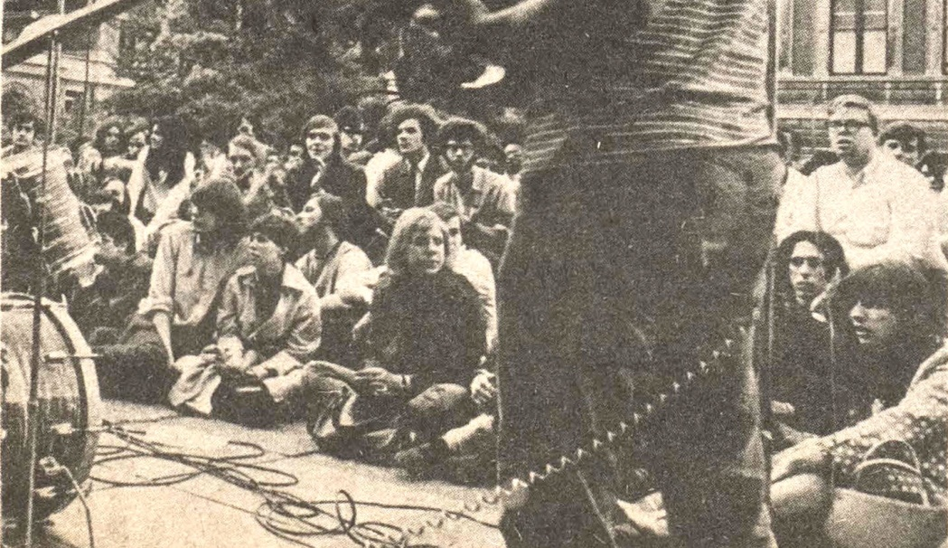

Slide 13
Tiny sampler of Spec Archive images

Slide 14
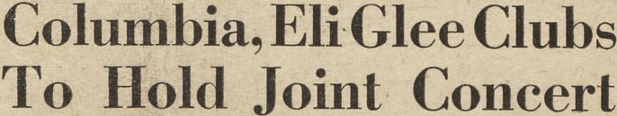
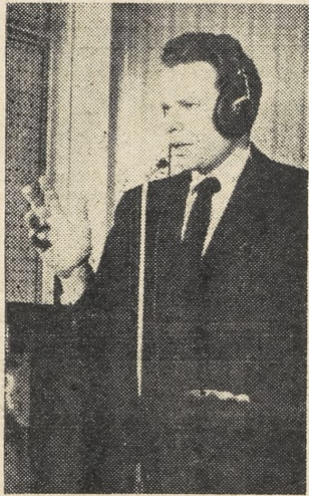
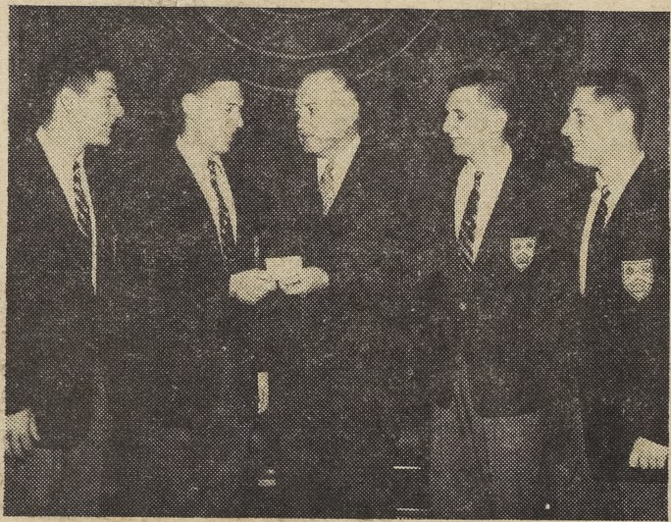

11 October 1956
19 February 1957

Slide 15
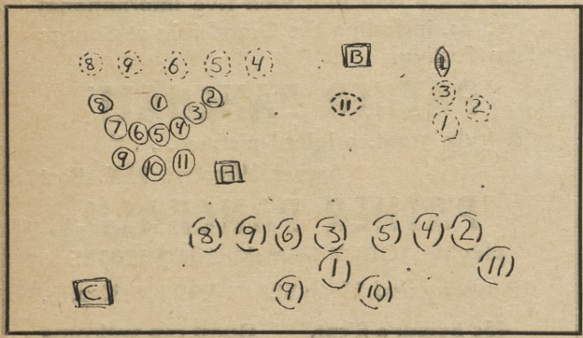
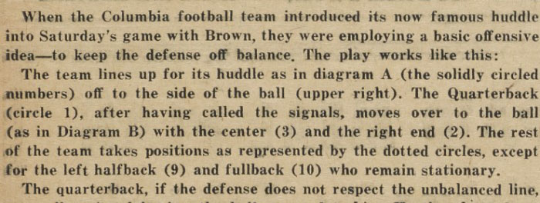
29 September 1959

Slide 16
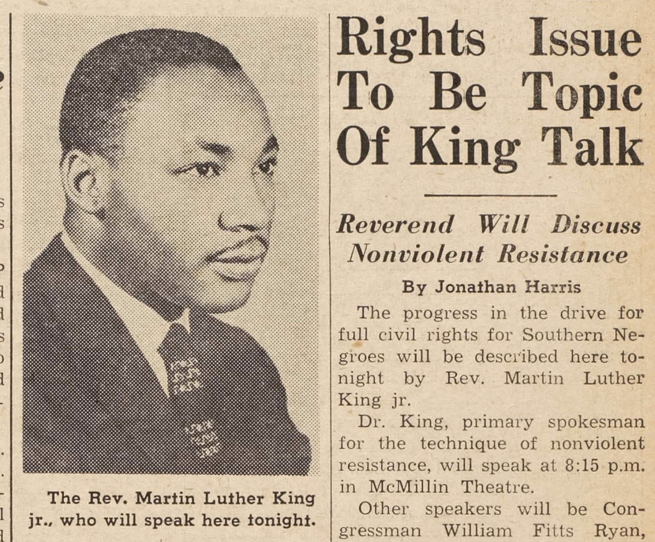
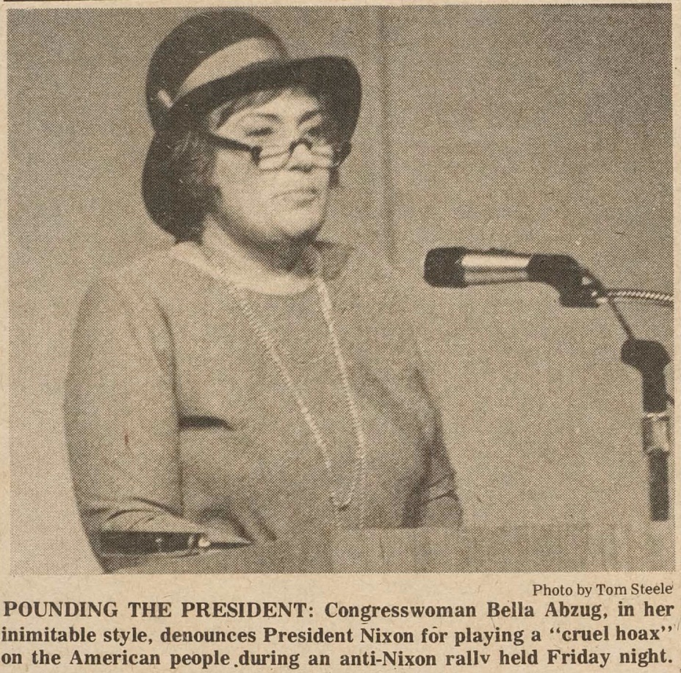
3 December 1973
27 October 1961

Slide 17
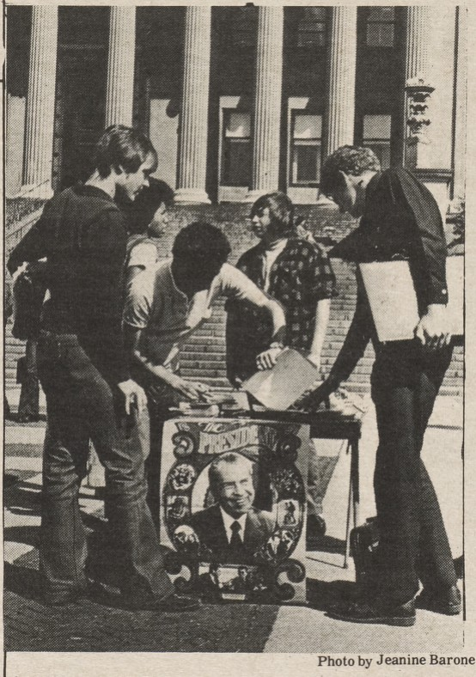
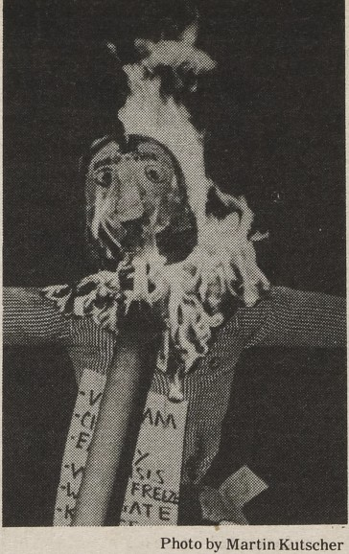


2 October 1972
7 March 1974

Slide 18
Challenges of Scanning from Originals

Slide 19
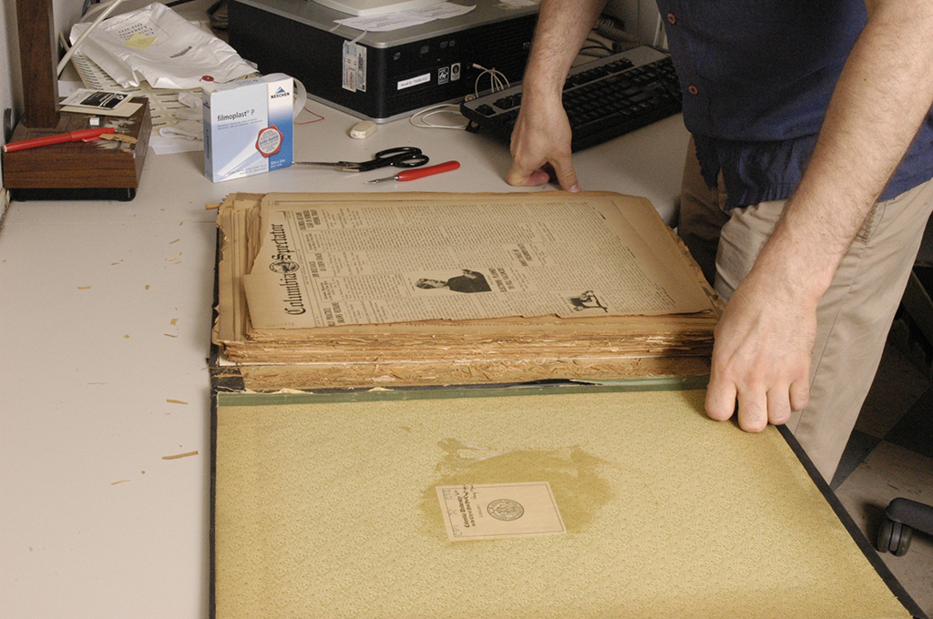
Disbinding fragile pages

Slide 20
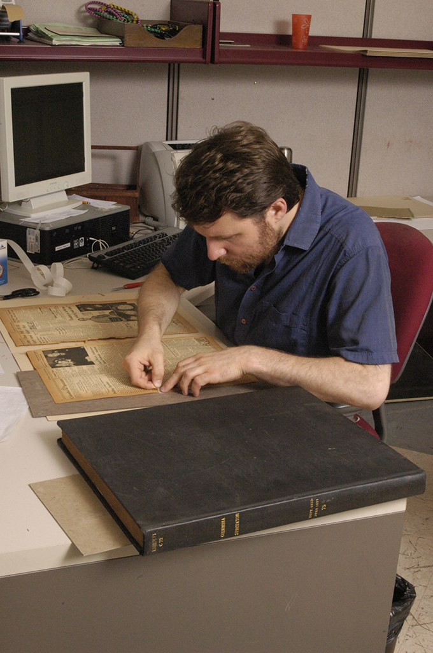
Repairing and Conserving

Slide 21
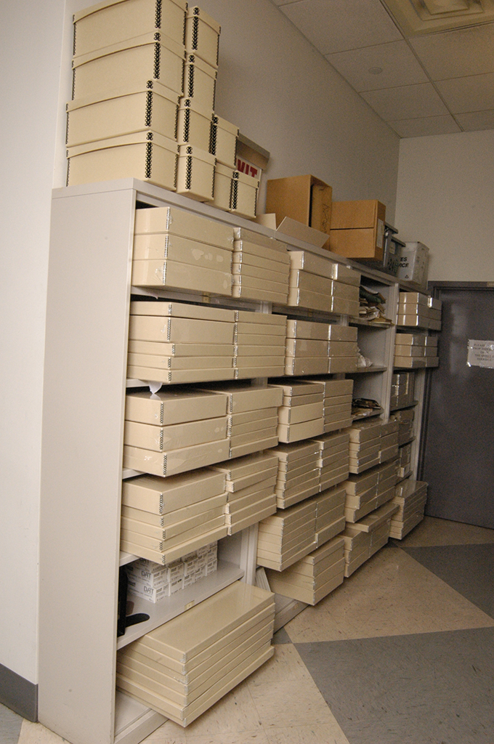
Preservation Boxing
(for shipping & long-term storage)

Slide 22
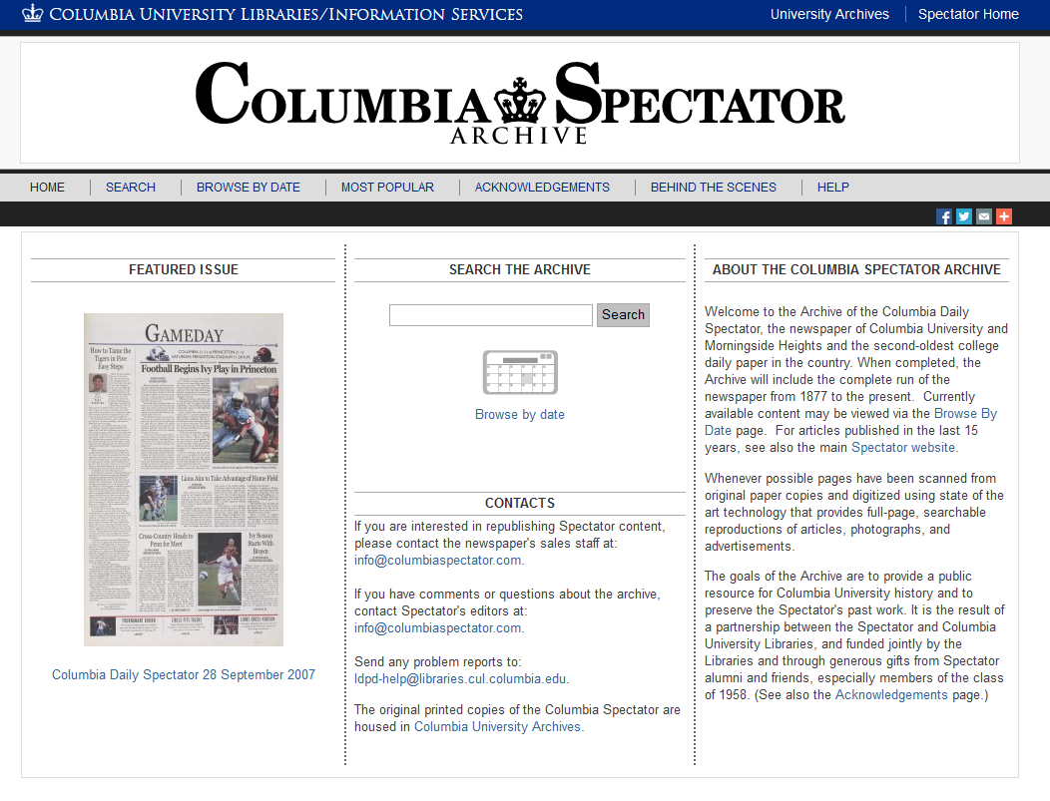

Slide 23
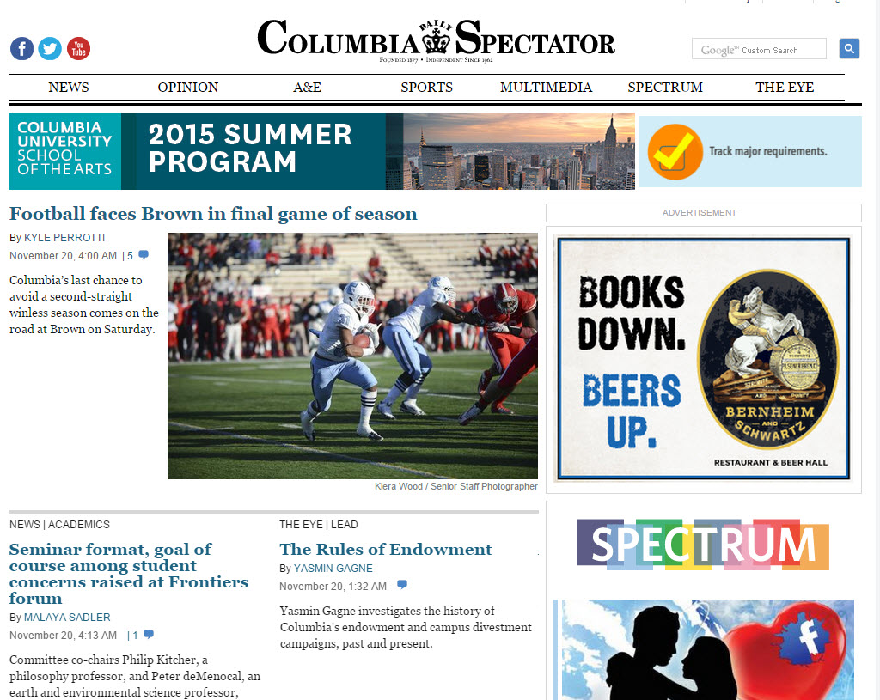
Future?
Include volumes
from 2013, 2014
Discuss long
term archiving
of and access
to Spec online
content

