Slide 1
Navigating the Born-Digital Wilderness
The Ford International Fellowships Archive At Columbia University
Stephen Davis, Ben Armintor
Columbia University Libraries
2015 Digital Library Federation Forum

Slide 2
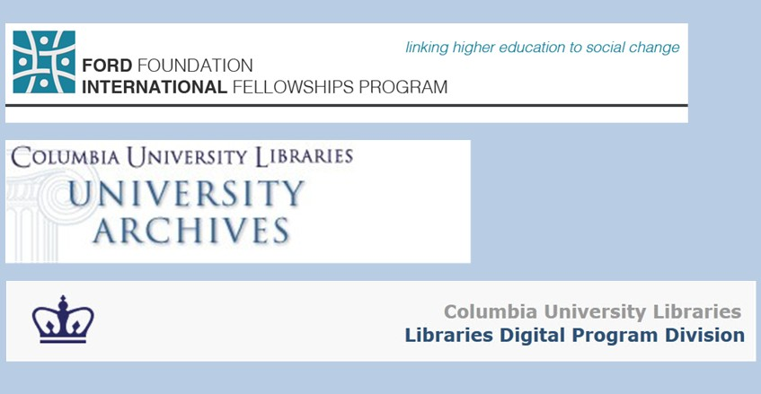

Slide 3

Ford Foundation International
Fellowships Program, 2001-2014
“The Ford Foundation International Fellowships Program (IFP) began with the conviction that social justice is advanced through equitable opportunities for higher education.
Foundation trustees and staff believed that, if given the right tools, socially committed individuals, grassroots leaders and social innovators from disadvantaged communities could succeed in postgraduate studies and would advance social change upon returning home.”

Slide 4
2011 Grant to Columbia
Accession all paper and digital archives from a worldwide organization
Build an online archive for the born-digital content
Build out and share capacity for acquiring, processing, preserving and making accessible digital archives
Also: create research fellowships, support external longitudinal study evaluation, etc.

Slide 5
IFP Digital Content
Content from 21 international partners and Secretariat
Ongoing content deposits for 10-year program evaluation study
Ca. 350,000 digital files
Ca. 250 data file formats
Content in 10 languages
Content with 5 non-Roman character sets

Slide 6
File Formats Received
32, 3gp, a5p, accdb, adb, adp, adx, ai, aif, amr, asf, avi, axd, back, bat, bin, bk, blb, bmp, BridgeSort, btr, bup, cab, cat, cda, cdr, cfg, chm, cnf, cnm, con, css, cst, csv, cxt, d, dat, db, dbf, ddb, ddx, dfont, dir, dll, dmi, doc, doc-MRB, docm, docx, dot, ds_store, dtd, dwz, dxr, edb, edx, emf, eml, emz, eps, exe, F&A, fcp, fff, fh9, fil, flp, flv, fol, frm, gdb, gdx, gif, hdb, hdx, hk4, hlp, hta, htm, html, ico, idx, ifo, inc, indd, inf, info, ini, itc2, itdb, itl, jar, jp2, jpe, jpeg, jpg, js, l, lck, ldb, ldif, lnk, log, m4a, m4v, mbx, mdb, mde, mdi, mdx, mht, mid, mls, mno, mov, mp3, mp4, mpeg, mpg, mpp, msf, msg, msi, mso, msv, mswmm, nri, ocx, odc, odt, ofa, oft, opd, opf, otf, p65, pab, pages, pcx, pdf, php, pif, plist, pm, pm!, pm0, pm5, pmd, pmh, pmi, pmj, pml, pmm, pmo, pmr, pms, pmx, pnc, pnd, png, pns, pnx, pot, pps, ppsx, ppt, pptx, prod, prod1, properties, psd, psp, pst, pub, qpw, qxd, r, ra, ra-att, rar, rdp, rel, rels, rem, rex, rpt, rsc, rtf, sav, sc4, sdb, sdx, sh, shs, snm, spi, spss, spv, spx, sql, svn-base, swa, swf, sys, tdb, tdx, thm, thmx, tif, tiff, tlb, tmp, toc, tpl, ttf, txt, txz, up, url, usr, utf8, vcd, vcf, vdproj, vob, vsd, wav, wbk, webarchive, wks, wma, wmf, wmv, wmz, wpd, wpl, wps, xla, xlk, xls, xlsb, xlsm, xlsx, xlt, xlw, xml, xnk, xps, zip, no extension

Slide 7
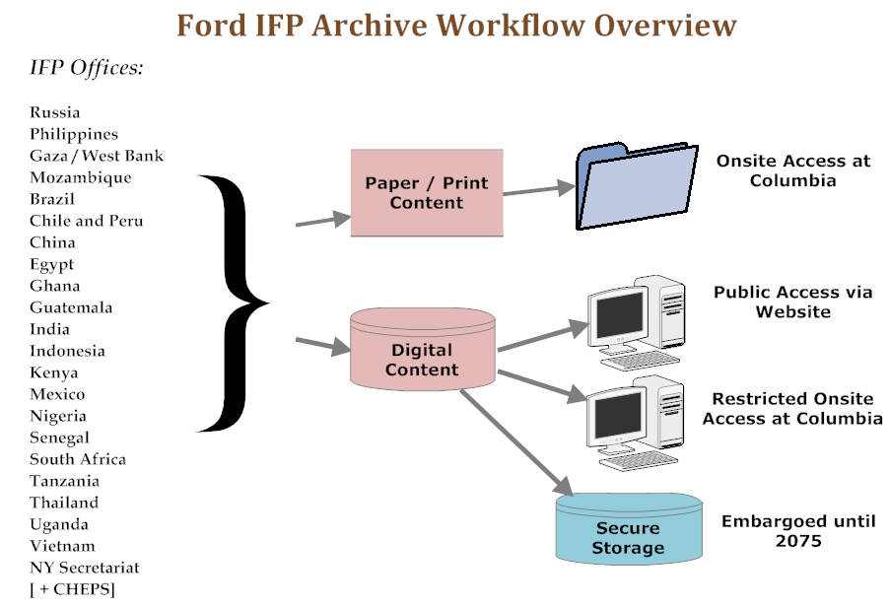
IFP Workflow Overview

Slide 8
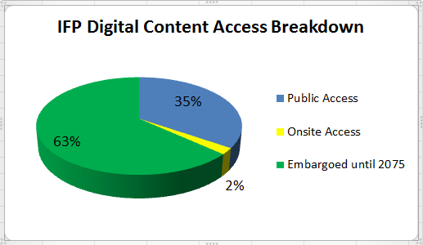
IFP Content Access

Slide 9
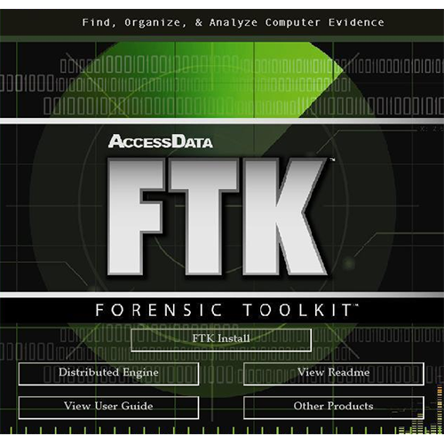
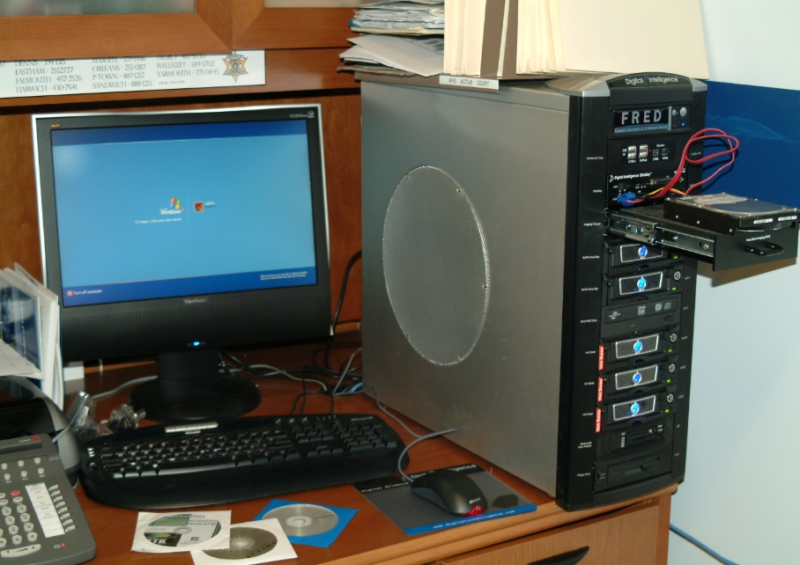
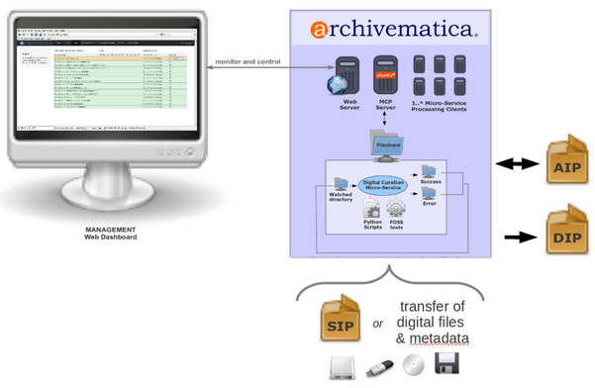


Slide 10
Metadata?
No conventional file-level metadata
Instead we used the following as surrogate metadata:
  Office of origin
  Original file name
  Original folder path from hard drive
  File format type (normalized)

Slide 11
“Metadata” Examples
  Country: Palestine
  Folder path: Recruitment/Guidelines/2006/
  File name: IFP Guidelines Arabic 2006.doc
  Resource type: Document
  Country: Philippines
  Folder path: /COMPUTER B (Program Officer)/IFP PHILIPPINES SLIDE
  PRESENTATIONS/Bali Presentations/
  File name: Indonesia (Needs Assessment).ppt
  Resource type: Presentation/Slideshow
  Country: South Africa
  Folder path: /
  File name: 0033.JPG
  Resource type: Image

Slide 12
The Ford IFP Archive website…

Slide 13
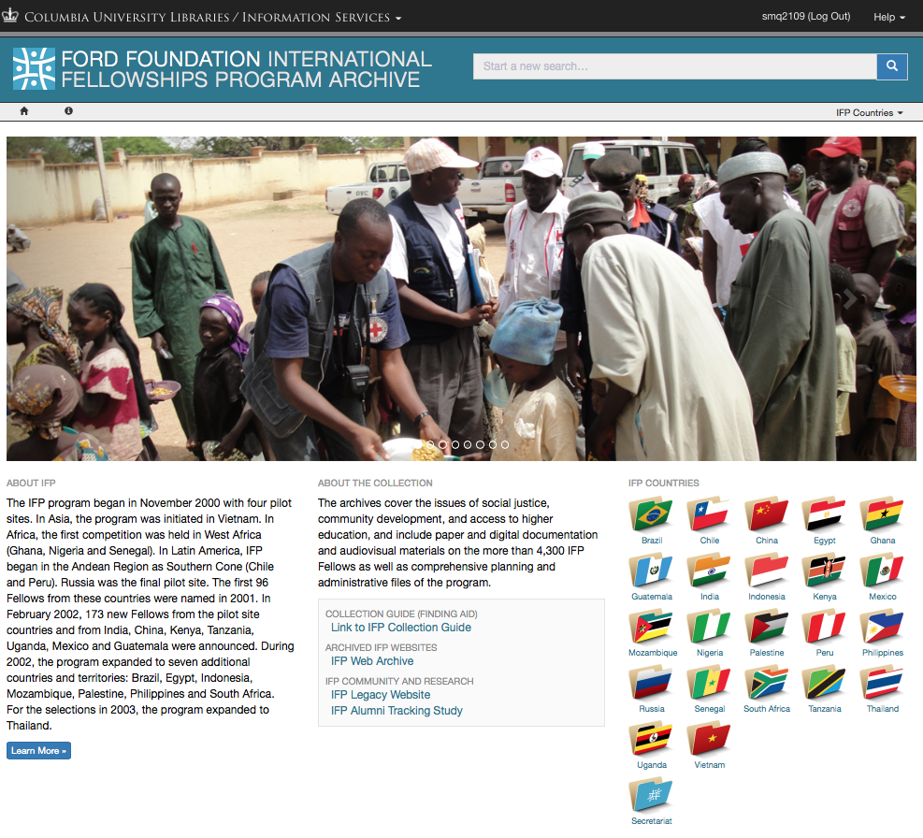

Slide 14
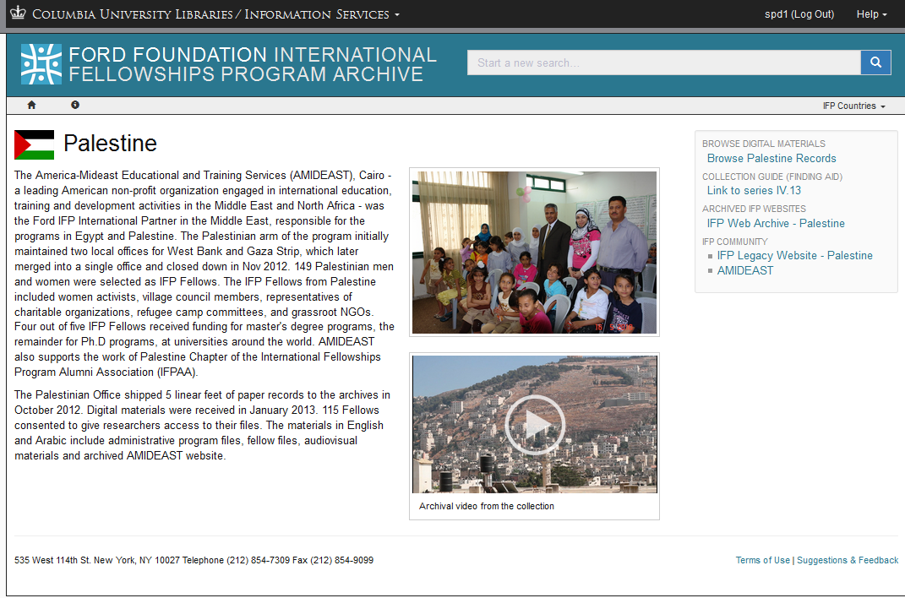

Slide 15
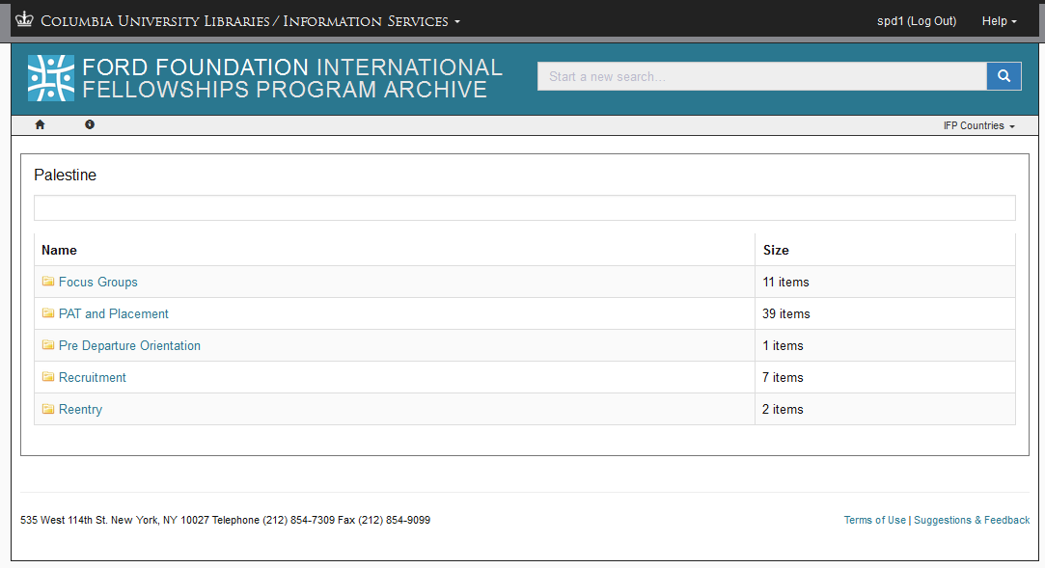

Slide 16
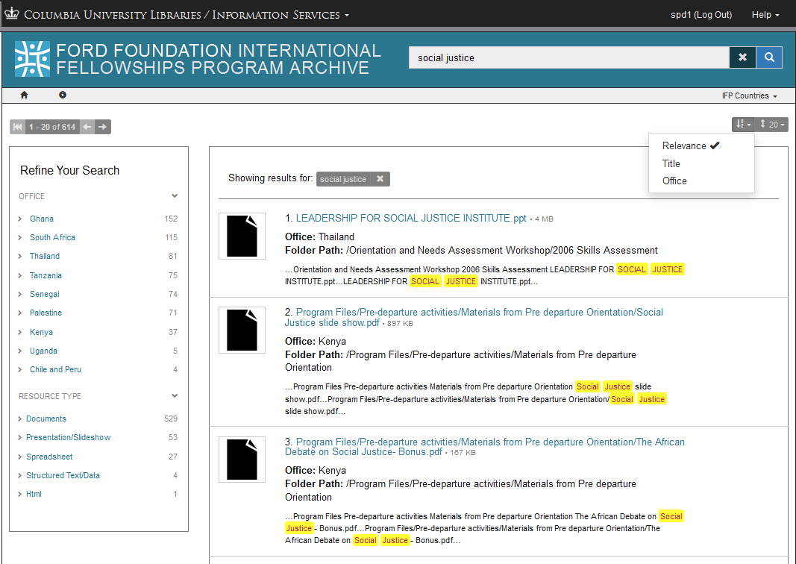

Slide 17
Lessons Learned from the Ford IFP Archive Project
Survey the born-digital content before acquiring it
Plan in advance for dealing with confidential content, personally identifiable information (PID), copyright and related issues
If possible, arrange with original content owners how content should be organized before delivery
Assume that there will be unexpected data types and conditions
Try to use (and help develop) ‘best practices’

Slide 18
Technology strategies …

Slide 19
Goals of the Ford IFP Web Interface
Build on well-established digital preservation practices
Make content available on our general repository platform
Provide a familiar interface for browsing the content

Slide 20
Or to Paraphrase…
Reconstruct the submitted disk images
From Archivematica AIPs
In Fedora (3.x)
Accessed via Hydra web apps

Slide 21
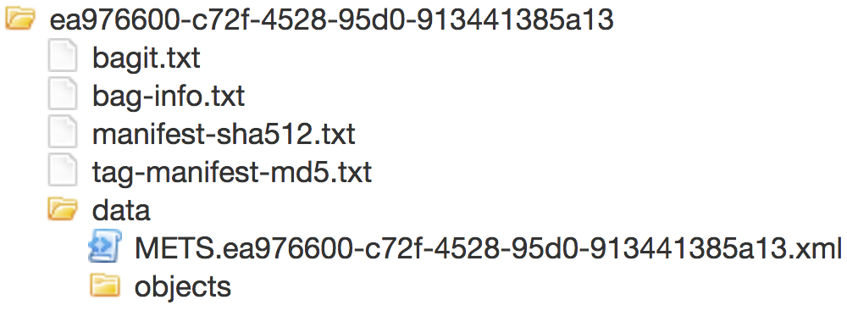
Archivematica produces BagIt Archives with a difference

Slide 22
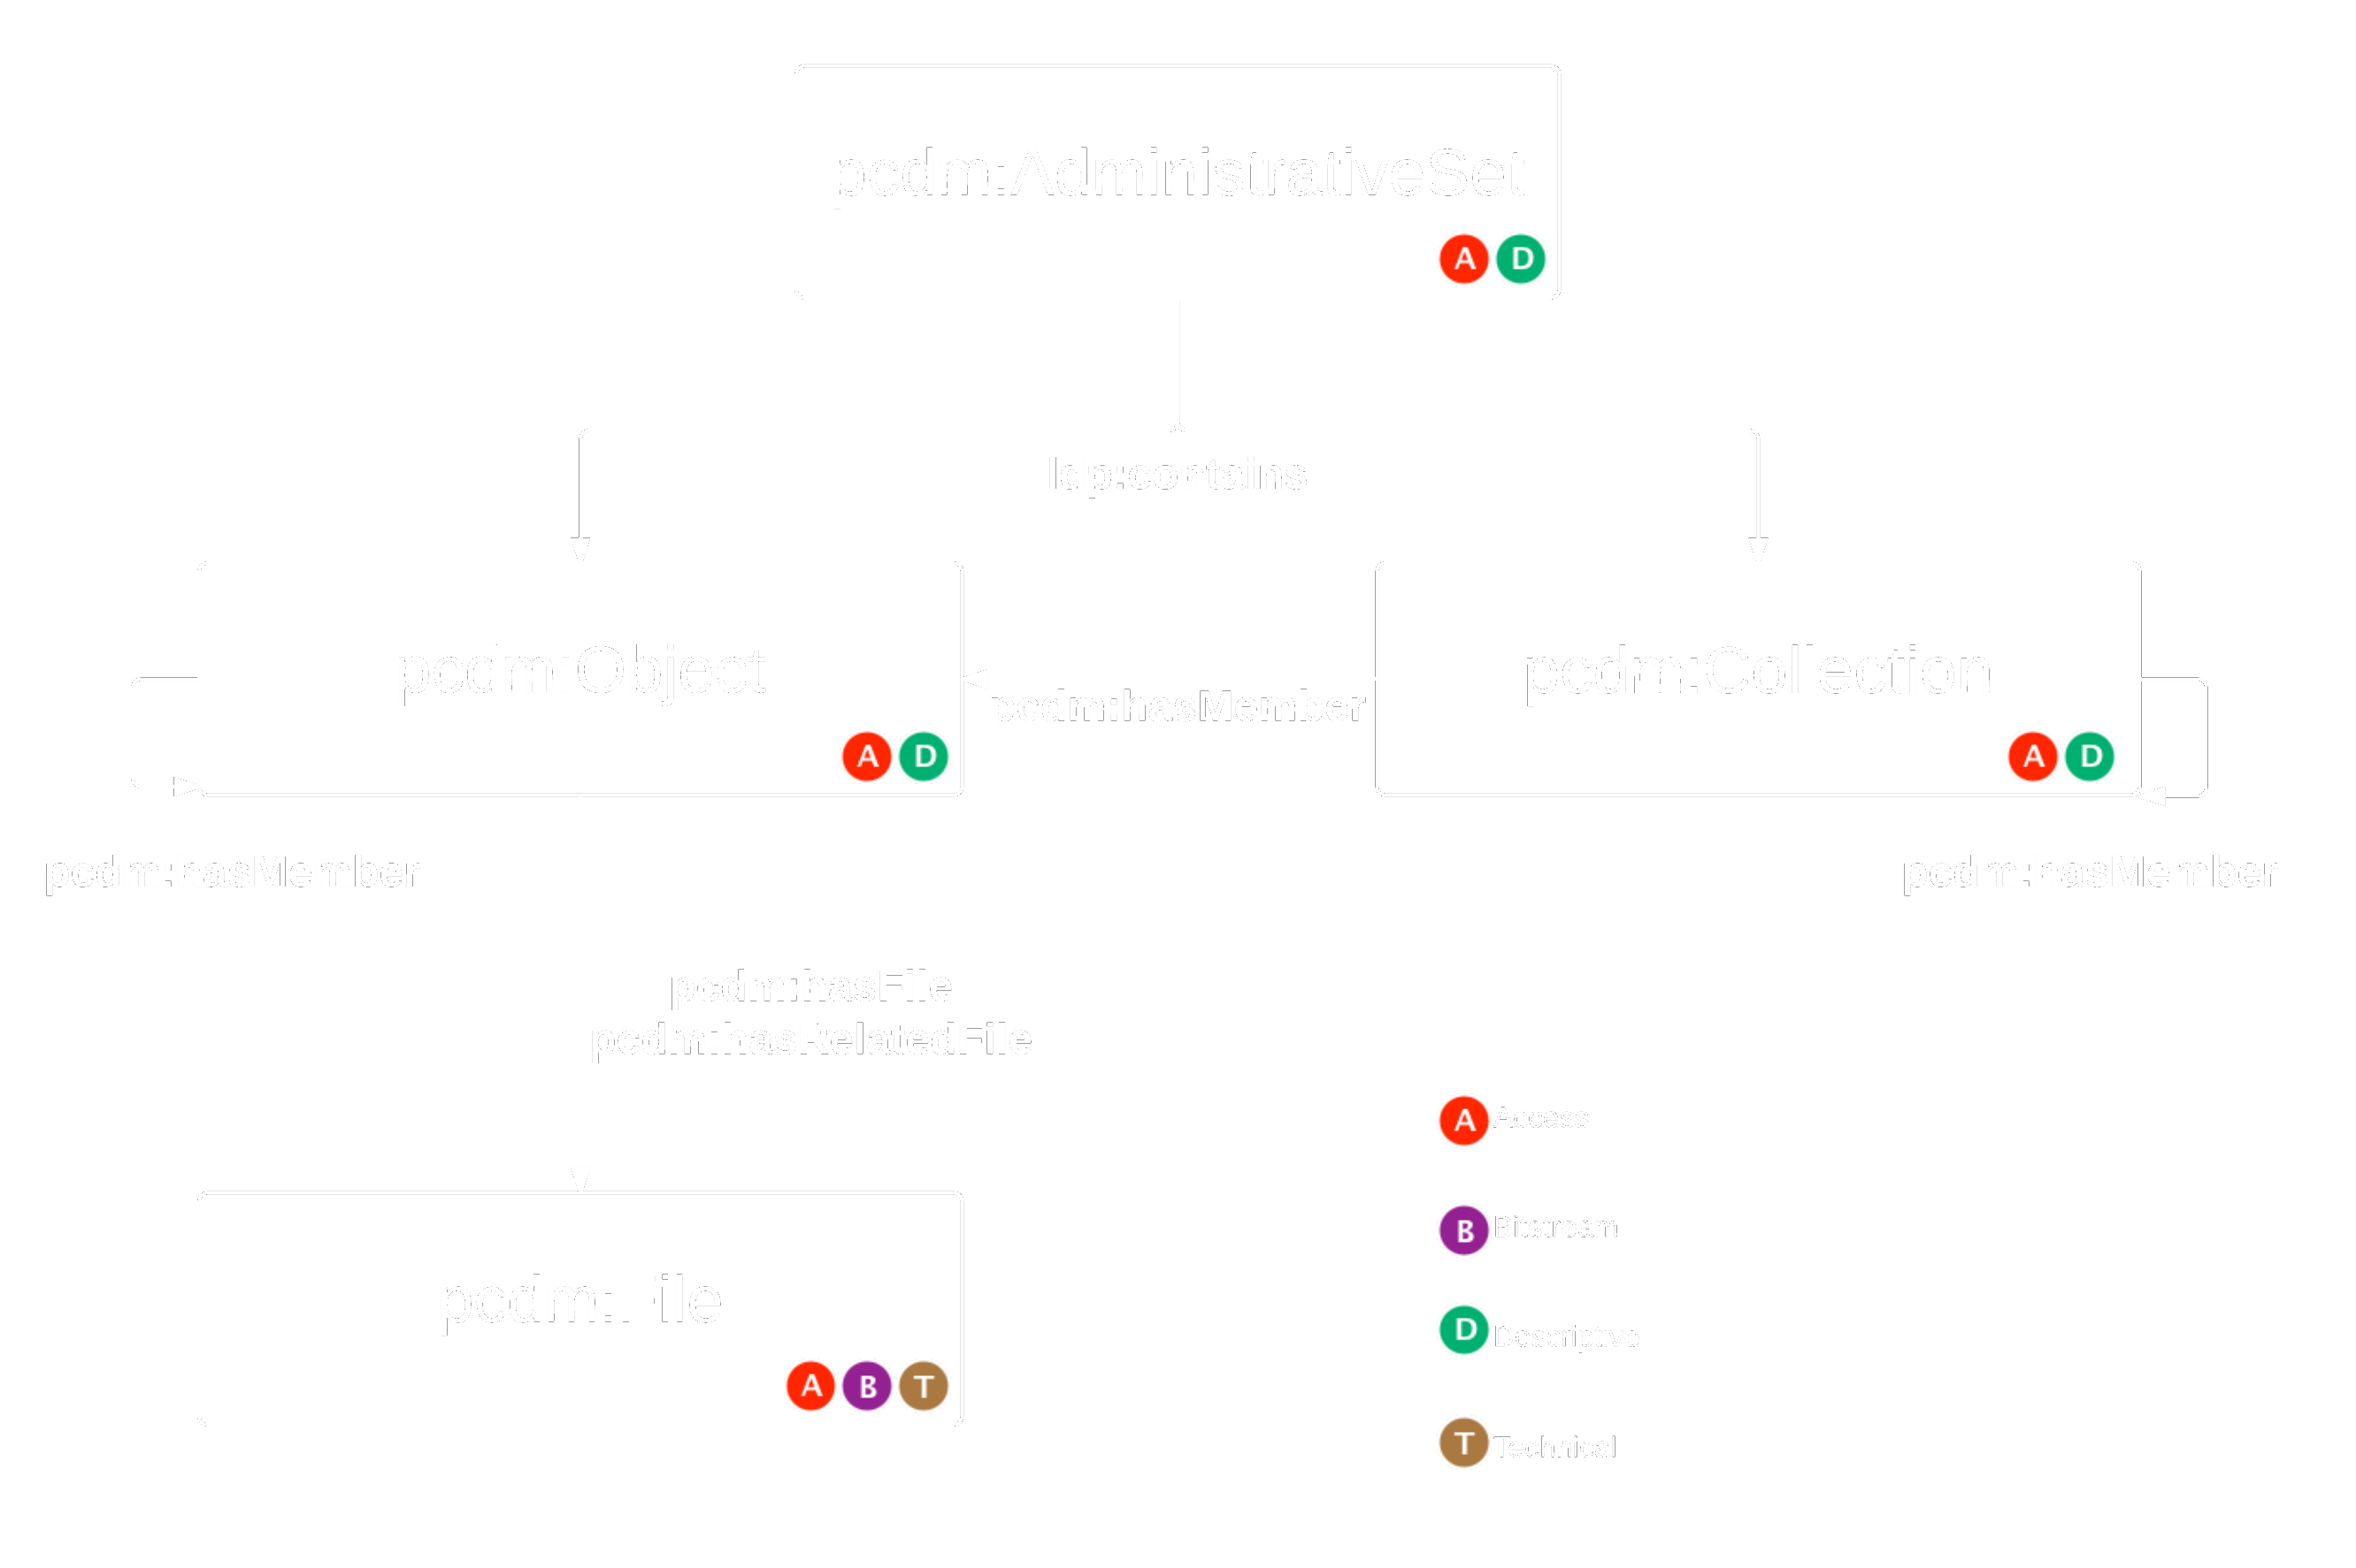
The Portland Common Data Model for Repository Content

Slide 23
Mapping Archivematica/BagIt to PCDM
BagIt Data | PCDM/Repository Target
The archive | AdministrativeSet
bag-info.txt | Collection (description)
Manifest & METS | Collection (structure)
Data/objects | FileSets (Object subclass)

Slide 24
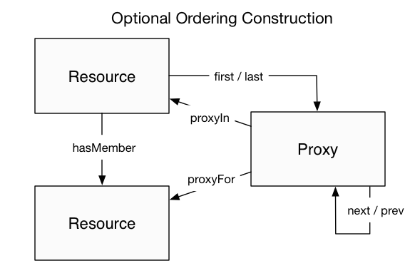
Making the Structure Navigable
PCDM Recommends ORE Proxies for List Structure

Slide 25
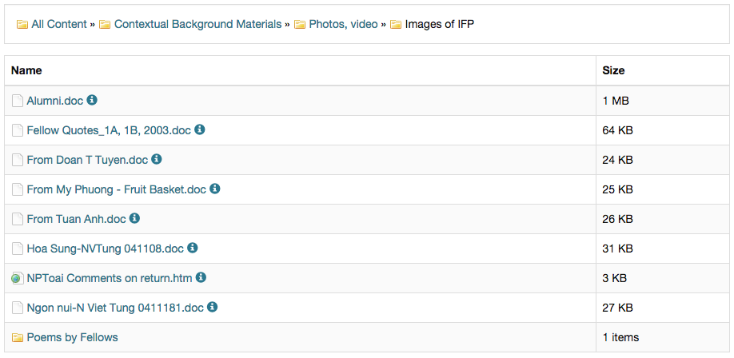
… but we don’t think of a file system like a linked list

Slide 26

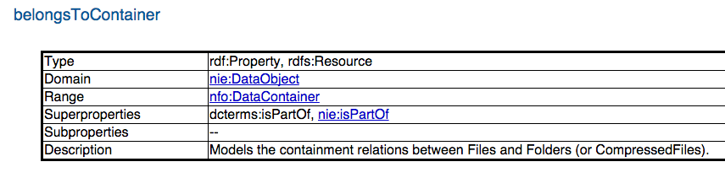
Don’t worry! There’s an ontology for that.

Slide 27
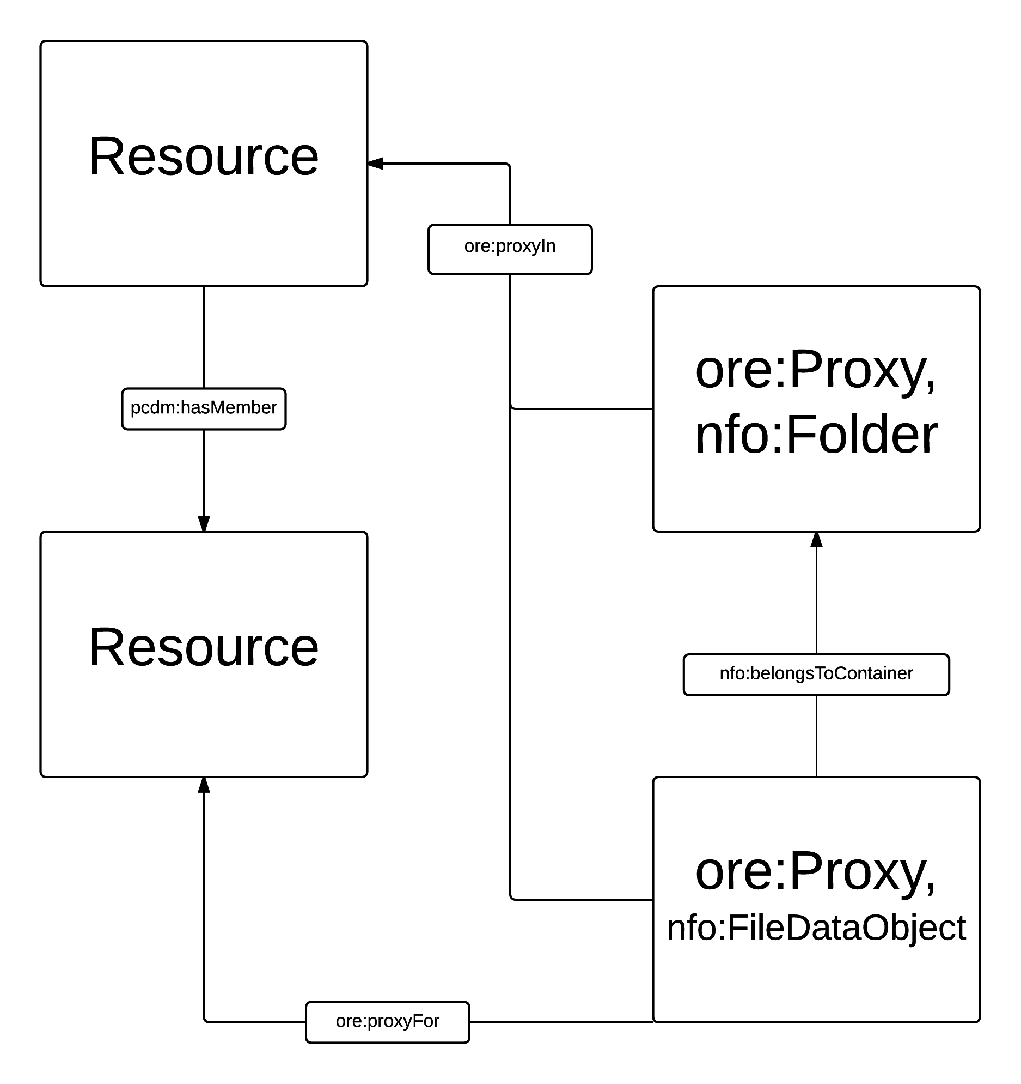
ORE + NEPOMUK
An Alternate Ordering Construction

Slide 28
Describing Files for Discovery
Leveraging External & Collaboratively Authored Vocabularies
dc:type – file type genre
  Cross-referencing UDFR, PRONOM, Getty, SKOS into a PCDM vocabulary for file types
  http://pcdm.org/file-format-types#
  https://github.com/duraspace/pcdm/blob/master/pcdm-ext/file-format-types.rdf

Slide 29
Benefits of Common Practices and Shared Modeling
A practice for separately linkable contexts (eg file folders)
A common practice for describing file categories, articulated in a number of frequently used vocabularies
Well-documented, shareable modeling practices

Slide 30
Thank you!
IFP Website: https://dlc.library.columbia.edu/ifp
IFP Project Page:
https://library.columbia.edu/bts/ford-ifp.html

