Slide 1



Slide 2
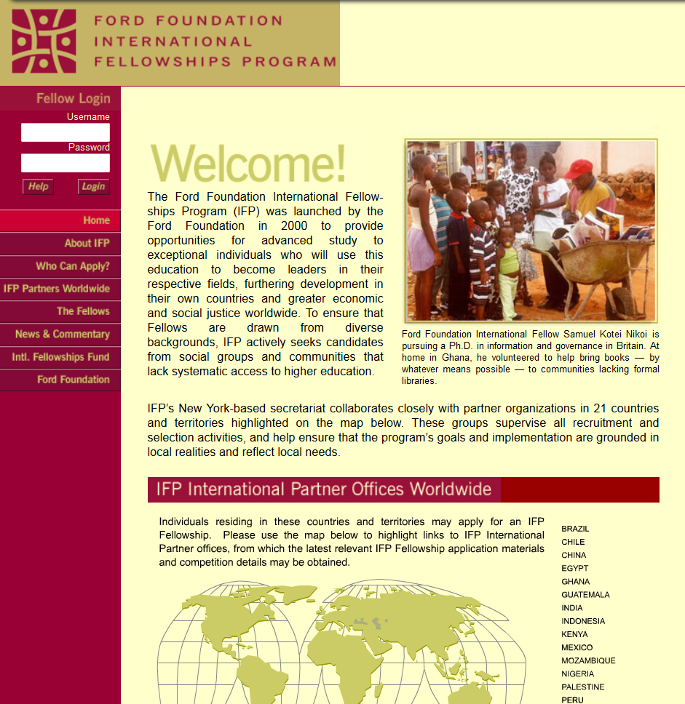
Archived IFP Website from August 11, 2002

Slide 3
Columbia’s tasks …
To preserve and make accessible IFP’s paper and digital archives to scholars, researchers and students
To build out a full set of digital archival repository systems and services at Columbia to support the IFP archive and other born-digital archives

Slide 4
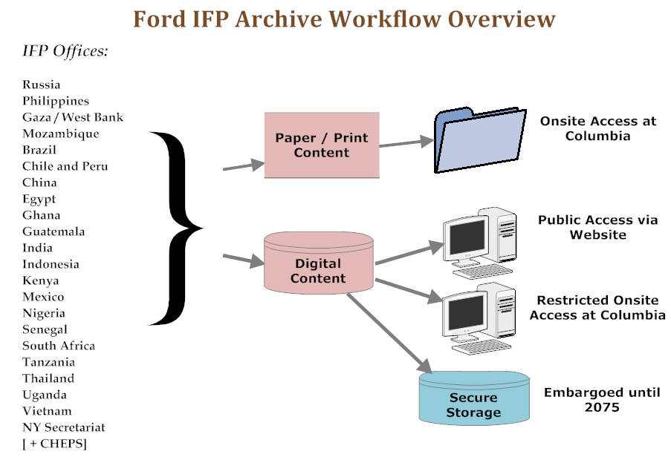

Slide 5
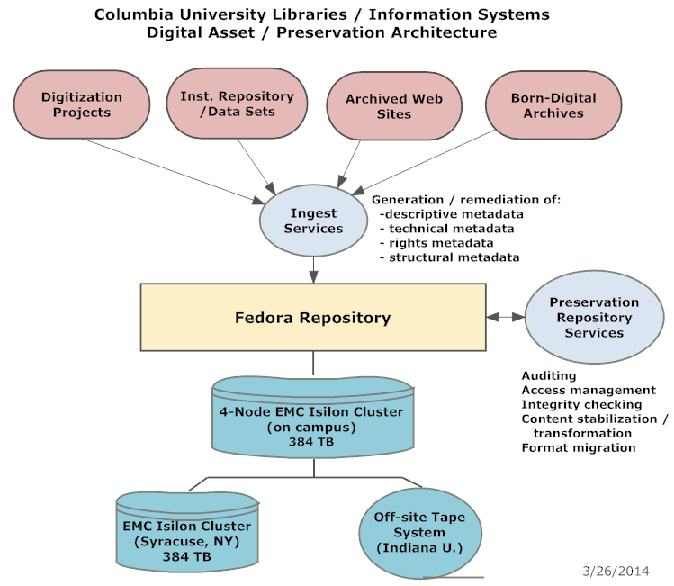

Slide 6
Project Timetable
2010: Preliminary discussion between Columbia and IFP
2011 Q1: Columbia proposal submitted
2011 Q4 Quarter: Project began
2012 Q1: Hired Columbia IFP Project Librarian
2012 Q2: Received first partner digital data set (Russia)
2012-2014: Implemented software tools, built out workflows, moved all data to replicated preservation storage
2014 Q4: Received last archival content (Secretariat)
2014 Q4: Developed online archive platform
2015 Q1: Release public beta of online archive

Slide 7
IFP Digital Content
Content from 21 international partners and Secretariat
Ca. 350,000 files
Ca. 250 data file formats
Content in 10 languages
Content with 7 non-Roman character sets

Slide 8
(File formats received…)
32, 3gp, a5p, accdb, adb, adp, adx, ai, aif, amr, asf, avi, axd, back, bat, bin, bk, blb, bmp, BridgeSort, btr, bup, cab, cat, cda, cdr, cfg, chm, cnf, cnm, con, css, cst, csv, cxt, d, dat, db, dbf, ddb, ddx, dfont, dir, dll, dmi, doc, doc-MRB, docm, docx, dot, ds_store, dtd, dwz, dxr, edb, edx, emf, eml, emz, eps, exe, F&A, fcp, fff, fh9, fil, flp, flv, fol, frm, gdb, gdx, gif, hdb, hdx, hk4, hlp, hta, htm, html, ico, idx, ifo, inc, indd, inf, info, ini, itc2, itdb, itl, jar, jp2, jpe, jpeg, jpg, js, l, lck, ldb, ldif, lnk, log, m4a, m4v, mbx, mdb, mde, mdi, mdx, mht, mid, mls, mno, mov, mp3, mp4, mpeg, mpg, mpp, msf, msg, msi, mso, msv, mswmm, nri, ocx, odc, odt, ofa, oft, opd, opf, otf, p65, pab, pages, pcx, pdf, php, pif, plist, pm, pm!, pm0, pm5, pmd, pmh, pmi, pmj, pml, pmm, pmo, pmr, pms, pmx, pnc, pnd, png, pns, pnx, pot, pps, ppsx, ppt, pptx, prod, prod1, properties, psd, psp, pst, pub, qpw, qxd, r, ra, ra-att, rar, rdp, rel, rels, rem, rex, rpt, rsc, rtf, sav, sc4, sdb, sdx, sh, shs, snm, spi, spss, spv, spx, sql, svn-base, swa, swf, sys, tdb, tdx, thm, thmx, tif, tiff, tlb, tmp, toc, tpl, ttf, txt, txz, up, url, usr, utf8, vcd, vcf, vdproj, vob, vsd, wav, wbk, webarchive, wks, wma, wmf, wmv, wmz, wpd, wpl, wps, xla, xlk, xls, xlsb, xlsm, xlsx, xlt, xlw, xml, xnk, xps, zip, no extension

Slide 9
Accomplishments -1
Accessioned all IFP content and moved it into our replicated Fedora-based preservation storage system
Performed core preservation actions (checksums, file characterization, basic metadata generation) on all content
Reviewed ca. ½ of content for personally identifiable information (PID) with assistance of outside consultant

Slide 10
Accomplishments -2
Built beta version of website presenting the IFP archive as a whole and as individual partner sites
Developed new repository-based software techniques for navigating archival files
Archived all legacy / current IFP websites in Archive-It and Wayback Machine
Gave presentations at several conferences about the project

Slide 11
Infrastructure Development -1
Implemented new state of the art hardware and software tools for preserving born-digital archives, including: FTK (Forensic Toolkit), FRED (Forensic Recovery Device), Archivematica and others
Created standard workflows for born-digital archival information
Upgraded / customized Fedora, Blacklight, and SOLR software platforms to accommodate IFP data

Slide 12
Infrastructure Development -2
Improved streaming media capacity for IFP audio-visual content
Developed hardware and software strategy for providing access to restricted content onsite in the Rare Book and Manuscript Library Reading Room
Built out knowledge base to enable staff to acquire and manage the increasing number of born-digital archival collections we receive

Slide 13
Biggest Challenge
Understanding and addressing issues of confidentiality in IFP digital content

Slide 14
Confidentiality Review…
Develop specification of what needs to be public, onsite or embargoed
Review and move relevant files to restricted, embargoed categories
Identify files marked as restricted or embargoed that could be made publicly available
Reorganize and reprocess ingest streams
About half-way done

Slide 15
Still to come -1
Completion of confidentiality review
Review of beta website by IIE, others
Implementation of full-text searching of textual content
Conversion / transcoding of audio and video content to allow for online access
Public launch of website

Slide 16
Still to come -2
Processing of paper archives
Completion of EAD finding aid
(see preliminary version)
Linking of finding aid to website

Slide 17
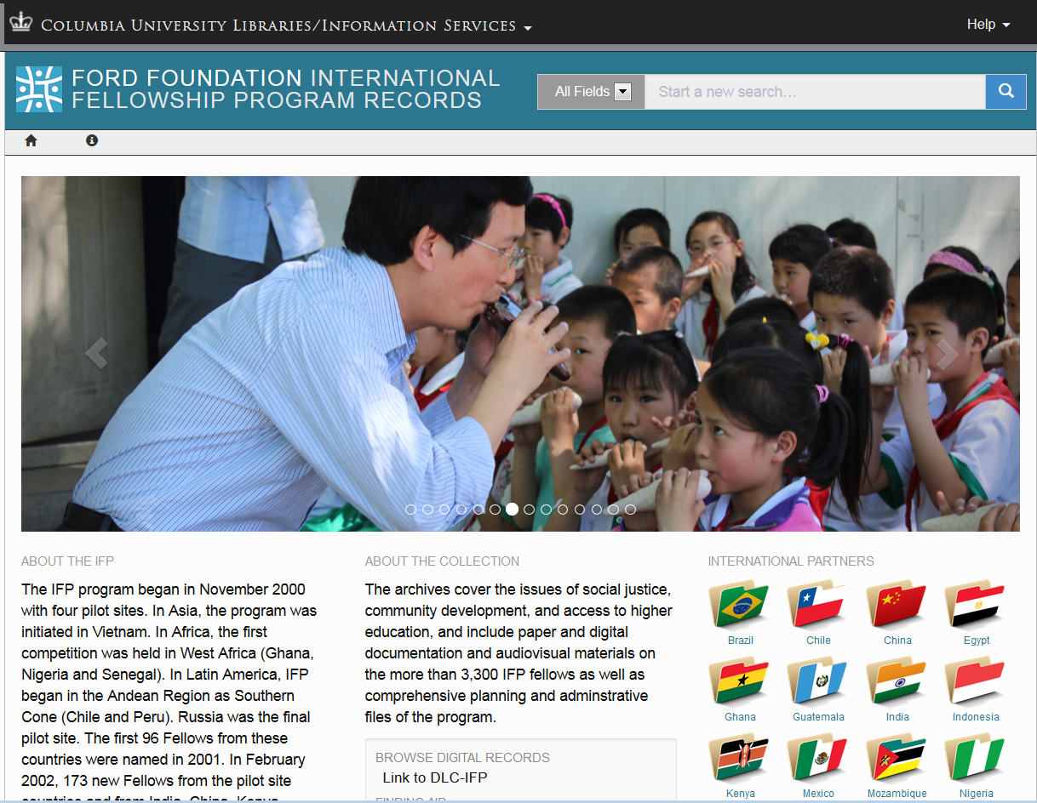
Quick demo of beta website

Slide 18
Thank you. Questions?

