Slide 1
Libraries Digital Program Division (LDPD)
Overview

Slide 2
LDPD Staff
Ben Armintor, Lead Programmer/Analyst
Robbie Blitz, Digital Projects Librarian
Terry Catapano, Special Collections Analyst
Fred Duby, Programmer/Analyst
Candice Kail, Web Services Librarian
Dmitri Laury, Senior Web Systems Manager
Eric O'Hanlon, Programmer / Analyst
Erik Ryerson, Web Designer / Developer
Dina Sokolova, Digital Preservation Librarian
(through 9/30/2016)
Stephen P. Davis, Director

Slide 3
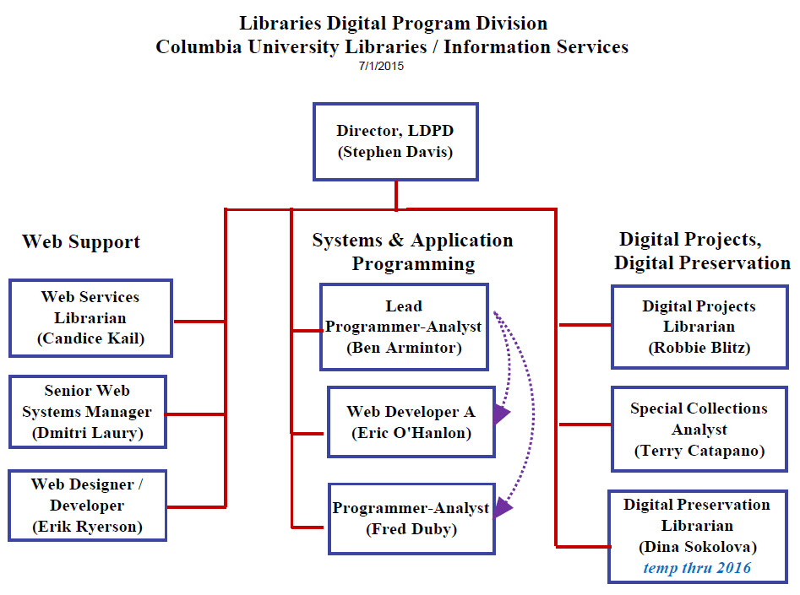

Slide 4
LDPD Task Areas

Slide 5
Support for Libraries’ Web Properties / Applications
Staff: Candice Kail, Dmitri Laury, Eric O’Hanlon (in part), Erik Ryerson (in part)
Content support LibraryWeb Behind the Scenes StaffWeb Alumni/Friends CUL Blogs CUL Wikis Usability / Assessment Staff Training Archives / Oral History Portal | Application support Adobe Enterprise Management CMS Wordpress LibGuides Aeon ProQuest/Serials Solutions Illiad Interlibrary Loan Library Hours application Bedework

Slide 6
Support for Digital Library /
Born-Digital Projects
Staff: Robbie Blitz, Fred Duby , Eric O’Hanlon (in part), Ben Armintor (in part), Terry Catapano (in part), Erik Ryerson (in part)
Content support Online Exhibitions Digital Library Collections Portal Collection Digitization Born-Digital Collections Web Archives | Application support Omeka Fedora Hydra Blacklight Hyacinth (Metadata Editor)

Slide 7
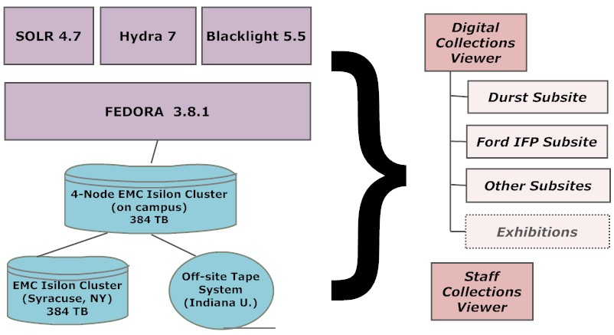
Consolidated Digital Collections Infrastructure

Slide 8
Support for Audio Visual Content
Staff: Dmitri Laury (in part), Erik Ryerson (in part), Dina Sokolova (in part)
Content support Digitized A/V Born-Digital A/V | Application support Wowza Streaming Media Server Media Elements Player Ffmpeg conversion software Avalon Media System (evaluation) Hyacinth (Metadata Editor)

Slide 9
Support for Digital Preservation
Staff: Dina Sokolova (in part), Terry Catapano (in part), Ben Armintor (in part)
Content support Digitized, born-digital & delivered-digital content Preservation Processing Preservation Metadata Asset Management | Application support FTK (Forensics Toolkit) Archivematica FRED (Forensic Recovery of Evidence) Fedora / Hydra / Blacklight Academic Preservation Trust Digital Preservation Network

Slide 10
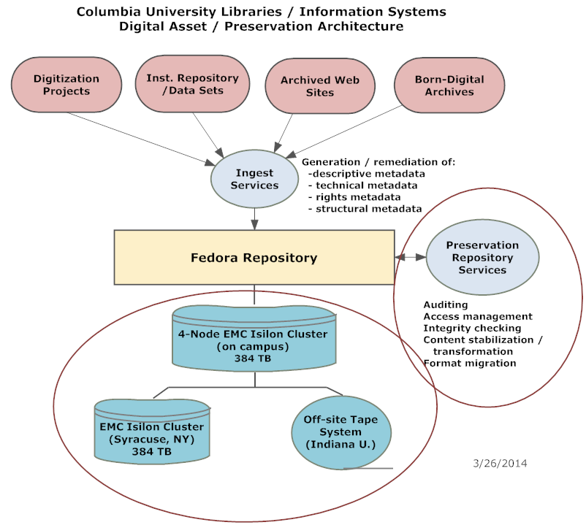
Consortial Solution?
Consortial Solution?

Slide 11
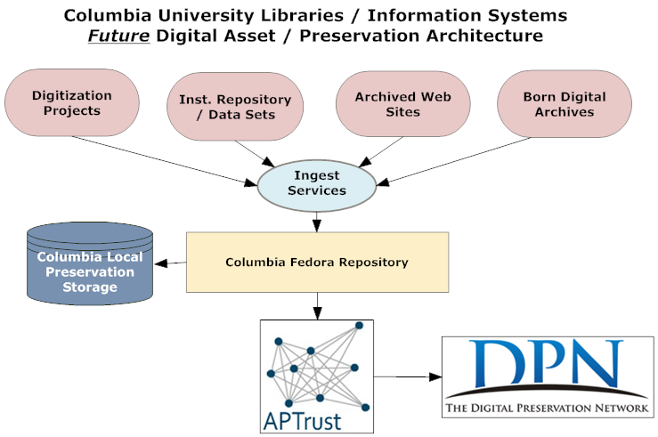

Slide 12
Support for CUL Center for
Digital Research and Scholarship
Staff: Ben Armintor (in part), Erik Ryerson (in part)
Fedora support for Academic Commons (ongoing) Academic Commons application support, emergency maintenance (2015) CIAO web design support (2015) Next generation Academic Commons support (Hydra, Sufia, 2016)

Slide 13
Areas of Strength
Talented and dedicated staff
Exceptional programming resources
Strategic internal / external collaborative initiatives
Strong relationships with LITO, Preservation, CDRS
Successful grantsmanship and grant-related capacity building

Slide 14
Gap Analysis
Digital Preservation Capacity (staff and storage funding)
A/V Expertise and Processing Capacity
Usability / Assessment Capacity
Training Capacity
Project Management Capacity
CUIT Support and Service

Slide 15
Pressure Points
Burgeoning born- and delivered-digital content acquisition by special and general collections
Proliferation of 3rd party software applications requiring support
Inadequate usability testing
Undefined need for Digital Humanities Support
Unpredictable and unprioritized inflow of unexpected new projects

