Slide 1
Columbia Digital Preservation Planning & Implementation
Status Report, August 2010

Slide 2
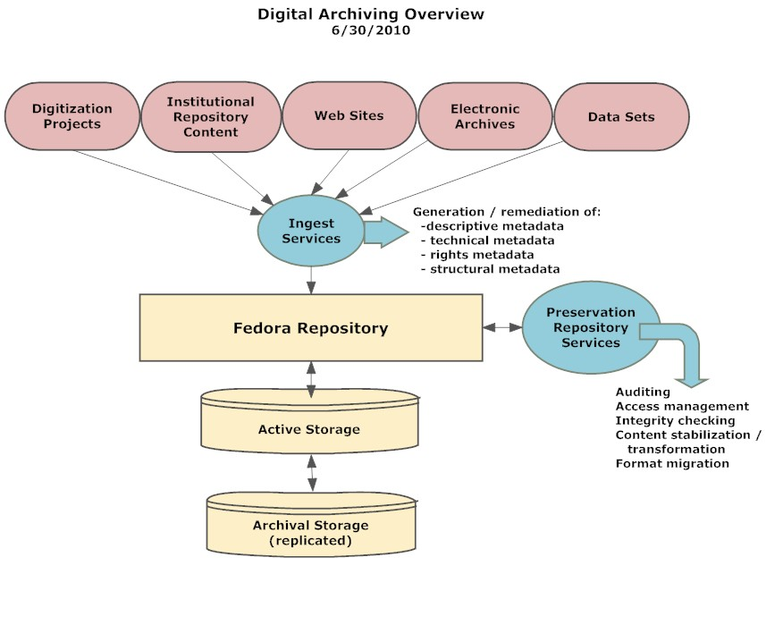

Slide 3
Populating Fedora
As of August 2010:
12 TB now in Fedora
8 TB staged on preservation storage system
25 TB in queue (in Dave Ortiz’s office)
Unknown amounts in University Archives, Avery, and Art Properties
Pilot video ingest project with CCNTML

Slide 4
Legacy Ingest
Tasks include:
Perform inventory- and file-level QC; upload to server
Generate MODS metadata from existing metadata when feasible
Apply basic structural metadata to multipart items

Slide 5
Ongoing Ingest
Currently beginning work on requirements for PRD input and workflow system front end to Fedora
Prioritize development of Hypatia metadata tool or develop custom application
Extend capacity from PRD to Avery and others.

Slide 6
Digital Preservation Services
Need to develop / implement Fedora preservation repository services:
Ingest auditing
Ingest and ongoing integrity checks
Content stabilization and transformation
Technical metadata generation
Rights and permissions framework

Slide 7
Access to Fedora
Staff Collection Viewer
Based on Blacklight open source software
Includes selected Fedora collections
Supports searching and browsing
Provides access to master file and derivative

Slide 8
CRL TRAC Certification
Certification as “Trusted Digital Repository”
Incrementally work towards this goal
Much of TRAC certification is organizational, not technical
Technical aspects will be boosted by Mellon Web Archiving Project programmer

Slide 9
Partnerships for Development
Will be doing ongoing information exchange / knowledge transfer with the Earth Institute’s CIESEN / SEDAC staff as well as with Cornell counterparts in the 2CUL framework
Will be communicating with digital preservation projects at other institutions
Join new LC “Digital Preservation Alliance”?

Slide 10
Staffing and Budget Requirements
Brand new programmatic area
Uncertain staffing requirements
Depends on scope and scaling of program
Will include support for Web and born digital archives as well as local digitization
Significant storage costs and maintenance
Will explore during 2010/2011

Slide 11
QUESTIONS?

