Slide 1
Carnegie Corporation of New York
The Digital Past and Future
Stephen Davis and Sean Quimby

Slide 2
First, some background
CCNY was founded in 1911 by Andrew Carnegie with an investment of $125 million “to promote the advancement and diffusion of knowledge and understanding.”
Over the years funding priorities have changed, but the core values have always included education and international peace.
Notable projects/grantees included library construction (1883-1929), TIAA Cref (1918), the Tuskegee Institute (1921), White House Fellows Program (1964), Sesame Street (1969), NPR (1970)
CCNY placed its corporate records with Columbia’s Rare Book & Manuscript Library in 1990 and funds a full-time archivist (Jennifer Comins) to process and provide access to them.
The archive continues to grow. At present, it comprises more than 1,000 linear feet. CCNY has moved to a paperless grants management system (Fluxx).
Notes:
During the last 18 years of his life, he gave away to charities, foundations, and universities about $350 million^{[3]} (in 2015 share of GDP, $78.6 billion) – almost 90 percent of his fortune.

Slide 3
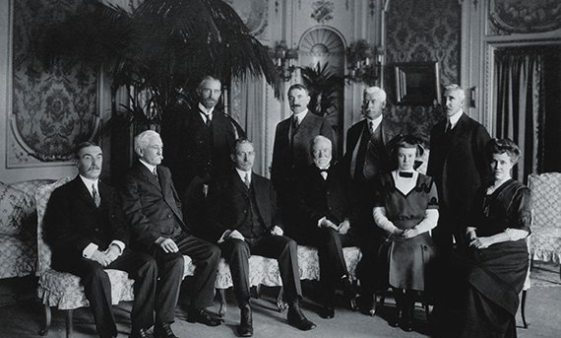
Andrew Carnegie, (seated, fourth from left), his daughter, Margaret, and wife, Louise, at the Corporation's first board meeting, November 10, 1911.

Slide 4
The CCNY records
The CCNY records include
  Administrative (Finance Committee, Staff & Trustee Files, Secretary’s Office)
  Microfilm (Gift & Grant files through 1950s)
  Grant Files (Correspondence, phone/in-person meeting notes, memoranda, reports)
  Special Initiatives (study-groups and taskforces)
  Material relating to Andrew Carnegie and other CCNY organizations (e.g. TIAA)
  Oral Histories (3 projects: 1966-70, 1996-2004, 2011-2013)
  Born-digital grant files, mostly promotional videos and exported data from Fluxx database.
  NYPL (1,000 documents relating to the NY public library system)

Slide 5
The Grant
$2.2 million over 3 years
To develop an online portal to the Corporation’s institutional records, from 1886 to the present.
Content will include digitized pre-1923 “paper” (ledger books, correspondence, reports, some 187,000 in total), time-based media (including 300+ oral histories), and digitized and born-digital content that we are receiving from CCNY (38 terabytes)
A “capacity building” grant:
  expand CUL’s capacity (i.e. storage) to preserve archival digital content,
  develop a module for the DLC viewer that provides for the delivery of oral history and other forms of time-based media,
  build rights management metadata into DLC, and
  to develop a mechanism for the ongoing ingest of born-digital content into our preservation repository.
Notes:
Gunnar Myrdal’s landmark study An American Dilemma: The Negro Problem and Modern Democracy, published in 1944.

Slide 6
The Project Team
Principal Investigator (Sean Quimby)
Project Manager (Eva Cunningham)
Steering Committee (Sean Quimby, Eva Cunningham, Stephen Davis, Janet Gertz, Jane Gorjevsky, Jennifer Comins)
Working Groups
  Oral History (David Olson, Ben Armintor, Robbie Blitz, Jane Gorjevsky, Eric O’Hanlon)
  Usability (Candice Kail, Stephen Davis)
  Rights Management (Rina Pantalony, Law School Intern, Trevor Reed)

Slide 7
The Technology Team
Ben Armintor – Programming Lead
Robbie Blitz – Metadata Coordination
Terry Catapano - Analyst
Fred Duby - Programming
Eric O’Hanlon - Programming
Candice Kail – Usability
Erik Ryerson - Design
Dina Sokolova – Digital Preservation / Asset Mgmt
PLUS … LITO, BSCDG, PDCD

Slide 8
The Glossary
Fedora – Columbia’s open source repository; currently includes 300,000+ files, 240+ TB
Hyacinth – Columbia’s metadata editing / management system
CUL LTA – Columbia’s Long Term Preservation Archive
DLC – Columbia’s Digital Library Collections portal & publishing platform
Oral Histories – Interviews that can include a textual transcript and an audio or video recording (or both)
OHMS – Oral History Metadata Synchronizer (from Doug Boyd, U. of Ky Libraries)

Slide 9
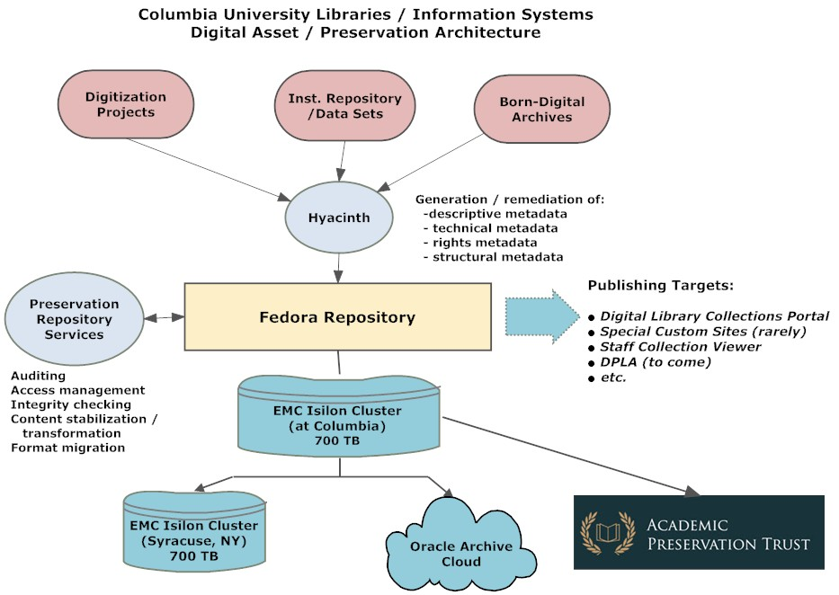

Slide 10
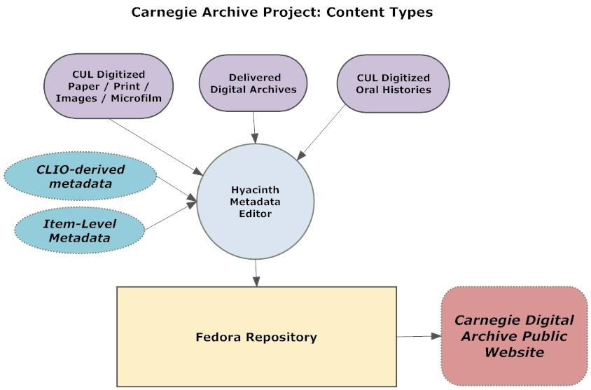

Slide 11
The Software
Outsourced / Collaborative Programming Development
Oral History Synchronizer module (OHMS-like)
Oral History Presentation module
Rights and Permissions module
All integrated within our Fedora/Hydra/Blacklight stack but able to be used by other institutions if desired.

Slide 12
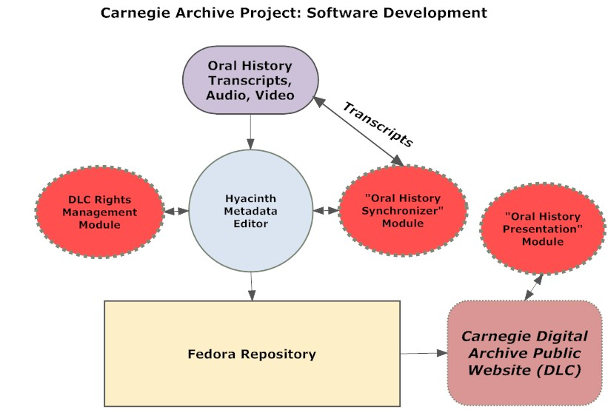

Slide 13
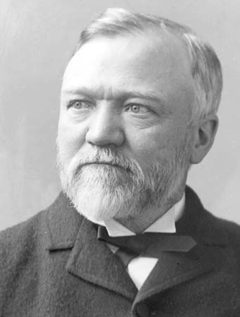
Thank you.

