Slide 1
Columbia University Libraries / Information Services
Stephen Davis, October 28, 2010
Digital Asset Management
Digital Preservation
Digital Publishing

Slide 2
Introductions
Stephen Paul Davis
Director, Libraries Digital Program,
Columbia University Libraries (2002-present)
Previously:
- Director, Library Systems Office, CUL
- Analyst, Network Development & MARC Standards Office, Library of Congress

Slide 3
Introductions
Columbia University Libraries / Information Services
  One of the top five academic research library systems in North America.
  The collections include over 10 million volumes, over 100,000 journals and serials, as well as extensive electronic resources, manuscripts, rare books, microforms, maps, graphic and audio-visual materials.
  The services and collections are organized into 22 libraries and various academic technology centers.
  The Libraries employs more than 470 professional and support staff. The website of the Libraries at www.columbia.edu/cu/lweb is the gateway to its services and resources.

Slide 4
Introductions
  LDPD: Libraries Digital Program Division
  PRES: Libraries Preservation and Digital Reformatting Division
  CDRS: Center for Digital Research and Scholarship
  CCNMTL: Center for New Media Teaching and Learning
  LITO: Libraries Information Technology Office

Slide 5
Key Issues
Why does a research library need digital asset management?
Which options are available?
What is Columbia University Libraries’ approach?

Slide 6
Why does a research library need digital asset management?

Slide 7
Research Libraries must:
. . . manage, preserve and provide access to unique digitized content created from their print, manuscript and multimedia collections
E.g.,
- papyri, medieval manuscripts, image and object collections, rare books and journals, archival collections, useful reference and curricular material

Slide 8
Research Libraries must:
  . . . collect and provide ongoing preservation of and access to University-generated content of all kinds (working papers, conference proceedings, theses, preprints, data sets)
E.g.,
Academic Commons (Columbia’ Institutional Repository)

Slide 9
Research Libraries must:
  . . . accept, process, preserve and provide access to born-digital personal and organizational archival collections (e.g., of authors, political figures, publishing houses, philanthropic organizations)
  E.g.,
  PricewaterhouseCoopers Records, 1891-2000

Slide 10
Research Libraries must:
  . . . harvest, preserve and provide ongoing access to significant and at-risk Web sites of potential value to scholars and researchers of the future
  E.g.,
  Columbia Human Rights Web Archive

Slide 11
Which options are available?

Slide 12
Options for Asset Management, Preservation & Access
  Commercial systems:
  Enterprise systems; focus on facilitation of content re-use within large organizations. Content is often marketing- or sales-related, e.g., product imagery, logos, marketing collateral or fonts
  or:
  Production asset management systems focused on managing assets as they are being created for digital media production (video game, 3D feature film, animation, visual effects shots, etc.); may include workflow features

Slide 13
Options for Asset Management, Preservation & Access
  Home-grown systems:
    Anything from basic “file system / file naming” techniques, to locally-developed database applications

Slide 14
Options for Asset Management, Preservation & Access
  Open Source Systems:
  ResourceSpace
  Razuna
  EnterMedia
  Notre DAM
  Etc.
  Fedora . . .

Slide 15
Fedora Commons Repository Software
Fedora provides a repository system and robust application development platform for:
  Digital asset management
  Digital asset ‘curation’
  Long-term digital preservation
  Controlled access to digital assets and collections

Slide 16
Fedora Commons Repository Software
  Store all types of content and its metadata
  Scale to millions of objects
  Access data via Web APIs (REST/SOAP)
  Provide RDF search (SPARQL)
  Rebuilder Utility (for disaster recovery and data migration)
  Entire repository can be rebuilt from digital object and content files.
  Content Model Architecture (define "types" of objects by content)
  Many storage options (database and file systems)
  JMS messaging (your apps can "listen" to repository events)
  Web-based Administrator GUI (low-level object editing)
  OAI-PMH Provider Service
  GSearch (fulltext) Search Service
  Multiple, customer driven front-ends

Slide 17
Fedora Commons Repository Software
  Robust open-source development community
  Supported by Duraspace consortium & several funding agencies
  Broad adoption within higher education (see User Registry)
  Columbia is a “gold” member of the Duraspace and one of our programmers is a Fedora “committer”

Slide 18
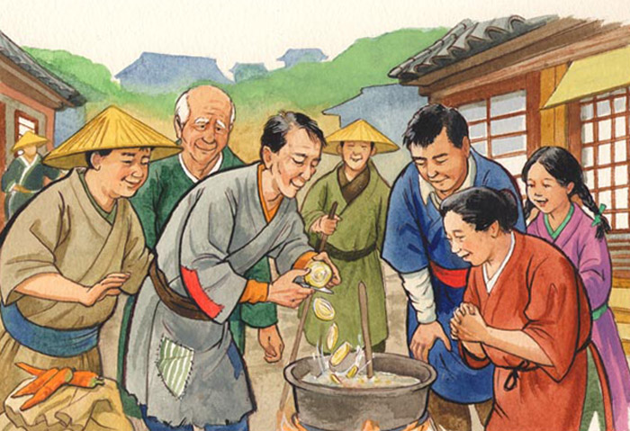
Stone Soup

Slide 19
What IS Columbia’s approach?

Slide 20
Columbia’s Approach
  Began Fedora implementation in 2008
  Released “Academic Commons” in 2009
  Began ingest of legacy data in 2010
  Implement “Staff Collection Viewer” in 2010
  Implement “Preservation Repository Functionality” 2011
  Really “just the beginning”

Slide 21
Columbia’s Approach
Digital Archiving Overview
http://www.columbia.edu/cu/libraries/inside/projects/digital_pres/lta/preservation_asset_overview.pdf

Slide 22
Columbia’s Approach
    Digital Library Content Management & Publishing
    http://www.columbia.edu/cu/libraries/inside/projects/fedora/new/fedora_inputs_outputs1.pdf

Slide 23
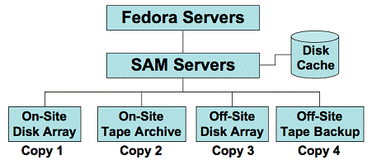
Columbia’s Approach
Columbia’s Long-Term Preservation Plan
Preservation Storage Infrastructure

Slide 24
Columbia’s Approach
Repository Tools
Metadata creation & editing tool (Hypatia)
Staff Collection Viewer
Command line admin tools

Slide 25
Columbia’s Approach
Fedora Repository Content
Digital Resources (all formats)
Object Relationship Information
Metadata types: descriptive, technical, structural, administrative & rights
Metadata formats: MODS, PREMIS, MIX, PBCore, etc.

Slide 26
Columbia’s Approach
Fedora Repository Content - 2
ca. 180,000 objects ingested or staged for ingest
ca. 50 TB
ca. 95 different projects / collections

Slide 27
Columbia’s Approach
Future CUL Fedora Developments
Columbia public collections viewer
Website preservation functionality
Digitization workflow-management tools
Scientific data set ingest and curation
Many new content projects & collections

Slide 28
Now You Know
Why a research library needs digital asset management
Which options are available
What Columbia University Libraries’ current approach is

Slide 29
QUESTIONS?
daviss@columbia.edu

