Slide 1
Human Rights Web Archive Portal – Technical Summary
Columbia University Libraries

Slide 2
HRWA Statistics, through July 31, 2012
ca. 500 web sites
26 million pages / documents
HTML pages = 24.5 million
Document files (e.g., doc) = .5 million
PDFs = . 5 million
XML = 100,000
Presentations (e.g., ppt) = ca. 1,800
Spreadsheets (e.g., xls) = ca. 700
ca. 65 languages

Slide 3
HRWA Relevant Tech Terms
Archive-It – IA’s web archiving service
SOLR (Lucene) – indexing tool
Blacklight – Discovery Interface for SOLR
MySQL – used as an intermediate index db
WARC (Web Archive Format) – web storage
Fedora – Columbia’s preservation repository

Slide 4
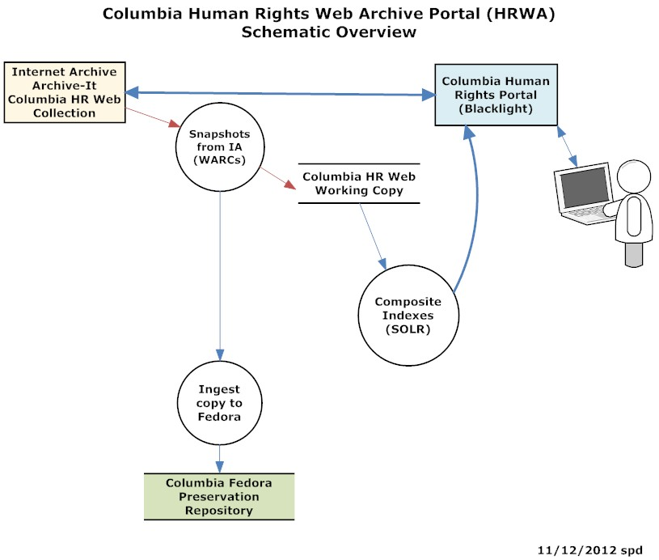

Slide 5
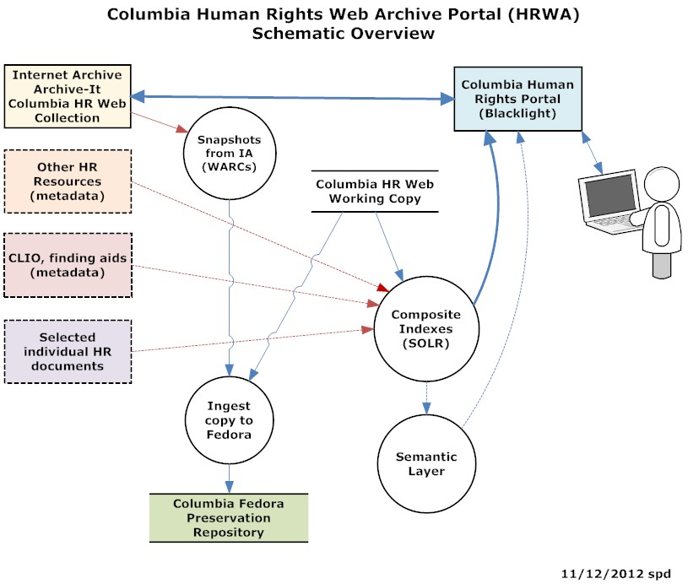

Slide 6
HRWA Challenges
Most challenging and innovative LDPD project to date.
Most data in single project (ca. 2 TB)
Largest indexes
Greatest number of servers for indexing / production
Most complex data (WARC / Web)
Most challenging end-user design requirements
Most uncharted in terms of users, possible uses, possible value added features, scoping, etc.
Most cutting edge, most unanswered tech questions

Slide 7
HRWA More Information
CUL/IS Behind the Scenes page
CUL/IS Mellon Web Resources Wiki
Archive-It: Columbia’s Web Archive Collections
Columbia’s Human Rights Web Archive Portal

