Slide 1

Strategies and Resources for Evidence-Based Practice Education in Social Work: A Transdisciplinary View
Jennifer L. Bellamy, Ph.D., MSSW
Bonnie Spring, Ph.D., ABPP
Edward J. Mullen, DSW, MSW
Grant Support: NIH/OBSSR N01-LM-6-3512 (B. Spring)

Slide 2
Learning Objectives
Compare and contrast the transdisciplinary model of EBBP with more traditional EBM models
Locate teaching and training resources designed to support education and training on the EBBP.org website
Integrate EBBP resources and competencies into social work teaching and training.

Slide 3
Roadmap
EBBP Intro and Overview
Introduction to the EBBP.org website
Ideas for Integration into Social Work education
Discussion

Slide 4
EBBP Introduction & Overview

Slide 5
The Translation Challenge
Uptake of scientific discoveries into clinical practice: 14% after 17 years (Balas & Boren, 2000)
Only 15% of clinical practices based on evidence (IOM, 1985; Eddy 2005).

Slide 6
EBP in Social Work
CSWE Standards explicitly reference evidence-based interventions and evidence informed practice
Increasing demand for EBP from the field, funders, policy makers
Many social work educators have favorable views of EBP (Rubin & Parrish, 2007), but..

Slide 7
EBP in Social Work
Most schools do not require didactic training or clinical supervision in any evidence-supported psychotherapy (Bledsoe et al., 2007; Weissman et al. 2006)
Social work educators have an inconsistent understanding of EBP (Rubin & Parrish, 2007)

Slide 8

2008
2003
2002
1997
2008
2003

Slide 9
Council on Evidence-Based Behavioral Practice*
Council
Bonnie Spring, Ph.D.
Ross Brownson, PhD
Edward Mullen, MSW, DSW
Robin Newhouse, PhD, RN
Stephen Persell, M.D.,M.P.H.
Jason Satterfield, PhD
Coordinators:
Molly Ferguson, MPH
Stephanie Russell, MPH
Advisory Board
David Barlow, PhD
Larry Culpepper, MD, MPH
Gordon Guyatt, MD, MSc
Marsha Linehan, PhD
Ann McKibbon, MLS, PhD
Enola Proctor, MSW, PhD
Mary Jane Rotherman-Borus, PhD
Kathleen Stevens, RN, EdD
Steven Teutsch, MD, MPH
Myrna Weissman, MSW, PhD
*Supported by NIH OBSSR N01-LM-6-3512, Resources for Training in Evidence-Based Behavioral Practice
Notes:
9

Slide 10
Original EBM Model
“conscientious, explicit, judicious use of current best evidence in making decisions about the care of individual patients”
Sackett, Rosenberg, Gray, Haynes & Richardson (1996) Evidence-based medicine: what it is and what it isn’t. BMJ, 312, 71-72
Deemphasized intuitive, unsystematic clinical expertise
Emphasized research.

Slide 11
Toward a Transdisciplinary EBP Model
Incorporates each discipline’s most important advances
Grounded in ecological framework emphasizing shared decision-making
Integrates practical consideration about resources
Highlights decision-making as the process that balances evidence, client characteristics, and resources, all considered in context

Slide 12
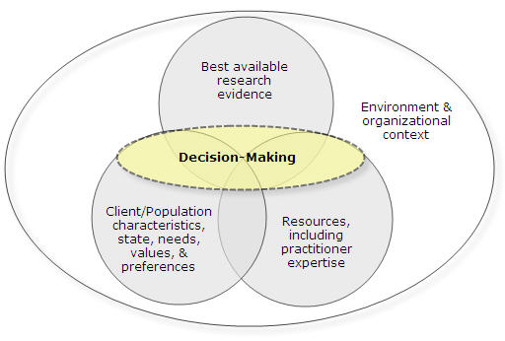
Transdisciplinary EBP Model
Satterfield, Spring, Brownson, Mullen, Newhouse, & Whitlock (2009) Toward a transdisciplinary model of evidene-based practice Milbank Quarterly, 87(2): 368–390.
Notes:
12

Slide 13




Introduction to the EBBP.org website
Web Tour & Training Resources

Slide 14

www.ebbp.org
Notes:
14

Slide 15


Slide 16
Training Modules
Registration is quick and free of charge
Continuing Education credits for social work (soon?)
Each module takes between 20-90 minutes
Audio and visual style learning
The modules are interactive in nature
  Quiz style reviews of key points
  Case studies and examples
  Embedded links to online sources, practice guidelines and other examples

Slide 17
EBBP Process Module
Addresses common misconceptions about EBP
Describes the purpose of EBBP
Discusses the five steps of the EBBP process
Uses a smoking cessation case and a community smoking prevention example

Slide 18
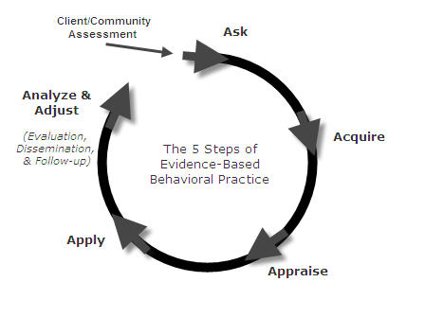
The 5 Steps of Evidence-Based Practice

Slide 19
EBP Process Module
Pre-work: Assess
Step 1: Ask Background and foreground questions
  Background: general knowledge about a condition rather than a specific case
  Foreground: specific choices about action options fit to the context of resources and client characteristics (PICO)
Hierarchy of evidence

Slide 20
Example from EBBP.org
Prioritize assessment questions to use time well
Sequence your next steps after meeting with the client

Slide 21
Step 2: Acquire Evidence
  2. Acquire the best available evidence to answer the question
    Introduced in the EBBP Process Module
    Detailed in Searching for Evidence Module

Slide 22
Searching for Evidence Module
Lead by a Medical Librarian
Types of Evidence
Types of EBBP Resources
Choosing a Resource (database)
Searching Techniques and Strategies
Augmenting Your Search
Reviewing and Revising
Documenting

Slide 23
Step 3: Appraise
  3. Appraise the evidence critically for validity and applicability to the problem at hand
    Introduced in the EBBP Process Module
    Detailed in the Critical Appraisal, RCT, and Systematic Reviews Modules

Slide 24
Critical Appraisal Module
Focus on studies that answer questions about whether or not an intervention works
  Controlled Trials
  Time Series
  Systematic Reviews
Review of the key study elements
  Sample Selection
  Group Assignment
  Data Collection
  Etc.
Evaluation of Internal and External Validity

Slide 25
Randomized Controlled Trials Module
Definition
Design and conducts of RCTs
Behavior scientist practitioners engagement in RCTs via:
  Design and conduct of RCTs
  Appraising and integrating RCT evidence
  Applying RCT knowledge in teaching and practice

Slide 26
Introduction to Systematic Reviews Module
Definition and overview
Differences between systematic reviews and traditional narrative reviews
Steps for conducting and evaluating a systematic review
Where systematic reviews fit in the EBBP process

Slide 27
Step 4: Apply
  4. Apply the evidence and implement the practice by engaging in shared decision-making that integrates research, client characteristics and resources in context
      Introduced in the EBBP Process Module
      Detailed in the Shared Decision Making Modules

Slide 28
Shared Decision Making with Individuals Module
Rationale for shared decision making
Evaluate how expertise and resources influence intervention options
Engage the client in intervention selection
Locate resources and update skills by learning interventions
Barriers and discrepancies between client preferences, resources and scientific evidence

Slide 29
Collaborative Decision Making with Communities Module
Similar steps as the collaborative decision making with individuals
Special consideration to community level issues
  Engage community in collaboration from the outset
  Implement an ongoing evaluation of the utilization and impact of the intervention
  Provide regular feedback on the results of the ongoing evaluation to the community, funder, and collaborating organizations

Slide 30
Shared Decision Making Module Example from EBBP.org
Leigh Foster First Consultation (Group option) – individual therapy vs. lay support group

Slide 31
Step 5: Analyze & Adjust
  5. Analyze the new health practice and Adjust practice. Evaluate outcomes, continue or adjust course, disseminate results, identify new needs
    Introduced in the EBBP Process Module
    Revisited in the Shared Decision Making Modules
Notes:
31

Slide 32
EBBP Teaching Examples
Professional Development for Practitioners and Continuing Education for Field Instructors
Integration into Curriculum in:
  Practice related courses
  Research
Consider anchoring the conceptual basis and basic competency in a current, pressing clinical need
Current implementation EBBP.org modules in schools of social work
  Seeking student evaluation and feedback regarding modules and the learning objectives
  Two examples

Slide 33
Strategies Being Implemented in Schools of Social Work
Integration of EBBP.org modules into an Advanced Clinical Social Work Research Course
  Replacement of standard textbook readings of EBBP.org Modules
  Supplements to traditional readings on EBP, particularly related to shared decision making
  Reinforcement of more challenging concepts (particularly evaluation of the quality of research)

Slide 34
Strategies Being Implemented in Schools of Social Work
Integration of EBBP.org modules into an Adult Psychopathology and Wellness class
  Integration of the EBP process module as an introduction to EBP
  Paired with Drake et al.’s Evidence Based Mental Health Practice Text readings on EBP and clinical decision making

Slide 35

EBBP Call to Action and Discussion
Where can you integrate the EBBP.org resources into your teaching?
What other supports or training would you like to see to support your use of EBBP.org in social work education?

