Slide 1
An Overview of Adolescence
Betsy Pfeffer MD
Assistant Clinical Professor Pediatrics
Morgan Stanley Children’s Hospital of New York Presbyterian
Columbia University

Slide 2
Overview of Adolescence Through the Ages

Slide 3
What is Adolescence ?
“The state of growing up from childhood to manhood or womanhood . . . The period of life between puberty and maturity . . . ” Random House Dictionary

Slide 4
What is Adolescence ?
In the classical world Aristotle (384-322 BC) recorded what is known as adolescent physical development but there were only three stages of life: childhood, youth and old age
In the Renaissance, children stayed in school longer but adolescence was still not defined as a separate stage

Slide 5
What is Adolescence ?
Globally, traditional societies have observed rites of passage signifying the emergence of young people from childhood to adulthood, no concept of adolescence intervened between stages

Slide 6
.What is Adolescence ?
Non-western societies had no defined stage of adolescence, but the period between childhood and adulthood often included unique
Visual markers (clothing, hairstyle, body decoration)
Pastimes like games/dancing,
Carnivals and festivals created by adults to help manage the sexual tension of this age group and to help socialize youth into the conscience of the community
In non-western societies this period between childhood and adulthood is typically 2-4 years
Notes:
Anthropologists who have worked with primitive tribes show that in such societies children can pass directly from childhood into adulthood, without going through an adolescence phase. This happens because preparation for adulthood in such settings presents few of the social, intellectual, or moral challenges that are common to advanced societies. We have personally witnessed the social/intellectual phenomenon in primitive settings. Many of the skills needed to participate in the adult community-for example, fishing, hunting, and crop planting-are actually gained before the onset of puberty. Primitive simplicity does not move children into adulthood earlier, but brings adult status closer in age to childhood. Parenting with Gary & Anne Marie: Adolescence / Teenagers The Reality of Adolescence

Slide 7
What is Adolescence ?
In contemporary western societies, the period of adolescence lasts between 10-15 years
A youth culture developed in the mid 1900s
The term teenager was coined in the 1940’s and was the recognition that the adolescent group was a distinct market segment with its own behavior, tastes and opinions

Slide 8
.Perceptions of the Period between Childhood and Adulthood Through the Ages = Trouble
In the 4th century BC, Aristotle stated “Youth are heated by nature as drunken men by wine”
According to the English poet and playwright William Shakespeare (1564-1616),
“I would be there no age between ten and three and twenty, or that youth would sleep out the rest: for there is nothing in the between but getting wenches with child, wronging the ancientry, stealing, fighting” The Winters Tale
Notes:
17th and 18th century America Protestant Puritans expected obedience from adolescents, “ If any child over the age of 16 and of sufficient understanding shall curse or smite their natural father or mother, they shall be put to death…”

Slide 9
.Perceptions of the Period between Childhood and Adulthood Through the Ages = Trouble
In 1904, G. Stanley Hall, the American Psychologist and father of adolescent research defined adolescence as a stage of its own and a time of storm and stress
1960s and 1970s: attempts to understand adolescent problems as due to “raging hormones”
Notes:
It appears that the effects of hormones on most measures of and behavior are quite small. The notion that hormones produce all problems from mood swings to acne is an over statement of their power. Hormones changes of adolescence are not raging but, in fact, gradual and are primarily involved in the regulation of physiologic systems
In the 1960s teens depicted as highly rebellious but presently many teens show commitment to volunteering in community and social causes

Slide 10
.Today’s Perceptions of the Period between Childhood and Adulthood =Opportunity
Although initially viewed as a time of turmoil, large scale studies have shown that most teens progress through this period of life without obvious behavior problems
Notes:
Knowledge of adolescent development has expanded significantly though science-really began in the 1900’s
Current research, however, has reexamined adolescent moods and behaviors and does not tend to support a pervasive rebellious characterization of the typical adolescent, nor does it support storm and stress as universal and inevitable (Arnett, 1999; Buchanan, Eccles, & Becker, 1992; Laurson, Coy, & Collins, 1998). Instead, low to moderate levels of conflictual behavior, moodiness, and risk-taking have been found to be more normative outcomes of the transitions of adolescence. Parents' and teachers' perceptions of adolescent storm and stress: relations with parenting and teaching styles
Culture and Adolescent Development Chen

Slide 11
Adolescence Today
Increasingly young people are becoming recognized as key participants in decision-making and development of organizations
Adolescents contribute to society in countless, influential ways
They publish newspapers and magazines
Run businesses
Serve as leaders in schools and communities
Some manage households; some care for younger siblings or ailing parents
Bursting with vitality, curiosity and spirit, young people have the potential to help advance the world
Notes:
UNICEF Adolescents contribute to society in countless, influential ways. They publish newspapers and magazines, run businesses, and serve as leaders in schools and communities. Some manage households; some care for younger siblings or ailing parents. Many work long days in factories and in fields.
They can educate their peers about life's challenges and the dangers of high-risk behaviours: about protecting themselves from diseases such as HIV/AIDS, for example. They can help others like themselves break cycles of violence and discrimination.

Slide 12
.The Health Paradox of Adolescence
Childhood to Adolescence
Improved strength, speed, reaction time, mental reasoning abilities
Increased resistance to cold, heat, hunger, dehydration, immune function
However …..
Notes:
In almost every measurable domain, adolescence is a developmental period of strength and resilience
Ronald Dahl Adolescent Brain Development a period of vulnerabilities and opportunities Keynote address RE Dahl - Ann. NY Acad. Sci, 2004 - pmbcii.psy.cmu.edu

Slide 13
The Health Paradox of Adolescence
Overall morbidity and mortality rates increase 200-300% from childhood to late adolescence
Injury and violence are the leading causes of death
Notes:
RE Dahl - Ann. NY Acad. Sci, 2004 - pmbcii.psy.cmu.edu
Professor of peds and psych at the unjiversity of Pittsburgh
He has published extensively on adolescent development, sleep disorders, and behavioral/emotional health in children.

Slide 14
.Adolescent Behavior
It is not their fault!
Puberty and motivation and emotion linked to “igniting passions” in the developing brain, development of the limbic system Dahl 2003
Skills of self regulation involving neurobehavioral systems in the pre-frontal cortex develop later National Institute of Mental Health
Cognitive development correlates with age and experience, not puberty Dahl 2003
Notes:
Connect misconception of ragging hormones to current knowledge of brain maturation
Teens have a proclivity toward high intensity feels, an appetite for adventure, a predilection for risks, desires for novelty. Studies of sensation seeking reveal a developmental increase that is linked to puberty. In some teens this tendency is subtle , in others outrageous (even in intelligent youth). These emotional and motivational changes at puberty don’t lead solely to bad outcomes. Effortful struggles to achieve challenging and heartfelt goals can also ignite high intensity feelings. Igniting passions in healthy ways in the service of higher good. Passions for ideas and ideals, passions for beauty. Passions to create art and music. Passions to succeed in sports, bussiness, politics. Passion for that one person, activity, object or pursuit that inspires transcendent feelings. Ronald Dahl Beyond Raging Hormones 2003

Slide 15
The Modern Category of Adolescence as a Product of Social and Cultural Change

Slide 16
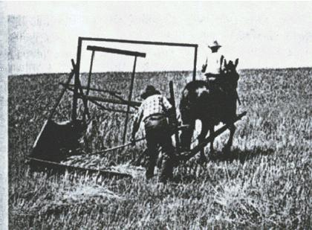
Pre-Industrial Society
In the pre-industrial world
Young people are in a state of semi-dependence and are viewed as economic assets to the family
Youth learn early and by example the function they are to perform later in life
Notes:
17th and 18th centuries Children worked alongside adults and many of the recreational activities took place in full view of the community where they were under adult surveillance and they knew they were being judged as the fellow citizens that they would be in a few years so in this way, adolescence wasn’t a self contained phase.
Pre Industrial world—hunting/farming after industrial revolution people leave family unit to be independent.

Slide 17
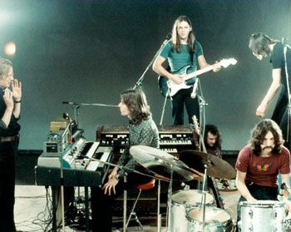
Transition to an Industrial Society
With transitions to an industrial-capitalist economy social and cultural changes emerge
In the US and Europe this began in the nineteenth century and intensified in the twentieth century

Slide 18
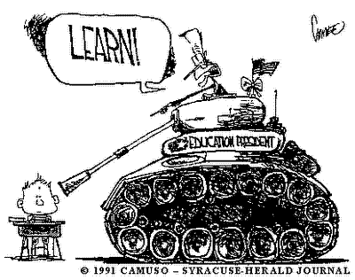
What are the Changes?
Industrialization and urbanization creates
Movement to cities
Exposure to cultural diversity
Dilution of traditional values
Progressive reforms bring adolescents together
Compulsory education
Legislation against child
labor
Notes:
In US 1890 6.7% 14-17 yr olds in school, 1920 32.2%, 1930 over 50% 1940 75% enrolled 50% graduating In 2006, 3.3 million
people, or 11 percent of people aged 18 to 24, were high school dropouts
1938 in the US federal regulation of child labor minimum age of employment and working hours for children.
Uganda’s 1995 Constitution (Article 34) defines a child as a person under 16 years of age, and states that children have the right to be protected from social and economic exploitation. The Constitution further states that children should not be employed in work that is “likely to be hazardous,” or work that would otherwise endanger their health, their physical, mental, spiritual, moral, or social development, or that would interfere with their education.

Slide 19
Post Industrialization
Cultural adaptation occurs allowing for societal growth and development
The middle class family strengthens
A private realm with less ties to the community and other adults
Adolescents are concentrated in schools and youth friendly centers
Increased value is placed on individual choice and initiative versus inherited status and prescribed roles
Identity formation

Slide 20
.Post Industrialization
By the mid 1900s, in the United States and Europe, a youth culture defined by distinct styles, behaviors and interests emerges
Peer groups become central to the youth culture
Many parents both begin working out of the home so teens are spending less time with parents and more time with peers
Peer groups become key in helping an individual develop identity
Prolonged dependence on parents leads to closer and more emotionally charged interactions
Notes:
Adolescent thirst to win peer approval helps them internalize and conform to group standards which mostly keeps adolescents “in line”
Taking adolescence out of the work place, place them in schools eliminating economic opportunities for independence
Post industrial teens not economic assets actually economic burdens
Smetana and Gaines (1999) summarized the views of many researchers by noting that parent-adolescent conflicts are common, but they are usually over mundane issues and rarely reach levels that could be construed as severe.

Slide 21
.Adolescent Rebellion
Leading theorists of adolescence note that
With cultural growth and change, the past is no longer an adequate guide for the future and children can’t look to their parents for guidance about adult roles
Rejection of parental values and allegiance with the views of the peer group are vital components of adolescents’ progress to adulthood
The ability to move beyond the values and ideas of one’s parents and to adapt to changing social and political conditions is essential to the progress of society
Notes:
In stable societies w/o change parental/adult role modeling is what is most important for perpetuation of the society values and culture
Leading Theorists include:
Eric Erikson, mid-twentieth century Danish-German-American developmental psychologist and Erik Ericson is the most influence theorist of emotional development
He looked at adolescence as a period of identity formation and separation from adult caregivers
Lawrence Frank, the most prominent figure in the parent education movement in the US in the 1920s
Children must, to some extent, relinquish parental beliefs and practices and learn the ideas, techniques, and patterns of conduct of their own generation
Parents should encourage rather than discourage adolescent rebellion and help adolescents adapt to the future rather than forcing them to only recapitulate any antiquated traditions of the past
Margaret Mead (1901-1978), an American cultural anthropologist With cultural growth and change, the past is no longer an adequate guide for the future and children can’t look to their parents for guidance about adult roles
The adolescent is in the process of freeing the self from dependency on parents and turns to models in mass media and to the peer group for guidance
That tolerant families produce wholesome individuals by allowing the adolescent to disagree with parents without loss of love, self respect or an increase of emotional tension
Do you think this is true for your culture
Has is changed over time

Slide 22
Western Youth Culture Developed…….Then it Spread
Migration via
Mass media
Rapid travel and mobility
Other technological developments expand direct communication and permits unlimited opportunity for youth expression and connection
“Rock music” shows up in remote villages throughout the world
Notes:
Rock music represents youth interests
Mass media has a major roll in socializing teens versus in traditional cultures where socializing by example predominated

Slide 23
What Adolescent Culture Helps Resolve
Who am I? Where am I going? Who am I to become?
As these questions get answered a commitment to a system of values grows and the capacity for intimacy and adult maturity is achieved
Formation of a healthy and stable self with a strong identity
Notes:
including a philosophy of life, religious beliefs, vocational goals

Slide 24
“Who am I?”
This is a very difficult question to answer!
Healthy to challenge one’s self and learn one’s own limit
Your identity has many aspects
Values
Romance
Religion
Politics
Occupation

Slide 25
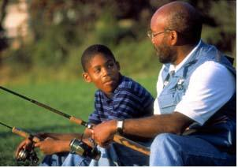
How do Teens Answer the Question, “Who am I?”
Some do follow in their parents’ footsteps with little obvious signs of rebellion
Notes:
Army, medicine, family business, take up family’s religion, politics, etc.
--very easy on the parents because the teens don’t make trouble
--this is TOTALLY NORMAL and can lead to a very happy teen who can grow up into a very happy adult

Slide 26
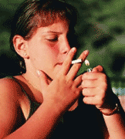
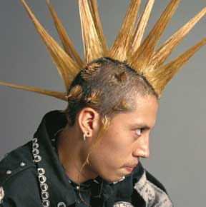
How do Teens Answer the Question, “Who am I?”
Some teens develop a “negative identity.”
Rebel against their parents in every way
Always doing the opposite of what their parents want
Notes:
Modern adolescents are oriented toward each other, relatively little orientation toward adults
It is expected that teens will want to rebel against their parents.
The luxury of secondary and university education permit this exploration

Slide 27
.But it is hard to be a teenager . . .
It can be painful to ask questions such as “Who Am I?”
Physical changes
Conflicts with parents, friends, schoolmates
Identity crises
Peer pressure
Notes:
It is a time of mood disruption in all cultures albeit much less in traditional cultures

Slide 28
The Journey from Childhood to Adulthood Today
Requires successful completion of adolescent physical, psychological, social and cognitive development
Healthy to have answers to the question “who am I?” by age 24 or 25
Getting to this point may be very difficult and requires
Questioning parental/societal views
Development of personal ideas, self worth, self efficacy and social competence

Slide 29
Support of the Modern Adolescent : Parents/Guardians Play a Key Role
Parents /authority figures are major participants in healthy adolescent development
Demonstrating acceptance of the adolescent
Understanding the teens are likely to accept and promulgate parental values after going through periods of rebellion and rejection

Slide 30
Parents/Guardians Play a Key Role
Research has shown that most young people share the deeper values of their parents
Role models/Setting examples
Parental warmth has a universal association with psychosocial well being
Notes:
Research has shown that young people share the deeper values of their parents Culture and adolescent development Friedman 1999
Do as I say, not as I do

Slide 31
.The Modern Adolescent
If a culture endorses the developmental goals of autonomy, individuation and independence then, it is helpful for all adults to
Understand and accept what is normative adolescent development and behavior (adolescent rebellion, risk taking, healthy identification with peer groups, youth culture)
Interact non-judgmentally
Support normal adolescent separation/individuation
Act as respectful mentors/advisors to teens
Notes:
Non-judgmental: does not mean that anything goes, it means identifying potential problems while showing acceptance of the adolescent as a person

Slide 32
Separation and Individuation
May not be a primary development goal in all cultures
In some cultures, interdependency and defining oneself as a member of a group is more valued than individuality
Often cultures embrace both individuality and interdependence

Slide 33
Non-Western Cultures
The result of the influence of western culture is the homogenization of cultural norms
Societal structures based on respect for authority are being threatened and strong inter-generational bonds are being weakened

Slide 34
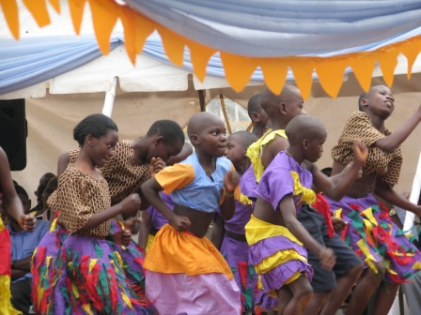
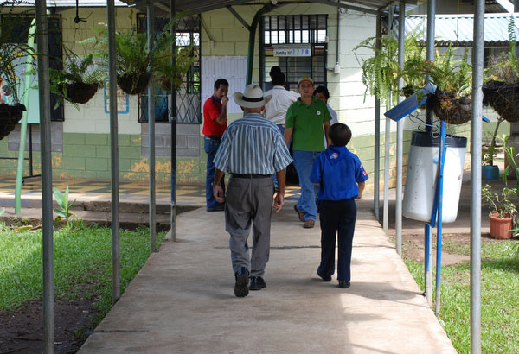
Non-Western Cultures
Re-assess how the wisdom of older generations and cultural traditions can augment, and not hinder, the growing needs of the newer independent youth culture
Notes:
During the past 150 years, more time w/ age mates less adult protection adolescence is a social and economic holding pattern
Rolelessness and loss of purpose only important role for a teen is as a student, no meaningful work roles
Pseudomaturity and heightened risk – no access to legitimate adult roles, can pursue adolescent activities
Today’s adolescents are less supervised and protected by adults, anticipate adulthood from a distance thru TV, film not firsthand and are tempted to experiment in some aspects of adulthood often the least imp things and the most dangerous
At a point, not long ago, adolescence was a time, w/ the help of adults who had genuine interest in their socialization, were gradually prepared for work and family roles. The status and purpose of adolescence was clear-adolescence, a time of semi-autonomy, of gradual transition of PREPARATION w/in the context of a protective network of relationships w/ immediate and extended family , adults in the community. Pathways other than schooling were available

Slide 35
The Birth of Adolescent Medicine

Slide 36
.A Doctor of Their Own
Adolescent Medicine had its origins in England in the 19th century physicians caring for boys in boarding schools joined together organizing the Medical Officers of Schools Association
American medical interest in adolescents began in college health in 1860 at Amherst College in Massachusetts
J.R. Gallagher MD, the father of adolescent medicine in the United States, developed the first adolescent clinic in 1951 at Boston Children’s Hospital
Notes:
Gallagher recognized the needs of the contemporary adolescent and modeled his unit based on these needs
Fostering independence to help build confidence
Normalizing adolescent rebellion and ensuring parents that it was natural and proper to rebel
Rejection of parental values and identification with those of the peer group as essential to normal adolescent development

Slide 37
A Doctor of Their Own
Dr. Gallagher recognized the benefits of a confidential relationship with a physician whom they consider to be their own
Leads to the adolescent taking responsibility for his/her own recovery
Promotes sharing information
For the adolescent who engages in high risk behaviors, there is a greater change of accessing heath care if confidentiality is assured
Notes:
Gallagher concluded that “ to protect adolescents and thwart their attempts to develop independence, is to rob them of abilities, confidence, and resiliency they must have in the demanding and unpredictable adult world they face.”

Slide 38
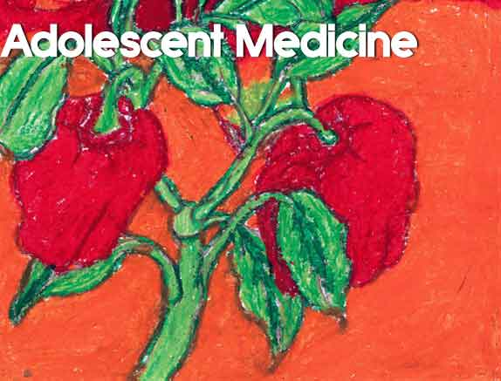
A Doctor of Their Own
This clinic served as a model for other adolescent programs growing in the US
The Society of Adolescent Medicine was established in 1968
In the 1970’s adolescent medicine was incorporated into pediatric education
Notes:
Problems seen in Gallagher’s clinic
School problems
Smoking
Drinking
Conflicts with parents
Strange hair, clothing
Emotional and behavior problems

Slide 39
Adolescent Medicine Today
Adolescents face similar problems worldwide
Accidents, homicide, suicide, depression, anxiety, sexually transmitted infections, early sexual debut and unwanted pregnancies, reckless behavior, drug alcohol and cigarette use
Value of individual autonomy
Underlie the contemporary promotion of adolescent health globally
Lends itself to reinforcement of youth culture
Notes:
Value of individual autonomy Culture and Adolescent Development Friedman
Cultures differ with respect to what they may value most and what they expect from their adolescent children of each sex

Slide 40
Adolescent Medicine Today
We live in a global society and must keep cultural differences in mind, cultural sensitivity is vital to successful interaction with the adolescent population

Slide 41
The Adolescent Climate Worldwide

Slide 42
Adolescents Worldwide
The twentieth century began with 1.6 billion people
Currently there are 1.2 billion adolescents age 10-19, more than 20% of the world’s population
50% of the world’s population is under the age of 25
85% of adolescents live in the developing world, Sub-Saharan Africa is home to about 16%

Slide 43
WHO Facts
Nearly 16 million girls aged 15 - 19 give birth annually to 11% of all births worldwide, mostly in developing countries
At least 20% of young people will experience some form of mental illness
Notes:
such as depression, mood disturbances, substance abuse, suicidal behaviours or eating disorders

Slide 44
WHO Facts
Young people aged 15-24 accounted for an estimated 45% of new HIV infections worldwide in 2007
The majority of tobacco users worldwide begin during adolescence. Today more than 150 million adolescents use tobacco
Harmful drinking among young people reduces self-control and increases risky behaviors

Slide 45
WHO Facts
Unintentional injuries are a leading cause of death and disability in adolescents
Among 15-19 year olds, suicide is the second leading cause of death , followed by violence in the community and family
Notes:
Source:http://www.who.int/features/factfiles/adolescent_health/facts/en/index9.html
AMSTAR Suicide is the second leading cause of death in industrialized countries and the 5th globally

Slide 46
WHO Facts
“ One in every five people in the world is an adolescent, and 85% of them live in developing countries. Nearly two thirds of premature deaths and one third of the total disease burden in adults are associated with conditions or behaviours that began in youth, including tobacco use, a lack of physical activity, unprotected sex or exposure to violence.” WHO

Slide 47
Status of Youth in Uganda
In 2003, the Ugandan Global School-Based Student Health Survey (GSHS) was conducted among students age 13-15 yrs from 50 schools to measure behaviors and protective factors related to the leading causes of morbidity and mortality in Ugandan youth
The WHO, UNICEF, UNAIDS, UNESCO and the CDC collaborated on this project
Notes:
Global school based student health survey CDC/WHO http://www.who.int/chp/gshs/gshs_fs_UG_national.pdf
Khat is a stimulant, a shrub w/ leaves that can be chewed

Slide 48
Status of Youth in the US
The Youth Risk Behavior Surveillance System (YRBSS) monitors health risk behaviors and their prevalence in high school students in the United States
It is conducted every two years by CDC
The most recent data is from 2007

Slide 49
Sexual Activity
Uganda
21% of students had sexual intercourse
59% used condoms during last sexual intercourse
US
48% of students had sexual intercourse
35% within the past month
61% used a condom during last sexual intercourse

Slide 50
Sexual Violence
Uganda
21% of 15-19 year olds females experience sexual violence according to the 2006 Uganda Demographic Health Survey
US
20-25% of women in college reported experiencing an attempted or completed rape in college

Slide 51
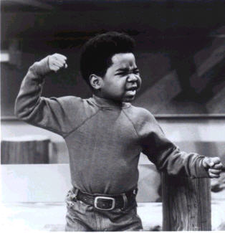
Fighting
Uganda
36% of students were in a physical fight and 64% of students were seriously injured one or more times 12 months prior to the survey
US
36% were in a physical fight one or more times 12 months prior to the survey

Slide 52
Drugs and Alcohol
Uganda
9% used drugs one or more times during their life
13% had alcohol in the past 30 days
15% reported being drunk at least once
US
38% used marijuana one or more times during their life and 20% were currently using
75% had at least one drink in their lifetime and 45% were currently drinking
Notes:
Marijuana and khat Khat is a stimulant, a shrub w/ leaves that can be chewed

Slide 53
Cigarettes
Uganda
20% lifetime use
US
50% lifetime use
20% current use

Slide 54
Mental Health
Uganda
19% of students seriously considered attempting suicide
10% of students felt lonely most of the time or always
US
14 % of students seriously considered attempting suicide
29% of students felt sad/hopeless daily for more than 2 weeks
Notes:
12 months prior to the survey

Slide 55
Adolescents are at Risk Worldwide
What can adolescent providers do to help
Awareness of the challenges that adolescents face
Knowing the youth culture
Talking to teens respectfully and confidentially
Encouraging parent/guardian involvement
Knowing the community resources
Providing anticipatory guidance and heath education…….

Slide 56
Health Education…it Works
School based programs that teach social resistance skills and general life skills successfully decrease the use of drugs, alcohol and cigarettes US dept of health and human services 2009
Parental discussions about risk taking and risk reduction is protective Guttmacher 2009
Discussions of contraception choices does not increase sexual activity Kirby 2005
Access to emergency contraception does not promote sexual risk taking Harper, 2008
Notes:
EC Over the counter access to EC for teens Harper
Advocates for Youth contraction does not increase SA
School-based drug prevention programs: a review of what works
Australian and New Zealand Journal of Criminology, August, 2008 by David W. Soole, Lorraine Mazerolle, Sacha Rombouts
National Institute on Drug Abuse Preventing drug use in children and adolescents US dept of health and human services 2009
Guttmacher Role of parents in Adolescent sexual activity and contraceptive use in four African countries (Uganda) found that communication w/ parents reduced the odds of adolescent sexual activity and improved the use of contraception use at last sex
Impact of Sex and HIV Education
http://www.advocatesforyouth.org GREAT WEB SITE
Programs on Sexual Behaviors
of Youth in Developing and
Developed Countries
by Douglas Kirby, B.A. Laris, and Lori Rolleri 2005 by Family Health International
Of the 83 studies identified that matched the study criteria,
18 were conducted in developing countries: Belize, Brazil, Chile, Jamaica, Kenya, Mexico,
Namibia, Nigeria, South Africa, Tanzania, Thailand, and Zambia. About half of the 83 focused
only on preventing HIV/STIs; nearly one-third covered both HIV/STIs and pregnancy; and nearly
one-fifth focused only on pregnancy.
The vast majority of the programs encouraged
abstinence but also discussed or promoted the use of condoms or contraception if young people
chose to be sexually active. Only 7 percent of the programs recommended only abstinence – most
in the United States.
The sex and HIV education programs evaluated by these studies did not increase sexual behavior,
as some people have feared. To the contrary, nearly half (45 percent) of the studies that measured
impact on sexual initiation, frequency of sex, or number of sexual partners found positive results
– the programs either delayed sex or reduced the frequency of sex or the number of sexual partners.
Almost all of the rest had no effect.
General Life skills-communication, negotiation, listening

Slide 57
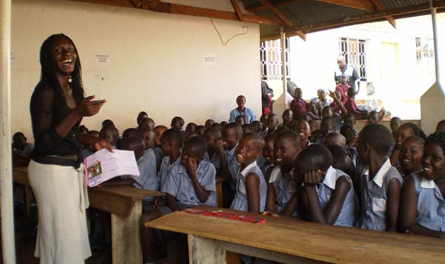
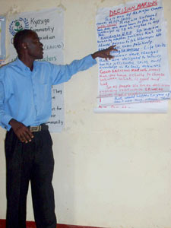
Health Education in Uganda Youth Reproductive Health Policy 2005
The role of young people in Uganda’s successful efforts to fight HIV/AIDS is well known
Characterized by behavior changes among youth, including a delay of sexual debut, increase in condom use, and reduction in number of partners, HIV prevalence has fallen by more than half since the early 1990s
Notes:
Sources
Sections on the status of youth and on the policy and program environment draw principally on
• Uganda: Youth Reproductive Health and HIV Policy Environment. May 2004. YouthNet.
• Adolescent Sexual and Reproductive Health in Uganda: A Synthesis of Research Evidence. December 2004.
Alan Guttmacher Institute. http://www.agi-usa.org/pubs/2004/12/20/or14.pdf.
• Reproductive Health of Young Adults in Uganda. July 2002. Macro International.
http://www.measuredhs.com/pubs/pdf/OD23/OD23.pdf.

Slide 58
Health Education…it Works
Comprehensive sex education programs that provide information about both abstinence and contraception
Help delay the onset of sexual activity among teens
Reduce their number of sexual partners
Increase contraceptive use when they become sexually active Kirby 2005
Abstinence only programs are ineffective in improving adolescent reproductive health outcomes and actually increase the likelihood of pregnancy UNESCO 2008
Notes:
Results demonstrated that the curricula had no effects on initiation of sexual intercourse, age of initiation of sexual intercourse,
abstinence in the previous twelve months, number of sexual partners, or condom use during sexual intercourse. International Guidelines on Sexuality Education :UNESCO (United Nations Education Scientific and Cultural Organization)
An evidence informed approach to effective sex,
relationships and HIV/STI education
"[E]xpert panels that have studied this issue, have concluded that comprehensive sex and HIV/AIDS education programs and condom availability programs can be effective in reducing high-risk sexual behaviors among adolescents. In addition, these reviews and expert panels conclude that school-based sex education and condom availability programs do not increase sexual activity among adolescents." (The Institute of Medicine, October 2000).
In US there are two main forms of sex ed. Abstinence only and comprehensive which addresses abstinence as a positive choice
58% of HS comprehensive
34% abstinence only
• • Federal law establishes a stringent eight-point definition of “abstinence-only education” that requires programs to teach that sexual activity outside of marriage is wrong and harmful Federal guidelines now define sexual activity to include any behavior between two people that may be sexually stimulating, which could be interpreted as including even kissing or hand-holding
There are three federal programs dedicated to funding restrictive abstinence-only education There is currently no federal program dedicated to supporting comprehensive sex education that teaches young people about both abstinence and contraception.[29]
• Despite years of evaluation in this area, there is no evidence to date that abstinence-only education delays teen sexual activity. Moreover, recent research shows that abstinence-only strategies may deter contraceptive use among sexually active teens, increasing their risk of unintended pregnancy and STIs
Evidence shows that comprehensive sex education programs that provide information about both abstinence and contraception can help delay the onset of sexual activity among teens, reduce their number of sexual partners and increase contraceptive use when they become sexually active Facts on Sex Education in the United States Guttmacher 2006
The Guttmacher Institute advances sexual and reproductive health worldwide through an interrelated program of social science research, public education and policy analysis. For nearly four decades, Guttmacher has demonstrated that scientific evidence — when reliably collected and analyzed, compellingly presented and systematically disseminated — can make a difference in policies, programs and medical practice

Slide 59
Health Education…it Works
Countries with conservative attitudes towards sex education (including the US/UK) have a higher incidence of STI’s and teenage pregnancy
Advocates for Youth
In US there are two main forms of sex education Guttmacher 2006
Abstinence only and comprehensive programs, both address abstinence as a positive choice
There is currently no federal program dedicated to supporting comprehensive sex education
Notes:
Advocated for Youth
Joy of sex education" by George Monbiot, The Guardian, 2004

Slide 60
Health Education…it Works
The Netherlands has one of the lowest teenage pregnancy and birth rates in the world and higher rate of contraception use UNESCO Courier
Early institution of sex education encouraged
Over half of the primary schools discuss sexuality and contraception
Aims to give teens the skills to make their own decisions regarding health and sexuality
Notes:
Weaver School based sex ed
Fam Plann Perspect 2002 dutch model Jan-Feb;34(1):56.
Unesco courier the

Slide 61
The Future
Building our global community and working together to keep our youth safe, helping them grow into well integrated and productive adults who actualize their potential
“There is no passion to be found playing small-in settling for a life that is less than the one you are capable of living” Nelson Mandela

Slide 62
Bibliography
Alderman, A. et al “ The History of Adolescent Medicine”. Pediatric Research 2003
Arnett, J. “Adolescent Storm and Stress” American Psychologist 1999
Arnett, J. “Stanley Hall’s Adolescence: Brilliance and Nonsense” History of psychology 2006
Greydanus, D. et al “Adolescent Medicine”. Primary Care: Clinics in Office Practice 2006
Steinberg, L. “The Logic of Adolescence”
Adolescence and Youth. “Encyclopedia of Children and Childhood in History and Society”
Adolescence… Overview, Historical Background and Theoretical Perspectives. King’s Psychology Network http://www.psyking.net
Chen, C. et al “ Culture and Adolescent Development” Online readings in Psychology and Culture 2002
Levine, S “Adolescent Consent and Confidentiality” Pediatrics in Review 2009
Friedman, H. “ Culture and Adolescent Development” Journal of Adolescent Health” 1999
Dahl, R. “Beyond Ragging Hormones: The Tinderbox in the Teenage Brain”. Cerebrum: The Dana Forum on Brain Science 2003
Teenage Brain: A Work in Progress (Fact Sheet) National Institute of Mental Health 2001
Biddlecom, A. “ Role of Parents in Adolescent Sexual Activity And Contraceptive Use in Four African Countries” Guttmacher Institute International Perspectives on Sexual and Reproductive Health 2009
In Brief, Facts on Sex Education in the United States Guttmacher Institute 2006
Harper, C. “ Over-the-counter Access to Emergency Contraception for Teens” Contraception 2008

Slide 63
Bibliography
Rivera, R. “ Contraception for Adolescents: Social, Clinical and Service Delivery Considerations” Journal of Gynecology and Obstetrics 2001
Advocates for Youth Adolescent Sexual Health In Europe and the US-Why the Difference?
Advocates for Youth. Effective Sex Education http://www.advocatesforyouth.org
Koyama, A. “ Global Lessons on Healthy Adolescent Sexual Development” Current 0pion in Pediatrics 2009
Kirby, D. “ The Impact of Abstinence and Comprehensive Sex and STD/HIV Education Programs on Adolescent Sexual Behavior” Sexual Research and Social Policy 2008
Kantor, M. “ Abstinence-Only Policies and Programs: An Overview” Sexuality Research and Social Policy 2008
United Nations Educational, Scientific and Cultural Organization (UNESCO). “International Guidelines on Sexuality Education: An Evidence Informed Approach to Effective Sex, Relationships and HIV/STI Education , www.ibe.unesco.org/.../UNESCO_Guidelines_Sexuality_Education.pdf
Weaver, H., “ School-Based Sex Education Policies and Indicators of Sexual Health Among Young People: A Comparison of the Netherlands, France, Australia and the United States” Sex Education 2005
Valk, G. “The Dutch Model” Unesco Courier
Prescott, H. “A Doctor of Their Own: The History of Adolescent Medicine” Harvard University Press 1998
Feldman, S. et al “ At the Threshold: The Developing Adolescent” Harvard University Press 2001
International Health Issues in Adolescents. AMSTAR 2009

