Slide 1
CPSE: Easy as A-B-C-D!
Improving the Referral Process to the
Committee on Preschool Special Education
Attendings: Adriana Matiz-Zanoni, Steve Caddle, Cristina Fernandez,
Shoshana Friedman, Melanie Gissen, Harriet McGurk,
Dodi Meyer, Kim Noble, Ozzie Purugganan, Minna Saslaw, Dana Sirota
Residents: Oliver Barry, Rachel Borlack, Julia Brown, Bianca Calderon,
Danny Coelho, Noa Fleiss, Andy Geneslaw, Priya Jain, Brian Jonat,
Divya Lakhaney, Natasha Li, Chris Mardy, Regina Myers, Shannon Nees,
Meredith Pesce, Monica Prieto, Christina Siliciano, Emily Skoda-Mount, Sam Zhao
Care Coordinator: Lucille Lebovitz
PFAs: Cindy Ferrer, Ivelisse Rodriguez, Tarreemha Taylor Caruso, Leilani Vinales

Slide 2
AIM Statement
Washington Heights Family Health Center will create a process of systematizing referrals to the CPSE in order to help families navigate the complex system. We will create a model guided by the system the Health Leads group used to ensure that by May 2015:
  100% of families receive an informational packet when being referred
  100% of families receive a follow-up phone call within 10 days of referral
  75% of patients referred successfully undergo an evaluation
  100% of providers are educated on the process involved in CPSE referrals
Notes:
Assist and support patients needing services
Navigate the system
Help with paperwork
Follow up with reminders for appointments
Replace a function previously carried out by the Health Leads Group

Slide 3
The Committee on Preschool Special Education
Created under the Individuals with Disabilities Education Act (IDEA)
Determines eligibility and level of services for children ages 3-5 years
Develops and implements individualized education plans (IEPs)
Notes:
Mandates that children with disabilities or developmental delays have the right to free, appropriate public education
Appointed by the school board
Goal to provide in least restrictive environment

Slide 4
The Referral Process
Referral to CPSE
Consent for evaluation
Evaluation
CPSE meeting
IEP implementation
15 calendar days
30 school days
30 school days

Slide 5
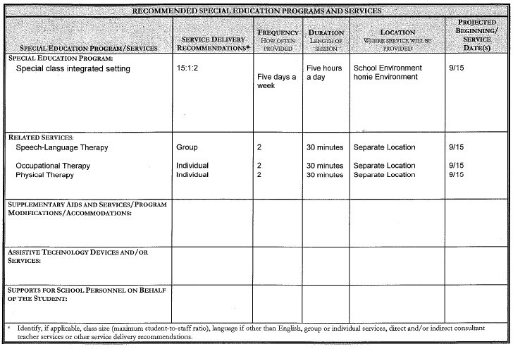
CPSE Recommendations

Slide 6
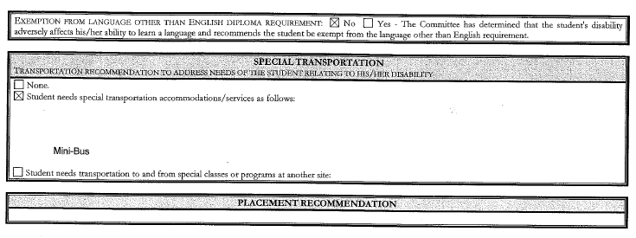
CPSE Recommendations

Slide 7
Where We Were:
120 patients
Yes: 43 (36%)
No: 77 (64%)
Two to five year old patients seen in September 2014
Suspected developmental delay?
Receiving services?
Yes: 23 (53%)
No: 20 (47%)
Why not?
Delay resolved: 7
New referral: 5
Did not qualify: 3
Evaluation pending: 4
Referral deferred: 1

Slide 8
The Referral Process
Referral to CPSE
Consent for evaluation
Evaluation
CPSE meeting
IEP implementation
15 calendar days
30 school days
30 school days

Slide 9
Key Drivers
Interventions
Study Aim:
Washington Heights Family Health Center will create a process of systematizing referrals to CPSE.
Accurate knowledge of referral system
  All providers educated about CPSE referral process
  PE form/application packet given to parent on day of referral
Effective communication between providers and families
  Informational packet about process created for families: MA/PFA to explain
Global Aim:
The goal will be to assist and support patients needing services to receive those services by helping families navigate the system, ensuring proper paperwork is completed prior to evaluations, and following up with reminders for appointments.
  Referral letter for CPSE office/agency
Efficient transmission of information
  Text/phone call reminder to families
  Referral log book in clinic
Effective communication between providers and CPSE agency/office
  Follow-up appointment scheduled to check referral status on same day referral made

Slide 10
PDSA Cycles
Started a logbook to keep track of CPSE referrals
Began sending biweekly reminders to providers via email
Created a referral packet, which includes: clinic letter of referral, agency information and request letter, PT/OT rx, physical form, and CPSE information form
Identified two community agencies to partner with: New York Center for Child Development and Village Child Development Center
Created new referral process incorporating the PFAs, an order in Eclipsys and our care coordinator, Lucille Lebovitz
Notes:
-New referral process: Family fills out packet → gives to PFA → we order “outpt service referral” which PFA prints and leaves in Lucille’s box → lucille f/u w/ agency in 1 week

Slide 11
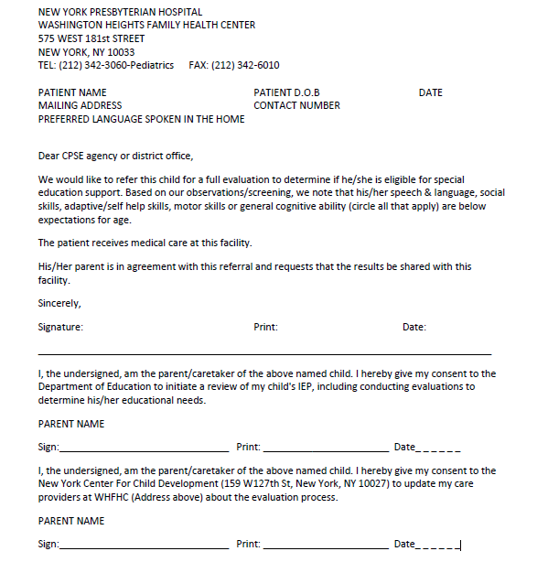
Our WHFHC Letter of Referral

Slide 12
Where We’ve Been Going:
Weekly Reminders
Care Coordinator Involvement
Referral
Packet
Biweekly Reminders
Second Agency

Slide 13
Where We Are Now:
Notes:
**Increased referral rate in September**
One patient lost to follow-up
One patient with multiple developmental issues, referred to Dr. Purugganan

Slide 14
Where We’ll Go in the Future:
Incorporate the referral letter template into Eclipsys
Systematize the timing of follow-up visits with the PMD to assess status of CPSE referral and/or services
Continually assess efficacy of various agencies in obtaining completed evaluations
  Village Child Development Center
  NY Center for Child Development

Slide 15
Spreading our Project
The referral letter
The packet
The community agencies
  Different agencies for different clinics?

Slide 16
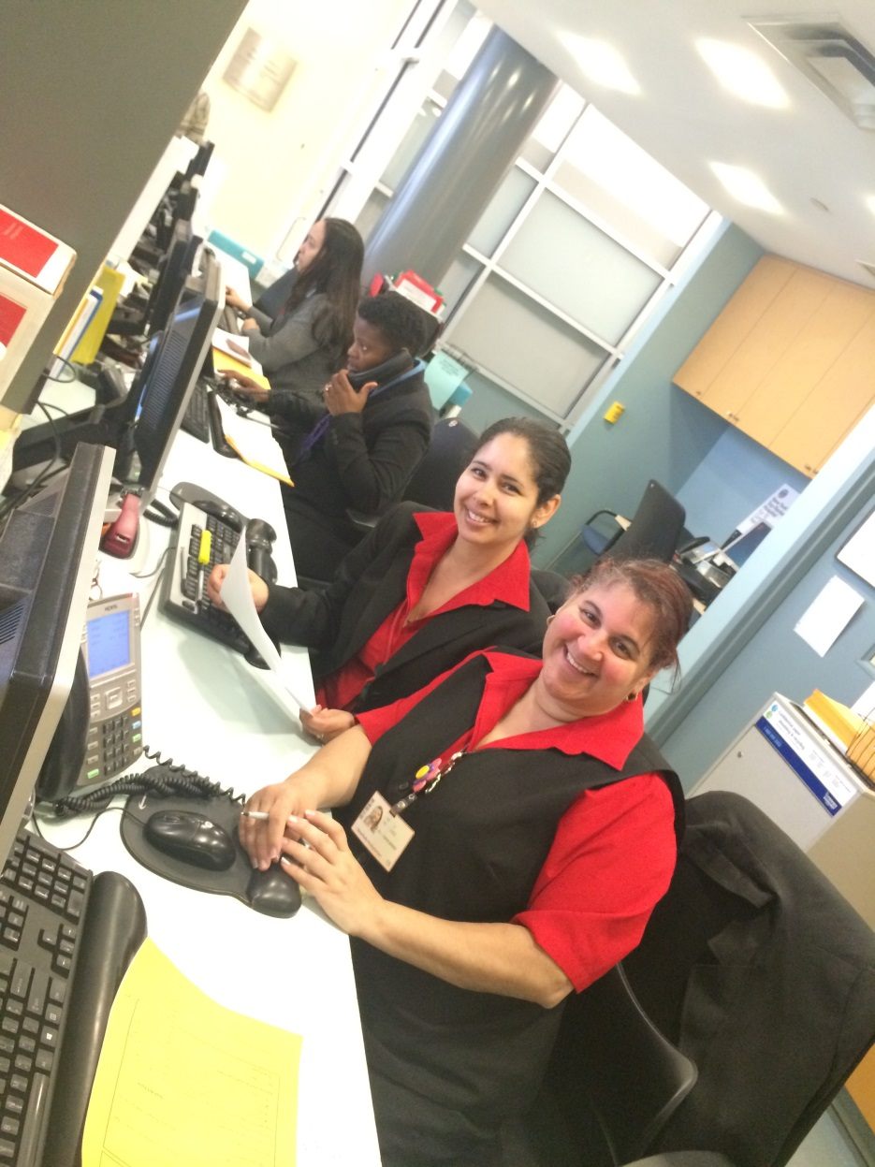
Questions?

