Slide 1
My Healthy Day
Lang Program: Doctors in Training

Slide 2
Do Now
What do you think is the message of this advertisement?

Slide 3
Lang Classroom Rules
Excellence
We are not satisfied with mediocrity. We strive for exceptional quality in our academics, professionalism, and service. We are hard workers who aim to go above and beyond what is expected of us.
Innovation
We are creative problem-solvers who think critically and devise out-of-the-box solutions.
Teamwork
We listen, help, share, participate, and communicate. Each of us contributes to a positive peer-support network that strives to help every member to reach common goals and aspirations.

Slide 4
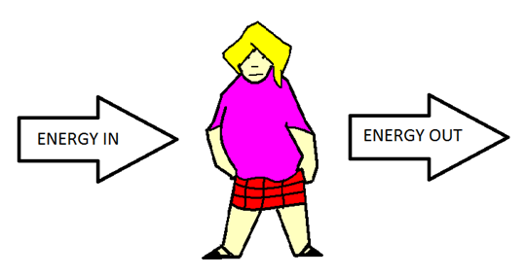
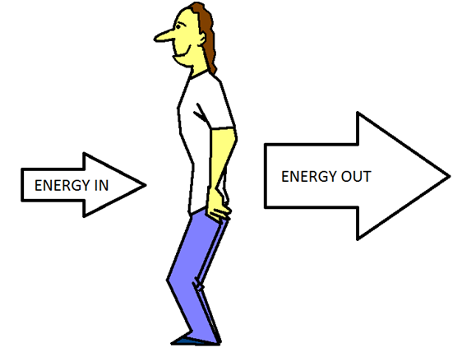
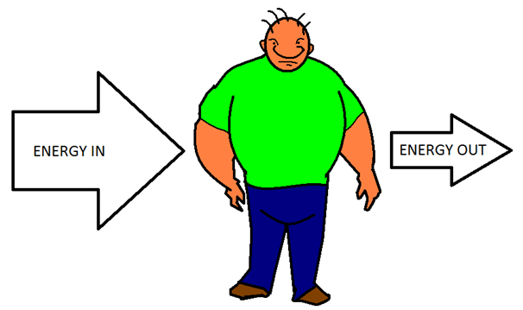
Energy

Slide 5
Prior knowledge
What do you think is the message of this advertisement?

Slide 6
Breakfast

Slide 7
Breakfast

Slide 8
Water!!!

Slide 9
Drinks

Slide 10
School lunch
Notes:
Healthy choices about school lunch

Slide 11
Dinner
Notes:
Plate method activity
No TV while eating dinner
Sit at the dinner table

Slide 12
Healthy Snack
Notes:
Give healthy snack to lang kids now

Slide 13
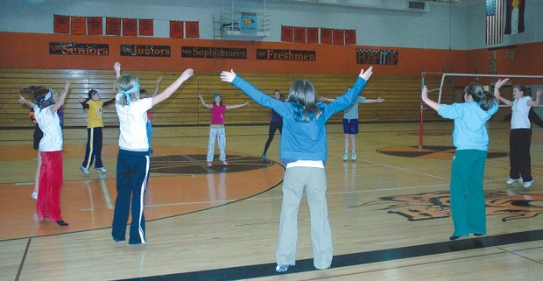
Gym
Notes:
Participate in gym class
Exercise between classes

Slide 14
After School Activities
Notes:
Exercise and sports
Limit TV time and video games to <2hr/day

Slide 15
Sleep

Slide 16
Design your own advertisement!
Importance of breakfast
Healthy lunch & dinner sizes
Importance of portion size
Making exercise a part of daily routine
Sleep hygeine

Slide 17
Motivational Interviewing

Slide 18
Motivational Interviewing
A tool used by doctors to help patients change behaviors that are harmful
Assessment of willingness to change and possible road blocks
Notes:
1.) It is about change
2.) Assessing willingness to change
3.) assessing road blocks and difficulties that must be overcome
4.) seeing the situation from the perspective of the person you are interviewing (cultural competency would fit in nicely here)
5.) How to suggest incremental changes that can have a good effect (ie realistic goals.)

Slide 19
Motivational Interviewing
Why might someone not want to change what they eat?
What might be some of the issues around changing dietary habits?
What would you tell them about why healthy eating and living is important?
What are some of the ways that they can make changes?
Notes:
Motivational interviewing is a conversation between two people about determining ones readiness to change, their motivations to do it and their motivations to

Slide 20
Homework
Obesity is one of the most important public health problems in the United States. Why do you think there is so much obesity in the community today? How would you approach it with yourself, your family, your friends?
Email your responses by 12/17/13 to: doctorsintraining.lang@gmail.com

