Slide 1
Intro To Radiology
Michael Goldman, MD
Sandhya Brachio, MD
Liz Seashore, MD
Christina Gutierrez, MD

Slide 2
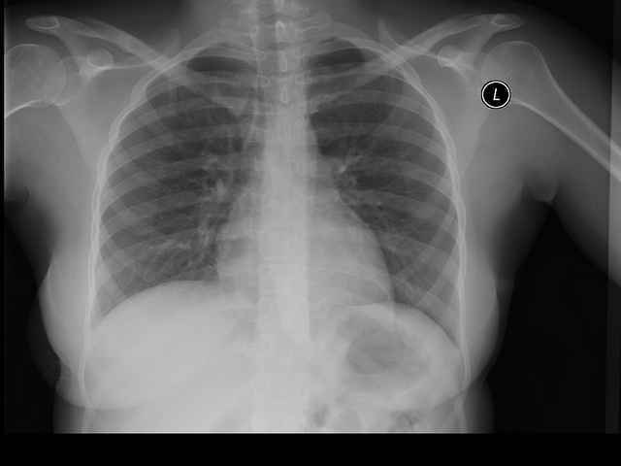
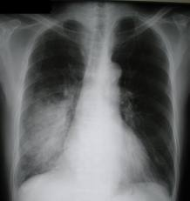
Do Now
There are two x-rays below A and B.
Write down 3 similarities and 3 differences
A
B

Slide 3
Lang Classroom Rules
Excellence
Innovation
Respect
Empathy
Responsibility
Teamwork

Slide 4
Key Rule for Today
Teamwork – Do Remember…
  You are a LANG SCHOLAR
  Health care professionals work as a team, so we will work as a team today
  You will learn more from each other if you keep your ears and minds open
  We listen, help, share, participate, and communicate. Each of us contributes to a positive peer-support network that strives to help every member to reach common goals and aspirations

Slide 5
Reviewing Do Now
There are two xrays below A and B.
Write down 3 similarities and 3 differences
A
B

Slide 6
#1 – DEFINING
“SUBJECTIVE” VS. “OBJECTIVE”

Slide 7
Subjective Vs. Objective
SUBJECTIVE
  Complaints
  Symptoms
  Feelings
  Beliefs
  Observations we can debate
OBJECTIVE
  Colors
  Sizes
  Shapes
  Numbers
  Facts!
  Observations we CANNOT debate because they are facts

Slide 8
#2 – A DIFFERENTIAL DIAGNOSIS
“DDX”

Slide 9
What can Cause a Cough?
THINK… PAIR… SHARE!
Take 30 seconds to think
Then 30 seconds to compare your notes with your neighbor
Then let’s share for 2 minutes a few of the causes of COUGH

Slide 10
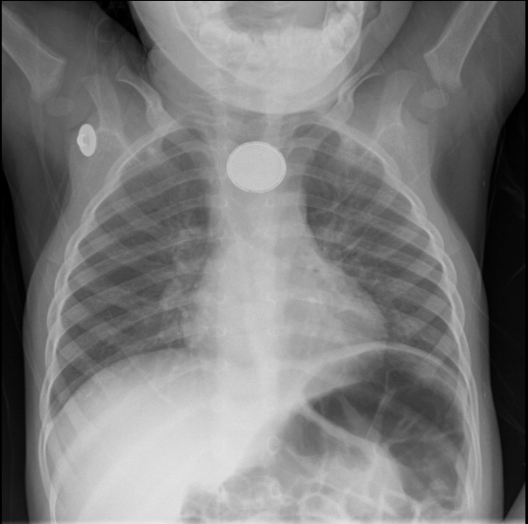
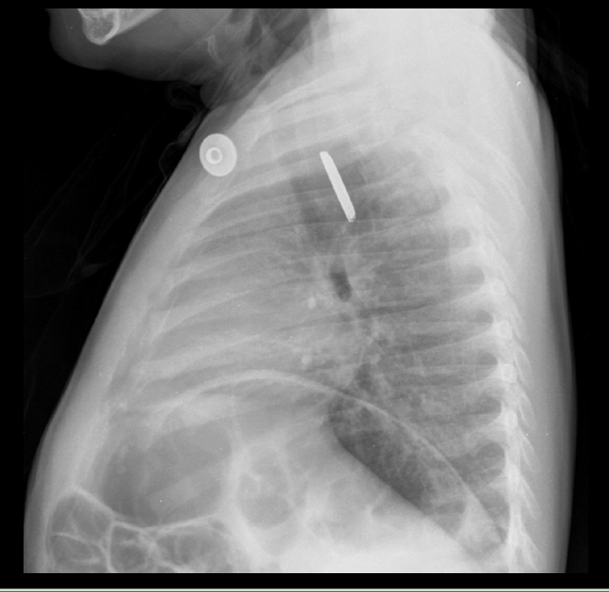
Make the Diagnosis
Notes:
IMAGE 1
IMAGE 2

Slide 11
#3 – RADIOLOGY BASICS

Slide 12
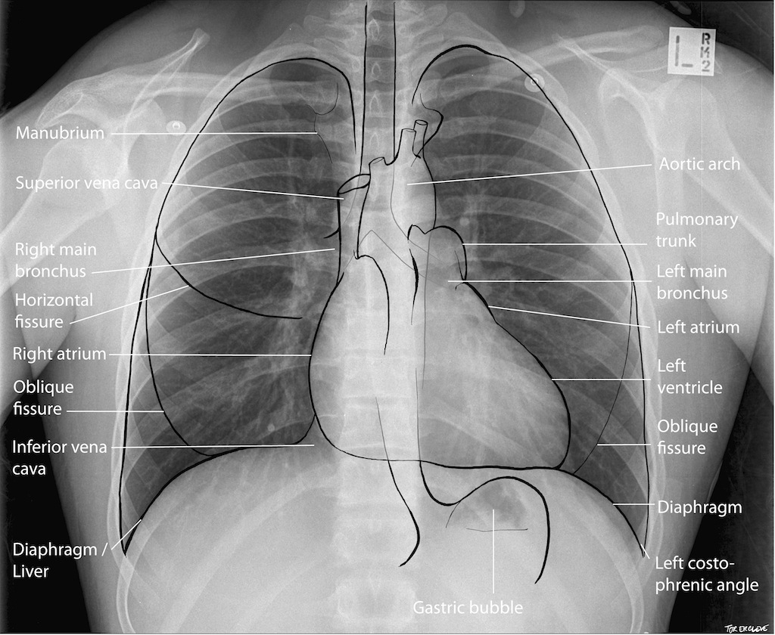

Slide 13
READY TO BE A RADIOLOGIST???

Slide 14
Expectations for DIT Activity
Work as a team
Ask questions of each other and your station supervisor
Respect everyone’s time – Move quickly and quietly between stations so everyone can have the chance to do all the stations

Slide 15
IMAGES OR LINKS FOR EACH STATION

Slide 16
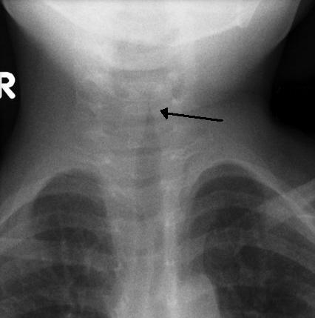
Station 1, Case 1

Slide 17
Station 1, Case 2

Slide 18
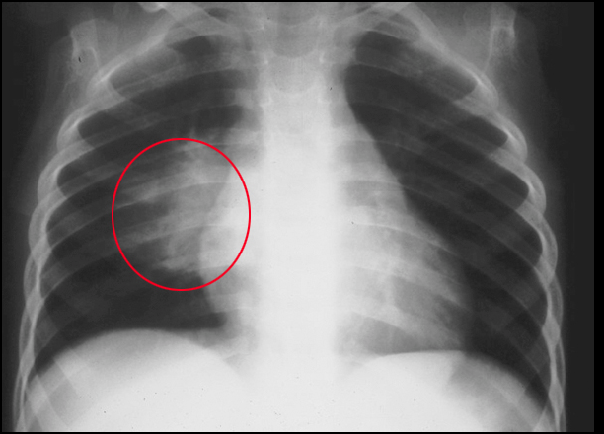
Station 1, Case 2
Notes:
https://www.cchs.net/pediatricradiology/imagegallery/default.asp?imageid=1&historyID=1&caseID=127&GBcaseid=&GBtopicID=100&GBsearchText=&GBsearchCriteria

Slide 19
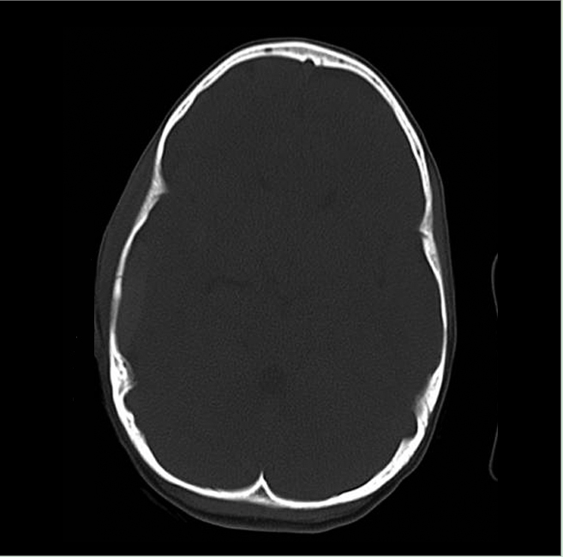
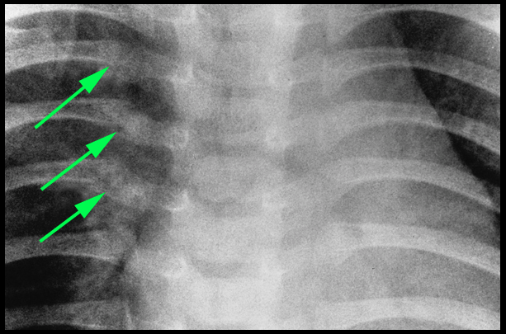
Station 2, Case 1
Notes:
https://www.cchs.net/pediatricradiology/imagegallery/default.asp?imageid=1&historyID=1&caseID=135&GBcaseid=&GBtopicID=104&GBsearchText=&GBsearchCriteria
https://www.cchs.net/pediatricradiology/imagegallery/default.asp?imageid=1&historyID=10&caseID=136&GBcaseid=136&GBtopicID=&GBsearchText=&GBsearchCriteria=

Slide 20
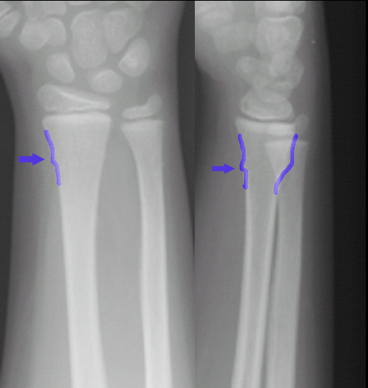
Station 2, Case 2
Notes:
https://www.cchs.net/pediatricradiology/imagegallery/default.asp?imageid=1&historyID=16&caseID=133&GBcaseid=&GBtopicID=103&GBsearchText=&GBsearchCriteria=

Slide 21
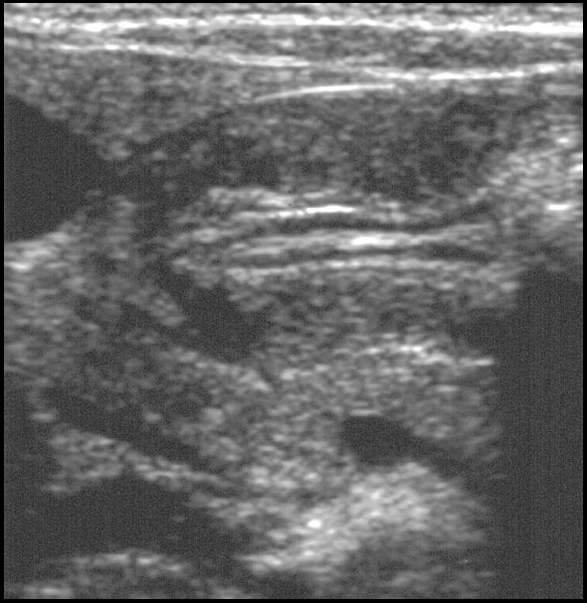
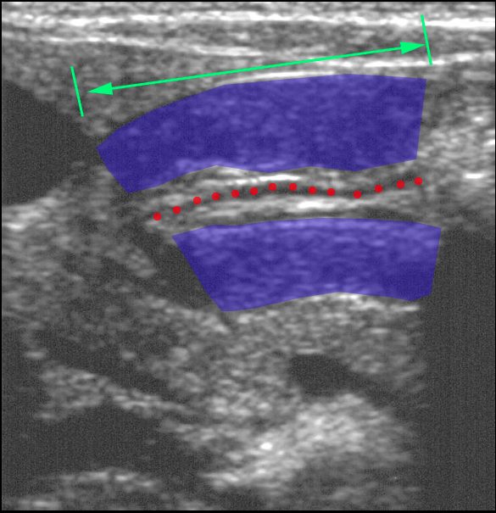
Station 3, Case 1

Slide 22
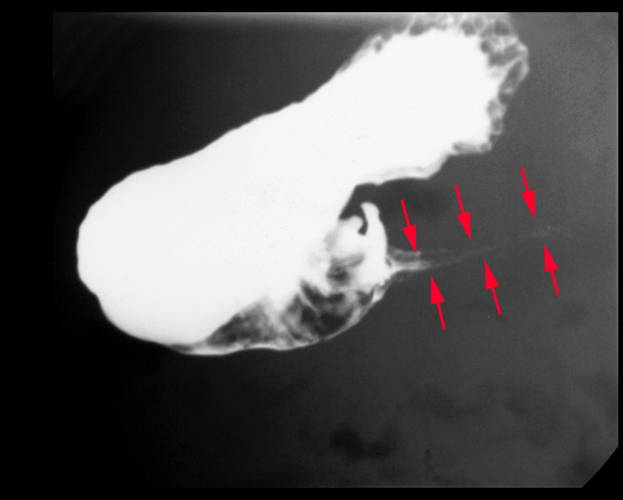
Station 3, Case 1

Slide 23
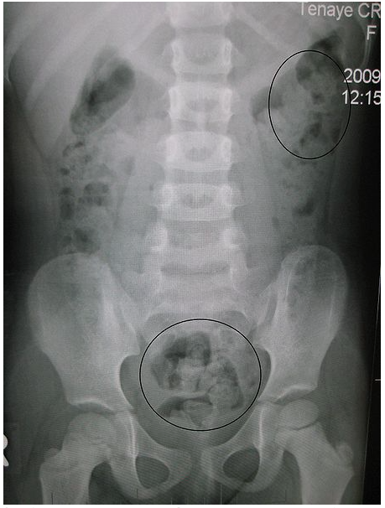
Station 3, Case 2

Slide 24
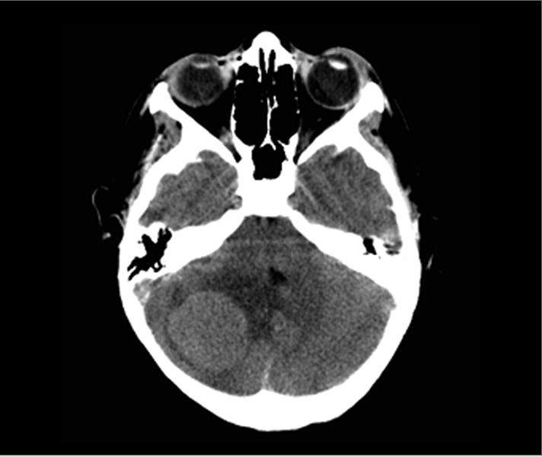
Station 4, Case 1
Notes:
https://www.cchs.net/pediatricradiology/imagegallery/default.asp?imageid=1&historyID=2&caseID=1873&GBcaseid=&GBtopicID=104&GBsearchText=&GBsearchCriteria=

Slide 25
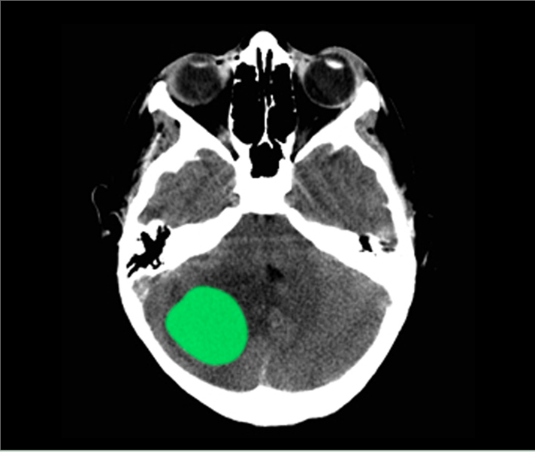
Station 4, Case 1
Notes:
https://www.cchs.net/pediatricradiology/imagegallery/default.asp?imageid=1&historyID=2&caseID=1873&GBcaseid=&GBtopicID=104&GBsearchText=&GBsearchCriteria=

Slide 26
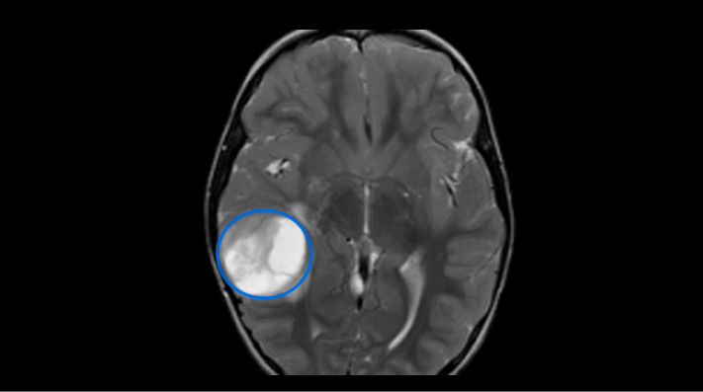
Station 4, Case 2

Slide 27
Resources
https://www.cchs.net/pediatricradiology

