Slide 1
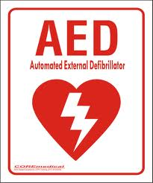
Automated External Defibrillators at Childhood Sporting Events
Legislative Advocacy
Noon Conference - April 24, 2012
Anna C. Gay, MD and Kris Woldu, MD

Slide 2
Outline:
Why Should You Care?
All About Sudden Cardiac Arrest
AEDs in Pediatrics
Legislation and Current Recommendations
Get Involved!

Slide 3
Why Should You Care?
http://www.cbsnews.com/2100-500165_162-20063564.html

Slide 4
Sudden Cardiac Arrest (SCA)
~2000 deaths/yr in people <25 yr
2.5 times relative risk for SCA in athletic children versus age-matched nonathletic patients.
Sudden death occurs in 2 in 100,000 high school athletes each year
Risk increases with athletic participation
Leading cause of death among young athletes

Slide 5
SCA and Athletes
SCA occurs at 1 in 25-50 high schools each year
  1/3 = students or student/athletes
  2/3 = non-students, including school staff, teachers or spectators
75% of all SCA cases in schools occur in relation to a sporting event or practice
Access to AEDs at these events = a critical component of emergency planning

Slide 6
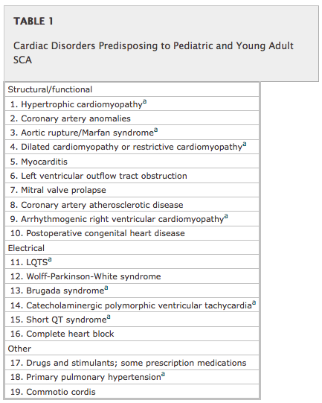
Causes of SCA in athletes:
AAP Policy on Pediatric Sudden Cardiac Arrest, 2012

Slide 7
SCA Prevention
Primary:
  medical and device therapy
  activity restriction
  avoidance of triggering medications
  family preparedness
Secondary: resuscitation (CPR, AED)

Slide 8
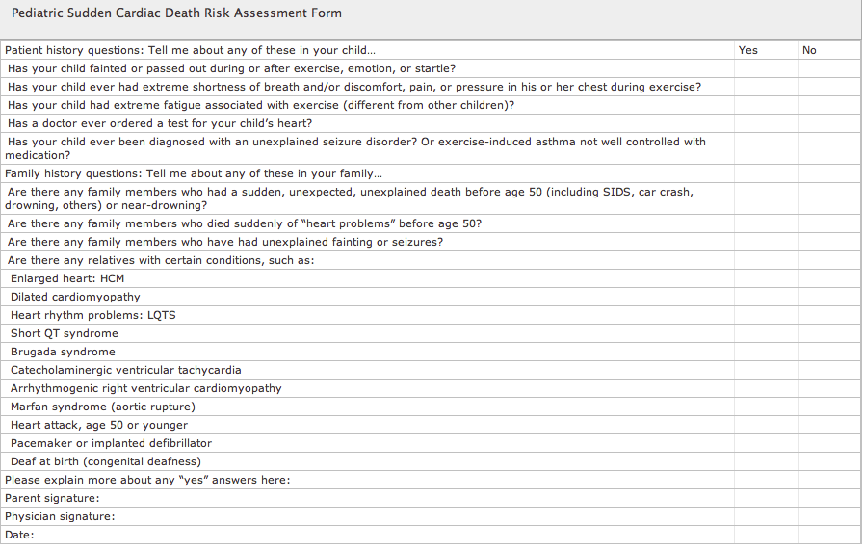
SCA Prevention
Screening Questions:

Slide 9
"Staying Alive, Staying Alive"
<10% of children with out-of-hospital SCA survive to discharge
Bystander CPR increases survival by 50%
...but...
CPR performed in only 30% of pediatric out-of-hospital SCA
Why?

Slide 10
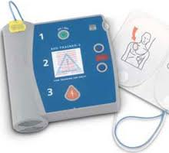
Automated External Defibrillators (AEDs):

Slide 11
History of AEDs
1998: FDA approves first AED using biphasic waves
1999: American Red Cross includes defibrillator training as part of standard CPR course
2000: CVS/Pharmacy offers AEDs to consumers
2001: FDA approves AEDs with specially-designed pads for children ages 0-8 yrs
Notes:
While majority of arrests in children are respiratory, VF does occur in children

Slide 12
Why AEDs?
VF and VT respond better to AEDs than asystole or PEA
Appropriate use of AEDs in unwitnessed VF arrests can lead to long-term survival rates >70% in adults
VF initial rhythm in 19-24% of pediatric out-of-hospital SCA
Notes:
While majority of arrests in children are respiratory, VF does occur in children

Slide 13
National Association for Sport and Physical Education (NASPE):
Establish a communication system to alert a predetermined school response team to the location of an emergency, and also to call 911
Place AEDs in all schools and in places of physical activity
  Goal time to defibrillation of 3-5 minutes
Ensure adequate staff training for administrators, PE teachers, coaches, athletic trainers, school RN

Slide 14
NAPSE Official Recommendations Cont:
Require regular maintenance, check before all sporting events
Practice emergency plan and AED use at start of each athletic seasons, or at least once annually

Slide 15
American Heart Association:
American Heart Association (AHA) and the American College of Sports Medicine (ACSM) provided recommendations for cardiovascular disease screening, appropriate staffing, equipment and emergency procedures to follow in the event of an emergency at health and fitness facilities -1998

Slide 16
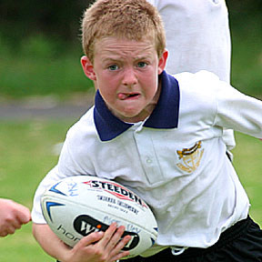
AEDs and the AAP
2007: AAP recommends AEDs for all children (reaffirmed in 2011)
0-8 yrs: use pediatric-specific AED, or attenuated-dosage adult AED
8 yrs - infinity: use adult-dosage AED

Slide 17
2012 AAP Policy Statement: Pediatric Sudden Cardiac Arrest
School-based programs essential: average school-age child spends 28% of the day and 14% of the total annual hours in school
School-based AED programs are cost-effective
Currently, no studies show efficacy of home AEDs

Slide 18
2012 AAP Policy Statement: Pediatric Sudden Cardiac Arrest
Key components of a comprehensive school-preparedness program:
Education and all-staff awareness
Knowledge and application of effective bystander CPR techniques
Implementation of a lay-rescuer AED program
Written emergency action plans and periodic practice drills

Slide 19

Early AED Legislation
First broad public access to AED law passed in Florida in 1997
U.S. Congress passed and the president signed into law the Cardiac Arrest Survival Act and the Rural Access to Emergency Devices Act as components of P.L. 106-505, the Public Health Improvement Act of 2000 (AHA, 2003).
  Provides limited liability protection for users of AEDs on federal property and directs the placement of AEDs in federal buildings.
(ACSM, 2002 & AHA, 2003).

Slide 20
Early AED Legislation
All 50 states and the D.C. have Good Samaritan laws in place that protect lay users of the devices (Chain of Survival – AED legislation, 2008).
The public-access defibrillation program makes AEDs available in public and/or private places where large numbers of people gather (AHA, AED, 2011).

Slide 21
Components of Initial Laws
allowed legal use of AEDs to save lives in event of cardiac arrest
required potential users to be trained in AED use
required AED maintenance and testing
advocated for creation of AED registry
established "Good Samaritan" policy for use
allowed state agencies to establish further requirements

Slide 22
Congressional Policy
1998: Aviation Medical Assistance Act
  immunity for providing or obtaining medical assistance in-flight
  encouraged airlines to decide re: onboard presence of AEDs
2000: Cardiac Arrest Survival Act
  AEDs required in all federal buildings
  civil immunity granted to authorized users
2002: Community Access to Emergency Devices (Community AED) Act
  $30 million in federal funds to place AEDs in public places "where cardiac arrests are likely to occur"
  encouraged private companies to purchase AEDs

Slide 23
NYS and AEDs
2002: AED and trained personnel on site at all public schools with >1000 people
2004: AED in all health clubs with >500 members
2006: AED and trained personnel in all places of "public gathering"
2008: "Year of AED" in NYS
  tax credit for business purchasing AEDs
  AED available at all recreational swimming facilities

Slide 24
AEDs in Schools
Only 14 states require AEDs in schools (California and Tennessee "urge" and "encourage" schools)
Only 1 state (Wisconsin) requires AED in daycares
Illinois is only state that requires AEDs on playing fields

Slide 25
Josh Miller HEARTS Act
Helping Everyone Access Responsive Treatment in Schools
Authorize funding for schools to purchase AEDS, requires adequate training of teachers and staff in CPR/AED use, and encourages schools to create medical emergency response plans. The bill was introduced by Representative Betty Sutton (D-OH) on April 5th.

Slide 26
In the News:
Senate Committee Advances Bill To Protect Child Athletes From Sudden Cardiac Arrest -New Jersey- January 23, 2012
  "Legislation sponsored by Senator Joseph F. Vitale that would require schools, recreational departments and youth camps to have automated external defibrillators (AED) for youth athletic events was unanimously approved today by the Senate Education Committee."
Notes:
“Janet’s Law” was named for Janet Zilinski, an eleven-year-old Warren girl who in 2006 went into sudden cardiac arrest during cheerleading practice. A nurse on site administered CPR and she was rushed to a nearby hospital where she eventually passed away.

Slide 27
In the News:
"The bill, S-157, would require that both public and nonpublic kindergarten through twelfth grade schools have an AED available within reasonable proximity of the athletic field or gym where school-sponsored events and team practices take place and that an on-site coach or other staff member is trained in CPR and to use an AED"
"All municipal or county recreation departments, nonprofit youth-serving organizations and youth camps must also have an AED accessible to athletic events and practices with at least one umpire, coach, counselor or staff member trained in CPR and use of an AED."
Notes:
“Janet’s Law” was named for Janet Zilinski, an eleven-year-old Warren girl who in 2006 went into sudden cardiac arrest during cheerleading practice. A nurse on site administered CPR and she was rushed to a nearby hospital where she eventually passed away.

Slide 28
In the News:
"A state-certified emergency services provider or other first responder could fulfill this requirement."
"Any public schools with grades six through 12 would be required to provide CPR training as part of their curriculum and high school students would be required to learn how to use an AED."
The bill now heads to the Senate Budget and Appropriations Committee for further review.
Notes:
“Janet’s Law” was named for Janet Zilinski, an eleven-year-old Warren girl who in 2006 went into sudden cardiac arrest during cheerleading practice. A nurse on site administered CPR and she was rushed to a nearby hospital where she eventually passed away.

Slide 29

Barriers to Implementation:
Untrained users may not be comfortable
Resources to provide training
Many different types of AED models
$$$

Slide 30
How can you get involved?
National Conference of State Legislators. "State Laws on Cardiac Arrest and Defibrillators."
www.ncsl.org/issues-research/health/laws-on-cardiac-arrest-and-defibrillators-aeds.aspx
Updated 9.2009. Accessed 4.18.2012
Sudden Cardiac Arrest Foundation. www.sca-aware.org
American Heart Association. "Sudden Cardiac Arrest - Advocacy.
"www.heart.org/HEARTORG/Advocate/IssuesandCampaigns/AccesstoCare/Sudden-Cardiac-Arrest---Advocacy_UCM_312652_Article.jsp.
Updated 2.9.2012. Accessed 4.18.2012.

Slide 31

Reference:
National Association for Sport and Physical Education (NASPE)– Position Statement
http://njtoday.net/2012/01/23/senate-committee-advances-bill-to-protect-child-athletes-from-sudden-cardiac-arrest/#ixzz1sAJy1xda
 Pediatric Sudden Cardiac Arrest. SECTION ON CARDIOLOGY AND CARDIAC SURGERY Pediatrics 2012;129;e1094 DOI: 10.1542/peds.2012-0144
Maron (2003) and Maron, Doerer & Haas, et al. (2009)
Hazinski, et al., 2004.
(Drezner, Harmon, Heistand, et al., 2009).
Hallstrom, A.P., et al., Public-access defibrillation and survival after out-of-hospital cardiac arrest. N Engl J Med, 2004. 351(7): p. 637-46.
http://electronicdesign.com/article/components/a-chronology-of-the-aed-s-development11661

