Slide 1
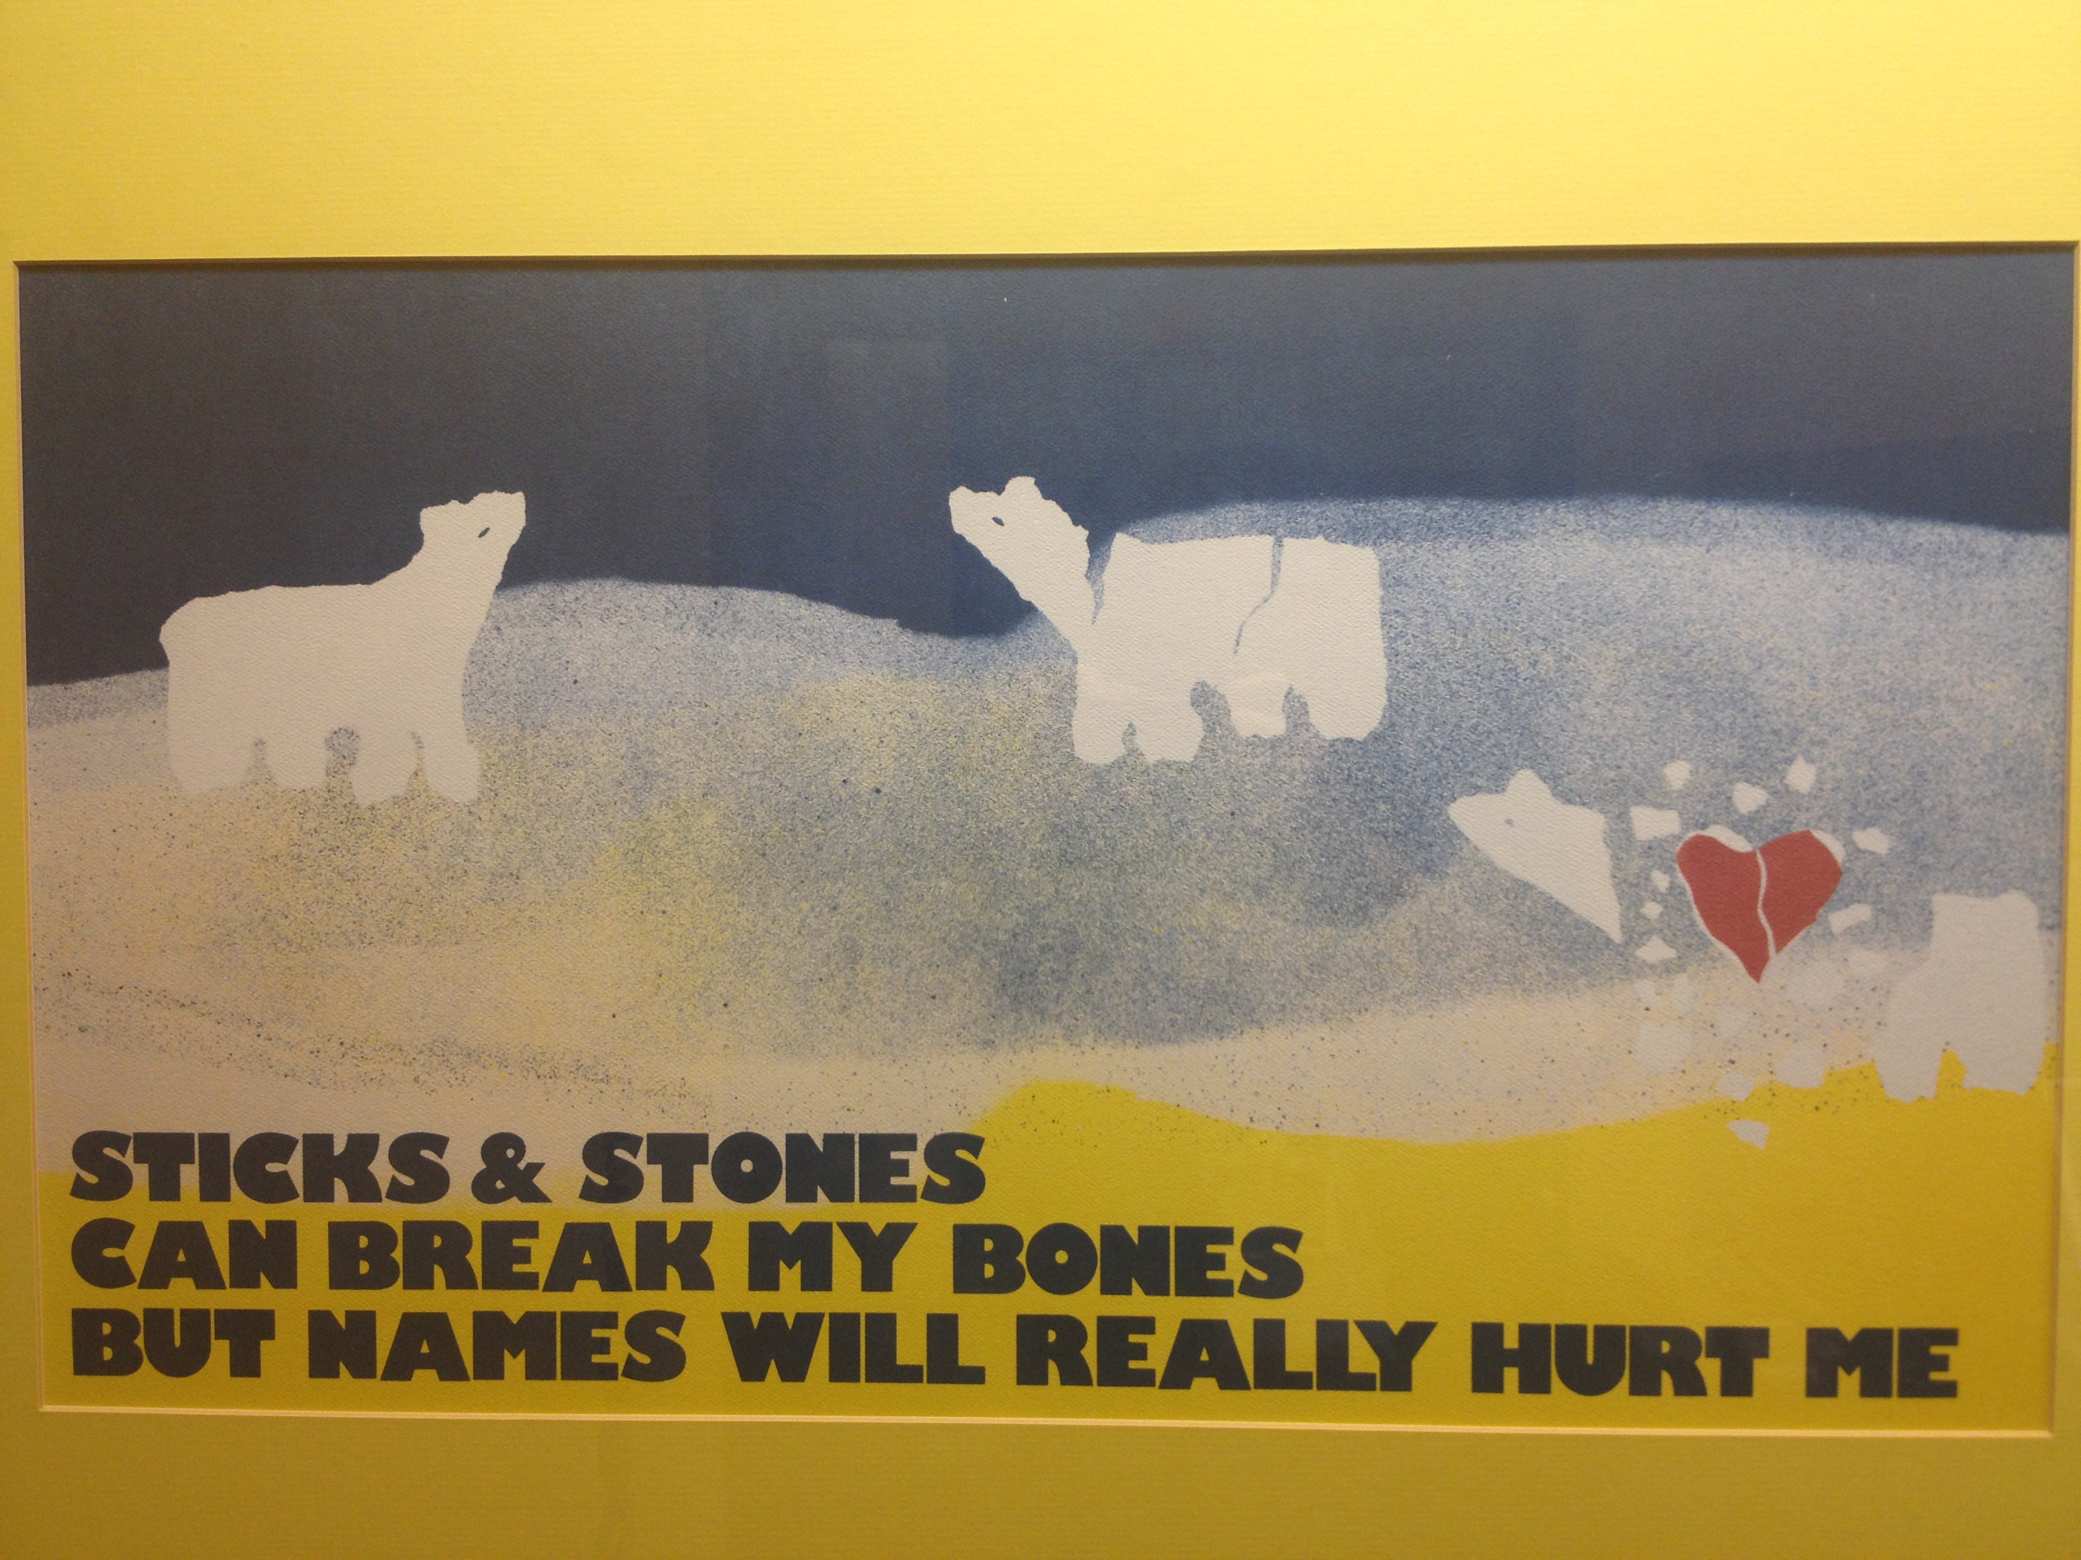

Slide 2
Bronx High School of Science Case
Three teens on the track team arrested with charges of forcible touching, assault, hazing in the second degree, and harassment
Allegations:
  Teammate pinned, sexually assaulted by touching, or hitting genitals
  “You need a good fingering, you freshman,” before using a digit to sodomize the victim though his shorts.
  “Touch my penis for three seconds or I will rape you”
Athletic director and two track coaches were suspended
New ADs and sensitivity training for athletes
School website features a form for students to anonymously report bullying
Teens attending another school according to DOE
News 12 Bronx, NY Daily News, Wall Street Journal
Notes:
teens (ages 16, 16, and 17)
Due in court next on 4/23
http://www.nydailynews.com/new-york/education/bronx-science-athletic-director-2-coaches-hazing-scandal-suspended-article-1.1280378#ixzz2O04OkLHB
http://www.nydailynews.com/new-york/new-ads-scandal-tarred-bronx-hs-science-article-1.1285435#ixzz2O03fmDXY
http://bronx.news12.com/news/bronx-high-school-of-science-students-plead-not-guilty-to-hazing-classmate-1.4779121?firstfree=yes News 12 Bronx Published: March 8, 2013 2:34 PM
http://online.wsj.com/article/SB10001424127887324178904578340862535536072.html

Slide 3
Pediatricians and Bullying
Legislative Advocacy Talk
Daniel Yu and Pam Fazzio
March 2013

Slide 4
Definitions of Bullying
Attack or intimidation with the intention to cause fear, distress, or harm
A real or perceived imbalance of power between the bully and the victim
Repeated attacks or intimidation between the same children over time.
AAP definition: A form of aggression in which one or more children repeatedly and intentionally intimidate, harass, or physically harm a victim who cannot defend herself or himself.
“Role of the Pediatrician in Youth Violence Prevention.” Pediatrics 2009;124;393.
Notes:
Bullying can include aggression that is physical (hitting, tripping), verbal (name calling, teasing), or psychologi- cal/social (spreading rumors, leaving out of group).
http://pediatrics.aappublications.org/content/124/1/393.full.pdf

Slide 5
Types of Bullying
Physical (hitting, spitting, tripping)
Verbal (name calling, teasing)
Psychological/social (spreading rumors, leaving out of group)
Cyber-bullying; e-mail, chat room, text messaging
Sexual (touching, bra snapping)
Notes:
Bullying can include aggression that is physical (hitting, tripping), verbal (name calling, teasing), or psychologi- cal/social (spreading rumors, leaving out of group).
Bullying can also occur through technology “cyberbullying”.
e-mail, a chat room, instant messaging, a website, text messaging, or videos or pictures posted on websites or sent through cell phones

Slide 6
Bullying Statistics
Bullying is widespread
2011 Nationwide survey, 20% of high school students reported being bullied on school property in the 12 months preceding the survey.
16% of high school students reports being bullied electronically in the 12 months before the survey.
Centers for Disease Control and Prevention. Youth risk behavior surveillance—United States, 2011. MMWR, Surveillance Summaries 2012;61(no. SS-4).
Notes:
Bullying, particularly among school-age children is a major public health problem both domestically and internationally
The 2011 Youth Risk Behavior Surveillance System (Centers for Disease Control and Prevention) indicates that, nationwide, 20% of students in grades 9–12 experienced bullying
The 2008–2009 School Crime Supplement (National Center for Education Statistics and Bureau of Justice Statistics) indicates that, nationwide, 28% of students in grades 6–12 experienced bullying

Slide 7
Risk Factors
Those perceived to be “different”
Overweight or underweight, wearing glasses or different clothing, being new to a school
Youth with disabilities
LGBT youth
Socially isolated youth
Notes:
No single factor puts a child at risk of being bullied or bullying others. Bullying can happen anywhere

Slide 8
Effects on Health
Bully victims:
Anxiety, depression, death
Increased sadness and loneliness
Changes in sleep and eating patterns
Health complaints
Decreased academic achievement
Miss, skip, or drop out of school.
Bullied children might retaliate through extremely violent measures. In 12 of 15 school shooting cases in the 1990s, the shooters had a history of being bullied.
Smokowski PR, Kopasz KH. Bullying in school: An overview of types, effects, family characteristics, and intervention strategies. Children and Schools 2005; 27:101-109.
Notes:
Kids who are bullied - Physical injury, social and emotional distress Death (suicide
Victimized youth are at increased risk for depression, anxiety, sleep difficulties, and poor school adjustment

Slide 9
Effects on Health
Youth who bully others are more likely to:
Abuse alcohol
Substance use
Get into fights, vandalize property
Drop out of school
Engage in early sexual activity
Have criminal convictions as adults
Be abusive towards spouses or children as adults
Smokowski PR, Kopasz KH. Bullying in school: An overview of types, effects, family characteristics, and intervention strategies. Children and Schools 2005; 27:101-109.
Notes:
. Youth who bully others can also engage in violent and other risky behaviors into adulthood. they are at increased risk for substance use, violence...
academic problems,
the experiences of bystanders—that is, individuals who watch bullying happen or hear about it—have largely been overlooked (Twemlow, Fonagy, & Sacco, 2004). What is known is that youth who witness bullying often report increased feelings of guilt or helplessness for not confronting the bully and/or supporting the victim

Slide 10
Bullying and Suicide
Suicide is the 3rd most common cause of death in youth
Although kids who are bullied are at risk of suicide, many issues contribute to suicide risk, including depression, problems at home, and trauma history.
Specific groups have an increased risk of suicide, including American Indian and Alaskan Native, Asian American, lesbian, gay, bisexual, and transgender youth.
Bullying and suicide. A review. Kim YS, Leventhal B. Child Study Center
Notes:
In recent years, a series of bullying-related suicides in the US and across the globe have drawn attention to the connection between bullying and suicide. Though the underlying causes of most suicide deaths are complex and not always obvious.
mental health professionals and those who work in suicide prevention say bullying-related suicides that reach the spotlight are painted far too simplistically. Bullying and suicide can indeed be connected, though the relationship between the two is much more complicated than a tabloid headline might suggest. To imply clear-cut lines of cause and effect, many experts maintain, is misleading and potentially damaging as it ignores key underlying mental health issues, such as depression and anxiety.

Slide 11
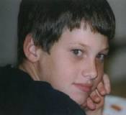



Cases of Suicide
Ryan Patrick Halligan
Megan Taylor Meier
Amanda Todd
Tyler Clementi
Notes:
Megan Taylor Meier – 15yo Missouri. Mother and other teenage girls living down the street created a fake Myspace account, impersonating a boy, sending messages to get information on her, to later tease her in school.
"I don't know if I want to be friends with you anymore because I've heard that you are not very nice to your friends“ “"Everybody in O'Fallon knows who you are. You are a bad person and everybody hates you. Have a shitty rest of your life. The world would be a better place without you.“"You’re the kind of boy a girl would kill herself over." – hung herself
Ryan Patrick Halligan – 13yo Vermont, teasing at school and online, accused of being gay
Asher Brown – 8th grader whose parents say 4 kids “teased him to death”
Seth Walsh – 13yo teased for being gay
Amanda Todd – 10th grader in British Columbia. In school for kids with “social and behavioral concerns”. Exposed her breasts in a video online to 19yo when she was in 7th grade. That person contacted ppl in her school to share the video. Moved and same thing at other schools. Teased for failed suicide.
Tyler Clementi – Rutgers student who jumped off the GWB

Slide 12
Celebrity Responses
Anti-bullying public service announcements from cast members of Glee
Ellen Degeneres
Lady Gaga
Madonna
Athletes
BULLY Trailer
Notes:
Rating changed from R to PG13 with help of 35 members of Congress and celebrities like Ellen Degeneres and Meryl Streep

Slide 13
NY Anti-bullying Legislations
Dignity for All Students Act (DASA)
NYS's Anti-Bullying Law that first created guidelines for local school districts to develop policies and procedures to address the problem of bullying
Signed into law in 2010, took effect in July 2012
All public elementary and secondary school students are protected

Slide 14
Dignity for All Students Act (DASA)
Each school's Code of Conduct must be amended to reflect the prohibition of harassment and discrimination
Districts must appoint at least one staff member in each school to handle all bullying incidents on school property (including athletic fields, playgrounds, and parking lots), in school buildings, on a school bus/vehicle, as well as at school-sponsored events or activities).
Administrators must report incidents of bullying or bias-based harassment to the NYS Department of Education
The curriculum for every grade, K – 12, must include a course on civility, citizenship and character education.

Slide 15
S7740: bullying and cyberbullying
School districts are required to institute protocols addressing bullying/ cyberbullying
- Students and parents to make both oral and written reports
- Assignment of a school official to receive and investigate reports
- Responsive actions to prevent recurrence of any verified bullying
- Coordination with law enforcement when appropriate
- Development of a bullying prevention strategy
- Notice to all school community members of the school’s policies.
- A copy of the school policy on such matters annually provided to
all employees, students and parents.
Notes:
Recognizing the seriousness of the problem of “cyberbullying,” the New York State Senate passed legislation (S.7740) that clarifies and expands the 2010 Dignity for All Students Act

Slide 16
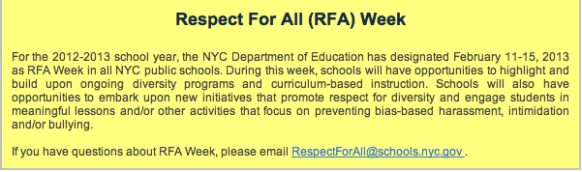
NY Anti-bullying Legislations
The law organizes training requirements for school employees “Teacher training programs”
Notes:
educates school officials and teachers on the identification and mitigation of harassment, bullying, cyberbullying and discrimination.

Slide 17
Law to Encourage the Acceptance of All Differences (LEAD)
Addresses bullying more directly.
It gives the term “bullying” a specific definition
Requires the curriculum in all grades, K – 12, to include a component on discouraging acts of bullying
Rather than simply requiring anti-bullying policies, it spells out the specific actions that school districts must take to prevent bullying before it happens, and respond to cases where bullying is already occurring.
LEAD was passed by the Senate in 2011
Needs to be passed by the Assembly and signed by Governor Cuomo before it can become law.
Notes:
LEAD defines bullying as severe or repeated actions by one or more students or school employees that has the effect of:
- Causing physical injury, emotional harm, or damage to a student’s property; - Placing the student in reasonable fear of harm or damage to his/her property; - Creating a hostile environment at school for the student; or - Materially and substantially disrupting the educational process or orderly operation of a school.

Slide 18
Tyler Clementi Higher Education Anti-Harassment Act
Federal Legislation
Currently no federal requirement that colleges and universities have policies to protect their students from harassment
Requires colleges and universities to enact an anti-harassment policy and distribute this policy to all students and employees

Slide 19
Tyler Clementi Higher Education Anti-Harassment Act
The bill creates a competitive grant program at the Department of Education
Institutions can apply for funding to expand bullying and harassment prevention programs
The bill was reintroduced in the 113th Congress in the House by Rep. Rush Holt (D-NJ) and in the Senate by Sen. Frank Lautenberg (D-NJ) on February 4, 2013.
Notes:
Funding - provide counseling to victims or perpetrators; or educate or train students, faculty and staff about ways to prevent or address harassment

Slide 20
Anti-bullying Bill of Rights (NJ)
Propelled by public outcry over the suicide of Tyler Clementi
Signed by Governor Christie in 2011
Considered the toughest legislation against bullying in the nation
Requires all public schools adopt comprehensive antibullying policies (there are 18 pages of “required components”)
Increase staff training and adhere to tight deadlines for reporting episodes.
Notes:
In 2002, bullying was anything that caused harm to a student. The law now defines bullying as any action that creates a hostile school environment or infringes on a student’s rights at school.

Slide 21
Anti-bullying Bill of Rights (NJ)
Each school must designate an antibullying specialist to investigate complaints; each district must, in turn, have an antibullying coordinator; and the State Education Department will evaluate every effort, posting grades on its Web site.
Safety team at each school, made up of teachers, staff members and parents, to review complaints.
Principals to begin an investigation within one school day of a bullying episode, and superintendents to provide reports to Trenton twice a year detailing all episodes.
Educators who fail to comply could lose their licenses.
Notes:
Cautioned that an unintended consequence of the new law could be that students, or their parents, will find it easier to label minor squabbles bullying than to find ways to work out their differences.
“Kids have to learn to deal with conflict,” she said. “What a shame if they don’t know how to effectively interact with their peers when they have a disagreement.”

Slide 22
The Bully Police
A watchdog organization that reports on and grades states’ anti-bullying legislation.
New York B-
New Jersey A++
South Dakota B+ (49th State to pass a Law)
Montana F (Only state with NO anti bullying law)

Slide 23
Role of the Pediatrician
Primary prevention:
Explain the difference between normal and abnormal;
Encourage parents to provide plenty of love and attention;
Foster positive self-esteem;
Encourage parents to talk with their children, not at them;
Emphasize the importance of parental supervision;
Aid parents in setting limits;
Teach responsibility;
Help parents teach problem-solving and decision-making skills;
Assist parents with helping their children minimize and manage stress;
Foster anger and conflict management;
Teach tolerance;
Enforce family values;
Minimize the effects of peer pressure;
Instruct parents to monitor their children's media use;
Help parents keep their children away from drugs;
Keep children away from guns and other weapons;
Empower parents to be responsible role models; and
Urge parents to get involved.
Mary E. Muscari. How Healthcare Providers Can Prevent Bullying: A Form of Youth Violence. Medscape. Sep 08, 2009.
Notes:
At well visits
Assist parents in raising non-violent children

Slide 24
Role of the Pediatrician
Primary prevention:
Explain the difference between normal and abnormal;
Encourage parents to provide plenty of love and attention;
Foster positive self-esteem;
Encourage parents to talk with their children, not at them;
Emphasize the importance of parental supervision;
Aid parents in setting limits;
Teach responsibility;
Help parents teach problem-solving and decision-making skills;
Assist parents with helping their children minimize and manage stress;
Foster anger and conflict management;
Teach tolerance;
Enforce family values;
Minimize the effects of peer pressure;
Instruct parents to monitor their children's media use;
Help parents keep their children away from drugs;
Keep children away from guns and other weapons;
Empower parents to be responsible role models; and
Urge parents to get involved.
Mary E. Muscari. How Healthcare Providers Can Prevent Bullying: A Form of Youth Violence. Medscape. Sep 08, 2009.
Notes:
Recommend after school activites – less likely to be bullied in a peer group

Slide 25
Role of the Pediatrician
Secondary prevention:
  Screen for bullying during well visits
  Screen patients who present with school phobia, mood or behavioral problems, or psychosomatic complaints
  Screen for depression and SI
Tertiary prevention:
  Refer to a mental health professional a child displays consequences of bullying
Mary E. Muscari. How Healthcare Providers Can Prevent Bullying: A Form of Youth Violence. Medscape. Sep 08, 2009.

Slide 26
Identifying the Bullies
Poorest outcomes are among bullies themselves
Bullies usually receive poor grades and lack good connections with their teachers, independent of intelligence
Children labeled by their peers as bullies at age 8 are more likely to end up incarcerated, less likely to be steadily employed, less likely to be in stable long-term romantic relationships by the time they reach age 30
Little evidence supports the idea that bullies have poor self-esteem
May be bullied themselves
AAP Connected Kids
Notes:
Research shows that bullies tend to be characterized by unusually low or average levels of anxiety and insecurity, and their self-image is also about average or even relatively positive.^{[6,10,14-15]}
could have parents that are bullies

Slide 27
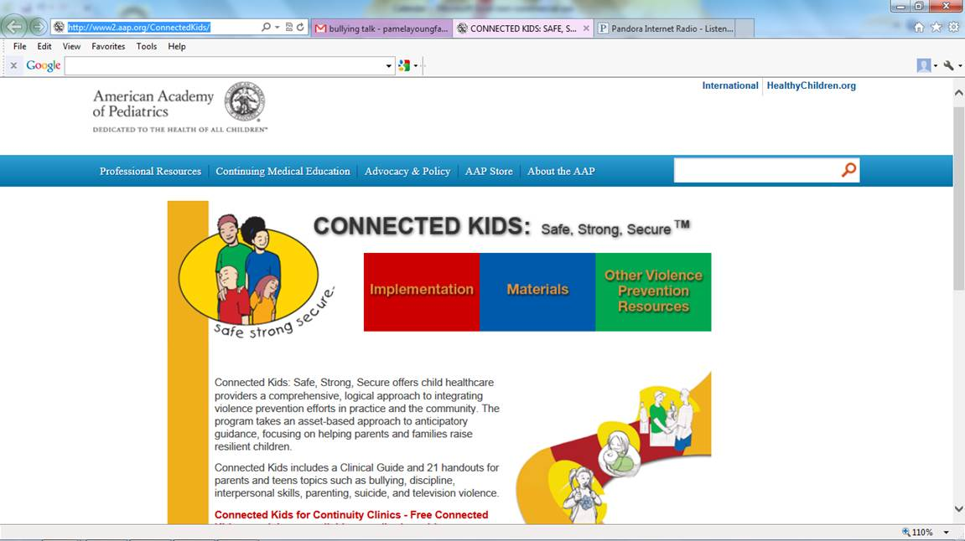
Notes:
Launched in 2005, anticipatory guidance for pediatricians around Violence prevention - training materials, ppts, brochures
Connected Kids for Continuity Clinics - Free Connected Kids materials are available to pediatric residency programs' continuity clinics, with support from the Friends of Children Fund. Continuity clinic directors can e-mail connectedkids@aap.org to sign up to receive materials.

Slide 28

Parents, kids, teachers
Signs of bullying, how to talk about it
Cartoon videos for kids
Laws by state (what they include)
Spanish site

Slide 29
Questions and Comments
…be nice, no bullying
Notes:
Time OpEd:
The word is being overused — expanding, accordionlike, to encompass both appalling violence or harassment and a few mean words.
Laws are confusing

