Slide 1

Screening for Critical Congenital Heart Disease using Pulse Oximetry
Legislative Advocacy
Anoop Rao PGY2, Pediatrics
Image www.overlakehospitalblog.org
Notes:
http://www.youtube.com/watch?v=qJMObPVjqKs

Slide 2

Why?
50%
of deaths from CHD occur in 1st year
of infant deaths occur in 1st month of life

Slide 3
Overview
Testing
New Born Screening
Critical Congenital Heart Disease Screening (CCHD’s)
Decision Making
Who decides?
Legislative progress

Slide 4
HISTORY OF NEWBORN SCREENING

Slide 5
History of New Born Screening
1960
1970
2000
2006
hemoglobin disorders, congenital hypothyroidism
PKU, galactosemia, MSUD
Tandem Mass Spec ~ 54 tests added
Newborn Screening:Toward a Uniform Screening Panel and System#
1980
Sickle cell disease
Recommended Uniform Screening Panel (RUSP) = 29 tests
# Watson MS, et al Exec Summary, Pediatrics Volume 117, Number 5, May 2006

Slide 6
History of New Born Screening:CCHD
2010
2011
2011
2012
2013
CCHD added to RUSP
SACHDNC¹ recommends CCHD to be added to RUSP
Strategies for Safe and effective Implementation of Screening for CCHD’s²
NY Gov Signed Legislation (Aug 1, 2013)
NJ first state to mandate screening
MD,NJ, IN
CT, NH, TN, WV
Secretary's Advisory Committee on Heritable Disorders in Newborns and Children (SACHDNC)
Kemper AR et al Pediatrics Vol. 128 No. 5 , 2011
Notes:
Early Adopters : CT, IN, MD, NH, NJ, TN, VA, WV

Slide 7
CCHD Screening
(subset of CHDs with life-threatening symptoms requiring intervention)
Corashopesanddreams.org

Slide 8
CCHD’s need surgery or catheter intervention in 1st year of life
  Hypoplastic left heart syndrome
  Pulmonary atresia (with intact septum)
  Tetralogy of Fallot
  Total anomalous pulmonary venous return
  Transposition of the great arteries
  Tricuspid atresia
  Truncus arteriosus
Problem: Neonates with CCHD’s can appear healthy at birth

Slide 9
Relative incidence of diseases
Disease | Incidence
CHD | 8/2000
CCHD | 2/1000
CF | 1/2000
Hypothyroidism | 1/4000
PKU | 1/10,000
MSUD | 1/180,000
~7,200 per year
Not screening = potential to miss ~ 2000 patients/year³
1) Heron, M., et al. (2009). Deaths: Final data for 2006. National Vital Statistics Reports, 57(14). U.S. CDC and Prevention.
2) http://www.cdc.gov/ncbddd/features/heartdefects-keyfindings2010.html
3) Missed Diagnosis of Critical Congenital Heart Disease Chang, et al. 2008

Slide 10
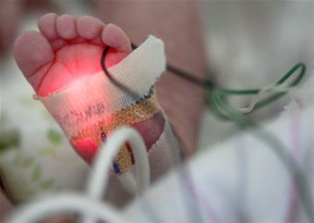
Role of Pulse Oximetry
Sensitivity: 76.5%
Specificity: 99.9%
For every 3 detected, 1 will be missed
Not meant to replace ECHO/Clinical Exam
Thangaratinam S, Brown K, Zamora J, Khan KS, Ewer AK. Pulse oximetry screening for critical congenital heart defects in asymptomatic newborn babies: a systematic review and meta-analysis. Lancet. 2012;379:2459-2464.

Slide 11
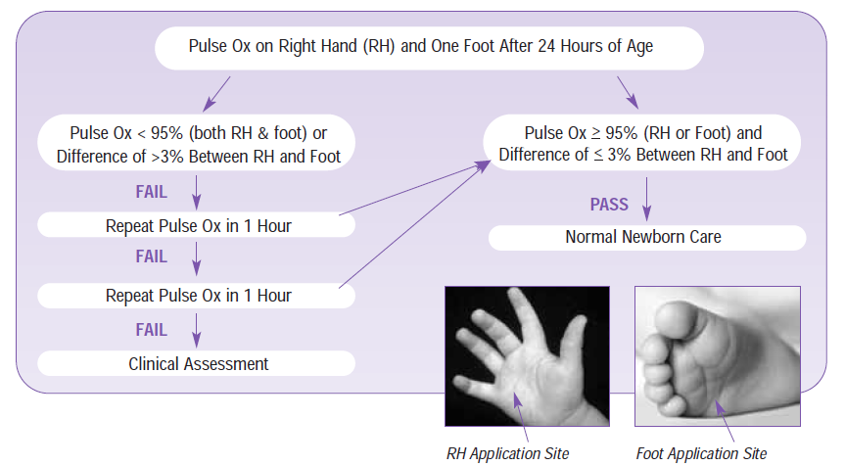
How to screen
Screening for Critical Congenital Heart Disease: The Newest Member of the Recommended Uniform Screening Panel

Slide 12
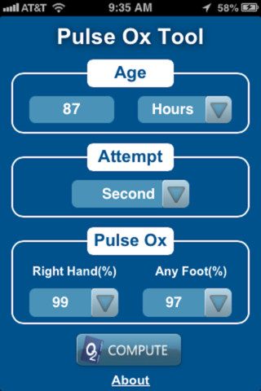
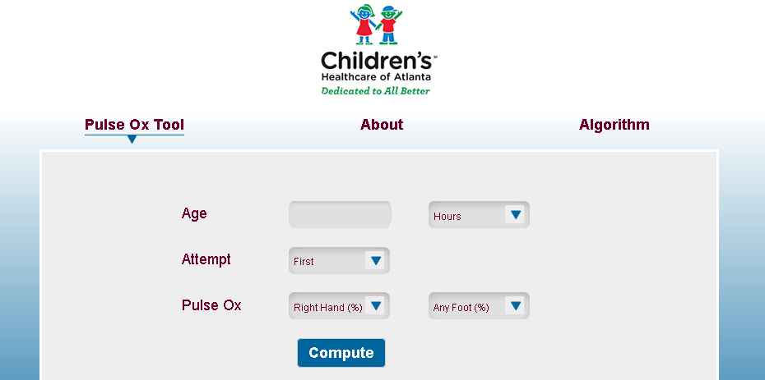
And there’s an App for that…
http://pulseoxtool.com/

Slide 13

DECISION MAKING AND LEGISLATION

Slide 14
Discretionary Advisory Committee on Heritable Disorders in Newborns and Children (DACHDNC)
American Academy of Family Physicians
American Academy of Pediatrics
Association of Maternal & Child Health Programs
Association of Public Health Laboratories
Association of State & Territorial Health Officials
Department of Defense
American College of Obstetricians & Gynecologists
American College of Medical Genetics
Genetic Alliance
March of Dimes
National Society of Genetic Counselors
Society for Inherited Metabolic Disorders
DACHDNC = new and improved SACHDNC

Slide 15
DACHDNC - Process
Nominate
Administrative Review
Evidence Working group Review
Present to the Committee
Vote

Slide 16
Vote → Recommended Uniform Screening Panel
Core Conditions
(31)
Secondary Conditions
(26)
Yet to be approved
Approved Conditions
_{RUSP}
http://www.hrsa.gov/advisorycommittees/mchbadvisory/heritabledisorders/nominatecondition/workgroup.html

Slide 17
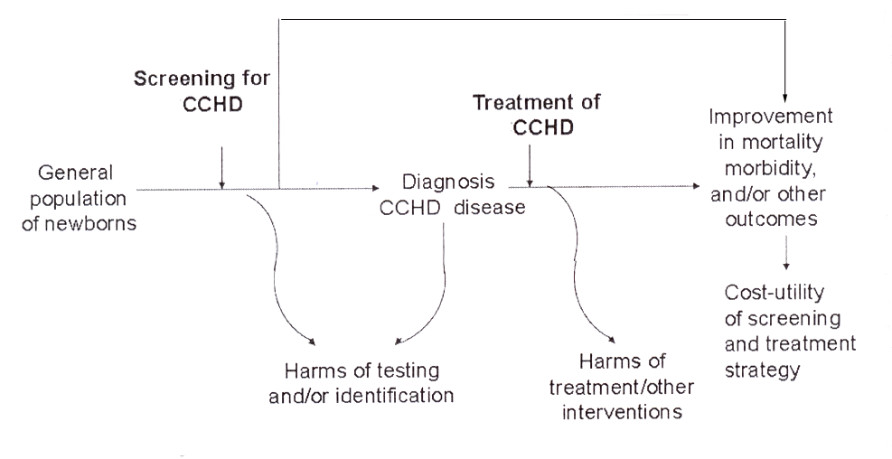
Thought process behind screening

Slide 18
CCHD: Demonstration Projects
CCHD Projects
Health Resources and Services Administration (HRSA) Funded
3 year projects
Location
WI, MI, NJ, UT, VA
New England Genetics Consortium: ME, NH, RI, CT, VT

Slide 19
CCHD: Role of Federal Agencies
HRSA
Guide development of screening standards/infrastructure
FDA
Guidance to industry, staff on pulse oximeters
NIH
Screening technology, diagnostic processes, care provided and health outcomes
CDC
Monitor infant mortality and health outcomes (utility and evaluation)
Fund Educational material

Slide 20
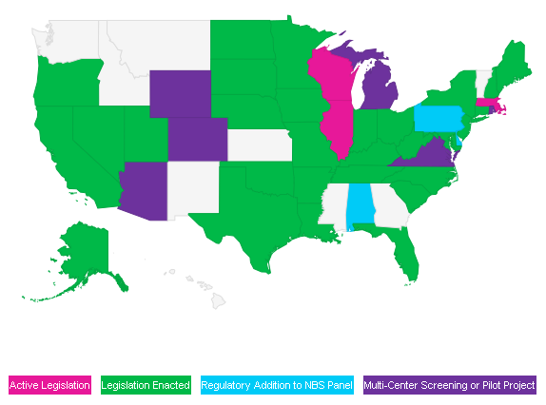
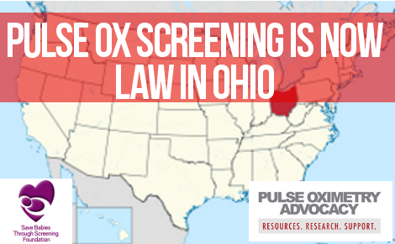

CCDH Screening Today
Aug 1, 2013: Law in New York State 180 days to implement
~ half the states have passed legislation
http://cchdscreeningmap.org

Slide 21


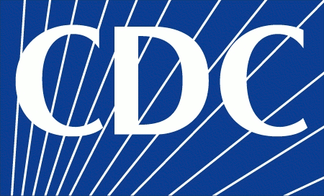

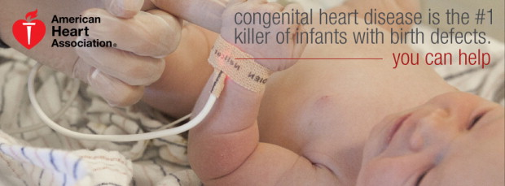


Advocacy Groups & Resources

Slide 22
Take Home Points
Pulse-ox screening is non-invasive, safe and effective tool
Pulse-ox Screening Mandated in NY
Legislation take time
You can't produce a baby in one month by getting nine women pregnant
– Warren Buffet

Slide 23
Preguntas?

