Slide 1
Violence in Video Games
Legislative Advocacy Presentation by Edna Akoto, Nina Dadlez, Cristina Fernandez, and Anna Hays
January 3, 2013

Slide 2

Outline
Background of violence in video games
Why pediatricians should care
Legislation around violence in video games
What we can do as pediatricians

Slide 3
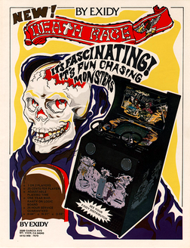
Background
Earliest recorded video game with “violence” was Death Race, a coin-operated arcade game released in 1976- players could run over black-and-white “gremlins” with a car
Working title for the game had been “Pedestrian” and the National Safety Council condemned anti-morals of Death Race
CBS show “60 Minutes” featured the
1st ever TV segment on psychological
effects of video games
Notes:
Video games gained popularity across American households in the early 1980s with the release of Atari’s Space Invaders’ and the arrival of Nintendo and its Super Mario Bros. game from Japan
NY Times featured its 1st article on a video game highlighting the controversy in December 1976 (The New York Times, ‘Death Race’ Game Gains Favor, But Not With the Safety Council, 1976, <http://select.nytimes.com/gst/abstract.html?res=FB0E10FD385B167493CAAB1789D95F428785F9>,)

Slide 4
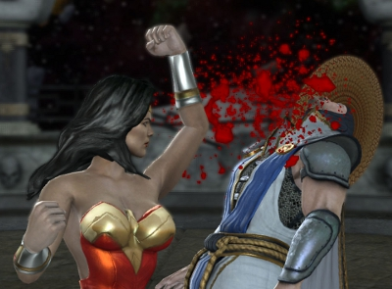
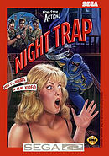
Background
Early 1990s unleashed games such as Mortal Kombat and Doom with more realistic graphics of gore, e.g. severing heads and ripping out hearts
Night Trap was released for the Sega Genesis in 1992 and featured a motion video horror adventure game where the main player could lead 5 girls at a slumber party into “death traps”
laid around the house or protect them
against vampiric creatures

Slide 5

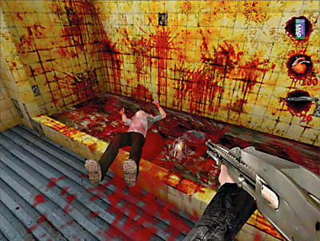
Parents and ultimately legislators grew concerned over violence and victimization of girls in the super popular games of Mortal Kombat and Night Trap among children mostly ages 7-12 years old
In 1993, the first joint hearings were held by Congress to investigate the video game industry marketing of violence to minors’
  Senators heard testimony from an expert panel of TV executives and psychologists as well as from Nintendo and Sega representatives
Notes:
Senators Herb Kohl of Wisconsin (Chairman of the Juvenile Justice Subcommittee) and Joe Lieberman of Connecticut (Chairman of the Governmental Affairs & Judiciary) presided over the 1993 hearings
http://www.c-spanvideo.org/program/52848-1

Slide 6
Background
As a compromise result of the federal hearings (and to avoid creation of a federal oversight group), the video game industry voluntarily created the Interactive Digital Software Association in 1993
In 1994 the IDSA created the Entertainment Software Rating Board (ESRB)- a self-monitoring panel that instituted a tiered rating system to track games' sexual and violent content
The ESRB created a rating system for video games: "Early Childhood," "Everyone," "Everyone 10+," "Teen," "Mature," or "Adults Only"
Notes:
The ISDA was renamed the Entertainment Software Association in 2003

Slide 7

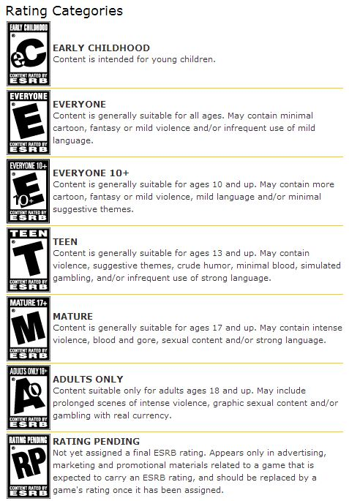
ESRB Content Descriptors
Alcohol Reference - Reference to and/or images of alcoholic beverages
Animated Blood - Discolored and/or unrealistic depictions of blood
Blood - Depictions of blood
Blood and Gore - Depictions of blood or the mutilation of body parts
Cartoon Violence - Violent actions involving cartoon-like situations and characters. May include violence where a character is unharmed after the action has been inflicted
Comic Mischief - Depictions or dialogue involving slapstick or suggestive humor
Crude Humor - Depictions or dialogue involving vulgar antics, including “bathroom” humor
Drug Reference - Reference to and/or images of illegal drugs
Fantasy Violence - Violent actions of a fantasy nature, involving human or non-human characters in situations easily distinguishable from real life
Intense Violence - Graphic and realistic-looking depictions of physical conflict. May involve extreme and/or realistic blood, gore, weapons and depictions of human injury and death
Language - Mild to moderate use of profanity
Lyrics - Mild references to profanity, sexuality, violence, alcohol or drug use in music
Mature Humor - Depictions or dialogue involving "adult" humor, including sexual references
Nudity - Graphic or prolonged depictions of nudity
Partial Nudity - Brief and/or mild depictions of nudity
Real Gambling - Player can gamble, including betting or wagering real cash or currency
Sexual Content - Non-explicit depictions of sexual behavior, possibly including partial nudity
Sexual Themes - References to sex or sexuality
Sexual Violence - Depictions of rape or other violent sexual acts
Simulated Gambling - Player can gamble without betting or wagering real cash or currency
Strong Language - Explicit and/or frequent use of profanity
Strong Lyrics - Explicit and/or frequent references to profanity, sex, violence, alcohol or drug use in music
Strong Sexual Content - Explicit and/or frequent depictions of sexual behavior, possibly including nudity
Suggestive Themes - Mild provocative references or materials
Tobacco Reference - Reference to and/or images of tobacco products
Use of Alcohol - The consumption of alcoholic beverages
Use of Drugs - The consumption or use of illegal drugs
Use of Tobacco - The consumption of tobacco products
Violence - Scenes involving aggressive conflict. May contain bloodless dismemberment
Violent References - References to violent acts

Slide 8

Several incidents fueled public outrage against violence in video games across the nation in the late 1990s-early 2000s:
  The 2 high schools boys who orchestrated the Columbine High School shootings in 1999 were allegedly “obsessed” with playing the game Doom
  In April 2000, 16-year-old teenager José Rabadán Pardo murdered his father, mother and his sister with a katana, proclaiming that he was on an "avenging mission" by Squall Leonhart, the main character of the video game Final Fantasy VIII
  Grand Theft Auto III, released in 2001, allowed players to kill police officers for points and to kill prostitutes to steal their money
  On June 7, 2003, 18-year-old American Devin Moore shot and killed two policemen and a dispatcher after grabbing one of the officers' weapons following an arrest for the possession of a stolen vehicle. At trial, the defense claimed that Moore had been inspired by the video game Grand Theft Auto: Vice City

Slide 9

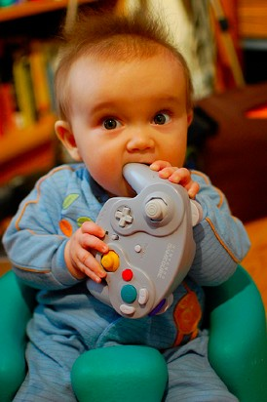
Why Should Pediatricians Care?

Slide 10

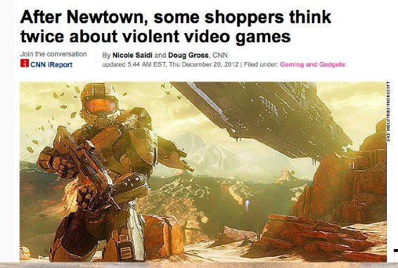
Violent Video Games in the Media

Slide 11
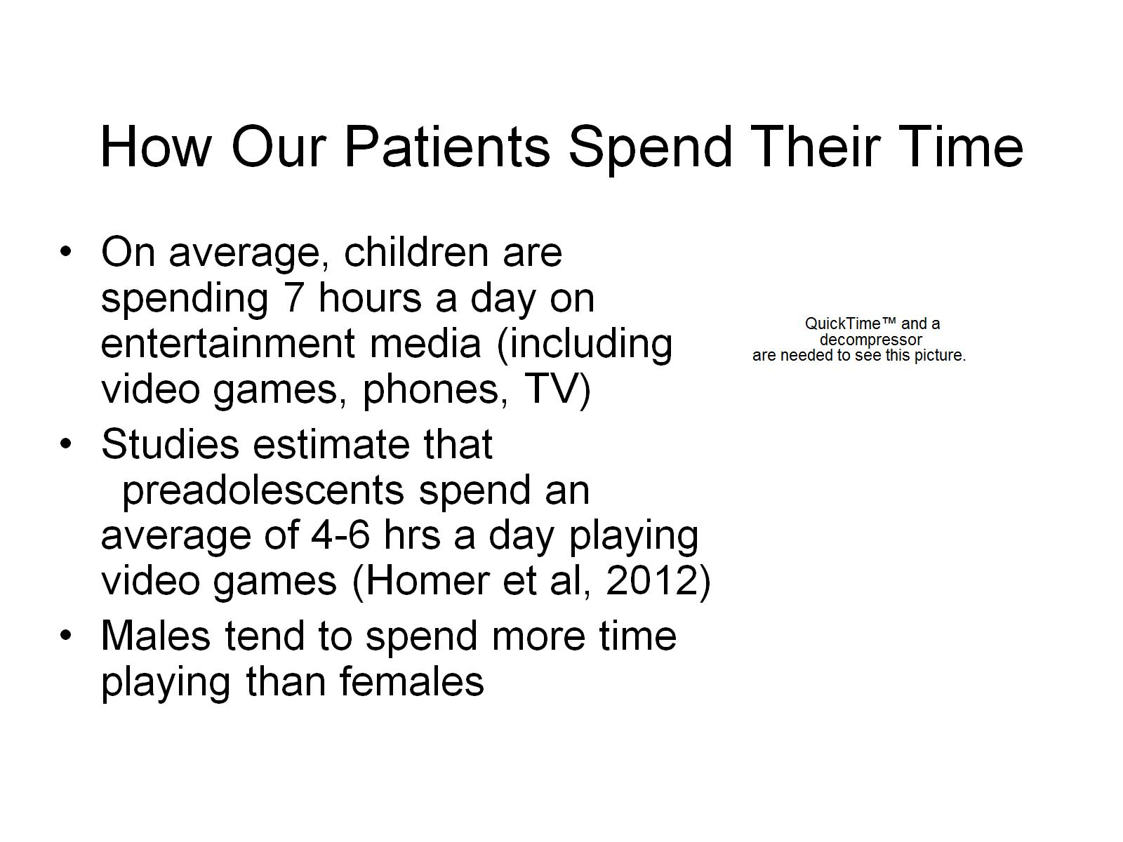

How Our Patients Spend Their Time

Slide 12
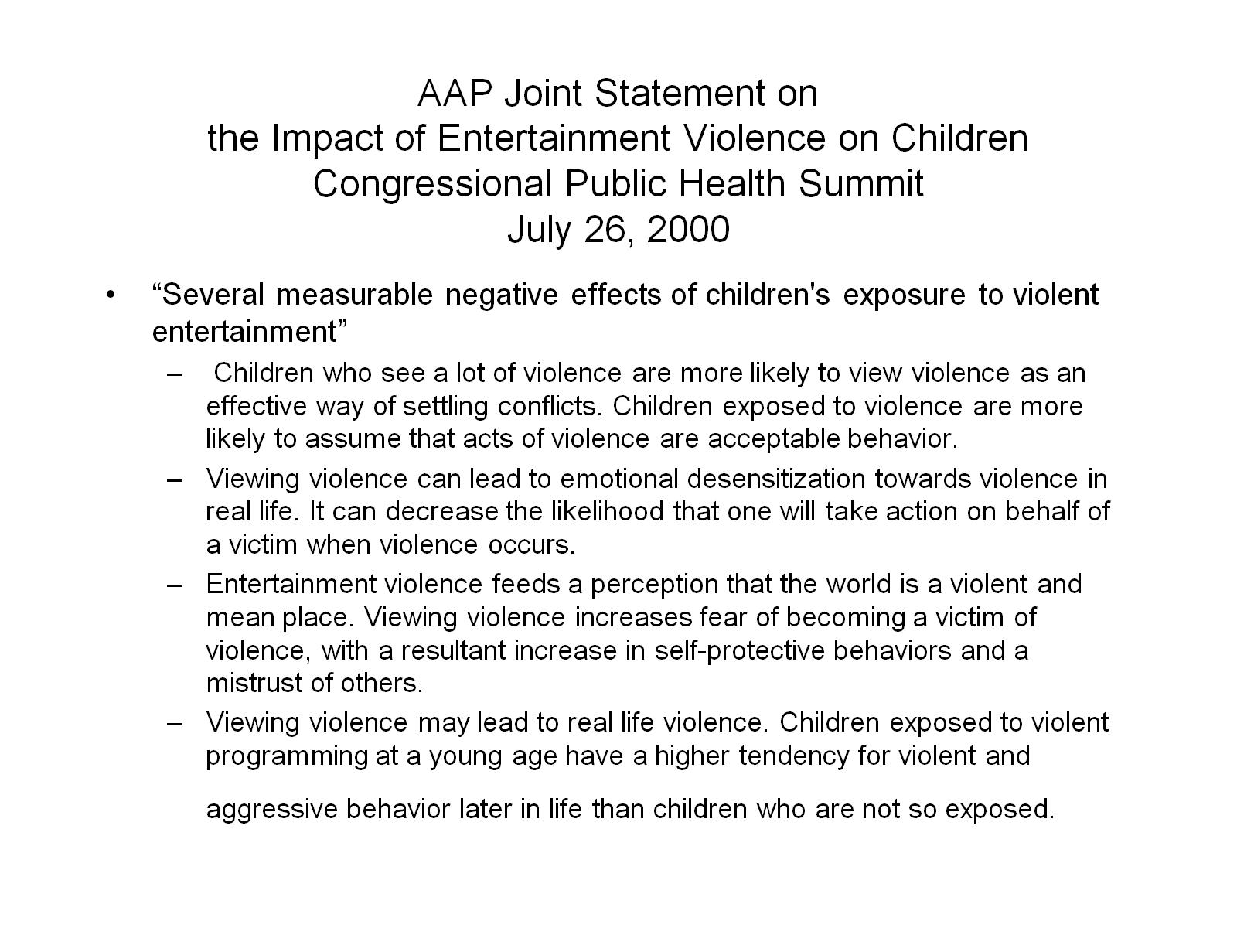
AAP Joint Statement on the Impact of Entertainment Violence on Children
Congressional Public Health Summit
July 26, 2000

Slide 13
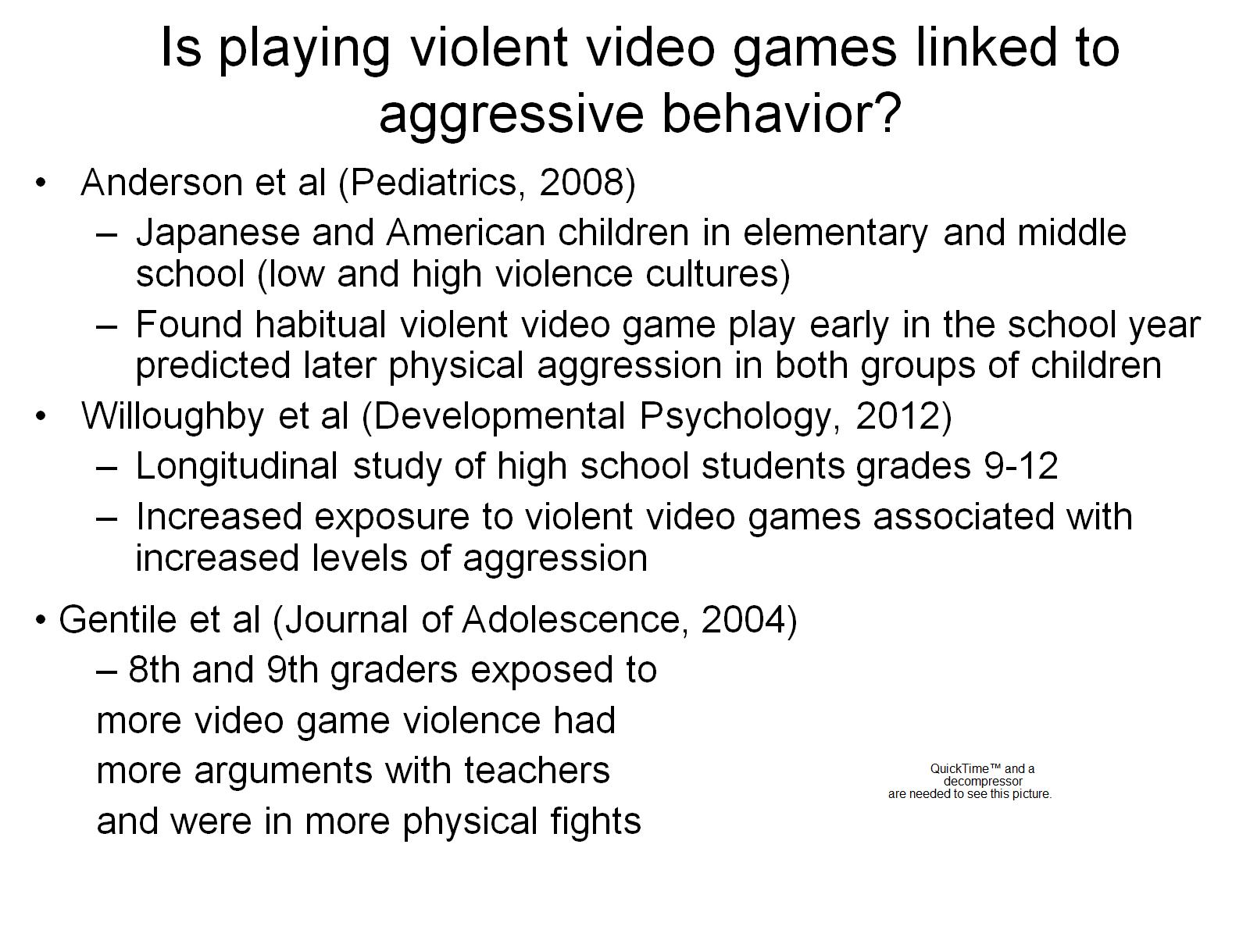

Is playing violent video games linked to aggressive behavior?

Slide 14
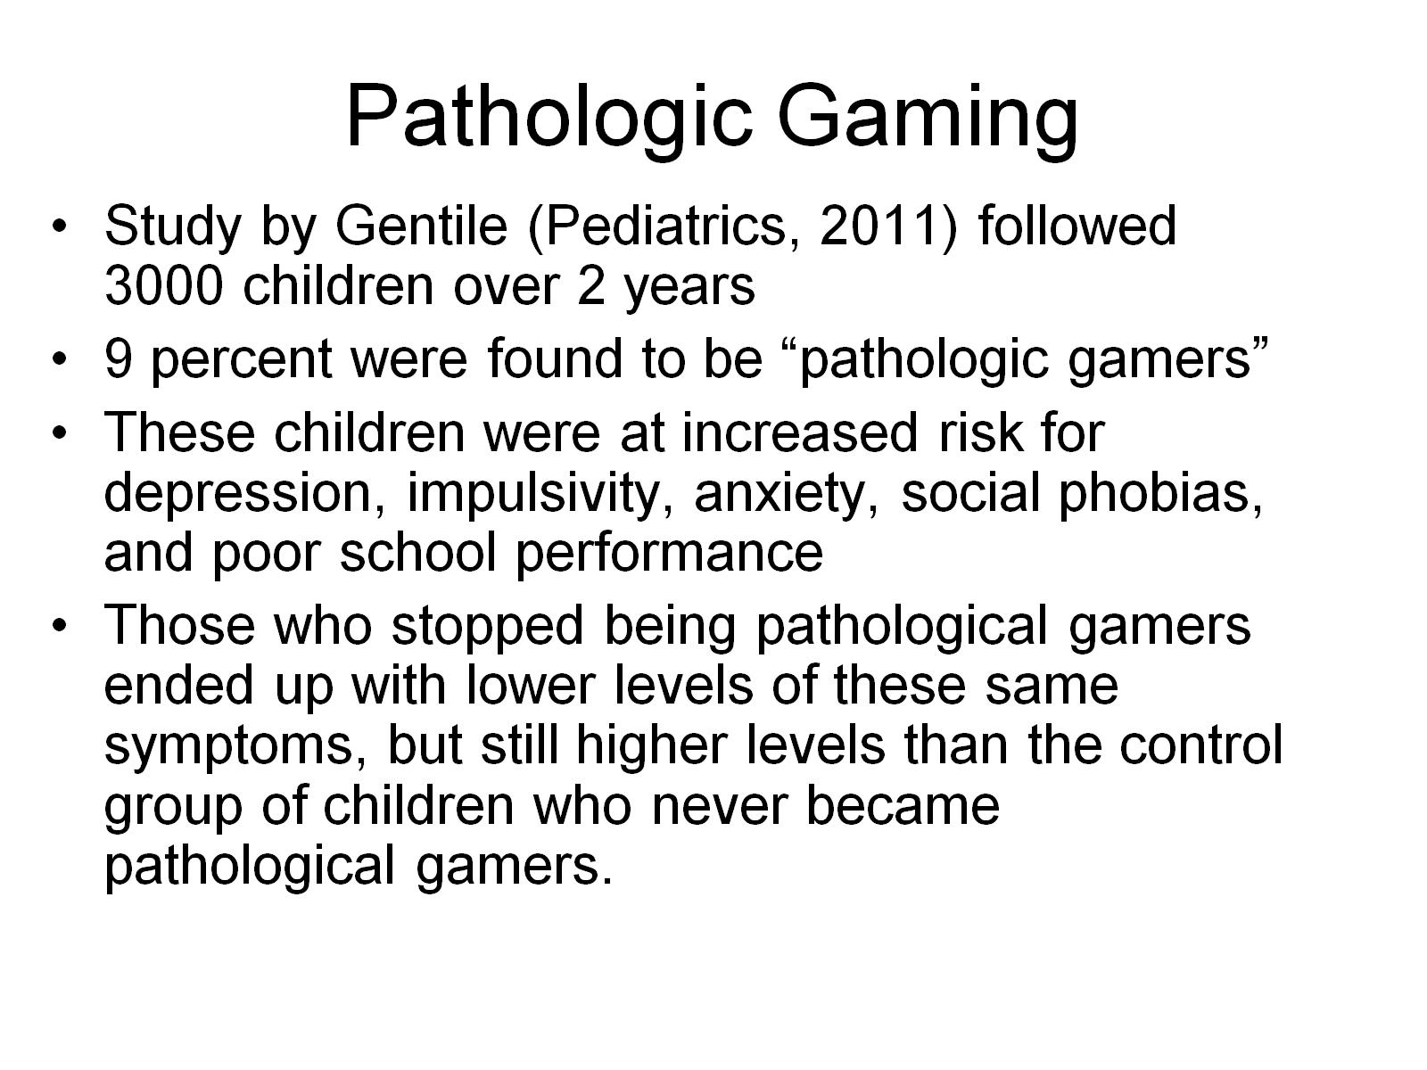
Pathologic Gaming

Slide 15
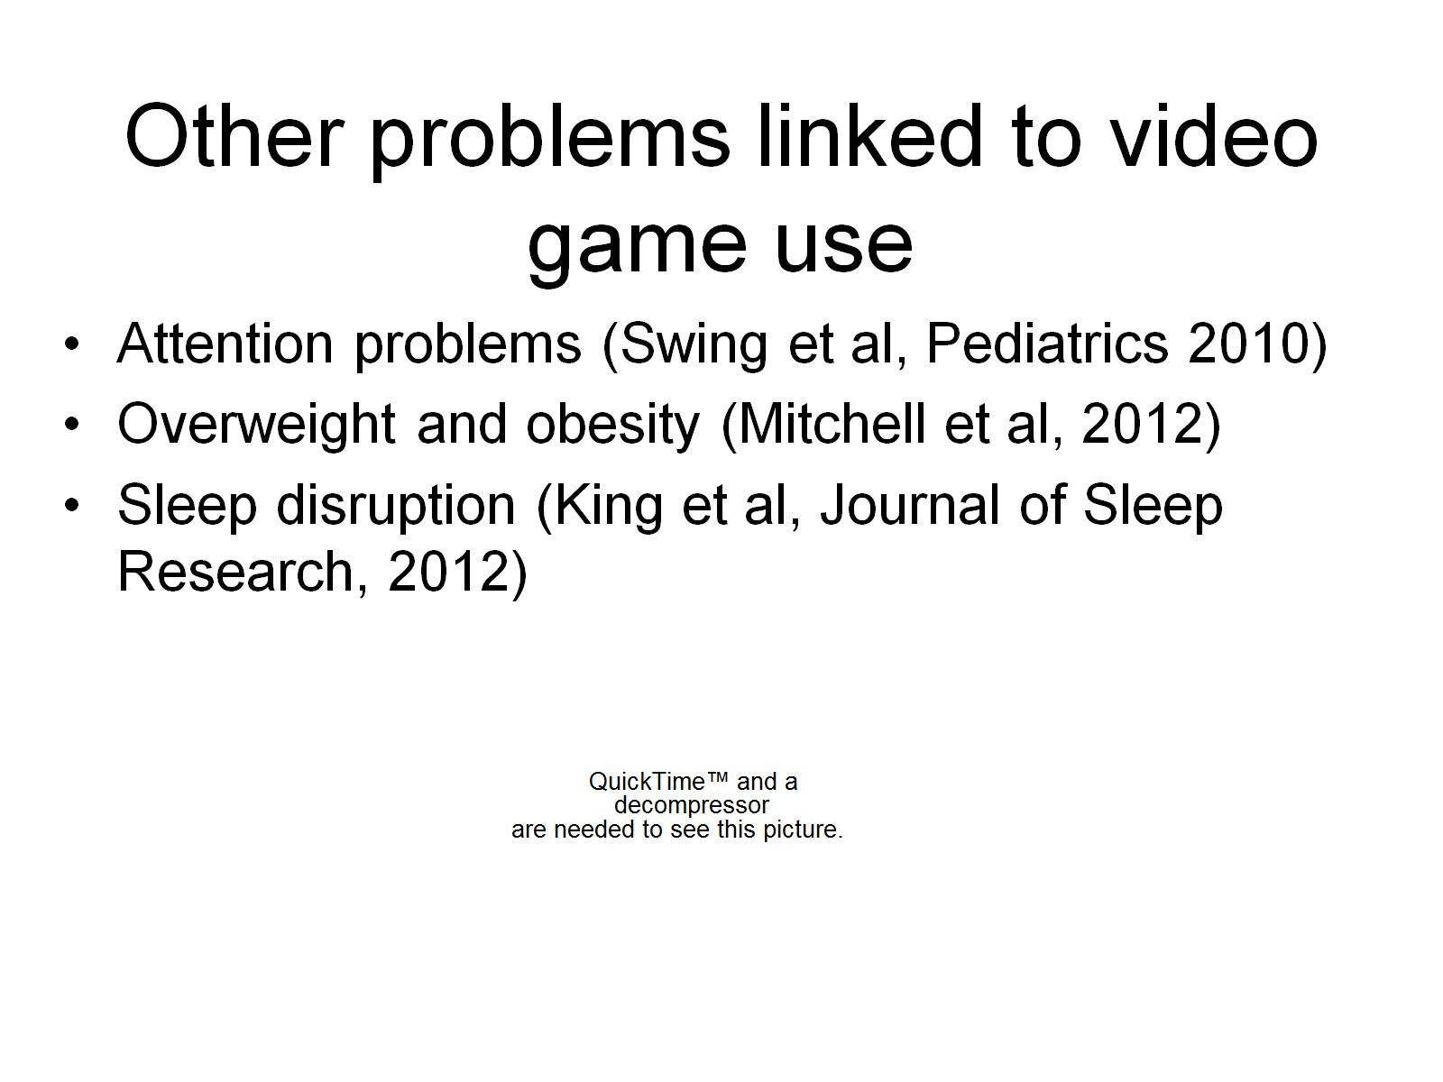

Other problems linked to video game use

Slide 16
Entertainment Software Rating Board
Industry Organization
Rates based on 6 point scale from “early childhood” to “adult only”
Rating system suggests the appropriateness of each game, but does not prohibit minor from purchasing videos with adult only ratings

Slide 17
ESRB Rating System
Early Childhood (EC) which has content that may be suitable for children ages 3 and older and does not contain material that parents would find inappropriate
Everyone (E) which has content that may be suitable for people age six and older and may contain minimal violence and some comic mischief, mild language or both
Everyone 10+ (E10+) which has content that may be suitable for age 10 and older and may contain cartoon, fantasy or mild violence, mild language and minimal suggestive themes
Teen (T) which h as content that may be suitable for people age 13 and older and may contain violent content, mild or strong language, and suggestive themes
Mature (M) which has content that may be suitable for people age 17 and older and may contain matures sexual themes, more intense violence and strong language
Adults only (AO) which has content suitable old for adults. Titles in this category may include graphic depictions of sex, violence, or both. These products are not intended for persons under the age of 18

Slide 18


Slide 19

Federal Bills
Video Game rating act of 1994 H.R.3785 (103)
Video Game Rating Act of 1994 S.1823 (103)
America’s Youth Commission Act of 1999 HR 3251 (106)
To Study Marketing Practices of Violent Games to Minors HR 2157 (106)
Children’s Defense Act of 1999 H.R.2036
Children’s Protection Act of 1999 H.R.1855 (106)
Children’s Protection Act of 2000 S.2127 (106)
Children’s Protection Act of 2000 S.3069 (106)
Children’s Protection Act of 2000 H.R.5350 (106)
Expressing the sense of the Congress regarding the need for a Surgeon General’s report on media and violence S.J.RES.23 (106)
Expressing the sense of the Congress regarding the need for a Surgeon General’s report on media and violence H.J.RES.47 (106)
Notes:
22 Federal Bills introduced since 1994. Warnings about video games being linked to aggressive behavior, rules to display warnings, rules to restrict sales, committees to research effects of video games on children

Slide 20

Federal Bills Continued
Children’s Protection Act of 2001 S.124 (107)
Protect Children from Video Game Sex and Violence Act of 2002 H.R.4645 (107)
Protect Children from Video Game Sex and Violence Act of 2003 H.R.669 (108)
Family Entertainment Protection Act S.2126 (109)*
Video Game Ratings Enforcement Act H.R.5345(109)
Video Game Decency Act of 2006 H.R. 6120 (109)
Video Game Decency Act of 2007 H.R.1531 (110)
Video Game Ratings Enforcement Act H.R.5990 (110)
Video Game Rating Enforcement Act of 2008S.3315 (110)
Child Protection from Video Game Violence and Sexual Content Act H.R.2958 (110)
Notes:
* Senator Hilary Clinton

Slide 21
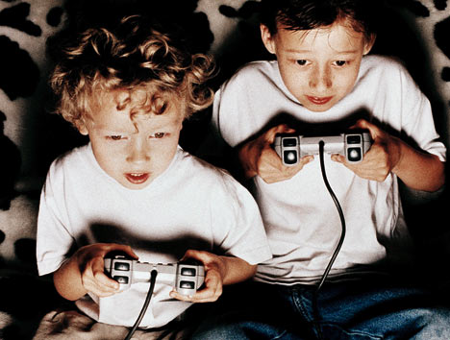
Children and Media Research Advancement Act
Purpose: to examine the role and positive and negative impact of electronic medial in children’s and adolescents’ cognitive, social, emotional, physical and behavioral development
Will create grants to fund this research through the CDC
Only federal act to get “floor action”, passed in Senate but referred to a committee and died in the House
4 versions of the bill before the 109th congress in 2005

Slide 22
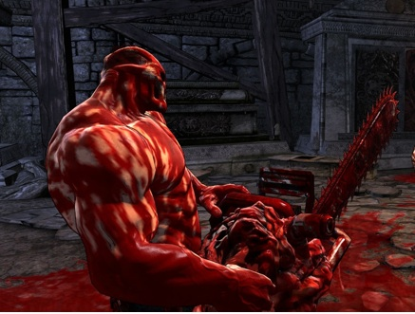
To Require Certain Warning Labels to be placed on Video Games that are Given Certain Ratings
Due to Violent Content
To display a clear warning on all video games rated T or higher by the Electronics Software Ratings Board
“WARNING: Excessive exposure to violent video games and other violent media has been linked to aggressive behavior.”
Introduced in the House in the 111th, died and reintroduced in the House before the 112th in two forms
Referred to a committee but not yet reported on
Prognosis: 3% chance of getting past committee and 1% chance of being enacted
Notes:
This bill goes on to define video game. Factors that helped this bill: there is at least one cosponsor from the majority party and one cosponsor out of the majority. Factors that hurt this bill: bill introduced in the first 90 days of Congress, the sponsor is a member of the minority party, the sponsor has a high leadership score but is not in the majority party, bill was a reintroduction

Slide 23
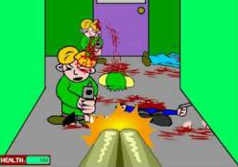
State Legislation
California | Bill 1792 banned sale of “ultra-violent video games” and bill 1793 required signs explaining regulation on such games be displayed where they were sold | Passed 2005, declared unconstitutional
Georgia | Requires anyone who sells or rents video games to display a sign explaining the ESRB rating system | Passed 2005
Illinois | Provides that the exhibition to or depiction to a minor of harmful materials as a Class A misdemeanor and a Class 4 felony for second offense | Passed 2005, declared unconstitutional
Louisiana | Allows a judge to rule on whether or not a video game meets criteria for being inappropriate for minors and be pulled from shelves Unlawful to distribute sexually-explicit video games to minors | Passed 2006, declared unconstitutional Passed 2006
Maryland | Bans games containing sexually explicit content to minors | Passed

Slide 24
State Legislation
Massachusetts | “Games as Porn” Bill – restricts violent and sexually explicit materials | Died
Michigan | Cannot sell or rent Adult or Mature videogames to anyone less than 17 yo | Passed 2005, ruled unconstitutional
Minnesota | Restricts sales or rentals of Mature or Adult games to minors, however puts onus on minors saying that if they were caught they would be fined $25 | Passed 2006, ruled unconstitutional
Oklahoma | Offers a content restricted-based tax break for game developers who produce games rated Teen Includes violent video games on a list of materials that is considered harmful to minors and requires stores to stock games out of plain sight | Died Passed 2006, ruled unconstitutional
Utah | Restricts minors access to violent video games, second bill to amend advertising law to encompass violent video games | Both Died

Slide 25
State/City Legislation
Washington | Bans sale of video games to minors that portrays realistic violence towards law enforcement officers Allows a person to maintain an action for personal injury or wrongful death against a manufacturer or retailer of violent video games , if the manufacturer or retailer has distributed violent video games to a minor and the game was a factor in creating conditions that encouraged the person to cause injury or death to another person Requires retailers to post signs detailing ESRB ratings and info to customers upon request | Passed 2003, ruled unconstitutional Died Passed
Indianapolis, Indiana | City Ordinance restricting minors access to violent video arcade games, requires coin-operated games featuring graphic violence or strong sexual content to have warning labels and be kept at least 10 feet from any nonviolent game | Ruled unconstitutional
St. Louis, MO | City Ordinance restricting sale or rental of violent video games to minors, requiring parental consent | Ruled unconstitutional

Slide 26
Brown v.
Entertainment Merchants Association
U.S. Supreme Court Case 2011, 7-2 decision
Ruled California law banning the sale of violent video games to children unconstitutional based on First Amendment
Justice Scalia says video games communicate ideas and social messages and compared them to Grimms Fairy Tales
Justice Alito : “The objective of one game is to rape a mother and her daughters, in another players attempt to fire a rifle shot into the head of President Kennedy”…soon, children may play three-dimensional high definition games wearing equipment that will allow them to “actually feel the splatting blood off the head of a victim”
Justice Thomas “Freedom of speech does not include the right to speak to minors without going through their parents of guardians”
Notes:
Justice Scalia said disgust is not a valid basis for restricting expression

Slide 27
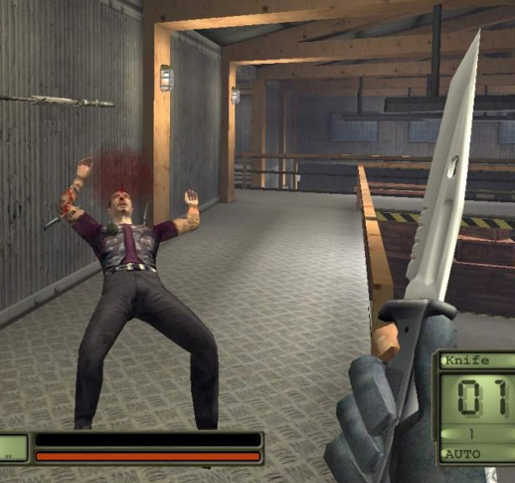
NY A11717 and S6401A
Passed in 2008
ESRB ratings must be displayed on
the outside of the package
New consoles sold in NY must have parental controls
Study of the relationship between media and youth violence and effectiveness of ESRB rating system
Does not apply to games/consoles sold online
Fine of no greater than $500 for single incident, no greater than 50,000 for multiple incidents
$100 for selling game without visible rating
Notes:
Fine of no greater than 500 dollars for single incident, no greater than 50,000 for multiple incidents and fine of 100 for selling game without visible rating.
Image from “Soldier of Fortune” – goal capture and brutally torture victims

Slide 28
NY AO 1474/A)2288 and S 699/S 753
Pending
Prohibits sale to minors of certain rated video games containing a rating that reflect various degrees of profanity, racist stereotypes or derogatory language and/or actions toward a specific group of persons

Slide 29

NY A02837 - Pending
Cannot sell or rent violent/explicit video games to minors
Warning label: 18+ Warning, Sale or Rental to Adults Only. May Contain Explicit Depictions Descriptive or Advocating of One or More of the Following: Commission of a Violent Crime, Suicide, Sodomy, Rape, Incest, Bestiality, Violent Racism, Religious Violence, Sado-Masochism, Sexual Assault, Sexual Activity, Murder, Morbid Violence, Illegal Use of Drugs or Alcohol, Parental Advisory.
ESRB rating
Labels must be in Black or Red Ink in 10 point or larger type and not readily removable from package
Lock videogames behind counter
$1000 for sale or purchase by non-custodial adult for minor

Slide 30
WHAT CAN WE DO AS PEDIATRICIANS??

Slide 31

Educator
Video game use at home?
Educate parents about use of video games in the home environment and outside the home
Parents to be aware of types of games being played by their children
Enforcement of rating system and sale of video games.

Slide 32

Advocate
-Federal
-State
-Community
-Local/practice

Slide 33
Resources
Internet
  Thomas.gov
  AAP
  Search Engines
Letters
Petitions

Slide 34
References
(The New York Times, ‘Death Race’ Game Gains Favor, But Not With the Safety Council, 1976. http://select.nytimes.com/gst/abstract.html?res=FB0E10FD385B167493CAAB1789D95F428785F9. Acessed 12/20/12
“The 10 Biggest Violent Video-Game Controversies.” CNN Tech News. June 29, 2011. <http://www.cnn.com/2011/TECH/gaming.gadgets/06/29/violent.video.games/index.html>. Accessed 12/21/12.
“A History of Virtual Violence.” Forbes.com. Digital Media, June 18, 2007. http://www.forbes.com/2007/06/15/games-violence-columbine-tech-cx_ag_0618videogames.html. Accessed 12/21/12.
“Video Game Violence.” Senate Committee Governmental Affairs. December 9, 1993. C-Span Video Library. http://www.c-spanvideo.org/program/52848-1. Accessed 12/23/12.
“Can a Video Game Lead to Murder?” CBS News. First aired March 6, 2005 with correspondent Ed Bradley. On-line February 11, 2009. < http://www.cbsnews.com/stories/2005/06/17/60minutes/main702599.shtml>. Accessed 12/23/12.
Legiscan: Bringing People to the Process. http://legiscan.com
Liptak, A. “Justices Reject Ban on Violent Video Games for Children”. New York Times: June 2011.
The Library of Congress: Thomas. http://thomas.loc.gov
“Splatterhouse Images”. www.IGN.com
Walters, L. “Game Censorship”. 2011. http://www.gamecensorship.com/legislation.htm

Slide 35
http://www.youtube.com/watch?v=sYNUp5rAZJo – After background section
http://www.youtube.com/watch?v=GfjuYhOS3XY – Max Payne 3 1:00 after Anna’s section
http://www.youtube.com/watch?v=HOLpVFrgvww – Grand Theft Auto 1:30 after Nina’s section
http://www.youtube.com/watch?v=pTtsn2Srm3E – Call of Duty 5:00 (play at beginning)

