Slide 1
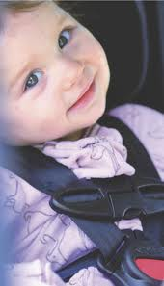
Child Passenger Safety
Vanessa Salcedo & Rebecca Turcotte
Legislative Advocacy
January 3, 2012

Slide 2
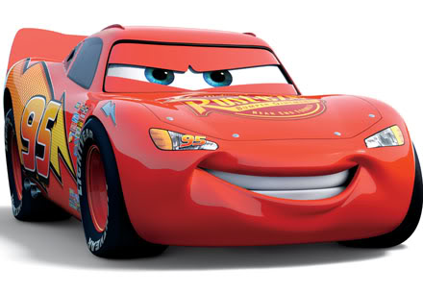
Outline
Background
Current Recommendations
Research
Legislation
NYC-Specific concerns
Resources for providers and caregivers

Slide 3
Epidemiology
Motor vehicle crashes are the leading cause of death in children 4 years of age and older.
15% of people killed in motor vehicle crashes in the US are under 21.
About 1500 children under 16 years old die in motor vehicle crashes in the US yearly; nearly half of them are unrestrained.
Many more are improperly restrained.
For every death, 18 children are hospitalized and 500 receive medical attention.
Child safety seats reduce the risk of injury by 71-82%, and risk of death by 28% as compared to seat belts.
Booster seats reduce risk on nonfatal injury by 45% in children 4-8 years old.
Significant racial disparities exist, with highest mortality rates for black and American Indian/Alaskan Native children.

Slide 4
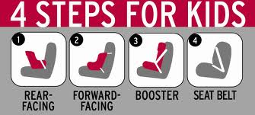
Current AAP Recommendations
Infants and toddlers under 2 yo should ride in rear-facing seats.
Children 2 and older should use a forward-facing seat for as long as possible (generally until 65-80 lbs.).
Children who have outgrown a forward-facing seat should use a booster seat until the lap-and-shoulder belt fits properly (generally 4 ft 9 in and between 8 and 12 yo).
Children should always use lap-and-shoulder belts once they’ve outgrown booster seats.
Children should ride in the back seat until age 13 yo.

Slide 5
How do I know when to transition?
In general, try to delay progression from one step to another, as there is always slightly less safety.
For test of selt belt fit, ask three questions:
  Is the child tall enough to sit against the seat back with his or her knees belt at the edge of the seat without slouching?
  Does the shoulder belt lie across the middle of the chest and should, not against the face or neck?
  Is the lap belt low and snug across upper thighs, not the abdomen?
www.seatcheck.org

Slide 6
Research behind Recommendations
Restraint systems are designed to:
  Reduce risk of ejection during a crash
  Better distribute the energy load to bones rather than soft tissue
  Limit the forces experienced by the occupant by prolonging deceleration time and
  Limit contact of the occupant with interior structures.
In 2008, restraint use was 99% among infants less than 1 yo, 92% among 1-3 yo, and 89% among 4-7 yo.
21% of children are not compliant with recommendations.

Slide 7
Why?
Rear-facing
  Support posterior torso, neck, head, and pelvis, and distribute forces over entire body.
  Babies’ incomplete vertebral ossification, horizontally oriented spinal facet joints, and ligamentous laxity, as well as large heads, put them at risk for movement of the head relative to the small neck.
  Swedish research has found a 90% decrease in significant injuries relative to unrestrained passengers, and they require rear-facing seats until 4 yo.
Forward-facing
  Spread crash forces over shoulders and hips, and control head excursion.
  54% reduction in death for children 1-4 yo compared to unrestrained.

Slide 8
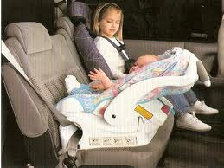
Why?
Booster seats and lap-and-shoulder systems.
  Prevention of “seat belt syndrome.”
  Use of shoulder belt reduces risk of injury by 81%.
Back seat
  Particularly back rear.

Slide 9
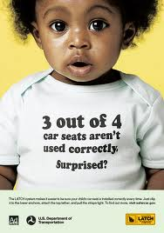
Videos
http://www.iihs.org/research/topics/child_restraints/default.html

Slide 10
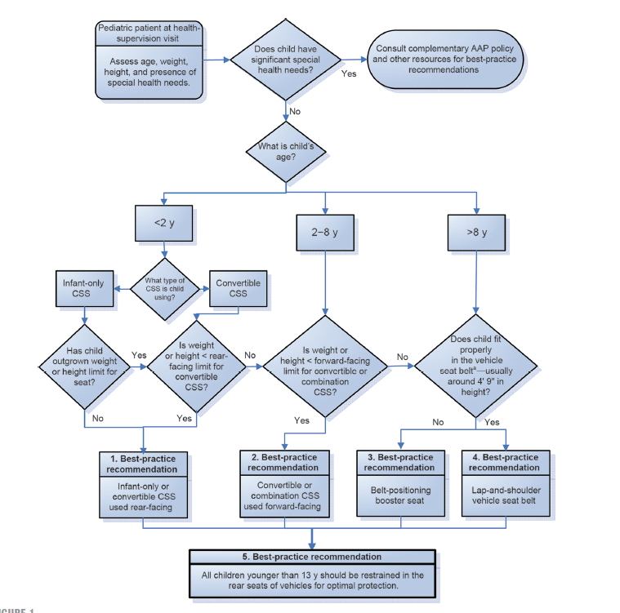

Slide 11
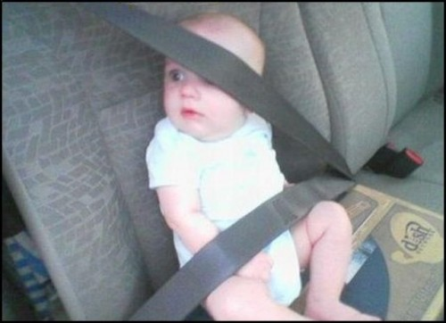

Slide 12
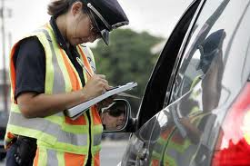
Types of Seat Belt Laws
Primary (standard) safety belt laws allow law enforcement officers to stop a vehicle and issue a citation for simply observing an unbelted driver or passenger.
Secondary safety belt laws allow law enforcement officers to only issue a citation for not wearing a seat belt only when the driver is stopped for another infraction.

Slide 13
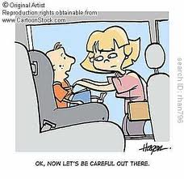
Child Restraint Law
Require children to travel in approved child restraint devices and some permit or require older children to use adult safety belts
Most restraints were put into place to protect adults without regard for children or infants
First State was Tennessee in 1978
  Robert Sander, Pediatrician
By 1985 all 50 states and DC had passed laws requiring child restraints for young children

Slide 14
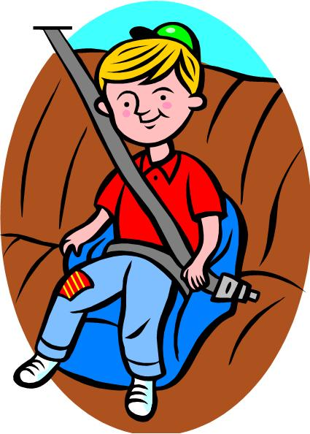
Child Restraint Law
Laws were inconsistent, several gaps
  The age at which belts can be used differ among states
  Young children usually are covered by child restraint laws
  Older children and Adults are covered by Safety belt law
  Enforcement and fines differ among states
  Poor compliance
In the 1990s, protection for older children would take a leap forward. Automakers were finally required to install three-point belts in rear

Slide 15
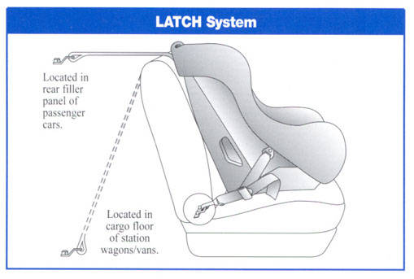
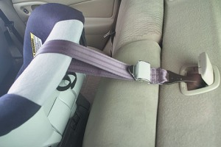
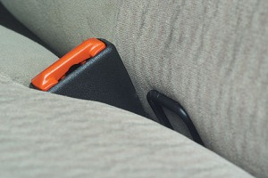
Lower Anchor and Tethers for Children (LATCH)

Slide 16
Anton’s Law
December 2002, the federal government passed legislation called "Anton's Law." Its goal was to improve federal standards for child restraint systems for kids weighing more than 50 pounds, typically children ages 4 to 8
The law is named for Anton Skeen, a Washington state four-year-old who was ejected from his seat belt and killed in a rollover crash. His mother, Autumn Alexander Skeen, succeeded in helping to get Washington's belt-positioning booster seat bill passed in 2000, the first ever in the U.S
Anton's mother worked for better federal standards for kids in the 4 to 8 age who may have outgrown their child safety seats but are too small for regular seat belts

Slide 17
National Highway Traffic Safety Administration (NHTSA)
Develop federal regulation and strategies for reducing the number of children killed and injured in motor vehicle crashes
Conducts national campaigns to educate the public about the importance of buckling children into child restraint systems.
To improve existing requirements for the performance and testing of child restraint system
Federal Motor Vehicle Safety Standards (FMVSS) and Regulations to which manufacturers of motor vehicle and equipment items must conform and certify compliance

Slide 18
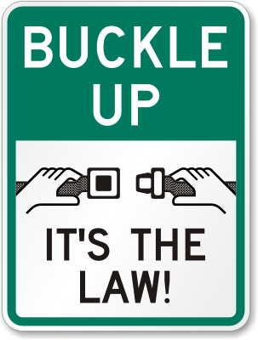
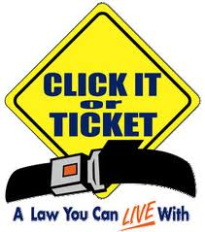
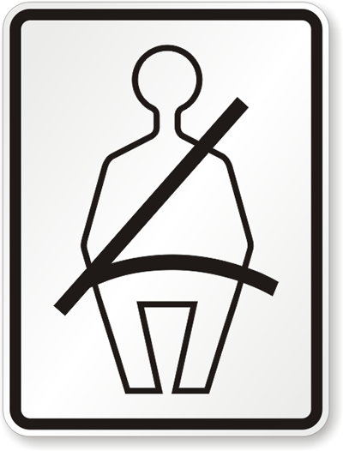
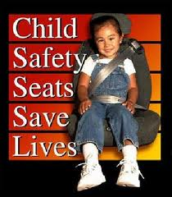
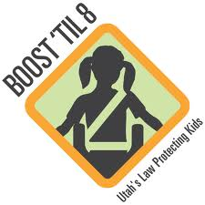
Campaigns

Slide 19
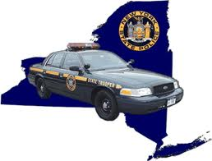
New York State Law
On April 1, 1982 New York State's first child passenger restraint law went into effect
The law requires children under the age of 4 to be restrained in a federally approved car seat when riding in a motor vehicle Section 1229-c(1)
If the weight of a child under the age of 4 exceeds 40 pounds, the child may be restrained in an appropriate child restraint system, allowing the child to use a booster seat
Children ages 4 -8 yr must be properly secured in an appropriate child restraint system, one for which your child meets the weight and height recommendations of the child restraint manufacturer. Section 1229-c(1)

Slide 20

New York State Law
Children < 4 y.o. must be restrained while riding on a school bus Section 1229-c(11)
It is highly recommended that all children age 12 and under ride properly restrained in the back seat but NO LAW against children riding in the front

Slide 21
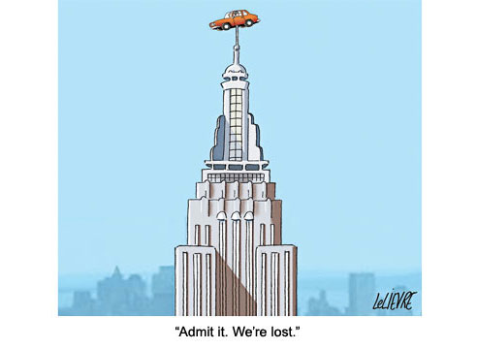
What about taxis?
Driver and passengers in NYC yellow cabs are exempt from car seat and seatbelt laws.
Everyone is “encouraged” to buckle up in a taxi.
Passengers with children are encouraged to bring their own car seats, and drivers must allow them to install their seats.

Slide 22
Resources
NHTSA – Standardized child passenger safety training and certification program in 1998
  Community-base child safety clinics
  Source of info installation of all types of CSS and booster seats
Formal Inspection Stations: www.seatcheck.org
National Child Passenger Safety Certification Web site http://cert.safekids.org
NHTSA child safety seat inspection station locator www.nhtsa.dot.gov/cps/cpsfitting/index.cfm
Car seat checkup events or updates www.safekidsweb.org
Guide for Families: Healthychildren.org

Slide 23
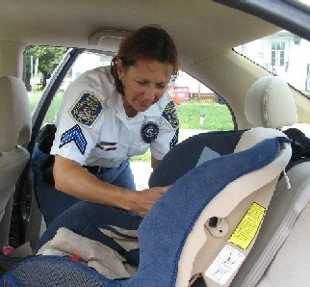
Inspection Stations
New York City DOT Safety Programs
Harrison Street, between West and Greenwich Streets, New York, NY 10013
Spanish Speaking Technicians are available.
NYC Department of Transportation, Access Safety City
672 West 158th Street, New York, NY 10032
Bronx Safety City (NYC DOT)
837 Brush Avenue, Bronx, NY 10465
Appointment required
Spanish Speaking Technicians are available.
Keeping Generations Safe
Lincoln Medical & Mental Health Center
234 East 149th Street, Bronx, NY 10451

Slide 24
References
New York City Taxi and Limousine Commission
(http://www.nyc.gov/html/tlc/html/passenger/faq_pass.shtml#9)
Durbin DR (2011) Pediatrics 127:e1050-e1066.
Durbin DR (2011) Pediatrics 127:788-793.
Bull MJ (2002) Pediatrics 109:550-553.
http://safeny.ny.gov
http://www.healthychildren.org
http://www.nhtsa.gov
http://www.iihs.org/laws/SafetyBeltUse.aspx
http://www.research.chop.edu/programs/carseat/

Slide 25

Thanks and Happy New Year!

