Slide 1
“TO LABEL OR NOT TO LABEL?”
Childhood Choking Hazards & The Law
Legislative Advocacy Project
Rakhee M. Bowker, MD/PGY-2
April 19th, 2011
Notes:
For my legislative advocacy project this year, I was interested in the legislation around protecting children from food-related choking, particularly legislation that would require vendors to place warning labels on high risk foods (popcorn, hotdogs, grapes, etc) stating clearly that such foods present a choking hazard for children 3 and under. I was particularly interested in this topic because my son Rohan, at age 6.5 months, has reached the stage at which everything he handles goes into the mouth. Although he is happily enjoying his pureed diet of pears and carrots, I realize that he is rapidly approaching toddlerhood, table food, and self-feeding. After having cared for children in the PICU who were neurologically devastated after aspirating popcorn, I was interested to know what legislation exists to protect children (and warn/inform parents) with regard to food-related choking hazards.

Slide 2
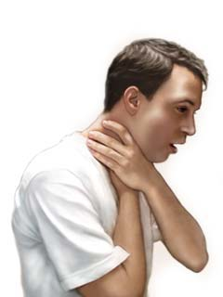
Choking
  Choking is the blockage or hindrance of respiration by a foreign-body obstruction in the internal airway, including the pharynx, hypopharynx, and trachea.
  Airway obstruction can be fatal if it leads to serious impairment of oxygenation and ventilation.
Committee on Injury, Violence, and Poison Prevention. “Policy Statement: Prevention of Choking Among Children.” Pediatrics 2010; 125 (3): 601-607
Notes:
Obviously you all know what choking means, but for the sake of clarity, when I speak about choking I refer to blockage or hindrance of respiration by a foreign body obstruction in the internal airway, including the pharynx, hypopharynx, and trachea
Airway obstruction in the setting of choking can be fatal if it leads to serious impairment of oxygenation or ventilation

Slide 3
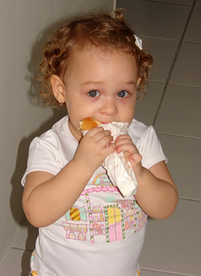
Epidemiology of Choking
Choking is a leading cause of morbidity and mortality in children, especially those < 3 yrs of age
  77% of choking episodes occur in children 3 yrs and under
  Every 5 days, 1 child in the U.S. dies from food-related choking, with 66-77 such deaths annually
  >10,000 ED visits annually for food-related choking among children < 14 yrs
CDC: Analysis of non-fatal choking episodes among children < 14 yrs old treated in US hospital EDs in 2001:
  17,537 kids treated for non-fatal choking in 2001
  60% w/ food-related choking
  31% w/ non-food choking
  9% cause of choking unknown
Hot dogs account for 17% of food-related asphyxiations among children < 10 yrs old (Harris, 1984)
Centers for Disease Control and Prevention. Nonfatal choking-related episodes among children: United States, 2001. MMWR 2002;51(42):945–948
Notes:
Choking is a leading cause of morbidity and mortality in children, especially those under 3 yrs of age. 77% of deaths related to choking occurred in children 3 yrs of age and under. Every 5 days, one child in the US dies from food-related choking. 66 to 77 children under age 10 die from choking on food each year in the United states. >10,000 ED visits can be attributed to choking on food among children aged 14 yrs and younger.
Nonfatal choking episodes are often not reported because many of these events are transient, don’t result in aspiration, and so don’t result in visits to health professionals. The CDC did an analysis of non-fatal choking episodes among children aged 14 or younger treated in US hospital ED’s in 2001. This was on the basis of data reported through the National Electronic Injury Surveillance System – All Injury Program (NEISS-AIP).
Of 17,500 children treated for nonfatal choking, 59.5% were treated for food-related choking, 31.4% for choking on non food items, and 9.1% had an unknown cause of choking. 13% of choking episodes were caused by coins. 19% of choking episodes were caused by candy or gum. Latex balloons are the leading cause of choking death. Between 1990 -2004, 68+ children died from choking on latex balloons. Most of these children were under 6 yrs of age.
Not surprisingly, choking rates were highest among infants. 30.5% of choking episodes occur among infants, and 77.1% of choking episodes occur among children aged 3 yrs or younger. Boys and girls were equally affected.
10.5% of the children receiving emergency medical treatment for choking were admitted to the hospital/transferred to a facility with an available ICU.

Slide 4
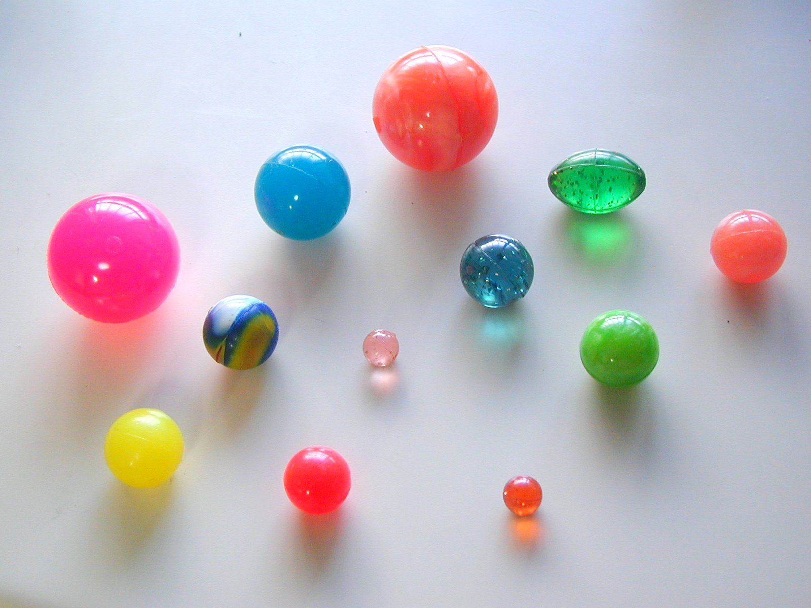
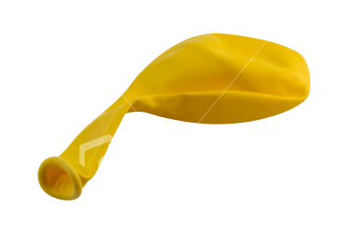


Common Non-Food Choking Hazards
Notes:
Latex balloons are the leading cause of choking death, mostly in children under 6 yrs.
At least 68 children died from choking on latex balloons from 1990 thru 2004 in the United States. [US Public Interest Research Group. Trouble in Toyland: The 20th Annual Survey of Toy Safety. Washington, DC: US Public Interest Research Group Educational Fund; 2005]
Balloons are a hazard because they can conform to a child’s airway and form an airtight seal.
Round, ovoid, or cylindrical objects (bouncing balls, marbles, spherical toys) pose great risk of choking death. If approximately the same diameter as a child’s upper airway, can completely occlude the airway with a snug fit and are difficult to dislodge with rescue maneuvers.

Slide 5
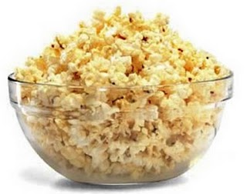

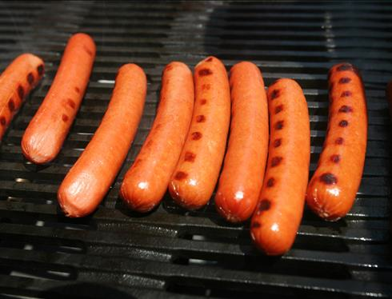
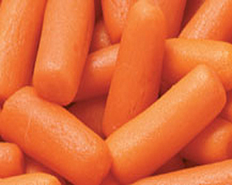
Deceptively Dangerous:
Common Choking Hazards in the Kitchen
Notes:
The hot dog shares physical characteristics of high risk toys. It is cylindrical, airway sized, and compressible, which allows it to wedge tightly into a child’s hypopharynx and completely occlude the airway.
Other high risk foods include hard candy, peanuts/nuts, seeds, whole grapes, raw carrots, apples, popcorn, chunks of peanut butter, marshmallows, chewing gum, and sausages.
Round candy, grapes, marshmallows, and hotdogs share high risk physical characteristics that create effective plugs for the pediatric airway.
Peanut butter, like balloons, can conform to the airway and form a seal that is difficult to dislodge or extract.

Slide 6

Choking is Particularly Dangerous in Children Under Age 3 Yrs
Underdeveloped ability to chew and swallow food
  Molars required for chewing and grinding food erupt at 13-19 months (1st molars) and 25-33 months (2nd molars)
  Kids 3 yrs and under lack the cognitive skills and behavioral control to chew well/eat slowly
Behavioral Factors
  Children explore their environment by placing objects in the mouth
  High activity while eating/eating quickly
Small airway is more vulnerable to obstruction
  Smaller diameter airway more likely to experience significant blockage by small foreign bodies
  Resistance to Air Flow ≅ 1/(radius⁴)
Decreased ability to dislodge foreign body
  Child’s cough has less force than an adult’s cough
Committee on Injury, Violence, and Poison Prevention. “Policy Statement: Prevention of Choking Among Children.” Pediatrics 2010; 125 (3): 601-607
Notes:
Why is choking so dangerous in children 3 yrs of age and younger?
Although infants are developmentally able to suck and swallow and have involuntary reflexes (gag, cough, glottic closure) that help protect against aspiration during swallowing, the molars required for chewing and grinding of food do not erupt until 13-19 months of age, and the second molars do not come in until 25-33 months of age. In addition, young children do not have the cognitive skills or the behavioral control to chew well and eat slowly.
A young child’s airway is more vulnerable to obstruction than that of an adult in several ways.
Smaller diameter airway is more likely to experience significant blockage by small foreign bodies. Remember that resistance to air flow is inversely related to the radius of the airway to the 4th power, so small changes in the cross-section of the airway of a young child can lead to dramatic changes in airway resistance and air flow. If the radius is reduced by ½, the resistance increases 16-fold.
Mucous and secretions around a foreign body in the airway will reduce the radius of the airway even further and may also form a seal around the foreign body, making it harder to dislodge by forced air (such as the Heimlich maneuver)
The force of air generated by a cough in an infant or a young child is less than an adult so a cough may be less effective in dislodging a complete or partial airway obstruction during early childhood
Behavioral factors may increase choking risk:
(1) High activity levels while eating (such as walking or running, talking, laughing), and eating quickly may increase a child’s risk of choking.
(2) Child games which involve throwing food in the air and catching it in the mouth, or stuffing large numbers of marshmallows or other food in the mouth (Chubby Bunny) may also increase the risk of choking

Slide 7

Existing Legislation Protecting Children from Choking Hazards
The Federal Hazardous Substance Act (FHSA)
  Pub L No.86-613 (1960)
  Amended in 1994 by the CSPA
  Section 1501: SPTF (small parts test fixture) test of object size
Child Safety Protection Act
  Pub L No. 109-248 (1994)
  Requires choking-hazard warning labels on packaging for small balls, balloons, marbles, and certain toys and games that contain small parts
  This act also bans any toy intended for use by children younger than 3 years that may pose a choking, aspiration, or ingestion hazard
Consumer Product Safety Improvement Act
  Pub L No. 110-314 (2008)
  Amended the FHSA to require choking-hazard warnings to be displayed on (or adjacent to) product ads on websites, in catalogs, or in other printed materials that provide a direct means for purchase of a product that requires an FHSA warning label
Notes:
Currently there are several laws that try to ensure that toys are safe for children and address choking hazards.
The Federal Hazardous Substance Act was amended in 1994 by the Child Safety Protection Act. Section 1501 of the FHSA defines a test of object size using the small-parts test fixture (SPTF). This is a truncated cylinder with a diameter of 3.17 cm simulating the mouth, and a depth between 2.54 and 5.71 cm, simulating the pharynx. An object is considered a small part if it fits completely within the SPTF. (FYI: The SPTF was developed on the basis of data regarding the dimensions of airway foreign bodies recovered by bronchoscopy by Chevalier Jackson in the early 1900s.)
The Child Safety Protection Act requires choking-hazard warning labels on packaging for small balls, balloons, marbles, and certain toys and games that contain small parts when these items are intended for use by children in defined age groups. The Child Safety Protection Act also bans any toy intended for use by children younger than 3 years that may pose a choking, aspiration, or ingestion hazard.
The Consumer Product Safety Improvement Act was passed in 2008 and amended the federal hazardous substance act to require choking hazard warnings to be displayed on product ads on websites, in catalogs, or in other printed materials that provide a direct means for purchase of a product that requires an FHSA warning label

Slide 8
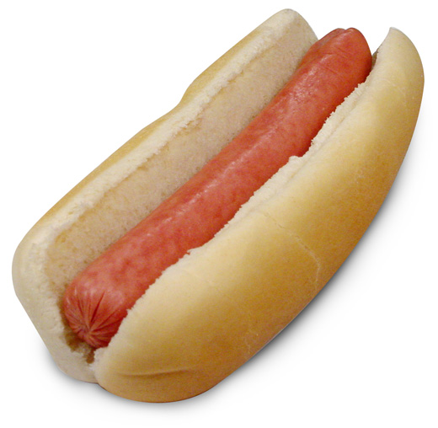
Two Illustrative Cases
POPCORN RELATED DEATH: Allison Hale
Allison died at age 23 months after choking on popcorn (July 2006 in Keller, TX)
  Patrick Hale, a CPR-certified Marine, was sitting down with his children watching TV and eating popcorn, when he witnessed his daughter turning purple and unable to breathe.
  He could not dislodge the popcorn with blows to her back and finger swipes down her throat. He called 911 but was too late; by the time they arrived at the hospital, Allison’s heart had stopped beating.
  Autopsy indicated that she had aspirated popcorn into her vocal cords, bronchial tree, and lung
“Neither one of us knew that popcorn was unsafe.” – Christie Hale (mother)
  After her daughter died, Mrs. Hale found that some brands of microwave popcorn had a small warning on the bottom of the box, which she had never noticed. “What person reads the bottom of a box?” she asked.
  The Hale family sued the popcorn manufacturer for wrongful death and settled out of court.
HOT DOG RELATED DEATH: Joseph Tyler (“J.T.”) Bartolomeo
J.T. died at age 3 from asphyxiation after choking on a hotdog. His family and friends became involved in advocacy attempting to prevent similar deaths, and helped propel the Food Choking Prevention Act into being.
“My advocacy of JT’s Law, endearingly named after my godson Joseph Tyler Bartolomeo, was prompted by his tragic choking death on a hot dog at the age of 3. This horrific devastation catapulted me into the legislative arena seeking solace in the knowledge that his story will be told and save hundreds of children from such a preventable waste of life and other families from the same incomprehensible pain.”
    – Joannie Hugues, J.T.’s godmother

Slide 9
J.T.’s Law
Food Choking Prevention Act (J.T.’s Law)
  On April 23, 2008, JT’s Law was enacted by Gov Paterson after 3 yrs in the NY legislature
    The Bill was originally introduced by Assemblyman Bob Barra (R) and State Sen. Dean Skelos (R) in March 2005
  Bill gives the New York Department of Health the authority to:
    Establish criteria for determining which foods & food products may pose a significant choking risk for children in various age groups.
    Conduct public awareness and education programs on choking risks, precautions and life-saving procedures
    Produce and distribute educational materials on food choking risks, precautions and life-saving procedures to child care centers, pediatricians, nursery schools, elementary and secondary schools, hospitals, and other health care providers
  What’s missing in this bill?
  NO MENTION OF WARNING LABELS FOR FOODS THAT REPRESENT CHOKING HAZARDS
  The original bill encompassed food labeling and corresponding warning signs for food that pose choking danger to young children
  Text was removed b/c generating negative press; believed the bill would not pass if the text was not removed
  Current Status?
  JT’s law STILL has not been implemented by the New York Department of Health
JT’s Law. Public Health, Article 2, Title 1, §201, subdivision 2-a, Consolidated Laws of New York. Available at: http://caselaw.lp.findlaw.com/nycodes/PBH2500-ITXPBH02500-I.html
Notes:
A 23 month old F choked on popcorn and died. Her family sued the company because the warning label was small and printed on the bottom of the box. The family claims they were unaware it was a choking hazard. It seems that many consumers are unaware of which foods are hazardous to young children and may need to be warned. The question is, is providing knowledge of which foods are dangerous the manufacturer’s/vendor’s responsibility or the parents’ responsibility?

Slide 10
Other Legislation and Developments
Food Choking Prevention Act of 2003 (Bill HR# 2773)
  Representatives Mike Honda (D-CA) and Michael Ferguson (R-NJ) proposed legislation which would do the following:
    Establish an Office of Choking Hazards within the FDA
    Establish a national database of choking incidents
    Authorize the FDA to require informational labels for certain foods
    Possess mandatory recall authority for significant and unacceptable choking hazards
    Provide educational materials on food chocking prevention to pediatricians and hospitals
  Current Status of the Bill
    Went to “purgatory” (referred to a subcommittee)
    Went through 3 iterations but was never enacted into law
In New York State:
  Senator Carl Kruger (D-Brooklyn) introduced legislation in 2007 requiring warning labels on choking-hazard foods
    Requires labels reading: “Warning: this product is a choking hazard to children under four” on items including popcorn, chewing gum, hard candies, peanut butter, and packages of nuts/seeds
    Would fine vendors $100 for every day they failed to comply
    Has not been enacted into law
  Council Member Domenic Rechhia (Brooklyn) introduced a bill in 2008 requiring store owners to put up signs/labels warning that certain foods could endanger lives of children < 5 yrs old
    Dept of Health and Mental Hygiene would determine the list of foods requiring labels
    Vendors who fail to alert customers to food that has been designated a choking hazard would be fined $250 per violation
    Has not been enacted into law
Notes:
Legislation focused on reducing the risk of choking on food by children was introduced by never enacted in each session of Congress from 2002 through 2006.
In a letter to the state Dept of Agriculture and Markets (agency in charge of food labeling), Sen. Kruger stressed the importance of “educating parents about foods they may have thought were safe for their children, and preventing deaths and life-changing injuries that are clearly preventable.” He made the point that babysitters and often grandparents lack the “parenting radar” that discerns between safe and choking-hazard foods. He said: “If fast-food cups can include warnings that coffee is hot, we can certainly mandate choking warnings on foods that aren’t as innocent as they appear – especially when that little label could save a life.”
Unfortunately, Senator Kruger’s bill was not enacted into law.
In 2008 Council Member Recchia introduced a bill requiring store owners to put up signs and labels warning that certain foods could endanger the lives of children under five years of age. The Department of Health and Mental Hygiene would determine the list of foods requiring labels. Vendors who failed to alert customers to food that have been designated choking hazards would be fined $250 per violation. Has not been enacted into law.

Slide 11
The AAP’s Position
“Prevention of food-related choking among children in the United States has been inadequately addressed at the federal level.”
The FDA “should establish a systemic, institutionalized process for examining and address the hazards of food-related choking.”
  Surveillance and hazard evaluation
  Cautionary food labeling
  Recalls when necessary
  Public education activities
“Food manufacturers should design new foods and redesign existing foods to avoid shapes, sizes, textures and other characteristics that increase choking risk to children.”
“Pediatricians, dentists, and other infant and child health care providers should provide choking-prevention counseling to parents as an integral part of anticipatory guidance activities.”
Committee on Injury, Violence and Poison Prevention. “Policy Statement: Prevention of Choking Among Children.” Pediatrics 2010; 125 (3): 601-607
Notes:
In 2010, the AAP Committee on Injury, Violence, and Poison Prevention issued a Policy Statement addressing the Prevention of Choking Among Children. In this policy statement, they stated that prevention of food-related choking among children in the US has been inadequately addressed on a federal level.
From the AAP’s point of view, increased federal action to prevent choking on food by young children should include surveillance, cautionary food labeling, recalls when necessary, and public education activities. The AAP believes that such actions will encourage food manufacturers to pay more attention to child safety and to modify products to prevent choking-related injury. The AAP noted that warning labels exist for toys but not for foods, despite the statistics we discussed earlier, namely, that food-related choking was responsible for 60% of choking-related ED visits in one study and is responsible for one death every 5 days in the US.
The AAP believes that current systems for conducting injury surveillance and strategies for prevention of choking associated with toys have direct application to the problem of food-related choking in the same high risk group of young children

Slide 12
The AAP’s Position
“Although the CPSC has well-established surveillance systems and an array of legislation and regulations to protect children against choking and injury on toys and other consumer products, there are currently no counterpart surveillance systems, laws, regulations, or dedicated resources to protect children against choking on food, yet food is more likely to go into a child’s mouth than a toy.”
“A mandatory system is needed to label foods with appropriate warnings according to their choking risk, to conduct detailed surveillance and investigate food-related choking incidents, and to warn the public about emerging food-related choking hazards.”
Committee on Injury, Violence and Poison Prevention. “Policy Statement: Prevention of Choking Among Children.” Pediatrics 2010; 125 (3): 601-607
Notes:
According to the AAP, a “mandatory system” is needed:
“to label foods with appropriate warnings according to their choking risk”
“to conduct detailed surveillance and investigate food-related choking incidents”
“to warn the public about emerging food-related choking hazards”
The AAP believes that the US FDA should be responsible for these measures and should work closely with the CSPC to integrate food-related hazards into product recalls and public notices.
The FDA has been involved in ensuring children’s safety from food-related choking before, in response to the danger of gel candy.

Slide 13
The FDA’s Role
The AAP believes that the FDA should be responsible for these measures
  The FDA should work closely with the CPSC (Consumer Product Safety Commission) to integrate food-related hazards into product recalls and public notices
Historical precedent
  In 2002, the FDA played a critical role in eliminating choking danger to children from gel candy
    6 choking deaths and a series of aspirations/near-deaths associated with gel candy containing konjac
    FDA seized the candies, issued warnings, issued an alert to prevent the product from entering the US, and declared gel candy as “unfit for food” under the Federal Food Drug and Cosmetic Act
Committee on Injury, Violence and Poison Prevention. “Policy Statement: Prevention of Choking Among Children.” Pediatrics 2010; 125 (3): 601-607
Notes:
According to the AAP, a “mandatory system” is needed:
“to label foods with appropriate warnings according to their choking risk”
“to conduct detailed surveillance and investigate food-related choking incidents”
“to warn the public about emerging food-related choking hazards”
The AAP believes that the US FDA should be responsible for these measures and should work closely with the CPSC (Consumer Product Safety Commission) to integrate food-related hazards into product recalls and public notices.
The FDA has been involved in ensuring children’s safety from food-related choking before, in response to the danger of gel candy. In 2002, there were 6 choking deaths and a series of aspirations/near-deaths associated with gel candy containing konjac (starchy Japanese plant used to make gel or gelatin). The dimensions of the candy, which approximated the diameter of a child’s upper airway, and the candy’s rounded shape, consistency, and slipperiness contributed to a serious choking risk. Similar to the rounded end of a hot dog. Candies were packaged in mouth-sized servings intended to be sucked out of the cups by the consumer. The product did NOT dissolve in the mouth.
In 2002, the FDA seized the candies at the manufacturer’s facility; issued warnings against consuming products containing konjac, and issued an alert to prevent the product from entering the country. They declared the candy as “unfit for food” under the Federal Food Drug and Cosmetic Act.
However, the AAP made the point that if we already had a coordinated surveillance system in place, and a mechanism for determining choking hazards associated with food, then we might have prevented additional deaths and other children might have been saved. The fact that gel candy shared characteristics of small balls and other high risk toys that made it a serious choking hazard should have alerted public health officials to the inherent choking risk to children that this gel candy product posed.

Slide 14
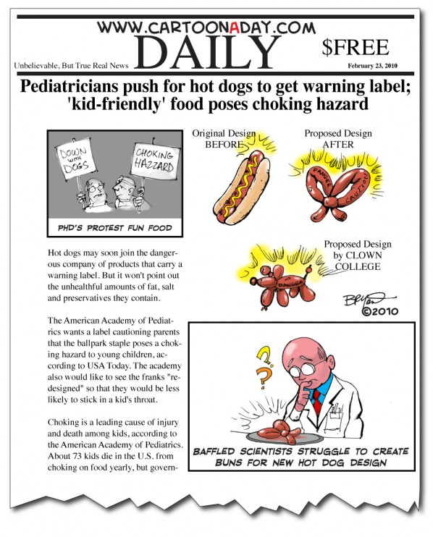
Notes:
In response to the AAP’s policy statement, there was a very strong response, with much ridicule and outrage at the idea that hotdogs and grapes might need warning labels. People particularly made fun of the AAP’s recommendation that certain foods be redesigned. The following represents a cartoon issued making fun of a newspaper article entitled “Pediatricians push for hot dogs to get warning label; ‘kid-friendly’ food poses choking hazard.”
In case you are unable to read the text, it reads:
“Hot dogs may soon join the dangerous company of products that carry a warning label. But it won’t point out the unhealthful amounts of fat, salt and preservatives they contain.
The American Academy of Pediatrics wants a label cautioning parents that the ballpark staple poses a choking hazard to young children, according to USA Today. The academy also would like to see the franks “re-designed” so that they would be less likely to stick in a kid’s throat.
Choking is a leading cause of injury and death among kids, according to the American Academy of Pediatrics. About 73 kids die in the U.S. from choking on food yearly…”
The cartoon on the upper right says: “Ph.D’s protest fun food.” They are carrying signs that say “Down with Dogs” and “Choking Hazzard” (spelled wrong)
The three pictures of hotdogs show the original hotdog design, and two possible hotdog redesigns, one in the shape of a pretzel, and one offered by clown college in the shape of a balloon animal
The bottom most panel reads: “Baffled scientists struggle to create buns for new hot dog design.”

Slide 15
Some Arguments Against Warning Labels and Food Redesign
Big government overstepping its bounds:
  The government should not decide what parents can and cannot feed their children
Overly burdensome to vendors:
  It is the responsibility of parents to monitor what their children eat, NOT supermarkets
Redesigning foods is NOT necessary:
  Parents can (and SHOULD) cut food into small bite-size pieces before serving to toddlers
Preaching to the choir:
  The type of parents who read warning labels on foods will already know not to feed their children “dangerous” foods
This
product is a choking hazard for children under 4 yrs.
Parents must use common sense when feeding kids
  It is common sense to avoid giving young children peanuts, popcorn, carrots and other foods that represent choking hazards
  Parents are already warned to avoid these foods by their pediatricians
  Parents must use discretion when monitoring what their children eat
  Young children must be supervised while eating
Notes:
In scanning articles, op-ed pieces, and blogs about this issue, I encountered a variety of opinions in response to the AAP policy statement. Many of these were expressed with anger and frustration at proposed legislation requiring certain foods to have choking hazard labels. People called it “paternalism” and “infantilization.”
The call to redesign the hot dog has been scoffed at and has become the object of many jokes. The President of the National Hot Dog and Sausage Council, Janet Riley, said she “redesigns” hot dogs herself with a knife, by cutting foods into small pieces before giving them to toddlers. She stated that a redesign of hot dogs is “not going to happen.” She also mentioned that many brands of hotdogs (roughly 2/3) already do have choking hazard warning labels. (This means 1/3 do NOT). However, one food designer has come up with a new hot dog design that is the same shape as hotdogs but has deep slits cut into the sides that open as it cooks, causing the hotdog to break apart as the child eats it.

Slide 16

Arguments in Favor of Warning Labels
  Precedent
    We label toys as choking hazards for children 3 and under; why NOT label similarly shaped foods which present similar risk?
  Risk/Benefit Ratio
    If labeling foods can avert death, the additional expense/hassle experienced by vendors is a small price to pay.
  Parental Autonomy
    Labeling foods as choking hazards is empowering parents to make well informed decisions about the foods they feed their children.
  Supervision does NOT prevent aspiration events
    Parents are usually with their children when they (fatally) choke on foods, but are unable to dislodge the food in time.
  Knowledge Gap
    Parents often believe their child is mature enough to handle a grape, popcorn, or a hot dog, not realizing the child is not cognitively or developmentally capable of chewing and swallowing such foods safely.
  Every 5 days 1 child (in the US) dies from a food-related choking event
    Many of these deaths could have been prevented if parents were appropriately educated/informed.

Slide 17
Where are we now?
JT’s Law has not been implemented in New York State
There are NO active federal laws regarding food-related choking
Previously proposed legislation has been referred to subcommittees or shelved
The FDA does NOT have mandatory recall authority for foods that are known to be hazardous to children
Currently, no enacted law (state or federal) requires labeling of foods that represent significant choking hazards to young children
  Some companies voluntarily include safety labels on their products
  Vast majority of companies do NOT provide such information
Notes:
Despite the fact that choking on food is responsible for >10,000 ED visits a year and is responsible for the death of one child every five days, as we discussed earlier, and despite the fact that those foods which represent choking hazards for children 3 and under share many similar characteristics to the dangerous foods, THERE IS NO LAW REQUIRING LABELING OF FOODS THAT REPRESENT SIGNIFICANT CHOKING HAZARDS TO YOUNG CHILDREN
Some companies voluntarily include safety labels on their products to alert consumers of choking hazards to children. (Kraft’s Louis Rich Franks and Oscar Mayer Franks; Ballpark Singles hot dogs; Kraft’s Natural Cheese Cubes, Crème Savers hard candy, and Lifesavers fusions; Hershey’s Jolly Rancher hard candy; Mars’ Starburst; and Nestle’s Wonka Gobstoppers. The overwhelming majority of companies do not provide any such information. [Products that do NOT include safety notices include Nathan’s hot dogs, Kraft’s Louis Rich Sausage, Jimmy Dean Sausage, Hersey’s Milk Duds, ConAgra’s Orville Redenbacher popcorn; Unilever’s Skippy peanut butter, and Mars’ Peanut M&Ms.
However, a food designer has come up with a new hot dog design that is the same shape as hotdogs but has deep slits cut into the sides that open as it cooks, causing the hotdog to break apart as the child eats it.

Slide 18


How Can We Prevent Food-Related Choking?
The Pediatrician’s Role as an Advocate:
Write letters to manufacturers of the more than 300 brands of hotdogs, candy, popcorn and other foods that do NOT currently carry warning labels, urging them to voluntarily add safety notices to their products
Contact our Senators and Congressmen urging them to implement the changes recommended by the AAP
  Sen. Kirsten Gillibrand (D-NY)
  Sen. Charles Schumer (D-NY)
  Rep. Charles Rangel (D-NY)
  Remaining NY Representatives (28)
Contact our Governor, State Senators and State Assembly Members, urging them to implement JT’s law as it currently exists, and further, asking them to amend JT’s law to include provisions for choking hazard warning labels on unsafe foods
  NY Governor Andrew M. Cuomo (D)
  State Senators
  State Assembly Members
AAP Recommendation:
“Pediatricians, dentists, and other infant and child health care providers should provide choking-prevention counseling to parents as an integral part of anticipatory guidance activities”

Slide 19
Helpful Resources
Governor Andrew Cuomo
  www.governor.ny.gov
U.S. Congressmen for NY: http://www.house.gov
U.S. Senators for NY:
  http://www.gillibrand.senate.gov
  http://www.schumer.senate.gov
Choking Hazard Product Recalls: http://www.health.state.ny.us/prevention/injury_prevention/choking/
Choking: First Aid: http://www.mayoclinic.com/health/first-aid-choking/FA00025
Safe Kids Worldwide: http://www.safekids.org
Consumer Product Safety Commission: http://www.nysconsumer.gov
CPSC Recall Hotline Choking Hazard number: 1 (800) 638-2772
New York State Consumer Protection Board: http://www.nysconsumer.gov
U.S. Food and Drug Administration: http://www.fda.gov/fdac
Centers for Disease Control and Prevention: http://www.cdc.gov

Slide 20
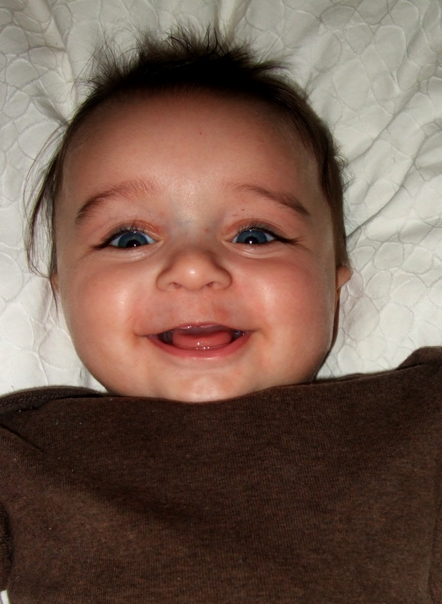

Thanks for Listening!

Slide 21
References
The Federal Hazardous Substance Act (FHSA). Pub L No.86-613 (1960)
Child Safety Protection Act. Pub L No. 109-248 (1994)
Consumer Product Safety Improvement Act. Pub L No. 110-314 (2008)
Committee on Injury, Violence, and Poison Prevention. “Policy Statement: Prevention of Choking Among Children.” Pediatrics 2010; 125 (3): 601-607
Centers for Disease Control and Prevention. Nonfatal choking-related episodes among children: United States, 2001. MMWR Morb Mortal Wkly Rep 2002; 51 (42): 945-948
Harris CS, Baker SP, Smith GA, Harris RM. Childhood asphyxiation by food: a national analysis and overview. JAMA 1984; 251 (17): 2231-2235
US Public Interest Research Group. Trouble in Toyland: The 20th Annual Survey of Toy Safety. Washington, DC: US Public Interest Research Group Educational Fund; 2005. Available at http://toyssafety.net/2005/troubleintoyland2005.pdf. (Accessed April 9, 2011)
Sadler, Eric. “Food asphyxiation in children.” http://www.ericsadler.net/food/faic.htm. (Accessed April 7, 2011)
http://www.nysenate.gov/press-release/sen-kruger-introduce-legislation-requiring-warning-labels-choking-hazard-foods (Accessed April 5, 2011)
JT’s Law. Public Health, Article 2, Title 1, §201, subdivision 2-a, Consolidated Laws of New York. Available at: http://caselaw.lp.findlaw.com/nycodes/PBH2500-ITXPBH02500-I.html. (Accessed April 6, 2011)

