Slide 1

Childhood Immunization:
Who Calls The Shots?
Sandhya Brachio, PGY2
September 11, 2012

Slide 2
BRIEF History of vaccination
7th century
  Indian Buddhists drank snake venom to induce toxoid-induced immunity against snake bites
  Hindu physician, Dhanwantari, wrote the first record of “vaccination”
Smallpox through the ages…
Notes:
Dhanwantari took fluid from udder of a cow, incised arm of human subject, mixed the fluid with blood, observed onset of fever – unclear whether subjects survived these experiments
1400s – major problem with crowding in Europe, but vaccination was not well-received
1700s – various methods for variolation were tried to protect people from smallpox, but were scientifically unproven and dangerous

Slide 3
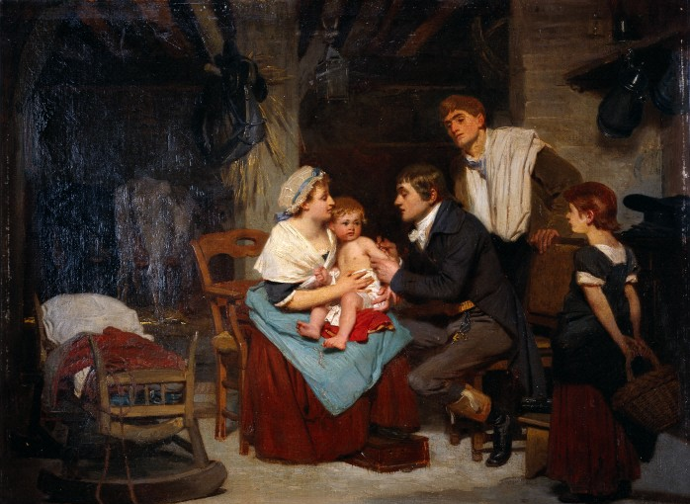
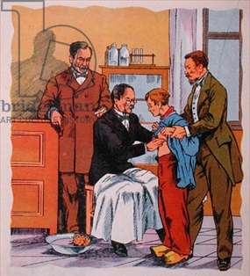
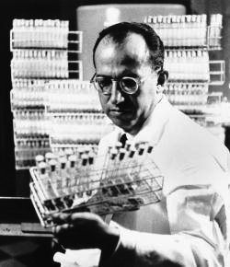
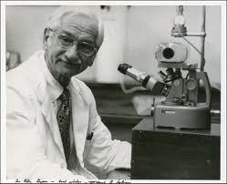
Beginning of the ImMunization AGE
Notes:
1796 – Edward Jenner & James Phipps (dairymaids were not affected by smallpox, so took small sample from cowpox sore on maid to innoculate 8yo James Phipps)
1885 – Louis Pasteur prevented rabies in Joseph Meister, who had been bitten by a rabid dog
1952 – Jonas Salk developed the first successful polio vaccine
1957 – Albert Sabin developed the live, oral vaccine, which became available in 1963

Slide 4
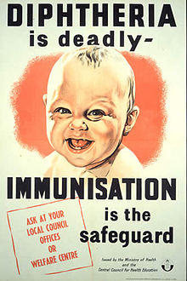
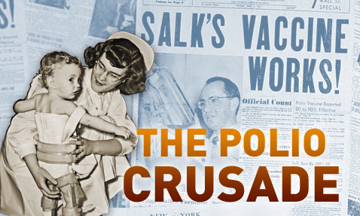
PUBLIC VACCINATION
1827 – Boston became first city to require proof of vaccination prior to school entry (NY in 1862)
School vaccination laws were modified over the years as newer vaccines were introduced
Notes:
1920s – 10,000+ children died from diphtheria each year
1940-1950s – 1000s paralyzed or killed by polio
Measles used to affect half million children each year
Varicella
Etc…

Slide 5
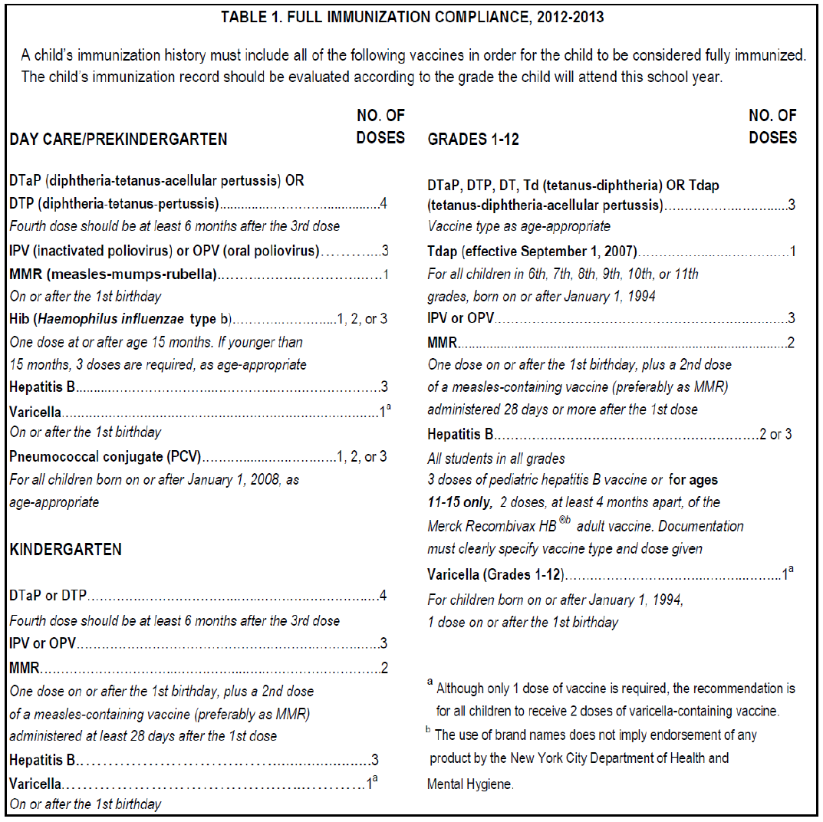
NYC DOE IMMUNIZATION COMPLIANCE

Slide 6
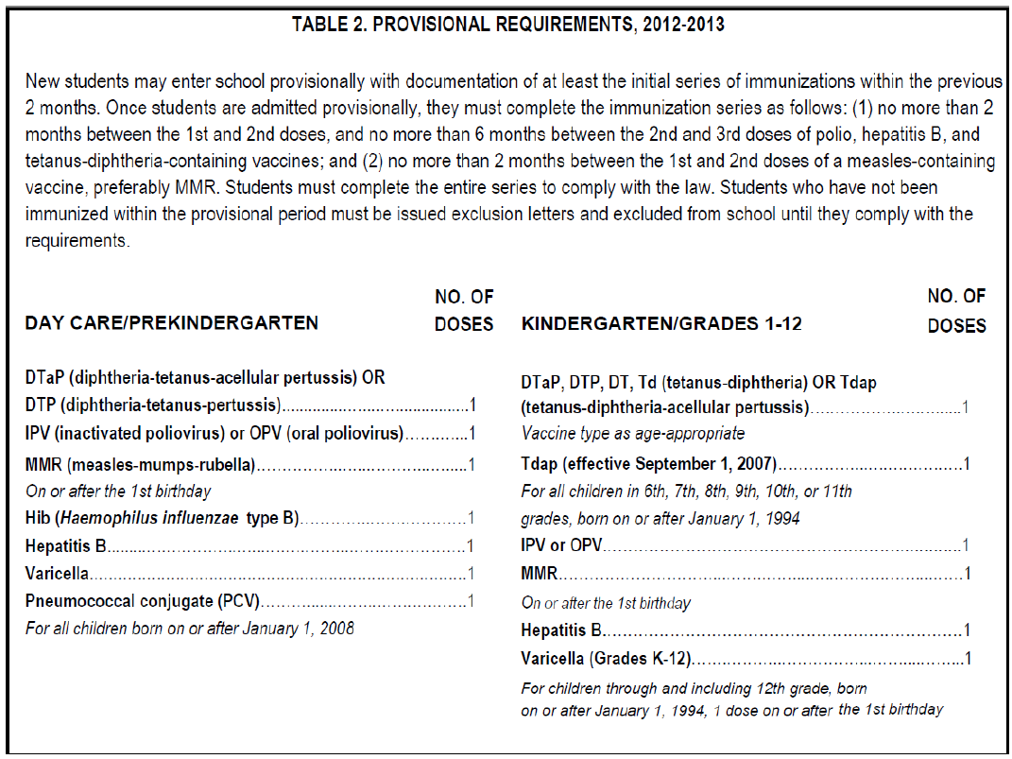
NYC DOE PROVISIONAL REQUIREMENTS
Notes:
“Students must complete the entire series to comply with the law. Students who have not been immunized within the provisional period must be issued exclusion letters and excluded from school until they comply with the requirements.”

Slide 7
AAP Policy on immunizations
“The Academy has long advocated for preventive care, including immunizations, as a major component of pediatric health care and disease prevention, and believes that economic barriers should not restrict access to immunizations or other forms of preventive care for children. The Academy advocates for sufficient funding for public immunization programs, and works with chapters to promote access to preventive care, including childhood immunizations.
As proponents of routine childhood immunization, Academy chapters have opposed the enactment of laws placing barriers to routine childhood immunization in states legislatures across the country. To help chapters counter the misinformation regarding vaccine issues, the Academy has assisted chapters addressing immunization exemption legislation by means of strategy suggestions and speaking points for educating lawmakers and the public on the value of routine immunization.”

Slide 8
universal immunization goals
First AAP policy statement on immunization in 1977 called for universal childhood immunization
Specific guidelines were implemented in 1995
    increased financing via Vaccines for Children (VFC) program
    distributing parent-friendly vaccine information statements
    promotion of Standards for Child & Adolescent Immunization Practices
    development of safer and combined vaccines
As of June 2011, 76.5% of US toddlers 19-35 months had received their basic immunization series
(4 doses of DTaP, 3 doses of IPV, 1 dose of MMR, 3 doses of Hib, 3 doses of Hep B, 1 dose of Varicella)
Notes:
universal immunization in children with no contraindication
Guidelines continue to be modified to improve compliance with universal immunization goals, one of the guidelines being that pediatricians should advocate for and educate their patients
Healthy People 2010 goal of 90% (minimum 80%) has been met for individual vaccines like MMR, polio, varicella and HepB, according to the September 6 issue of the CDC’s M&M Weekly Report
Less than 1% of toddlers had received no vaccines at all, per this recent CDC report
Almost one quarter of America’s children lack ast least 1 of the basic childhood immunizations (in NYC, 69.7%)
Rates are lower in adolescent population

Slide 9
Barriers to universal immunization
increase in new vaccines & new vaccine combinations
unanticipated manufacturing & delivery problems
increase in acquisition cost of vaccines
lack of adequate payment to practitioners to buy & administer vaccines
use of Internet & social media by public anti-vaccination movement

Slide 10
DISRUPTIONS OF VACCINE SUPPLY
poorly integrated vaccine delivery system
  separate systems for production, distribution & financing
fragile nature of US childhood vaccine supply
missed opportunities to immunize
large administrative burdens
increased parental anxiety
increased demands on practice setting

Slide 11
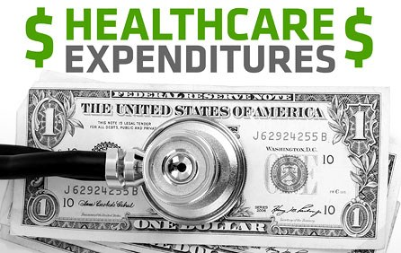
HIGH COSTS & INADEQUATE PAYMENT
acquisition cost of immunizing otherwise healthy child through age 18: $900 for boys, $1200 for girls
including storing and administering costs: $1450 for boys, $1800 for girls
Notes:
sixfold increase since 1995 because of addition of new vaccines or substitution of newer vaccines for older products
even with universal purchase of vaccines, administrative payment level varies, usually inadequate to justify actual cost
Medicaid and third-party payers don’t consistently pay an adequate level to cover the costs

Slide 12
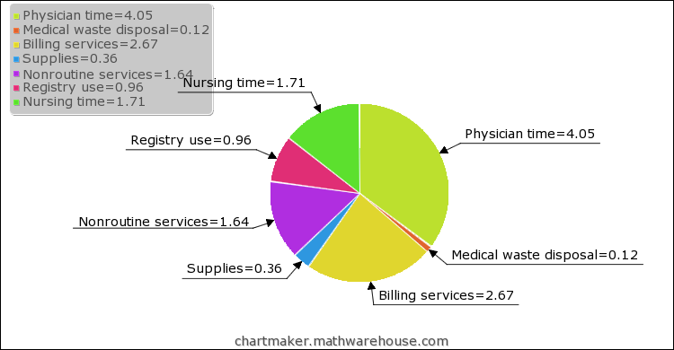
costs of vaccines
Marked variability in vaccine pricing
Another study looked at the variable administrative cost of each injection (excluding vaccine cost), which averaged to $11.51 per vaccine:
Notes:
In December 2009, article published in Pediatrics detailing a cross-sectional study looking at private practices in 5 states that purchased vaccines for administration to privately insured children & adolescents. Outcome was prices paid to purchase recommended vaccines and reimbursement from 3 most common, non-Medicaid payers for vaccine purchase and administration. Prices ranged from $4-$30 for vaccine purchase, from $0 to $26 for administration.
More than 1/3 of payment agreements paid practices paid practices less than the combined variable costs for 2 immunizations. Variable costs of administration exceeded reimbursement from some insurers and health plans.

Slide 13
Business demands for practitioners
in a recent survey, 5% of pediatricians & 20% of family physicians reported seriously considering discontinuation of vaccination of privately insured patients because of financial reasons
public sector does not have the infrastructure to immunize the numbers of children who would be referred if private providers stopped administering vaccines
Notes:
in a recent survey, HALF of pediatricians & family physicians had delayed purchase of specific vaccines because of financial reasons
-5% of pediatricians & 20% of family physicians reported seriously considering discontinuation of vaccination of privately insured patients because of financial issues
-larger problem for children in rural areas and sparsely populated areas where care is provided by family practitioners most of the time

Slide 14
PUBLIC FUNDING FOR VACCINES
>50% of public sector vaccines purchased through 3 major sources of public funding
    federal VFC program
    Section 317 federal discretionary grants
    state funds
Eligibility for VFC:
    uninsured children
    recipients of government-funded health coverage
    children identified as Alaska Native/American Indian
    underinsured children seen at federally qualified health centers or rural health clinics
Notes:
states use Section 317 discretionary funds and their own funds to provide vaccines to children who are not covered by the VFC program or private third-party insurance
VFC has to consider cost of covering expensive vaccines (like HPV and meningococcal vaccines - $82 & $109 per dose, respectively) vs alternative use of money to improve uptake of other routine vaccines in eligible population (for example, recent CDC analysis showed that it would be more cost-effective to ensure proper HPV vaccination of eligible girls than to extend the program to boys)

Slide 15
MORE ON PUBLIC FUNDING…
VFC use varies depending upon Medicaid eligibility rules
administrative burdens of different sources of funding
inadequate reimbursement for administrative costs
  levels of payment far less from Medicaid and private payers than Medicare payment for administration of vaccines to adults
National Vaccine Advisory Committee has released 24 recommendations to ensure adequate supply, distribution and administration of vaccines
Notes:
VFC eligibility can be confusing because even though federal rules don’t vary from state to state, Medicaid eligibility does vary from state to state, which leads to differences in eligibility for VFC vaccines
-in some states, VFC can be used for families with up to 400% of federal poverty level, other states may limit to just 100% of federal poverty level
variations in supply of vaccines covered by other vaccines sources and privately-sourced vaccines
rules that may prohibit interchange of VFC-sourced vaccines with privately-sourced vaccines (so different vaccines are available to different sets of patients in the same practice)
less work to administer vaccines to consenting adults than kids who are frequently nonverbal and less cooperative
need higher payment for combination vaccines than single component vaccines because additional time required to explain risks and benefits of each than compared to single component vaccines

Slide 16
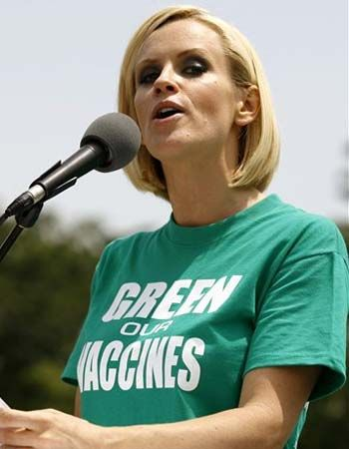
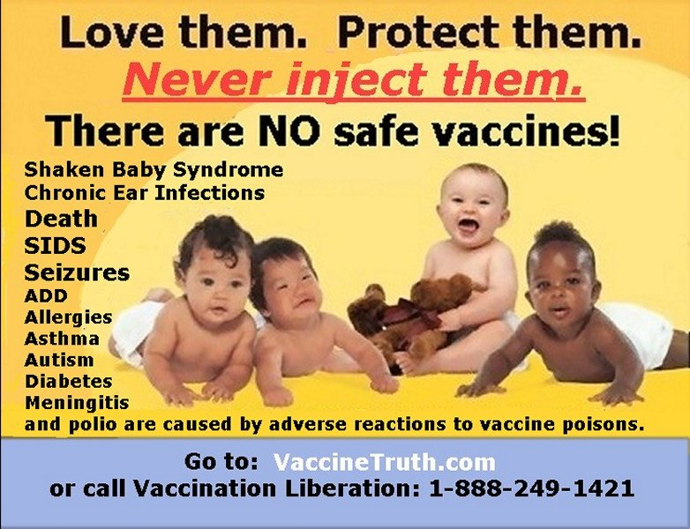
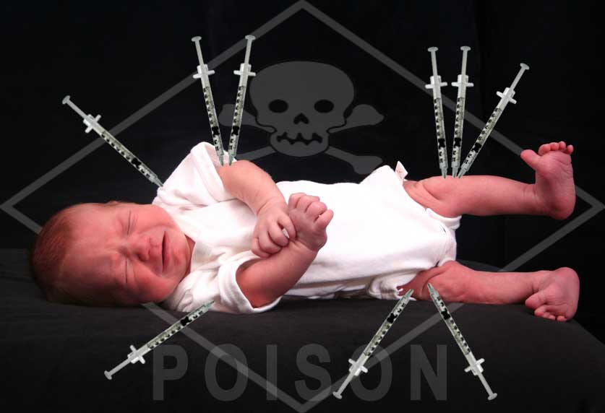
PUBLIC ANTIVACCINATION MOVEMENT
has been present since advent of vaccines
religious and philosophical objections
flawed and biased information in media
Notes:
AAP believes that governmental obligation arises when parental practices subject minor children to possible loss of life or to substantial risk of harm

Slide 17
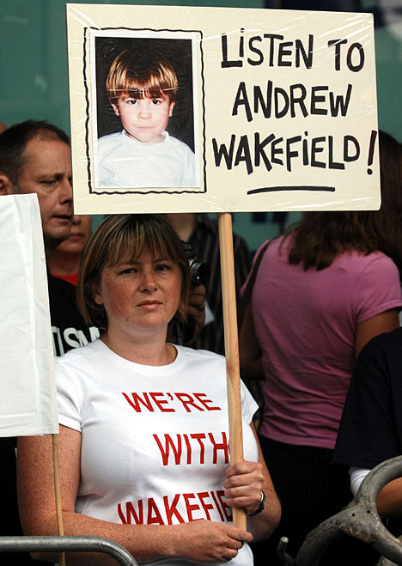
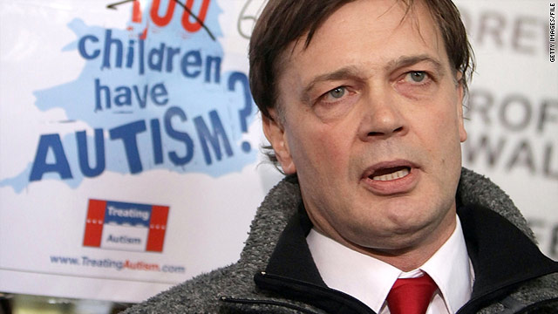
MMR & AUTISM
In 1998, Dr. Andrew Wakefield published a study suggesting that the MMR vaccine could cause autism
  10 out of 13 authors renounced paper’s conclusions
  paper was retracted from Lancet
  …but MMR immunization rates have suffered dramatically since the study was published
Notes:
-Wakefield’s paper was analyzed → he and colleagues doctored information about the children involved
-all the cases were misrepresented when medical records and data from children’s parents was reviewed
-five of the 12 children who “developed” autism had previously documented developmental problems
-failed to disclose that he received financing from lawyers who were mounting a case against vaccine manufacturers
-General Medical Council has revoked Wakefield’s license to practice medicine in Britain, Lancet has retracted artcile, and British Medical Journal concluded that work was fraudulent
“To our community, Andrew Wakefield is Nelson Mandela and Jesus Christ rolled up into one. He is a symbol of how all of us feel.” – J.B. Handley, co-founder of Generation Rescue, a group that disputes vaccine safety

Slide 18

religious objections
Some religious groups prevent children from receiving routine preventive care
some parents falsely claim religious exemption
NY State: “…shall not apply to children whose parent, parents or guardian hold genuine and sincere religious beliefs which are contrary to the practices herein required…no certificate shall be required as a prerequisite to such children being admitted or received into school or attending school.”
Notes:
“if God wanted someone to die from smallpox, it’s a sin to fight against God’s will with a vaccine”
embryonic tissue origins of certain vaccines (developed from therapeutic abortions performed in the 1960s)
rate of exemption requests is rising
no state enforces any penalty for parents who falsely claim religious exemptions

Slide 19

philosophical objections
Jacobson vs. Massachusetts (1905)
Zucht vs. King (1922)
18 states currently allow exemption to vaccination based on philosophical, personal or conscientiously held beliefs
Notes:
unwarranted governmental interference with human autonomy & liberty
1905 – Jacobson was a Swedish immigrant and a minister who lived in Cambridge, MA. He refused smallpox vaccine during the 1902 outbreak and refused to pay $5 fine because he felt it was against his liberty (he had gotten very sick as a child and had made others sick as well). Supreme Court ruled against him, 7-2, because they said the state can encroach on personal liberty when “the safety of the general public may demand.:
1922 – school system could refuse admission to a student who failed to receive a required vaccination
Philosophical exemption indicates that the statutory language does not restrict the exemption to purely religious or spiritual beliefs. For example, Maine allows restrictions based on "moral, philosophical or other personal beliefs," and California allows objections based on simply the parent(s) beliefs

Slide 20
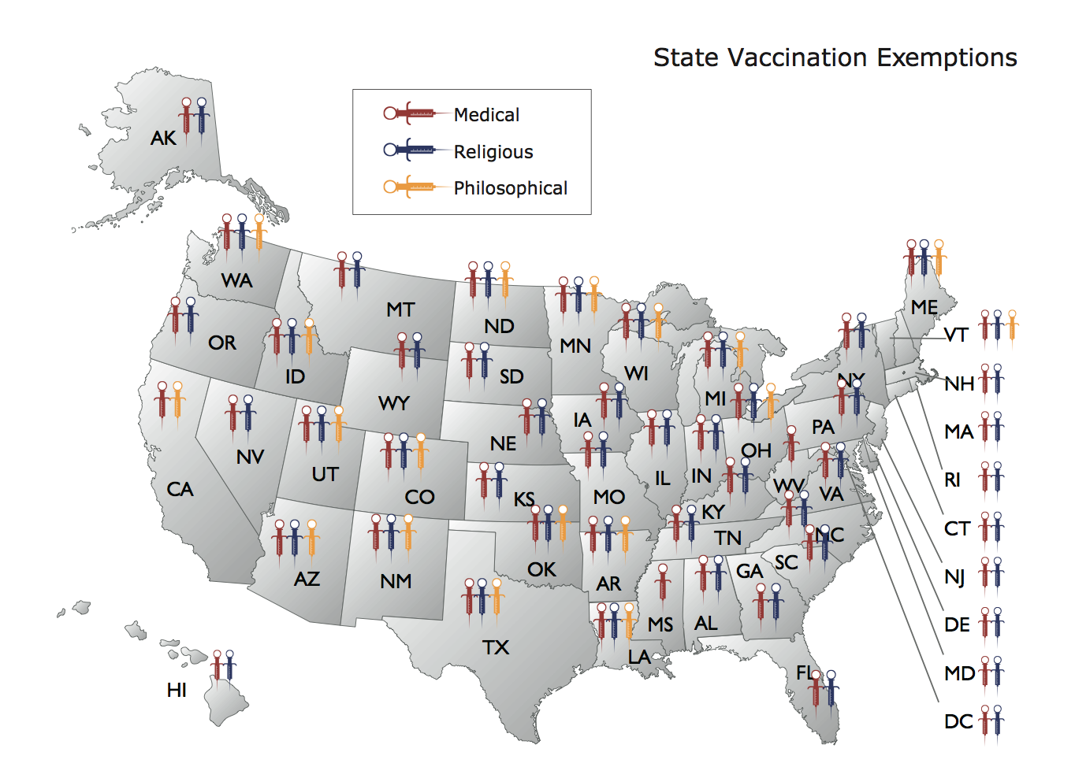
state-based exemption regulations
Notes:
medical, philosophical and religious exemptions worded differently in each state
18 states allow exemption to vaccination based on philosophical, personal or conscientiously held beliefs (NY not among them)
All states except CA, MS and WV allow religious exemption – different forms of proof depending on the state
All 50 states allow medical exemption with signed statement from MD or DO
in many states, must object to all vaccines, not just a few in order to use philosophical or personal belief exemption

Slide 21
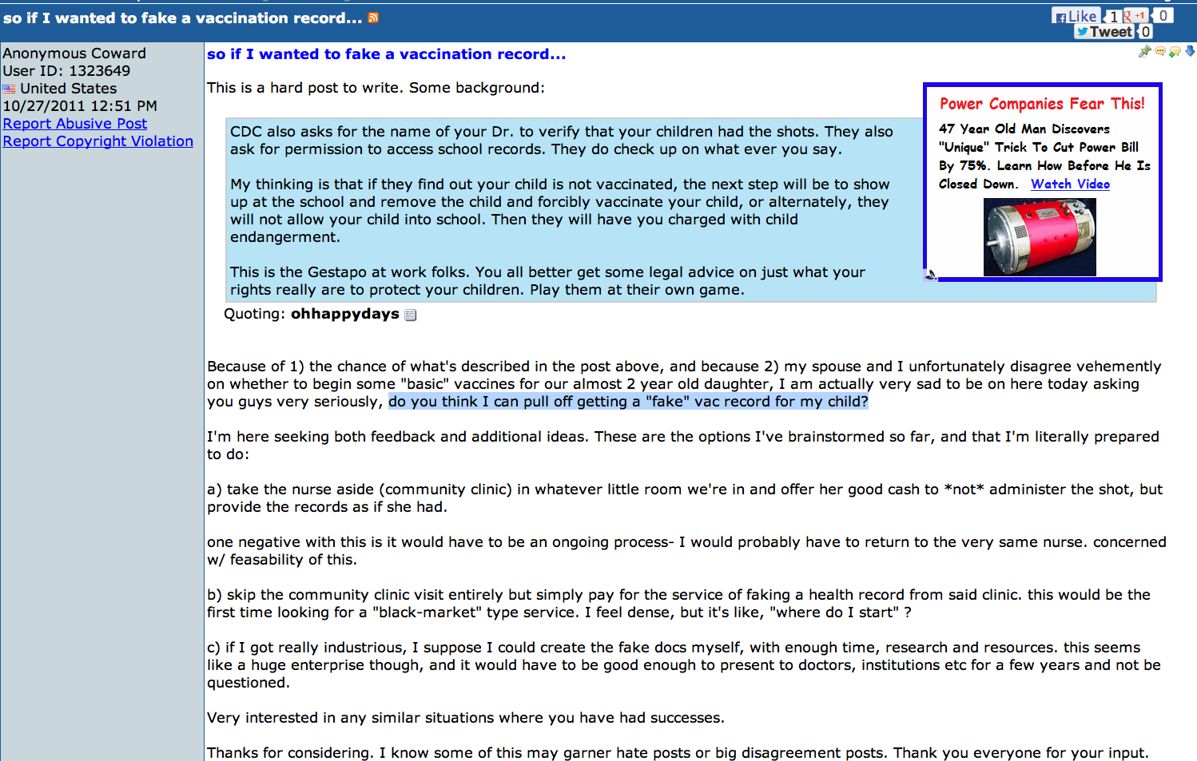
FAKE VACCINATION RECORDS

Slide 22

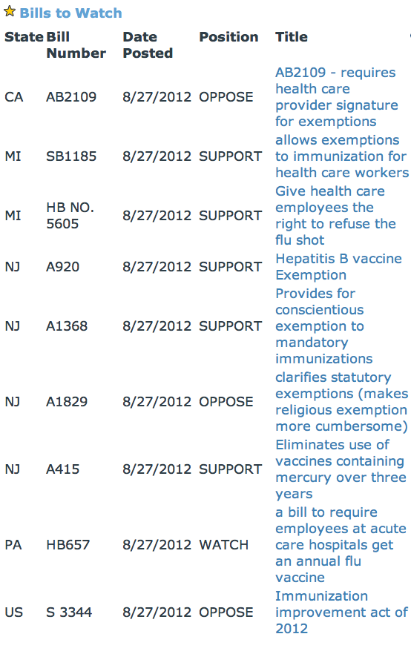
current legislation
Notes:
NJ laws:
conscientious exemption to mandatory immunizations
makes religious exemption more cumbersome
eliminates vaccines containing mercury for over three years

Slide 23
immunization improvement acts of 2012
introduced June 27, 2012 by Senator John “Jack” Reed (D-RI)
aims to increase immunization rates
    improve vaccination rates among Medicare beneficiaries
    inclusion of recommended immunizations under Medicare Part B
    provision for vaccine administration fees
    improve vaccination rates among health care workers

Slide 24
what can you do?
Educate your patients
  www.vaccinateyourbaby.com
  www.aap.org/immunization
  www.vaccine.chop.edu
  Immunization Safety Office
Support legislation that ensures funding for universal immunization and for the repeal of exemption laws
Notes:
CDC, AAP and other professional agencies are making use of the Internet and other media to promote acceptance of universal vaccination
Immunization Safety Office – infrastructure for high quality vaccine safety research, surveillance, and effective clinical translation of important findings
Use of genomic research techniques to identify gene-based individual differences in vaccine recipients who have adverse but not causally related events like Guillain Barre syndrome

Slide 25
resources
Hodge, Jr., JG and Gostin, LO. School Vaccination Requirements: Historical, Social & Legal Perspectives – A State of the Art Assessment of Law & Policy
American Academy of Pediatrics. Fisher, MC (Ed.). Immunizations & Infectious Diseases: An Informed Parent’s Guide, 2006.
Centers for Disease Control and Prevention. National, state, and urban area vaccination coverage levels among children aged 19-35 months – United States, 2011.
Freed, GL, Cowan, AE, Gregory, S, and Clark, SJ. Variation in Vaccine Purchase Prices and Payer Reimbursement. Pediatrics 2009; 124:S459.
Glazner JE, Beaty, B, Berman, S. Cost of Vaccine Administration Among Pediatric Practices. Pediatrics 2009; 124:S492-S498.
Increasing Immunization Coverage. Pediatrics 2003; 112(4):993-996.
Hammer, LD et al. Increasing Immunization Coverage. Pediatrics 2010; 125(6):1295-1304.
Religious Objections to Medical Care. Pediatrics 1997; 99(2):279-281.
Leblanc, S. (2007, October 18). Parents use religion to avoid vaccines. USA Today. Retrieved from http://www.usatoday.com/news/nation/2007-10-17-19819928_x.htm
Dominus, S. (2011, April 20). The Crash and Burn of an Autism Guru. The New York Times. Retrieved from http://www.nytimes.com/2011/04/24/magazine/mag-24Autism-t.html?pagewanted=all

