Slide 1

Reauthorizing the Children's Hospital Graduate Medical Education program.
Sarah Richman, PGY2
Marleine Ishak, PGY2
Shawn Sen, PGY2

Slide 2
THE ISSUE: The upcoming need for reauthorization of the CHGME (Children’s hospitals graduate medical education) payment program, a federal program that funds a large portion of pediatric residency programs in freestanding children’s hospitals
WHY IS THIS IMPORTANT?
WHAT IS THE CURRENT SITUATION?
WHAT IS THE ADVOCACY ISSUE AT HAND?

Slide 3
“Three-pronged mission” of children’s hospitals from the HRSA (health resources and services administration):
Educate and train future pediatricians and pediatric sub-specialists
2. Provide care for vulnerable and underserved
children
3. Conduct innovative and valuable pediatric research
The purpose of the CHGME Payment Program is to compensate for the disparity in the level of Federal funding for pediatric teaching hospitals versus other types of teaching hospitals.

Slide 4
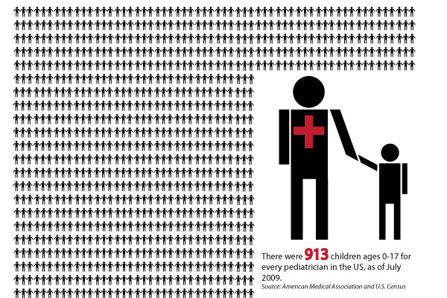
SHORTAGE
There is a shortage of the pediatricians, especially suspecialists, leading to:
increased wait times
increased travel times

Slide 5

Average wait times for subspecialists at children’s hospitals
• Developmental pediatrics : 13 weeks
• Endocrinology: 10 weeks
• Neurology: 9 weeks
• Pulmonology: 8 weeks
• Gastroenterology: 5 weeks
NACH Issue Brief

Slide 6
Example of how the CHGME funding can address shortages
“With its CHGME support, Nationwide started a gastroenterology fellowship, resulting in a reduction in wait times for gastroenterology clinic visit from 14 weeks in 2004 to four weeks in 2010. Today, almost 40 percent of children’s hospitals have pediatric gastroenterology vacancies resulting in average wait times of five weeks for care.”
National Association of Children’s Hospitals, May 2011

Slide 7
Providing care for vulnerable and underserved children
Representing about one percent of all short-term acute care hospitals these
hospitals provide almost 50 percent of the patient care to low-income children,
including those covered by Medicaid and those who are uninsured.
In addition, these hospitals are regional and national referral centers for
critically ill children, often serving as the only source of care for many
critical pediatric services. More than 75 percent of inpatient care at
children’s hospitals is devoted to children with one or more chronic
conditions.

Slide 8
Conduct innovative and valuable pediatric research
Ongoing need for more research in pediatrics. Although funding for pediatric research increased from 1998 to 2003, its proportion of total NIH spending went down.
Much of the research in pediatrics occurs at freestanding children’s hospitals
CHGME program indirectly promotes pediatric research by funding the training of future academic pediatricians

Slide 9
Children’s Hospital Graduate Medical Education Program
Definition:
CHGME program provides federal support for pediatric residency and fellowship programs .
It provides the funding needed to sustain training at 55 freestanding children’s hospitals across 30 states.
Notes:
I will be talking about the CHGME which plays a key role in the children’s healthcare
… is defined as …
Which accounts only for 1% of all Americas hospitals , But we all know how greatly USA ’s children’s hospitals contribute to the nation’s pediatric workforce

Slide 10
GME is supported primarily by the Centers for Medicare and Medicaid Services (CMS).
Freestanding children’s hospitals receive little or no Federal GME support from CMS, because GME funding is tied to a number of Medicare beneficiaries being treated at the hospital.
Freestanding children’s hospitals generally do not provide care to patients eligible to receive Medicare.
To address this disparity in Federal GME support between freestanding children’s hospitals and other teaching hospitals , The CHGME Payment Program was created

Slide 11
CHGME funds are responsible for
training and providing GME to
  40% of general pediatricians
  43% of all pediatric subspecialists
  totaling more than 5,600 pediatric residents/year
Enhancing research capabilities
Caring for vulnerable and underserved children
Notes:
Training More than
Provides critical federal support for residency and fellowship programs which includes the funding needed to sustain their teaching missions without draining resources for patient care .

Slide 12
Background Information on CHGME reauthorization Legislation
Congress created CHGME in 1999 .
Congress reauthorized the CHGME program with nearly unanimous bipartisan support.
In FY 2010, Congress appropriated the highest amount the program has ever received at $317.5 million. In FY 2011 , funding was maintained at $317.5
In December 2011 ,Congress and the President approved $268 million for the CHGME in Fiscal Year 2012 .

Slide 13
How does CHGME Payment Program Work?
Each summer, eligible hospitals complete and submit an initial application.
Using data from those applications, the program calculates the payments that each hospital will receive from direct medical education (DME) and indirect medical education (IME).
  DME funding is designed to cover costs associated with stipends for residents, salaries for faculty, overhead and other costs of running a training program.
  IME funding is designed to assist in expenditures such as reduced productivity of staff training residents and the processing of additional diagnostic tests residents may order.
Notes:
Without this investment in training the next generation of general pediatricians and expanding the ranks of pediatric subspecialists and pediatric surgical specialists in the United States, access to specialized children’s health care services will only deteriorate further.

Slide 14
Why is CHGME a critical investment in children’s health care?
provided important federal GME support for freestanding children’s hospitals, similar to the support that other teaching hospitals receive through Medicare GME.
improved the quality and depth of their training, and prevent a net decline in the number of pediatric residents
Notes:
So why is it criical?

Slide 15
Making a difference
CH have doubled the number of total pediatric specialty residents in response to local, regional and national needs
CH have increased the number of new training programs by 50 %
CHGME funding now provides CH with 80 % of the GME support that Medicare provides to adult teaching hospitals.
Notes:
In terms of numbers, Since the program’s inception…

Slide 16
Current Legislation
Congress created CHGME in 1999 and has reauthorized the program twice, now is scheduled to expire end of 2011.
Bipartisan reauthortization bills have been introduced (S.958/HR. 1852) to extend the program to 2016 and fund $330 million per year.
August 2011, House passed H.R. 1852
September 2011, Senate passed S. 958
Both House and Senate are expected to consider companion measures this fall.
Notes:
Since the program’s inception…

Slide 17
Notable Advocates
AAP President – Robert Block, MD
Dr. Marion Burton – former AAP president
Co-sponsor senators: Kathy Castor and David Reichert, co-chairs of the Congressional Children’s Heath Care Caucus.
In September, more than 150 children’s hospitals, child health and advocacy organizations sent a letter to House and Senate supporting CHGME.
Notes:
Since the program’s inception…

Slide 18

What we can do to Advocate
Sponsor: Rep. Joseph Pitts
Email/contact our New York Senators:
  Kirsten Gillibrand
  Charles Schumer
Notes:
Since the program’s inception…

