Slide 1

Thank you for not smoking
Pelton A Phinizy, MD

Slide 2
Overview
Why is smoking bad? Why should pediatrician’s care?
Laws about the purchase of tobacco products
Laws regulating advertising
Laws regarding smoking in public
What can we do? In and out of the office.

Slide 3
How are children exposed to smoke?
Adolescents smoke
  In 2009, 46% of teens in high school had tried smoking.
  Nearly 20% had smoked cigarettes at least 1 day in the last 30
  7% smoked cigarettes on at least 20 days in the last 30
Secondhand smoke
  60% of children aged 3-11 years, almost 22 Million children, are exposed to secondhand smoke.

Slide 4
Smoking is bad for you
Cancers
Heart disease
Vascular disease
Pulmonary disease
Increased perinatal morbidity and mortality.

Slide 5
Secondhand smoke is bad too
Increased rate of SIDS
Increased LRTIs
Increased prevalence and severity of asthma
Decreased lung growth/function
Increased middle ear disease
Dental caries
Cancer – Definitely increased for lung cancer later in life (eg. Adulthood) but unknown association for childhood cancers.

Slide 6

Purchases

Slide 7
Purchasing tobacco
Varies country to country (15-21 years)
In most states in the US the purchasing age is 18 years
  Except Alabama, Alaska, New Jersey, Utah where it is 19 years.
  Onondaga, Nassau, and Suffolk counties in NY state have also made the purchasing age 19.
  A purchaser is supposed to show ID if less than 26.
Nonetheless in 2009 about 14% of students <18 yo who currently smoked cigarettes were able to buy the cigarettes on their own.

Slide 8
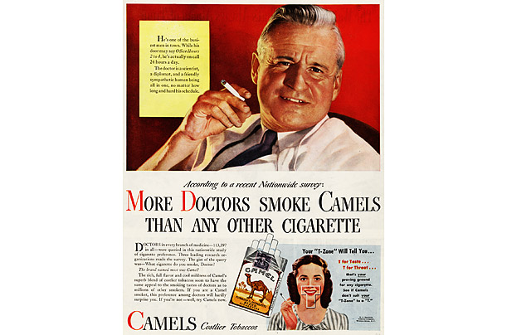
Advertising/Marketing

Slide 9
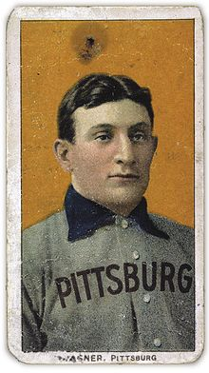
Advertising/Marketing
1789: First ad in the US ran in a local New York newspaper was for Lorillard Tobacco Company
Late 19th century cigarette cards like Honus Wagner were being used to help market cigarettes.
1950-60s: Cigarettes frequently sponsored television shows
1964: Following the Surgeon General report, based on >7,000 scientific studies linking smoking with lung cancer, emphysema, and other diseases, laws were put into place requiring warning labels on tobacco products and tobacco advertisements were banned on radio and TV.

Slide 10
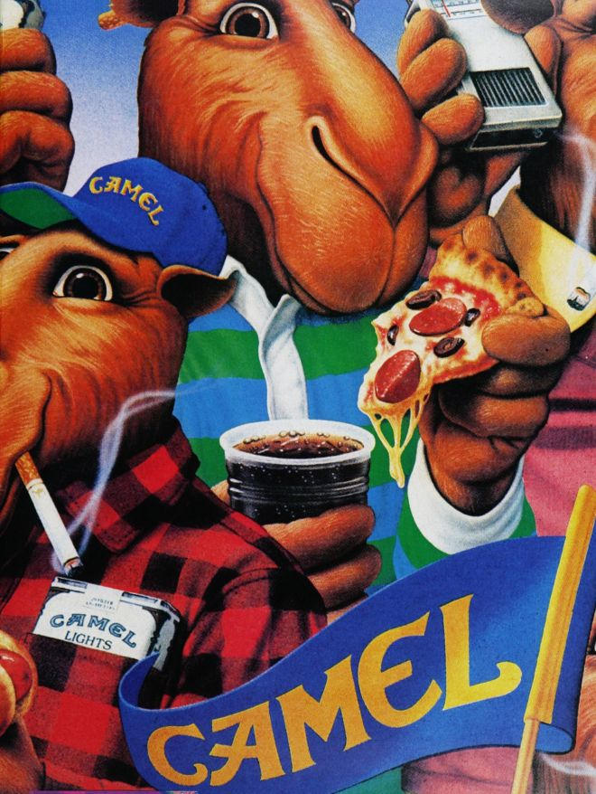
Advertising/Marketing
Tobacco advertisers changed strategies and started advertising to younger markets.
  A 1991 study found that Joe Camel was more recognizable by 5 and 6 year olds than Mickey Mouse.
  Candy/Gum shaped like cigarettes.

Slide 11
Laws
1996: Cigarettes were labeled an “addictive drug” and the FDA sought to have control of them.
2000: Supreme Court ruled that FDA was never given proper authority to regulate tobacco by congress.
June 22, 2009 The President signed the Family Smoking Prevention and Tobacco Control Act
  This law granted the FDA the authority to regulate the manufacture, marketing, and distribution of tobacco products

Slide 12
Family Smoking Prevention and Tobacco Control Act
Prohibits sale from vending machines (except special cases like in an adult-only venue)
Prohibits tobacco brand sponsorship of athletic, musical, social, or cultural event.
Prohibits sale or distribution of items such as hats, tee-shirts, etc. with tobacco branding.
Eliminated descriptors such as “light,” “low,” or “mild.”

Slide 13
Family Smoking Prevention and Tobacco Control Act
Tobacco products will require a larger warning label
  50% of the front and rear label
  Pictures of negative health consequences of smoking
  Cigarette Health Warnings
Banned cigarettes with flavors other than tobacco and menthol
The act seeks to limit the color and design of packaging --still pending litigation.

Slide 14
Bans

Slide 15
Robocop?
Smoking enforcement?

Slide 16
Don’t know much about history
1575: Tobacco forbidden in churches in Mexico and Spanish colonies in the Caribbean
1590: Pope Urban VII prohibited smoking in the church.
1604: King James I, of England, published “A Counterblaste to Tobacco” which had the effect of raising taxes on tobacco.
1633: Ottoman Sultan Murad IV prohibited smoking in his empire.
1723: One of earliest citywide smoking bans in Berlin

Slide 17
Don’t know much about history
First modern smoking ban was by German govt in 1941 which restricted smoking in every university, post office, military hospital, and Nazi party office.
1975: Minnesota became the first state to regulate smoking in most public places. Restaurants divided into smoking and non-smoking sections.
  Did not apply to bars.
1985: Aspen Colorado was first city in USA to restrict smoking in restaurants.
1990: San Luis Obispo, CA was first city to restrict smoking in all public places including restaurants and bars.
1994: California banned smoking in all restaurants and then in 1998 it was banned in bars too.

Slide 18
Smoking bans
As of April 2012, 27 states have enacted statewide bans on smoking in all enclosed public places, including bars and restaurants
Effective April 1998, smoking is banned by the United States Department of Transportation on all commercial passenger flights in the United States, and/or by American air carriers.

Slide 19
New York State
Effective March 30, 2003, smoking is banned statewide in all enclosed workplaces in New York, including all bars and restaurants and construction sites. The law exempts (1) private homes and automobiles, (2) hotel/motel rooms, (3) retail tobacco businesses, (4) private clubs, (5) cigar bars (A cigar bar that makes 10 percent of its gross income from the on-site sale of tobacco products and the rental of on-site humidors, not including vending machines sales are exempt from the ban), (6) outdoor areas of restaurants and bars, and (7) enclosed rooms in restaurants, bars, convention halls, etc., when hosting private functions organized for the promotion and sampling of tobacco products. Local governments may regulate smoking more stringently than the state law. Breaking the state law can result in a fine of between $200 and $2,000, depending how many violations one has had within a year.

Slide 20
New York City
New York City, Effective May 23, 2011, smoking was banned in all parks, boardwalks, beaches, recreation centers, swimming pools and pedestrian plazas.
Bloomberg is proposing new legislation that would require residential buildings to develop written policies that address whether smoking is allowed in both indoor and outdoor locations, including lobbies, courtyards, balconies, laundry rooms, and individual apartments.
  Not specifically banning smoking in private housing but setting up the possibility of smoke-free apartment buildings in New York City.

Slide 21
What can we do?
Screen adolescents for smoking. Encourage positive behaviors and offer to help when they disclose.
Smoke Free TXT- A text message service designed to help young adults quit smoking.
Screen for parental smoking at WCCs, sick visits.
  Parents may be seeing us more frequently than their own doctors.
  If child has illness associated with secondhand smoke use it to help encourage quitting.
  Encourage smoke-free homes and vehicles
  1800-QUITNOW

Slide 22
What can we do?
Help parents talk to their adolescent children about smoking
  Mayoclinic.com has advice on how to “help your teen stop smoking” and “10 ways to help teens stay smoke-free.” Just type in to the search box “teen smoking.”
    Appeal to their vanity: smelly clothes, bad breath, yellow teeth, wrinkles
    Do the math: go over how expensive smoking is as a habit. How will they afford music, cell phone, clothes, and cigarettes.
    Think the way teens do. They don’t spend the time mentally preparing like adults do. Also more likely to act on impulse and less likely to think about the long term consequences.

Slide 23
What can we do? Outside of clinic
Support groups like www.tobaccofreekids.org
Advocacy with the AAP:
  http://www.aap.org/en-us/advocacy-and-policy/state-advocacy/Pages/State-Advocacy.aspx#TobaccoPrevention
Advocacy with the ACP:
  http://www.acponline.org/advocacy/where_we_stand/other_issues/#tobacco

Slide 24
For more info
www.tobaccocontrollaws.org
www.tobaccofreekids.org
www.smokefree.gov
www.healthychildren.org
www.aap.org

Slide 25
References
www.fda.gov/tobaccoproducts/default.htm
http://smokefree.gov/smokefreetxt/
http://www.tobaccofreekids.org/
www.health.harvard.edu
www.mayoclinic.com
James, Randy. “Cigarette Advertising.” Time Magazine. 2009
U.S. Department of Health and Human Services. The Health Consequences of Involuntary Exposure to Tobacco Smoke: A Report of the Surgeon General. U.S. Department of Health and Human Services, Centers for Disease Control and Prevention, National Center for Chronic Disease Prevention and Health Promotion, Office on Smoking and Health, 2006.
Youth Risk Behavior Surveillance System, CDC. http://www.cdc.gov/healthyyouth/yrbs/index.htm

