Slide 1
The Anti-Obesity Initiative:
Setting a Maximum Size on Sugary Beverages
Joe Grillo PGY-2

Slide 2
What is the proposal?
Proposed by the Department of Health and Mental Hygiene to the Board of Health
Amendment of Article 81 (Food Preparation and Food Establishments) of the New York City Health Code, found in Title 24 of the Rules of the City of New York
Article 81 consists of the rules and regulations pertaining to the establishments and people responsible for preparing, distributing, and selling food
Regarding the maximum size of sugary drinks and self-service beverage cups sold and offered in food service establishments.

Slide 3
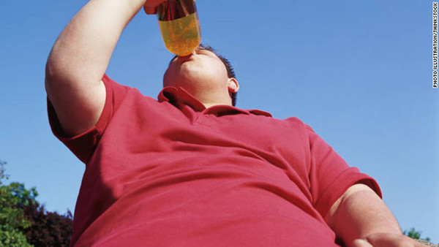
Why are they doing this to us?

Slide 4
NYC Obesity Task Force
Created by Mayor Bloomberg
Multi-agency task force convened to “recommend innovative, aggressive solutions to address the obesity challenge in New York City”

Slide 5
Task Force Members
Linda Gibbs, Deputy Mayor for Health and Human Services, co-chair, Caswell Holloway, Deputy Mayor for Operations, co-chair, Alan Aviles, President, Health and Hospitals Corporation, Adrian Benepe, Commissioner, Department of Parks and Recreation, David Bragdon, Director, Office of Long Term Planning and Sustainability, Amanda Burden, Commissioner, Department of City Planning, David Burney, FAIA, Commissioner, Department of Design and Construction, Robert Doar, Commissioner, Human Resources Administration, Dr. Thomas Farley, Commissioner, Department of Health and Mental Hygiene, Kim Kessler, Food Policy Coordinator, Robert LiMandri, Commissioner, Department of Buildings, John Rhea, Chairman, NYC Housing Authority, Janette Sadik-Khan, Commissioner, Department of Transportation, Carter Strickland, Commissioner, Department of Environmental Protection, Dennis Walcott, Chancellor, Department of Education

Slide 6
Obesity Task Force Findings
Obesity is among the most rapidly growing serious health problems we face as Americans
  Second leading cause of preventable death(Cigarettes are # 1)
  In the 1960’s, the prevalence of obesity in the US: 13%
  In 2008 the prevalence of obesity in the US: 34%

Slide 7

New York City
58% or 3,437,000 New Yorkers are overweight or obese

Slide 8
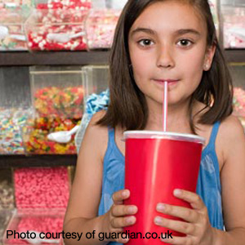
What about the children?
Almost 40% of NYC’s public school students (K-8) are obese or overweight
In Washington Heights/Inwood >50% of school age children are overweight or obese
Obese children and adolescents are more likely to develop obesity and obesity-related-illnesses as adults

Slide 9
Obesity Task Force Findings
2. Obesity has a disproportionate impact on low-income and minority communities
3. Obesity is expensive
- in 2006, $147 Billion spent in direct medical costs

Slide 10
Obesity Task Force Findings
4. Obesity is an environmental disease
-ubiquity of calorie dense foods/drinks
- physical activity levels are environmentally determined

Slide 11
Obesity Task Force Initiatives
Prevent obesity in children
Encourage healthy eating
Promote physical activity

Slide 12
Healthy Eating
We consume 200-300 more calories than we did 30 years ago
  Single largest increase due to sugary drinks
Nearly half of added sugar we consume is from sugar-sweetened drinks
Even though overall sugary drink consumption declined sugary drink consumption in high-need neighborhoods like the South Bronx ranged between 32 and 45 percent, compared to 28 percent in other neighborhoods.
Portion sizes have increased
  McDonald’s beverages have increased 457% since 1950’s

Slide 13
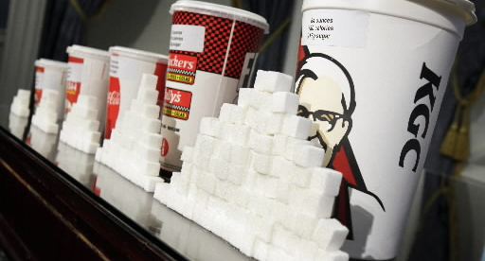
Fast food “large” drinks can have anywhere from 380-780 calories

Slide 14
Portion size counts
Studies show:
  People given larger portion sizes of food eat ~20-50% more, without reducing intake at subsequent meals
  People eating soup from self-refilling bowls ate 73% more, without perceiving that they had eaten more or feeling more full.
  People given beverages 50% larger consume 20% (women) to 33% more (men), with no decrease in food eaten.

Slide 15
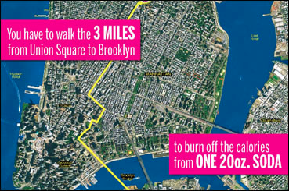
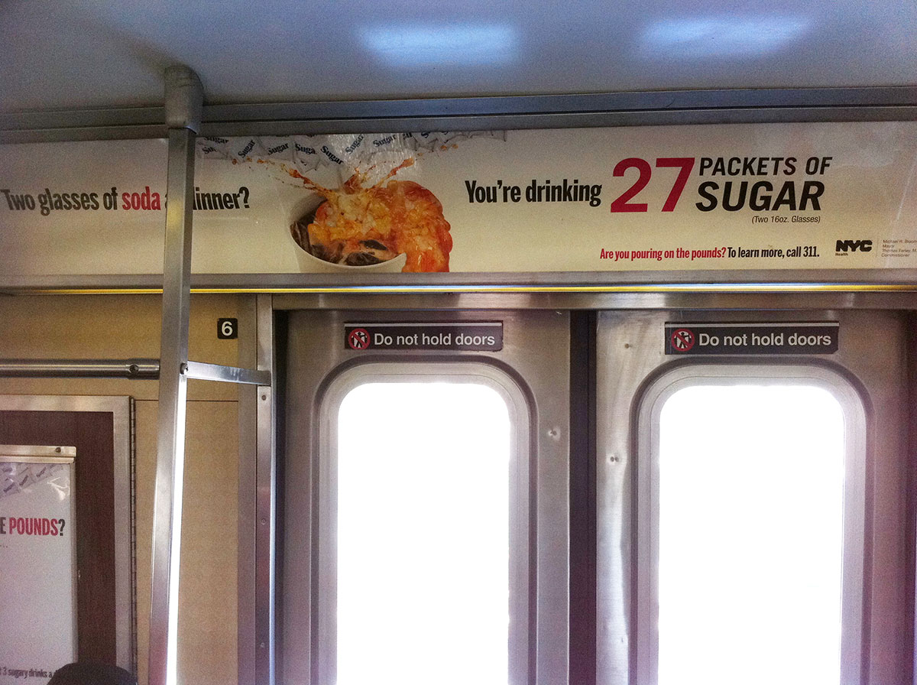
Healthy Eating Initiative
Public Education Campaigns

Slide 16
Healthy Eating Initiative
Healthy food pantries and soup kitchens
Urban agriculture at New York City Housing Authority developments
Create new community garden sites
Expanding healthy food access in the retail environment
Access to NYC tap water

Slide 17
Healthy Eating Initiative
Establish a maximum size for sugary drinks in food service establishments (FSEs)
“way we can change the default and help reacquaint New Yorkers with ‘human size’ portions to reduce excessive consumption of sugary drinks”

Slide 18
What is the proposal?
Set a maximum size for sugary drinks: Non-alcoholic sugary drinks may not be offered or sold in cups or containers that can contain more than 16 fluid ounces.
Set a maximum size for self service cups: Food service establishments may not offer or sell self-service cups that can contain more than 16 fluid ounces.
Set a fine for violations: No more than two hundred dollars for each violation as described in the proposed rule.

Slide 19
What is a sugary drink?
Non-alcoholic
Sweetened by the manufacturer with sugar or any caloric sweetener
> 25 calories per 8 ounces
Does not contain >50% milk or milk substitute by volume
Does not apply to juice as long as there is no added sugar

Slide 20
Food Service Establishments
Includes
  Restaurants
  Mobile Food Vendors
  Deli’s
  Anywhere that prepared food comprises the majority of sales
Enforcement will take place during the regularly scheduled food inspections
Fines will not influence letter grade

Slide 21
AAP
“The AAP recommends eliminating sweetened drinks in schools and strictly limiting soft drinks and fruit juice in children’s diets”
AAP recommendations regarding juice:
  Juice should be 100% pasteurized fruit juice and not fruit drinks
  Infants under 6 months of age should not be given juice
  Children aged 1 to 6 years should have only 4-6 ounces of juice a day
  Older children should be limited to 8-12 ounces of juice a day
  Instead of juice, children should be encouraged to eat whole fruits

Slide 22
What's next?
NOTICE OF PUBLIC HEARING
Subject: Opportunity to Comment on the Proposed Amendment of Article 81 (Food Preparation and Food Establishments) of the New York City Health Code, found in Title 24 of the Rules of the City of New York.
Date/Time: July 24, 2012 / 1 P.M. to 3 P.M.
Location: New York City Department of Health and Mental Hygiene
2 Gotham Center, Third Floor, Room 3-32
42-09 28th Street
Long Island City, NY 11101-4132

Slide 23
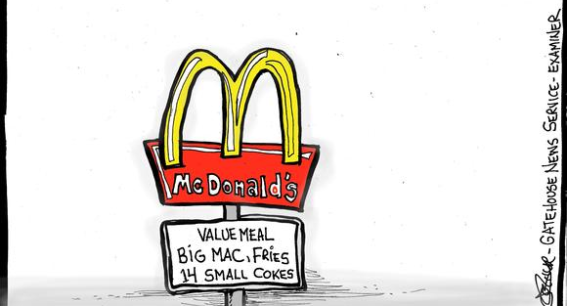
The Opposition

Slide 24

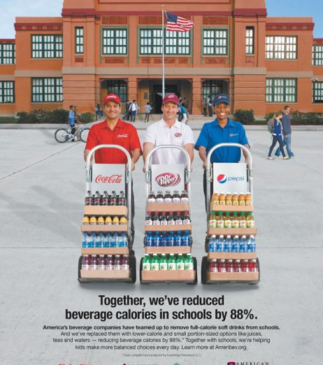
“The Association also serves as liaison between the industry, government and the public, and provides a unified voice in legislative and regulatory matters”

Slide 25
The American Beverage Association
By nearly every measure, the contribution of calories from beverages to the diet is declining, yet obesity is still rising
Since 1998, the average calories per serving from beverages is down 23 percent due to more low- and zero-calorie beverages.
Sugar-sweetened beverages account for only 7 percent of calories in the average American’s diet, according to government data. With 93 percent of our calories coming from other foods and beverages, meaningful steps to reduce obesity need to look at the bigger picture

Slide 26
References
“Absurd: Ridiculously Unreasonable, Unsound and Incongruous. American Beverage Association. June 2010
http://www.nyc.gov/html/doh/html/home/home.shtml
Hassink, Sandra. “Innovations in Addressing Childhood Obesity” TESTIMONY OF SANDRA G. HASSINK, MD MPH FAAP. ON BEHALF OF THE AMERICAN ACADEMY OF PEDIATRICS. ENERGY AND COMMERCE SUBCOMMITTEE ON HEALTH, UNITED STATES HOUSE OF REPRESENTATIVES. December 16, 2009
Juice Boxes. Food Fights, 2nd Edition (Copyright 2010) American Academy of Pediatrics.
Kansagra, Susan. Maximum Size for Sugary Drinks: Proposed Amendment of Article 81. Bureau of Chronic Disease Prevention and Tobacco Control New York City Department of Health and Mental Hygiene. June 12, 2012
Reversing the Epidemic:The New York City Obesity Task Force Plan to Prevent and Control Obesity. May 31, 2012

Slide 27
