Slide 1


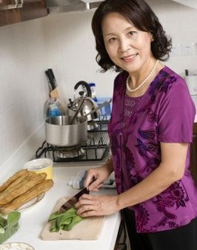
USER PROFILES
arroyo
Wen-ti
Greg
Song
Young boutique store owner
Goal: Make more profits buying and selling new products.
Recent MBA graduate
Goal: Make more profits selling raw materials.
Former real-estate agent
Goal: Develop own luxury jewelry line.
Notes:
Song – was taught how to make jewelry by grandparents, and has been practicing it as a hobby my whole life. I’d like to start a business in jewelry, but unfortunately, the price of supplies is exceedingly high, and the quality is low. I want to make a better quality product, find cheaper supplies, and also, find a customer who will buy the jewelry.

