Slide 1


Neighborhood Walkability and Bikeability
Andrew Rundle, Dr.P.H.
Associate Professor of Epidemiology
Mailman School of Public Health
Columbia University

Slide 2
Neighborhood Walkability
A set of urban design characteristics that support pedestrian activity.
Low walkability neighborhoods are often discussed in reference to urban sprawl.
Low walkability is typified by:
      Low population density
      Poor access to public transit
      Little pedestrian activity
      Car dependence
      Little mixing of residential and retail/commercial land uses

Slide 3
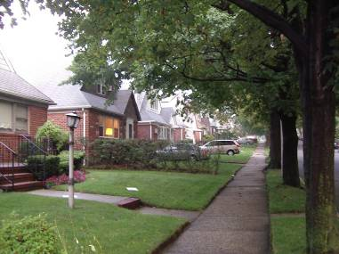
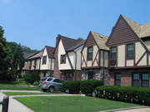
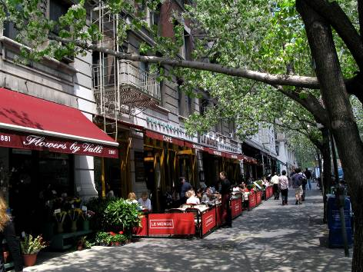
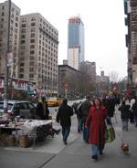
Neighborhood Walkability

Slide 4
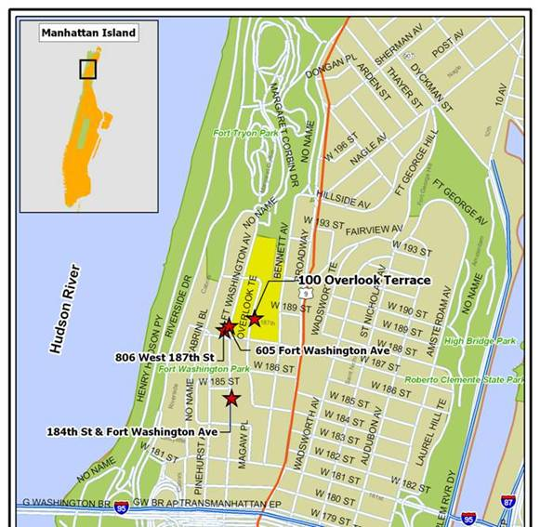
Census Tracts in New York City
Median Area
0.18 Km²
10th - 90th Percentile Range
0.13 - 0.60 Km²
Notes:
These four slides are to give the audience a sense of scale in NYC.
100 Overlook is my address
605 Fort Washington is my dry cleaner, which I use every two weeks or so
806 west 187th is my local bar where I get dinner several times a month
184th street and Fort Washington is my subway stop that I use every day

Slide 5
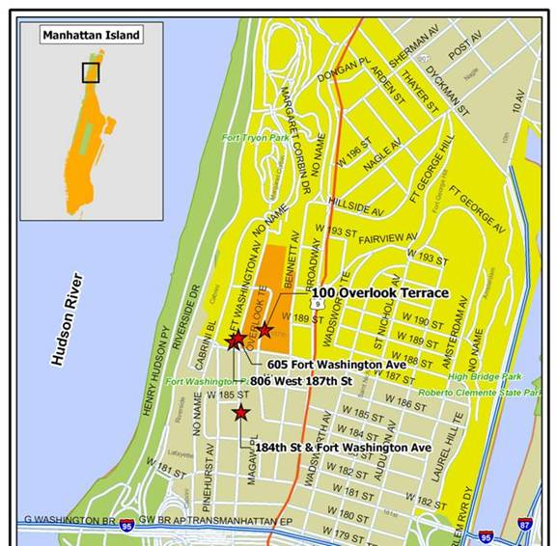
Zip Codes in New York City
Median Area
3.58 Km²
10th - 90th Percentile Range
1.13 - 7.52 Km²

Slide 6
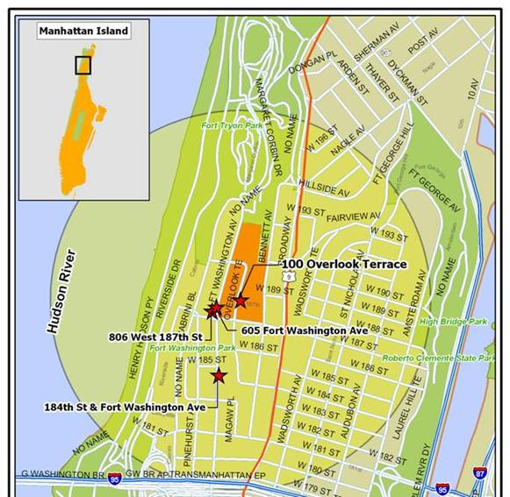
½ Mile Radial Buffer
Median Area
2.03 Km²
10th - 90th Percentile Range
1.58 - 2.03 Km²
Notes:
Many of the radial buffers have water removed from their area calcs so that is why there is a distribution of area sizes.

Slide 7
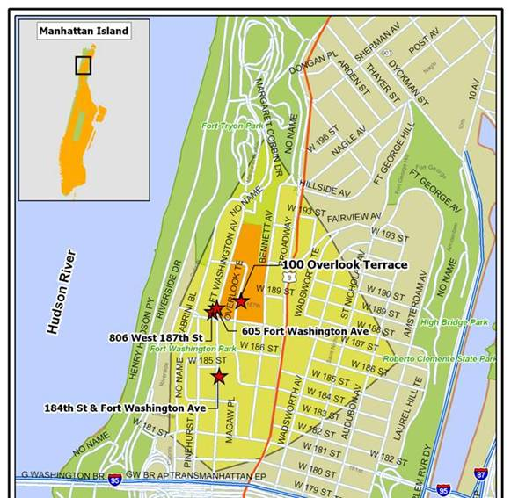
½ Mile Network Buffer
Median Area
1.23 Km²
10th - 90th Percentile Range
0.81 - 1.37 Km²

Slide 8
New York Cancer Project
A 2000-2002 health survey of residents of New York City and the surrounding area, during which height and weight were measured.
13,102 subjects were geocoded to addresses within New York City.
92% of residential census tracts in the City are represented.
37% overweight, 28% obese.

Slide 9
Adjusted Mean¹ BMI and Population Density
P for trend <0.001
Adjusted for individual age, race, gender and education, neighborhood poverty, % Black, and % Hispanic.

Slide 10
Adjusted Mean¹ BMI and Access to Public Transit
P for trend <0.001
Adjusted for individual age, race, gender and education, neighborhood poverty, % Black, and % Hispanic.

Slide 11
Multiple Aerial Unit Problem (MAUP)

Slide 12
Effect of Neighborhood Definition
Population Density
% Commuting by Transit

Slide 13
Replication in a Second
New York City Sample
New York Cancer 2002 CHS
Cohort Data Data
Population Density -0.38* -0.39*
(per 10K people/km²)
Mixed Land Use -1.05* -0.77*
(per unit change)
Bus stops -0.04* -0.04*
(per stop/km²)
Subway stops -0.13* -0.08
(per stop/km²)
% of commuters -3.95* -3.67*
using public transit
* P<0.05, adjusted for individual age, race, gender and education, neighborhood poverty, % Black, and % Hispanic.

Slide 14
Problem of Multi-colinearity
The indicators of neighborhood walkability that we have studied thus far all tend to be correlated with each other.
  Transit is organized around where people live and around commercial space.
  Population density and land use mix tend to co-exist.
So it is difficult to analyze all these indicators in a single statistical model.

Slide 15
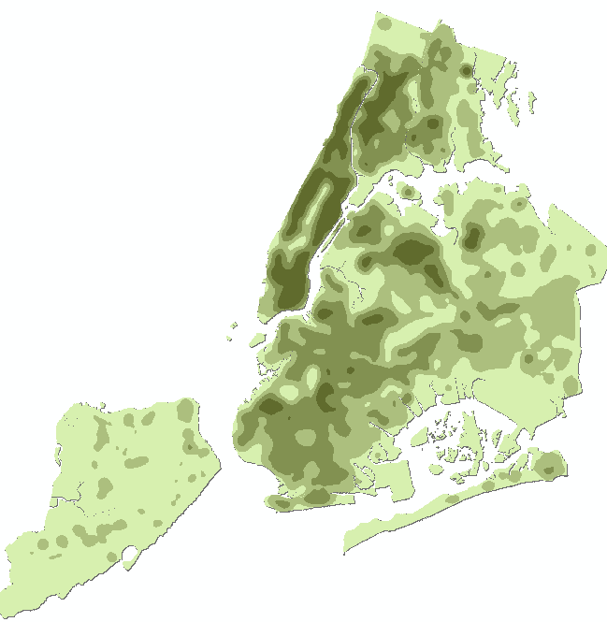
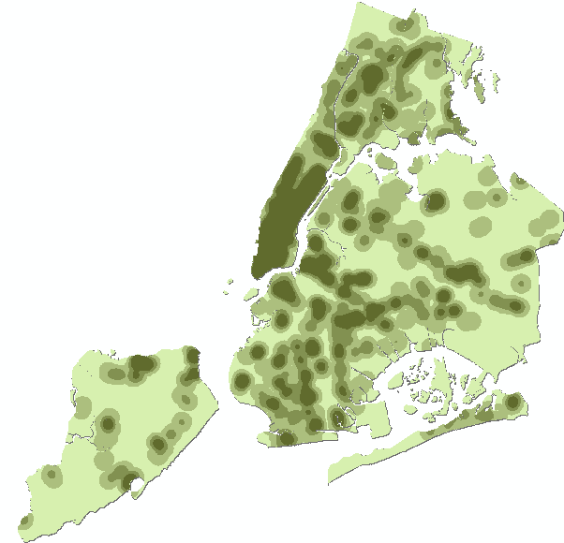
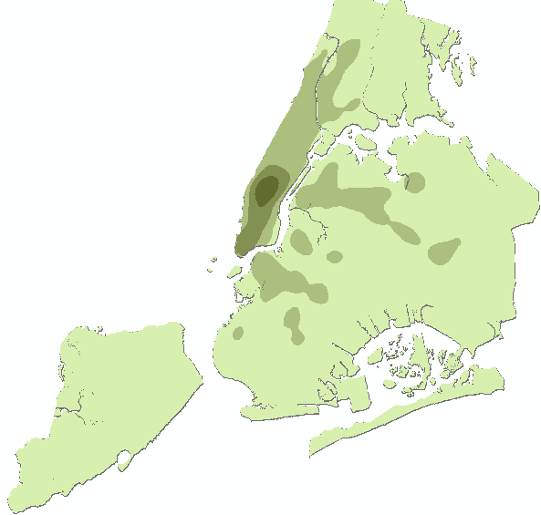
NYC Neighborhood Walkability Index
This walkability index combines data on population density, total commercial space and subway ridership.
Population density
Square footage of commercial space
Subway ridership
The walkability index score predicts pedestrian counts across the City (R=0.66, p=0.03)
Notes:
Sandro: each map shows quartiles of the variable, darker equals more. The walk-ability index score based on combining the full range of the variables not just quartiles mapped here. Pop dense is from Census, commercial area from a City database that has tax lot data for every square foot of the city, subway ridership from MTA subway map data and turnstile data.
Published in Journal of Enviro

Slide 16
Neighborhood Walkability and BMI for NYC Residents
P for trend <0.001
Adjusted for individual age, race, gender and education, and neighborhood poverty, % Black, and % Hispanic.
Notes:
Sandro: Graph shows adjusted mean BMI and 95% CI around mean. Neighborhood defined as ½ mile network buffer around each subject’s home address, so 13,102 separate neighborhoods estimated. A ½ unit reduction in BMI moves 10% of the obese into the overweight category, we see about 1.33 BMI units difference between 1st and 5th quintile.

Slide 17
Active Transport and Neighborhood Walkability.
2003 CHS respondents (N=9,802) were asked how frequently they walked or cycled a distance of 10 blocks or more.
Subjects linked to Zip codes of residence.
Neighborhood walkability index measured for each Zip code.
44% reported no episodes of active transport of 10 blocks or more.
Data analyzed using Zero-inflated negative binomial regression.

Slide 18
Modified Frank et al., Neighborhood Walkability Index
Includes 5 urban design characteristics:
    residential density;
    intersection density;
    land use mix for five types of land use - residential, office, retail, education, and entertainment;
    subway stop density;
    the ratio of retail building floor area to retail land area.
The index is the sum of the z-scores of each component.

Slide 19
Active Transport and Neighborhood Walkability.
 | Zero Episodes OR (95% CI) | Count of Episodes Exponentiated Beta (95% CI)
Zip code Walkability (per Z-score) | 0.87 (0.82, 0.93) | 1.03 (1.00, 1.05)
Adjusted for other variables in the table and for gender, age, race/ethnicity, education, income, nativity, employment status, martial status, family size, Zip code level poverty rate & % Hispanic.

Slide 20
Active Transport and Neighborhood Walkability.
 | Zero Episodes OR (95% CI) | Count of Episodes Exponentiated Beta (95% CI)
Zip code Walkability (per Z-score) | 0.87 (0.82, 0.93) | 1.03 (1.00, 1.05)
Interactions with Neighborhood Poverty
In High Poverty Zips | 0.96 (0.85, 1.08) | 1.00 (0.89, 1.13)
In Low Poverty Zips | 0.80 (0.72, 0.90) | 1.03 (0.98, 1.07)
Adjusted for other variables in the table and for gender, age, race/ethnicity, education, income, nativity, employment status, martial status, family size, Zip code level poverty rate & % Hispanic.

Slide 21
Physical Activity and Neighborhood Walkability and Park Access.
In 2002-2005 CHS respondents were asked if they engaged in any recreational PA in the past month.
    71% reported engaging in some recreational PA.
In 2005 respondents were asked to report the number of hours per week they engaged in moderate or vigorous PA.
    42% reported zero hours.
    Among those who were active the median was 15 hours per month.

Slide 22
Recreational Physical Activity, Neighborhood Walkability and Park Access.
 | Any Activity OR (95% CI)
Zip code walkability (per Z-score) | 1.03 (1.02, 1.05)
Percent of Zip covered by large parks (per IQR) | 1.10 (1.04, 1.17)
Percent of Zip covered by small parks (per IQR) | 1.04 (0.99, 1.09)
Graffiti Index (per IQR) | 0.49 (0.24, 0.98)
All OR adjusted for other variables in the table and for gender, age, race/ethnicity, education, income, nativity, employment status, martial status, family size, Zip code level poverty rate, % Hispanic, homicide rate, and park level litter index.

Slide 23
Moderate and Vigorous PA, Neighborhood Walkability and Park Access.
 | Zero Hours OR (95% CI) | Count of Hours Exponentiated Beta (95% CI)
Zip code walkability (per Z-score) | 0.94 (0.91, 0.98) | 0.99 (0.98, 1.00)
Percent of Zip covered by large parks (per IQR) | 0.79 (0.67, 0.93) | 0.99 (0.92, 1.07)
Percent of Zip covered by small parks (per IQR) | 0.96 (0.83, 1.11) | 1.02 (0.98, 1.08)
Graffiti Index (per IQR) | 2.53 (0.50, 12.88) | 0.41 (0.18, 0.94)
All OR adjusted for other variables in the table and for gender, age, race/ethnicity, education, income, nativity, employment status, martial status, family size, Zip code level poverty rate, % Hispanic, homicide rate, and park level litter index.

Slide 24

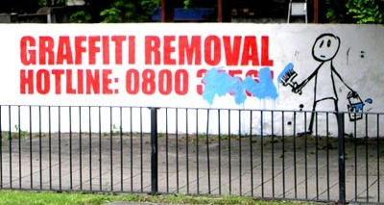

Slide 25
Neighborhood Bikeability
A set of urban design characteristics that support cycling.
The primary dimension of bikeability is safety.
  Bike lanes
  Traffic calming
  Physical or spatial buffers from traffic
The development of bikeability scales or indexes lags far behind the development of walkability indexes.

Slide 26
Bikeability Indicators
Across 13,088 neighborhoods from the New York Cancer Study.
 | Mean | 10th percentile | 90th percentile
# Bike Injuries (2002) | 14.0 | 0.0 | 32.0
% Streets with Bike Lanes (2001-2002) | 4.7 | 0.0 | 14.0
Bike Lane Density (2001-2002) | 0.8 | 0.0 | 2.3
% of residents who commute to work on a bike (2000) | 4 | 0.0 | 11

Slide 27
Bikeability Indicators
Correlations between measures across 13,088 neighborhoods from the New York Cancer Study.
 | % Streets with Bike Lanes | Bike Lane Density | % of residents who commute to work on a bike
Bike Injuries | 0.48 | 0.59 | 0.55
% Streets with Bike Lanes |  | 0.95 | 0.43
Bike Lane Density |  |  | 0.49

Slide 28
Neighborhood Bikeability and BMI
Across 13,088 neighborhoods from the New York Cancer Study.
 | Model 1* Beta P-Value
% Bike Commuters | -0.534 (<0.01)
% streets with bike lane
Bike lane density
Bike injuries
Adjusted for individual age, race, gender and education, and neighborhood poverty, % Black, and % Hispanic.

Slide 29
Neighborhood Bikeability and BMI
Across 13,088 neighborhoods from the New York Cancer Study.
 | Model 1* Beta P-Value
% Bike Commuters
% streets with bike lane | -2.134 (0.04)
Bike lane density
Bike injuries
Adjusted for individual age, race, gender and education, and neighborhood poverty, % Black, and % Hispanic.

Slide 30
Neighborhood Bikeability and BMI
Across 13,088 neighborhoods from the New York Cancer Study.
 | Model 1* Beta P-Value
% Bike Commuters
% streets with bike lane
Bike lane density | -0.261 (<0.01)
Bike injuries
Adjusted for individual age, race, gender and education, and neighborhood poverty, % Black, and % Hispanic.

Slide 31
Neighborhood Bikeability and BMI
Across 13,088 neighborhoods from the New York Cancer Study.
 | Model 1* Beta P-Value
% Bike Commuters
% streets with bike lane
Bike lane density
Bike injuries | -0.022 (<0.01)
Adjusted for individual age, race, gender and education, and neighborhood poverty, % Black, and % Hispanic.

Slide 32
Neighborhood Bikeability and BMI
Across 13,088 neighborhoods from the New York Cancer Study.
 | Model 1* Beta P-Value
% Bike Commuters | -0.534 (<0.01)
% streets with bike lane | -2.134 (0.04)
Bike lane density | -0.261 (<0.01)
Bike injuries | -0.022 (<0.01)
Adjusted for individual age, race, gender and education, and neighborhood poverty, % Black, and % Hispanic.

Slide 33
Neighborhood Bikeability and BMI
Across 13,088 neighborhoods from the New York Cancer Study.
 | Model 1* Beta P-Value | Model 2** Beta P-Value
% Bike Commuters | -0.534 (<0.01) | -0.361 (0.01)
% streets with bike lane | -2.134 (0.04) | -1.513 (0.13)
Bike lane density | -0.261 (<0.01) | -0.172 (0.01)
Bike injuries | -0.022 (<0.01) | -0.012 (0.01)
Adjusted for individual age, race, gender and education, and neighborhood poverty, % Black, and % Hispanic.
** Additionally adjusted for population density and land use mix.

Slide 34
CPPW GPS and Accelerometer Study
Measure travel mode and route choice.
Measure activity and pedestrian patterns within the residential neighborhood.
Define individual’s activity spaces.
Evaluate how built environment characteristics being altered by NYC interventions affect pedestrian activity and total activity.
    E.g. Street trees, Intersection safety, Bike lanes, Transit, Land use, Park development, Age Friendly Streets……

Slide 35
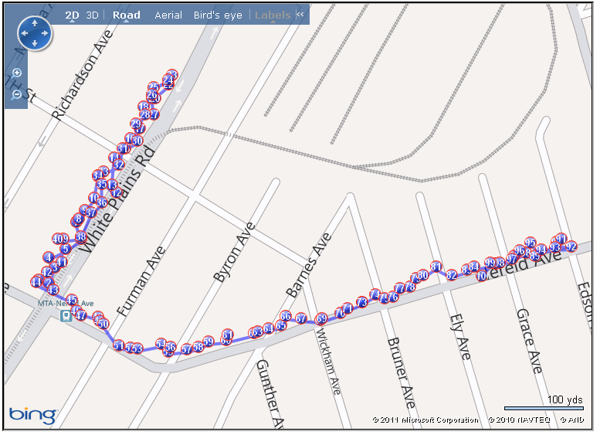
Interning For Rundle: GPS Tracking

Slide 36
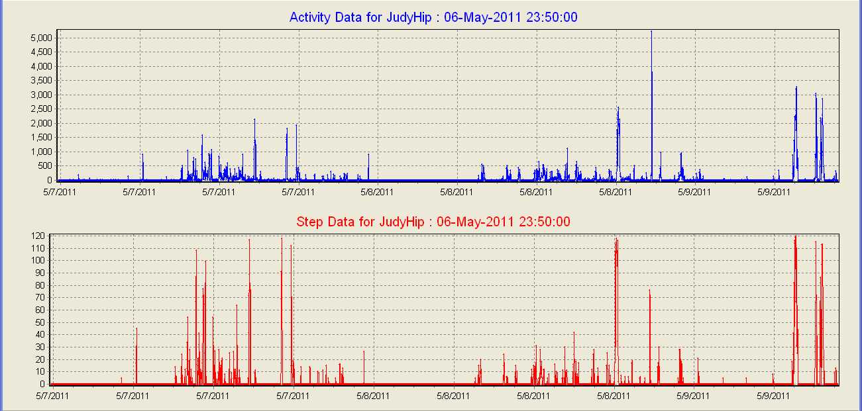
Interning For Rundle: Accelerometer Tracking
Have completed four studies using accelerometry, two validation studies and two population studies

Slide 37
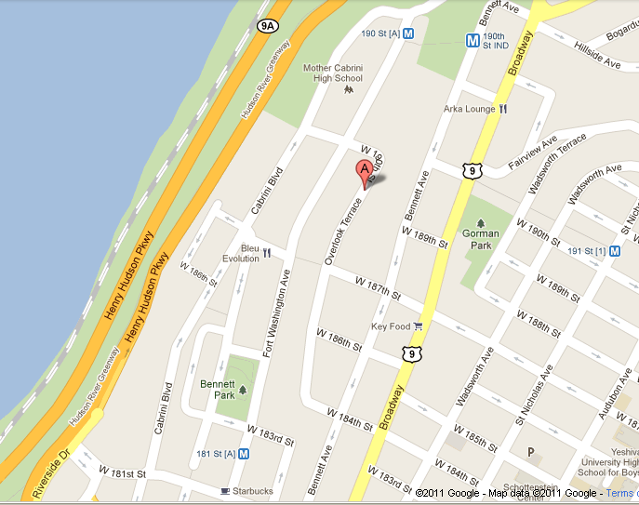

Slide 38
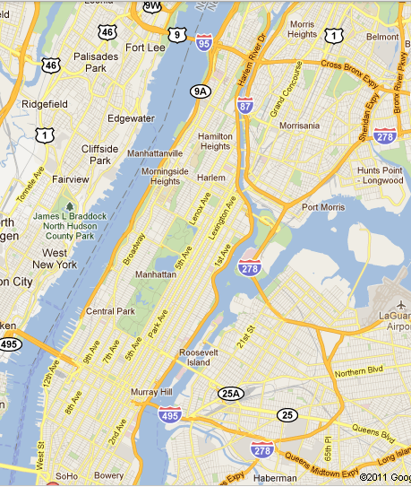

Slide 39
Plan for Analyses of GPS and Accelerometer Data
Across subjects: assess whether the built environment characteristics of the residential neighborhood predict pedestrian activity and total physical activity.
Across subjects: assess whether the built environment characteristics of the total activity space predict physical activity.
Within subjects: Assess whether built environment characteristics of blocks within the residential neighborhood predict walking route choice.

