Slide 1
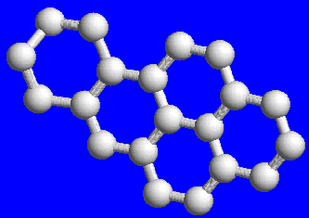

Prenatal Exposures to Polycyclic Aromatic Hydrocarbons and Childhood Obesity
Andrew Rundle, Dr.P.H.
Associate Professor of Epidemiology
Mailman School of Public Health
Columbia University

Slide 2
Childhood Obesity In NYC Elementary Schools by Ethnicity (2007-2008)
N=311,953

Slide 3
Evaluation of Childhood Obesity
Data on height, weight, age and gender are required.
These data can be used with CDC growth charts to estimate the BMI percentile for age and gender.
CDC has released a SAS macro to calculate BMI Z-score and BMI percentile.
The calculation of BMI Z-score and percentile uses data from NHANES from the last 30 years as a standard.

Slide 4
Issues in Evaluating Childhood Obesity: Changing Definitions
BMI Percentile | 1994 - 2006 | 2007
85 – 94.9 | At risk of overweight | Overweight
95 – 100 | Overweight | Obese

Slide 5
BMI Z-Score for 10-11 Year Olds in New York City Schools
Mean = 0.71
Median = 0.86

Slide 6
BMI Percentile for 10-11 Year Olds in New York City Schools
Mean = 69th
Median = 81st
25% are obese

Slide 7
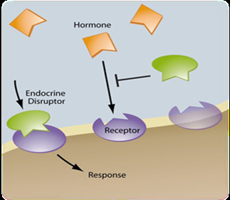
Endocrine Disruptors and Obesity
Growing concern that exposures to “endocrine disruptor (ED)” chemicals, may alter metabolic programming in early life and cause obesity/metabolic syndrome.
  EDs are often referred to as hormone mimics since they imitate hormones and disrupt normal cell signaling.

Slide 8
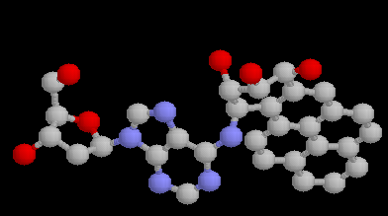
Endocrine Disruptors and Obesity
Polycyclic aromatic hydrocarbons (PAH)
PAH, particularly hydroxy-PAH, have been shown to have estrogenic effects.
Induce estrogen-dependent cell proliferation.
In adipocyte cell culture experiments B[a]P inhibit lipolysis.
Shown to induce weight gain & gain in fat mass in rats and mice.

Slide 9
CCCEH Birth Cohort
Pregnant African American and Dominican women were recruited during their 3rd trimester through prenatal clinics in N. Manhattan.
Key entrance criteria: registered with OB/GYN clinic by 20th week of pregnancy, non-smoker, non-diabetic, non-hypertensive and lived in Bronx or N. Manhattan.
48 hour personal air monitoring for 8 carcinogenic PAH.
Child’s height & weight measured at age 5 & 7, body composition measured at age 7.

Slide 10
Conceptual Design of the CCCEH Birth Cohort Obesity Project
Maternal
Obesity
Neighborhood social and
physical context
Risk of obesity and Metabolic Syndrome
Childhood growth trajectories
Prenatal PAH & BPA exposure
Early life PAH & BPA exposure

Slide 11

Prenatal Air Monitoring in the CCCEH
Particles (PM_{2.5}) and vapor phase were collected and analyzed for PAH.
Concentrations of the 8 PAH were summed for statistical analyses.
Motion detectors were placed in a sub-set of bags to monitor compliance.

Slide 12
Anthropometric Outcome Measures.
Age 5
  Height measured by SECA wall mounted stadiometer.
  Weight measured by Detecto Cardinal 750 digital scale.
Age 7
  Height measured by SECA wall mounted stadiometer.
  Weight measured using a Tanita digital scale (BC-418).
  Body composition measured via bio-impedance (Tanita BC-418).

Slide 13
Follow-Up in the CCCEH
Mothers enrolled during pregnancy N=702
Children followed to age 5 N=453
N=58
follow-up with height and weight data
N=331
N=33
N=7
Children followed to age 7 N=371
N=20
follow-up but height and weight height data not collected.

Slide 14
Follow-Up in the CCCEH
 | Total cohort N=702 | Age 5 N= 453 | Age 7 N= 371
Child’s Sex
Girls | 352 (51%) | 240 (53%) | 200 (54%)
Boys | 335 (48%) | 213 (47%) | 171 (46%)
Child’s Ethnicity
Afr. Am. | 256 (37%) | 185 (41%) | 160 (43%)
Dominican | 446 (63%) | 268 (59%) | 211 (57%)
Mother received public assistance during pregnancy
No | 402 (57%) | 255 (56%) | 211 (57%)
Yes | 294 (42%) | 194 (43%) | 156 (42%)
Poverty Rate | 36% | 35% | 35%
PAH levels (ng/m³) | 2.38 | 2.34 | 2.54

Slide 15
Follow-Up in the CCCEH
 | Total cohort N=702 | Age 5 N= 453 | Age 7 N= 371
Child’s Sex
Girls | 352 (51%) | 240 (53%) | 200 (54%)
Boys | 335 (48%) | 213 (47%) | 171 (46%)
Child’s Ethnicity
Afr. Am. | 256 (37%) | 185 (41%) | 160 (43%)
Dominican | 446 (63%) | 268 (59%) | 211 (57%)
Mother received public assistance during pregnancy
No | 402 (57%) | 255 (56%) | 211 (57%)
Yes | 294 (42%) | 194 (43%) | 156 (42%)
Poverty Rate | 36% | 35% | 35%
PAH levels (ng/m³) | 2.38 | 2.34 | 2.54

Slide 16
Follow-Up in the CCCEH
 | Total cohort N=702 | Age 5 N= 453 | Age 7 N= 371
Child’s Sex
Girls | 352 (51%) | 240 (53%) | 200 (54%)
Boys | 335 (48%) | 213 (47%) | 171 (46%)
Child’s Ethnicity
Afr. Am. | 256 (37%) | 185 (41%) | 160 (43%)
Dominican | 446 (63%) | 268 (59%) | 211 (57%)
Mother received public assistance during pregnancy
No | 402 (57%) | 255 (56%) | 211 (57%)
Yes | 294 (42%) | 194 (43%) | 156 (42%)
Poverty Rate | 36% | 35% | 35%
PAH levels (ng/m³) | 2.38 | 2.34 | 2.54

Slide 17
Follow-Up in the CCCEH
 | Total cohort N=702 | Age 5 N= 453 | Age 7 N= 371
Child’s Sex
Girls | 352 (51%) | 240 (53%) | 200 (54%)
Boys | 335 (48%) | 213 (47%) | 171 (46%)
Child’s Ethnicity
Afr. Am. | 256 (37%) | 185 (41%) | 160 (43%)
Dominican | 446 (63%) | 268 (59%) | 211 (57%)
Mother received public assistance during pregnancy
No | 402 (57%) | 255 (56%) | 211 (57%)
Yes | 294 (42%) | 194 (43%) | 156 (42%)
Poverty Rate | 36% | 35% | 35%
PAH levels (ng/m³) | 2.38 | 2.34 | 2.54

Slide 18
Follow-Up in the CCCEH
 | Total cohort N=702 | Age 5 N= 453 | Age 7 N= 371
Child’s Sex
Girls | 352 (51%) | 240 (53%) | 200 (54%)
Boys | 335 (48%) | 213 (47%) | 171 (46%)
Child’s Ethnicity
Afr. Am. | 256 (37%) | 185 (41%) | 160 (43%)
Dominican | 446 (63%) | 268 (59%) | 211 (57%)
Mother received public assistance during pregnancy
No | 402 (57%) | 255 (56%) | 211 (57%)
Yes | 294 (42%) | 194 (43%) | 156 (42%)
Poverty Rate | 36% | 35% | 35%
PAH levels (ng/m³) | 2.38 | 2.34 | 2.54

Slide 19
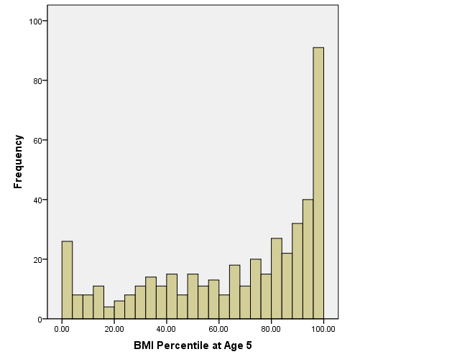
BMI Percentile At Age 5
Mean percentile = 66th
21% are Obese

Slide 20
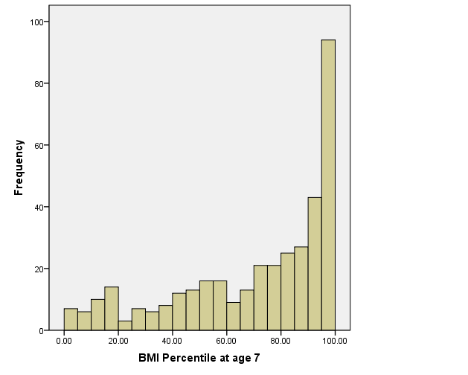
BMI Percentile At Age 7
Mean percentile = 71th
25% are Obese
Mean % body fat = 24%

Slide 21
Obesity Risk Factors and Anthropometric Outcomes
Risk factors | BMI Z-score age 5 Beta, p-value | BMI Z-score age 7 Beta, p-value | % body fat Beta, p-value
Birth weight (per 100 grams) | 0.05, 0.001 | 0.04, 0.001 | 0.14, 0.05
African American | -0.10, 0.46 | -0.11, 0.38 | -1.59, 0.02
Received public assistance | -0.07, 0.60 | -0.20, 0.11 | -1.38, 0.04
Mother was obese prior to pregnancy | 0.38, 0.02 | 0.72, <0.001 | 3.85, <0.001
Adjusted for age and gender

Slide 22
Obesity Risk Factors and Anthropometric Outcomes
Risk factors | BMI Z-score age 5 Beta, p-value | BMI Z-score age 7 Beta, p-value | % body fat Beta, p-value
Birth weight (per 100 grams) | 0.05, 0.001 | 0.04, 0.001 | 0.14, 0.05
African American | -0.10, 0.46 | -0.11, 0.38 | -1.59, 0.02
Received public assistance | -0.07, 0.60 | -0.20, 0.11 | -1.38, 0.04
Mother was obese prior to pregnancy | 0.38, 0.02 | 0.72, <0.001 | 3.85, <0.001
Adjusted for age and gender

Slide 23
Obesity Risk Factors and Anthropometric Outcomes
Risk factors | BMI Z-score age 5 Beta, p-value | BMI Z-score age 7 Beta, p-value | % Body Fat Beta, p-value
Birth weight (per 100 grams) | 0.05, 0.001 | 0.04, 0.001 | 0.14, 0.05
African American | -0.10, 0.46 | -0.11, 0.38 | -1.59, 0.02
Received public assistance | -0.07, 0.60 | -0.20, 0.11 | -1.38, 0.04
Mother was obese prior to pregnancy | 0.38, 0.02 | 0.72, <0.001 | 3.85, <0.001
Adjusted for age and gender

Slide 24
Prenatal PAH Exposure and BMI Z-score
Adjusted for age, gender, ethnicity, birth weight, maternal obesity and maternal receipt of public assistance

Slide 25
Prenatal PAH Exposure and Percent Body Fat
+1.1 Kg fat mass
Adjusted for age, gender, ethnicity, birth weight, maternal obesity and maternal receipt of public assistance

Slide 26
Critiques of Analyses
Confounding by neighborhood socioeconomic status
Confounding by sources of PAH
Bias due to loss to follow-up

Slide 27
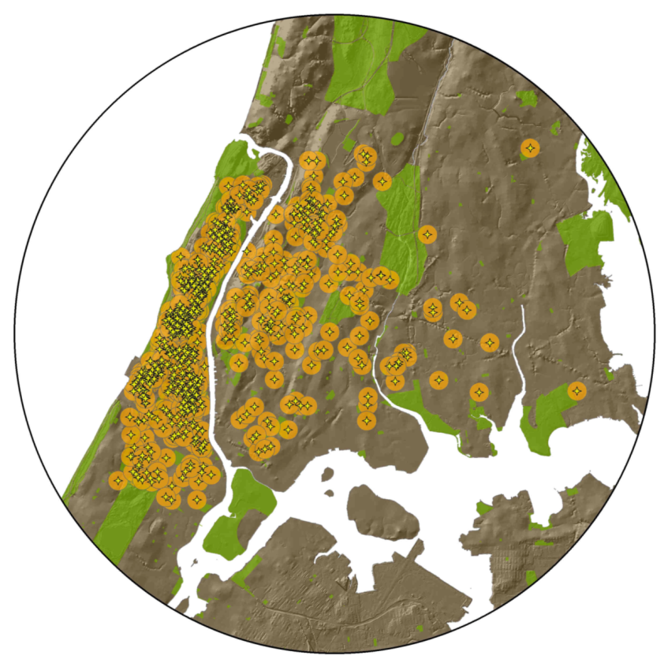
Spatial Analyses

Slide 28
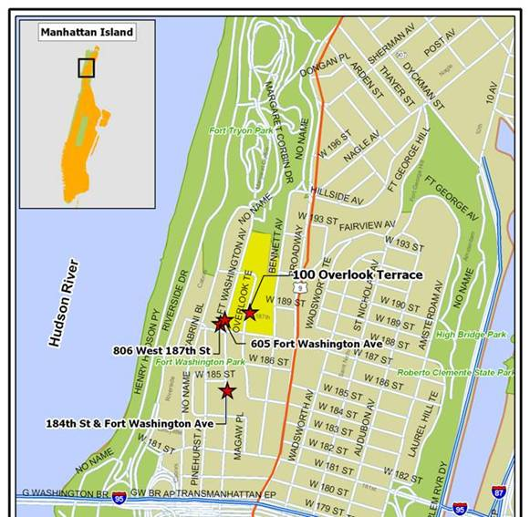
Defining Neighborhoods: Census Tracts
Median Area
0.18 Km²
10th - 90th Percentile Range
0.13 - 0.60 Km²
Notes:
These four slides are to give the audience a sense of scale in NYC.
100 Overlook is my address
605 Fort Washington is my dry cleaner, which I use every two weeks or so
806 west 187th is my local bar where I get dinner several times a month
184th street and Fort Washington is my subway stop that I use every day

Slide 29
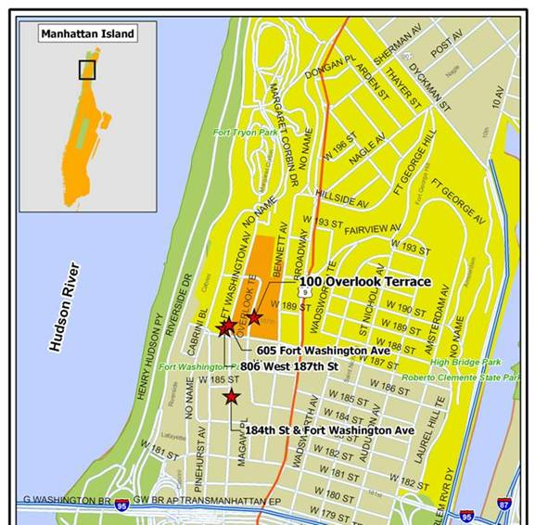
Defining Neighborhoods: Zip Codes
Median Area
3.58 Km²
10th - 90th Percentile Range
1.13 - 7.52 Km²

Slide 30
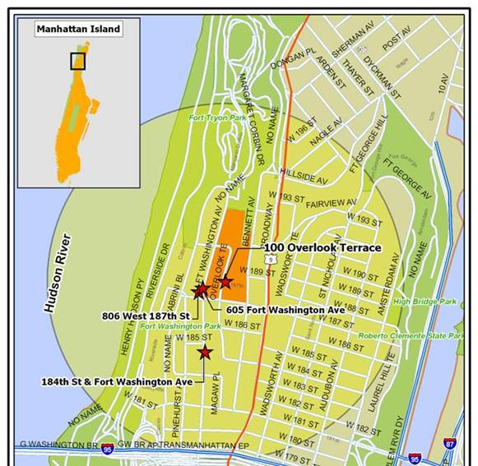
Defining Neighborhoods: Radial Buffer
½ Mile Radius
Median Area
2.03 Km²
10th - 90th Percentile Range
1.58 - 2.03 Km²
Notes:
Many of the radial buffers have water removed from their area calcs so that is why there is a distribution of area sizes.

Slide 31
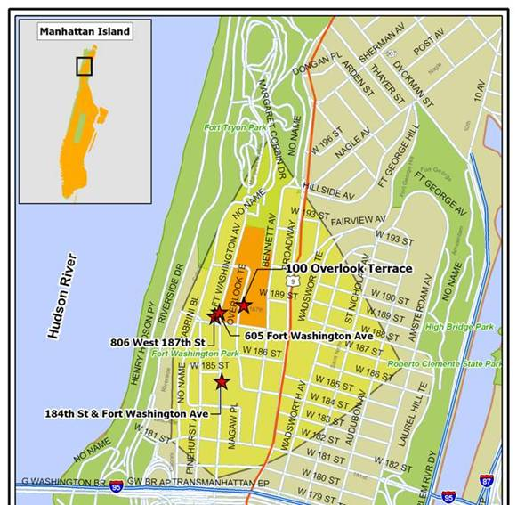
Defining Neighborhoods: Network Buffer
½ Mile Distance
Median Area
1.23 Km²
10th - 90th Percentile Range
0.81 - 1.37 Km²

Slide 32
Defining Neighborhoods

Slide 33
Aggregating Census Data to Street Network Buffers
Census data are available by Census block, a polygonal spatial shape.
Census data must be aggregated to neighborhood boundaries.

Slide 34
Assessing Confounding by Neighborhood Socioeconomic Status
Median and Interquartile range
Neither percent poverty nor median household income predicted PAH levels or outcomes.

Slide 35
Assessing Confounding by
Sources of PAH
Predictors of Ambient Air PAH Exposure
Residential ETS exposure: maternal self report of living with a smoker.
Seasonal effects: Air monitoring during “heating season”, period of mandatory heating in apartment buildings, (10/15 – 4/31)..
Street density: Linear Km of streets per Km² neighborhood area (1 Km radial buffer).
Oil furnaces: Number of oil furnaces burning oil # 4 (0.25 radial buffer).

Slide 36
Assessing Confounding by
Sources of PAH
Predictors of Ambient Air PAH Exposure
 | Maternal PAH Exposure % Difference, P-value
Home ETS exposure | +2.32%, 0.72
Heating season | +47.40%, <0.001
Street density | +2.43%, <0.001
Number of oil #4 furnaces | +1.61%, 0.004
Adjusting for ethnicity, receipt of public assistance, and neighborhood poverty rate.

Slide 37
Bias Due to Loss to Follow-up
Use Inverse Probability Weighting to adjust for loss to follow-up and failure to collect data.
Subjects are weighted by the inverse of the probability of successful follow-up/data collection.
Logistic regression model estimates probability of follow-up/data collection conditional on baseline characteristics.
Analyses of outcomes are conducted using marginal models with inverse probability weighting for follow-up/data collection.

Slide 38
Modeling Approach to Calculate Weights
Gender
Ethnicity
Maternal obesity
Birth weight
Public assistance during pregnancy
Maternal education
Maternal satisfaction with living conditions
Neighborhood poverty rate
Neighborhood percent linguistically isolated
Ambient air PAH levels
Indicator variables for subjects missing data on education and satisfaction

Slide 39
Modeling Approach: Age 5
Gender
Black Ethnicity (+)
Maternal obesity
Birth weight (+)
Public assistance during pregnancy
Maternal education (+)
Maternal satisfaction with living conditions
Neighborhood poverty rate
Neighborhood percent linguistically isolated
Ambient air PAH levels
Indicator variables for subjects missing data on education and satisfaction (-)

Slide 40
Modeling Approach: Age 7
Gender
Black Ethnicity (+)
Maternal obesity
Birth weight (+)
Public assistance during pregnancy
Maternal education
Maternal satisfaction with living conditions
Neighborhood poverty rate (-)
Neighborhood percent linguistically isolated
Ambient air PAH levels (+)
Indicator variables for subjects missing data on education and satisfaction (-)

Slide 41
Standard Verses IPW Regression Analyses
PAH Age 5 Age 7
Exposure Standard IPW Standard IPW
Beta Beta Beta Beta
1st Tertile ref ref ref ref
2nd Tertile 0.26 0.25 0.17 0.28
3rd Tertile 0.39* 0.33* 0.30* 0.39*
* P<0.05, adjusted for age, gender, ethnicity, birth weight, maternal obesity, receipt of public assistance.

Slide 42
Standard Verses IPW Regression Analyses
PAH Age 5 Age 7
Exposure Standard IPW Standard IPW
Beta Beta Beta Beta
1st Tertile ref ref ref ref
2nd Tertile 0.26 0.25 0.17 0.28
3rd Tertile 0.39* 0.33* 0.30* 0.39*
* P<0.05, adjusted for age, gender, ethnicity, birth weight, maternal obesity, receipt of public assistance.

Slide 43
Prenatal PAH Exposure and BMI Z-score
Adjusted for age, gender, ethnicity, birth weight, maternal obesity and maternal receipt of public assistance

Slide 44
Conclusions
Prenatal PAH exposure is associated with higher BMI Z-score at age 5 and 7.
Prenatal PAH exposure is associated with higher percent body fat at age 7.
Findings are robust to control for neighborhood factors and loss to follow-up.
Data are consistent with prior rodent studies.
First data showing that exposure to an environmental pollutant is associated with higher body size.

Slide 45

Collaborators
CCCEH Team
  Howard Andrews
  Greg Freyer
  Lori Hoepner
  Darrell Holmes
  Frederica Perera
  Virginia Rauh
  Deliang Tang
  Robin Whyatt
BEH Team
  Gina Lovasi
  Kathryn Neckerman
  James Quinn
  Danniel Sheehan
  Chriss Weiss
Funding: NIEHS, EPA, RWJ, NIDDK

