Slide 1
Energy, Energy, Energy
Worldwide efforts to reduce energy consumption
People can conserve. Large percentage savings possible, but each individual has small total impact
Industry can conserve. Larger potential impact because of scale.
Datacenters are estimated to use 2 to 4% of the electricity in the United States.

Slide 2
Thesis
Energy is now a computing resource to manage and optimize, just like
  Time
  Space
  Disk
  Cache
  Network
  Screen real estate
  …

Slide 3
Is computation worth it?
In April 2006, an instance with 85,900 points was solved using Concorde TSP Solver, taking over 136 CPU-years,
250 Watt * 136 years = 300000 KWatt hours
$0.20 per KWatt hour = $60000 + environmental costs

Slide 4
Random Facts
A google search releases between .2 and 7 grams of CO₂.
Windows 7 + Office 2010 require 70 times more RAM than Windows 98 and Office 2000 to perform the same simple tasks.
By 2020, servers may use more energy than air travel

Slide 5


Power
What matters most to the computer designers at Google is not speed, but power, low power, because data centers can consume as much electricity as a city
  Eric Schmidt, former CEO Google
Energy costs at data centers are comparable to the cost for hardware

Slide 6
What can we do?
We should be providing algorithmic understanding and suggesting strategies for managing datacenters, networks, and other devices in an energy-efficient way.
More concretely, we can
  Turn off computers
  Slow down computers (speed scaling)
  Are there others?

Slide 7
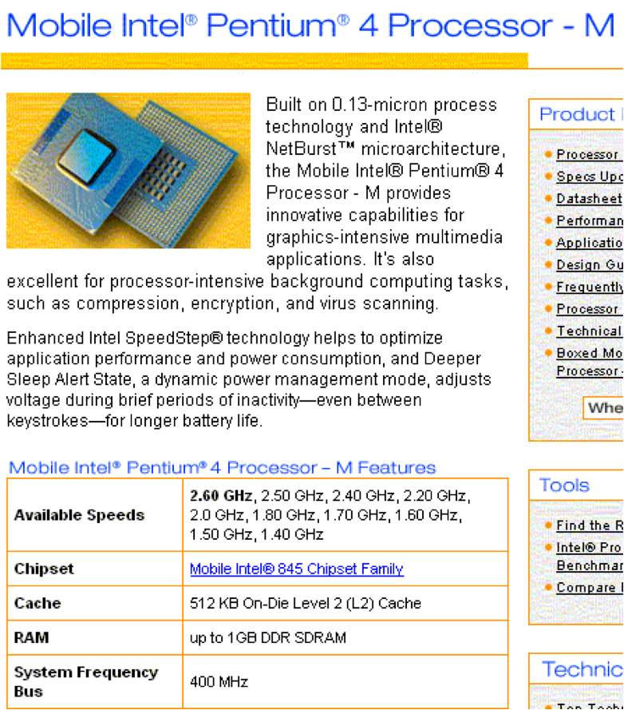
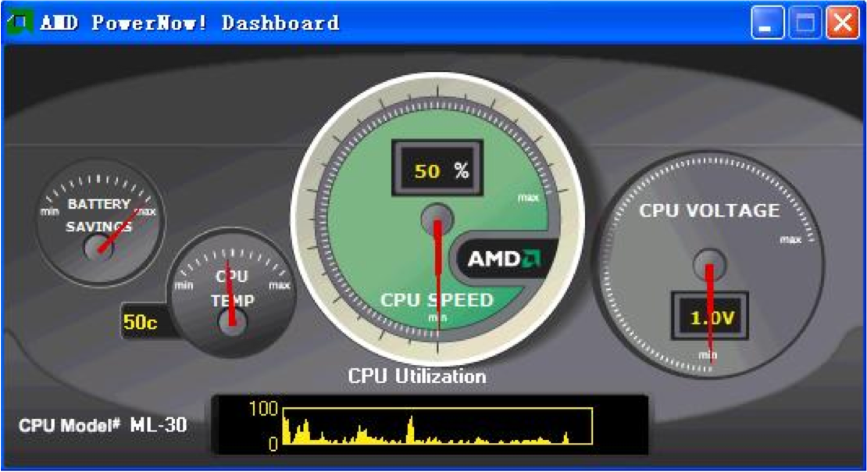
Speed Scaling Technology
Dynamic Power ≈
Speed³ in CMOS
based processors

Slide 8
Routing can also be green
Worldwide more 50 billion kWH are used per year by data networking,
US DoE study estimates a 40% reduction in network energy if the energy usage of network components was proportional to traffic.
Routing in an on-chip network for a chip multiprocessor -- As the number of processors per chip grows, interprocessor communication is expected to become the dominant energy component.

Slide 9
Two basic approaches
Turn off machines
Slow down/speed up machines

Slide 10
Turning Off Machines
Simplest algorithmic problem:
  Given a set of jobs with
    Processing times
    Release dates
    Deadlines
  Schedule them in the smallest number of contiguous intervals
  Why this problem? Fewer, longer idle periods provide opportunities to shut down the machine

Slide 11
Example

Slide 12
Example - EDF schedule
idle
idle
4 short idle periods

Slide 13
Example
idle
idle
1 long, 1 short interval

Slide 14
Algorithms
Can solve via dynamic programming (non-trivial) [Baptiste 2006]
Can model more complicated situations
  Minimize number of intervals
  Minimize cost, where cost of an interval of length x is min(x,B). (can shut down after B steps).
  Multiple machines.
  All solved via dynamic programming
On-line algorithms with good competitive ratios don’t exist (for trivial reasons)
Competitive ratio =
max_{I} (on-line-alg(I) / off-line-opt(I))
Can also ask about how to manage an idle period

Slide 15
Speed Scaling
Machines can change their speeds s
Machines burn power at rate P(s)
Computers typically burn power at rate P(s) = s² or P(s) = s³.
Also consider models where P(s) is an arbitrary, non-decreasing function
Can also consider discrete sets of speeds.

Slide 16
Speed Scaling Algorithmic Problems
The algorithm needs policies for:
  Scheduling: Which job to run at each processor at each time
  Speed Scaling: What speed to run each processor at each time
The algorithmic problem has competing objectives/constraints
  Scheduling Quality of Service (QoS) objective, e.g. response time, deadline feasibility, …
  Power objective, e.g. temperature, energy, maximum speed
Can consider
  Minimizing power, subject to a scheduling constraint
  Optimizing a scheduling constraint subject to a power budget
  Optimizing a linear combination of a (minimization) QoS objective and energy

Slide 17
First Speed Scaling Problem [YDS 95]
Given a set of jobs with
  Release date r_{j}
  Deadline d_{j}
  Processing time w_{j}
Given an energy function P(s)
Compute a schedule that schedules each job feasibly and minimizes energy used
energy = ∫P(s_{t}) dt

Slide 18
Toy Example
2 jobs
  Release date 0
  Deadline 2
  Work 2
Power = 2³ +2³ = 16
Power = 4³+ 1.5³
= 67.4
0 1 2

Slide 19
Facts
By convexity, each job runs at a constant speed (even with preemption)
A feasible schedule is always possible (run infinitely fast)

Slide 20
Offline YDS Algorithm (1995)
Repeat
  Find the time interval I with maximum intensity
    Intensity of time interval I = Σ w_{i} / |I|
      Where the sum is over tasks i with [r_{i},d_{i}] in I
  During I
    speed = to the intensity of I
    Earliest Deadline First policy
  Remove I and the jobs completed in I

Slide 21
YDS Example
Release time
deadline
time

Slide 22
YDS Example
First Interval
Intensity
Second Interval
Intensity = green work + blue work
Length of solid green line

Slide 23
YDS Example
Final YDS schedule
  Height = processor speed
YDS theorem: The YDS schedule is optimal for minimizing energy (also for minimizing temperature, or maximum power)

Slide 24
Minimizing linear combinations
Example:
  Total response time + α (energy cost)
  Assumption: both time and energy can be translated into dollars
  E.g. How much am I willing to pay to save one minute?

Slide 25
Minimizing Energy + Response Time
1 machine
Jobs have weights a, release dates
Scheduler chooses job to run, and speed for each job
Schedule gives completion times to jobs C_{j}
Objective is Σ_{j} a_{j}(C_{j}-r_{j}) + ∫_{t} P(s_{t}) dt
Algorithm is on-line.

Slide 26
Results for Response Time Plus Energy [BCP09]
Scheduling Algorithm (HDF – highest density first). Density is weight/processing time
Speed setting algorithm involves inverting a potential function used in the analysis.
Power function is arbitrary.
Algorithm is (1+ ε)-speed, O(1/ε)-competitive
(scalable).

