Slide 1
IEOR 4405
Lecture 1 Introduction

Slide 2
Scheduling
Topics in this class
  Modeling and formulating scheduling problems
  Algorithms for solving scheduling problems
  Understanding “hard” vs. “easy” problems
Analysis Tools
  Algorithm design and analysis of running times
  Solution quality
  NP-completeness
  Probability
  Linear programming
  Dynamic programming

Slide 3
Four Components of a Scheduling Problem
Processes/Tasks
Resources/Machines
Constraints
Objectives

Slide 4
Example: Project Scheduling – System Installation
Development and installation of trading tools for the Frankfurt Stock Exchange by Deutsche Borse Group
  Tasks: 300 software projects
  Resources: 1500 employees divided into 200 types
  Constraints: Projects may be interrelated by
    Precedence constratintss
    Milestones
    Joint use of resources
  Objective: minimize makespan (schedule length)

Slide 5
Example: Hot Strip Mill Production Scheduling
Integrated Steel plant, Acme Steel, Chicago
The mill transforms large bars of steel into coils of sheet
  Tasks: Orders for some quantity and types of coils
  Resources: Machines
  Constraints:
    Product quality restrictions
    Process efficiency standards
  Objectives:
    Minimize set up times
    Minimize energy usage
    Minimize number of delays orders

Slide 6
Flight Crew Scheduling
At American Airlines, crew costs are the 2nd highest component of direct operating cost
  Tasks: Flights
  Resources: Crews
  Constraints:
    Union work rules
    Safety rules
    Limits on flight time, connection time, maintainance time
  Objective: Minimize the total cost (salary, hotel expense, etc.)

Slide 7
Example: Robot Scheduling in a Circuit Board Production Line
Control of robots requires real-time scheduling
A circuit board must be sequentially processed within a series of chemical tanks
A board can stay in a tank for a fixed time, otherwise it becomes defective

Slide 8
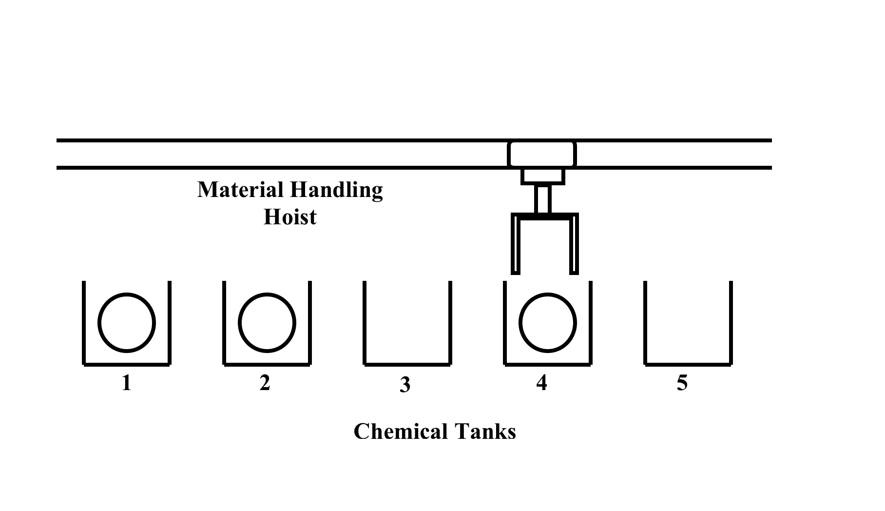

Slide 9
Robot Control (cont)
Tasks: Circuit Boards
Resources: Chemical tanks
Constraints:
  Fixed sequence of jobs
  Robot can move one job at a time from tank to tank
Objective: maximize throughput (rate that jobs are finished)

Slide 10
Sequencing of Commercial Breaks by a TV Network
Management of commercial airtime at Channel 4
Scheduling 5 minute breaks across 6 regions
Tasks: Commercials
Resources: Time spots in regions
Constraints:
  No overlaps or gaps
  Advertisers may express preferences for certain spots
Objective:
  Maximize profitability of commercials sold

Slide 11
Assigning CPU time to Tasks in a Data Center
Companies such as Amazon, Google, Facebook run large data centers and need to allocate time to processing tasks
  Tasks: Computing jobs with processing times, priorities, arrival times, etc.
  Resources: Computers (homogeneous or heterogeneous)
  Constraints: Precedence constraints, use of memory or disk
  Objective: Response time or fairness or energy usage or ….

Slide 12
Automobile Factory
Tasks: Car
Resources: Machines and Labor
Constraints:
  Precedence constraints on the various parts of the car, e.g. tires, axles, glass, body ..
  Each machine can work on one car at a time
  Each worker can work on one car at a time
Objective: Throughput

Slide 13
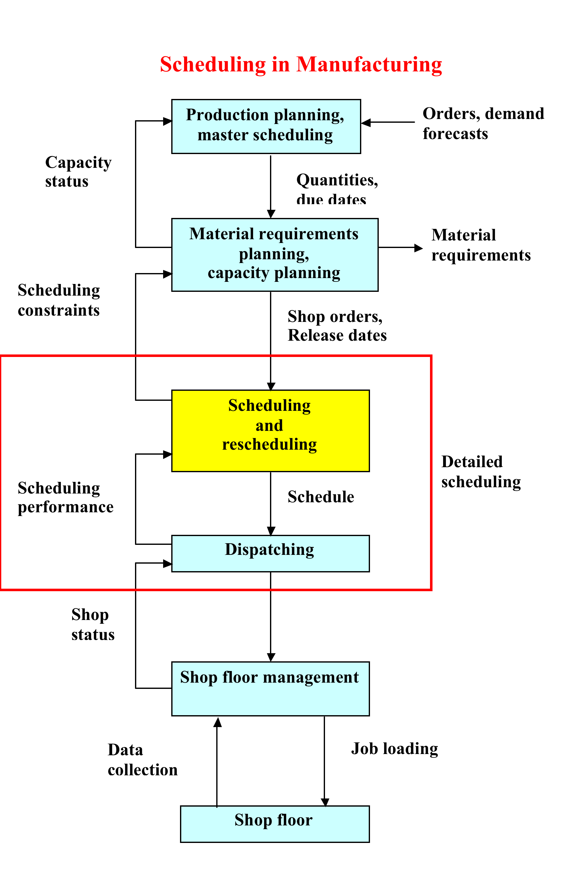

Slide 14
