Slide 1

Physiology of human voice production revealed by in-vivo experiments
World ENT Congress 2022
Orlando, Florida, USA
C. Julian Chen
Columbia University

Slide 2
Physiology of human voice production Why important?
Medical: voice diagnosis, treatment, rehabilitation.
Computer technology: speech recognition, speech synthesis, speech enhancement.
Telecommunication technology: speech coding.
Linguistics: acoustic phonetics, language education.
Vocal music: scientific basis for improving singing.

Slide 3
Outline
The physiology of human voice production
The source-filter theory
  LPC: voice analysis according to source-filter theory
Facts of in-vivo experiments
The timbron theory
  Pitch-synchronous analysis of human voice
Pitch-synchronous spectrogram of human voice
Applications: medical, IT, and linguistics

Slide 4
Physiology of human voice production
Leonhard Euler’s transient resonance theory (1727)
Robert Willis’ mechanical voice simulation (1829)
Ludimar Hermann’s phonograph study (1890)
Peter Ladefoged’s superposition description (1960)
Philippe Fabre’s electroglottograph study (1956)
Robert Sataloff’s hand-clap analogy (1972)
Ronald Baken’s water-hammer analogy (1980)

Slide 5
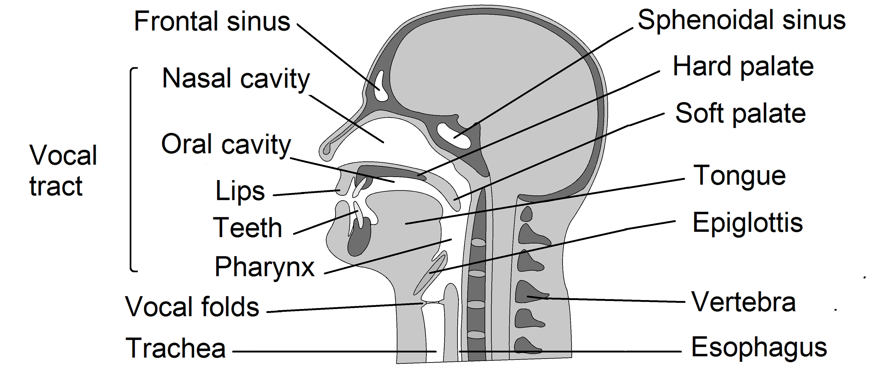
Voice Producing Organs

Slide 6
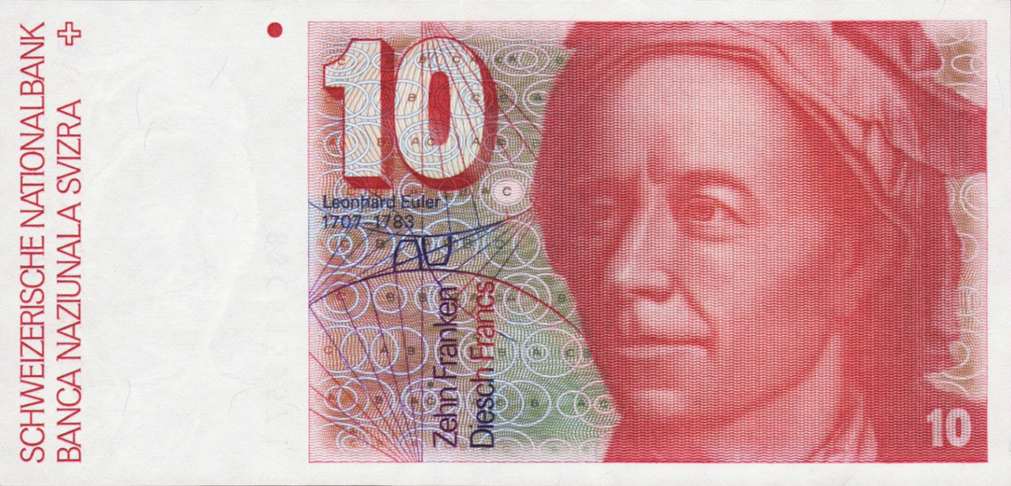
Leonhard Euler’s transient resonance theory
In 1727, Euler published the first (basically correct) theory on human voice production, the transient resonance theory.

Slide 7
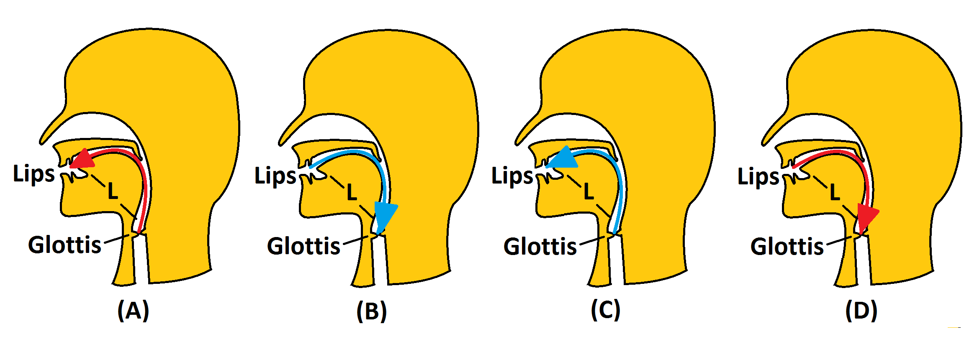
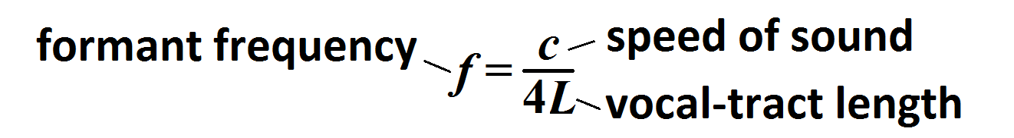
Leonhard Euler’s transient resonance theory
For each pitch period, the glottis emits an impulse. Then travels four times in the vocal tract to form a formant.

Slide 8
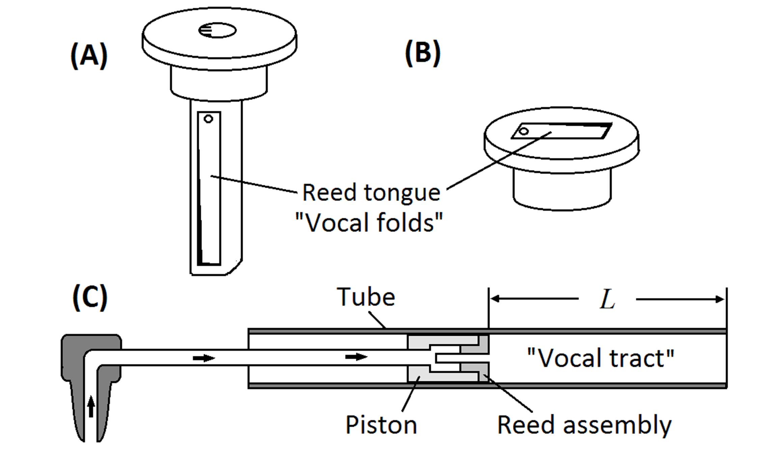
Robert Willis’ mechanical model
In 1829, British scientist Robert Willis built models to verify Euler’s theory on voice production, used a reed tongue as the vocal folds, and a tube as vocal tract.

Slide 9
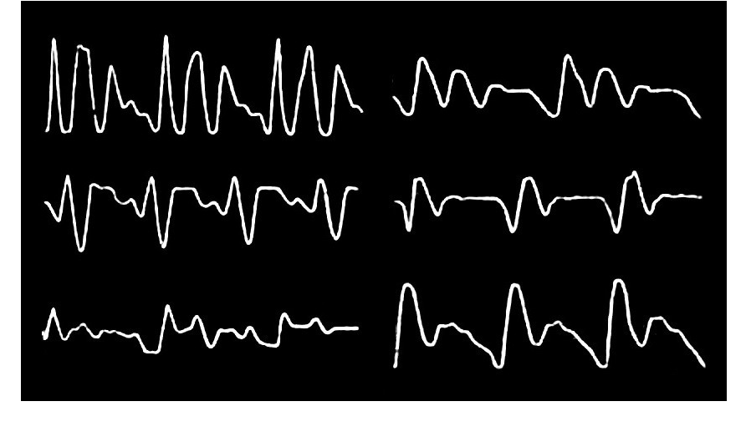
Ludimar Hermann’s phonograph study
In 1890s, Ludimar Hermann studied the phonograph tracks.
(A) In each pitch period, the waveform starts with a sharp pulse, then decays.
(B) For each vowel, the Fourier coefficients show characteristic peaks, independent of pitch frequency. He coined a term Formant for those peaks.
Samples of phonograph tracks
Studied by Ludimar Hermann

Slide 10
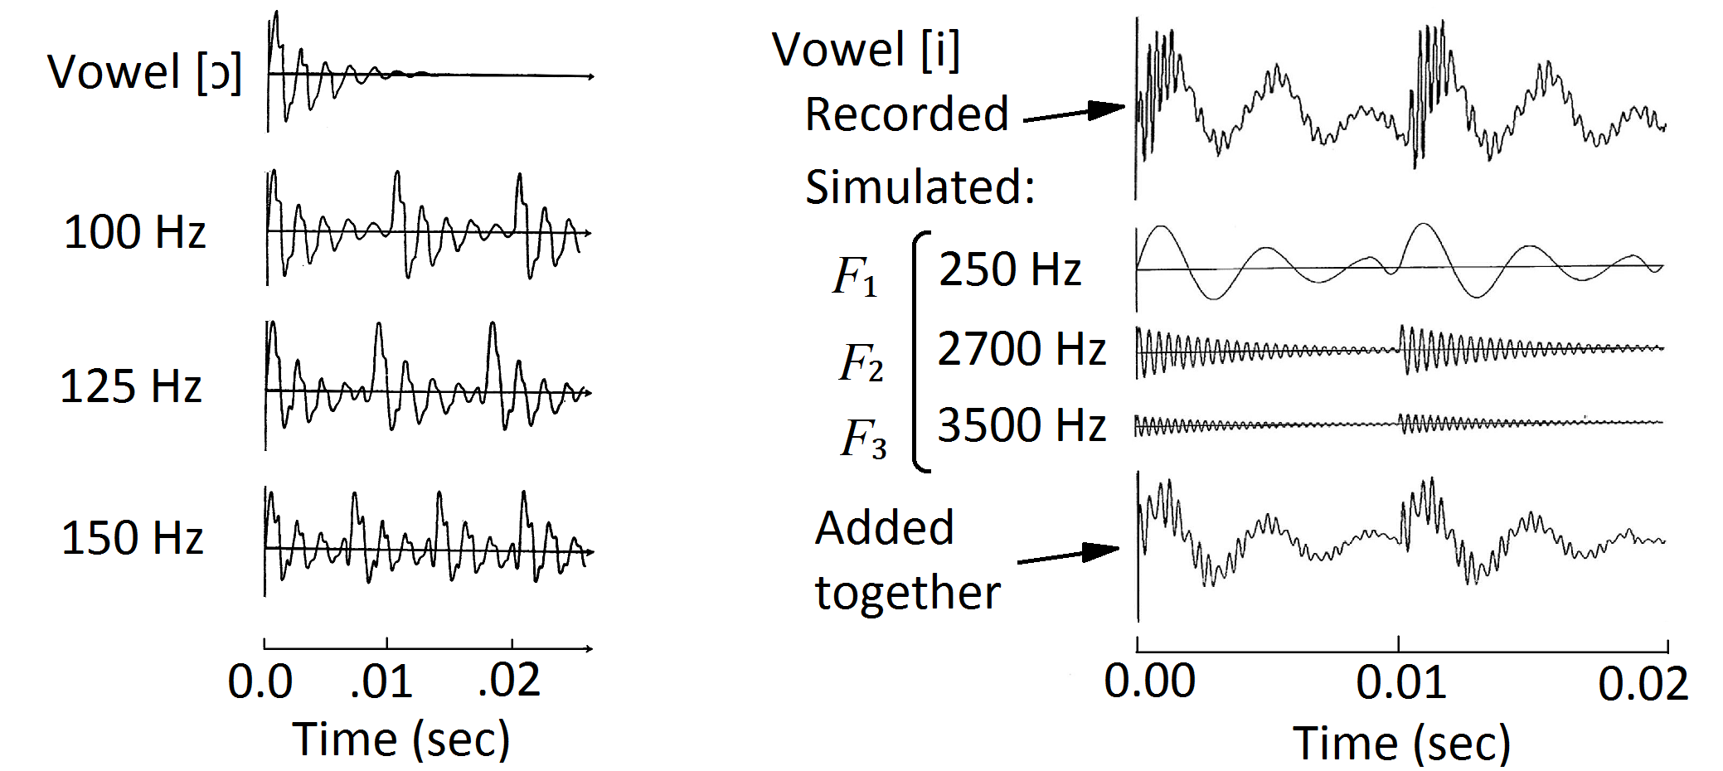
Peter Ladefoged’s repeating chord concept
P. Ladefoged, Elements of Acoustic Phonetics, Univ. Chicago Press (1966).

Slide 11
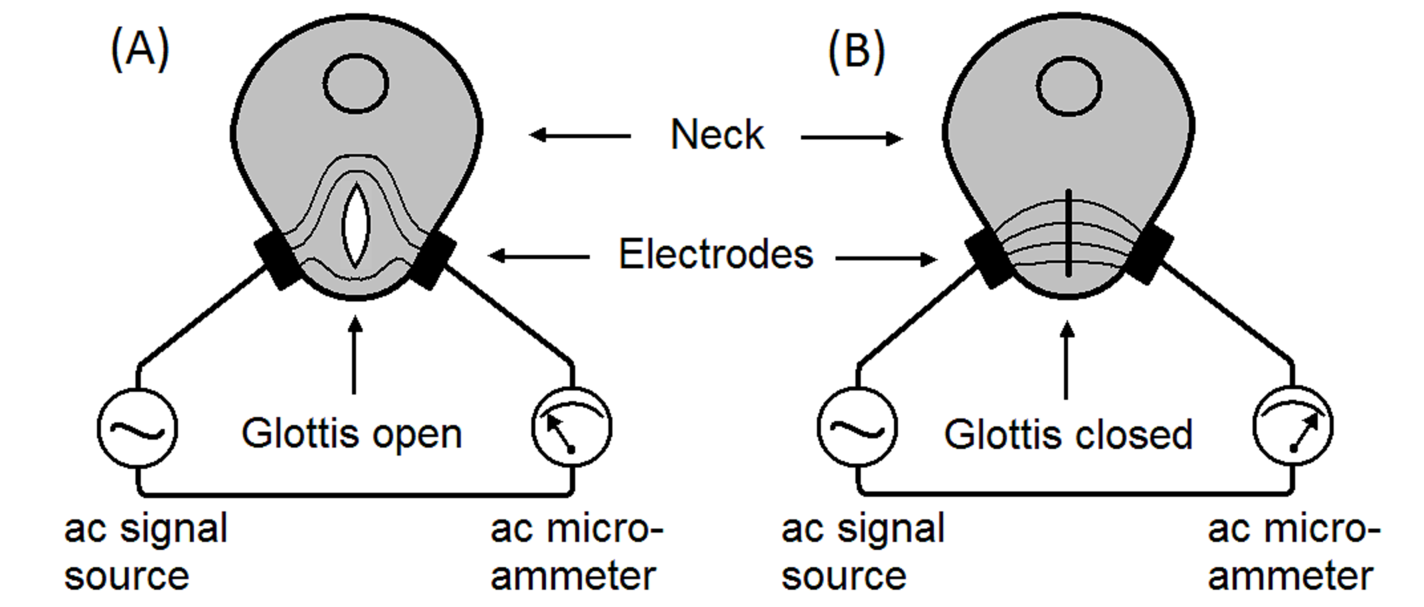
Philippe Fabre’s electroglottograph (EGG)
The time of the vocal-folds closing can be precisely measured.

Slide 12
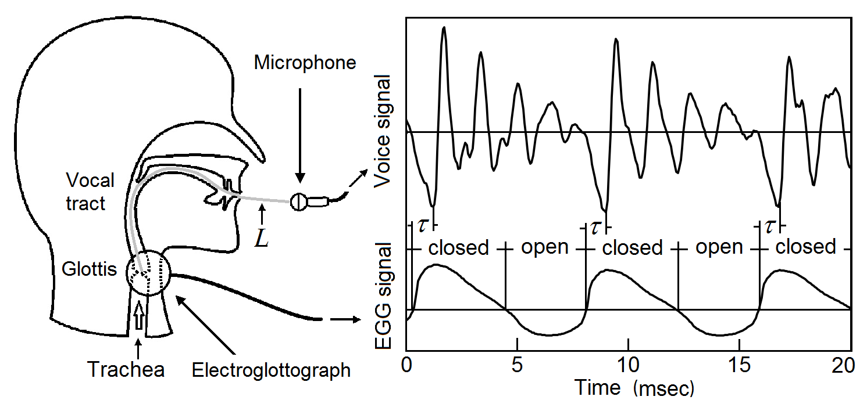
Temporal correlation of EGG and voice signals
A glottal closure triggers an elementary sound wave (timbron).

Slide 13

Robert Sataloff’s Hand-Clapping Analogy
“Sound is actually produced by the closing of the vocal folds, in a manner similar to the sound generated by hand clapping. The more frequently they open and close, the higher the pitch.”

Slide 14
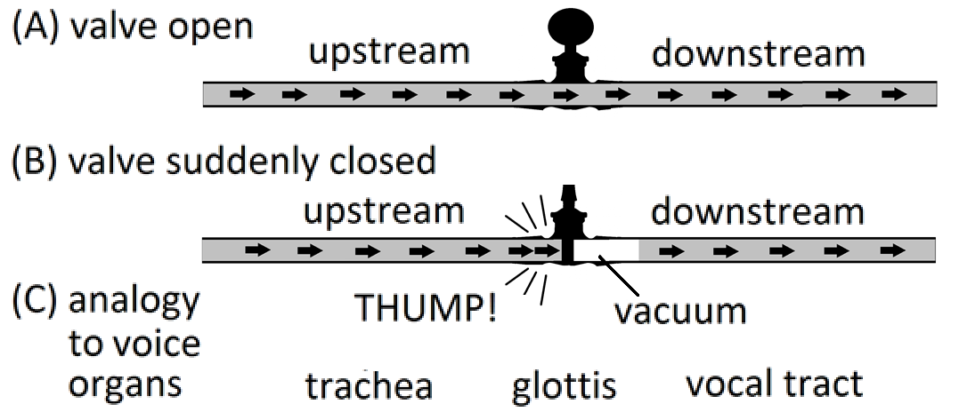
Ronald Baken’s Water-Hammer Analogy
“The sharp cutoff of flow is particularly crucial, because it is this relatively sudden stoppage of the air flow that is the truly the raw material of voice. This generates a shock wave.”

Slide 15
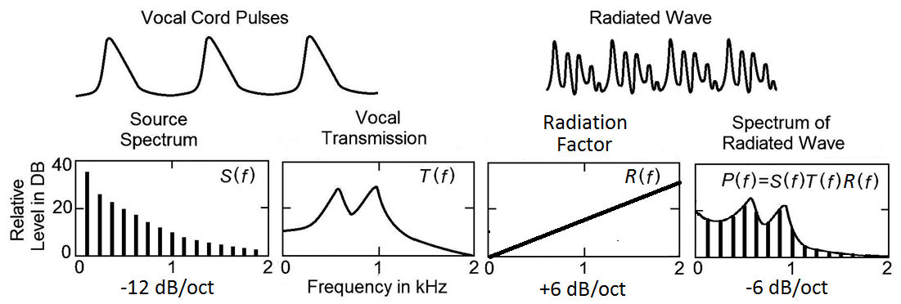
The Source-Filter Theory of Voice Production
A quasi-periodic airflow function generated by the opening-closing of the glottis creates a buzzing source, then filtered by the spectrum of vocal track with a radiation factor to form the voice (Fant 1970).

Slide 16
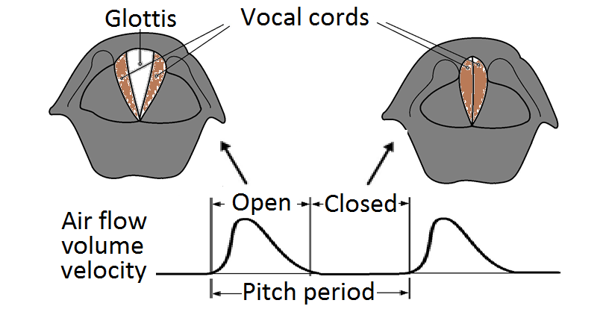
Analysis of the Source-Filter Theory (1)
The source is the periodic airflow in the glottal open phase; the amplitude Fourier coefficients of its volume velocity is the source spectrum S(f).

Slide 17
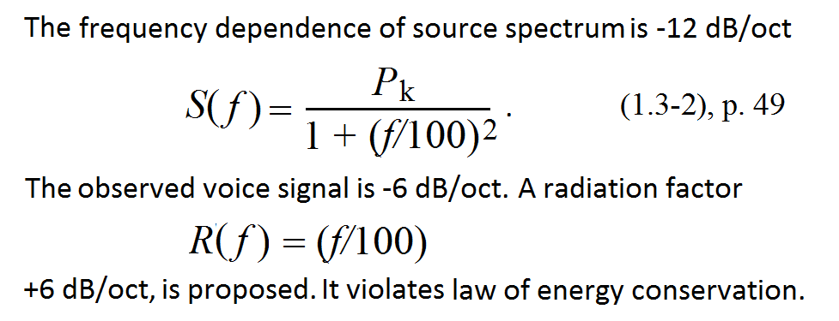
Analysis of the Source-Filter Theory (2)
Gunnar Fant, Acoustic Theory of Speech Production (1970).

Slide 18
Analysis of the Source-Filter Theory (3)
Voice is strong in the closed phase and weak in the open phase.

Slide 19
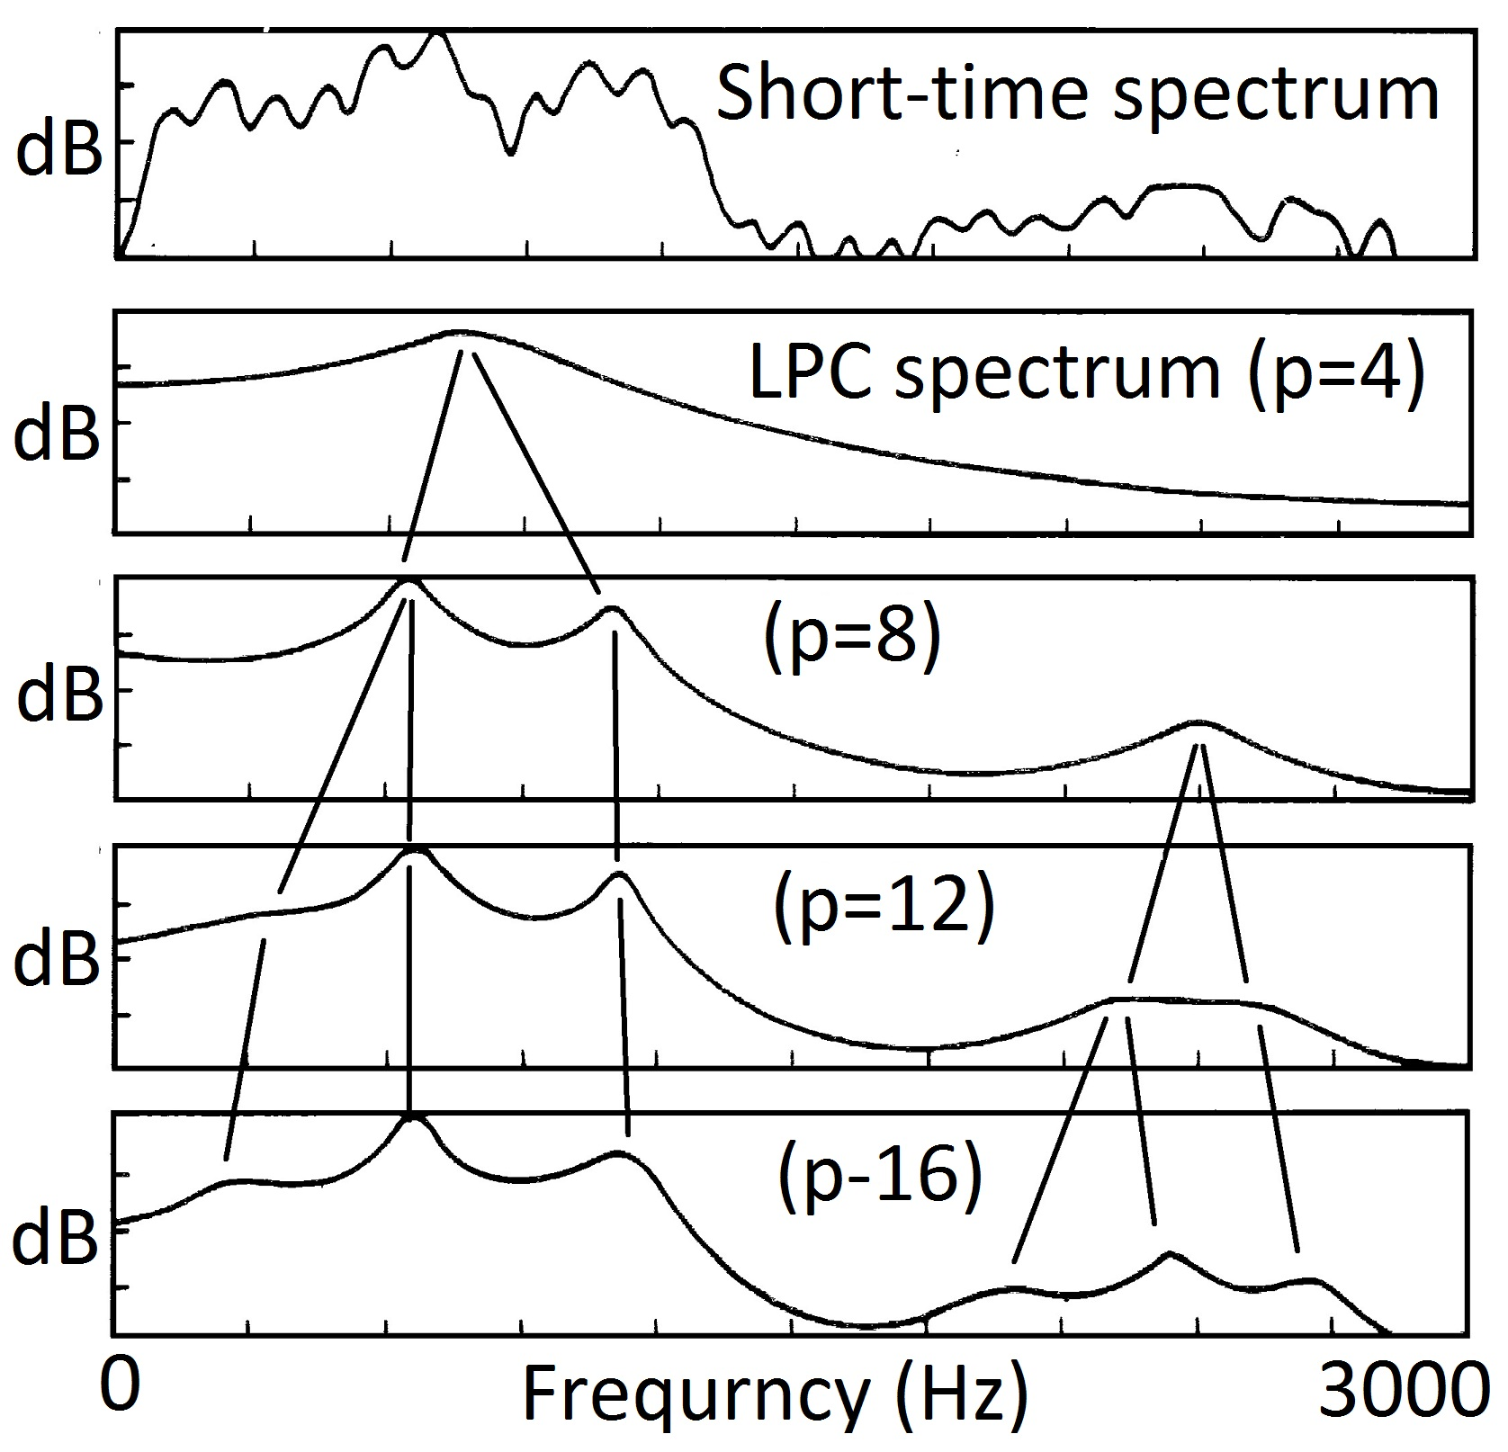
LPC, typical method of source-filter theory
It requires at least 200 msec of signal with an almost constant pitch
It only provides two parameters per formant.
The output frequencies of the formants depends on input order of LPC.

Slide 20
Deficiencies of the Source-Filter Theory
It violates the law of energy conservation
It contradicts experimental observations
It implicates a poor analysis method LPC
  Requires lengthy stationary voice signal
  Incomplete (2 parameters per formant)
  Not reproducible and not objective

Slide 21
Towards a Correct Theory of Voice Production
First, to explain why a speech waveform starts at a glottal closing.

Slide 22
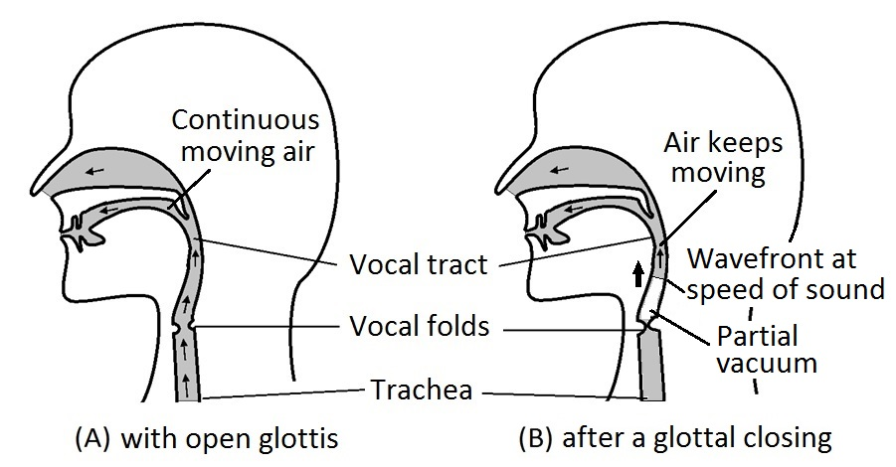
The Timbron Theory of Voice Production (1)
When the glottis is open, there is a continuous airflow in the vocal tract. A glottal closing abruptly blocks the airflow. The moving air in the vocal tract continues to move due to inertia. It resonates in the vocal tract and radiates. A wave is formed by the vocal tract.

Slide 23
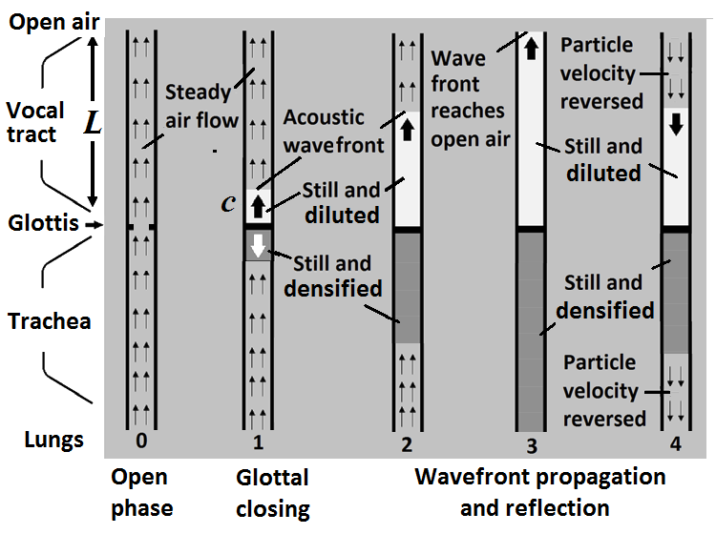
The Timbron Theory of Voice Production (2)
Before a closing, air flows from trachea to vocal tract.
A closing shuts off the flow.
Moving air in the vocal tract keeps moving due to inertia.
Kinetic energy of moving air converts into acoustic energy.
At the end of the vocal tract, the sound wave reflects.
The sound wave radiates into the open air to make voice.
The sound wave is -6dB/oct.

Slide 24
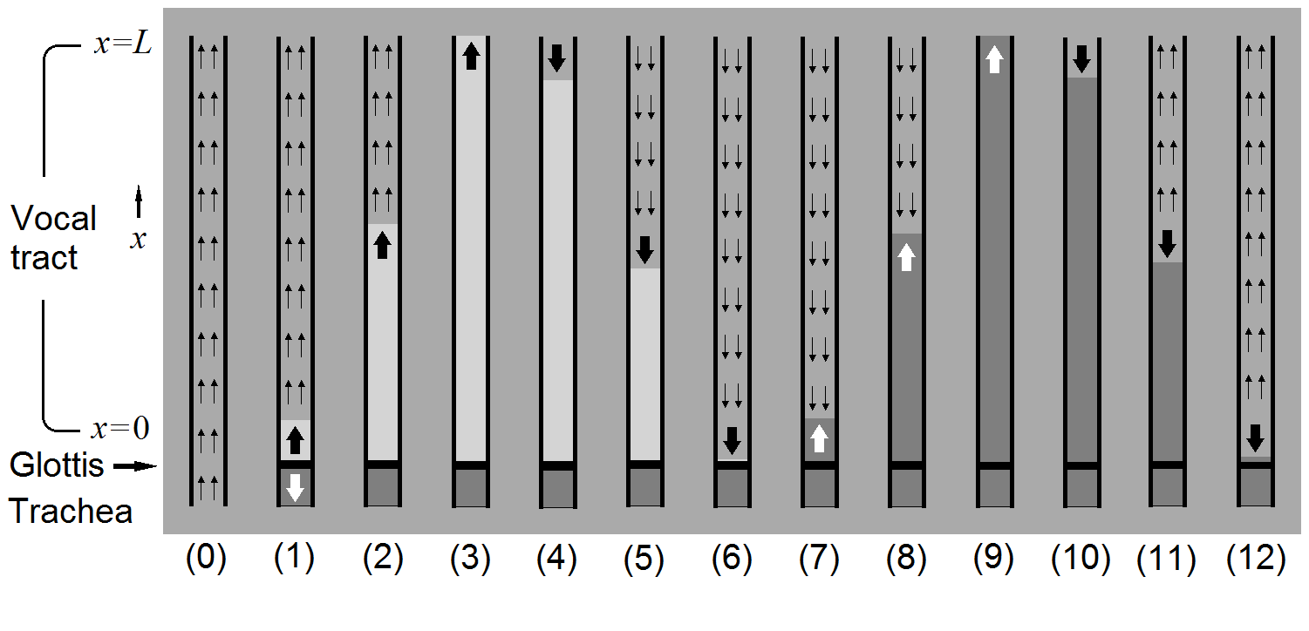
The Timbron Theory of Voice Production (3)
A formant cycle has four steps, formant frequency is f = c/4L.

Slide 25
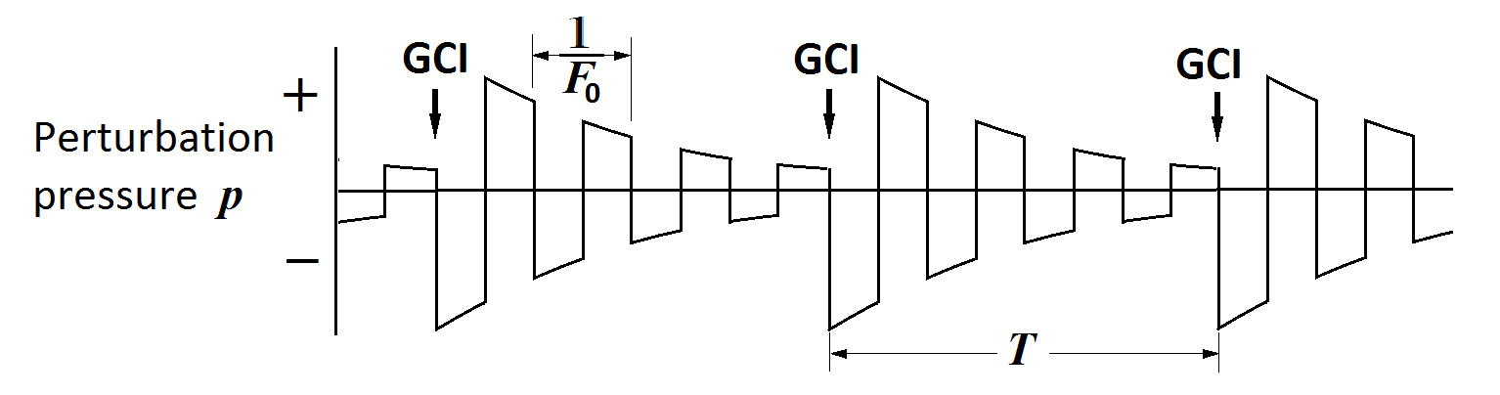
The Timbron Theory of voice production (4)
The starting waveform of voice signal is a step function.
The source spectrum is -6 dB/oct, same as observed.
There is no need to assume an absurd radiation factor.

Slide 26
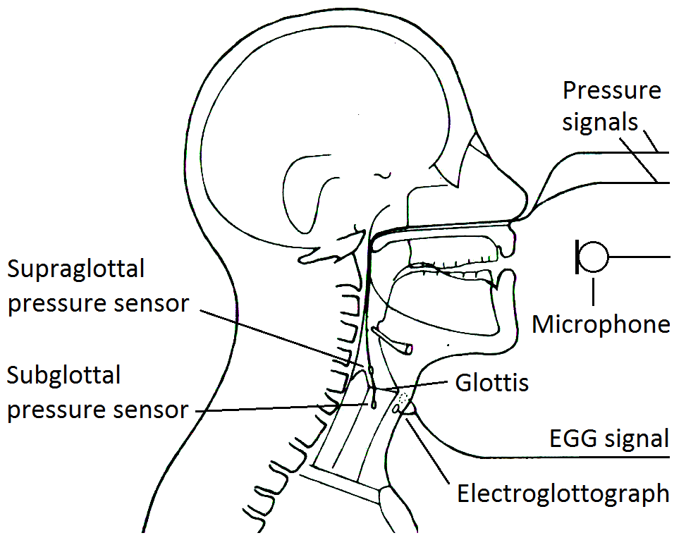
In-vivo measurements of supra- and subglottic pressures
In 1984, D. Miller and H. Schutte did a simultaneous measurement of subglottal pressure and supraglottal pressure with EGG signal and voice signal, provided direct information on the process of human voice production. It showed the effect of the sudden glottal closings as the origins of timbrons, the elementary building blocks of voice.

Slide 27
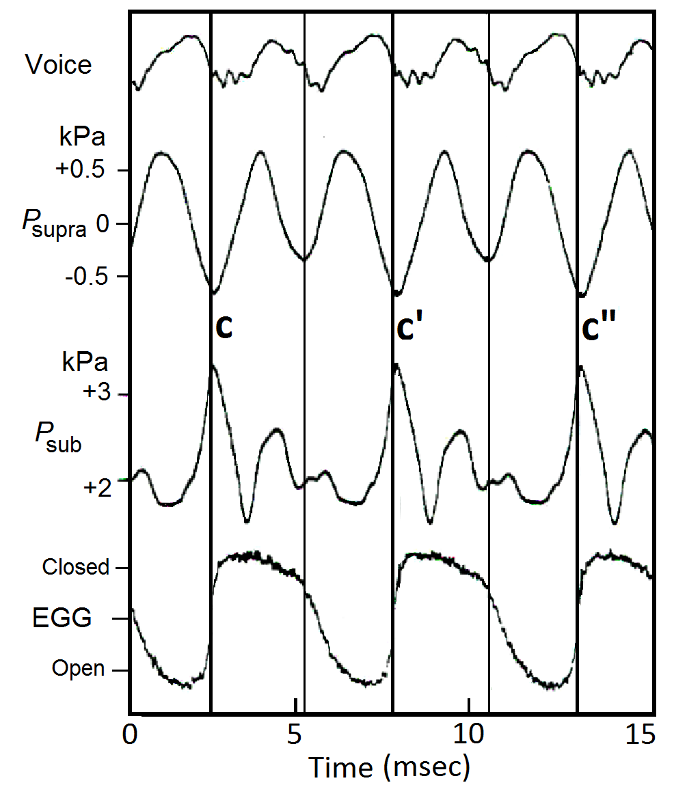
In-vivo measurements of supra- and subglottic pressures
At a glottal closing instant,
An elementary wave is triggered.
The supraglottal pressure reaches a minimum, about -0.6 kPa over its average value, the lowest pressure in each pitch period.
The subglottal pressure reaches a maximum, about +0.6 kPa over its average value, the highest pressure in each pitch period.

Slide 28
Interpretations of in-vivo supra- and subglottic pressures
After a glottal closing…
The momentum of the moving air in the vocal tract creates a partial vacuum (rarefication) above the vocal folds.
The momentum of the moving air in the trachea creates a compression (densification) of air below the vocal folds.

Slide 29
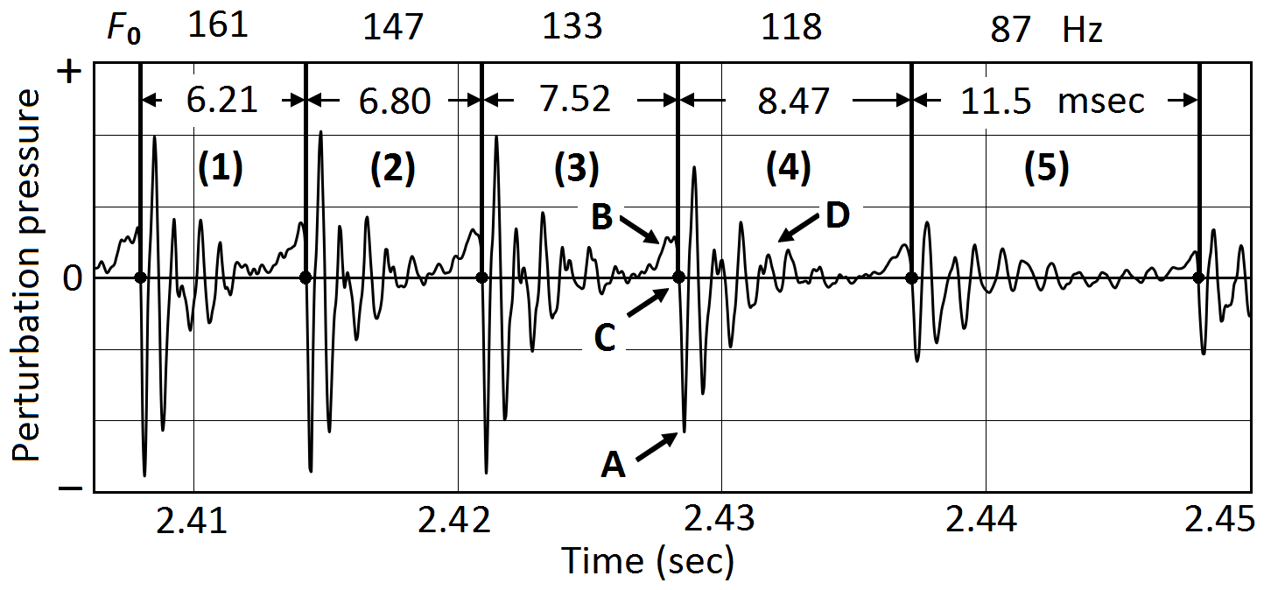
Pitch-synchronous analysis of voice signals (1)
For each pitch period, T = 1/f is defined as the time interval between two consecutive glottal closing instants. The waveform in each pitch period contains full information on the timbre.

Slide 30
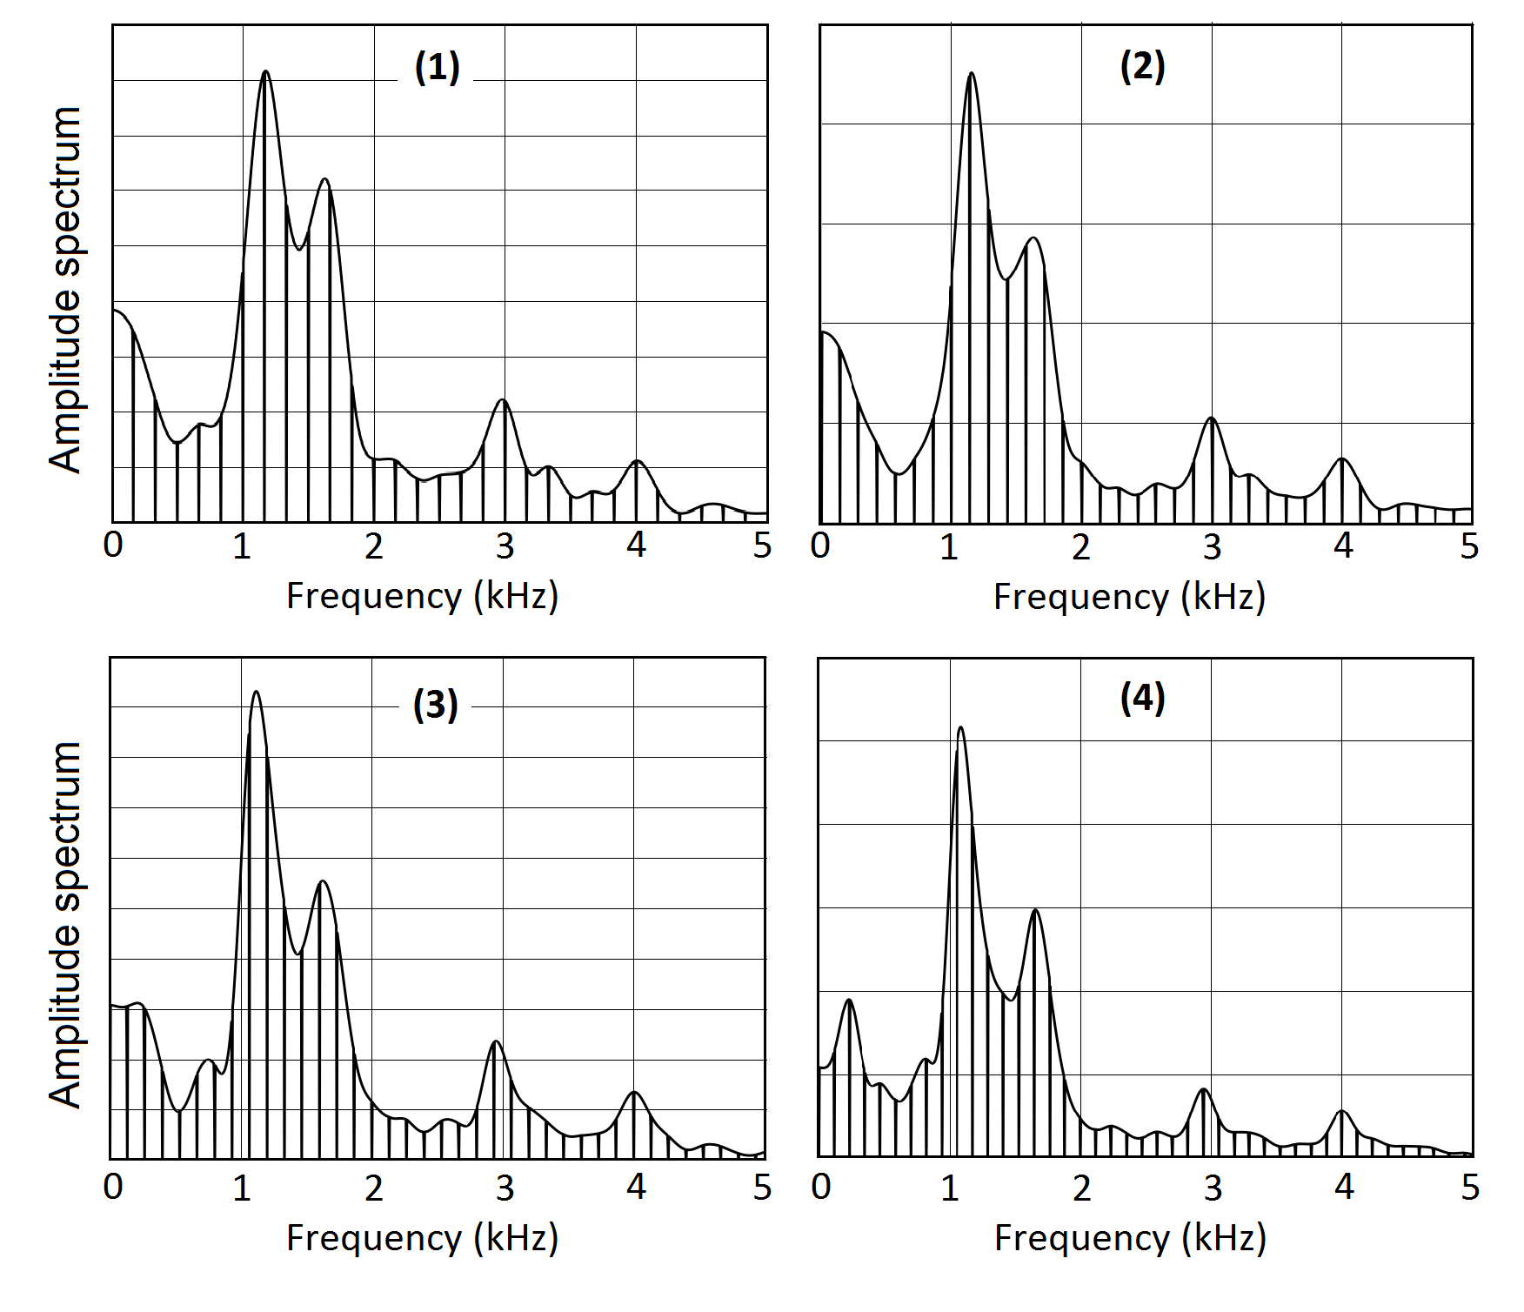
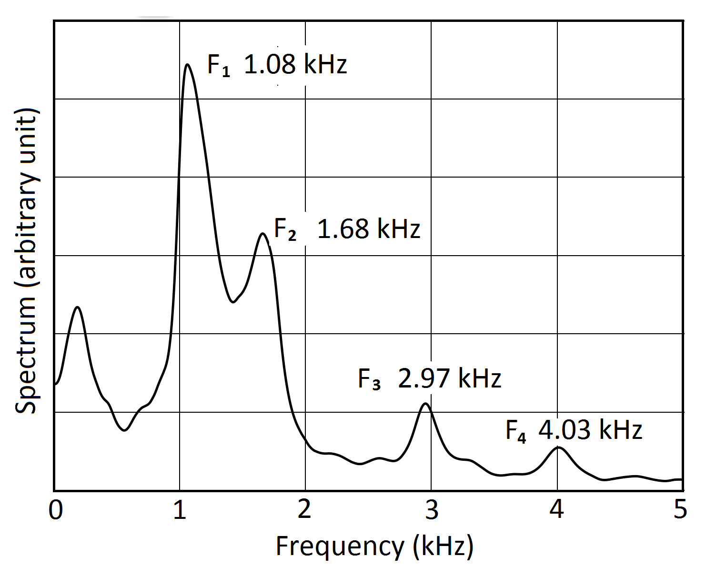
Pitch-synchronous analysis of voice signals (2)
Spectra in consecutive periods can be averaged to improve accuracy.

Slide 31
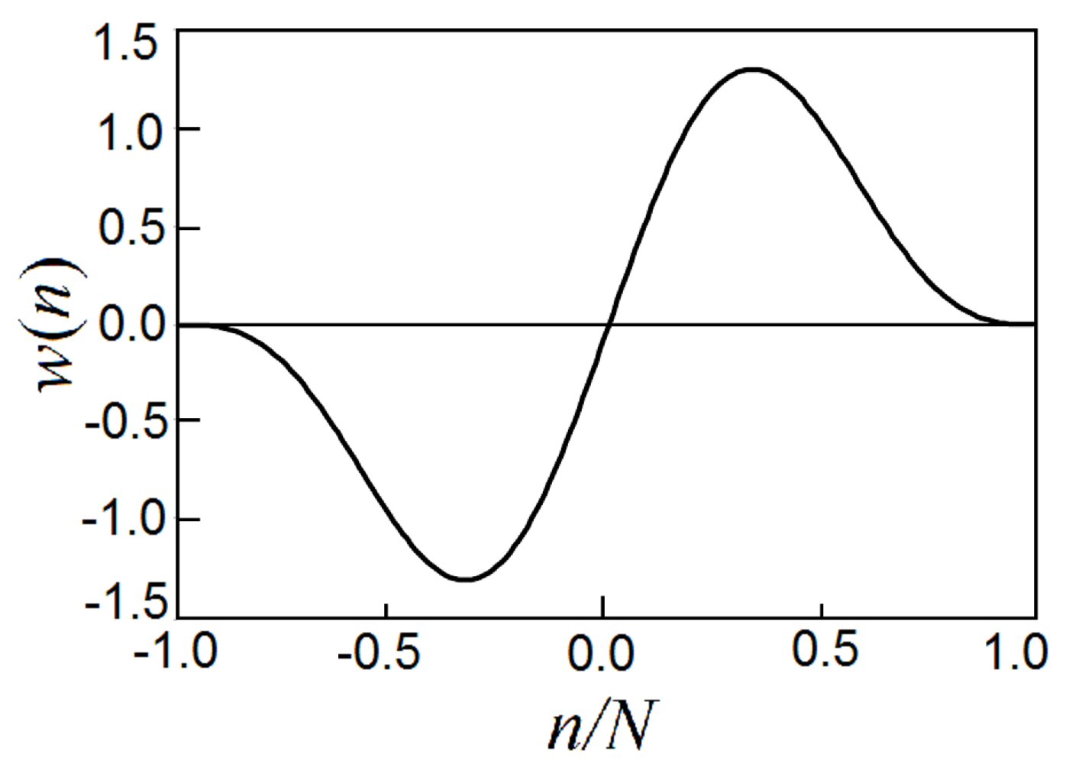
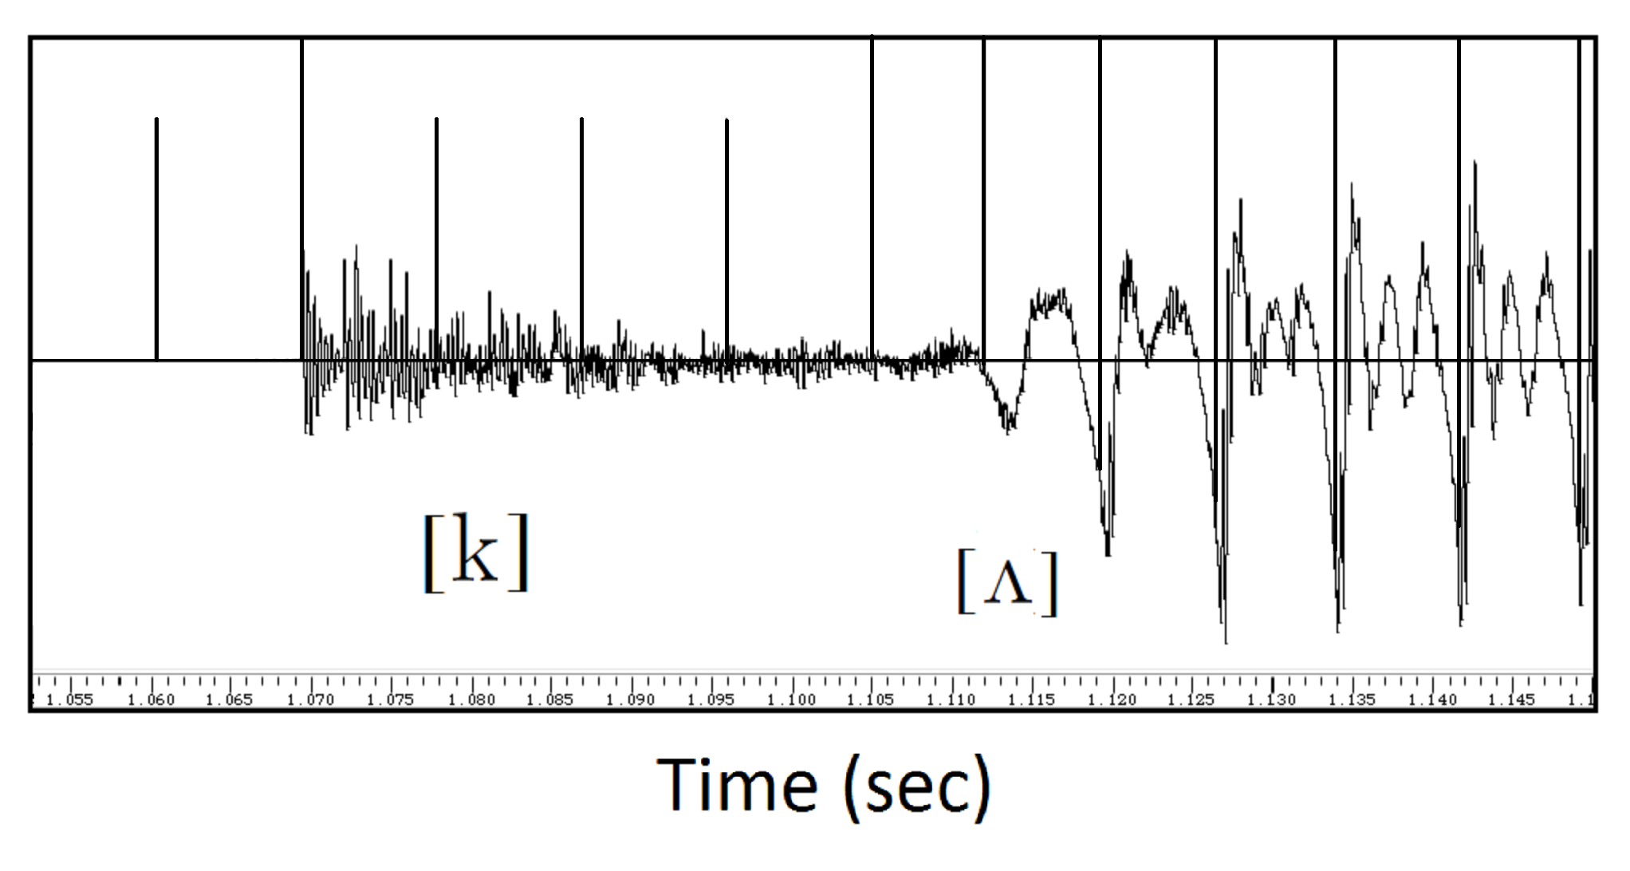
Automatic pitch-synchronous segmentation
(A)
(B)
(A) By multiplying the voice signal with an asymmetric wavelet then picking up maximal values, the segmentation points for voiced sections are obtained.
(B) The segmentation points can be extended to unvoiced sections.

Slide 32
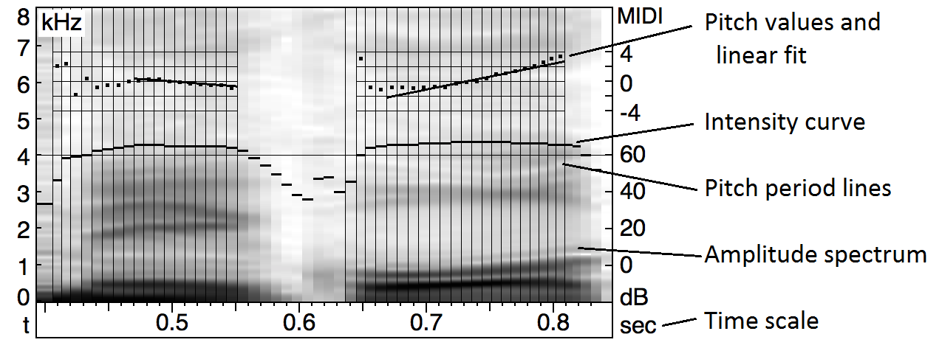
Pitch-synchronous spectrogram
A graphical display of the amplitude spectrum together with intensity (in dB), relative pitch (in MIDI) and its linear approximation, can be created.

Slide 33
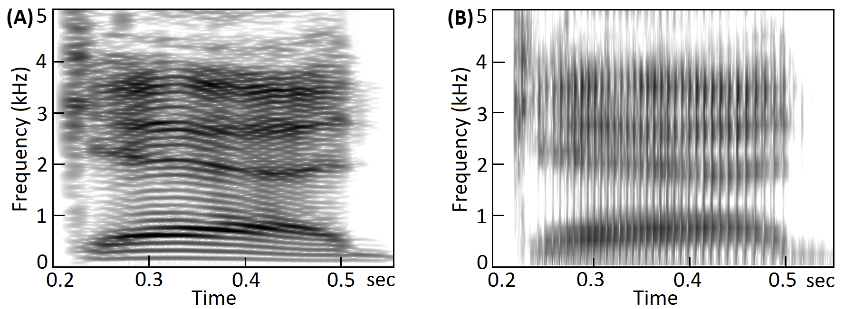
Pitch-asynchronous spectrogram
Pitch and timbre spectrum are mixed. No quantitative results displayed. Features depend on processing window size. (A) long window. (B) short window.

Slide 34
Summary: Timbron Theory of Voice Production
Human voice is a linear superposition of elementary waves
Each elementary wave carries full information on the timbre
An elementary wave (timbron) is triggered by a glottal closing
Pitch period is the time between two consecutive glottal closings
The timbron theory is based on experimental observations
  Decaying features of timbrons in each pitch period
  Temporal correlation of voice and EGG signals
  Temporal correlation of EGG signal and cross-glottis pressures
  Overall spectrum (roughly -6 dB/oct) of voice signals
Voice with incomplete closings shares some similarities
Unvoiced signals are of different origins.

