Slide 1


Wavefunction is an observable physical field
A Keynote Speech at the 2021 Physics and Astronomy World Forum, Frankfurt, Dec. 3
C. Julian Chen
Columbia University

Slide 2
The Philosophy of Physics
Richard Feynman said, “I think I can safely say that nobody understands quantum mechanics. ’’
The philosophy to understand it should be
Experiments are the only means of knowledge at our disposal. The rest is poetry, imagination.
-- Max Planck
Measuring is knowing.
-- Heike Kamerlingh Onnes

Slide 3

Synopsis
Using a scanning tunneling microscope, details of Schrödinger’s wavefunction are observed and mapped to sub-picometer resolution with negligible disturbance.
Wavefunction is a classical field, the same as Maxwell’s electromagnetic fields.
Electron is never a geometrical point. It is only and always a field spread out in space.

Slide 4

Outline
The Scanning Tunneling Microscope
Experimental observation and mapping of atomic and molecular wavefunctions
Classical fields in quantum field theory
Second quantization as the only quantization
Schrödinger wavefunction as a classical field
The non-existence of point-like electrons

Slide 5

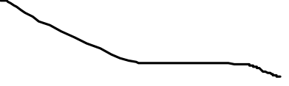
The Scanning Tunneling Microscope (1)
Heinrich
Rohrer
Invented
In 1981
Gerd
Binnig
Nobel Prize
1986

Slide 6
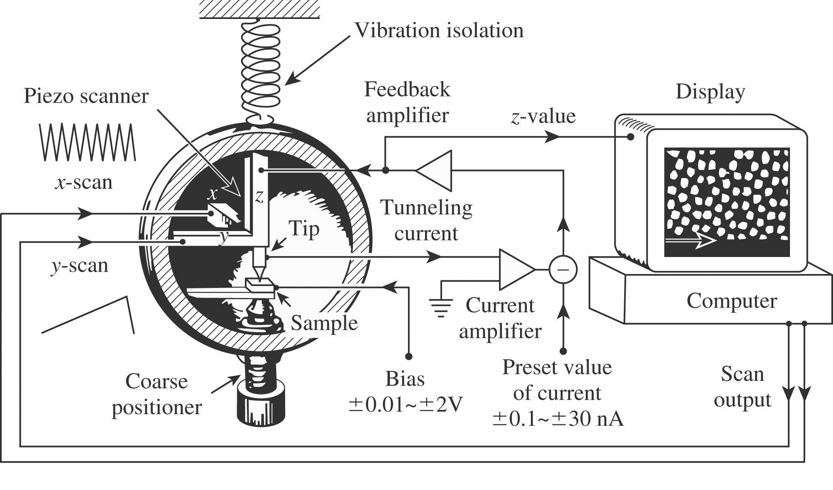
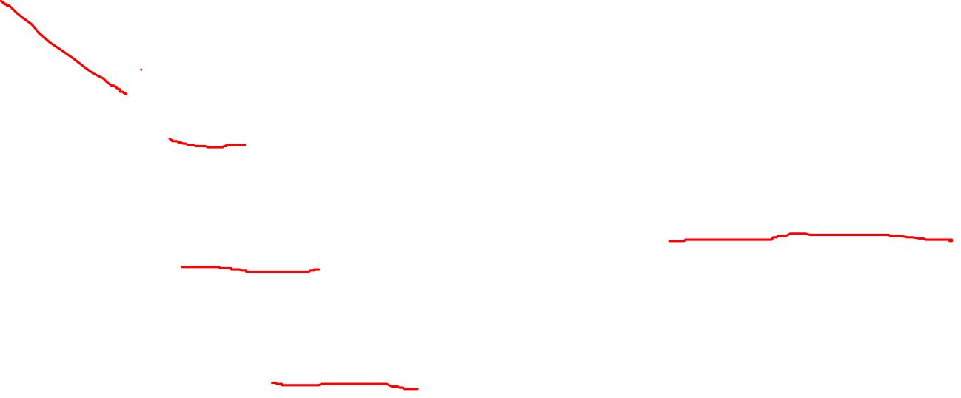
The Scanning Tunneling Microscope (2)

Slide 7
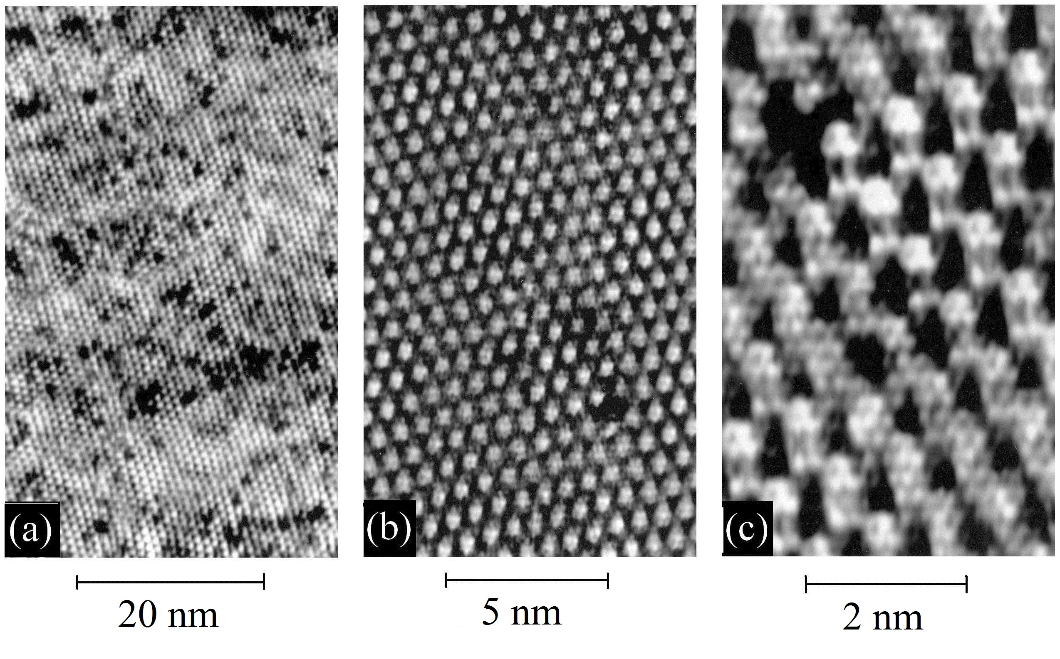
The Scanning Tunneling Microscope (3)
The resolution can be adjusted to zoom in to the atoms

Slide 8
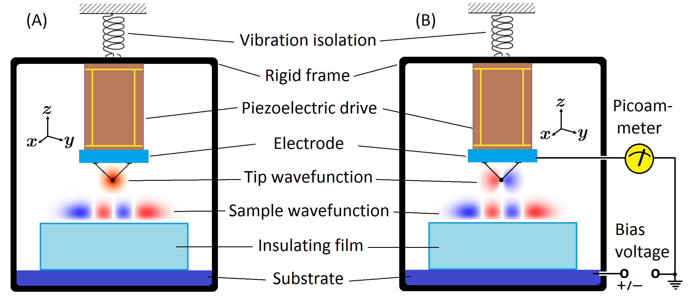

Imaging Wavefunctions (1)

Slide 9
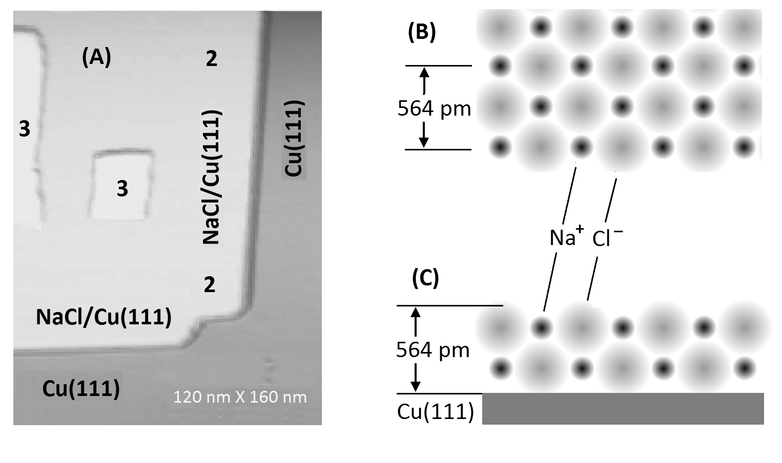
Imaging Wavefunctions (2)

Slide 10
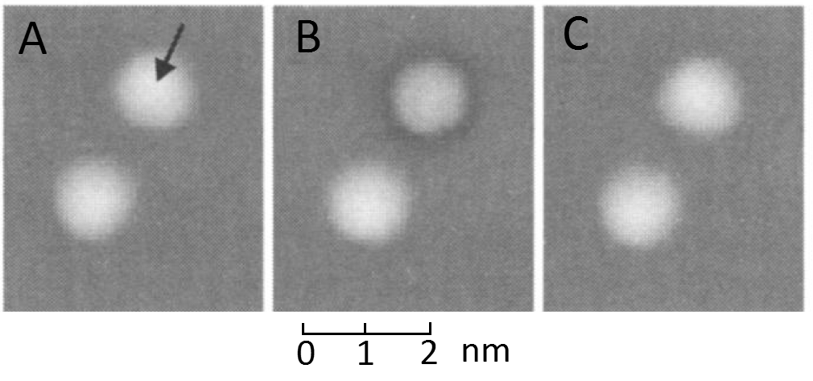
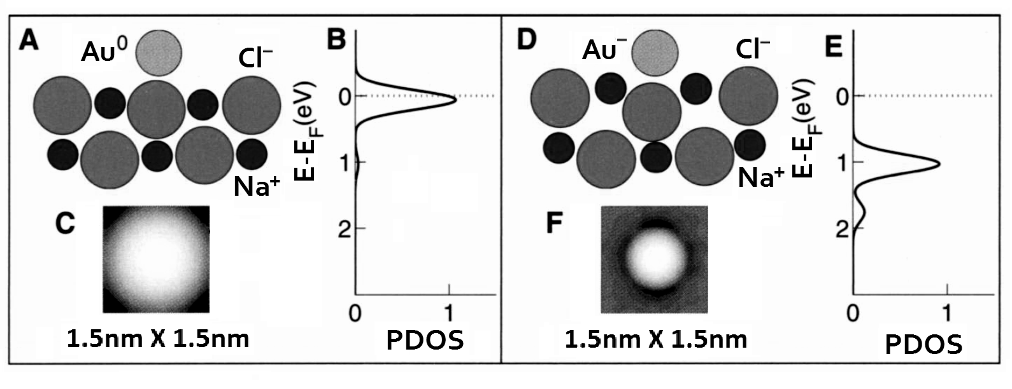
Imaging Atomic Wavefunctions
Wavefunctions of gold atoms and gold ions are directly observed and mapped by the STM. The energy level change in ionization is observed.

Slide 11
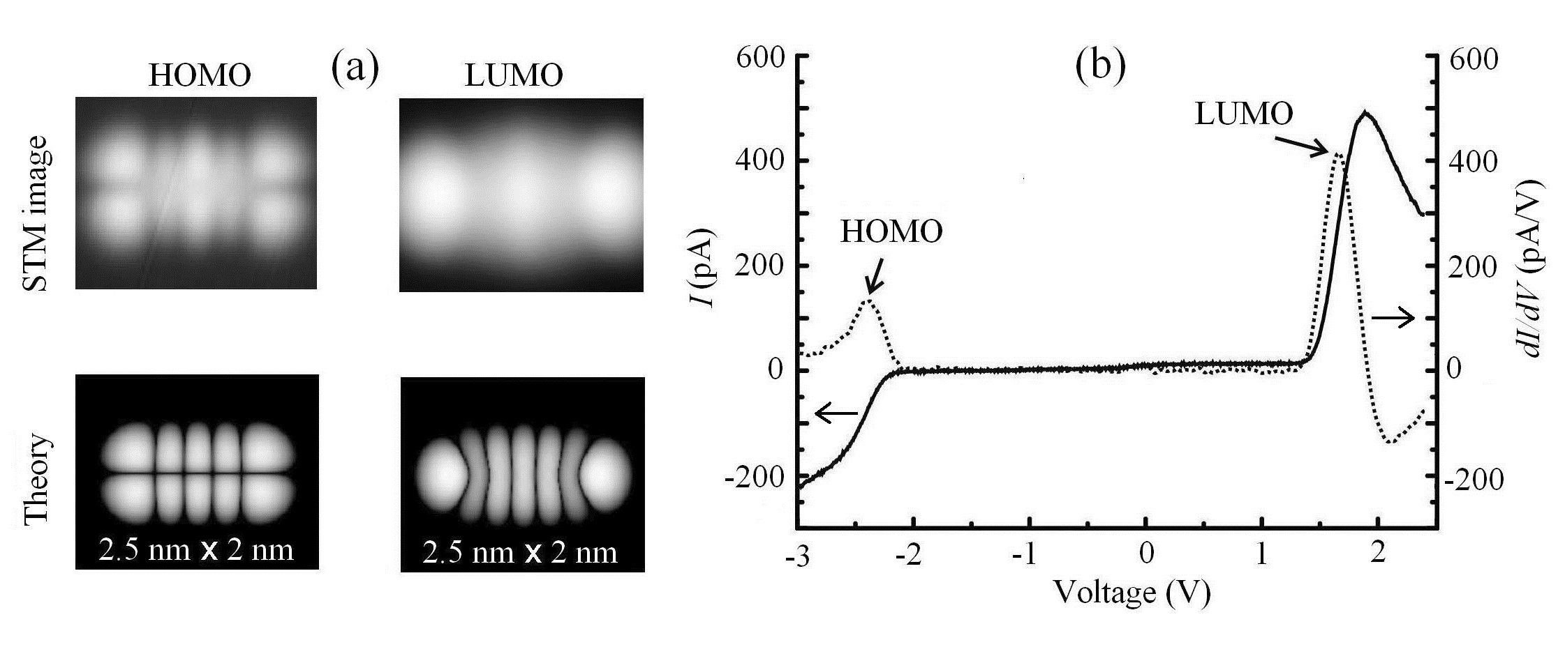
Imaging Molecular Wavefunctions (1)
Charge density distributions of pentacene of the highest occupied molecular orbital and the lowest unoccupied orbital are directly observed with a metal tip.

Slide 12
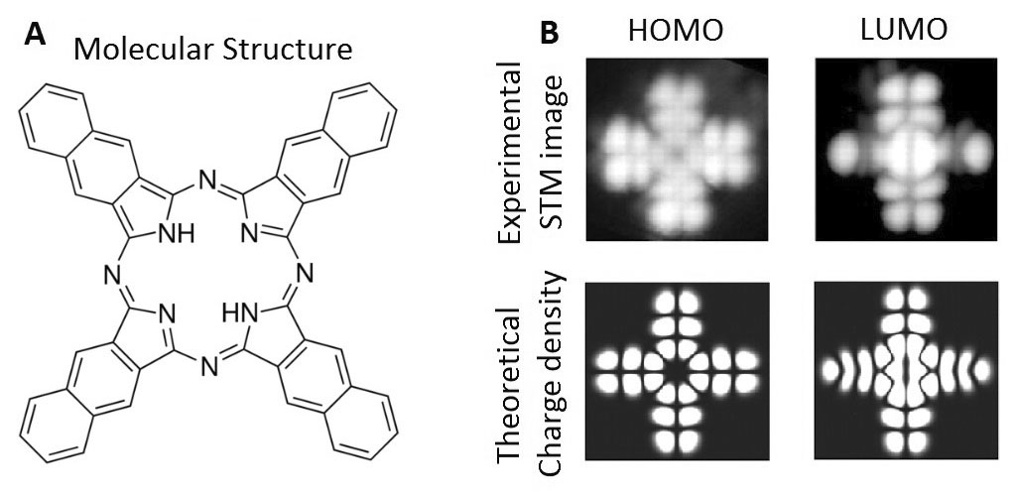
Imaging Molecular Wavefunctions (2)
Charge density distributions of another organic molecule, naphthalocynine, are observed for both HOMO and LUMO, agreeing with quantum-mechanics.

Slide 13
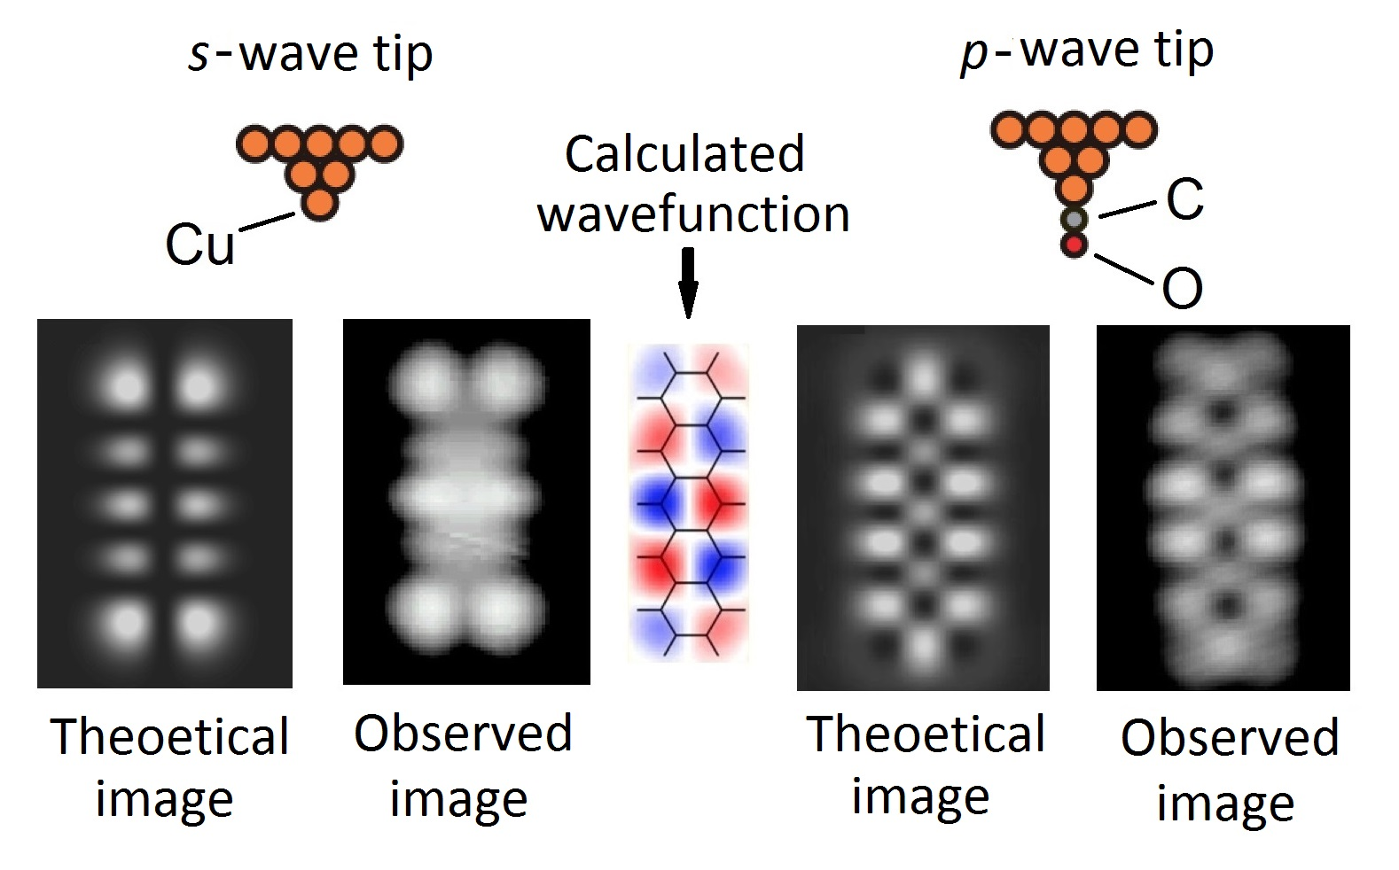
Imaging Nodal Structures in Wavefunctions (1)
HOMO of pentacene
Using a CO-functionalized tip, the nodal structures inside wavefunctions are observed as the square of the lateral derivatives of the molecular wavefunction.

Slide 14
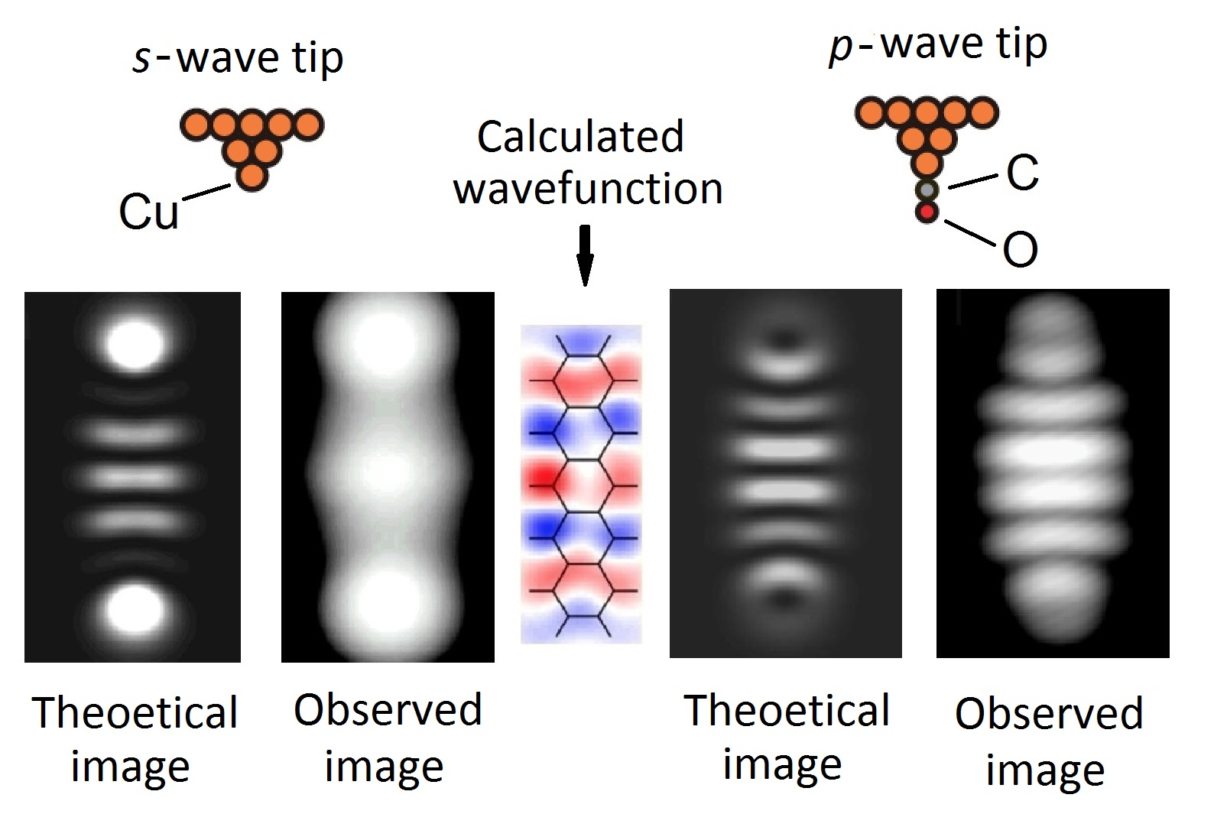
Imaging Nodal Structures in Wavefunctions (2)
LUMO of pentacene
Using a CO-functionalized tip, the nodal structures inside wavefunctions are observed as the square of the lateral derivatives of the molecular wavefunction.

Slide 15
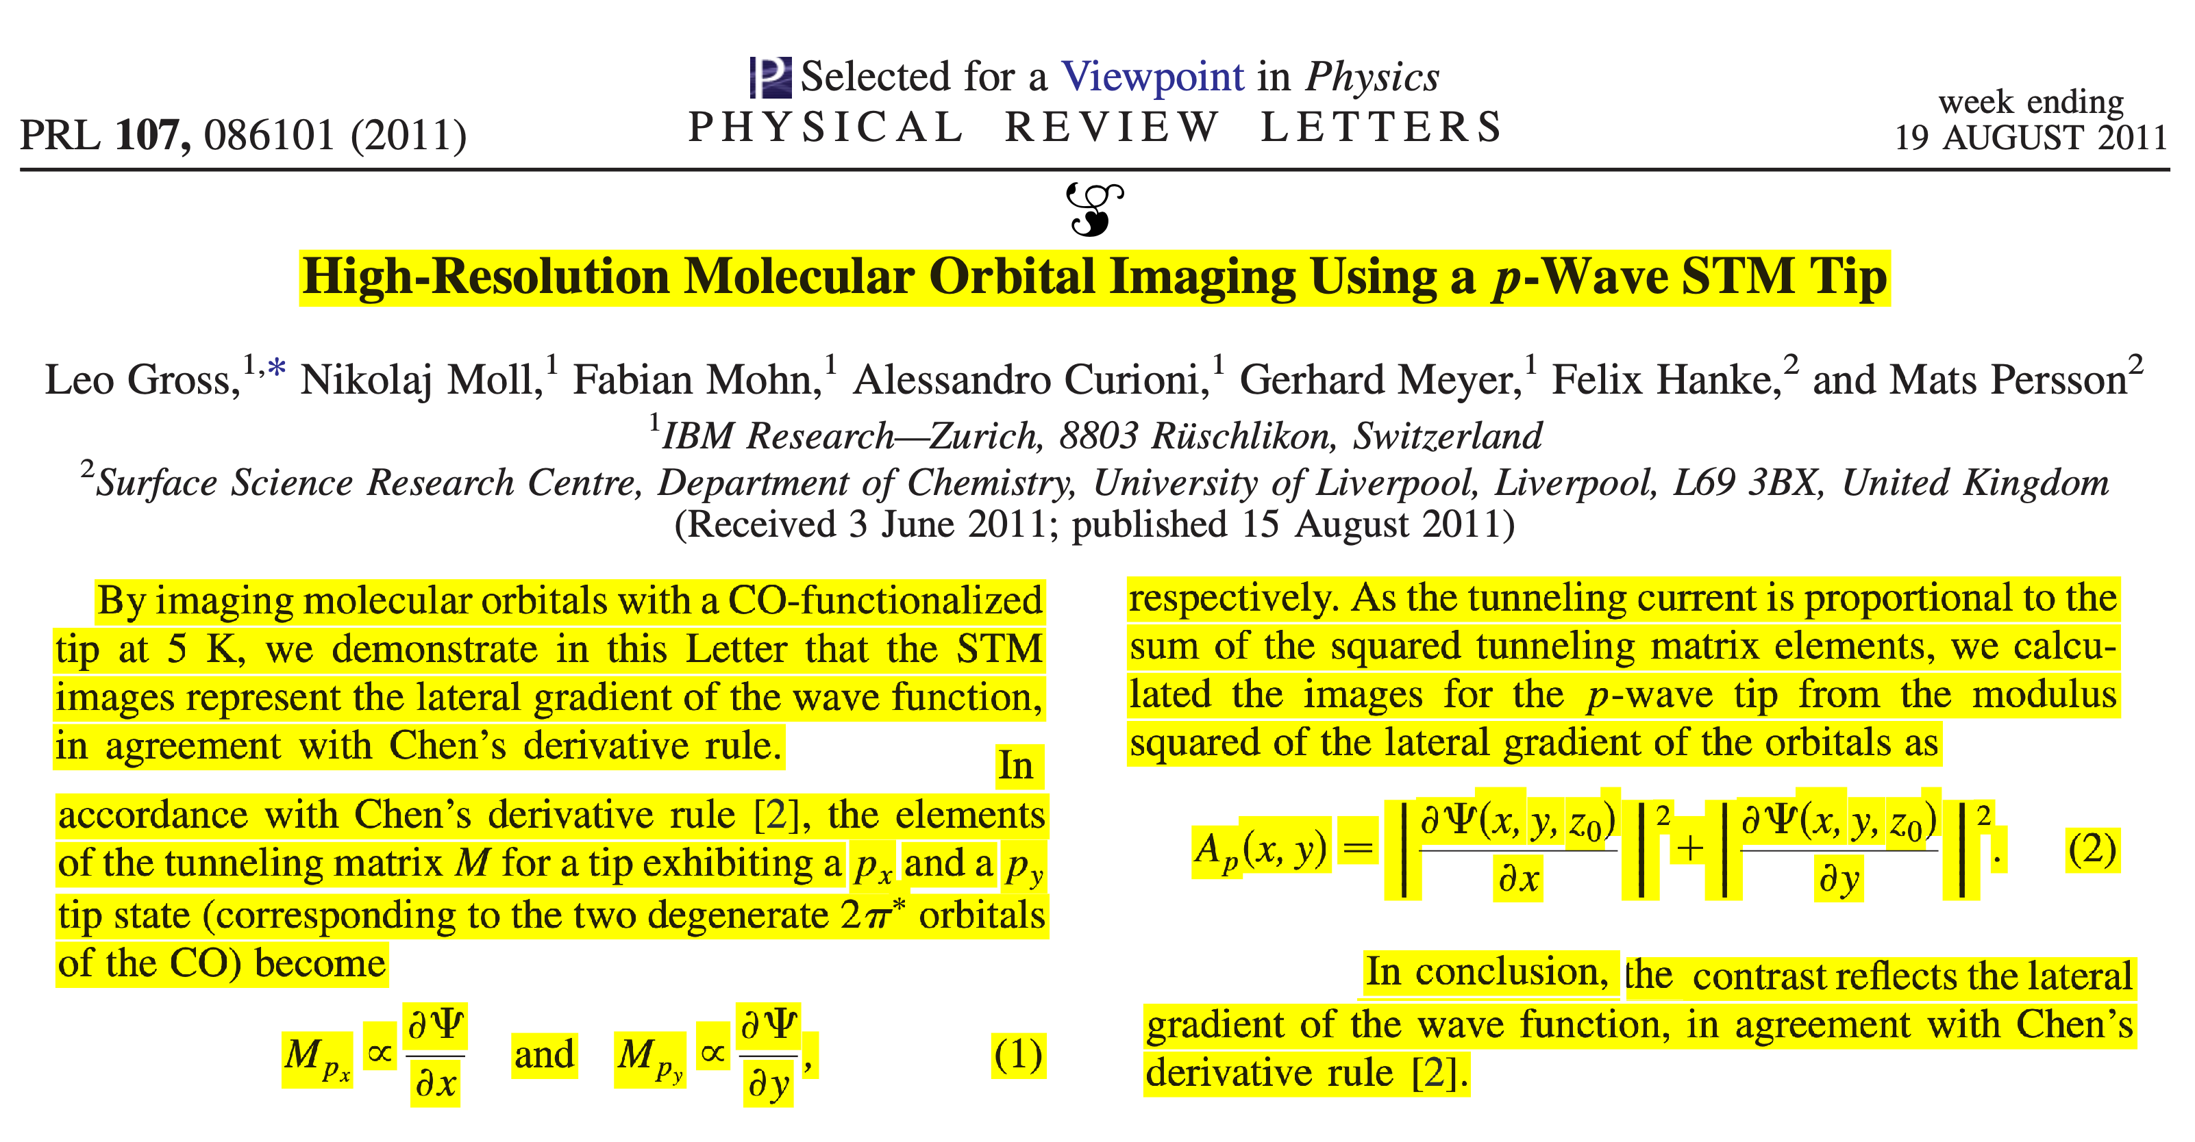
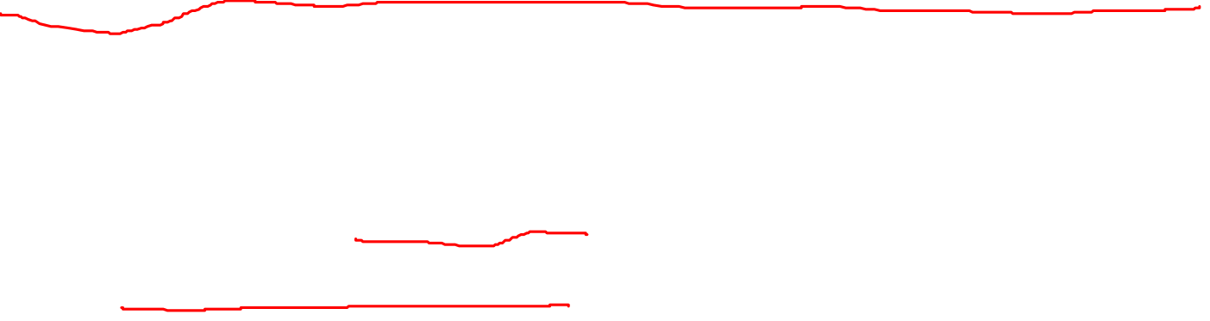
A key publication on the observation of nodal structures

Slide 16
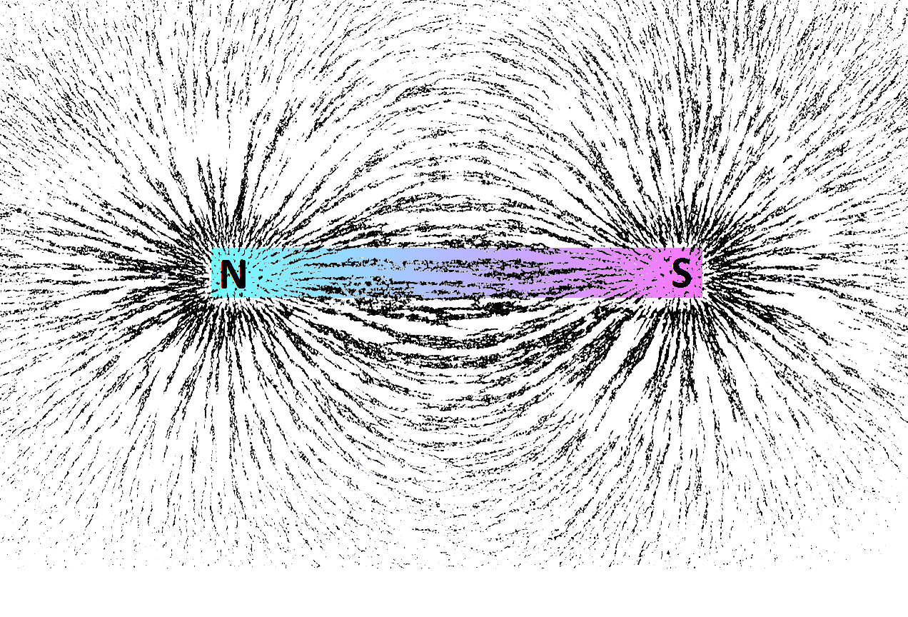
Similarity with mapping magnetic fields
By using a magnetic device: iron filings.

Slide 17
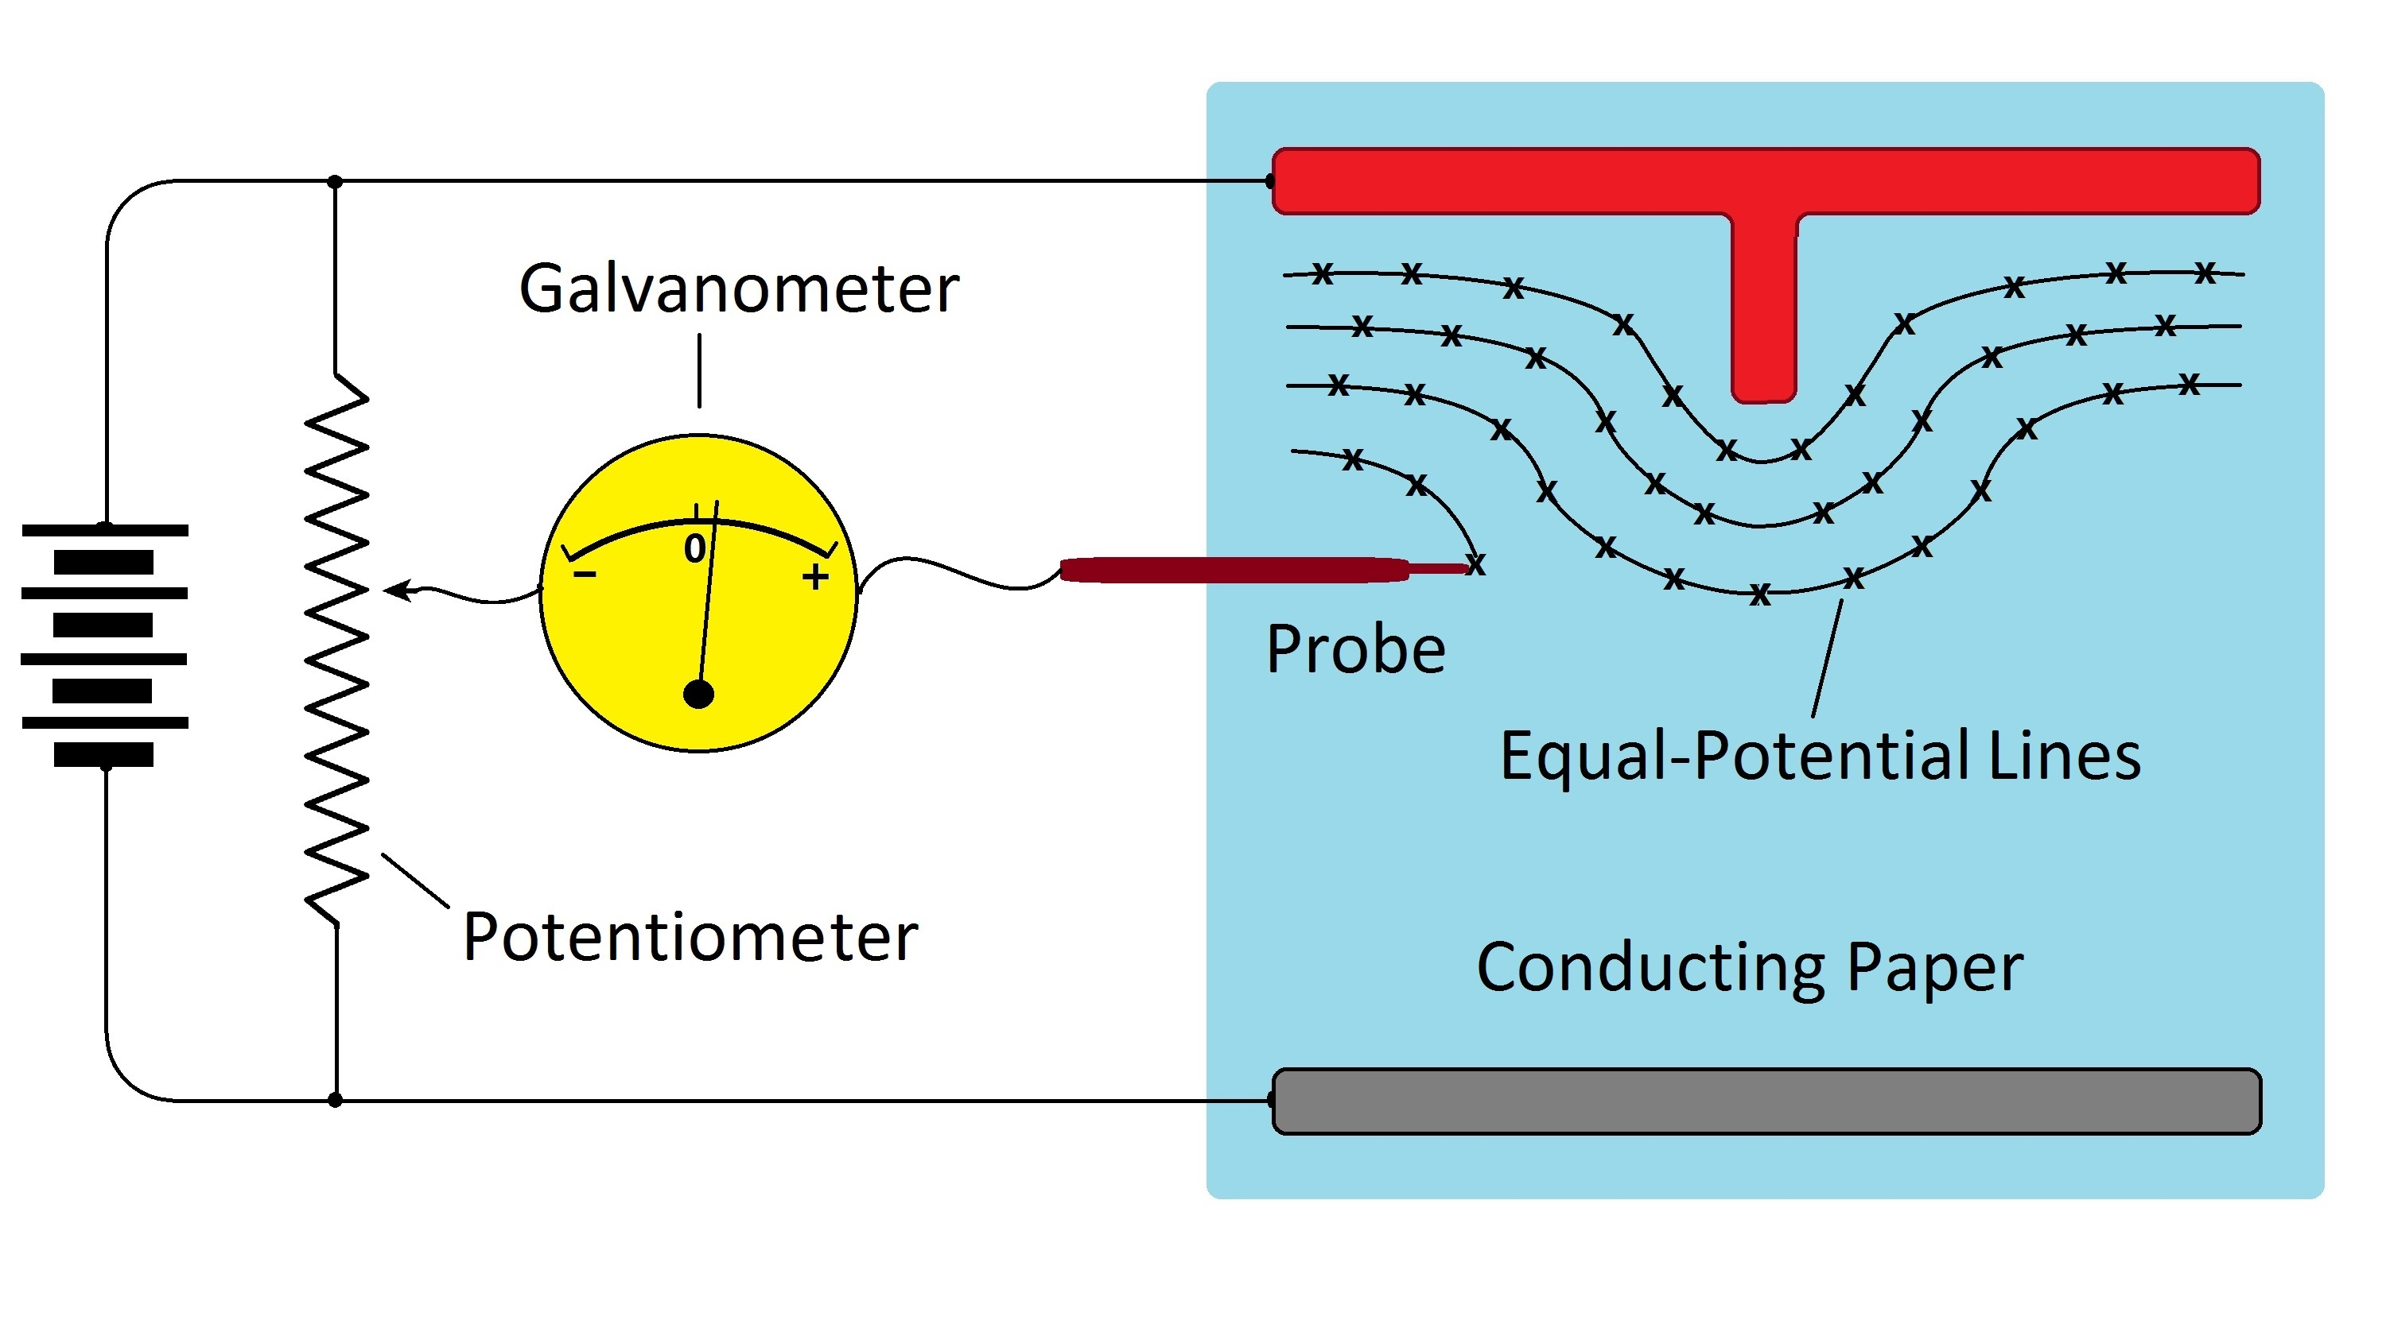
Similarity with mapping electric fields
By using an electric device: potentiometer.

Slide 18
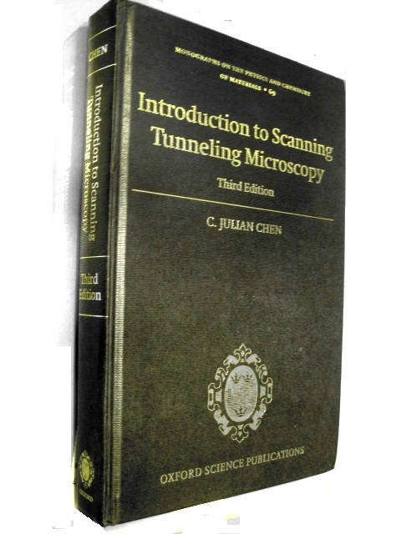
Introduction to Scanning Tunneling Microscopy, Third Edition
The scanning tunneling microscope (STM) was invented by Binnig and Rohrer and received a Nobel Prize of Physics in 1986. Together with the atomic force microscope (AFM), it provides non-destructive atomic and subatomic resolution on surfaces. Especially, in recent years, internal details of atomic and molecular wavefunctions are observed and mapped with negligible disturbance.
Additions to the third edition include: theory, method, results, and interpretations of the non-destructive observation and mapping of atomic and molecular wavefunctions.

Slide 19
Quantum Electrodynamics (QED)
The relativistic quantum field theory of electrodynamics. For its extremely accurate predictions of quantities like the anomalous magnetic moment of the electron and the Lamb shift of hydrogen, it is the crown jewel of physics.
Bjorken and Drell, Relativistic Quantum Fields (1965)
Itzykson and Zuber, Quantum Field Theory (1980)
Peskin and Schroeder, An Introduction to Quantum Field Theory (1995)

Slide 20

Second Quantization in QED
Before second quantization, both Maxwell fields and Dirac spinor are classical fields.
Definition of a classical field:
At a given time, the state of the field for each point in space is represented by a finite set of numbers.
The field can be observed without disturbing it.

Slide 21
Concept of Electrons in QED
Electron is represented by a Dirac spinor, a classical field spread out in space, with mass and charge quantized while interacting with electromagnetic fields or other electrons. No point-like electrons or photons whatsoever.
In non-relativistic quantum mechanics, the electron is also a classical field, a wavefunction spread out in space, not a point particle.

Slide 22

How is the Dirac field classical before second quantization?
Maybe this is why I can't seem to understand the first thing about QFT. They say that the name shouldn't really be "second quantization", because:
One is not quantizing "again", as the term "second" might suggest; the field that is being quantized is not a Schrödinger wave function that was produced as the result of quantizing a particle but is a classical field (such as the electromagnetic field or Dirac spinor field), essentially an assembly of coupled oscillators, that was not previously quantized.
WHAT??? I thought the Dirac equation was just the relativistic Schrodinger equation, albeit with the added benefit of spin and relativistic corrections. It still gives discrete energy states, involves complex numbers, etc. etc. I thought, a classical field is something where you can directly measure the value at any point, like you can measure the electric/magnetic field by putting a stationary/moving charge there.

Slide 23
Absence of Point-like Electrons as an Experimental Fact
All experiments showed that the electron is a wave. Mass and charge are quantized only on interacting with light or other fields.
Same is the electromagnetic wave, only when interacting with materials, energy is quantized according to the Planck-Einstein formula.

Slide 24
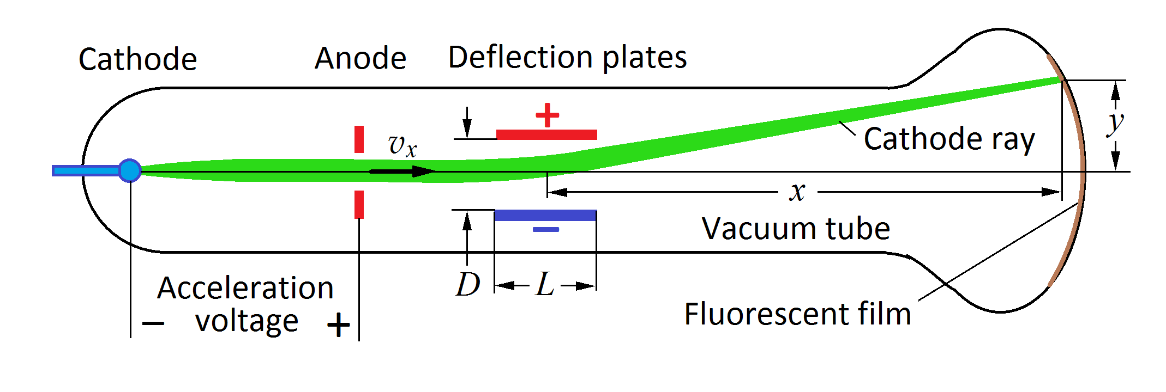
Discovery of Electrons as Cathode Ray by J. J. Thomson
The charge-mass ratio was measured. However, it was not known whether it was a particle stream or a wave.

Slide 25
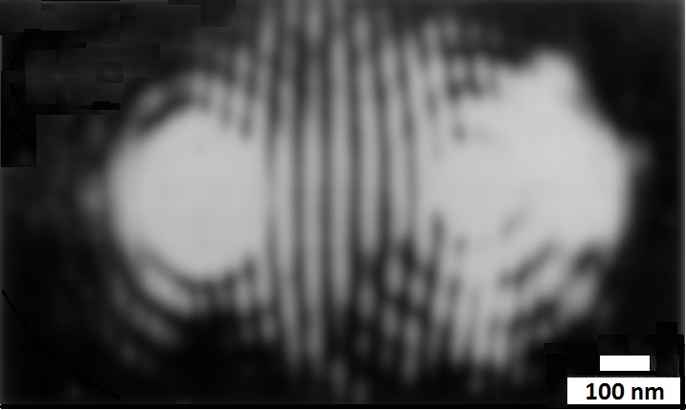
Diffraction and Interference of Electrons
By passing the cathode ray through two small holes, diffraction and interference patterns were observed. Electron is a wave.

Slide 26
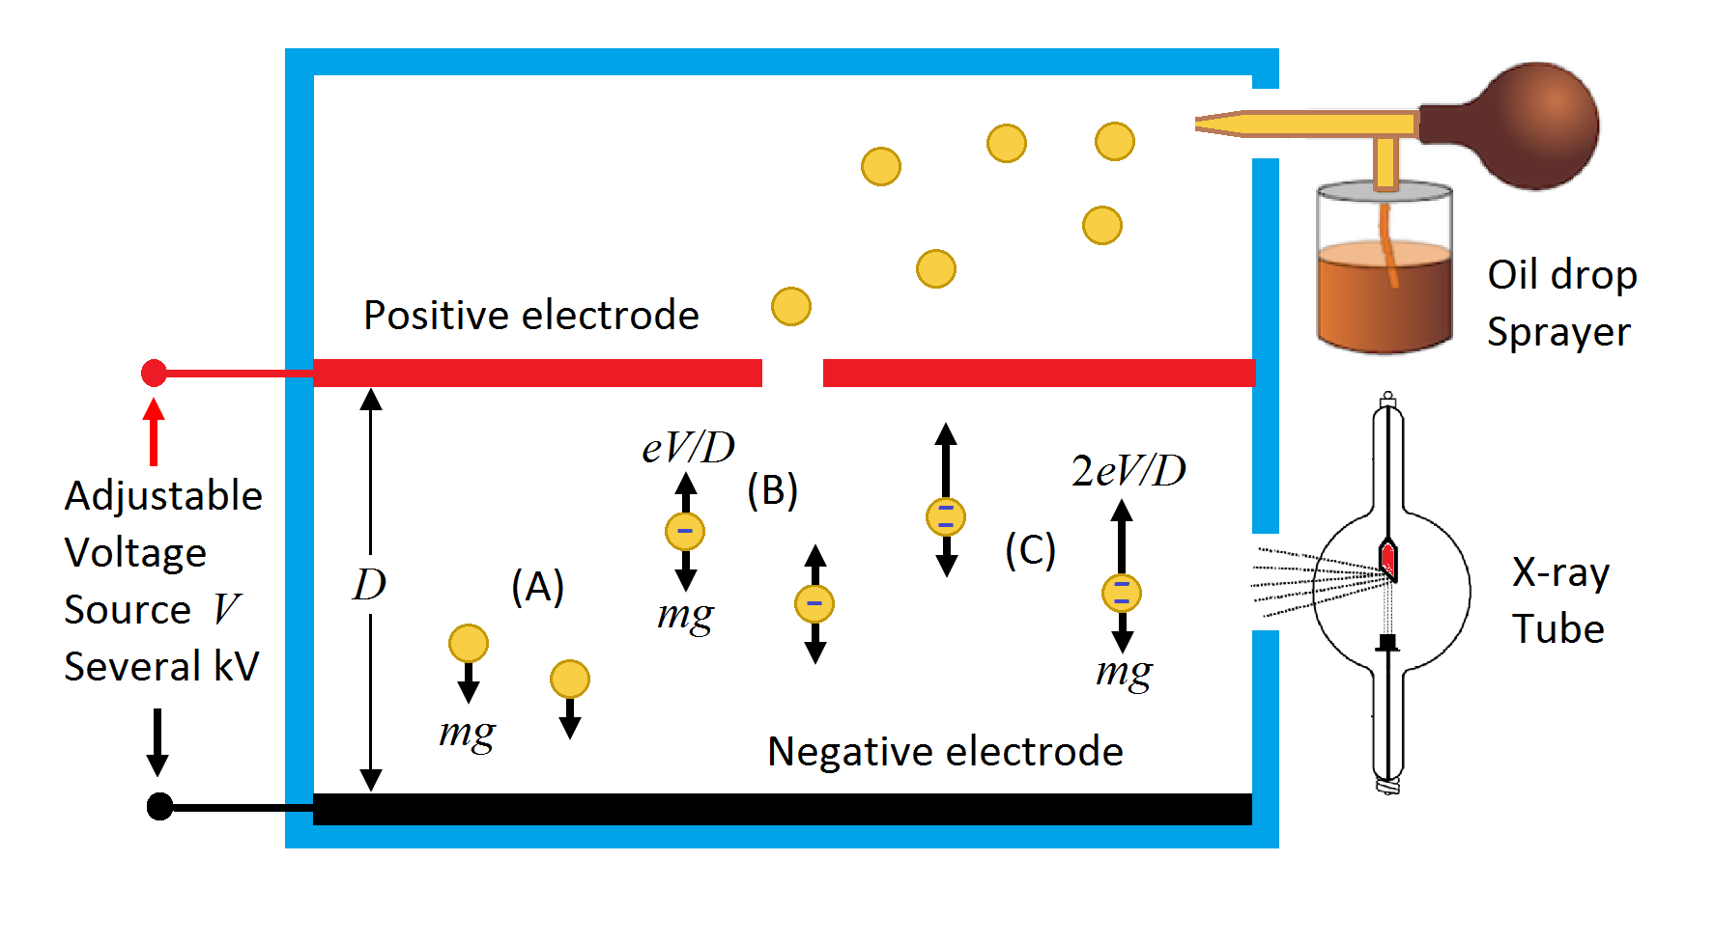
Millikan’s Oil-Drop Experiment
The diameter of the oil drops is about 1 micron. Each electron as a field fills the entire oil drop. There is no point-like electrons

Slide 27
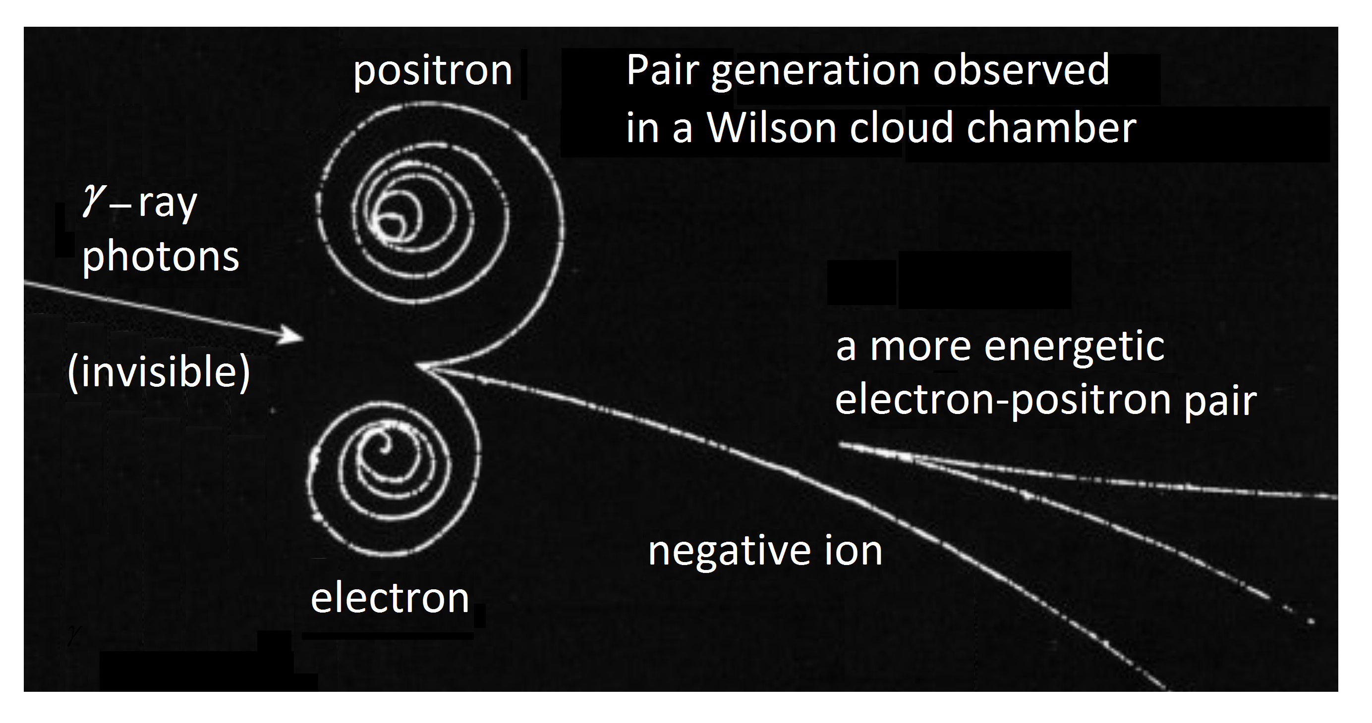
Particle tracks in a Wilson chamber
The cloud-chamber tracks are on a macroscopic scale.
Charged particles as electrons are not permanent:
those particles can be created and annihilated.

Slide 28
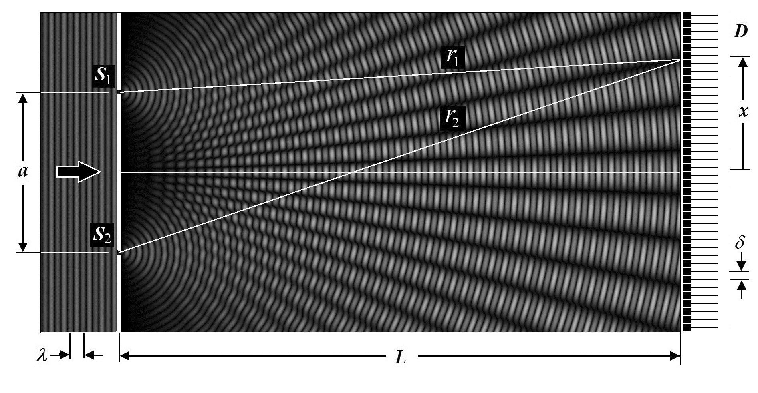
The Puzzle of Double-Slit Experiment
By considering that light is strictly a wave in space, the energy is quantized only at the detectors, there is no puzzle.

Slide 29
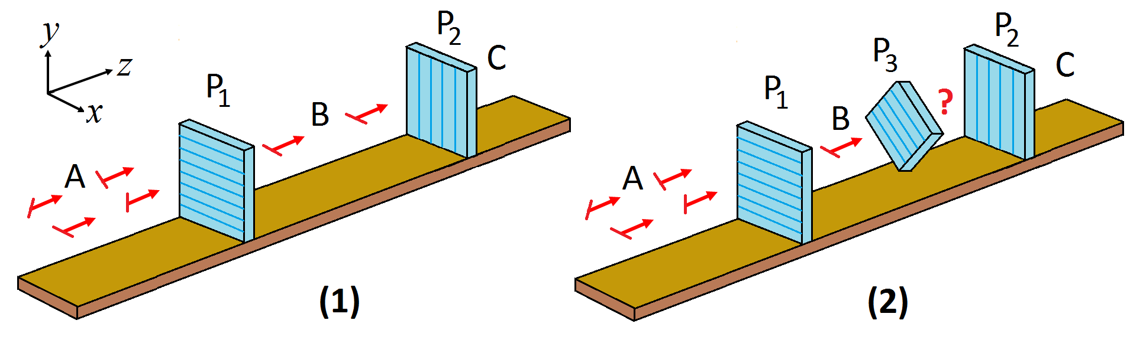
The Puzzle of Three-Polarizer Experiment
The origin of the puzzle is the erroneous concept that there are individual point-like photons, each with a well-defined polarization. By considering that light is strictly a wave in free space, energy is quantized only at the detectors, there is no puzzle.

Slide 30
Conclusions
A unified view of quantum field theory and elementary quantum mechanics as supported by all experiments…
Nature is composed of continuous fields
Fields are observable physical objects
Upon interacting with other fields, energy, mass, and electrical charge are quantized
There is no point-like electrons.

