Slide 1
Aerosol Effects on Climate & Human Health
Urgent Research Needs
James Hansen*
17 October 2018
AGU-CAS Meeting on Atmospheric PM_{2.5}
*Director, Climate Science, Awareness & Solutions, Columbia University Earth Institute
Notes:
I want to thank my friend Junji Cao for twisting my arm to give this talk. I objected, because what little research I have done on aerosols was decades ago. A lot of good aerosol research has been done in the meantime, but I would not dare to attempt to review it.
What I will say about the overall status of knowledge will be broad brush and perhaps unfair, but it is of my nature to be blunt.

Slide 2
Aerosol Effects (Outline)
1. Human Health Effects (3 slides only!)
2. Aerosol Climate Forcing (introduction)
3. Climate Story (aerosol context)
4. Climate Amelioration (aerosol role)
5. Global Aerosol Measurements (!)
Notes:
I will be brief about aerosol health effects, despite their great importance.
I will expand from the aerosol discussion into the larger climate change matter, because it is the climate story that will make aerosols very important in the future.

Slide 3
Evidence on the impact of sustained exposure to air pollution on life expectancy from China’s Huai River policy*
Yuyu Chen, Avraham Eberstein, Michael Greenstone and Hongbin Li
Principal finding: particulate air pollution caused by provision of free coal to 500 million residents in North China [north of Huai River] for winter heating for several decades reduced life expectancy of people in North China by 5.5 years.
*Proc. Natl. Acad. Sci. USA, 110, 6 August 2013
People north of line received free home-heating coal.
Notes:
Energy use is a source of both human health effects and climate change.
China did an inadvertent experiment on health effects by providing free coal for winter heating to people in North China for several decades.
It reduced their life expectancy by five and a half years.

Slide 4
Annual Deaths Attributable to Outdoor Air Pollution (WHO)
Lower Respiratory Disease
Lung Cancer
Obstructive Pulmonary Disease
Stroke
Heart Disease
Notes:
I organized a workshop on Air Pollution as a Climate Forcing in Hawaii almost two decades ago. At that workshop I began to realize how conservative scientists are. Overall, the health professionals were somewhat reticent to describe air pollution as a major health threat. Kirk Smith was an exception, as he emphasized how harmful indoor air pollution was, especially to women and children.
Now we have authoritative studies by the World Health Organization. Globally, outdoor air pollution, mainly from fossil fuel burning, is killing more than three and a half million people per year. That’s 10,000 people per day. Indoor air pollution, from burning of coal, wood and other biofuels, kills an additional 3.7 million people per year.
Aerosols that people breathe in are so tiny that they enter the blood stream, causing cardiac problems as well as respiratory problems. Because the fuels are used for cooking, women and children are especially affected. Many of the deaths from air pollution are prolonged and painful, to the victim and the family.

Slide 5
Crucial Requirement
Abundant Clean Carbon-Free Energy
This can happen on the required scale, that is fossil fuels will be replaced, only if the entire energy system is economic relative to coal and gas
Notes:
The crucial requirement to solve both health and climate problems is abundant clean carbon-free energy.
However, in most countries fossil fuels will not be replaced by an alternative unless the entire energy system is economic relative to coal and gas, including costs of additional transmission lines and energy storage, if those are necessary.

Slide 6
Source: Climate Change 2013: The Physical Science Basis (IPCC, 2013).
Notes:
This is a familiar climate forcing bar chart. Red bars are positive forcing, the warming by greenhouse gases (GHGs}. GHGs act like a blanket on the planet, absorbing heat radiation.
Blue bars are the negative forcing by aerosols that reflect sunlight, and the indirect effect of aerosols by increasing cloud cover or cloud brightness.
We do not actually have measurements of these negative aerosol forcings. I don’t mean to be cynical, but as a matter of fact the magnitude of the blue forcing, to large degree, is based on the value needed by climate models to yield observed global warming of about 1C for a climate sensitivity of 3C for doubled CO2.

Slide 7
Cartoon for GHG, Aerosol and Net Anthropogenic Climate Forcings (IPCC, 2013).
Notes:
In other words, we know the greenhouse gas climate forcing accurately -- it is more than 3 Watts per square meter. We also know that the net climate forcing is probably about 2 Watts, based on observed global warming and our best understanding of climate sensitivity.
Voila. The aerosol forcing must be of the order of minus 1 Watt per square meter.
However, a scientific approach, and future aerosol and climate issues, demand that we actually measure the aerosol climate forcing. I proposed an aerosol monitoring program three decades ago, with the help of several colleagues. Aerosols have a short lifetime and thus an inhomogeneous spatial distribution, so global satellite measurements are required, as I will describe more a little later.
The strategy is analogous to Keeling’s CO2 measurement – precise continuous long-term data. ‘Long-term’ demands that the measurement system be inexpensive. As the data record gets longer, the data become more and more valuable. The science that can be extracted from the data increases as the record becomes longer.

Slide 8
Notes:
There are many reasons that we need precise global monitoring of aerosol amount and aerosol properties. Let me provide a few examples.
When I was in high school, Keeling began to measure CO2 so accurately that we could calculate the annual change in atmospheric CO2 amount. The annual increase fluctuated from year to year, but averaged over several years the annual CO2 increase, the yellow area in this figure, was growing steadily.
However, the growth of CO2 in the air was much less than the amount of CO2 injected into the air by fossil fuel burning. Much of the emitted CO2 was disappearing somewhere, into the soil, the biosphere, and the ocean. After year 2000 the amount disappearing each year increased enormously. Today about 5 gigatons of carbon (GtC) is disappearing into these carbon sinks each year.

Slide 9
Despite rapid growth of fossil fuel emissions in the 21st century, the fraction of emissions showing up in the air has decreased to less than 50%.
Update of Fig. 3 of Hansen, J., P. Kharecha and M. Sato, Climate forcing growth rates: doubling down on our Faustian bargain, Environ. Res. Lett., 8, 01106, 2013.
Notes:
Thanks to Keeling’s measurements, we began to have two accurate numbers characterizing the carbon cycle:, and we could calculate their ratio, the fraction of the CO2 emissions that was showing up as an increase of atmospheric CO2, that is, the airborne CO2 fraction.
When I was a young scientist, the airborne fraction was about 60 percent. We were told to expect this airborne fraction to increase, because the sinks for CO2 would begin to saturate. However, in contrast, the airborne fraction actually decreased. It was about 60 percent in the first three decades after Keeling began to measure CO2 in 1958, but it decreased to about 50 percent in the next three decades.
Moreover, it was believed that there was an additional net source of CO2 from deforestation and from increasing forest fires.
In our 2013 paper we suggested that human-made aerosols, as well as increasing CO2, were fertilizing the biosphere, and thus aerosols may be part of the reason for the small and declining value of the airborne fraction.

Slide 10
Deposition fluxes of soluble N, P and Fe
Source: Kanakidou, M., S. Myriokefalitakis & K. Tsigaridis, Aerosols in atmospheric chemistry and biogeochemical cycles of nutrients, Environ. Res. Lett., 13, 063004, 2018.
Notes:
That is just one reason that we need to measure aerosols accurately. Global models are very helpful for estimating the deposition on the surface of nutrients such as nitrogen, phosphorous and iron. However the models should be grounded in global aerosol observations including accurate information on how the aerosol amount, geographical distribution, and physical properties are changing as a function of time.

Slide 11
Terrestrial vegetation & marine phytoplankton produce O₂ and remove CO₂ from the air.
Photosynthesis requires nutrients; aerosols are a major source of these trace elements.
Atmospheric chemistry converts insoluble elements to soluble, bioavailable, nutrients.
These processes, & feedback of aerosols on climate via nutrients, are largely neglected in climate modeling.
Source: Kanakidou, M., S. Myriokefalitakis & K. Tsigaridis, Aerosols in atmospheric chemistry and biogeochemical cycles of nutrients, Environ. Res. Lett., 13, 063004, 2018.
Notes:
The processes involved in drawdown of CO2 from the atmosphere are complex. Global models are being developed to study these processes. Reliable conclusions from these models require a good aerosol climatology and accurate knowledge of how the aerosol climatology is changing.
This time-dependent aerosol climatology should include composition specific information on the aerosols with spatial resolution on a regional scale and at least seasonal temporal resolution. I will discuss the required satellite observations after giving another example of why aerosol measurements are needed.

Slide 12
Notes:
So let’s turn to climate change. The world is getting warmer, more than 1°C since 1880-1920. That base period provides the best estimate of pre-industrial temperature, because that period was warmed a bit by early human-made GHGs, but it was cooled a comparable amount by unusually large volcanic activity.
This temperature record is scientific data that has stood the test of time. This is the GISS temperature analysis that I started back in the 1970s. So this is real global warming. It exceeds the level of natural variability. Global warming is not a hoax created by the Chinese government to destroy America.
The warming rate during the past 50 years, 0.17°C per decade, seems to be almost linear. However, if we look more closely we can see that the rate of global warming is accelerating.

Slide 13
0.21°C/decade
0.24, .32, .38
0.17°C/decade
Notes:
Jeremy Grantham pointed out that if we connect the global temperature peaks of the last two Super El Ninos we find a warming rate higher than the 50-year trend.
We can get a more recent evaluation by using La Nina minima. La Nina minima provide a more stable measure of the global warming than El Ninos, which vary greatly in their strength. We know that the 12-month running mean of global temperature in September 2018 should be the minimum for the most recent La Nina cycle, because the tropical Pacific Ocean is now moving into at least a weak El Nino.
We see in this figure that global warming is accelerating markedly. The most recent two La Nina minima imply a warming rate twice the 50-year rate!
Why is the warming rate accelerating? We need to know. Part of the reason may be that the growth of human-made aerosols, which partially offset warming by greenhouse gases, has slowed. It is not so much the change of aerosols over places such as China, which are known from ground-based observations, but rather small changes over the broad Pacific Ocean. Evaluation of this matter demands precise global measurements of aerosol physical properties.

Slide 14
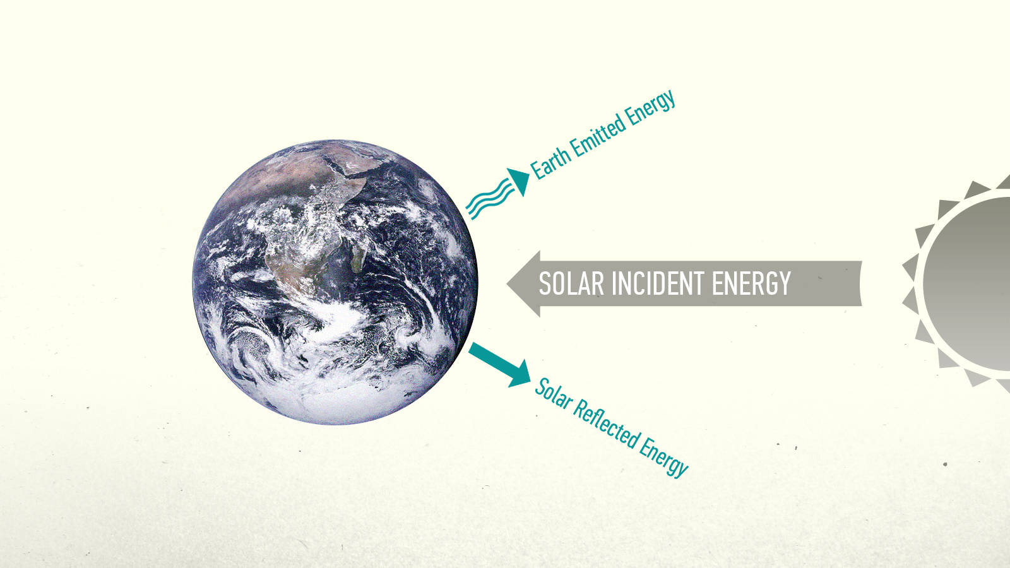
Notes:
Earth’s energy imbalance, which drives climate change, is another key quantity to monitor. Adding CO₂ to the air is like throwing another blanket on the bed.
It reduces Earth's heat radiation to space, so there is an energy imbalance, more energy is coming in than going out – until Earth warms up enough to again radiate to space as much energy as it absorbs from the sun.
As long as more energy is coming in than going out, more global warming is in the pipeline … it will occur even without any more greenhouse gases.

Slide 15
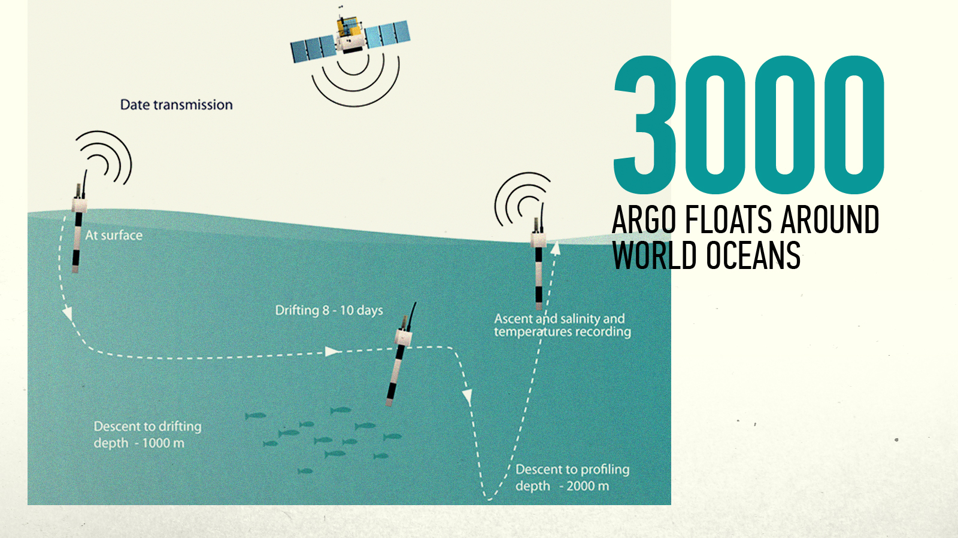
Notes:
We can now measure Earth's energy imbalance by measuring the heat content in Earth's heat reservoirs.
The biggest reservoir, the ocean, was the least well measured until more than 3000 Argo floats were distributed around the world's oceans.

Slide 16
WHERE EXCESS ENERGY IS GOING
0.6
During Solar Minimum Earth gained energy at a rate nearly 20 times greater than humanity’s energy use.
0.5
0.4
0.3
W/m² of Globe
0.2
0.1
0
Upper Ocean
(200 m)
Deep Southern
Ocean
Abyssal
Ocean
Ice Melt
Land (Ground)
Warming
Notes:
These floats reveal that the upper ocean is gaining heat at a substantial rate, and the deep ocean at a smaller rate.
Energy is also going into net melting of ice all around the planet. And the continents, to depths of tens of meters, are getting warmer.
The total energy imbalance is now about three-quarters of a watt per square meter.

Slide 17
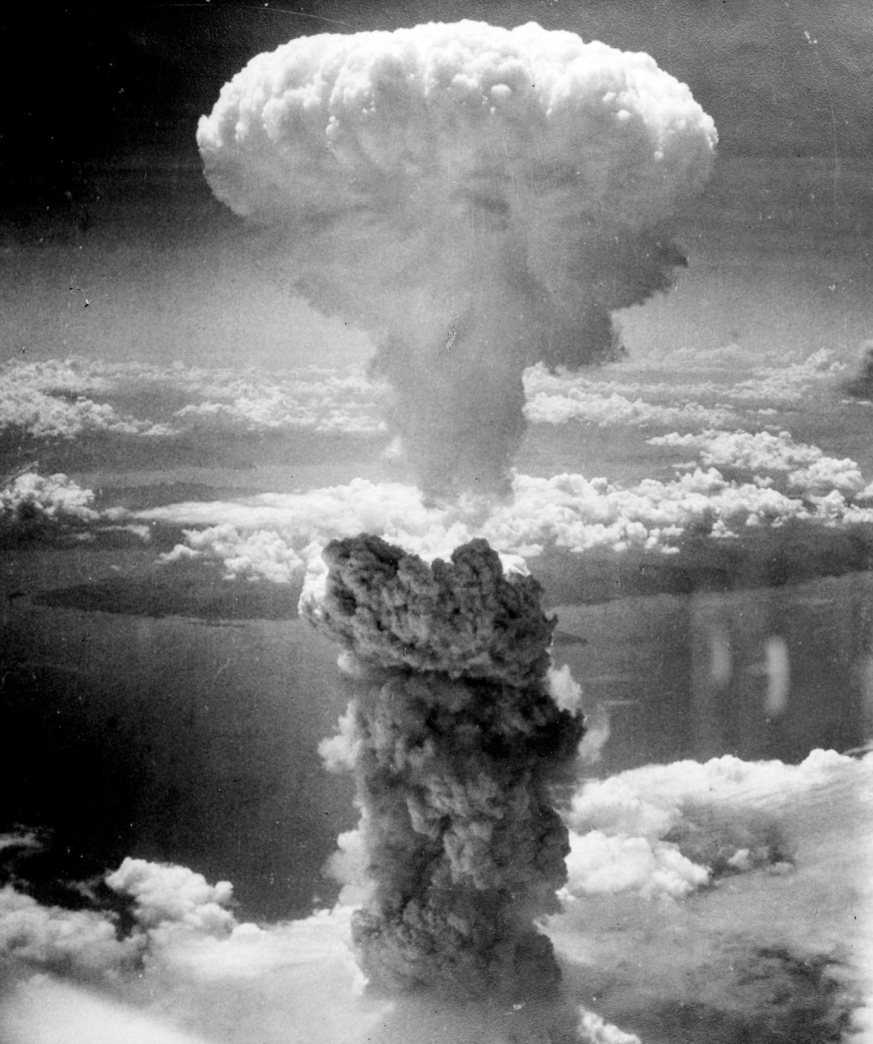
Notes:
That's about 20 times greater than the rate of energy use by all of humanity.
It's equivalent to exploding about 500,000 Hiroshima atomic bombs per day 365 days per year. That's how much extra energy Earth is gaining each day.
This imbalance means there is more warming in the pipeline, without additional CO₂. It also means, if we want to stabilize today’s climate we must reduce CO₂ from 410 ppm (parts per million) to at most 350 ppm. That’s the change needed to restore energy balance.

Slide 18
Notes:
Climate change deniers argue that the sun is the main cause of climate change.
But the measured energy imbalance occurred during the deepest solar minimum in the record, when solar energy reaching Earth was least. Yet more energy was coming in than going out.
So the effect of the Sun's variability is overwhelmed by the increasing greenhouse effect due to fossil fuel burning.

Slide 19
2
GLOBAL TEMPERATURE CHANGE (°C)
Holocene
0
Temperature Anomaly (°C))
-2
-4
Ice Age
800
700
600
500
400
300
200
100
0
CO₂ CONCENTRATION (PPM)
300
250
CO₂ (ppm)
200
800
700
600
500
400
300
200
100
0
50
SEA LEVEL (METERS)
0
Sea Level (m)
-50
-100
800
700
600
500
400
300
200
100
0
) Time (Thousands of Years Before Present)
Notes:
Earth's history contains remarkable information on climate change. Global temperature, atmospheric CO₂, and sea level over 800,000 years can be derived from ocean cores and Antarctic ice cores – from ocean sediments and from snowflakes that piled up year-after-year forming a 3-kilometer thick ice sheet. Sea level is a measure of ice sheet size – when the ice sheets melt, sea level rises.
Climate change on such long time scale is instigated by oscillations of Earth’s orbit and the tilt of Earth’s spin axis, which alter the seasonal and geographical distribution of sunlight on Earth. These orbital forcings are weak and slow, changing on time scales from 20,000 to 100,000 years.
Climate changes on these long time scales are very large. The large magnitude is due almost entirely to two powerful amplifying feedbacks: ice sheets and CO₂. As Earth warms, ice melts and exposes darker ground that absorbs more sunlight. As the ocean warms it releases CO₂ – somewhat like a warm Pepsi.

Slide 20
Atmospheric CO₂ amount (right scale) during past 800,000 years (Luthi et al., 2008)
Global temperature change (left scale) is approximately half of the Antarctic
temperature change (data from Jouzel, et al., 2007).
Fig. from: Ice Melt, Sea Level Rise and Superstorms, Hansen et al., Atmos. Chem. Phys., 16, 1-52, 2016.
Notes:
CO₂ is the control knob on global temperature, as confirmed by this remarkable comparison of atmospheric CO₂ and Antarctic temperature
The same powerful amplifying feedbacks must occur today. Physics does not change. As Earth warms, ice sheets will melt. CO₂, and its companions methane and nitrous oxide, will be released by the warming ocean, melting tundra, and wetlands.
We can't say exactly how fast these amplifying feedbacks will occur, but they will occur.

Slide 21
Note that the time scale for the past century has been expanded. A logarithmic scale is used for CO₂ because climate forcing and temperature change increase with the logarithm of CO₂.
Paleo global surface temperature change is from ocean core data of Zachos et al. (Nature 451, 279-283, 2008) via equations of Hansen et al. (Phil. Trans. Roy. Soc. A, 371, 20120294, 2013).
Notes:
Let’s tack modern data onto the paleo record. CO₂ is shooting off scale. Temperature is also rising, but it has not caught up to the CO₂. That takes time. Why?
First, the ocean has great thermal inertia. It takes 100 years for the ocean surface temperature to reach two-thirds of its quasi-equilibrium response.
Second, there are the slow feedbacks that drive the temperature further, beyond the quasi-equilibrium response.
Ice sheets do not melt overnight. The paleoclimate record shows sea level lagging temperature by a few centuries. Does that mean that coastal cities are safe for several centuries? No, because human-caused change in greenhouse gases is much faster than any change in Earth’s history.

Slide 22
Fig. 3. Estimated global temperature for the last interglacial (Eemian) period (McKay et al 2011; Clark and Huybers 2009; Turney and Jones 2010), the Holocene (Marcott et al 2013), and 11-year mean of modern data (Fig. 2). Vertical downward arrows indicate likely overestimates (see discussion of this figure in Hansen et al., Young People’s Burden, Earth System Dynamics, 2017).
Notes:
Global temperature has already reached the Eemian level. Consequences of staying at this temperature level likely would include eventual sea level rise of several meters, thus loss of functionality of today’s coastal cities.
How long can we leave global temperature in the dangerous zone and still avoid disastrous sea level rise? The best measure of the response time of the ice sheets, and thus sea level change, has been obtained by Eelco Rohling’s group (Grant et al.), who find that sea level change lags temperature change in the paleoclimate record by 1-4 centuries. However, paleoclimate forcings were weak and changed much more slowly than today’s human-driven changes.
We present evidence in the paper Ice Melt, Sea Level Rise & Superstorms that multi-meter sea level rise is likely on a time scale of 50-150 years, if business-as-usual fossil fuel emissions continue.

Slide 23
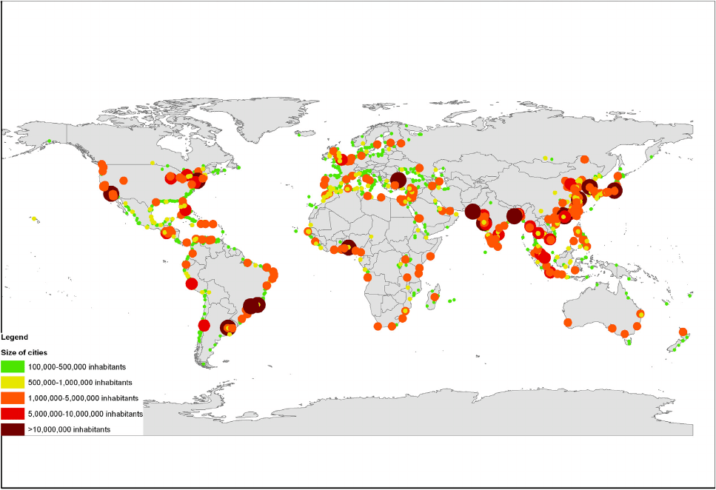
More than half of the world’s largest cities are on the coastline.
Notes:
Cities become dysfunctional long before they are totally under water.
These are all of the world’s largest cities. More than half are on coastlines.

Slide 24
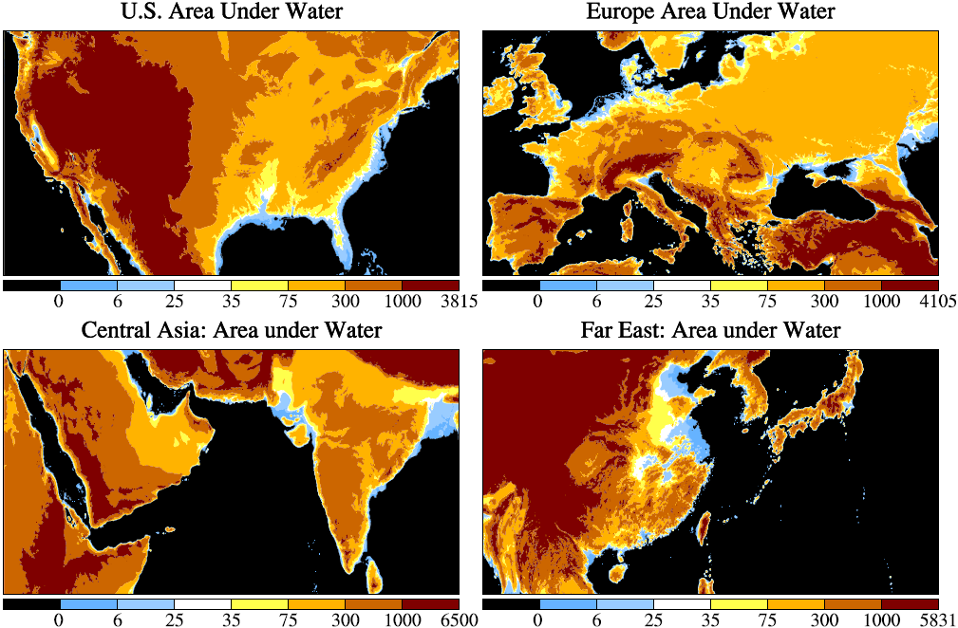
Notes:
Florida, the Netherlands and Bangladesh would be under water – also a good part of China.
Sea level rise does not need to reach several meters before the economic impact becomes intolerable and the world likely becomes ungovernable.

Slide 25
Threat of Mass Exterminations
Multiple Human-Made Stresses Overharvesting, Land use changes, Nitrogen fertilization, Introducing exotic species, etc.
in Combination with
Rapid Shifting of Climate Zones
IPCC (2007) estimates that business-as-usual greenhouse gas emission will commit to extinction ¼ to ½ of all species.
Notes:
The second irreversible impact of rapid large climate change would be on other species.
We cause stress on other species in many ways as we take over the planet.
We could commit to extinction a quarter to half of all species from the combined effect of these stresses and rapidly shifting climatic zones, according to estimates of the Intergovernmental Panel on Climate Change.

Slide 26
Notes:
Older people notice that climate is changing, especially in summer.
Year-to-year variability of seasonal temperature in the 20th century formed a nice bell curve about the average, but now that bell curve has shifted.
What was an unusual extreme hot season last century is now much more likely to occur.

Slide 27
Notes:
In the subtropics such as the Mediterranean and Middle East and Southwest United States, every summer is now hotter than average climate 50 years ago. That’s almost true in Southeast Asia.

Slide 28
Impacts of Shifting Bell Curves
1. Increase of Regional Climate Extremes
- Dry regions: Greater heat, drought, fire
- Wet regions/times: Greater rain, floods, storms
2. Summer Outdoor Livability Declines
- More than half non-household labor is outdoors
- Measurable impact on national economies
3. Conflicts, Violence Increase (Hsiang et al., 2013)
- Interpersonal: +4%/standard deviation
- Groups, Nations: +14 %/standard deviation
Notes:
Increased heat causes dry regions to have more drought and wildfires, and a longer fire season.
But warm air holds more water, so wet regions and rainy seasons can have more extreme rain and floods.
Low latitudes are becoming less livable outdoors in the warm season, and more than half of the jobs are outdoors in agriculture or construction.
Higher temperatures also lead to a measurable increase of violence.

Slide 29
Climate Situation
Global Crisis, but not Recognized
Thermal Inertia → Warming in Pipeline
+
Amplifying Feedbacks → Losing Control
Notes:
Yet the urgency of the climate crisis is not recognized by most of the public.
Because of the ocean’s thermal inertia, much of the warming is still ‘in the pipeline’.
Further, the existing and growing warming will drive slow feedbacks, such as melting of permafrost and ice sheets.

Slide 30
Potential Injustices
1. Today’s Adults to Young People
- Because of continuing fossil fuel emissions → Climate Close to Being Out of Control
2. North to South
- North burned most of carbon budget
- Climate impacts largest at low latitudes
3. Humans to Other Species
- Climate change & other stresses
- Potential 25-50% extinctions
Notes:
So, if the world does not reduce fossil fuel emissions, it will be an injustice to young people, because we will hand them a situation out of their control.
It also would be an injustice of the industrial North, which is burning the allowable carbon budget for the entire world.
And an injustice of humans to all other species.

Slide 31
Update of Fig. 6 of Hansen and Sato, Regional Climate Change and national responsibilities, Environ. Res. Lett., 11, 2016.
Proportionality of global warming to cumulative emissions was shown by Hansen et al., Dangerous human-made interference with climate: a GISS modelE study, Atmos. Chem. Phys., 7, 2287-2312, 2007.
Notes:
It’s important to recognize national responsibilities for climate change, which is proportional to cumulative emissions. The U.S., the UK and Germany are much more responsible for climate change than developing countries. In other words, developed countries burned more than their fair share of the global carbon budget that is permitted if we are to stabilize climate and avert disasters.
This is an added reason for developed nations to assist in reducing emissions in developing countries, in addition to the fact that we are all sailing in the same boat.

Slide 32
Artistic representation of options for solar radiation management (SRM). From left to right: surface level albedo modification, marine cloud brightening, stratospheric aerosol injection, and space mirrors. From Fig. 1 of Governing Solar Radiation Management, Academic Working Group on Climate Engineering Governance, Forum for Climate Engineering Assessment, American University, Washington, DC, 2018.
Notes:
Continued failure to rapidly reduce fossil fuel emissions will raise the issue of whether actions can be taken to restore Earth’s energy balance rapidly, in a way that avoids or at least minimizes the most deleterious climate impacts. Extraction of CO2 from the air will be a slow process, requiring decades for substantial removal.
In contrast, actions to reduce solar heating of Earth could be implemented quickly, Common sense dictates research be carried out in solar radiation management, even while redoubling efforts to phase out fossil fuel emissions.

Slide 33
Four Experiments: Pinatubo-like aerosol amount distributed over different regions.
Notes:
Craig Rye of my group (CSAS) has initiated four climate model simulations in which a Pinatubo aerosol amount is distributed uniformly over a fixed area, as illustrated here.

Slide 34
Change of surface temperature after 40 years. Number in upper right is global cooling (°C).
Notes:
The global surface temperature change after 40 years with fixed aerosol amount is largest, minus 1.1°C, for the case with aerosols uniformly covering the globe.

Slide 35
Change of internal ocean temperature after 40 years (mean for years 35-45).
Notes:
The most important cooling may be that in the ocean, specifically the cooling along the coast of Antarctica at depths of a kilometer or so, where ice shelves are melting most rapidly.
This temperature change pattern is similar, and opposite in sign, to the calculated and observed ocean warming described in our Ice Melt, Sea Level Rise & Superstorms paper, which is caused by increasing CO2 and increasing fresh water injection. Such cooling may have the potential to slow or even stop sea level rise.

Slide 36
Discusses monitoring of global distribution of natural and anthropogenic aerosols (black carbon, sulfates, mineral aerosols, etc.) and clouds with specificity, accuracy and coverage sufficient for reliable quantification of the direct and indirect aerosol effects on climate, the anthropogenic component of these effects, and the long-term change of these effects caused by natural and anthropogenic factors.
Notes:
Three decades ago my colleagues and I proposed an inexpensive small satellite mission* to measure crucial missing climate data needed to understand long-term climate change. The focus was on aerosol time-dependent climatology essential to complement greenhouse gas measurements.
Based on fundamental theory and experience, the one instrument capable of the required aerosol measurements is a high precision (0.1% accuracy) polarimeter with spectral bands from the near-ultraviolet into the near-infrared and with multi-angle views obtained by along-track scanning from a high inclination orbit.
NASA declined the small satellite (“Climsat”) proposal, which was viewed as a threat to the multi-billion dollar Earth Observing System. President Bush’ Science Adviser induced NASA to build a high precision polarimeter (APS), but it was lost in a launch failure and no replacement was built.
*Hansen, J., W. Rossow and I. Fung: The missing data on global climate change, Issues Sci. Tech., 7, 62-69, 1990.

Slide 37
Question put to Aerosol Experts:
Do we have a good aerosol climatology?
Aerosol Experts: “No.”
I am shocked, shocked*… (by their response)
Captain Renault, Casablanca (1942): “I am shocked, shocked, to find that gambling is going on here.”
Notes:
As a result, we have no adequate quantitative time-dependent global aerosol climatology today.
Of course, just as Captain Renault, we are not actually shocked by the absence of an ongoing time-dependent aerosol climatology. Just one consequence is the impossibility of reliably assessing the cause of the current acceleration of global warming.

Slide 38
Hansen, J. and Kharecha, P., Cost of carbon capture: can young people bear the burden?, Joule 2, 1405-1407, 2018.
Notes:
Let’s return to the global energy situation. Energy use continues to grow. People want to raise living standards. People want to travel, and they will. They need air conditioning. The world needs energy.
Governments give large subsidies to renewable energies. They pretend this will cause fossil fuel use to decline. Courage to use the true scientific method is lacking.

Slide 39
Data through 2017. Source: BP (2018) Statistical Review of World Energy.
Notes:
India will soon pass China in population, and India will pass the U.S. in carbon emissions, becoming second to China.
Renewable energy, the green area, provides only a tiny portion of the energy. It cannot stop growth of fossil fuels, let alone cause their phase-out.

Slide 40
Scientific Method
Study All Available Data on the Matter
Be Very Skeptical of Your Interpretation
Reassess from Scratch with any New Data
Notes:
The core of the scientific method is simple – in principle.
You must use all the data, be very skeptical of your interpretation, and honestly reassess from scratch when new data become available.

Slide 41
Scientific Method
Study All Available Data on the Matter
Be Very Skeptical of Your Interpretation
Reassess from Scratch with any New Data
Your Preference, Your Ideology Must Not Affect Your Assessment
Notes:
Your preference, your ideology, must not affect your assessment.
So it is difficult.

Slide 42
Solution
Fossil Fuel Price Must Include Costs to Society
- Human Health & Climate Change Costs
- Practical Solution: Rising Carbon Fee
Notes:
Now let’s consider the solution to the health and climate problems. The essential requirement is a rising carbon fee, to make the price of fossil fuels honest, by including their human health and climate change costs.

Slide 43
Solution
Fossil Fuel Price Must Include Costs to Society
- Human Health & Climate Change Costs
- Practical Solution: Rising Carbon Fee
2. Some Regulations Still Required
- Refrigerator Efficiency, for example
- No Power Use by Idle Electronic Products
3. Technology Development Needed
- Rising Carbon Fee Will Spur Tech Development
- but Government must Facilitate Long-Lead RDD&D
Notes:
Some regulations will still be required.
And governments must support research, development, demonstration and deployment of carbon-free power, because it is essential to have 100 percent carbon-free electricity.

Slide 44
Agreement Needed: China, U.S. (India)
Rising Internal Carbon Fees
- Spurs life style changes & Innovation
- Stimulates economies
Border Duty on Products from Nations w/o Fee
- WTO rules allow equivalent duty
- Strong incentive for others to join
Technology Cooperation Required
- Includes advanced generation nuclear power
Notes:
I doubt that the climate problem will be solved by 190 nations sitting around a table. What is required, I believe, is the United States and China to agree on the need for a carbon fee. They could readily impose it on a near-global basis.
However, this will not happen in the absence of technological advances that allow practical economical movement to carbon-free electricity in countries such as China and India. For that to happen rapidly requires concerted, high-priority technology cooperation.
The notion that humanity can escape to Mars is nonsense. Either we learn to work together preserving our remarkable home planet, or we sink together.

Slide 45

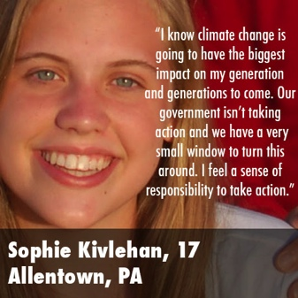
FEDERAL LAWSUIT:
U.S. District Court, District of Oregon:
Trial Begins October 29, 2018
Plaintiffs: 21 U.S. Youth & Future Generations
Defendants: U.S. President & Federal Agencies
Constitutional Basis: Due Process, Equal Protection, and Public Trust Doctrine
Seeking: Science-based National Climate Recovery Plan
Notes:
China and India are not the only big emitters. There is also the United States, which has withdrawn from the Paris Agreement and says that climate change is a hoax.
Nevertheless, there is a basis for optimism. The United States is still a nation of laws. Twenty-one young people, including my oldest grandchild, and I have filed a lawsuit against the federal government demanding a national plan to phase down emissions rapidly.
I expect that we will win this case even with a conservative Supreme Court, because our case is based on the most fundamental Constitutional principles: young people are being deprived of life, liberty and property without due process of law; they are not receiving equal protection of the law. It is analogous to the case of civil rights in the 20th century.

Slide 46
CitizensClimateLobby.org
Citizens Climate Lobby is a volunteer nonprofit organization advocating for Carbon Fee and Dividend, which would place a steadily-rising fee on the carbon dioxide content of fuels and distribute all the revenue to households as equal payments.
CCL now has more than 400 chapters with more than 90,000 members in 30 countries and is growing rapidly.
Please visit CitizensClimateLobby.org and consider joining!
Notes:
But the courts cannot write laws, so it is important to also influence the legislative branch.
Good progress is being made in the U.S. by a rapidly growing organization, CitizensClimateLobby, which has Carbon Fee & Dividend as its objective.
CCL uses the democratic process. They visit Washington, speak to Congress people and their staffers about fee-and-dividend, and write op-eds and letters-to-the-editor. Joining this organization is probably the single most important thing a citizen can do to address climate change.
Note that Carbon Fee & Dividend is progressive, because wealthy people have large carbon footprints, so it helps address worldwide growing wealth disparity.

Slide 47
Discussion Available at:
www.Columbia.edu/~jeh1
The following backup charts were not used:
Notes:
Further discussion of these topics is available on my web site, where you can also sign up for future Communications.

Slide 48
Fossil fuel emissions; purple are emissions through 2017.
1 GtC (gigaton carbon) = 1 billion tons of carbon or ~3.7 GtCO₂; 1 ppm CO₂ ~2.12 GtC
Update of Fig. 2 of Hansen et al., Assessing ‘dangerous climate change’, PLOS One, 8 (12), e81648, 2013. Error bars on reserves and resources, from reference 9 in that paper, likely are underestimates of uncertainty. Update is average of four recent assessments, available from author.
Notes:
Governments continue to seek fossil fuels, and there are plenty to find.
We have burned only the purple portion so far.
The science is crystal clear: we must leave most of the remaining carbon in the ground.

Slide 49
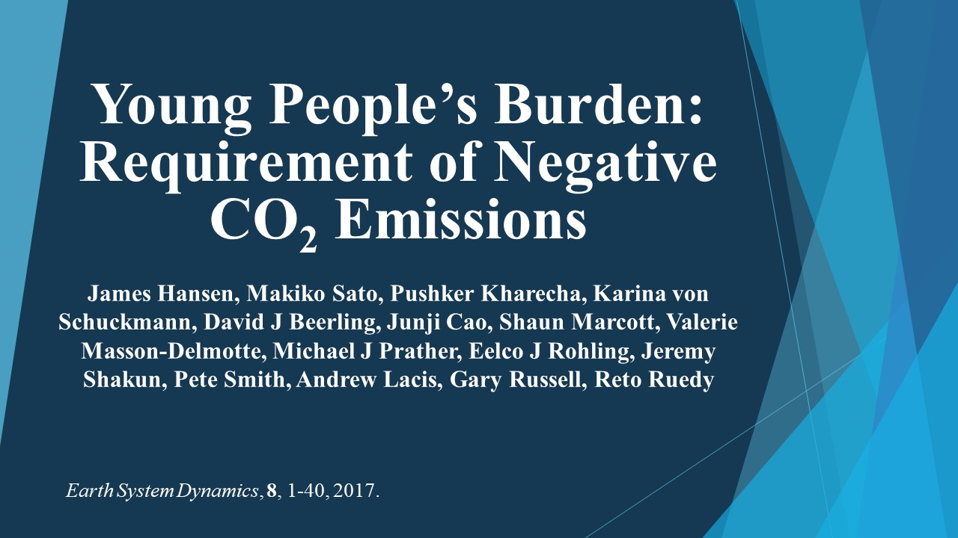
Notes:
We must also extract some CO₂ from the air, which is possible via improved agricultural and forestry practices.
However, we must leave young people a feasible task and tools to address it.
In Young People’s Burden we describe quantitatively the situation that young people face.

Slide 50
“Young People, do not underestimate your potential, aided by the Scientific Method, to change the World’s Course."
From Sophie’s Planet (coming soon)
Notes:
Young people must take up the fight and they must demand their rights.
But to succeed, they must understand the matter and use the scientific method.
We old scientists did not change the world’s course. I am writing Sophie’s Planet to explain what I learned, which I hope is helpful.

Slide 51
Fig. 9. Fossil fuel emission scenarios. Scenarios in (a) have constant emissions in 2015-2020 and then simple specified rates of emission increase or decrease. IPCC (2013) RCP scenarios are shown in (b).
Notes:
Figure 9 in Young People’s Burden defines alternative scenarios for future fossil fuel emissions.
The scenarios with fossil fuel emissions phased down have reductions beginning in 2021, the year after the next Presidential election in the United States.
Three of our scenarios are similar in effect to IPCC scenarios, but our emission changes are in a simple percent change per year.

Slide 52
Fig. 12. Simulated global temperature for forcings of Fig. 11. Observations as in Fig. 2. Gray area is 2σ (95% confidence) range for centennially-smoothed Holocene maximum, but there is further uncertainty about the magnitude of the Holocene maximum, as noted in the text and discussed by Liu et al (2014).
Notes:
Simulated global temperature for the four fossil fuel emission scenarios in Fig. 9 of Young People’s Burden.
The figure on the right includes extraction of CO2 from the air of the indicated amounts.
Part of the CO2 extraction could be via increased storage in the soil and biosphere, but it is believed that the maximum potential storage in the soil and biosphere is no more than 100-150 PgC. 1 PgC = 1 pica gram carbon = 1 giga ton carbon.

Slide 53
Carbon Fee & Dividend
Fee: Collected at Domestic Mine/Port of Entry
Covers all Oil, Gas, Coal → No Leakage
Dividend: Equal Shares to All Legal Residents
Effect is “progressive”; Low-income people gain
Merits:
Transparent; Public can understand & support it
Market-based; Stimulates Innovation
Notes:
It is easy to implement an across-the-board carbon fee, collecting it at the first sale at domestic mines and ports-of-entry.
If 100 percent of this collected fee is distributed equally to all legal residents, we obtain a simple, transparent, market-based approach that spurs innovation.
With the present distribution of energy use, 70 percent of the public will make money, but if they want to stay on the positive side of the ledger they need to pay attention to the price of things on the shelf – products that employ a lot of fossil fuel in their production will become more expensive.
Most rich people have a large carbon footprint, from large houses and flying around the world, so they will lose money, but they can afford it.

Slide 54
Carbon Fee & Dividend Addresses
1. Economy: Stimulates It
Puts Money in Public’s Hands
Provides Certainty to Businesses and Entrepreneurs
2. Energy: Solves Fossil Fuel Addiction
Stimulates Innovation – Fastest Route to Clean Energy
Complements Efficiency Regulations & Energy RD&D
3. Climate: Viable International Approach
Border Duties on Products from Nations w/o Carbon Fee
Rebate Industry on Exports to Nations w/o Carbon Fee
Notes:
Fee & Dividend spurs the economy, creating jobs, increasing GNP and increasing government revenue.
Fee & Dividend is the one effective international approach. When the U.S. and/or China adopt a carbon fee, they will also impose border duties on products from countries that do not have an equivalent carbon fee. That will be an incentive for other countries to adopt a carbon fee, so they can collect the money themselves.

Slide 55
Sources: EIA Table E1 Estimated Primary Energy Consumption in the United States, 1635-1945
and EIA Table 1.3 Primary Energy Consumption Estimates by Source, 1949-2015.
Notes:
Energy history of the United States is educational. Wood was the first energy source, but coal, with greater energy density, powered the industrial revolution, until the more convenient liquid and gas fossil fuels were discovered.
Because fossil fuels are a finite resource, and a big pollution problem, it was hoped that peaceful use of nuclear power would be a major long-term energy source. There is enough nuclear fuel in the ocean to last forever, for billions of years, so it would be possible to stop mining of uranium.
Nuclear power could reduce CO2 emissions, as well as air and water pollution. However, development of nuclear power practically stopped in the 1970s.

Slide 56
Biological Effect of Low Level Atomic Radiation
1. Threshold Criterion
- Doses comparable/less than natural radiation O.K.
- This was the Recommended Criterion until 1956
2. Radiation Hormesis: Positive Biologic Response
- Low radiation levels beneficial: stimulate activation of repair mechanisms that protect against disease
3. Linear-No-Threshold (LNT) Criterion
- Even the tiniest radiation presumed to be harmful
- NAS BEAR Committee recommended LNT in 1956
Notes:
What happened? The root problem for nuclear power is concern about health effects of atomic radiation.
Until 1956 it was assumed that there was a threshold for harm, consistent with the idea that radiation is probably not dangerous if it is less than the amount that we get from cosmic rays and radioactive elements in the soil.
Some scientists even argue for radiation hormesis, the idea that low levels of radiation are beneficial.
However, in 1956 the National Academy of Sciences BEAR Committee, Biological Effects of Atomic Radiation, declared that the tiniest amount of radiation is harmful.

Slide 57
Biological Effect of Low Level Atomic Radiation
1. Threshold Criterion
- Doses comparable/less than natural radiation O.K.
- This was the Recommended Criterion until 1956
2. Radiation Hormesis: Positive Biologic Response
- Low radiation levels beneficial: stimulate activation of repair mechanisms that protect against disease
3. Linear-No-Threshold (LNT) Criterion
- Even the tiniest radiation presumed to be harmful
- NAS BEAR Committee recommended LNT in 1956
Notes:
Proponents of nuclear power continue to argue that the BEAR Committee was wrong, that LNT is not correct and was ideologically driven.
I doubt that this battle will be fruitful. Small radiation effects are difficult to prove and depend on the circumstances. In such case, health professionals are likely to prefer the strictest criterion, which is LNT.
However, young people have a good basis to be very unhappy with us old people for not being scientific, for not being objective.
We owe it to young people to provide an honest comparison of the health and environmental effects of nuclear power, health and environmental effects of fossil fuels, and health and environmental effects of renewable energies. We have science academies capable of such evaluations, which should be presented side-by-side.

Slide 58
Public Concern About Radiation
Atmospheric Tests of Nuclear Bombs
Concern about radioactive fallout from nuclear weapons testing helped spur the Limited Test Ban Treaty in 1963.
China Syndrome + Three-Mile-Island Accident
Popular film about the danger of a nuclear core meltdown.
Actual accident exposed Pennsylvania residents to radiation
Notes:
Linus Pauling used the idea that even the tiniest radiation is harmful to help achieve a ban on atmospheric testing of nuclear weapons by the U.S. and USSR. This incidentally had an effect on public perception of nuclear power.
Public attitudes were also affected by the 1979 disaster thriller film, The China Syndrome, about the danger of a nuclear meltdown.

Slide 59

Notes:
This film almost coincided with an actual accident and partial core meltdown at the Three-Mile-Island power plant in Pennsylvania.
Enthusiasm for nuclear power in the U.S. dissipated, even though it was determined later that the radiation released did not harm Pennsylvania residents.

Slide 60

Notes:
This is from a concert held that year in New York.
Did you hear the line in the song “give me the warm glow of a wood fire”? Remember that 10,000 people per day are dying from indoor air pollution.

Slide 61
“We are eliminating programs that are no longer needed, such as nuclear power research and development.”
President William Clinton,
1993 State of the Union address
Argonne National Laboratory was ready to construct a commercial-scale reactor that:
Burns >90% of nuclear fuel, compared with ~1% in existing reactors,
Can utilize nuclear waste, depleted uranium and excess weapons material as fuel,
Leaves less waste, which can be disposed of safely,
(4) Can shut down automatically in the event of an anomaly (e.g., earthquake),
(5) Does not require power to cool reactor in case of shut down,
(6) Does not require uranium mining for centuries; indeed, it has been shown that fuel can be sieved from the ocean – the supply will last billions of years.
Notes:
Young people have reason to question the wisdom of us old people.
President Clinton, 25 years ago, terminated R&D on nuclear power, just when the Department of Energy was ready to build an advanced generation nuclear reactor with major improvements over today’s reactors, which are 50 year old technology.
Nuclear power in the U.S. has an outstanding safety record, but next generation nuclear power can be even much safer and produce less nuclear waste. We would not force solar energy or windmills to use 50-year-old technology.

Slide 62
Another Potential Technology
Thorium-Powered Molten Salt Reactor
Operates near Atmospheric Pressure
Factory or Shipyard Construction
Inexhaustible Fuel Supply
Reduced Waste, Shorter Half-Life
Passively Safe Operation
Not Well-Suited for Weapons Material
Notes:
I am not advocating any specific technology. My opinion is that, because of prior government failure to support R&D, the best chance for advanced technology to contribute to rapid phasedown of CO2 emissions, in the near-term, is probably via modular light-water reactors.
However, the Nuclear Regulatory Commission and the Department of Energy need to facilitate progress with modern technology, which they are not doing well. Canada has a more responsive regulatory commission. Yet, from an engineering perspective, the best nuclear innovation potential still seems to be in the U.S.

Slide 63
Grandsons Connor and Jake – Connor reading Indiana Jones book.
Notes:
Let me give the last word on this topic to my oldest grandson, here at about age seven reading an Indiana Jones book about an urgent problem.

Slide 64
Connor’s Thoughts
If we keep doing what we are doing now then the environment will be ruined when the people who are kids now are grownups.
And unless we can figure out how to make a time machine that actually works, there will be no way to go back in time to fix it.
It’s not fair that the grownups now are ruining the atmosphere for the grownup in the future.
Grownups now are scared of nuclear power but they should be scared of what will happen if they keep doing what they’re doing now because we know the ways to use nuclear power safe and we know that using fossil fuels is not safe. It is very dangerous.
Notes:
A few years later Connor correctly identified two basic conclusions about the energy/climate matter.
First, if grownups keep doing what they’re doing, and kids can’t figure out a time machine that actually works, kids are screwed.
Second, some grownups are scared of nuclear power – but what about fossil fuels? We know that using fossil fuels is not safe. It is very dangerous!

Slide 65
Aerosol distribution from different sources in Monitoring Atmospheric Composition and Climate(MACC) reanalysis for 2010 (Tegen and Schepanski, Curr. Clim. Chan. Repts., 4,1-10, 2018) based on ECHAM-Hamburg Aerosol Model.

Slide 66
Aerosol total optical depth in Monitoring Atmospheric Composition and Climate(MACC) reanalysis for 2010 (Tegen & Schepanski, Curr. Clim. Chan. Repts., 4, 1-10, 2018) based on ECHAM-Hamburg Aerosol Model (Zhang et al., 2012)

Slide 68
Fig. 24 (Kinne et al. 2013)
Simulated temporal change of aerosol direct forcing.
Future based on RCP-8.5

Slide 69
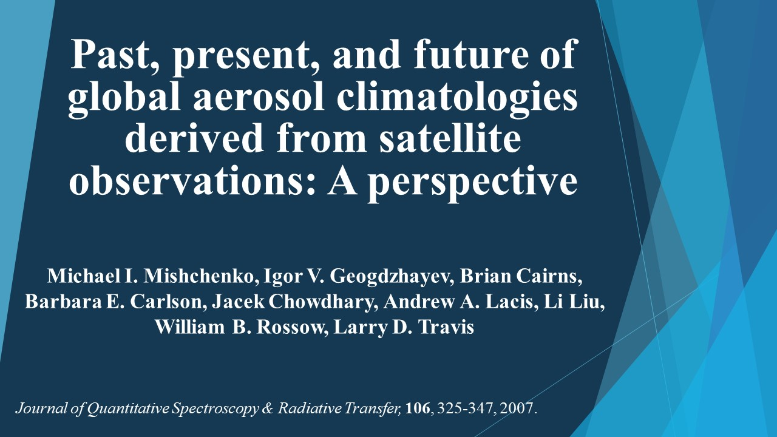

Slide 71
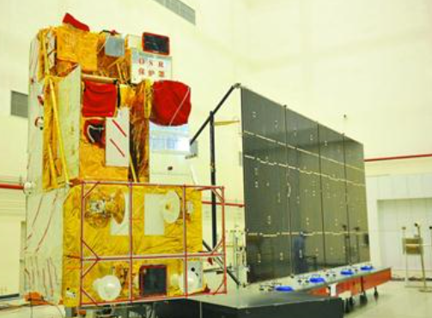
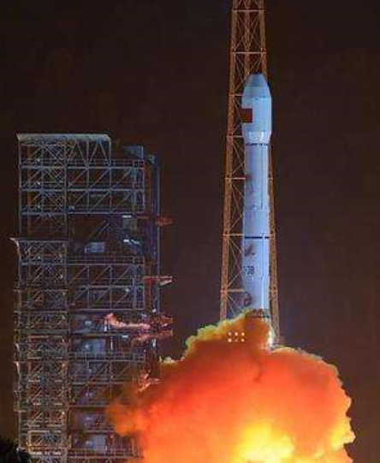
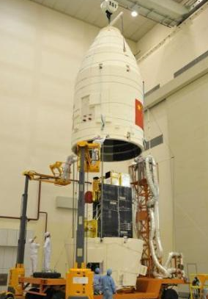
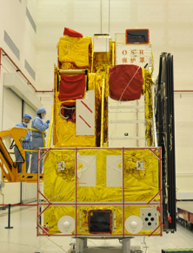
Successful Launch of GaoFen-5 Satellite
9 May, 2018, 02:28 (Local Time)

Slide 72
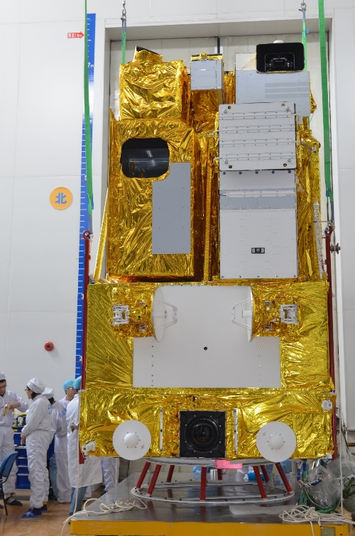
Directional Polarization Camera（DPC） on GaoFen-5
Main Task/Function:
Obtain multi-angles, multispectral and polarization information of atmosphere. Through combine them with atmosphere retrieval model base on polarization, DPC could provide the production of global atmospheric aerosol and cloud as well as the atmospheric correction parameters for other loads on GF-5 Satellite.
Type：
  Sun –synchronous
  Inclination: ~98°
  Altitude: ~705 km
  Ascending node: 13:30
Platform specifics：
  Pointing accuracy: ≤0.1°
  Total mass of scientific payload: ~60.5 kg
  Power for payload: ~51 W
  Design life: >8 years

Slide 73

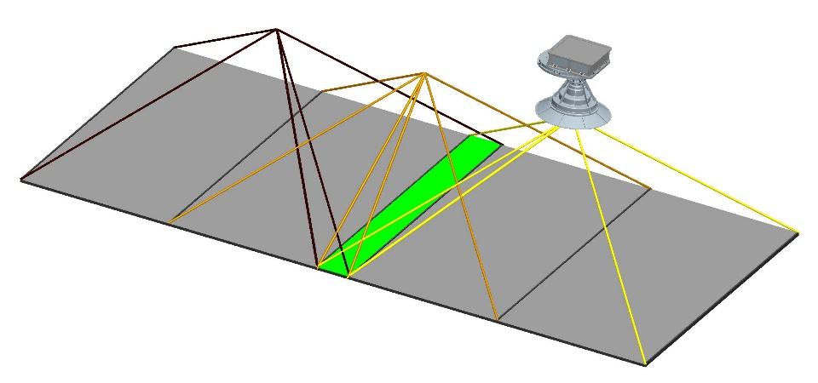
Directional Polarization Camera（DPC） on GF-5
DPC：
  FOV: ±50°
  Spatial resolution: 3.3km
  Multi-angle: 9
  Detector: 512×512
  Period of image: 485ms
  alignmentSpectral band: 443nm, 490nm(P), 565nm, 670nm(P), 763nm, 765nm, 865nm(P), 910nm
  0°, 60°, 120°
  Observable Stokes parameters: I, Q, U
  Photometric accuracy: 5%
  Polarimetric accuracy: 0.02
  No on-board calibration

