Slide 1
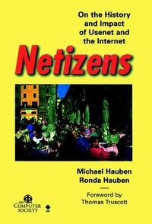
Then, Now and Into the Future Thoughts on the 25th Anniversary of the print edition of
Netizens: On the History and Impact of Usenet and the Internet
Ronda Hauben

Slide 2
“There is an urgent need to look back at the way we came, revisit the original intention …. Remembering the original intention and mission, let the Internet back on the right track of the road for the benefit of mankind.”
Introduction to Annual Conference of World Internet History

Slide 3
Usenet
(1979 - present)
A worldwide distributed discussion system available on computers.
Usenet was created by graduate students in 1979 using features of the UNIX operating system created by Bell Labs researchers. Usenet was described as a “public access network.” Participants included universities, corporations, research centers, etc. The computer users on Usenet were eager to discuss many topics. Also users helped each other with computer technology in general and other problems.

Slide 4
"Start discussing on sci.econ. We're all ears."

Slide 5
"`The Largest Machine': Where it came from and its importance to Society”
Michael explained:
"I propose to write a paper concerning the development of ‘The Net’. I am interested in exploring the forces behind its development and the fundamental change it represents over previous communications media. I will consult with people who have been involved with Usenet from its beginnings, and the various networks that comprise the Computer Network around the world. I wish to come to some understanding of where the Net has come from, so as to be helpful in figuring out where it is going to.”
Michael Hauben

Slide 6
“I want to hear from the four corners of the Net - That means YOU!”
“Howdy!
I would like to hear from EVERYONE on the Net-Frontier. If you think you are weird or abnormal (or special) in terms of net-connections or usenet connection, please tell me all about it. I am doing research for a paper about the “largest machine” – the Net. So, I’m looking for people on “the fringe”, or who are at obscure connections or who believe they are connected to some kind of interesting makeshift connection.”
To the further expansion of the Net!:)
– Michael Hauben

Slide 7
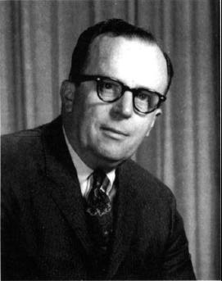
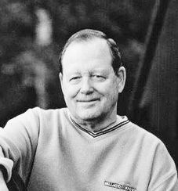
J. C. R. Licklider and R. W. Taylor,
“The Computer as a Communication Device,”
Science and Technology, Vol. 76, 1968, pp. 21-38.

Slide 8
"We believe that communicators have to do something nontrivial with the information they send and receive . . . to interact with the richness of living information—not merely in the passive way that we have become accustomed to using books and libraries, but as active participants in an ongoing process, bringing something to it through our interaction with it, and not simply receiving something from it by our connection to it.... “
Licklider and Taylor, 1968

Slide 9
“. . . We want to emphasize something beyond its one-way transfer: the increasing significance of the jointly constructive, the mutually reinforcing aspect of communication—the part that transcends ‘now we both know a fact that only one of us knew before.’ When minds interact, new ideas emerge. We want to talk about the creative aspect of communication.”
Licklider and Taylor, 1968

Slide 10

Michael changed net.citizen to
Netizen
(网络公民)
to describe the users he found were doing what they could to contribute to and spread the Net

Slide 11
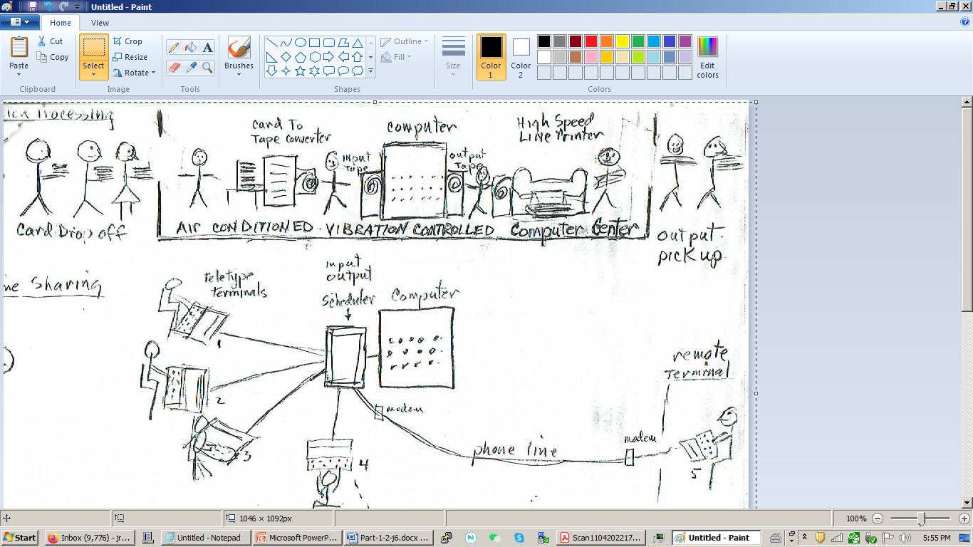
Batch Processing

Slide 12
Time Sharing

Slide 13
Information Processing Techniques Office
(IPTO)
Originally "Command and Control Research“ within the Advanced Research Projects Agency
ARPA.

Slide 14
The essence of Licklider’s quest was to gain an understanding of
the computer as a communication device

Slide 15
A phrase that J.C.R. Licklider frequently used to express his vision was
“an intergalactic network”

Slide 16
“. . . before there was a time-sharing system, let’s say at MIT, then there were a lot of individual people who didn’t know each other who were interested in computing in one way or another, and who were doing whatever they could, however they could.
As soon as the time-sharing system became useable, these people begin to know one another, share a lot of information, and ask of one another, 'how do I use this? Where do I find that?'
It was really phenomenal to see this computer become a medium that stimulated the formation of a human community…”
Robert Taylor, 1968

Slide 17
“We have seen the beginnings of communication through a console, communication among people and consoles located in the same room or in the same university campus or even at distantly separate separated laboratories of the same research and development organization. This kind of communication-through a single multi access computer with the aid of telephone lines is beginning to foster cooperation and promote coherence more effectively then do present arrangements for sharing computer programs by exchanging magnetic tape, by messenger or mail.”
Licklider and Taylor 1968

Slide 18
“The collection of people, hardware, and software – the multi access computer together with its local community of users – will become a node in a geographically distributed computer network. Let us assume for a moment that such a network has been formed… through the network of message processors, therefore, all the large computers can communicate with one another. And through them, all the members of the super community can communicate – with other people, with programs, with data, or with selected combinations of those resources.”
Licklider and Taylor, 1968

Slide 19
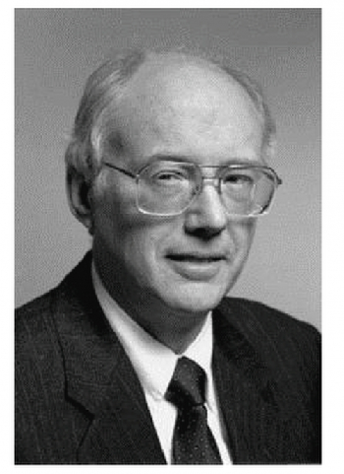
“It is not proper to think of networks as connecting computers. Rather, they connect people using computers to mediate. The great success of the internet is not technical, but in human impact. Electronic mail may not be a wonderful advance in Computer Science, but it is a whole new way for people to communicate. The continued growth of the Internet is a technical challenge to all of us, but we must never loose sight of where we came from, the great change we have worked on the larger computer community, and the great potential we have for future change.”
RFC-1336, 1992
David Clark

Slide 20
“It’s either mere access to information or interaction with information. And for mankind it implies either an enmeshment in the silent gears of the great electronic machine or mastery of a marvelous new and truly plastic medium for formulating ideas and for exploring, expressing, and communicating them.”
J.C.R. Licklider
Keynote talk at “Information Utilities and Social Choice ”
Conference , Dec 2-3, 1969

Slide 21
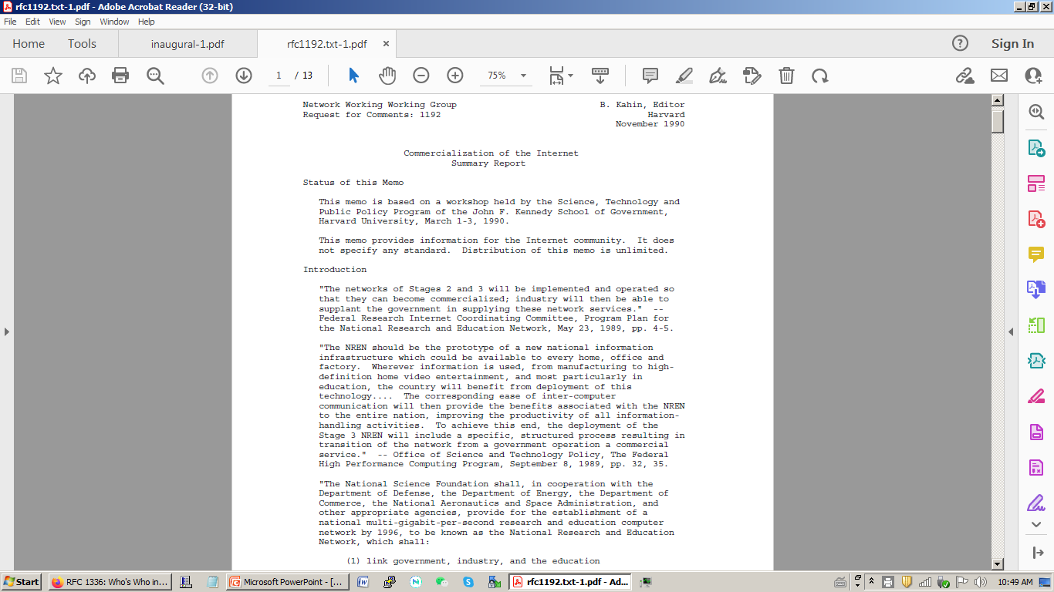

Slide 22
NTIA Virtual Conference
November 14-23. 1994
The US National Telecommunications Information Administration (NTIA) under the US Dept of Commerce, held a nation-wide online conference shortly before the privatization was carried out. Maintaining a public internet was a major thread, many defending the Internet as a public good. During the discussion the distinction was raised between the Net encouraging interactive forms of communication versus the passive transfer of information and the importance of this distinction to the future of the Net.

Slide 23
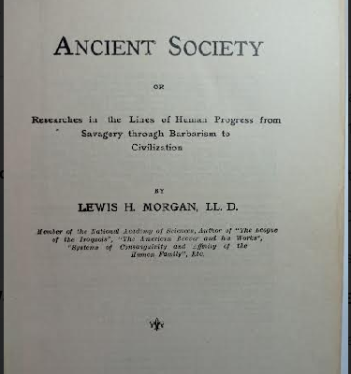

Slide 24
Morgan points to the importance of writing in documenting the level of development so society can build on the advances made thus far. Understanding the advances in communications that the computer makes possible can help to understand how to build on those advances.

Slide 25
What then for the future
To move to a digital civilization requires studying what advances have been made and learning how to appreciate and recognize new modes of development like the communication advances Usenet and email and the ARPANET and Internet have made possible.
Along with changes in technology, there are also changes in political forms and social customs. Even as old forms of citizenship continue, new forms like netizens and netizenship are developing side by side. Morgan’s book helps to demonstrate why recognizing the importance of such developments is needed along with recognizing the importance of changes in technology.

Slide 26
Netizens: On the History and Impact of Usenet and the Internet the Internet
Netizens: On the History and Impact of Usenet and the Internet the Internet http://www.columbia.edu/~rh120/
Ronda Hauben
ronda.netizen@gmail.com

