Slide 1
Blind Fair Routing in
Large-Scale Service Systems
Mor Armony
Stern School of Business, NYU
*Joint work with Amy Ward
Columbia University March 2012
TexPoint fonts used in EMF.
Read the TexPoint manual before you delete this box.: AAAAAAAAAAA

Slide 2
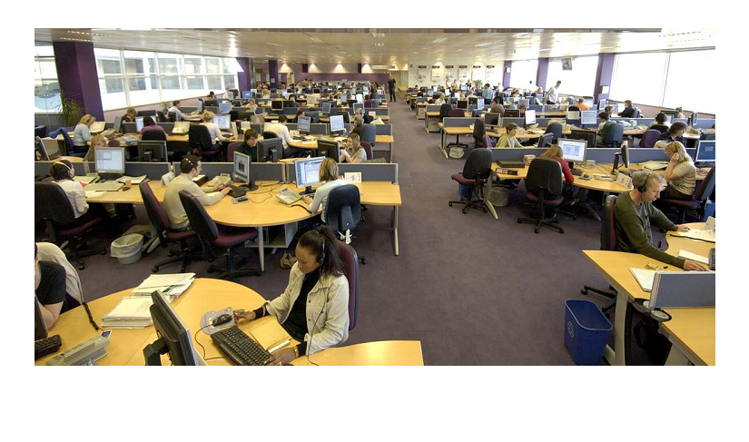
Motivation: Large Call Centers

Slide 3






A Call Center
There are callers that
have different needs.
There are agents that
have different skill levels.
(Experienced agents serve
faster.)
Which agent should answer an incoming call when
more than one agent is available?
Which caller a newly idle agent should serve when
more than one caller is waiting?

Slide 4
Call Center Management:
Why is it important?
It is a multibillion dollar industry.
Every Fortune 500 company has at least one call center, and the average Fortune 500 company employs 4500 call center agents.
For many companies, the call center is a primary point-of-contact between itself and its customers.
  Hence a well-run call center promotes good customer relations, and a poorly managed one hurts customer relations.

Slide 5
The Multiskill Queueing Model
I customer classes:
Poisson(λi) arrivals
J server pools:
Service time exp(μj)
Control Decisions:
  Routing: When an incoming
  call arrives, which agent
  pool should take the call?
  Scheduling: Upon service
  completion, which customer
  class should be served?
λ
λ
1
I
Scheduling and
Routing
N
N
1
J
μ
μ
1
J
Notes:
Simplifying assumption: Service speed depends only on the pool, and not on the customer class. Not perfect, but it is a hard problem!
Example: Customers classes are differentiated by their language, but all have need for the same kind of service. Some agents are bi- or multi-lingual. Others are not. Then, not all agent pools can serve all customer classes. The speed of service depends on how experiened the agent is at handling the request only, and not on the customer class.

Slide 6
The Customer Optimization Problem
Routing: According to the Fastest-
Server-First (FSF) Policy
Scheduling: Generalized c policy
Admit to service a customer from class

Slide 7

The Fairness Issue
Gurvich and Whitt (2009) show the aforementioned policy
is asymptotically optimal with respect to the finite horizon
cost criterion as the number of servers becomes large
BUT … idleness is mostly experienced by the slow servers.
This is unfair.
Slow servers
Fast servers
Do we care?
Perceived injustice amongst employees leads to low
employee satisfaction and hampers performance.
Call centers care, and prefer “fair” routing policies.

Slide 8
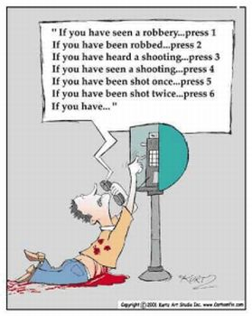
Quality of Service is Important, but...

Slide 9

So is employee satisfaction

Slide 10
The Fairness Optimization Problem
This is hard to solve exactly.
We can solve it asymptotically.

Slide 12
Literature Review
The Limit Regime
  Halfin and Whitt (1981)
General Skill-based Routing
  Gurvich and Whitt (2009a,b, 2010),
  Dai and Tezcan (2008)
Fair Policies for The Inverted-V Model
  Idleness Balancing through Random Routing;
  Mandelbaum, Momcilovic and Tseytlin (2011)
  The LISF Policy; Atar(2008)
  A Threshold Policy; Armony and Ward (2009)
  A Weighted Blind Fair Policy; Atar, Shaki, and Shwartz (2009), Reed and Shaki (2012)
This work combines the above two literature streams.

Slide 13
The Fairness Problem Solution Outline
The Approximating Fairness Optimization Problem.
The Proposed Blind Routing and Scheduling Policy.
Performance Evaluation.

Slide 14
The Fairness Problem Solution Outline
The Approximating Fairness Optimization Problem.
The Proposed Blind Routing and Scheduling Policy.
Performance Evaluation.

Slide 15
The QED Limit Regime

Slide 16
Resource Pooling Assumption
The graph is connected.
₁
₂
₁
₂
O.K.
Not O.K.
N₁
N₂
N₁
N₂
₁
₂
₁
₂
x_{ij} is the proportion of class i arrivals served by pool j.

Slide 17
Asymptotically Efficiency Controls
Definition:
Consequence:

Slide 18
Determining the Approximating Problem
Key Step: State the problem in terms
of a one-dimensional limit process.

Slide 19
Diffusion Control Problem (DCP)
Class i Queue-length
Pool j Idle Servers
Where X is a diffusion process with
infinitesimal variance 2 and infinitesimal drift
Note: Diffusion drift and variance are not dependent on p_{Q,I} ... SO there is separability in the solution.
Notes:
Separability: the constraints can be ignored when finding, for a given x, how to split customers between the classes, and the splitting of customers between the classes can be ignored when satisfying the constraints. Note that the constraints fix X^+, which means that routing will determine the queue size, and scheduling will determine how to split custoemrs between classes.

Slide 20
DCP Solution: Separability
Objective function:
Notes:
Separability: the constraints can be ignored when finding, for a given x, how to split customers between the classes, and the splitting of customers between the classes can be ignored when satisfying the constraints. Note that the constraints fix X^+, which means that routing will determine the queue size, and scheduling will determine how to split custoemrs between classes.

Slide 21
DCP Solution: Separability – two separate problems
Scheduling:
Routing:
Notes:
Separability: the constraints can be ignored when finding, for a given x, how to split customers between the classes, and the splitting of customers between the classes can be ignored when satisfying the constraints. Note that the constraints fix X^+, which means that routing will determine the queue size, and scheduling will determine how to split custoemrs between classes.

Slide 22
The DCP Solution: Separability
₁
_{I}
Schedule as in G&W to minimize
convex delay costs, disregarding
fairness. (Routing is FSF.)
Use threshold routing, as in A&W
to achieve fairness. (There is
no scheduling.)
₁
_{J}
₁
_{J}
Notes:
22

Slide 23
Policy Translation: The TR-Gc Policy
Routing: Threshold policy
FSF \ J
Pool J idles.
FSF \ J-1
Pool J-1 idles.
FSF
Pool 1 idles.
No routing
No one idles.
0
Number in system is x.
Scheduling: Generalized c policy
Admit to service a customer from class

Slide 24
We conjecture that the TR-Gc policy is asymptotically optimal
BUT …
Determining threshold levels requires extensive
knowledge of the system parameters, including
demand.
Are there other fair policies under which the
performance degradation is small?

Slide 25
The Fairness Problem Solution Outline
The Approximating Fairness Optimization Problem.
The Proposed Blind Routing and Scheduling Policy.
Performance Evaluation.

Slide 26
The Longest Weighted Idleness
FFIR-Gcµ Policy
Routing: Given weights f₁, …, f_{J}, route an arriving
customer to pool
Scheduling: Same = According to the Gc policy.
The policy is blind in the sense that it does not require
arrival or service rate information.

Slide 27
In order to advocate use of the FFIR-Gcµ Policy…
We must answer the following question:
How does the FFIR-Gc policy perform?
Is the desired fairness fraction vector (f₁, …, f_{J}) achieved?
What is the performance degradation from
the TR-Gc policy?

Slide 28
Asymptotic Performance of LWI-Gc
(Fairness)
(Delay Minimization)
(Asymptotic Efficiency)

Slide 29
The One-Dimensional Limit Process
The implication of always maintaining fairness.
The implication of only requiring fairness
to be achieved in the long run.

Slide 30
The Fairness Problem Solution Outline
The Approximating Fairness Optimization Problem.
The Proposed Blind Routing and Scheduling Policy.
Performance Evaluation.

Slide 31
Predicting the Percentage Cost Increase:
Reduction to Inverted-V
does not depend on either the cost function or
The number of customer classes.
It is enough to consider the delay probability in an
inverted-V system under FFIR and TR.

Slide 32
Reduction to Inverted-V, 2 Pool System

Slide 33
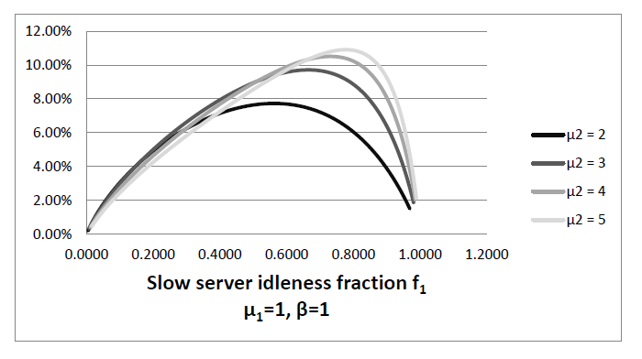
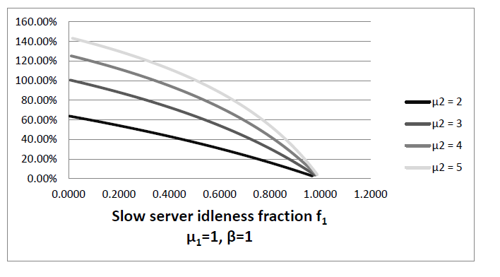
Predicted Percentage Cost Increase
FFIR vs TR
(Cost of
Blindness)
FFIR vs FSF
(Cost of
Fairness)

Slide 34
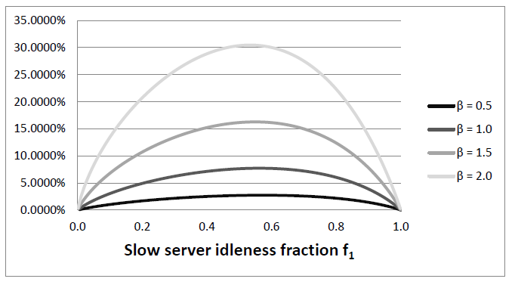
Predicted Percentage Cost Increase:
Cost of Blindness

Slide 35
Policy Performance Comparison:
Simulation
₁=800
₂=800
=1600
N₁=340
N₂=650
N₁=340
N₂=650
₁=1
₂=2
₁=1
₂=2
N-model
Inverted V-model

Slide 36
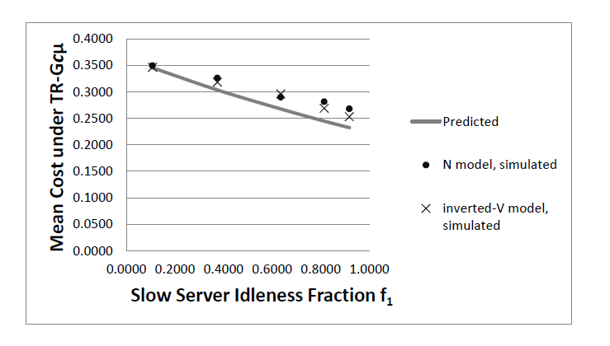
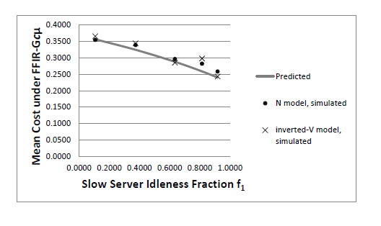
Simulation: Cost Comparison
N-model cost:
Inverted-V model cost:

Slide 37
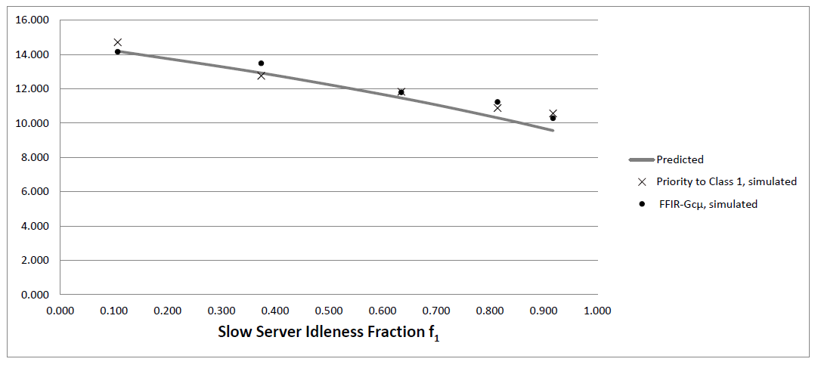
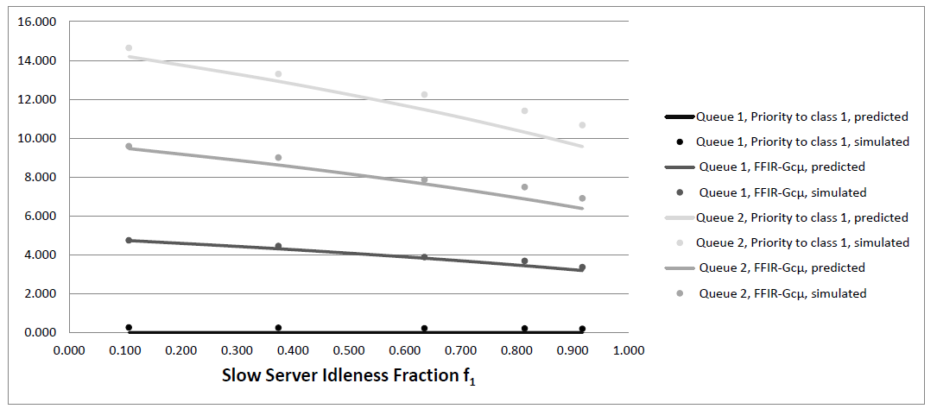
Separability

Slide 38
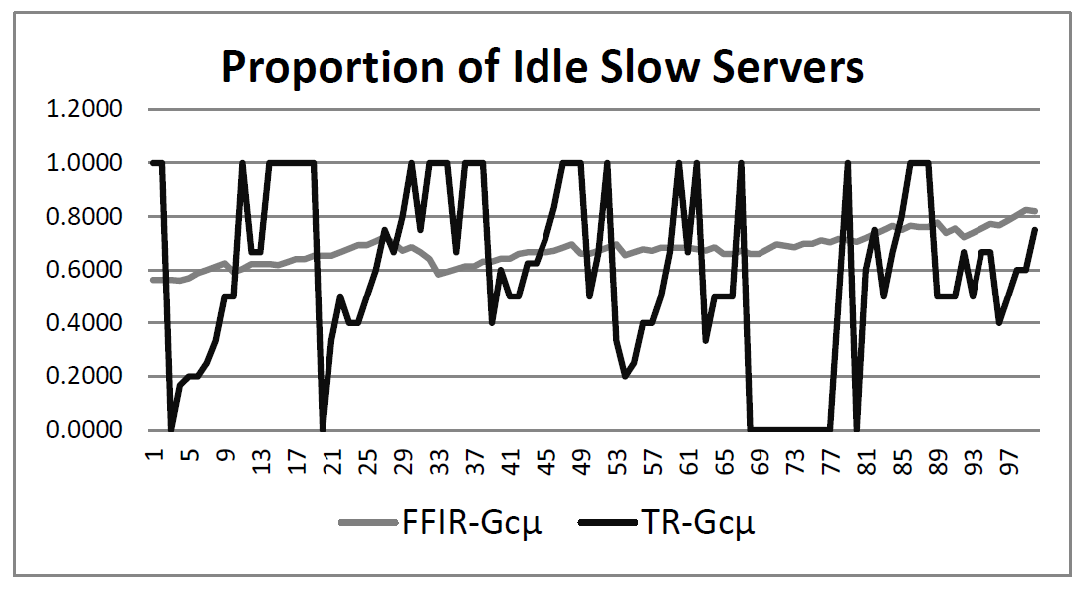
Fairness over time
(Which is the appropriate fairness constraint?)
Target idleness proportion f₁=0.64

Slide 39
Summary
Fairness problem formulation
Asymptotic Separability
  Scheduling according to Gcμ (Gurvich & Whitt (2009))
  Routing according to TP (Armony & Ward (2009))
But TP is
  not blind, and
  only fair in the long run
The FFIR-Gcµ policy has
  small performance degradation that is
  independent of the cost function.
  fairness is maintained at all times.
Acknowledgement: Itay Gurvich, Avi Mandelbaum

