Slide 1
Distributed Storage for Intermittent Energy Sources: Control Design and Performance Limits
Yashodhan Kanoria
Stanford University
Joint work with:
Andrea Montanari, David Tse and Baosen Zhang

Slide 2
The challenge of renewables
Intermittent
Intrinsically distributed
How to manage?
Strategy | Requirement
Spatial averaging | Transmission
Time averaging | Storage
Over-provisioning | Generation
Demand response | Signaling, incentives
The
paper

Slide 3
The challenge of renewables
Intermittent
Intrinsically distributed
How to manage?
Strategy | Requirement
Spatial averaging | Transmission
Time averaging | Storage
Over-provisioning | Generation
Demand response | Signaling, incentives
This
talk

Slide 4
Questions?
Optimal control of grid with transmission and storage?
Infrastructure improvement:
New transmission line? Upgrade in existing line?
New storage facility?
New generation?
Which will help more?
How to optimally allocate budget?

Slide 5
Our contribution
Control design for discrete time model
Analytical insights quantifying benefits of storage, transmission and overprovisioning

Slide 6
Model
3
2
1
4

Slide 7
Model
3
2
1
4
= Electric load

Slide 8
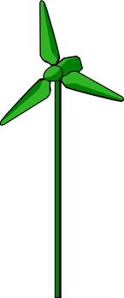
Model
3
2
1
4
= Renewable sources

Slide 9
Model
$${Wind}_{3}(t)$$
3
$${Wind}_{2}(t)$$
2
1
4
$${Wind}_{1}(t)$$
$${Wind}_{4}(t)$$
−
$$=Wind$$

Slide 10
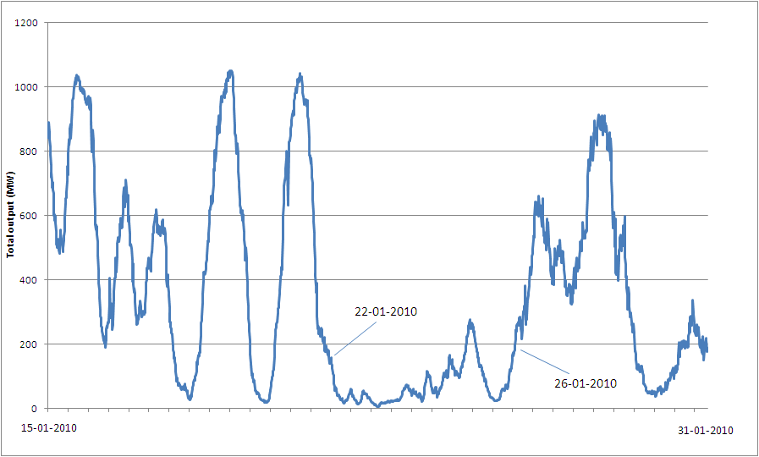
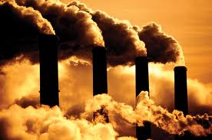
Model
$$−$$
$$=Wind$$
$${Wind}_{3}(t)$$
3
$${Wind}_{2}(t)$$
2
1
4
$${Wind}_{1}(t)$$
$${Wind}_{4}(t)$$

Slide 11
Model
$$−$$
$$=Wind$$
$${ Fast}_{2}(t)$$
$${Wind}_{3}(t)$$
$${ Fast}_{2}(t)$$
3
$${Wind}_{2}(t)$$
2
$${Fast}_{1}(t)$$
$${ Fast}_{2}(t)$$
1
4
$${Wind}_{1}(t)$$
$${Wind}_{4}(t)$$
$$=Fast$$

Slide 12
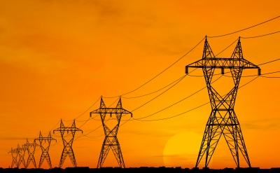
Model
$$−$$
$$=Wind$$
$$=Fast$$
$${ Fast}_{2}(t)$$
$${Wind}_{3}(t)$$
$${ Fast}_{2}(t)$$
$$F_{23}(t)$$
3
$${Wind}_{2}(t)$$
2
$$F_{34}(t)$$
$${Fast}_{1}(t)$$
$${ Fast}_{2}(t)$$
$$F_{12}(t)$$
1
$$F_{24}(t)$$
4
$${Wind}_{1}(t)$$
$${Wind}_{4}(t)$$

Slide 13
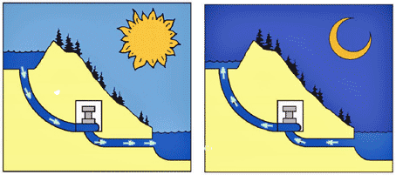
Model
$$−$$
$$=Wind$$
$$=Fast$$
$${ Fast}_{2}(t)$$
$${Wind}_{3}(t)$$
$${ Fast}_{2}(t)$$
$$F_{23}(t)$$
3
$${Wind}_{2}(t)$$
3
2
$$F_{34}(t)$$
2
$${Fast}_{1}(t)$$
2
$${ Fast}_{2}(t)$$
$$F_{12}(t)$$
1
$$F_{24}(t)$$
1
1
4
$${Wind}_{1}(t)$$
4
4
$${Wind}_{4}(t)$$

Slide 14
Model
$$−$$
$$=Wind$$
$$=Fast$$
$${ Fast}_{2}(t)$$
$${Wind}_{3}(t)$$
$${ Fast}_{2}(t)$$
$${ Save}_{3}(t)$$
$$F_{23}(t)$$
$${Wind}_{2}(t)$$
$$F_{34}(t)$$
$${Fast}_{1}(t)$$
$${ Save}_{2}(t)$$
$${ Fast}_{2}(t)$$
$$F_{12}(t)$$
$$F_{24}(t)$$
$${ Save}_{1}(t)$$
$${Wind}_{1}(t)$$
$${ Save}_{4}(t)$$
$${Wind}_{4}(t)$$
Energy pushed into
$$=Save$$

Slide 15
Model
$$−$$
$$=Wind$$
$$=Fast$$
$${ Fast}_{2}(t)$$
$${Wind}_{3}(t)$$
$${ Fast}_{2}(t)$$
$${ Save}_{3}(t)$$
$$F_{23}(t)$$
$${Wind}_{2}(t)$$
$$F_{34}(t)$$
$${Fast}_{1}(t)$$
$${ Save}_{2}(t)$$
$${ Fast}_{2}(t)$$
$$F_{12}(t)$$
$$F_{24}(t)$$
$${ Save}_{1}(t)$$
$${Wind}_{1}(t)$$
$${ Save}_{4}(t)$$
$${Wind}_{4}(t)$$
Control inputs:
${Fast}_{i}(t)$
${Save}_{i}(t)$
Dependent variables:
Flows $F_{ij}(t)$
Storage buffers $B_{i}(t)$

Slide 16
Constraints
Storage capacity constraints Hard constraint
Transmission constraints Soft constraint

Slide 17
Cost function
$ε_{Fast}=$ Cost of fast generation (free disposal of energy)
$ε_{F}=$ Cost of violating transmission constraints
Performance criterion: ${ε = ε}_{Fast} + ε_{F}$
0
-C_{e}
C_{e}

Slide 18
What’s the issue?
Centralized control problem
$F(t)$ is linear function of controls
Storage constraints cause thresholding
Non-quadratic cost function
Idea: Use surrogate cost function
(drop storage constraints for now)
X
X
$$Var\left(Fast\right)+λ Var\left(F\right)$$
$$+ \hat{λ} Var\left(B\right)$$

Slide 19
The surrogate problem
‘State’ consisting of buffer sizes
‘Noise’ $Wind\left(t\right)$
State and noise fully observed
Linear state evolution
Quadratic cost
Assume $Wind\left(t\right)$ is Gaussian
We have an LQG problem!
Can be solved numerically yielding control scheme
Can be mapped back to original problem

Slide 20
The surrogate LQG problem
Is the scheme any good?
Any insights into roles of storage and transmission?

Slide 21
Specific networks
Transmission network is almost a tree
What happens on an infinite line?
What about a two-dimensional grid?

Slide 22
1-D and 2-D grids
Assume:
Storage $S$ at each node
Capacity $C$ on each line
${Wind}_{i}(t) \sim N(0, σ^{2})$ iid

Slide 23
1-D and 2-D grids
$S=$ Storage
$C=$ Transmission
$$σ^{2}=Var(Wind)$$
We find, for original problem:
Analytical expressions for cost of LQG-based schemes
Fundamental limits
$⇒$ LQG is near optimal

Slide 24
Results ${ε = ε}_{Fast}+ε_{F}$
$S=$ Storage
$C=$ Transmission
$$σ^{2}=Var(Wind)$$
 | Only $S$ | Only $C$ | $$C=S$$
1-D grid |  | $$\frac{σ^{2}}{C}$$ | $$σ exp\left(−\frac{C}{σ}\right)$$
2-D grid | $$\frac{σ^{2}}{S}$$ | $$σ exp\left(−\frac{C}{σ}\right)$$ | $$σ exp\left(−\frac{C^{2}}{σ^{2}}\right)$$

Slide 25
Results ${ε = ε}_{Fast}+ε_{F}$
$S=$ Storage
$C=$ Transmission
$$σ^{2}=Var(Wind)$$
 | Only $S$ | Only $C$ | $$C=S$$
1-D grid |  | $$\frac{σ^{2}}{C}$$ | $$σ exp\left(−\frac{C}{σ}\right)$$
2-D grid | $$\frac{σ^{2}}{S}$$ | $$σ exp\left(−\frac{C}{σ}\right)$$ | $$σ exp\left(−\frac{C^{2}}{σ^{2}}\right)$$

Slide 26
Results ${ε = ε}_{Fast}+ε_{F}$
$S=$ Storage
$C=$ Transmission
$$σ^{2}=Var(Wind)$$
 | Only $S$ | Only $C$ | $$C=S$$
1-D grid | $$\frac{σ^{2}}{S}$$ | $$\frac{σ^{2}}{C}$$ | $$σ exp\left(−\frac{C}{σ}\right)$$
2-D grid | $$\frac{σ^{2}}{S}$$ | $$σ exp\left(−\frac{C}{σ}\right)$$ | $$σ exp\left(−\frac{C^{2}}{σ^{2}}\right)$$

Slide 27
Results ${ε = ε}_{Fast}+ε_{F}$
$S=$ Storage
$C=$ Transmission
$$σ^{2}=Var(Wind)$$
 | Only $S$ | Only $C$ | $$C=S$$
1-D grid | $$\frac{σ^{2}}{S}$$ | $$\frac{σ^{2}}{C}$$ | $$σ exp\left(−\frac{C}{σ}\right)$$
2-D grid | $$\frac{σ^{2}}{S}$$ | $$σ exp\left(−\frac{C}{σ}\right)$$ | $$σ exp\left(−\frac{C^{2}}{σ^{2}}\right)$$

Slide 28
Results ${ε = ε}_{Fast}+ε_{F}$
$S=$ Storage
$C=$ Transmission
$$σ^{2}=Var(Wind)$$
 | Only $S$ | Only $C$ | $$C=S$$
1-D grid | $$\frac{σ^{2}}{S}$$ | $$\frac{σ^{2}}{C}$$ | $$σ exp\left(−\frac{C}{σ}\right)$$
2-D grid | $$\frac{σ^{2}}{S}$$ | $$σ exp\left(−\frac{C}{σ}\right)$$ | $$σ exp\left(−\frac{C^{2}}{σ^{2}}\right)$$

Slide 29
Results ${ε = ε}_{Fast}+ε_{F}$
$S=$ Storage
$C=$ Transmission
$$σ^{2}=Var(Wind)$$
 | Only $S$ | Only $C$ | $$C=S$$
1-D grid | $$\frac{σ^{2}}{S}$$ | $$\frac{σ^{2}}{C}$$ | $$σ exp\left(−\frac{C}{σ}\right)$$
2-D grid | $$\frac{σ^{2}}{S}$$ | $$σ exp\left(−\frac{C}{σ}\right)$$ | $$σ exp\left(−\frac{C^{2}}{σ^{2}}\right)$$

Slide 30
Results ${ε = ε}_{Fast}+ε_{F}$
$S=$ Storage
$C=$ Transmission
$$σ^{2}=Var(Wind)$$
 | Only $S$ | Only $C$ | $$C=S$$
1-D grid | $$\frac{σ^{2}}{S}$$ | $$\frac{σ^{2}}{C}$$ | $$σ exp\left(−\frac{C}{σ}\right)$$
2-D grid | $$\frac{σ^{2}}{S}$$ | $$σ exp\left(−\frac{C}{σ}\right)$$ | $$σ exp\left(−\frac{C^{2}}{σ^{2}}\right)$$

Slide 31
Results ${ε = ε}_{Fast}+ε_{F}$
$S=$ Storage
$C=$ Transmission
$$σ^{2}=Var(Wind)$$
 | Only $S$ | Only $C$ | $$C=S$$
1-D grid | $$\frac{σ^{2}}{S}$$ | $$\frac{σ^{2}}{C}$$ | $$σ exp\left(−\frac{C}{σ}\right)$$
2-D grid | $$\frac{σ^{2}}{S}$$ | $$σ exp\left(−\frac{C}{σ}\right)$$ | $$σ exp\left(−\frac{C^{2}}{σ^{2}}\right)$$
$C$ and $S$ together works best!

Slide 32
Results ${ε = ε}_{Fast}+ε_{F}$
$S=$ Storage
$C=$ Transmission
$$σ^{2}=Var(Wind)$$
 | Only $S$ | Only $C$ | $$C=S$$
1-D grid | $$\frac{σ^{2}}{S}$$ | $$\frac{σ^{2}}{C}$$ | $$σ exp\left(−\frac{C}{σ}\right)$$
2-D grid | $$\frac{σ^{2}}{S}$$ | $$σ exp\left(−\frac{C}{σ}\right)$$ | $$σ exp\left(−\frac{C^{2}}{σ^{2}}\right)$$

Slide 33
Results ${ε = ε}_{Fast}+ε_{F}$
$S=$ Storage
$C=$ Transmission
$$σ^{2}=Var(Wind)$$
 | Only $S$ | Only $C$ | $$C=S$$
1-D grid | $$\frac{σ^{2}}{S}$$ | $$\frac{σ^{2}}{C}$$ | $$σ exp\left(−\frac{C}{σ}\right)$$
2-D grid | $$\frac{σ^{2}}{S}$$ | $$σ exp\left(−\frac{C}{σ}\right)$$ | $$σ exp\left(−\frac{C^{2}}{σ^{2}}\right)$$

Slide 34
Results ${ε = ε}_{Fast}+ε_{F}$
$S=$ Storage
$C=$ Transmission
$$σ^{2}=Var(Wind)$$
 | Only $S$ | Only $C$ | $$C=S$$
1-D grid | $$\frac{σ^{2}}{S}$$ | $$\frac{σ^{2}}{C}$$ | $$σ exp\left(−\frac{C}{σ}\right)$$
2-D grid | $$\frac{σ^{2}}{S}$$ | $$σ exp\left(−\frac{C}{σ}\right)$$ | $$σ exp\left(−\frac{C^{2}}{σ^{2}}\right)$$
Averaging over 2-D much more effective than 1-D

Slide 35
Results ${ε = ε}_{Fast}+ε_{F}$
$S=$ Storage
$C=$ Transmission
$$σ^{2}=Var(Wind)$$
 | Only $S$ | Only $C$ | $$C=S$$
1-D grid | $$\frac{σ^{2}}{S}$$ | $$\frac{σ^{2}}{C}$$ | $$σ exp\left(−\frac{C}{σ}\right)$$
2-D grid | $$\frac{σ^{2}}{S}$$ | $$σ exp\left(−\frac{C}{σ}\right)$$ | $$σ exp\left(−\frac{C^{2}}{σ^{2}}\right)$$
$S$ seems to provide extra dimension for averaging!
Intuition: Time is like extra spatial dimension

Slide 36
Results ${ε = ε}_{Fast}+ε_{F}$
$S=$ Storage
$C=$ Transmission
$$σ^{2}=Var(Wind)$$
 | Only $S$ | Only $C$ | $$C=S$$
1-D grid | $$\frac{σ^{2}}{S}$$ | $$\frac{σ^{2}}{C}$$ | $$σ exp\left(−\frac{C}{σ}\right)$$
2-D grid | $$\frac{σ^{2}}{S}$$ | $$σ exp\left(−\frac{C}{σ}\right)$$ | ??

Slide 37
Results ${ε = ε}_{Fast}+ε_{F}$
$S=$ Storage
$C=$ Transmission
$$σ^{2}=Var(Wind)$$
 | Only $S$ | Only $C$ | $$C=S$$
1-D grid | $$\frac{σ^{2}}{S}$$ | $$\frac{σ^{2}}{C}$$ | $$σ exp\left(−\frac{C}{σ}\right)$$
2-D grid | $$\frac{σ^{2}}{S}$$ | $$σ exp\left(−\frac{C}{σ}\right)$$ | $$σ exp\left(−\frac{C^{2}}{σ^{2}}\right)$$

Slide 38
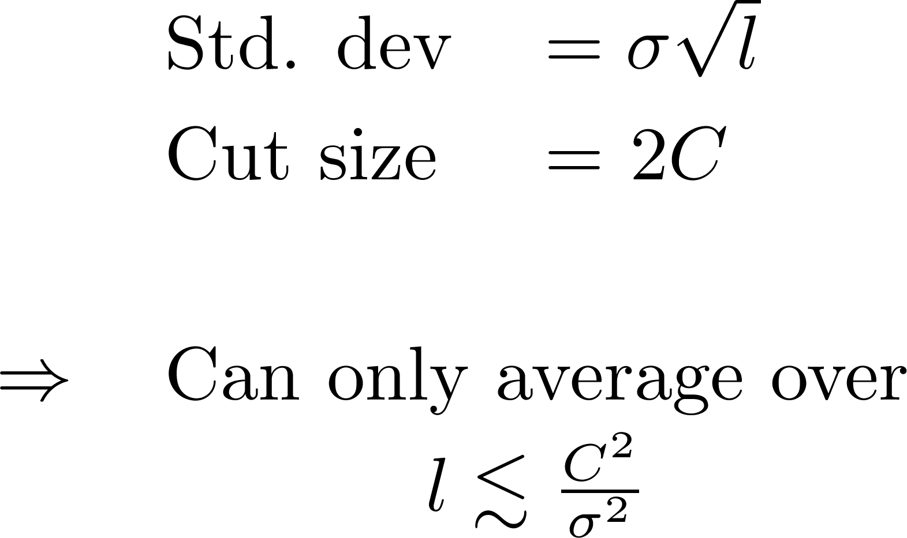
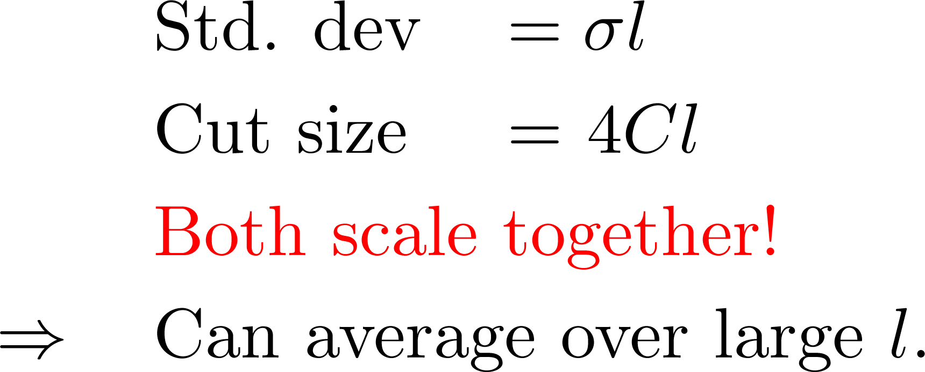
Spatial averaging is much easier in 2-D
1-D
Segment of length $l$
2-D
Square of side $l$

Slide 39
Conclusions and future work
Gaussian assumption optimistic
But key insights should remain valid:
2-D averaging much better than 1-D
S facilitates averaging over extra dimension
In the paper: A little overprovisioning can go a long way

Slide 40
Thank you!

