Slide 1

The Obesity Epidemic:
An Overview
Betsy Pfeffer MD
Assistant Clinical Professor Pediatrics
Columbia University
Morgan Stanley Children’s Hospital of New York Presbyterian
Notes:
Adolescent Medicine Specialist in Washington Heights, the population is primarily Hispanic form the DR, Audubon patients age 11-21, > 30% overweight/obese

Slide 2
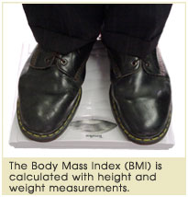
Obesity
Obesity means excess body fat
Standard Method of Assessing Body Fat
  Dual Energy X-ray Absorptiometry (DEXA Scan)
Other Methods:
  Body Mass Index: BMI (kg/m²)
  Skinfold Thickness
  Waist Circumference

Slide 3
BMI
BMI is the most widely accepted measure of obesity
  BMI correlates closely with total body fat and
  other risk factors of obesity related
  morbidity, especially in those with BMI’s>95%
  High BMI associated with adiposity in most
  individuals, but must also take into account increased lean body mass Pediatrics, 2007
Healthy BMI in adults is < 25
  BMI ≥ 25 =overweight(>85% in weight for age)
  BMI ≥ 30 = obese (>95% in weight for age)
Notes:
Standardized curves, 200 developed by the National Center for Health Statistics, CDC & AAP

Slide 4
Skinfold Thickness/Waist Circumference
Skinfold thickness does predict total
body fat but adds nothing more than
BMI
Increased Waist Circumference: measure from top of hip bone
  In children is defined as > 90th percentile for
  age, sex (ethnic specific) Fernandez et al J Peds 2004
  In Adults: Males>40inches, Females>35inches
  Increased waist circumference adds
  substantially to BMI alone for assessment of
  risk for CV disease
  Lee,et al. JPeds 2006
Notes:
Visceral fat: Central obesity is associated with a statistically higher risk of heart disease, hypertension, insulin resistance, and diabetes mellitus and is a symptom of metabolic syndrome( abdominal obesity, increased BP, lipids, insulin resistance, Increased CRP, fibrinogen)
Physical inactivity leads to a significant increase in visceral fat (hypertension, cardiovascular disease, hyperinsulinemia, diabetes mellitus, gallbladder disease, stroke, and cancer of the breast and endometrium)
Duke study: low-intensity exercise prevents visceral fat accumulation, but high-intensity exercise is needed to reduce it.
Sedentary lifestyle increases visceral fat independent of weight gain-Duke study
Fernández JR, Redden DT, Pietrobelli A, Allison DB. Waist Circumference Percentiles in Nationally Representative Samples of African-American, European-American, and Mexican-American Children and Adolescents J Pediatr 2004;145:439-44.

Slide 5
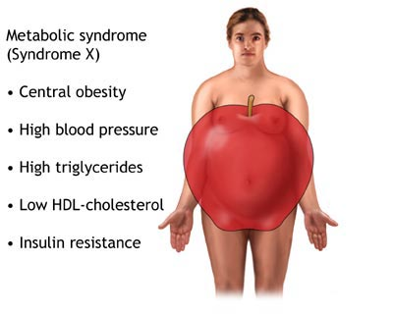
Visceral Fat
Visceral fat
  Associated with a statistically
  higher risk of heart disease,
  hypertension, insulin
  resistance, diabetes and
  the metabolic syndrome
  Physical inactivity leads to
  a significant increase in
  visceral fat independent of
  weight gain
  Low-intensity exercise prevents visceral fat accumulation, but high-intensity exercise is needed to reduce it
Notes:
Duke Study
Other Features:
Acanthosis Nigricans, increased fibrinogen and CRP

Slide 6
Less than Half of U.S. Adults are a Healthy Weight
68% of adults over the age of
20 are overweight
or obese
32.2% of men are obese
35.5% of women are obese
The prevalence of adult obesity
has doubled since 1980
Flegal et al, JAMA 2010

Slide 7
Obesity Trends* Among U.S. Adults
BRFSS, 1991
(*BMI ≥30, or ~ 30 lbs overweight for 5’ 4” person)
No Data <10% 10%–14% 15%–19%

Slide 8
Obesity Trends* Among U.S. Adults
BRFSS, 2000
(*BMI ≥30, or ~ 30 lbs overweight for 5’ 4” person)
No Data <10% 10%–14% 15%–19% ≥20%

Slide 9
Obesity Trends* Among U.S. Adults
BRFSS, 2008
(*BMI ≥30, or ~ 30 lbs. overweight for 5’ 4” person)
No Data <10% 10%–14% 15%–19% 20%–24% 25%–29% ≥30%

Slide 10
Ethnic Differences in Adults
Hispanic and Mexican Americans adults have higher rates of obesity than Non-Hispanic Whites
African American adults have the highest obesity rates
  37% among men
  Nearly 50% among women
  CDC, MMWR 2009
  Flegal et al, JAMA 2010 JAMA
Notes:
The prevalence of obesity in the United States is high, exceeding 30% in most age and sex groups except for men aged 20 to 39 years. Among men, age-adjusted obesity prevalence was 32.2% overall (95% confidence interval [CI], 29.5%-35.0%) and within racial and ethnic groups ranged from 31.9% (95% CI, 28.1%-35.7%) among non-Hispanic white men to 37.3% (95% CI, 32.3%-42.4%) among non-Hispanic black men. For women, the age-adjusted prevalence was 35.5% (95% CI, 33.2%-37.7%), ranging from 33.0% (95% CI, 29.3%-36.6%) among non-Hispanic white women to 49.6% (95% CI, 45.5%-53.7%) among non-Hispanic black women. The age-adjusted prevalence of overweight and obesity combined was 68.0% (95% CI, 66.3%-69.8%) overall, 72.3% (95% CI, 70.4%-74.1%) among men, and 64.1% (95% CI, 61.3%-66.9%) among women.
^{JAMA 2010}

Slide 11
Current Obesity Trends
The increases in the prevalence of obesity previously observed do not appear to be rising at the same rate over the past 10 years, particularly for women and possibly for men
^{Flegal},^{JAMA 2010}

Slide 12
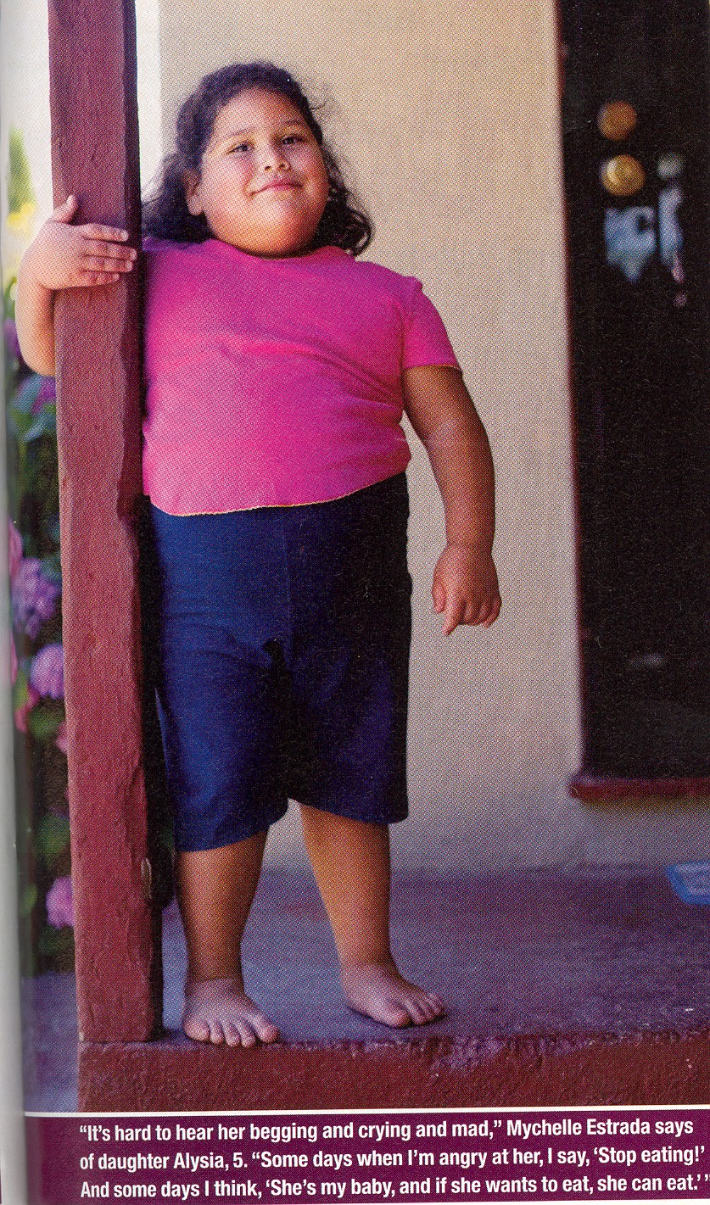
Childhood Obesity
According to NHANES between
1980-2006 overweight/obesity prevalence tripled in 6 to 19 year olds and doubled in 2 to 5 year olds
Presently, children ages 2-19 years
  16.9% obese
  31.7% overweight
CDC, NHANES 2003-2006
Notes:
for children aged 2–5 years, prevalence increased from 5.0% to 12.4%; for those aged 6–11 years, prevalence increased from 6.5% to 17.0%; and for those aged 12–19 years, prevalence increased from 5.0% to 17.6%. ^{NHANES} CDC
National Health and Nutrition Examination Survey

Slide 13
Ethic Differences in Children and Adolescents
Hispanic and African American children have higher obesity rates than non-Hispanic whites
Adolescent girls with BMI>95%
  Non-Hispanic Black 27.7%
  Mexican American 19.9%
  Non-Hispanic White 14.5%
Adolescent boys with BMI>95%
  Mexican American 22.1%
  Non-Hispanic Black 18.5%
  Non-Hispanic White 17.3%
  CDD NHANES 2003-2006
Notes:
Using a sample of 20,000 adolescents (Add Health data), this study examined the influences of community poverty and race/ethnicity on adolescent obesity.The prevalence of obesity is significantly higher in poor communities than in affluent communities; and it is higher among African Americans, Hispanics and Native Americans than among Whites. The interaction between race/ethnicity and community poverty indicates that race/ethnicity moderates the influence of community poverty on the prevalence of obesity. Although the prevalence of obesity is higher among minorities than among Whites, the influence of community poverty is stronger for Whites than for minorities.
social factors including poverty and a lower level of education have been linked to obesity. One reason for this may be that high-calorie processed foods cost less and are easier to find and prepare than healthier foods, such as fresh vegetables and fruits. Other reasons may include inadequate access to safe recreation places or the cost of gym memberships, limiting opportunities for physical activity. However, the link between low socioeconomic status and obesity has not been conclusively established, and recent research shows that obesity is also increasing among high-income groups

Slide 14
New York State Statistics
NY ranks 33rd for children and 14th for adults among the 50 states and D.C. in overall prevalence
32.2% of low‐income 2-5 yr olds are overweight/obese
32.9% of 10-17 yr olds are overweight/obese

Slide 15
New York Statistics
NY children are less likely than their counterparts nationwide to be physically active and slightly more likely to spend 2 hours or more in front of a TV
Trust for America’s Health and RWJ 2009
National Initiative for Children’s Healthcare Quality 2008

Slide 16
Vermont Statistics
Vermont ranks 9th for children and 6th for adults among the 50 states and D.C. in overall prevalence
29.6% of low‐income 2-5 yr olds are overweight/obese
26.7% of 10-17 yr olds are overweight/obese

Slide 17
Vermont Statistics
Vermont children are more likely than their counterparts nationwide to be physically active and far less likely to spend 2 hours or more in front of a television or computer screen
Trust for America’s Health and RWJ 2009
National Initiative for Children’s Healthcare Quality 2008

Slide 18
Current Trends in Children and Adolescents
The prevalence of high BMI for age among children and adolescents showed:
  NO significant changes between 2004 and 2006
  and
  NO significant trends between 1999 and 2006
The one exception was an increase for boys ages 6-16 who are at the heaviest weight levels
Ogden et al, JAMA 2008/JAMA 2010
Notes:
New York Times 2010

Slide 19
Possible Reasons for the Leveling Off
We have reached the biological limit to how obese people can get
  “When we eat more, we initially gain weight then an increasing share of calories go into maintaining and moving around the excess tissue”
  Dr. David Ludwig, Children’s Hospital Boston
Those who are genetically susceptible, or susceptible for psychological reasons, have already become obese
Belluck, New York Times 1/14/10

Slide 20

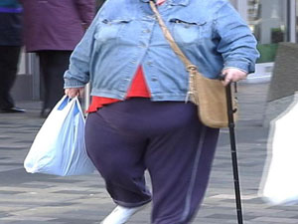
Why is this happening?

Slide 21
Etiology.
At the population level, the increase in prevalence is too rapid to be explained by a genetic shift
However:
  Twin studies do demonstrate a genetic contribution
  Activity levels of the hormones leptin, ghrelin, adiponectin influence appetite, satiety and fat distribution and contribute to physiologic risk
  Barlow et al Pediatrics 2007
Notes:
leptin, ghrelin, adiponectin are hormones that influence appetite, satiety and fat distribution
Leptin binds to neuropeptide Y (NPY) neurons in the arcuate nucleus, in such a way that decreases the activity of these neurons. Leptin signals to the brain that the body has had enough to eat, or satiety. Obese people have an unusually high circulating concentration of leptin.^{[26]} These people are said to be resistant to the effects of leptin
Ghrelin has emerged as the first circulating hunger hormone
Levels of adiponectin , secreted from adipose, are inversely correlated with body fat percentage low levels ass w/ developing DM and the metabolic syndrome

Slide 22
Pima Indian Women Living in Mexico and Arizona
Mexico
Arizona
% Fat in Diet 23 41
Weight (kg) 70 90
Body Mass Index 25 37
Incidence Type 2 DM
in people > 35 years old 8% 50%
Ravussin et al., Diabetes Care, 1994

Slide 23
Hormone Activity
Leptin, secreted primarily from adipose, signals to the brain that the body has had enough to eat, or satiety. Obese people have an unusually high circulating concentration of leptin and are thought to be resistant to the its effects
Levels of adiponectin, also secreted from adipose,
are inversely correlated with body fat percentage
Ghrelin, secreted from the stomach and the pancreas, has emerged the first circulating hunger hormone

Slide 24
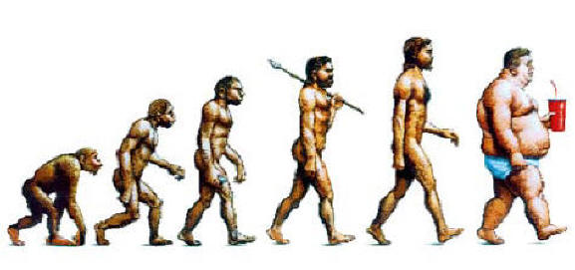
Etiology.
Most obesity is due to exogenous causes
Social influences include lower of education and poverty
Genetics do influence susceptibility
  Thrifty Gene Hypothesis: famines common millions of years ago and selected for thrifty genes, genes that enable individuals to store fat
  Drifty Gene Hypothesis: release of our ancestors from predation 2 million yrs ago allowing the genes regulating the upper limit of body weight to randomly drift
  Set Point Theory : Thermostat for body fat in everyone that keeps weight fairly constant and explains why obesity is a chronic refractory condition
Hormonal conditions
Syndromes
Notes:
Nutrition Research: A review of the literature Human Obesity Gene Map Consortium counts over 240 genes that are able to modulate body weight and adiposity. Predisposition for females to be overweight in all age groups
Genes which were selected for over many millenia would favor the storage of excess calories as fat in service of reproductive integrity (better able to breastfeed, more fertile). This environment allows stronger expression of those genes leading to increased fatness at an earlier age.
Flaws with Thrifty Gene Hypothesis: Famines are too infrequent and involve insufficient mortality to select for thrifty genes, no evidence that fat people survive famines better than lean people and modern hunter gather populations do not indicate that between famines they fatten up and hence suggest that they did not inherit the thrifty gene. Also, many of the populations that have developed obesity and DM appeared to have no discernible h/o famine or starvation for example pacific islanders whose tropical islands had luxuriant vegetation all year round and waters full of fish
Set Point- Can loose up to 7-9% body weight but most regain weight within 5 years.
Set Point: we self regulate intake
Hormonal conditions: usually associated w/ short stature
Thyroid disease
Cushing’s disease
Growth Hormone Deficiency
Acquired Hypothalamic Lesions (Infections, vascular malformations, neoplasms and trauma)
Syndromes
Prader-Willi (short stature, small hands and feet, mental retardation and cryptorchidism)
Bardet-Biedl (retinitis pigmentosa, mental retardation, polydactaly and hypothalamic hypogonadism)
Cohen (Mental retardation, microcephaly, short stature, dysmorphic features)
Set Point- Can loose up to 7-9% body weight but most regain weight within 5 years.

Slide 25
Exogenous Causes:
Obesogenic Environment
Environmental risks
Consumption of calorie-dense snacks, nutritionally replete foods
Increase in juice/soda consumption
Increase in portion size
Increase in sedentary behaviors
  TV, video games, computers
Decrease in physical activity
Poverty
  In countries that are in economic transition obesity is more prevalent in affluent families

Slide 26

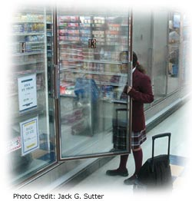
Excess Risk in the Environment
Advertising
Fast food
  170,000 fast food restaurants and 3 million soft drink vending machines across the country
Lack of big supermarkets
Unhealthy food in home
Lack of place to exercise
Unsafe neighborhoods
Notes:
Increased fast food consumption ass with increased body weight Tabacchi

Slide 27


Lifestyle Changes
Dietary
High fat foods:
Take out
Fast foods
High fat snacks
“Super-Sized” portions
  Small size fries 220 cal
  Super size fries 620 cal

Slide 28
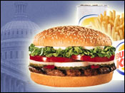
The Burger Has Gotten Bigger!
  Example: the Burger King Hamburger
    1954 Hamburger 3.9 oz
    2002 Hamburger 4.4 oz
    2002 Whopper Jr 6.0 oz
    2002 Whopper 9.9 oz
    2002 Double Whopper 12.6oz

Slide 29
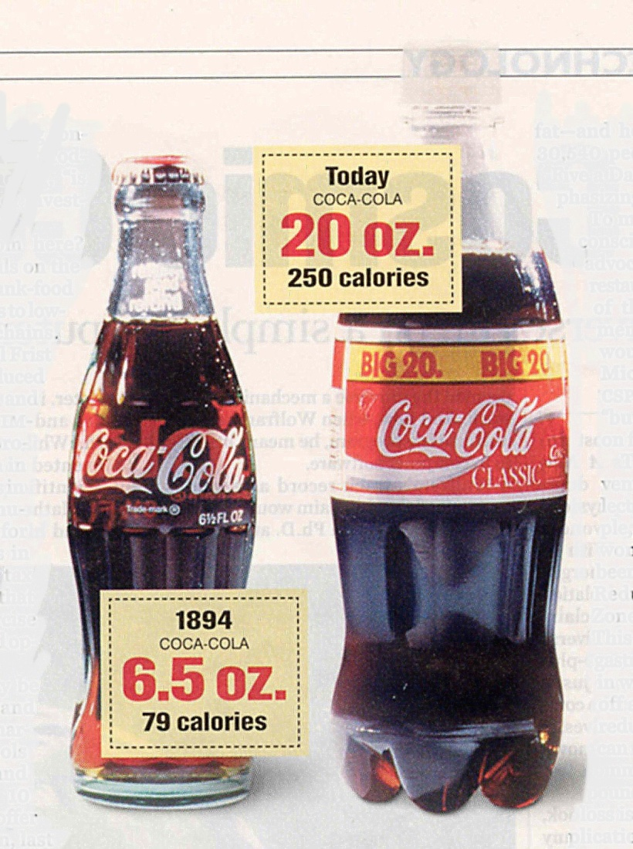
Lifestyle Changes
Liquid calories:
  12 ounces juice, iced tea,
  regular soda = ~150 cal
  1 serving/day in excess of the
  calories that your body needs
  can lead ~15 pounds per year
  weight gain
  Studies show a 60% increase risk
  of development of obesity in
  middle school children for every
  additional daily serving of sugar
  sweetened drinks
  Lancet, 2001, direct association with obesity
  Lancet, 2002, childhood obesity
  J Ped, 2003
  BMJ,2004;
  Obesity Research, 2004
  Circulation, 2007: association with MS
Notes:
One pound equals 3500 calories

Slide 30
Lifestyle Changes
Diet Soda:
  People who drink diet soft drinks don't lose weight, they gain weight
  People who only drink diet soft drinks have a higher risk of obesity than people who drink regular soft drinks
  No proof that diet soda causes obesity. More likely, something linked to diet soda drinking is also linked to obesity. Perhaps, people feel that by changing to diet drinks it will help with weight loss so they make no other changes in their diet and they continue to gain weight
  Some soft drink studies do suggest that diet drinks stimulate appetite
  Fowler et al, American Diabetes Association Meeting 2005
Notes:
Sharon P. Fowler, MPH, and colleagues at the University of Texas Health Science Center

Slide 31
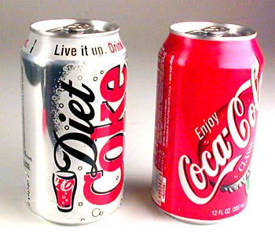
Diet versus Regular Soda
For regular soft-drink drinkers, the risk of becoming overweight or obese was:
  26% for up to 1/2 can each day
  47.2% for more than 2 cans each day
For diet soft-drink drinkers, the risk of becoming overweight or obese was:
  36.5% for up to 1/2 can each day
  57.1% for more than 2 cans each day
Fowler et al, American Diabetes Association Meeting 2005
Notes:
Fowler's team looked at seven to eight years of data on 1,550 Mexican-American and non-Hispanic white Americans aged 25 to 64. Of the 622 study participants who were of normal weight at the beginning of the study, about a third became overweight or obese

Slide 32
Increased Liquid Calorie Consumption
According to the USDA the per capita soft drink consumption has increased 500% over the past 50 years
Daily consumption of soft drinks
  83% 14 yr old boys, 78% 14 yr old girls
  72% 9-13 yr olds
  56% 8 yr olds
Since 1978, soft drink consumption has
doubled in children 6-11 yrs; tripled in
teenaged boys
SHPPS/ CDC 2006
Notes:
Alliance for a healthier generation AHA/Clinton Foundation Nationally, 83% of elementary schools, 97% of middle/junior high schools, and 99% of high schools sell food and beverages through vending machines, school stores, or a la carte in the cafeteria
Additionally, from 1978 to 1998, average daily soft drink consumption almost doubled among adolescent females, increasing from 6 ounces to 11 ounces, and almost tripled among adolescent males, from 7 ounces to 19 ounces.^{11, 15}
32.7% of elementary schools, 71.3% of middle schools, and 89.4% of high schools had either a vending machine or a school store, canteen, or snack bar where students could purchase foods or beverages. School Health Policy and Program Study 2006

Slide 33
Increased Liquid Calorie Consumption
90% of High Schools have vending machines and snack bars
Non-citrus juice increased by 300% in young children
Milk consumption has continued to decline among adolescents, has decreased 36% between 1965 to 1996
US Department of Agriculture
J Peds 2003
Commentary J Peds 2005

Slide 34
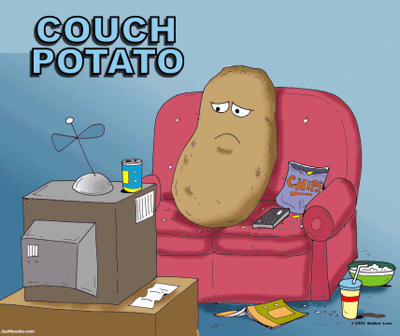

TV Makes Us Fat!
Average child and adolescent spend over 3 hours/day watching TV, playing video games, using the computer CDC 2007
For every 2 hours of TV watched, the risk for obesity increases 23% and the risk for Type 2 diabetes increases 14% Hu et al JAMA 2003
Almost 50% of TV commercials concern food 91% of which is rich in fats, sugars, salt and NONE included fruit or veggies
Tabacchi A review of the literature
Each year the average child sees about 40,000 commercials on television alone and the majority targeted at them are for candy, sugared cereal, and fast food Lempert 2005
Notes:
It's been estimated that for every additional hour of television that adolescents watch each week
above the average, obesity rises about two percent
Limit TV to under 2 hours/day
Nurses Health Survey
Prevalence of food and beverage brands in movies 1996-2005 energy dense nutrient poor foods frequent in movies so in addition movies are an imp source of advertising to children
Sutherland et al Pediatrics 2010

Slide 35
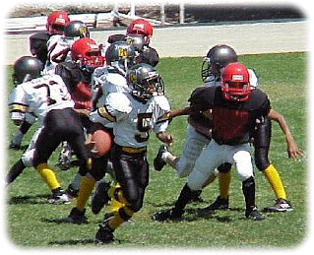


Physical Activity
Participation in all types of physical activity declines strikingly as age or grade in school increases
Only 30% of high school students are enrolled in daily physical activity classes and only 35% met the recommended levels of daily physical activity YRBS CDC 2007
The U.S. Department of Health and Human Services recommends that young people (ages 6–17) participate in at least 60 minutes of physical activity daily

Slide 36
Periods of Development Linked to Obesity
Gestation
  Infant of a diabetic mother
  SGA
Adiposity rebound
  Normal decrease in BMI in children until age 5-7, earlier rebound associated with adult obesity
Early onset of puberty
  Women with early menarche have a five fold increased
  risk of obesity
Childhood/Adolescence
  20-40% obese children and 70-80% obese adolescents are likely to become obese adults, compared to their lean counterparts, especially if their parents are obese
  Whitaker et al, 1997, NEJM
Notes:
Obese children and adolescents are more likely to become obese as adults. For example, one study found that approximately 80% of children who were overweight at aged 10–15 years were obese adults at age 25 years.³ Another study found that 25% of obese adults were overweight as children.⁵ The latter study also found that if overweight begins before 8 years of age, obesity in adulthood is likely to be more severe.
CDC
There is a clear association between childhood adiposity and early pubertal development. Women with a h/o early menarche < 11.9 years have a fivefold increased risk of obesity. ? If risk due to their prepubertal weight status or is it directly exacerbated by earlier pubertal development. Early puberty ass w/ increased adult BMI, waist circumference, Increased CV risk, metabolic syndrome, increased risk premenopausal breast CA. According to this review , the relationship of obesity to puberty is not clear. Childhood obesity and the timing of puberty M. Lynn Ahmed Trends in Endocrinology and Metabolism July 2009
Early pubertal onset predicts a central fat mass distribution in young adult males Diabetes Journal Pubertal timing is independent predictor of central adiposity in young adult males 11/06
Parental obesity more than doubles the risk of adult obesity among both obese and non obese children younger than 10 years of age
An obese two year old is two times more likely to become an obese adult than a non-obese two year old
25% of obese preschool children become obese adults
50% of obese six year olds become obese adults

Slide 37
Adult Obesity: The Bottom Line
Hazards of obesity now rival smoking USA Today 1/14/10
Extreme obesity can cost you 12 years USA Today 1/14/10
In midlife (age 50), the risk of death increases in overweight individuals by one third and in the obese by two to three times Adams et al NEJM 2006
According to CDC, more than 110,000 deaths in US every year are caused by obesity/inactivity
  Most of the increased risk of mortality is due to DM, kidney and CV disease
  Greater that 80% of premature deaths occur among people with a BMI > 30

Slide 38
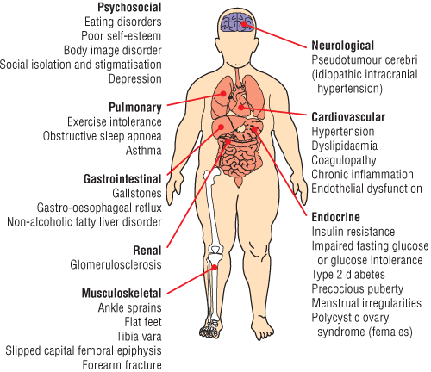
Medical Complications of Obesity
Notes:
38

Slide 39
Type 2 Diabetes
Characterized by resistance to the actions of insulin
Strongly genetic
Mostly obese
Usually in adulthood, but now occurring younger and younger
According to a preliminary report, 10% of children with T2D develop renal failure requiring dialysis or resulting in death by young adulthood
Dean et al, Diabetes, 2002
Impaired Glucose Tolerance/Pre-diabetes
  In a study reported in the NEJM 25% of obese children age 4-10 and 21% age 11-18 already had IGT Sinha NEJM 2002

Slide 40
Type 2 Diabetes in Youth:
Risk Factors
Obesity and increased BMI
  85% are obese
Family History of Type 2 Diabetes
  75-100% have 1st or 2nd degree relative
Membership of ethnic minority
  African American, Hispanic, Native American, Asian
Female gender
  2:1 Ratio
Born Small for Gestational Age (SGA)
Features of Metabolic Syndrome
Notes:
Mean age on diagnosis 13-14 at time of puberty

Slide 41

Prevalence of Diabetes among U.S. Adults, BRFSS, 1993-94
4%
4-6%
6%
n/a
Source: Mokdad et al., Diabetes Care 2000;23:1278-83

Slide 42
Prevalence of Diabetes among U.S. Adults, BRFSS, 1997-98
4%
4-6%
6%
n/a
Source: Mokdad et al., Diabetes Care 2000;23:1278-83

Slide 43
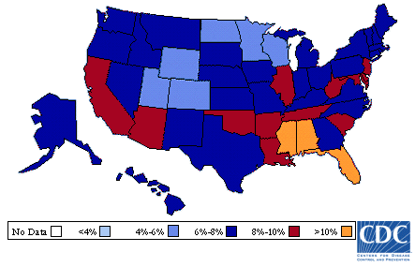
Diabetes Prevalence 2007

Slide 44
CDC Estimates
Of children born in the year 2000 one-third to one-half will develop T2D in their lifetime
  10% of those who get diabetes will get it
  before the age of 30 and lose 14 years of life
  38.5% Females
  32.8% Males
  The lifetime risk for diabetes is higher among minority groups
  The highest estimated lifetime risk for diabetes is among Hispanics (females, 52.5% and males, 45.4% )
  Narayan et al. JAMA 2003

Slide 45
Benefits of Weight Reduction
Luckily a Little Goes a Long Way
Modest amount of weight loss (5-10%), through dietary changes and increased physical activity, reduces the chance of developing diabetes in overweight pre-diabetic adults by 60%
Taking metformin also reduces the risk, although less dramatically
Other health benefits of modest weight loss
  Reduction in risk factors for CV disease (decreased
  CRP, fibrinogen)
  Improvement in serum lipids
  Improved blood pressure
  NIH: Diabetes Prevention Program 2002
Notes:
In the DPP, 3,234 study participants were overweight and had pre-diabetes, participants where from 27 clinical centers around the United States

Slide 46
Cardiovascular
Stroke
Increased BP
  Common in obese adolescents
LVH
Hyperlipidemia
  Common in obese adolescents
  Atherosclerotic lesions present by late adolescence
  Statins considered in children >10 yrs old with LDL >190
  Physical activity, fiber and omega 3 fatty acids improve lipoprotien profiles
  Peeples AMSTAR 2008
Notes:
LDL<110 elevated>130 Chol Satinis for teens > 10 w/ LDL levels > 190
Elevated Blood Pressure: defined average systolic & diastolic BP > 95th %ile for age, sex, & height
Seen in 20-30% of 5 - 11 yr, BMI > 85th percentile
Figueroa-Colon, et al. South Med J.1997
Obese adolescents account for 50% of cases of hypertension in this age group; prevalence increases with increasing age and BMI
Figueroa-Colon, et al. South Med J.1997
Teenagers who are obese show signs of artery damage that may increase their risk of heart attack and stroke later in life, according to a study in Circulation: Journal of the American Heart Association.

Slide 47
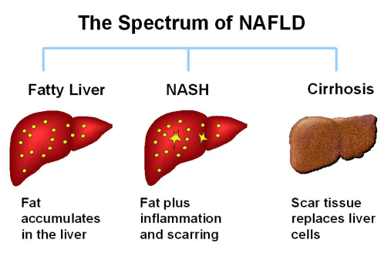
Gastrointestinal
Non-alcoholic fatty liver
  Manifests as increased transaminases
  Vague recurrent abdominal pain
  Ranges from steatosis-fatty liver to NASH which may advance to fibrosis and cirrhosis
  Ultrasound confirms steatosis, need liver biopsy to distinguish between simple fatty liver, NASH or NASH with fibrosis
Notes:
On ultrasound a fatty liver shows up as a brighter-than-normal image. Other ways of obtaining images of the liver include a CT or MRI scan. Both tests
are, however, more expensive than ultrasound and do not provide any extra useful information. Unfortunately, neither the blood tests nor the ultrasound scan can reliably distinguish between simple fatty liver, NASH or NASH with cirrhosis. Accurate staging of the disease and
exclusion of other conditions that cause abnormal liver enzymes, requires a sample of liver tissue to be examined under the microscope. This sample is obtained by liver biopsy.
Insulin resistance seems to play a key role leading to altered glucose and lipid metabolism and ultimately ending in hepatic steatosis which can then progress to NASH Nonalcoholic Steatohepatitis Peeples,P AMSTAR 2008
Prevalence 10-20% Pediatrics 2007
10-30% of obese children , 50 - 75% of morbidly obese
Strongly associated with Obesity & Insulin Resistance
Current Options in Pediatrics, 2005, 17: 636-641
9.6% of US-2-19 yr olds have NAFLD
Schwiimmer JB, et al. Pediatrics, 2006, 118: 1388-1393

Slide 48
Gastrointestinal
Non-alcoholic fatty liver, continued
  Prevalence of
    10-30% in obese children/teens
    40-70% of the morbidly obese
  Commonly seen in association with obesity, IR, DM, HTN, increased triglycerides
  Insulin resistance seems to play a key role leading to altered glucose and lipid metabolism, ultimately ending in hepatic steatosis which can then progress to NASH
Gallstones
  50% cholecystitis is associated with obesity
Constipation
Gastro-esophogeal reflux
Notes:
Insulin resistance seems to play a key role leading to altered glucose and lipid metabolism and ultimately ending in hepatic steatosis which can then progress to NASH Nonalcoholic Steatohepatitis Peeples,P AMSTAR 2008
Prevalence 10-20% Pediatrics 2007
10-30% of obese children , 50 - 75% of morbidly obese
Strongly associated with Obesity & Insulin Resistance
Current Options in Pediatrics, 2005, 17: 636-641
9.6% of US-2-19 yr olds have NAFLD
Schwiimmer JB, et al. Pediatrics, 2006, 118: 1388-1393
48

Slide 49
Psychosocial Complications
Low self-esteem, anxiety, depression, suicide, eating disorders, poor body image, self-destructive behavior, risk-taking, teasing by peers
Overall lower quality of life in obese children, equal to those diagnosed with cancer
Women with BMI > 30 complete fewer years of school, are less likely to marry, have lower household incomes and higher rates of household poverty
Peebles et al, AMSTAR 2008

Slide 50
Medical Complications of Obesity.
Notes:
50
Pulmonary
Restrictive lung disease
Asthma
Sleep apnea
Confirmed by the occurrence of 5 or more episodes of apnea, respiratory-related arousals per hour during sleep, daytime sleepiness
Significant association with future CV disease
Obesity hypoventilation syndrome (pickwickian)
Obesity hypoventilation syndrome is defined as the combination of obesity, hypoxia during sleep and hypercapnia during the day
Sleep deprivation leads to increased insulin resistance, decreased leptin levels, decreased satiety and hence weight gain
GYN
PCOS
Anovulation associated with hyperandrogenism
Greater than 50% are obese with visceral abdominal obesity
Menstrual Irregularities
Early Menarche
DERMATOLOGIC
Candida
Intertrigo
Forunculosis
Acanthosis Nigricans
Stretch Marks
Hirsuitism
ORTHOPEDIC
SCFE
Degenerative Disease of the Spine
Osteoarthritis on weight baring bones
Blount Disease
Chronic excess weight can lead to bowing of the tibia and femur causing overgrowth of the medial aspect of the proximal tibia
NEUROLOGIC
Pseudotumor Cerebri (Idiopathic Intracranial Hypertension) is rare but 59% of children and 91% of teens with IIH are obese
Increased ICP w/o intracranial path c/o HA, can have visual problems, can have papilledema

Slide 51
Cancer Risk
Increased risk of
  Endometrial
  Ovarian
  Post- menopausal breast
  Renal
  Esophageal
  Gallbladder
  Colon cancer
  National Cancer Institute
Notes:
Impaired cell mediated immunity, maturation rates of monocytes/macrophages

Slide 52
What Can We Do?

Slide 53
Medical Doctors:
Key Role in Recognition
Majority of clinicians recognize the importance of pediatric obesity
  2/3 recognize treatment is needed
  Federal Maternal & Child Health Bureau
>50% of providers were concerned but did not know how to approach the problem and felt unprepared and ineffective at addressing it
Caprio, 2006, Future of Children
Majority identified barriers to the treatment
  Lack of patient/parent motivation: 62%-86%
  Lack of time: 31-58%
  Lack of reimbursement: 46-68%
  Felt unprofessionally prepared: ~½ MD
  Pediatrics. 2002
Notes:
Klein, Jonathan Pediatrics 2010 Adoption of BMI guidelines for screening and counseling in pediatric practice:
52% pediatricians assess BMI
Most say they do not have time to counsel on overweight obesity, that counseling has poor results.
23% felt there were good treatment strategies available

Slide 54
Treatment Strategies
Overall best to focus on prevention and weight maintenance, particularly if still growing
Individual
  Improve nutrition
  Increase exercise
Family
  Get involved
School
  Increased PE mandated
  Remove vending machines and improve nutritional standards
Community
  Safe recreational facilities
Notes:
Overall may be best to focus on weight maintenance particularly if they are still growing

Slide 55
Treatment Strategies.
Media
  Can help disseminate health messages and display healthy
  behaviors
  Ban unhealthy food advertising directly
Calorie Counts on Menus
  Diners eat less when see calorie counts
  Labeled menus may affect parents’ food choices for their children American Journal of Public Health 2010, Tandon et al, Pediatrics 2010
MD
  Plot BMI (about 50% pediatricians routinely plot BMI)
  Klein, Pediatics 2010
  Obesity prevention messages
  Assess dietary patterns
  Assess readiness to change
Notes:
Motivational interviewing;
Not yet considering the change: contemplation: preparation: action: maintenance (> 6 months)
Nonjudgmental questions and reflective listening
Nondirective questions: Your BMI is > 30, what concerns if any do you have about your weight
Directive is when you inform the patient of the seriousness of the condition
Peds 2010 Tandon children ages 3-6 parents’ who saw labeled menus ordered an avg of 100 fewer calories for their children than parents in the control group

Slide 56
Recommendations for Obesity Screening
BMI >85-94%
  Fasting lipids
BMI >85-94%ile w/ 2 risk factors (For example, elevated BP, elevated lipids, FH obesity related diseases, smoking)
  Fasting lipids, glucose and AST/ALT
BMI >95%ile
  Fasting lipids, glucose and AST/ALT

Slide 57
Who to Screen for Diabetes Screening (ADA)
Major criteria: Obesity
With two additional minor criteria:
  Family history of T2D
  Belong to high risk/ethnic group (native american, african american, hispanic, asian)
Signs of insulin resistance
  AN, keratosis pilaris, skin tags
Conditions associated with insulin resistance
  Metabolic syndrome, HTN, dyslipidemia, PCOS
Notes:
Metabolic Syndrome > 3 of these: abdominal obesity, Increased BP, TG and low HDL, insulin resistance
AN, KP and skin tags ass w/ IR Pediatrics 2010

Slide 58
Recommendations for Diabetes Screening
Fasting glucose (<100 normal, >126 DM)
  But misses IGT in up to 70%*, which would be detected with a OGTT with a 2 hour postprandial measurement
  So ADA suggests doing both (FG and OGTT) in patients with multiple risk factors Libman, et al. 2008, JCEM
Initiate at age 10 or at onset of puberty because this is the time of increased prevalence
Re-screen every two years if results are normal and yearly if results are consistent with pre-diabetes
Additional tests: HgbA1c, urinary microalbumin
  HgbA1c> 6.5% DM, Pre-Diabetes 5.7%-6.4%
Notes:
2 hour > 200 Dm, 140-199 IGT
Increased prevalence b/c of the natural insulin resistance of puberty due to growth hormone

Slide 59
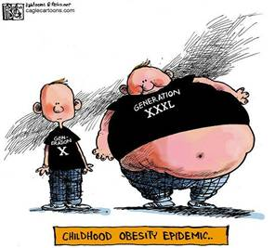
Obesity Interventions
Dietary
Modifications
Exercise
Behavioral
Medical
Surgical

Slide 60
Dietary Recommendations.
General
  Just need to consume fewer calories
Specific Diets: All Work!
  Low Glycemic Diets
  Protein slows digestion and increases satiety
  Milk/dairy products may exert positive effect on body weight perhaps by binding fat in the gut by calcium
    Tabacchi et al, Nutrition Research 2007
Avoid Fad Diets
Notes:
Low Glycemic Diet:
In patients who are insulin resistant best to recommend low glycemic index diet to regulate insulin secretion
Trend towards diets containing lower proportion of fats, higher proportion of low glycemic carbohydrates and more fiber
Ludwig from Harvard Low glycermic diet The glycemic index (GI) is a numerical system of measuring how much of a rise in circulating blood sugar a carbohydrate triggers–the higher the number, the greater the blood sugar response. So a low GI food will cause a small rise, while a high GI food will trigger a dramatic spike

Slide 61

Dietary Recommendations
Infant Feeding
  Breast feeding is protective against childhood obesity
  Longer duration of breast feeding
  Delay introduction of solid foods
  Tabacchi et al , Nutrition Research 2007
Notes:
Longer duration of breast feeding associated with less obesity in childhood: children breast fed for >12 months are less obese than children breast fed for only 2 months
Delay introduction of solid foods: early introduction of solid food (before 6 months) corresponds to an increase percentage of body fat by age 7

Slide 62
Dietary Recommendations
Current evidence:
  Increased fast food and sweetened beverage consumption is associated with increased BMI
  Weak association between 100% fruit juice consumption and excessive weight gain
Krebs et al, Pediatrics 2007
The AAP concluded that 100% fruit juice had no beneficial effect over whole fruit for infants > 6 months of age
  Limit juice to 4-6 ounces age 1-6 and 8-12 ounces for older children
Notes:
AAP committee on nutrition 2001

Slide 63
Dietary Recommendations
Limit Portion Size
Avoid saturated fats and trans fats
  associated with increased risk of CV disease and T2D
Fruits and Veggies
  High in fiber and water content and may promote satiety
Family Meals
  Associated with a higher quality diet and lower obesity prevalence
Eating breakfast
  There is a positive association between skipping breakfast and an increased BMI in children
  Barlow et al Pediatrics 2007

Slide 64

Exercise
Exercise: Family Affair
  Recommendations
  60-90 minutes/day, ideally
  in schools
Decrease Inactivity
  Turn off TV, video and
  computer games, < 2 hrs
  per day combined
  Family walks
  Interactive TV programs and
  video games: dance
  dance revolution,
  Wii, Wii Fitness

Slide 65
Why Exercise?.
"Americans need to understand that overweight and obesity are literally killing us.“ Tommy Thompson former Secretary of Health and Human Services
Major impact on health
  Decreases visceral fat
  Reduces risk of chronic diseases
  Delays physical changes of aging
  Critical for weight maintenance after weight loss
  There is some evidence that >250 minutes/week of moderate-intensity physical activity will prevent weight re-gain ACSM
Notes:
Physical inactivity rates with cigarette smoking, poor diet and alcohol misuse as a major health risk factor
100,000 preventable deaths a year are due to poor eating habits and physical inactivity
Visceral fat:
Physical inactivity leads to a significant increase in visceral fat (hypertension, cardiovascular disease, hyperinsulinemia, diabetes mellitus, gallbladder disease, stroke, and cancer of the breast and endometrium.)
Waist Circumference: Women<35, Men<40
Duke study: low-intensity exercise prevents visceral fat accumulation, but high-intensity exercise is needed to reduce it.
Sedentary lifestyle increases visceral fat independent of weight gain-Duke study
Changes with age:
Over age 20, one half a pound of muscle is lost every year – results in one half percent decrease in metabolic rate annually
Decreased flexibility
Decreased bone density females > males. Exercise increases bone acquisition in youth, by age 18 skeletal growth nearly complete. Most studies of pre-menopausal women demonstrate a positive bone benefit from exercise, with greater loading and higher impact activities producing the greatest skeletal benefit. Exercise continues to confer a skeletal benefit for many postmenopausal women. However, there is no evidence that physical activity alone is sufficient to fully offset the damaging effects of estrogen withdrawal in the first three to five years following menopause. Once the phase of accelerated bone loss is complete, regular exercise can have a protective effect on bone. (exercise and bone health ).
Kathleen Sebelius (née Gilligan, born May 15, 1948) is an American politician currently serving as the 21st Secretary of Health and Human Services

Slide 66

Benefits of Exercise.
Overall Well-being
Cardiovascular
Neurologic
Psychological
Immunologic
Endocrine
Orthopedic
Decreases Cancer Risk
Vigorous exercise programs in young children have multiple health benefits without effecting BMI Bernard Gutin
Notes:
GENERAL:
Weight reduction/maintenance
Increased energy but sleep better
Moderate exercise can help decrease appetite
Higher levels of regular exercise are associated with lower mortality in all age groups (CDC)
CARDIO:
Decreases risk of coronary artery disease
Decreases blood pressure, risk of stroke
Improves lipid profile: higher HDL, lower LDL and triglycerides
Decreases heart rate/Increases stroke volume: Improves myocardial function
NEURO:
Older women who were physically active, walking at a leisurely pace 2-3 hours/week, performed much better on tests of memory and thinking ability than inactive women (Harvard School of Public Health)
Exercise may protect against dementia and Alzheimer's Disease (Lancet)
PSYCH:
Decreases symptoms of anxiety and depression
Improves mood
Relieves stress
IMMUNO:
Moderate physical activity reduces risk of getting colds (American college sports med) by 25%
ENDO:
Decreases risk of developing Type 2 Diabetes- 5% reduction in weight decreases chance of getting diabetes by 60%
Improves glucose tolerance
Lean muscle is more insulin sensitive
ORTHO:
Helps maintain healthy joints/flexibility
Improves mobility and strength
Decreases risk of developing arthritis
Improves bone density
CANCER: American Institute Cancer Research
10 to 30 percent risk reduction for prostate cancer
30 to 40 percent risk reduction for breast, endometrial and lung cancer
40 to 50 percent risk reduction for colon cancer.
youths who engage in more than one hour per day of vigorous physical activity tend to be relatively lean and ingest more energy than youths who engage in lesser amounts of vigorous physical activity; (3) interventions that feature vigorous physical activity have favorable effects on percent body fat, visceral adipose tissue, bone density, cardiovascular fitness, and cardiometabolic risk profile; and (4) there is a dose-response relationship between physical activity and cardiometabolic health, such that larger volumes and intensities of physical activity lead to greater benefits.

Slide 67
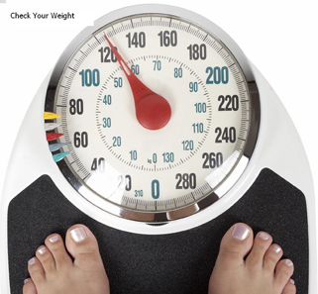
Behavioral Interventions
Comprehensive moderate to high intensity behavioral interventions resulted in a modest decrease in BMI (1.9-3.3) 12 months after the beginning of the intervention
  Involved more than 25 hours of contact with the child and or the family
  Took place over a six month period
Notes:
USPSTF UNITED STATES PREVENTIVE SERVICES TASK FORCE Comprehensive= Counseling for weight loss/healthy diet, counseling for PE or a PE program, instruction in and support for use of behavioral management techniques ( self-monitoring, stimulus control, eating management, and CBT) to help make and sustain changes in diet and PE. Modest change in BMI after 6 months (1.9-3.3) in 1258 mostly obese 4-18 year olds
Epstein Studies: Clinic based 6-12 year olds
Weekly meetings for 8 weeks, followed by monthly meetings for 12 months
Compared parental participation, exercise, and diet interventions
At 5 and 10 year follow-up found significant decreases in overweight with all treatment groups, best in groups with parental participation and lifestyle exercise
Adult programs show successful short term results but less convincing long term results Krebs, Pediatrics 2007 and only achieve a 10-15% total weight loss, Addition of exercise imp in maintenance of weight loss.
Bright Bodies at Yale
Study Group2 x week for 6 months Exercised 2-50 mins, Nutrition /Behavior 40 mins per week Weighed weekly
Diet Better food choice Parents/Caregiver participated Every other week for an additional 6 months
Results: No weight gain over 12 months, but growth fall in BMI, –1.7(-2.3 to –1.1)3.7 kg in body fat (4%)
Control Group
Pediatric Obesity Clinic every 6 months Received diet & exercise counseling by RD, Physician visit along with psychosocial counseling by social worker Caregiver present
Results: Body weight , body fat & % body fat increased Difference BMI –3.3, body weight –7.4 kg, body fat –9.2 kg (6%). Improved TC, IS (HOMA), SBP
Savoye, M, et al. JAMA 2007; 297: 2697-2704

Slide 68
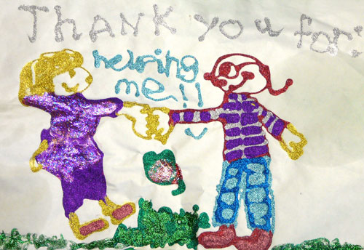
Behavioral Interventions:
USPSTF Recommendations
Screening children age 6 and older for obesity and then, if obese, offering referral for intensive counseling and behavioral interventions
Pediatrics, on line 2010
Notes:
USPSTF UNITED STATES PREVENTIVE SERVICES TASK FORCE Comprehensive= Counseling for weight loss/healthy diet, counseling for PE or a PE program, instruction in and support for use of behavioral management techniques ( self-monitoring, stimulus control, eating management, and CBT) to help make and sustain changes in diet and PE. Modest change in BMI after 6 months (1.9-3.3) in 1258 mostly obese 4-18 year olds
Epstein Studies: Clinic based 6-12 year olds
Weekly meetings for 8 weeks, followed by monthly meetings for 12 months
Compared parental participation, exercise, and diet interventions
At 5 and 10 year follow-up found significant decreases in overweight with all treatment groups, best in groups with parental participation and lifestyle exercise
Adult programs show successful short term results but less convincing long term results Krebs, Pediatrics 2007 and only achieve a 10-15% total weight loss, Addition of exercise imp in maintenance of weight loss.
Bright Bodies at Yale
Study Group2 x week for 6 months Exercised 2-50 mins, Nutrition /Behavior 40 mins per week Weighed weekly
Diet Better food choice Parents/Caregiver participated Every other week for an additional 6 months
Results: No weight gain over 12 months, but growth fall in BMI, –1.7(-2.3 to –1.1)3.7 kg in body fat (4%)
Control Group
Pediatric Obesity Clinic every 6 months Received diet & exercise counseling by RD, Physician visit along with psychosocial counseling by social worker Caregiver present
Results: Body weight , body fat & % body fat increased Difference BMI –3.3, body weight –7.4 kg, body fat –9.2 kg (6%). Improved TC, IS (HOMA), SBP
Savoye, M, et al. JAMA 2007; 297: 2697-2704
68

Slide 69
School Based Programs
Planet Health, an interdisciplinary program, targets decreased fat consumption, increased fruit and vegetable consumption, promotes physical activity and limits TV
  Over two years, the prevalence of obesity decreased in girls in the intervention group versus the control group
  Success thought to be due to reduced TV viewing
Other school based programs have not decreased obesity prevalence
Ebbeling et al, The Lancet, 2002
Notes:
Most SB programs focus on fat consumption even though fat might not be an important cause of obesity and they have programmed exercise prescription even though increasing lifestyle activity might be better for long term weight control.
The prevalence of obesity has increased despite the apparent decrease in the proportion of the total calories consumed as fat in the diet of US children. However, In many low-income countries, the percentage of fat energy in the everyday diet increases in people who reach a higher socioeconomic level, and this is accompanied by an increased prevalence of overweight and obesity. The passive over-consumption of energy-dense, high-fat diets combined with the decline in physical activity are the two main factors that account for the rising prevalence of obesity. The latter probably explains why several epidemiological studies report a trend of a decreased fat consumption in United States, while obesity prevalence is rising (1). The well-documented fact of dietary underreporting by obese people (2), however, is to be taken into account when assessing the results of such epidemiological studies, because worldwide the prevalence of overweight and obesity is significantly related to the percentage of fat energy in the diet Jequier, Is fat intake a risk for fat gain in children J clinical Endocrinoly metab 2001
However, a high intake of lipids is often associated with weight increase, the Women’s Health Initiative showed that over 7.5 years, reductions in the proportion of energy derived from fat were associated with reductions in body weight . The National Institutes of Health (NIH) established the Women's Health Initiative (WHI) in 1991 to address the most common causes of death, disability and impaired quality of life in postmenopausal women.
Type of fat consumption is associated w/ obesity related morbidities, CV DM ass w/ trans and saturated fat
Unsaturated fat consumption from veggies and marine sources decreased the risk of these diseases
Ebbeling, The Lancet 2002

Slide 70
Energy Up: Pilot Program 2003-2004
Voluntary weekly two hour after-school program
  All-girl parochial high school in Washington Heights, NYC
  Employs psycho-educational skills building
  Focuses on addictive food avoidance, exercise and self esteem building
Outcome measurements:
  Level of participation
  Changes in weight and body mass index (BMI)
Chehab et al, Journal of Adolescent Health, 2007
Notes:
We evaluated “Energy Up,” an innovative program for inner-city girls that focuses on addictive food avoidance, exercise, and
self-esteem building. Over a 9-month period, obese participants lost 12.9 pounds and overweight
participants lost 2.9 pounds, prompting expansion to other schools.

Slide 71
Components of the Program
15-30 minutes of health education
60 minutes of aerobic workout
Healthy food tastings
Positive affirmations
On-site physicians
Incentives
Parental involvement
Local and national media coverage

Slide 72



Energy Up: Pilot Program 2003-2004
Obese Participants lost 12.9 lbs and Overweight Participants lost 2.9 lbs
Notes:
Program ran for 9 months
72

Slide 73
Results
In girls who attended 2 of more sessions
Mean age 14.4, expect some weight gain
Notes:
One year follow up showed promising results and we hope to continue to study various aspects of this program
might say that we attempted a follow-up study using an extra-curricular group as a control, but by that time EU was so pervasive in the entire school culture. It was hard to find a comparable group that did not have many former EU members

Slide 74
Results
So promising that it prompted expansion to other schools
Attempted a follow-up study using an extra-curricular control group but by that time Energy Up was so pervasive in the entire school culture it was hard to find a comparable group that didn’t have many former Energy Up members

Slide 75

Medical Treatment
Medications recommended as an adjunct to therapy
  BMI > 30
  OR
  BMI 27-30 and co-morbid condition
Medications can lead to a 10% weight loss at best
Effects tend to level off after six months of use
Notes:
Effects level off mayo clinic

Slide 76
Medical Treatments for Obesity
  Sibutramine (Meridia) approved > 16yrs
    Starting dose 5-10mg per day may increase to 15mg per day
    Blocks re-uptake of norepinephrine, serotonin, and dopamine
    Side effects include dry mouth, constipation, insomnia, and an increased heart rate and blood pressure
  Orlistat (Xenical) approve >12 yrs
    120mg PO TID
    Inhibits absorption of dietary fat
    Side effects include stomach cramps, diarrhea and malabsorption of fat-soluble vitamins
  Metformin
    Produces weight loss in obese adolescents with insulin resistance and hyperinsulinemia
Notes:
Peds 2010 US Preventive Services Task Force Combined found med and behavioral interventions led to modest short term improvement in weight in children 12 years and older. No long term data on the maintenance of improvement after the discontinuation of the meds. Behavioral plus meridia led to BMI decrease of 1.6-2.7 greater than in those treated w/ only behavior therapy.

Slide 77
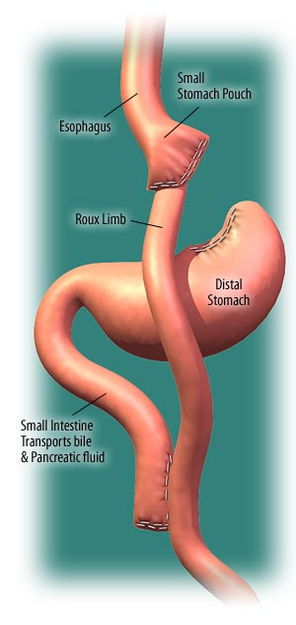
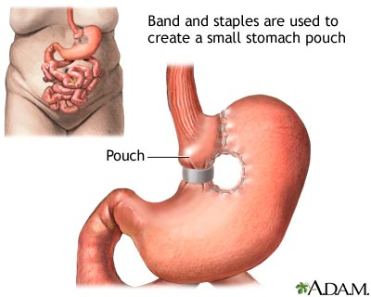
Surgical Treatments for Obesity
Bariatric Surgical Options
  Gastric Bypass Roux-en-Y
    Most popular
  Gastroplasty
    Decreasing stomach size
  Gastric Banding
Risks associated
  Infection
  Intestinal obstruction
  Vitamin deficiencies
  Gallstones
  Dumping syndrome
  Mortality in <1%

Slide 78
Surgical Treatment
Bariatric surgery recommended if all other attempts at weight loss have failed and your patient has:
  BMI > 40 w co-morbid DM, sleep apnea, pseudotumor OR
  BMI > 50 w/ less serious co-morbidities
Maturity level must be considered
  Physical Maturity
    Generally 13 for girls and 15 for boys
  Emotional and cognitive maturity
Must have a good social support
Notes:
When a portion of the stomach is removed, the hormone ghrelin decreases which leads to a decrease in appetite

Slide 79

Societal Implications and Interventions

Slide 80

$ Obesity Dollars $.
Health problems attributed to obesity are estimated to cost $147 billion in 2008
Hellmich USA Today 1/12/10
Estimated diabetes costs in the US in 2008 $174 billion
YET…
  The government subsidizes the marketing of junk food and fast food
  In 2006, McDonald’s spent $1 million every day on advertising aimed at American children, legally a tax-deductible business expenditure
Notes:
Some health advocates have long argued that taxing sugared beverages not only would cut calorie consumption by children but also would raise money for health care and education needs

Slide 81
Collaboration is the Key:
LET’S WIN THE WAR
Consistent messages about health and fitness delivered to all children from families, teachers, schools, religious communities, corporations and health professionals
Easy access to healthy food
Ample opportunity for physical activity
Focus on prevention of overweight/obesity

Slide 82
WE HAVE ALWAYS KNOWN THE SOLUTION…..

Slide 83
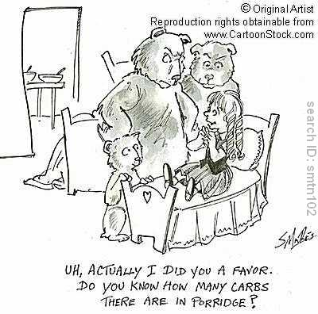
EVEN GOLDILOCKS KNEW

Slide 84
IT IS THE IMPLEMENTATION THAT HAS BEEN CHALLENGING BUT.... MAYBE A CHANGE IS IN SIGHT

Slide 85
Michelle Obama’s Campaign
LET’S MOVE.
Components of the Initiative
  Helping parents make healthy food choices
  Improving the quality of school meals
  Improving access to affordable, healthy foods
  Increasing physical activity
Involvement of politicians, entertainers and sports personalities to get the message across. Parents, businesses, schools and local government will need to increase their efforts as well
President Obama created a task force to fight childhood obesity with orders to come up with a plan in 90 days…
HOPEFULLY, WE WILL FINALLY WIN!!!
Notes:
The three major suppliers of school lunches — Sodexo, Chartwells Schools Dining Services and Aramark — pledged Tuesday to reduce the amount of fat, sugar and salt in their meals over the next five years. Beverage makers promised more consumer-friendly labeling on all cans, bottles, and vending and fountain machines within two years.
The American Academy of Pediatrics called on doctors to measure body mass index, an indicator of obesity, in children. Professional athletes from 12 leagues, including football and baseball, have volunteered to promote the message of “60 Minutes of Play a Day” through public service announcements; media companies including the Walt Disney Company and NBC have pledged to broadcast them.
include more healthful food in schools, more accurate food labeling, better grocery stores in communities that don't have them, public service announcements and efforts to get children to be more active. Some of her plans, such as tax incentives for businesses, will need congressional approval.
* The American Beverage Assn. has committed to putting front-of-pack calorie labels on cans, bottles, vending machines and soda-fountain machines within two years.
* The American Academy of Pediatrics says it will call on members to regularly monitor body mass indexes for children age 2 and older.
* Major food suppliers to school cafeterias have pledged to cut sugar, salt and fat and increase whole grains and produce.
* About 40 executives of major food producers and agribusinesses indicated in an open letter that they would join the first lady in promoting healthy eating. Among the signers: the chief executives of Kraft Foods and Sara Lee Corp.
* Major media companies including the Walt Disney Co., NBC, Universal and Viacom committed to join Michelle Obama's effort by running public service announcements. And professional athletes will join the chorus of voices urging kids to put away the video games and to get some exercise.
By the year's end, the Food and Drug Administration will begin working with retailers and manufacturers to adopt new nutrition labels that will be displayed on the front of food packages.

