Slide 1
The Role of Aerosols in Climate Change
and Climate Mitigation
James Hansen*
31 August 2026
Xi’an, China
*Director, Climate Science, Awareness & Solutions, Columbia University Earth Institute
Notes:
I thank my good friend, Junji Cao, for the invitation to talk about aerosols and climate. Junji is amazing – not only as a top-ranking scientist, but also in helping governments understand important issues. Climate change is such an issue and aerosols play a big role in the climate story.

Slide 2

Michael Mishchenko
(1960-2020)
Notes:
I also want to pay tribute to the late Michael Mishchenko. Michael was a brilliant scientist, the best physicist I knew, and the leading expert in light scattering by complex, non-spherical, particles. He set upon an even harder task of measuring the climate forcing by aerosols, which is very hard because the larger part of the forcing is probably the effect of aerosols on clouds. I have a big regret in not being able to obtain the institutional support he needed to achieve satellite monitoring of aerosol forcing. Despite that, Michael made major contributions to the science of light scattering and aerosols. He was an enthusiastic, inspirational person, and we miss him.

Slide 3
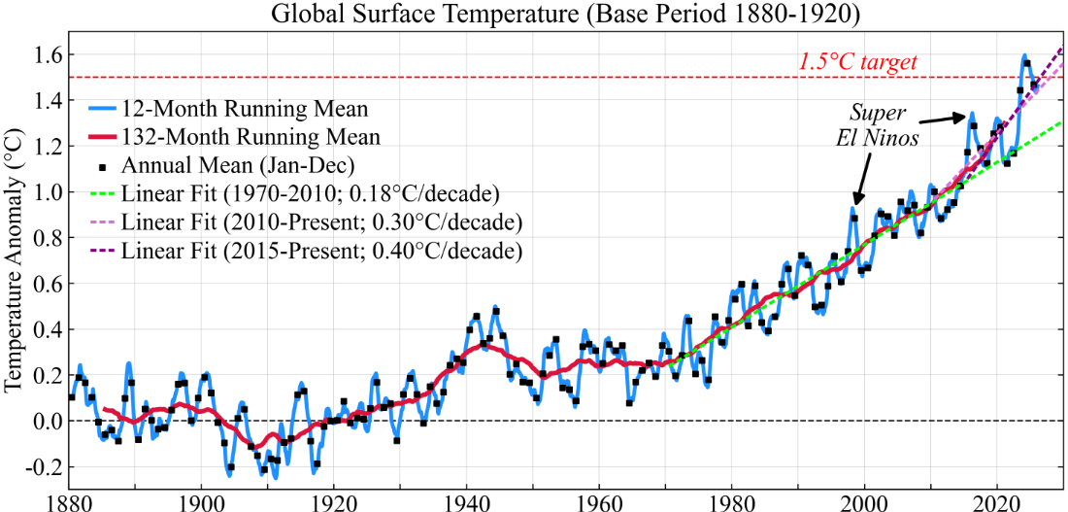
GISS temperature analysis. Temperature anomaly in 1940-1946 is likely exaggerated due to WWII data inhomogeneity over the ocean; Fig. A2c, Hansen J, Sato M, Kharecha, et al., Young people’s burden: requirement of negative CO₂ emissions, Earth Syst Dyn 8, 1-40, 2017
Notes:
Climate is changing. The world is getting warmer, and the rate of warming has accelerated in the past decade, approximately doubling, consistent with observed doubling of Earth’s energy imbalance. Climate change is more important than the public realizes, because they have only seen the beginning. Our climate system is characterized by delayed response and amplifying feedbacks, which are a recipe for intergenerational injustice. So, as scientists we have an obligation to clarify the climate situation to governments and to not shirk from describing policy implications.

Slide 4
Greenhouse gas forcing and IPCC estimated aerosol forcing.
Notes:
To carry out that responsibility, the first thing we must know is the forcing that is driving climate change. A climate forcing is an imposed change to Earth’s energy balance. There are two climate forcings that dominate over all others, and both of these are human-made. Greenhouse gases, which cause warming, and aerosols, which increase the reflection of sunlight to space, so they cause global cooling. Greenhouse gases are measured precisely and greenhouse forcing can be calculated accurately. Unfortunately, the aerosol forcing is not measured. I will discuss where this guesstimate, the blue curve, came from in a moment, but first let me note that aerosol cooling may sound like a good thing, but it is a Faustian bargain.

Slide 5
Because of climate’s delayed response, the Faustus generation pays a bit for its pleasures.
But a bigger debt is willed to young people.
Young people need to understand the situation and affect their future.
Notes:
Because of climate’s delayed response, a debt is being built up for young people to pay. The current generation benefits from aerosol cooling, but that offset of greenhouse warming will not continue because aerosols have a huge impact on human health that humanity will not tolerate. And as aerosol pollution is reduced, the Faustian payment comes due and global warming accelerates, as it is today. So, the question arises, how big is the Faustian debt, in other words, how large is the aerosol forcing today?

Slide 6
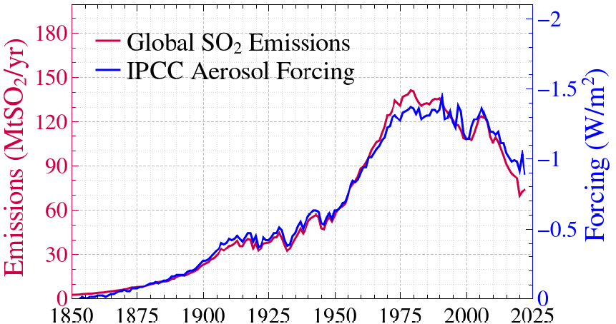
Global SO₂ emissions and IPCC’s best estimate of aerosol forcing
From “Global warming has accelerated: are the United Nations and the public well-informed?” Environment, 67(1), 6-44, 2025
SO₂ emissions from R.M. Hoesly et al., Community Emissions Data System(CEDS), Geosci. Model Dev. 11, 369–408, 2018.
Notes:
It’s clear where the SHAPE of the IPCC aerosol forcing comes from. Here is the global SO2 emissions in the CEDS data base plotted with IPCC’s best estimate of the aerosol forcing. Assuming that sulfates are the dominant human-made aerosol, this estimate for the temporal shape of the aerosol forcing would be reasonable, IF the aerosol forcing were due only to reflection from aerosols -- because that effect is nearly linear. However, the indirect aerosol forcing, via the aerosol effect on clouds, is probably larger than the direct aerosol forcing. And it is very nonlinear – adding more aerosols to polluted air has much less effect than adding aerosols to more pristine air.

Slide 7
Greenhouse gas forcing and IPCC estimated aerosol forcing.
Notes:
The GHG forcing began increasing rapidly in 1950, but the aerosol forcing largely offset the GHG forcing until 1970. Then, according to IPCC, the aerosol forcing stopped increasing in 1970, and the net forcing began to increase steeply after 1970. As a result…

Slide 8
Notes:
temperature increased after 1970, almost 2 tenths of a degree Celsius per decade. Climate modelers liked this interpretation – that aerosol forcing stopped increasing – because, if GHGs are the only changing forcing, the climate sensitivity required to match observed warming is 3 degrees Celsius for doubled CO2. Three degrees is the easiest climate sensitivity to get from a climate model. The water vapor and sea ice feedbacks and a small cloud feedback from poleward expansion of climate zones yields 3 degrees. There is no need to do realistic cloud modeling with cloud microphysics, which is very hard. So, all modelers were fat and happy. They thought they understood global warming, including us at the Goddard Institute, I must confess.

Slide 9
Greenhouse gas forcing and IPCC estimated aerosol forcing.
Notes:
Unfortunately, there was a fly in the ointment. Aerosol indirect forcing is NOT proportional to global aerosol amount. When Susanne Bauer developed an aerosol/cloud model and put in the changing geographical sources for the aerosols, which were mainly over the U.S. and Europe in the 1950s and 60s, but spread to India and China and to an increased ocean area, she found, with her most realistic model, that the aerosol forcing increased, became more negative by half a watt, between 1970 and 2005. That changes the story dramatically.

Slide 10
Notes:
The NET forcing becomes smaller, so higher climate sensitivity is required to match observed global warming, a sensitivity between 4 and 5 degrees for doubled CO2. How did we get in this mess? By, de facto, trying to infer two quantities – climate sensitivity and aerosol forcing – from one constraint: observed warming. IPCC focuses heavily on this modern temperature change and GCM modeling, but that approach cannot yield a unique solution. We need more information, preferably measurement of aerosol forcing, but failing that, we can use paleoclimate data and modern observations of critical processes.

Slide 11
Equilibrium Climate Sensitivity (ECS)
Charney et al. (1979) estimated eventual global warming for doubled atmospheric CO₂ as:
3°C ± 1.5°C
Notes:
So, let’s talk about climate sensitivity. I will go through this quickly, as it’s tangential to aerosols, but climate sensitivity is the most fundamental climate issue. Charney sensitivity refers to the case in which ice sheets on Greenland and Antarctica are fixed. Charney’s estimate had a huge uncertainty, from 1.5 to 4.5 degrees. Today, the best estimate of IPCC is still 3 degrees.

Slide 12
Feedbacks Alter Equilibrium Climate Sensitivity (ECS)
1. With no climate feedbacks, a 4 W/m² forcing requires
ΔT = ECS = 1.2°C
2. Water vapor and sea ice feedbacks approx. double ECS
ECS → 2.4°C
3. Cloud (& water vapor) feedbacks varied in the models Charney examined ECS → 2-4°C
The algebra is simple: ECS = 1.2C/(1 – g). Total feedback gain, g = g_{wv} + g_{si} + g_{cl}, where g_{wv} = 0.4, g_{si} = 0.1, and g_{cl} ranged from 0 to 0.2 in the models Charney had.
Notes:
If there were no climate feedbacks, sensitivity, ECS, would be 1.2 degrees, the warming needed to radiate 4 W/m2. Water vapor and sea ice feedbacks approximately double ECS to 2.4 degrees. Cloud feedback is the big uncertainty. Charney based his estimate on two GCMs that differed in their treatment of moist convection, that’s cumulus convection, as I will discuss later.

Slide 13
Equilibrium Climate Sensitivity (ECS)
1. Paleoclimate: Last Glacial Maximum
Last Glacial Maximum cooling 6-7°C → ECS = 4-5°C for 2xCO₂
2. Earth’s Darkening: 2 W/m² in 25 years
Cloud Albedo decrease implies large amplifying cloud feedback
3. Global Temperature Change Since 1850
Best fit occurs with ECS 4-5°C for 2xCO₂
4. Planetary Evolution
Last Snowball Earth, 600 Million years ago, suggests ECS 4-5°C
Notes:
I will conclude, with more than 99 percent certainty, that climate sensitivity is higher than 3 degrees, based on four independent evaluations. Paleoclimate should provide out best measure of climate sensitivity because we can compare two equilibrium climate states. If we know the forcing that maintains the climate change, we have a direct measure of climate sensitivity.

Slide 14
CO₂ amount (Luthi et al.) and Antarctic Dome C temperature (Jouzel et al.) from ice cores.
Recent studies of Tierney et al., Osman et al. and Seltzer et al. provide accurate evaluation of global LGM (last glacial maximum) temperature.
Notes:
Ice core data reveal atmospheric composition during the last glacial maximum, the LGM, 20,000 years ago, but we also need GLOBAL ice age temperature to infer sensitivity. The large CLIMAP and MARGO projects estimated that the LGM was only 3-to-4 degrees colder than the Holocene, based on the distribution of microscopic species in the ocean, a dubious measure of temperature. Recently, Jessica Tierney used CHEMICAL proxies, finding that the LGM was 6-to-7 degrees colder than the Holocene. And Alan Seltzer used noble gas abundance in groundwater deposited during the ice age, and found temperatures consistent with 6-to-7-degree global cooling.

Slide 15
Peak LGM (21-18 kyBP) cooling = 7.0 ± 1°C (2σ, 95% confidence)
LGM surface albedo forcing = 3.5 ± 1.0 W/m² (2σ)
LGM Greenhouse gas forcing = 2.25 ± 0.225 W/m² (2σ)
Climate Sensitivity = 7.0/(3.5+2.25) = 1.2 ± 0.3°C per W/m² (2σ)
= 4.8 ± 1.2°C for 2×CO₂ (2σ)
Excludes IPCC best estimate (3°C for 2×CO₂ ) at 3σ (99.7% confidence)
Notes:
The upshot of 6-to-7-degree LGM cooling is climate sensitivity near the upper end of Charney’s range. Paleoclimate data by itself, excludes 3-degree climate sensitivity with more than 99 percent confidence.

Slide 16
Equilibrium Climate Sensitivity (ECS)
1. Paleoclimate: Last Glacial Maximum
Last Glacial Maximum cooling 6-7°C → ECS = 4-5°C for 2xCO₂
2. Earth’s Darkening: 2 W/m² in 25 years
Cloud Albedo decrease implies large amplifying cloud feedback
3. Global Temperature Change Since 1850
Best fit occurs with ECS about 4.5°C for 2xCO₂
4. Planetary Evolution
Last Snowball Earth, 600 Million years ago, suggests ECS 4-5°C
Notes:
Source number 2 is the rapid, strong, darkening of Earth in the past 25 years.

Slide 17
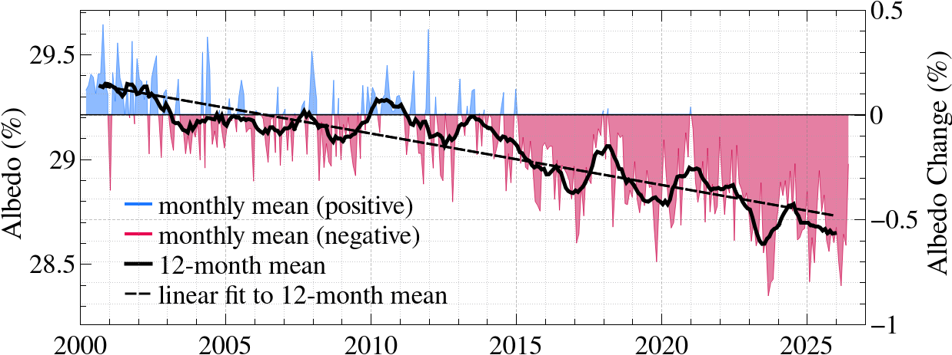
Earth’s albedo (reflectivity, in percent), seasonality removed
The darkening of Earth as seen from space is an increase of 2 W/m2 of absorbed solar energy, averaged over the planet. Data are from the CERES (Clouds and Earth’s Radiant Energy System) instruments (NG Loeb, GC Johnson, TJ Thorsen et al., “Satellite and ocean data reveal marked increase in Earth’s heating rate,” Geophys Res Lett 48, e2021GL093047, 2021).
Notes:
Satellite data show that Earth’s albedo, its reflectivity, decreased half a percent in the last 25 years, so sunlight absorbed by Earth increased 2 watts per square meter. That’s a big deal, but don’t double-count it. This is not a 2-watt climate forcing – most of this is climate feedback.

Slide 18
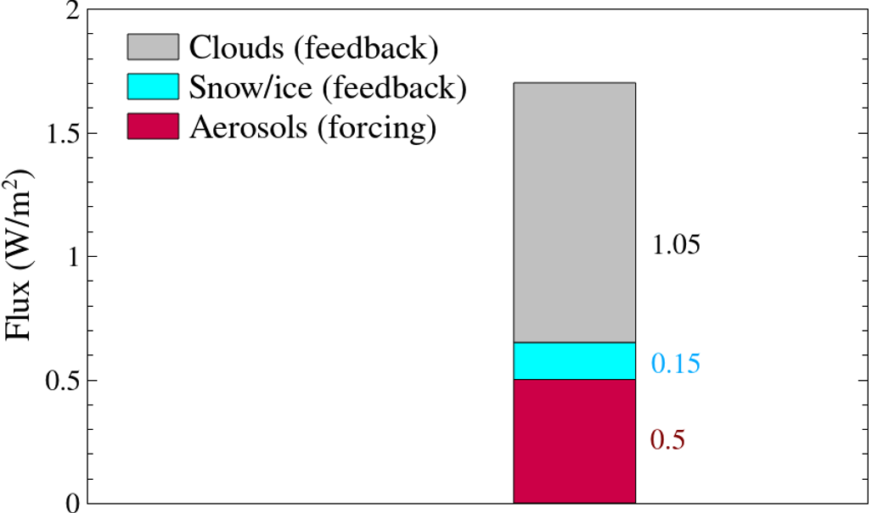
Contributions to Earth albedo change estimated from CERES data
Notes:
Part of the albedo change is due to decreased aerosols, which is a forcing that might be as large as about half a watt. But most of it has to be cloud feedback. Such a large cloud feedback implies high climate sensitivity, surely larger than 3 degrees, but it’s hard to say exactly based on this nonequilibrium change, until the data record is longer.

Slide 19
Equilibrium Climate Sensitivity (ECS)
1. Paleoclimate: Last Glacial Maximum
Last Glacial Maximum cooling 6-7°C → ECS = 4-5°C for 2xCO₂
2. Earth’s Darkening: 2 W/m² in 25 years
Cloud Albedo decrease implies large amplifying cloud feedback
3. Global Temperature Change Since 1850
Best fit occurs with ECS about 4.5°C for 2xCO₂
4. Planetary Evolution
Last Snowball Earth, 600 Million years ago, suggests ECS 4-5°C
Notes:
Source number 3, global temperature for the past century, has limitations, as I discussed, but if you look at the ENTIRE PERIOD since 1850, including the rapid warming in the last decade, that provides some discrimination, and a sensitivity of 4-to-5 degrees is the best fit.

Slide 20
Ambiguity from Unmeasured Aerosol Change
1. IPCC’s aerosol forcing (little change in 1970-2005)
Best match with observed 1970-2005 warming → ECS = 3°C
2. Increase of aerosol cooling (−0.5 W/m²) 1970-2005
Best match with observed 1970-2005 warming → ECS = 4.5°C
3. Increase of aerosol cooling (−1.0 W/m²) 1970-2005
Best match with observed 1970-2005 warming → ECS = 6°C
Best fit to 1850-2024 global temperature slightly favors case 2 (ECS = 4.5°C).
Best Bauer et al. (2020) aerosol model also favors case 2 (ECS = 4.5°C).
Notes:
To clarify that, we compared 3 cases. IPCC’s aerosol forcing, Bauer’s model with its most realistic aerosol physics, and a model with even stronger aerosol cooling. The best fit to observed temperature is obtained with the intermediate aerosol forcing and climate sensitivity 4-to-5 degrees.

Slide 21
Equilibrium Climate Sensitivity (ECS)
1. Paleoclimate: Last Glacial Maximum
Last Glacial Maximum cooling 6-7°C → ECS = 4-5°C for 2xCO₂
2. Earth’s Darkening: 2 W/m² in 25 years
Cloud Albedo decrease implies large amplifying cloud feedback
3. Global Temperature Change Since 1850
Best fit occurs with ECS about 4.5°C for 2xCO₂
4. Planetary Evolution
Last Snowball Earth, 600 Million years ago, suggests ECS 4-5°C
Notes:
Information source number 4, planetary evolution, is interesting. To appreciate it, let’s go back to Charney’s 1979 study.

Slide 22
Equilibrium Climate Sensitivity (ECS)
Charney et al. (1979) estimated eventual global warming for doubled atmospheric CO₂ as:
3°C ± 1.5°C
Of the models Charney considered, models with penetrating moist (cumulus) convection yield higher climate sensitivity.
Notes:
Charney focused attention on moist convection, cumulus convection, which lifts moisture and heat from low levels to the upper troposphere, reducing low clouds and increasing upper-level water vapor and cirrus clouds. In Charney’s study, models using layer-average adiabatic adjustment to move water vapor and heat vertically yielded sensitivity near 2 degrees. Models that parameterized moist convection, allowing moisture and heat to penetrate to higher levels, yielded 4 degrees. Charney took the average of these as his best estimate.

Slide 23
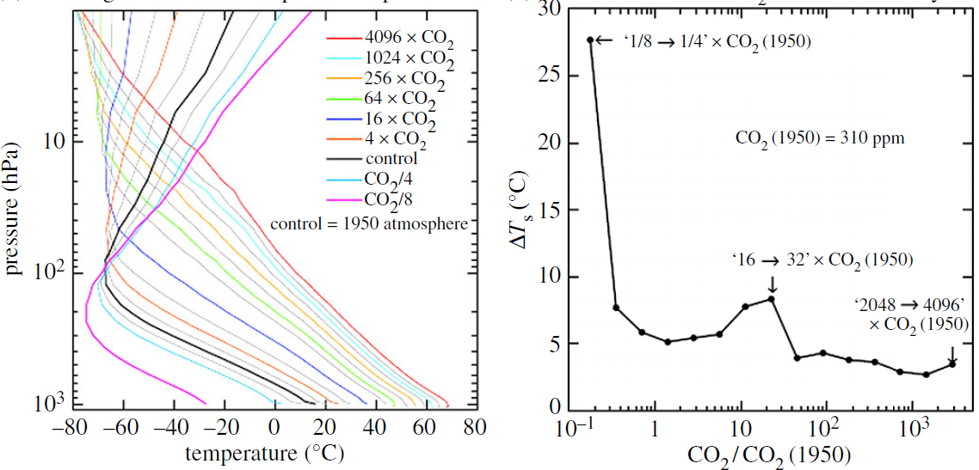
Global Atmospheric Temperature Earth System Sensitivity (ESS)
Earth System Sensitivity (ESS) in Russell version of GISS GCM (G.L. Russell et al., GRL 40, 2013; Figure is from J. Hansen et al., Phil Trans Roy Soc A 371, 2013). Doubled CO₂ and +2% Solar Irradiance are each an effective climate forcing of 4 W/m².
Earth System Sensitivity is larger than ECS, as ESS includes changing ice sheet size. Runaway snowball-Earth occurs at 1/8 CO₂, i.e., at forcing −12 W/m². Cloud and water vapor feedbacks increase as the tropopause rises, until the tropopause disappears.
Notes:
We can examine climate sensitivity and indirectly test the effect of cumulus convection thanks to a version of the GISS model developed by Gary Russell that can be used for a wide range of climates. Runaway snowball-Earth occurs in the model when CO2 declines to one-eighth of 1950 CO2, a forcing of minus 12 W/m2, equivalent to a 6 percent decrease of solar irradiance. Solar irradiance is changing 1 percent per 100 million years, so 600 million years ago solar forcing was minus 12 W/m2. Indeed, the last snowball-Earth, when land ice reached sea level at the equator, occurred 600 million years ago, which provides a nice check that supports high climate sensitivity.

Slide 24

GISS temperature analysis. Temperature anomaly in 1940-1946 is likely exaggerated due to WWII data inhomogeneity over the ocean; see Fig. A2c, Hansen J, Sato M, Kharecha, et al., Young people’s burden: requirement of negative CO₂ emissions, Earth Syst Dyn 8, 1-40, 2017).
Notes:
We have shown that accelerated warming since 2010 is real and it’s a FORCED climate change. That’s good, in a sense. It’s not nebulous feedbacks running amuck, as some people speculate. Global temperature is now 1.5 degrees averaged over the Nino cycle and it’s headed higher. How do we know that?

Slide 25
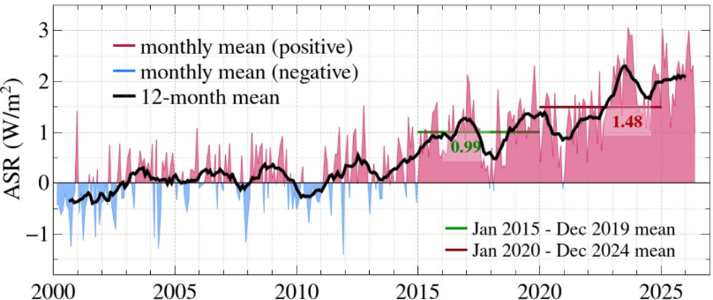
Absorbed Solar Radiation (W/m²)
Reduced aerosols increase solar radiation absorbed by Earth, but it is hard to separate that from the cloud feedback, which also reduces cloud albedo. Reduction of aerosols from China was mainly in 2005-2015 and ship aerosol reduction in 2015-2020. Observed ASR increase thus suggests that ships had the larger effect, but that is a secondary issue. Observations by CERES (Loeb et al. 2021), base period March 2000-February 2010.
Notes:
Spatial and temporal distribution of absorbed solar radiation helps, even though it’s hard to apportion the increasing absorption between aerosol forcing and cloud feedback. Increased absorption is mainly in the Northern Hemisphere, especially over the North Pacific and Atlantic. It’s timing suggests that ship aerosols might have more effect than China aerosols, but that’s a secondary question.

Slide 26
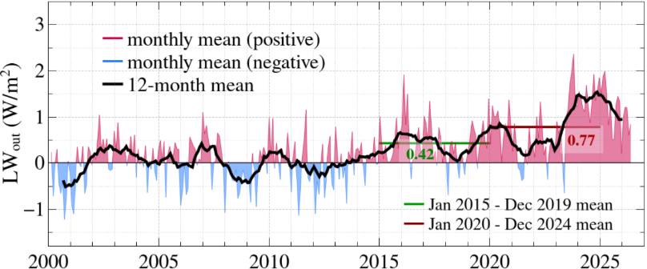
Heat Radiation Emitted to Space (W/m²)
Separation of aerosol forcing and cloud feedback is aided by the fact that aerosol forcing increases heat radiation to space immediately, while cloud feedback grows gradually with global temperature. Large increase of heat radiation to space in the past two years, a response to the jump of global temperature, decreases Earth’s energy imbalance. Observations by CERES (Loeb et al. 2021), base period March 2000-February 2010.
Notes:
Aerosol forcing increases heat radiation to space promptly, while cloud feedback grows slowly as global temperature changes, so the heat radiation to space suggests that aerosol forcing was added mainly since 2015. The large increase of heat radiation from late 2023 thru early 2025 is a response to the large jump of global temperature in those two years.

Slide 27
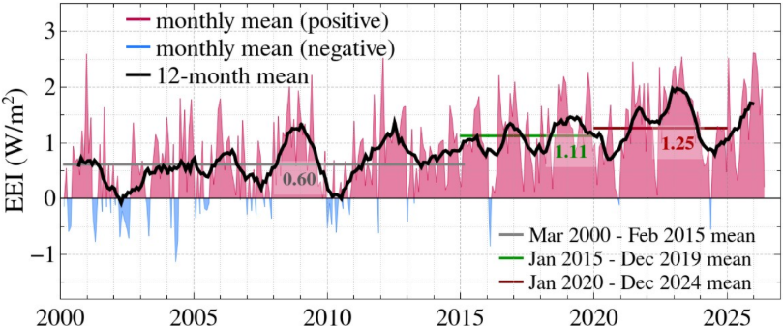
Earth’s Energy Imbalance (W/m²)
Earth’s energy imbalance is measured by the CERES satellite instrument (Loeb et al., 2021) with absolute calibration via ocean heat content change measured by Argo deep-diving floats (von Schuckmann et al., 2020). Base period = July 2005- June 2015, the Argo calibration period.
Notes:
Which reduces Earth’s energy imbalance, but the imbalance is still more than 1 watt per square meter, double what it was in the first decade of this century. Implications are great. The 1.5 degree warming level has been breached and global temperature will rise much higher. It will probably reach 2 degrees in the 2030s and keep rising. How do we know that? Because of this huge energy imbalance AND…

Slide 28
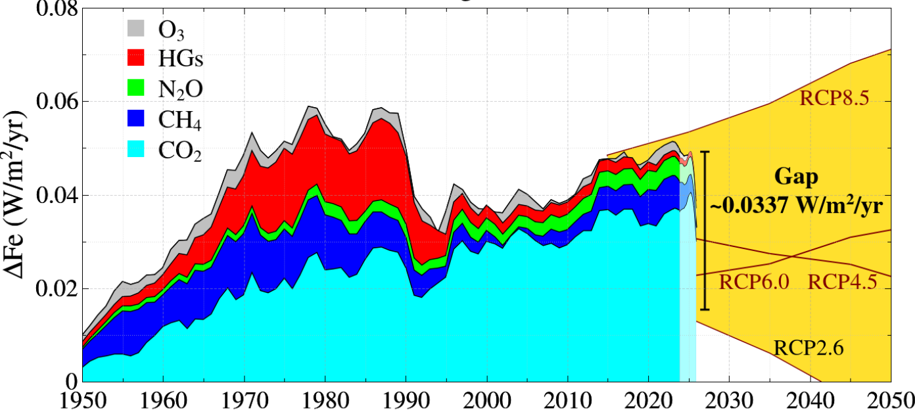
Annual growth of climate forcing by greenhouse gases
MPTG and OTG are Montreal Protocol and Other Trace Gases. Forcings are 5-year running-means.
RCP2.6 scenario is designed to keep global warming < 2°C.
The final 2.5 years are less than a 5-year mean and will change as more data are added.
Notes:
Greenhouse forcing is increasing at the astounding rate of half a watt per decade. Much ado has been made about the fact that projected emissions are now much less than scenario RCP8.5. But the projections are based on promises and wishful thinking. The one thing we can say is that RCP2.6, designed to keep global warming under 2 degrees, is dead. RCP2.6 assumed that the world would shift to biomass burning powerplants, which was always foolish and unrealistic. So, now we cannot keep global warming below 2 degrees without purposeful action to alter Earth’s energy balance.

Slide 29
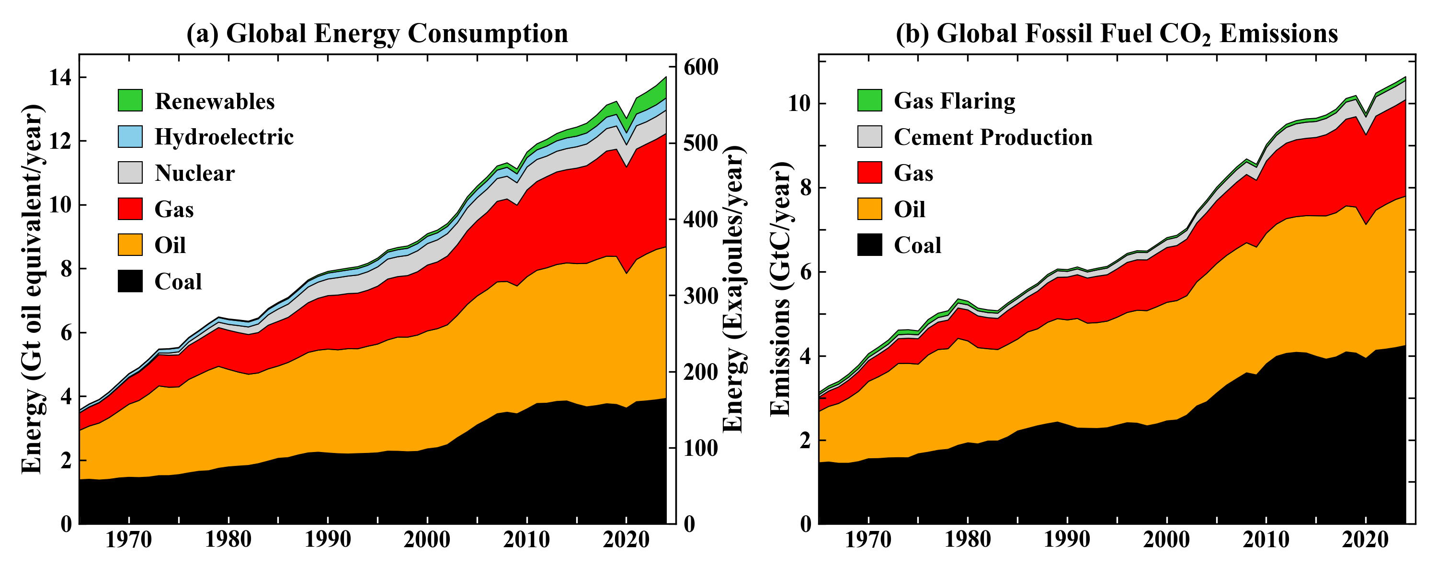
Sources: Energy Institute, 2025: Statistical Review of World Energy 2024. https://www.energyinst.org/statistical-review/home; Hefner M, Marland G, 2025: Global, regional, and national fossil-fuel CO2 emissions:1951-2021 CDIAC-FF, Research Institute for Environment, Energy, Economics, Appalachian State University https://neee.appstate.edu/projects-programs/cdiac both sources last accessed 8 October 2025
Notes:
This is the real world. Energy use is rising and will continue to rise. Fossil fuels are valuable. They raise living standards. One gallon of petrol, 3.8 liters, has the energy of 400 hours of labor by an adult. Global use of fossil fuels will not decline rapidly, if they do not have to pay their cost to society. This is the tragedy of the commons. Waste products of fossil fuels can be dumped in the atmosphere with zero cost. Worse, fossil fuel use is subsidized.

Slide 30
“New Type of Great Power Relationship”
A symposium on climate change and public health
Beijing, February 2014
Chinese scientists convened by the think tank of China’s State Council, U.S. scientists by the Kissinger Institute on China and the United States (Tom Frieden, Director of the Center for Disease Control, and I were the invited U.S. scientists) met to discuss climate and infectious disease.
Notes:
12 years ago, I had the opportunity to participate in discussions that were notable because the Chinese government seemed genuinely interested in the science. Other governments often take political positions, either climate change is a hoax or it is such an urgent problem that we must throw all of our money into subsidizing renewable energies, even if we must borrow the money from our grandchildren. I believe that we had a more thoughtful discussion.

Slide 31
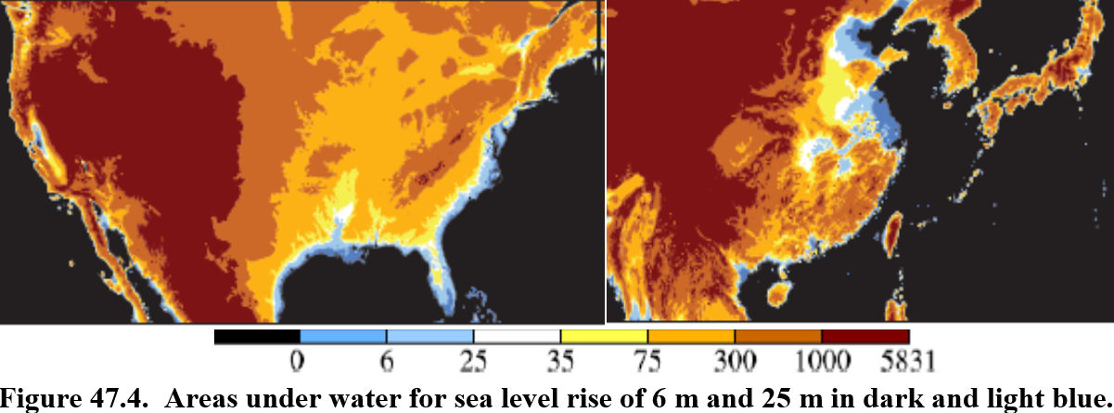
Notes:
I emphasized the long-term climate threat. The greatest long-term danger is the possibility of handing young people a situation where they cannot avoid passing the point of no return, when collapse of the West Antarctic ice becomes unavoidable. It’s hard to say when that is, but we will soon have greenhouse gas levels greater than the early Pliocene, when maximum sea level was 15 to 25 meters higher than today. So, at some point, which is also hard to know, the net forcing must be reduced, a lot. We could not answer such difficult questions, but our Chinese hosts took us to view facilities where they were making progress in reducing the cost of solar panels and windmills, but there was nothing on the agenda about nuclear power, perhaps because there was no interest in nuclear power in the Obama administration.

Slide 32
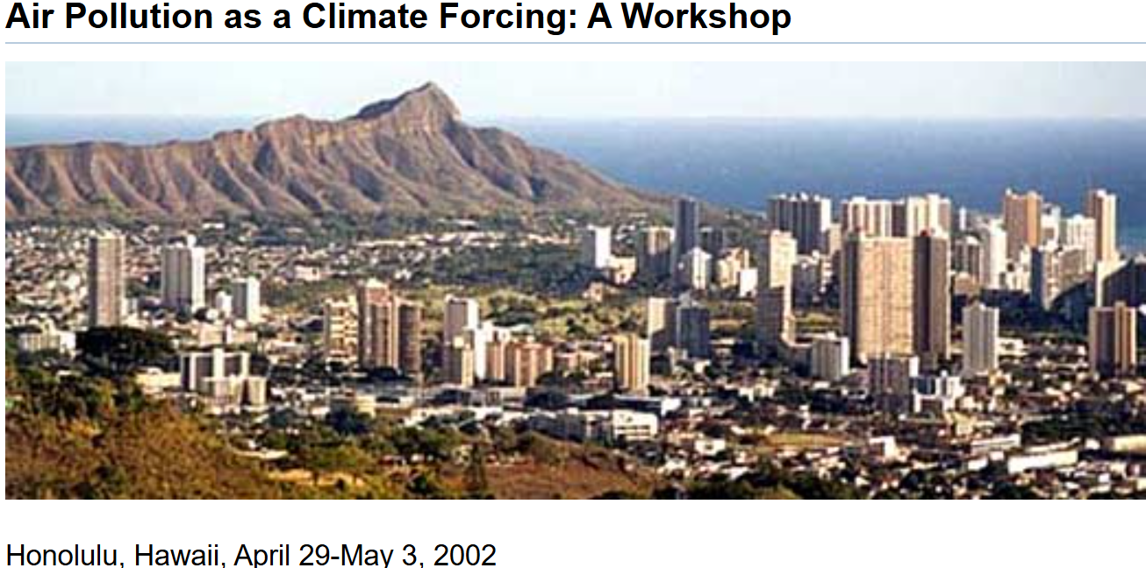
Notes:
So, from the Beijing airport, I contacted Richard Lester, chairman of nuclear engineering at MIT, and asked if he would help me organize a workshop on nuclear power at the East-West Center in Hawaii, where I had organized workshops on air pollution in 2002 and 2005. He agreed, but I had trouble finding a philanthropist to support it. That’s when my friend Junji said “let’s have it in China, then all you have to pay is the travel.”

Slide 33
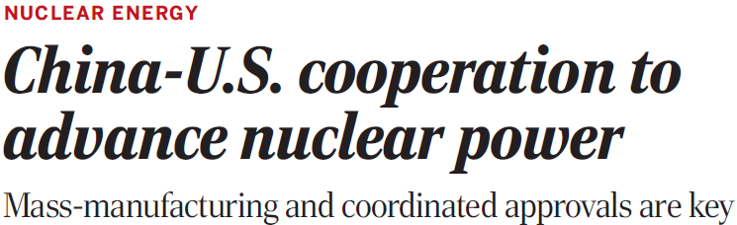

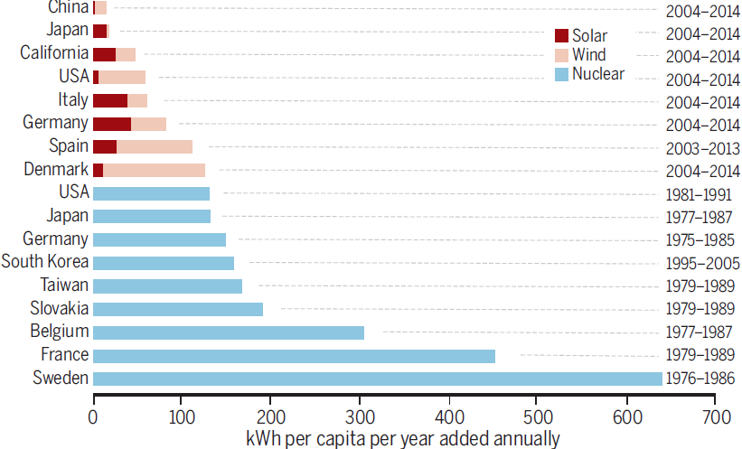
Notes:
So, we had a workshop in Hainan and published a paper in Science. Among other things we showed that nuclear can be very fast, IF a policy decision is made to support it. Sweden, for example, decided to get off oil. They built 10 nuclear power plants, decarbonizing their electricity in 10 years. We need nuclear to complement intermittent renewables – otherwise the complement will be gas or coal and we likely will pass the point of no return.

Slide 34
Efforts to overcome obstacles to expanded U.S.-China cooperation in the development of advanced nuclear power technologies are justified by the large potential benefits. Each country has a major stake in the other’s success in reducing its carbon emissions, and each has a major stake in the achievement of enhanced nuclear safety in the other country and the rest of the world.
Notes:
We did not achieve the cooperation that we hoped for. However, I think that, within a few years, as it is realized how serious climate change is, there may be greater understanding that we are all in the same boat and we either sink together or sail together.

Slide 35
Carbon Fee & 100% Dividend
Fee: Collected at Domestic Mine/Port of Entry
Covers all Oil, Gas, Coal → No Leakage
Dividend: Equal Shares to All Legal Residents
Effect is “progressive”; Low-income people gain
Merits:
Transparent; Public can understand & support it
Market-based; Stimulates Economy & Innovation
Notes:
An amazing thing about the workshop is that Kejun Jeong flew from Beijing to Hainan to attend one day and have lunch with us. I had heard Kejun speak earlier – he knew everything about energy in China, plans for efficiency, renewables, etc. I wanted to discuss a potential solution to the tragedy of the commons – a gradually rising carbon fee with all the money given to the public. Rich people will lose money, but they can afford it. The fee can rise only gradually, yet it is the basic underlying requirement for global decarbonization. If China and the U.S have it, it will quickly be global, enforced by border duties on products from countries without a carbon fee. Kejun agreed and said “let’s write a paper.”

Slide 36
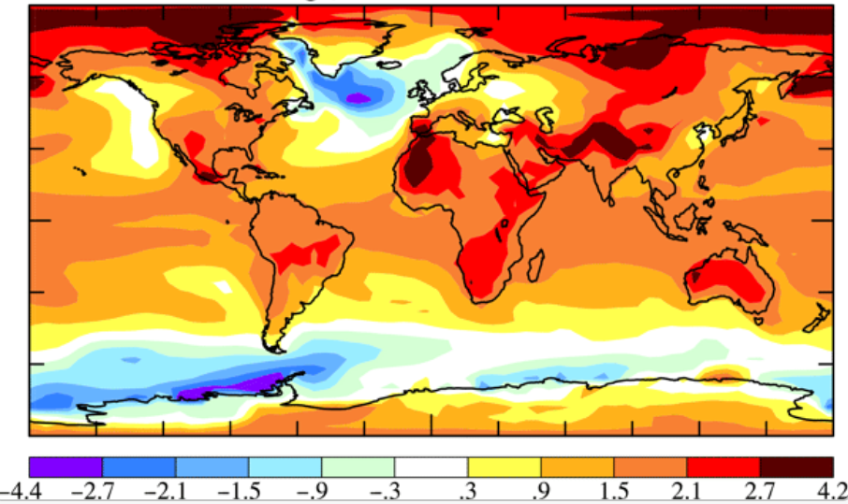
Paper published in Atmos. Chem. Phys. in 2016:
Ice melt, sea level rise and superstorms: evidence from paleoclimate data, climate modeling, and modern observations that 2°C global warming could be dangerous
James Hansen, Makiko Sato, Paul Hearty, Reto Ruedy, Maxwell Kelley, Valerie Masson-Delmotte, Gary Russell, George Tselioudis, Junji Cao, Eric Rignot, Isabella Velicogna, Blair Tormey, Bailey Donovan, Evgeniya Kandiano, Karina von Schuckmann, Pushker Kharecha, Allegra N. Legrande, Michael Bauer, and Kwok-Wai Lo
But the title of the paper submitted in 2015 ended: “...2°C is highly dangerous”
Notes:
That paper was never written. Other papers intervened, especially this one, Ice Melt, Sea Level Rise and Superstorms. Our climate model had coarse resolution, but it got the physics right, forming deepwater at the right locations, unlike some high-resolution IPCC models. We found that both AMOC in the north and SMOC in the South, Antarctic Bottom Water Formation, both shut down by midcentury if ice melt continues to increase.

Slide 37
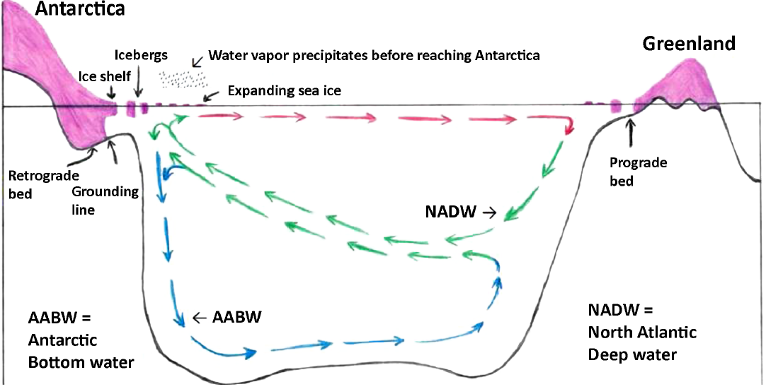
North Atlantic Deep Water (NADW) formation is susceptible to shutdown by freshwater injection on the ocean from ice melt and increased precipitation.
Notes:
Our paper also gave the first description of an important feedback. Increasing ice melt and increasing precipitation, reduce the density of surface water, thus reducing production of Antarctic Bottom Water, closing the escape valve of heat from the deep ocean and accelerating ice shelf melt. There is evidence of this feedback in paleoclimate, in modern data, and in our GCM – but how fast will this accelerate and cause large sea level rise, and what can we do about it? Those are difficult issues.

Slide 38
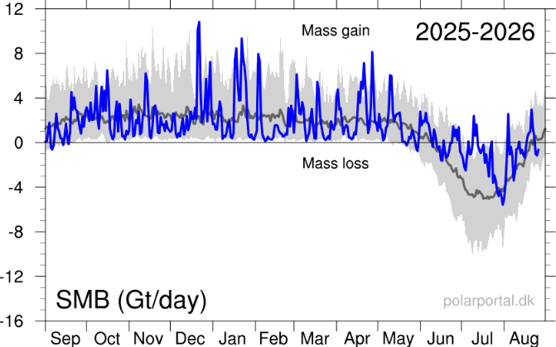
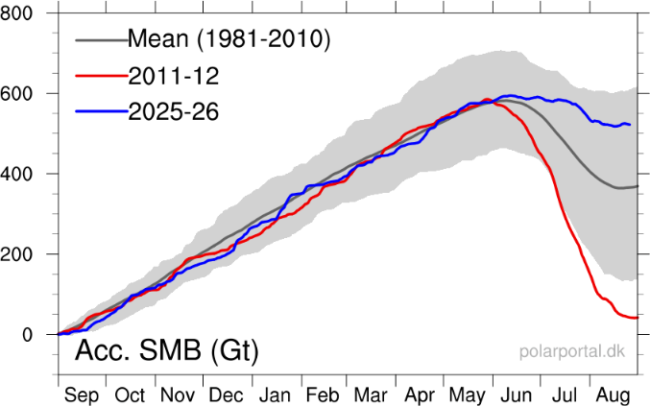
Daily Surface Mass Balance
Cumulative Surface Mass Balance
Notes:
Here’s the surface mass balance on Greenland. The black curves are averages over 30 years. For nine months Greenland gains mass because it snows and it’s too cold for melting. In June, July, August there is mass loss from melting. The cumulative curve, on the right, shows that in the average year Greenland gains 360 billion tons of snow. In equilibrium, the ice sheet must lose as icebergs the same mass that it accumulates from the surface mass balance. But with global warming, it snows more because the warmer atmosphere holds more water vapor. The blue curve shows that it snowed so much this year that the surface mass balance is +530 billion tons.

Slide 39
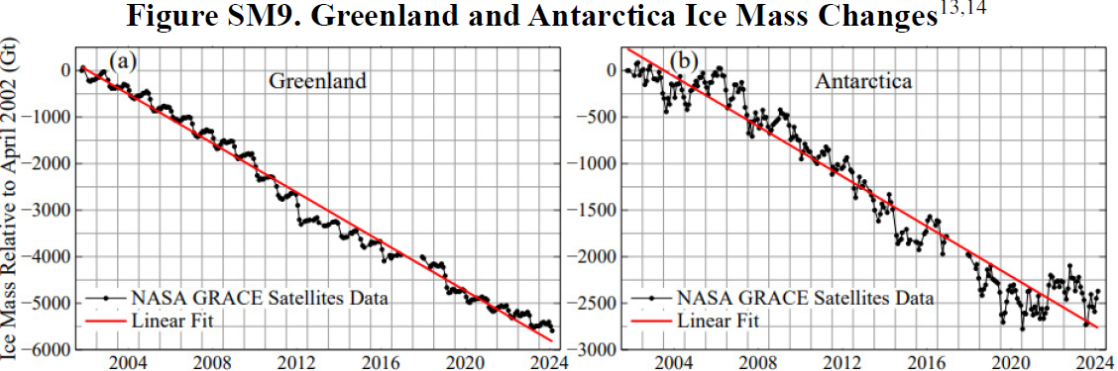
Notes:
Nevertheless, the gravity satellite shows that Greenland is losing mass. So, the speedup of iceberg discharge exceeds the snowfall increase, although in Antarctica in 2022 the snowfall increase was so large that the continent gained mass. What we are doing is adding some mass on the ice sheet, but melting the foot of the ice sheet, especially the ice shelves that buttress the ice sheet. If this continues, we may get rapid ice sheet collapse. It happened in the last interglacial, when sea level went up several meters is less than 100 years. It’s a very nonlinear problem, and dangerous, so some people may say “let’s do something quick before it’s out of control.”

Slide 40
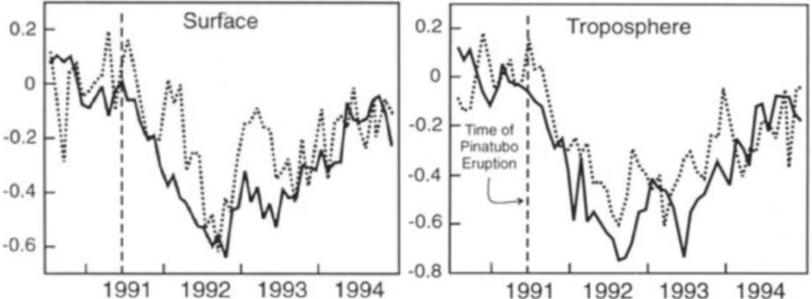
Predicted (solid line) and observed global temperature after Pinatubo eruption
Notes:
We know one way to cool the planet quickly, which Nature demonstrated with the Pinatubo volcanic eruption. Pinatubo aerosols reflected enough sunlight to cause a forcing of minus 3 watts per meter square and Earth cooled off by a few tenths of a degree for a couple of years. It would have cooled a lot more, but the half-life of the aerosols was only about a year.

Slide 41
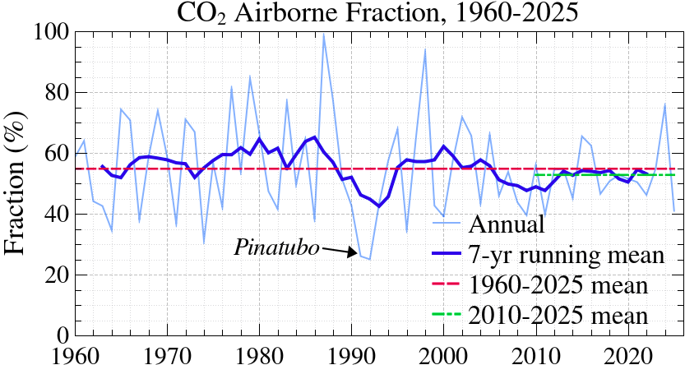
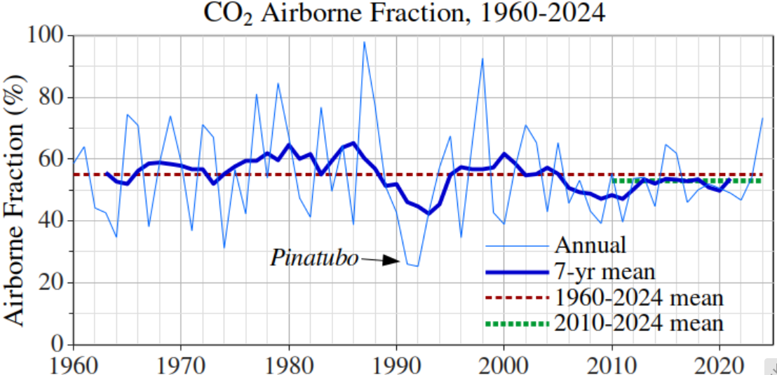
Notes:
Another merit of the aerosol cooling was that the uptake of CO2 emissions increased to 75% from the usual average of 45%. Nobody wants to geoengineer the planet, but the fact is we ARE already geoengineering the planet, and it makes sense to have a break-glass option, in case we get to the point that the dangers in taking such action are clearly a lot smaller than the dangers of not taking action.

Slide 42
Four Experiments: Pinatubo-like aerosol amount distributed over different regions. Hansen, J., Aerosol effects on climate & human health: urgent research needs, American Geophysical Union – Chinese Academy of Sciences Meeting on Atmospheric PM2.5, Xi’an, China, 17 October 2018.
Notes:
So, for the aerosol conference in Xi’an 8 years ago, we did GCM experiments, to verify that the Antarctic Bottom Water formation feedback would work the opposite way if stratospheric aerosols were used to cool the Southern Ocean surface via solar radiation management. We assumed injection of Pinatubo-like aerosols in four alternative areas as shown by the shading. We recently confirmed the results with a finer resolution model.

Slide 43
Change of internal ocean temperature after 40 years (mean for years 35-45).
Notes:
As anticipated, the cooling causes Antarctic Bottom Water Formation to speed up, opening up the escape valve of heat from the Southern Ocean, thus cooling the ocean at the depths that are most effective for stabilizing and even regrowing the ice shelves. The point is that large sea level rise is not necessarily inevitable. It is conceivable that there are actions that would help avert that. Of course, stopping a runaway freight train at the last moment is a tall order.

Slide 44
Change of surface temperature after 40 years. Number in upper right is global cooling (°C).
Notes:
As expected, the stratospheric aerosols produced near-global cooling at Earth’s surface.

Slide 45
Annual growth of climate forcing by greenhouse gases
MPTG and OTG are Montreal Protocol and Other Trace Gases. Forcings are 5-year running-means.
RCP2.6 scenario is designed to keep global warming < 2°C.
The final 2.5 years are less than a 5-year mean and will change as more data are added.
Notes:
Finally, I note a small bit of good news. It’s conceivable that the growth rate of GHGs might begin to decline. Don’t get excited, though, because these are 5-year running means, so the last 2 and a half years are not final. They will change as more data come in. In fact, we can say with confidence that the forcing during this last 2.5-year period will increase

Slide 46
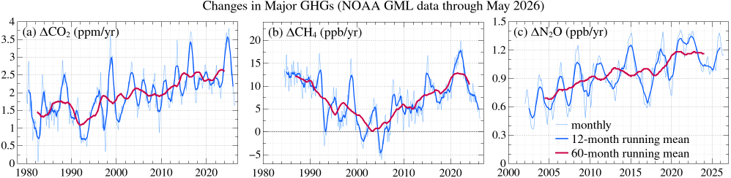
Notes:
Because all three of the major gases are at relative minima, and what goes down must come up, at least to some degree. The most important one is CO2 and the blossoming El Nino will drive it up, possibly to a record high level. Methane is harder to predict. If the sources go down, it’s amount could decline a lot because of its short lifetime, and there are some efforts to make that happen.

Slide 47
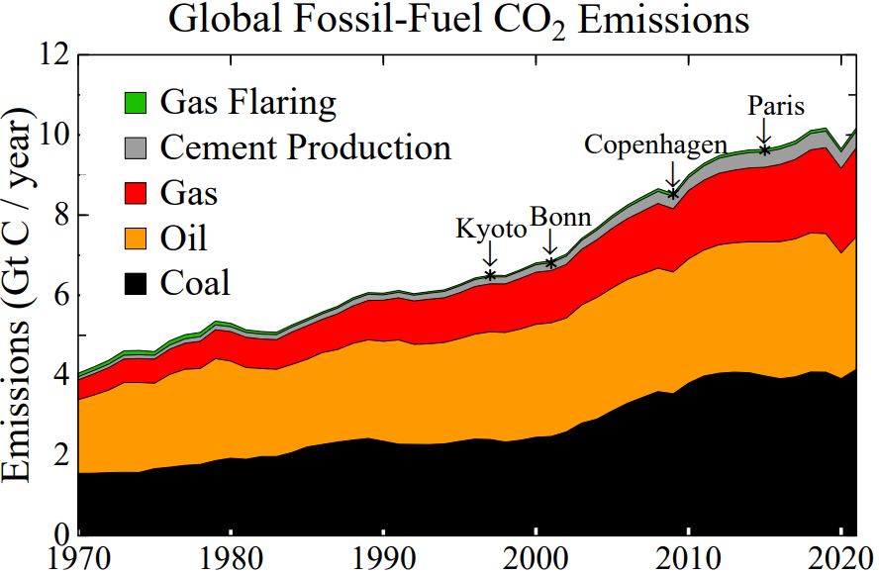
Notes:
We have seen hopeful expectations of emissions downturn many times in the past 30 years, and they were unfounded because there was no effective policy to achieve a downturn. The main reason that I have hope now is the development of inexpensive clean energy in China, which could help achieve emission reductions worldwide, not just in China. However, for that decline to be steep, we must have a price on carbon implemented in a way that the public will accept it, as I have discussed many times. Thank you.

Slide 48
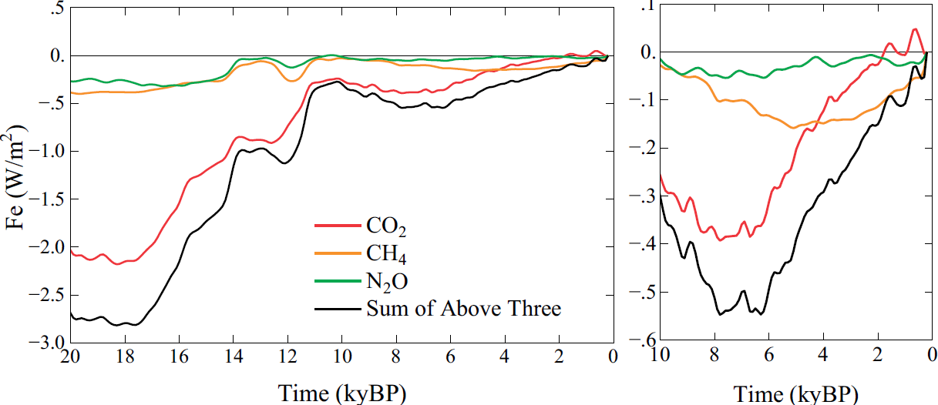
Notes:
If there is time for one more comment, I can clarify a topic raised at last evening’s reception. The Holocene interglacial period began like other interglacials, with peak GHGs and peak global temperature early in the interglacial, probably because the overturning of the deep ocean in the Southern Ocean flushes out the GHGs that accumulated during ice age. However, an unusual thing then happened: the GHGs began increasing several thousand years ago, probably because, as Bill Ruddiman hypothesized, the human population was increasing, using wood as its fuel, and developing rice agriculture. This is a huge climate forcing, at least half a watt, and the planet had millennia to respond. So, there should have been a big global warming.

Slide 49
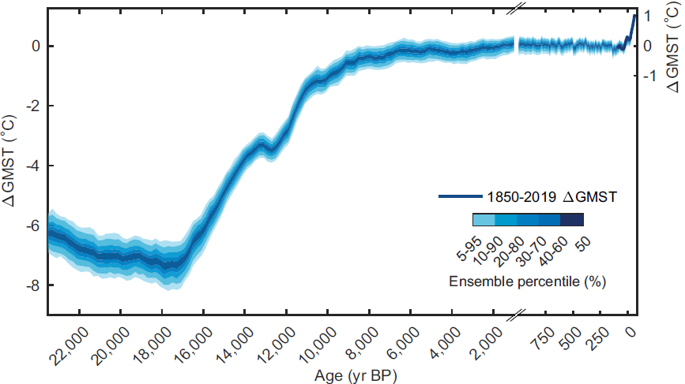
Source: Osman MB et al., “Globally resolved surface temperatures since the Last Glacial Maximum, Nature 599, 239-44,2021.
Notes:
Yet the real world did not warm up at all. Some analyses show a slight global cooling, with a significant cooling in the Northern Hemisphere. That is the Holocene conundrum, which climate models cannot reproduce. The answer to this conundrum is probably that humans also produced aerosols, mainly by burning wood, injecting aerosols into a pristine atmosphere, with the forcing being mainly the indirect aerosol effect. That aerosol source, which is continuing today, is not included by IPCC, at least not with a realistic magnitude. It’s important because it affects what we can expect from the Faustian bargain. Aerosols are an interesting and important story. Thank you very much.

