Slide 1
Capital Controls Measures: A New Dataset
Andres Fernandez (IDB)
Michael W. Klein (Tufts)
Alessandro Rebucci (JHU)
Martin Schindler (IMF)
Martín Uribe (Columbia)
Capital Flows in Frontier and Emerging markets
IMF, Washington DC, 25 February 2015.

Slide 2
Motivation
Continued debate and renewed interest in capital controls
Emerging market crises
Global financial crisis
Theoretical literature (Trilemma, Pecuniary externalities)
Interest in understanding what countries are doing and what are the effects of these policies
Need data to describe policies, assess their effectiveness and test new theories!

Slide 3
Contribution of this paper
New annual capital control data set, updating, expanding, and revising Schindler (2009), FRU (2013) and Klein (2012)
9 more countries relative to FRU (2013)
7 more years of data (1995-2013) relative to Schindler (2009)
4 more asset categories (10 in total now) relative to Schindler (2009) and FRU (2013)
Spelled out detailed set of criteria and rules to code based on IMF AREAER
Describe some features of the data

Slide 4
Outline
The data
Assets categories
Transaction categories
Coding rules
Aggregation
Some properties of the data
Conclusions

Slide 5
Capital controls: differential treatment of residents & non-residents
Administrative
Outright prohibitions
Authorizations, permissions, clearances
Licensing requirements
Market-Based
Taxes
Brazil’s IOF tax
Chile’s encaje 1992 – 1998
Thailand 15% withholding tax on interest payments and capital gains on bonds held by foreign investors (introduced 10/2010

Slide 6
Asset categories
Money Market (mm): Maturity one year or less (e.g. certificates of deposit, treasury bills, commercial papers, interbank deposits, and repurchase agreements).
Bonds (bo): original maturity of more than one year.
Equities (eq): Shares, other securities if not DI.
Collective Investments (ci): Share certificates, registry entries, other collective investment (e.g. mutual funds, investment trusts).
Derivatives (de): e.g. options, futures, forwards, warrants, str. fin.
Financial Credits (fc): Credits other than cc, including banks.
Real Estate (re): Not DI (e.g. Personal or for Financial Investment)
Commercial Credits (cc): Linked with trade in goods or services
Guaranties, Sureties & Financial Backup Facilities (gs): Securities pledged for payment or performance, or financial guarantees.
Direct Investment (di): Lasting relations for investor management, e.g. wholly owned enterprise, subsidiary, branch, acquisition.

Slide 7
32 Transaction Categories
Notes:
While the data base is granular, with 32 sub categories in total, one can aggregate as desired.

Slide 8
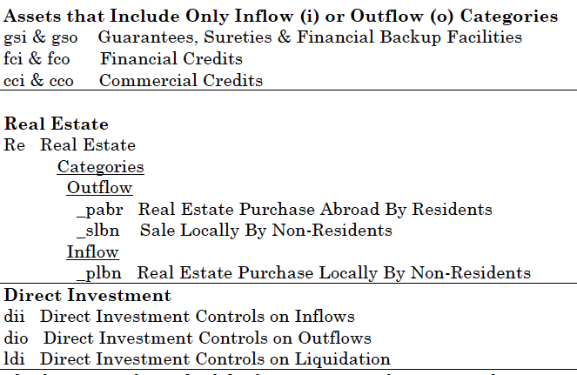
Transaction Categories (cont.)

Slide 9
Coding the AREAER Information
We follow Schindler (2009), and we use the narrative description in AREAER
We formulated rules consistent with those originally used by Schindler (2009), elaborating them if needed (and revising the data backward as necessary)

Slide 10
Example of AREAER Information

Slide 11
Coding rules

Slide 12
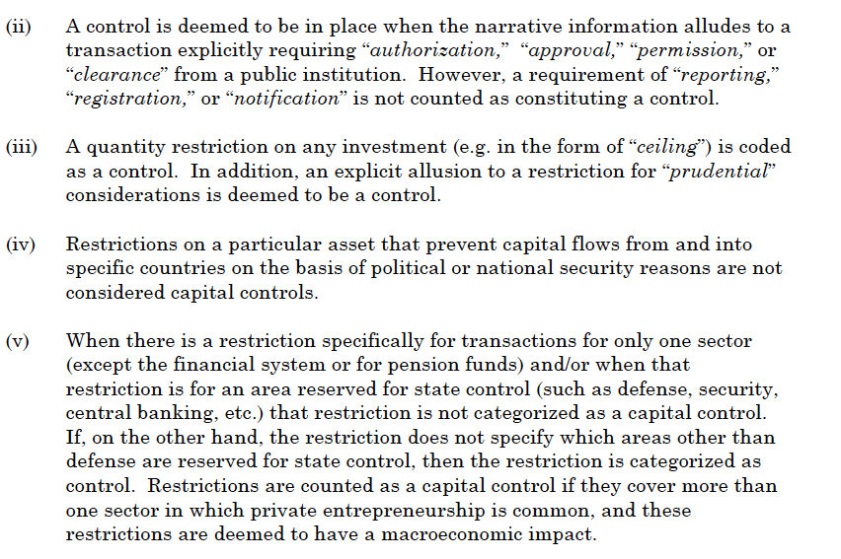
Coding rules (cont.)

Slide 13
Aggregation
While the data base is granular, with 32 categories in total, one can aggregate as desired.
In the paper we define inflows and outflows based on direction of flows and then construct indexes taking simple averages:

Slide 14
Alternative indexes correlate closely

Slide 15
Some features of the data

Slide 16
Open/Gate/Wall Designations
Values of Average CCM
Open: 0 – 0.10
Gate: 0.11 – 0.69
Wall: 0.70 – 1.00

Slide 17
Incidence of controls (Share of observations with controls)
Notes:
Higher on short term instruments, portfolio flows
Higher on outflows (except real estate)

Slide 18
Controls on inflows
Notes:
Different scales
Trends change

Slide 19
Controls on outflows

Slide 20
Correlation between (and within) inflows and outflows

Slide 21
Comparison with other indicators
Other de jure indicators also use AREAER information, but do not distinguish among asset or transaction categories, or between inflows and outflows
Dennis Quinn (1997, 2011): Reads narrative of AREAER to get intensity of capital controls for capital account receipts and payments. Range [12.5,100] in increments of 12.5
Menzie Chinn and Hiro Ito (2006, 2008): 1st Principal Component of AREAER Codings of Current Account Transactions, Capital Account Transactions, Presence of Multiple Exchange Rates, Requirements for Surrendering Export Proceeds. Range [-1.86, 2.46]
Both converted to [0,1] for purposes of comparison.

Slide 22
Correlation is tight

Slide 23
Conclusions
New data set on capital controls: most comprehensive data set available based on IMF reports
Can be easily expanded with more countries, updated, or coded at different frequency as we have honed and tracked the coding rules
Only started to explore it
There is plenty to investigate with these data
23

Slide 24
Thank you

